Slide 1


Slide 2
Welcome to our guide on using the survey booklet for Redplus, Xontum, and Cefobactum.
Purpose of the Booklet
The purpose of this booklet is to conduct a comprehensive survey in hospitals & nursing homes to understand the consumption trend and pricing of competitors of Redplus, Xontum, and Cefobactum.
This booklet is designed to help our TMs gather valuable information to better serve our customers.

Slide 3
Introduction of Booklet Content
We have prepared this booklet for Redplus, Xontum, and Cefobactum injectables. It is a report consisting of 10 month’s data for each injectable, covering the period from July 2024 to April 2025. Each section of the booklet is dedicated to one of the injectables, providing detailed monthly reports for 10 months.

Slide 4
Walkthrough of Booklet Fields
Let’s walk through the key fields included in the booklet:
-Each brand has 10 pages of monthly reports (as given below). Each page should be used for one month: the first page for July, the second for August…so on and so forth.

Slide 5
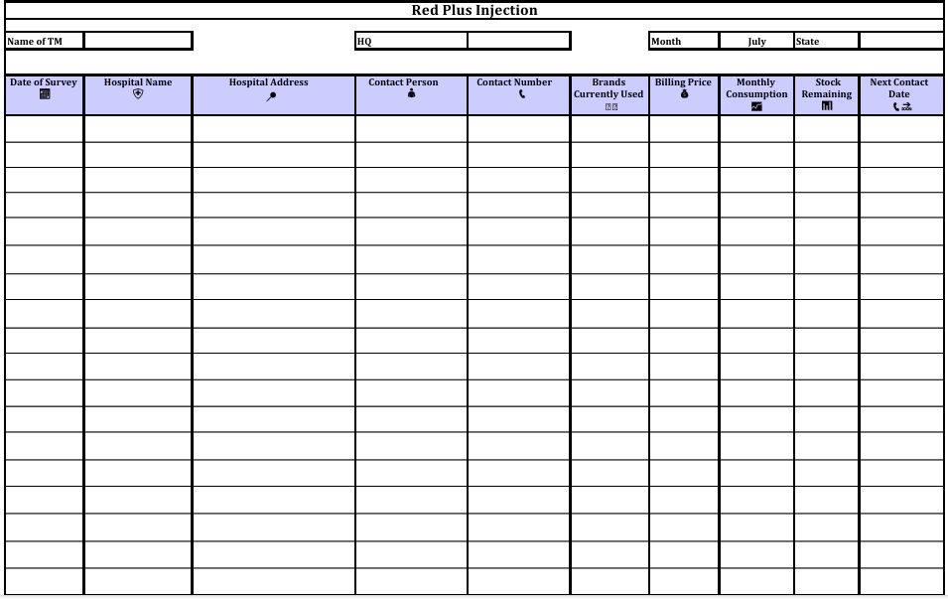

Slide 6
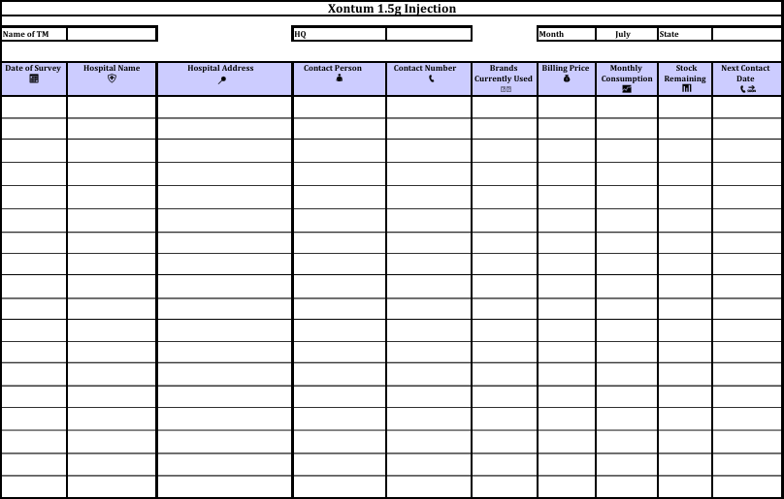
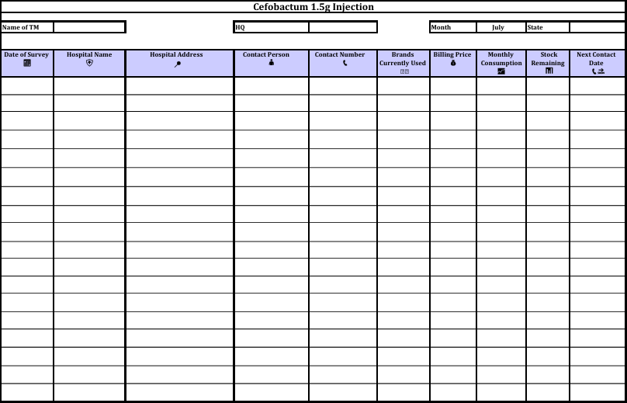

Slide 7
Name of TM: The name of the Territory Manager responsible for the survey.
HQ Month State: Headquarters information and the month and state where the survey is conducted.
Date of Survey: The specific date the survey is conducted.
Hospital Name: The name of the hospital being surveyed.
Hospital Address: The full address of the hospital.
Contact Person: The main point of contact at the hospital with the details like consumption and pricing.
Contact Number: The phone number of the contact person.
Brands Currently Used: The current brands of injectables the hospital uses. Mention maximum upto 3 brands
Billing Price: The price at which the hospital is billed for the injectables.
Monthly Consumption: The amount of each product used by the hospital monthly.
Stock Remaining: The current stock levels of the injectables at the hospital.
Next Contact Date: The scheduled date for the next follow-up, based on the stock lying with them and daily usage.

Slide 8
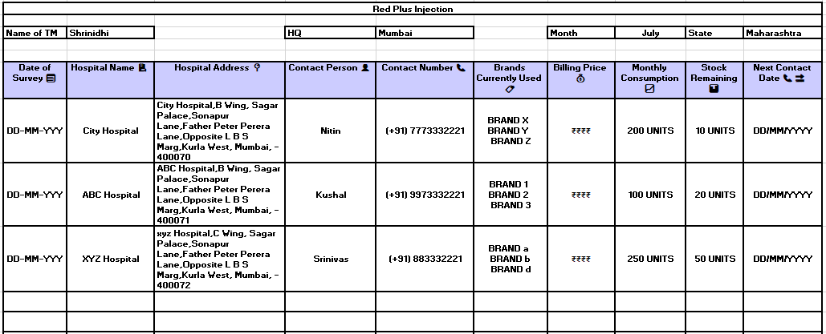
Still wondering how to fill out this booklet? Here is an example. By following this example, you will
know how to fill in the booklet for the remaining injectables for 10 months.

Slide 9
Name of TM:
  Enter your name as the Territory Manager responsible for this survey.
HQ Month State:
  Record the headquarters information, including the month and the state where the survey is conducted.
Date of Survey:
  Specify the exact date the survey is conducted.
Hospital Information:
  Hospital Name: Enter the name of the hospital being surveyed.
  Hospital Address: Provide the full address of the hospital.
Contact Details:
  Contact Person: Identify the main point of contact at the hospital, including details like their name, consumption, and pricing.
  Contact Number: Provide the phone number of the contact person.
Current Brands Used:
  List up to three brands of injectables currently used by the hospital.
Billing Information:
  Billing Price: Record the price at which the hospital is billed for the injectables.
  Monthly Consumption: Document the monthly usage of each product by the hospital.
  Stock Remaining: Note the current stock levels of the injectables at the hospital.
Follow-Up:
  Next Contact Date: Schedule the next follow-up date based on the remaining stock and daily usage.

Slide 10
Goals of the Survey
By collecting this detailed information, we aim to achieve several goals:
  Understanding Market Demand: Identifying the market demand and be present at the right place with the right price.
  Competitive Analysis: Knowing the brands currently used allows us to understand our position in the market and strategize accordingly.
  Stock Management: Tracking the stock levels ensures that hospitals never run out of our injectables, maintaining a steady supply.
  Price Monitoring: Keeping an eye on the billing prices helps us stay competitive and make necessary adjustments.
How to Use the Booklet
Here’s how you can effectively use this booklet:
  Prepare: Before your visit, ensure you have all necessary materials, including the booklet and any product information.
  Engage: Meet with the hospital’s contact person and explain the purpose of the survey.
Build rapport and be thorough in collecting the information.
  Record: Accurately fill in each field in the booklet. Make sure to double-check for completeness.
  Analyze: After the survey, review the collected data for any immediate insights.
  Follow-Up: Schedule the next contact date and ensure timely follow-up to maintain a strong relationship with the hospital.

Slide 11
Benefits of the Survey
The benefits of conducting this survey are immense. It helps us provide better service to our customers, ensure product availability, and understand the market landscape. Ultimately, this leads to improved patient care and satisfaction.
Thank you for taking the time to learn about our survey booklet. For any questions or further assistance, please contact our support team or visit our website. Together, let's make a difference in healthcare.

