Slide 1

Notes:
The Geofreq is an In-House web portal developed by EDRC-GEOTECH team of Heavy Civil Construction, L&T for monitoring the instruments installed on the Underground structures. %%TTS_FEMALE%

Slide 2
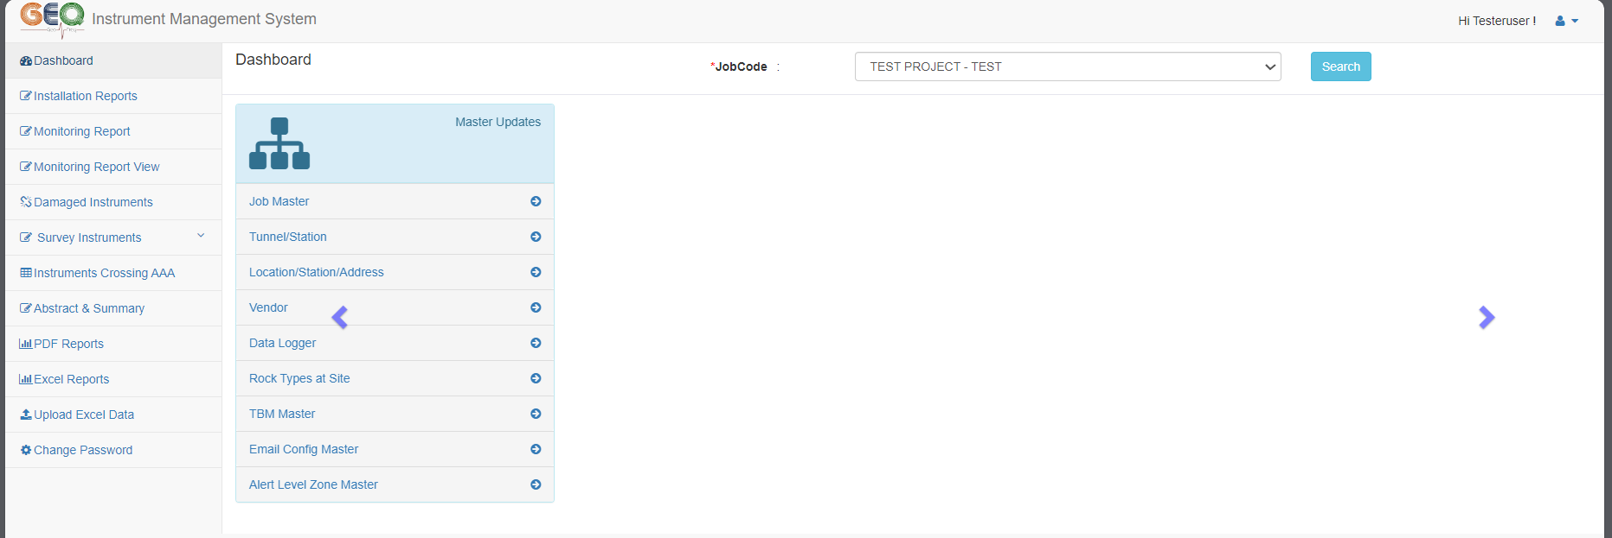
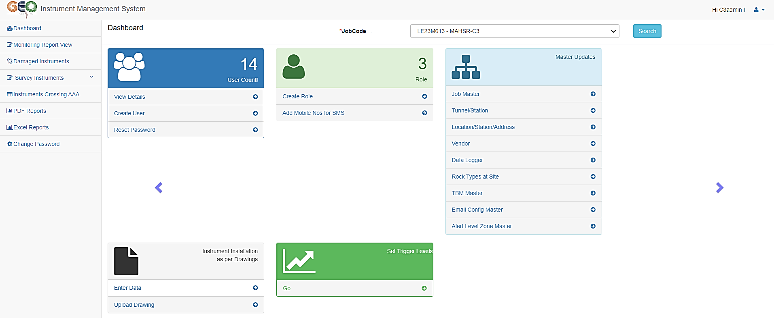

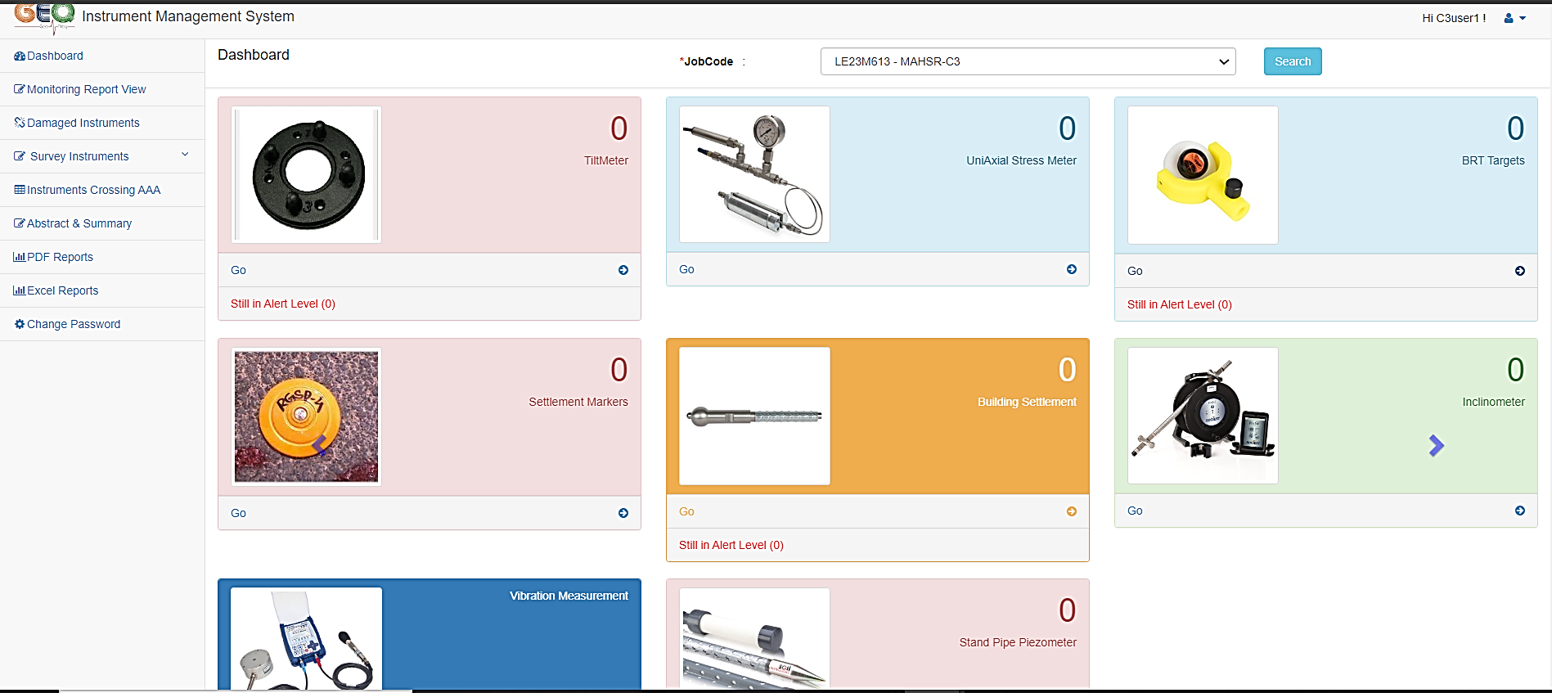
Notes:
The GEOFREQ web portal with user-specific permissions to access the data revolutionizes tunneling project monitoring by seamlessly handling complex data streams from various instruments, offering universal compatibility. These are the various dashboards pertaining to different type of users like Site User, Admin and Client. %%TTS_FEMALE%

Slide 3
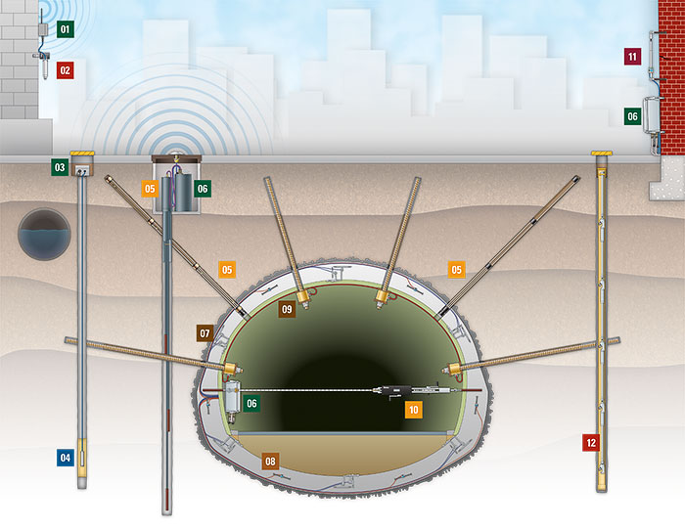
Legend
1. wired or wireless network for collection of data
2. Tilt meters
3. Data loggers for collection of data
4. Piezometers
5. Extensometers (Electrical/Mechanical types)
6. Multi Channel Data loggers for Electrical type Extensometers
7. Pressure Cells
8. Strain Gauges
9. Load Cells
10. Tape Extensometers
11. Crack meters
12. In place Inclinometers(IPI)
Notes:
The Geofreq is a universal web portal where it can be used for monitoring the various instruments provided by multiple vendors and once these instruments are installed as desired. %%TTS_FEMALE%

Slide 4
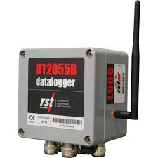
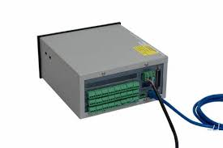
Notes:
Then the data captured by these instruments can be transferred to the data loggers which are either wired or wireless. %%TTS_FEMALE%

Slide 5
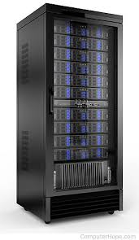
Notes:
From these date loggers the data will be communicated to the Server and the Geofreq installed in the server will captures the incoming data %%TTS_FEMALE%

Slide 6
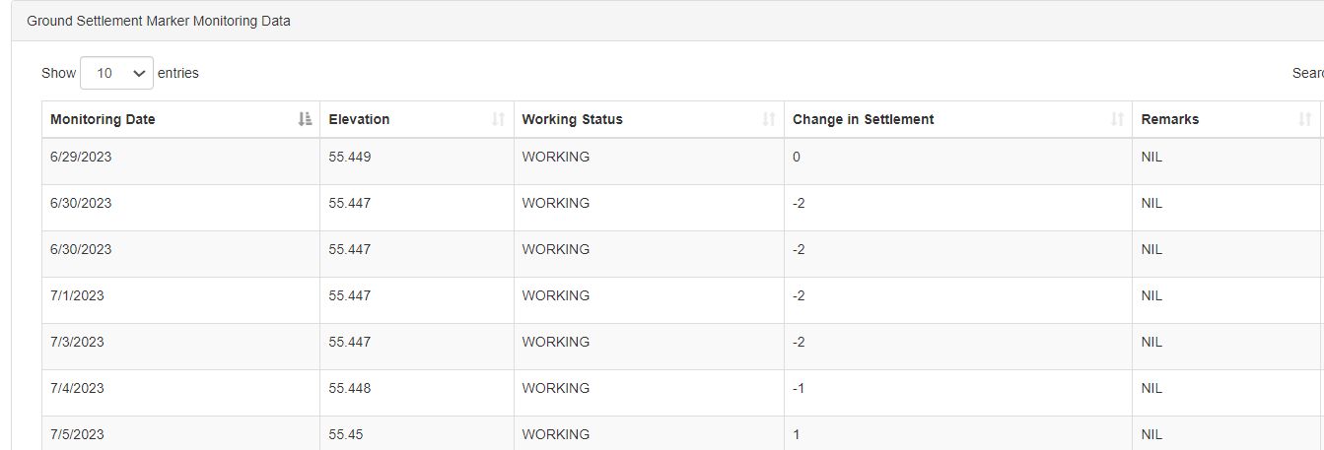
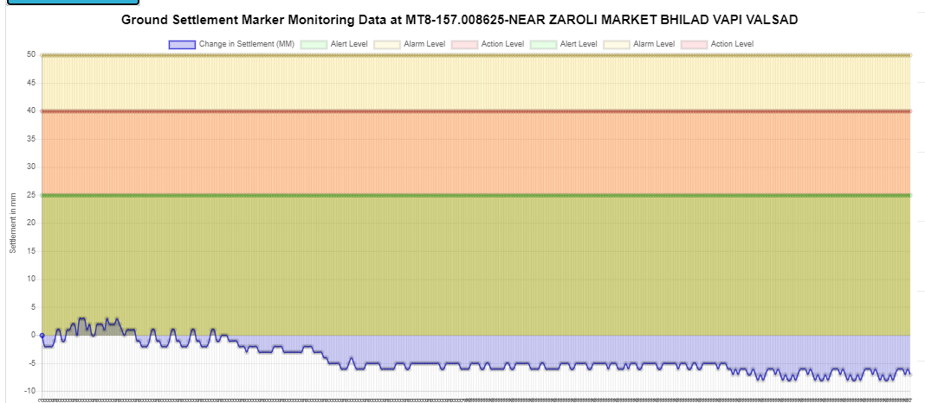
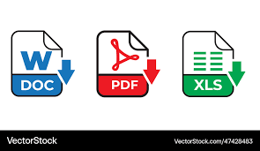
Notes:
Once the data is captured by the Geofreq then it will calculate the results in desired engineering units and displays the results in both the tabular and graphical. These computed results can be exported into either PDF or Excel formats depending on the user requirement. %%TTS_FEMALE%

Slide 7
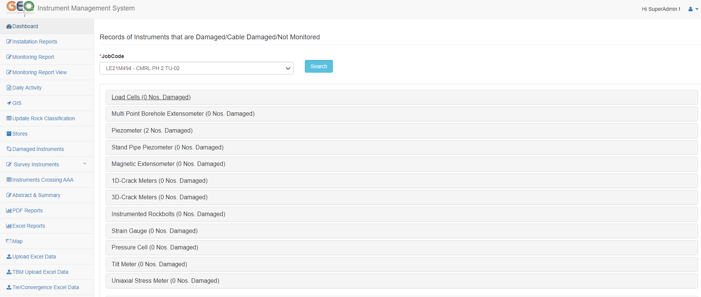
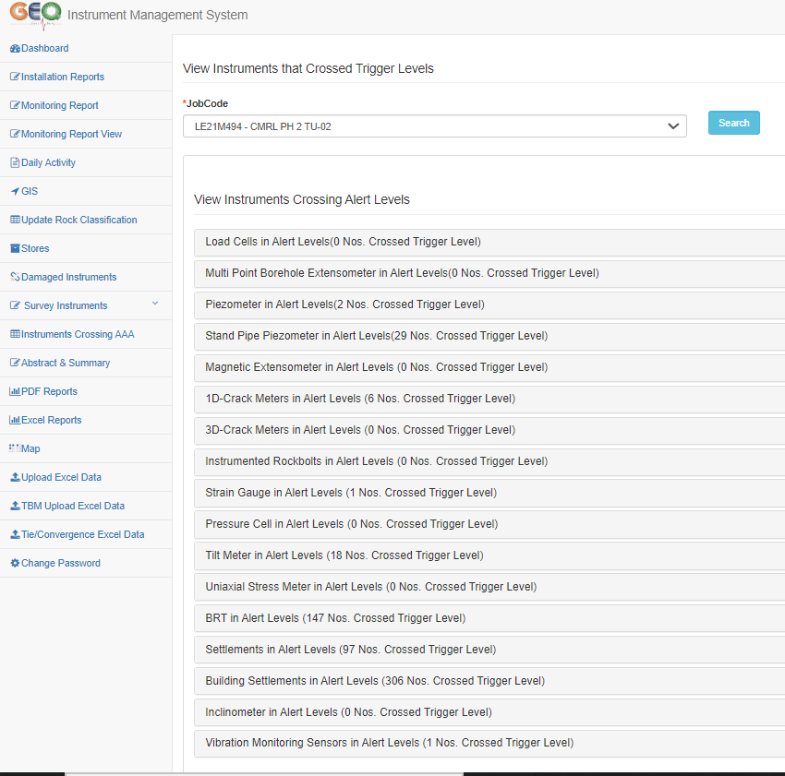
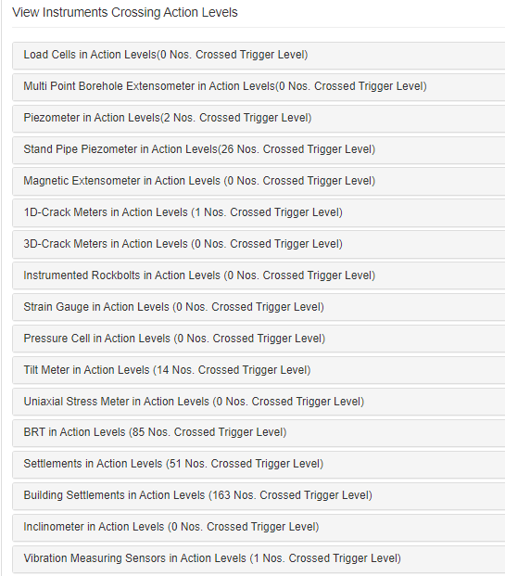
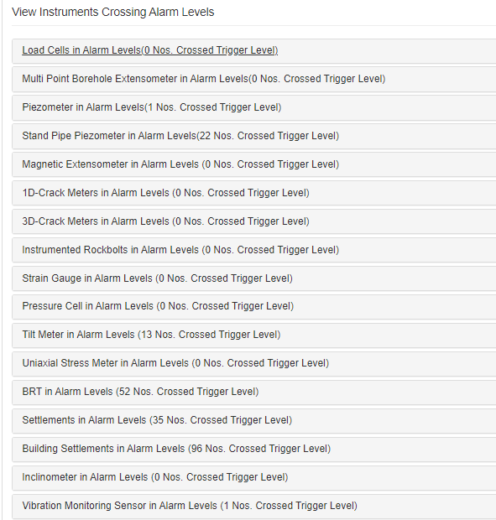
Notes:
This web portal also notifies about the list of damaged instruments and the instruments that had crossed their threshold values along with their location, date and time of occurance. %%TTS_FEMALE%

Slide 8
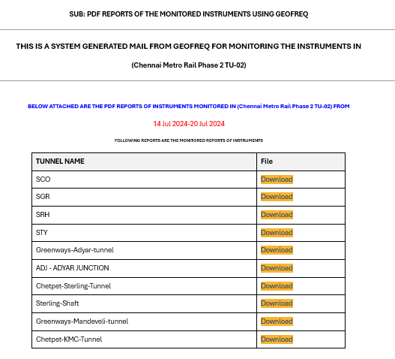
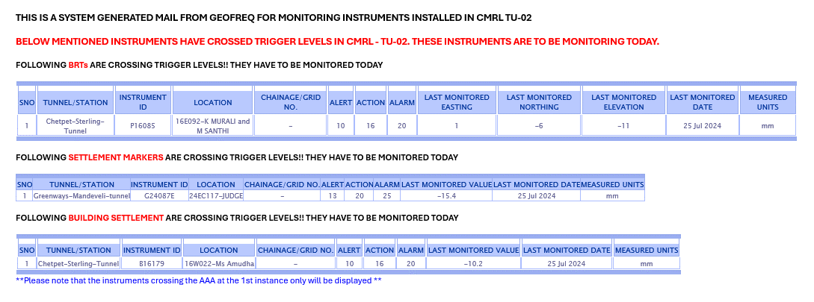
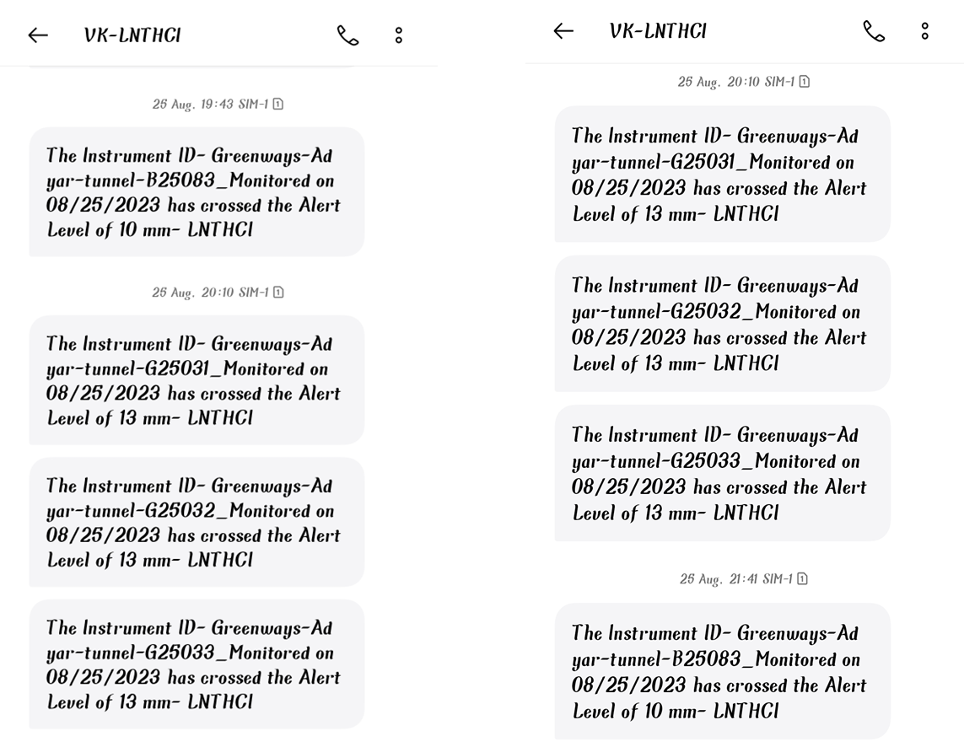
Notes:
It also generates the weekly reports based on the locations and shares the alerts in the form of mails and SMS to the registered users. %%TTS_FEMALE%

Slide 9
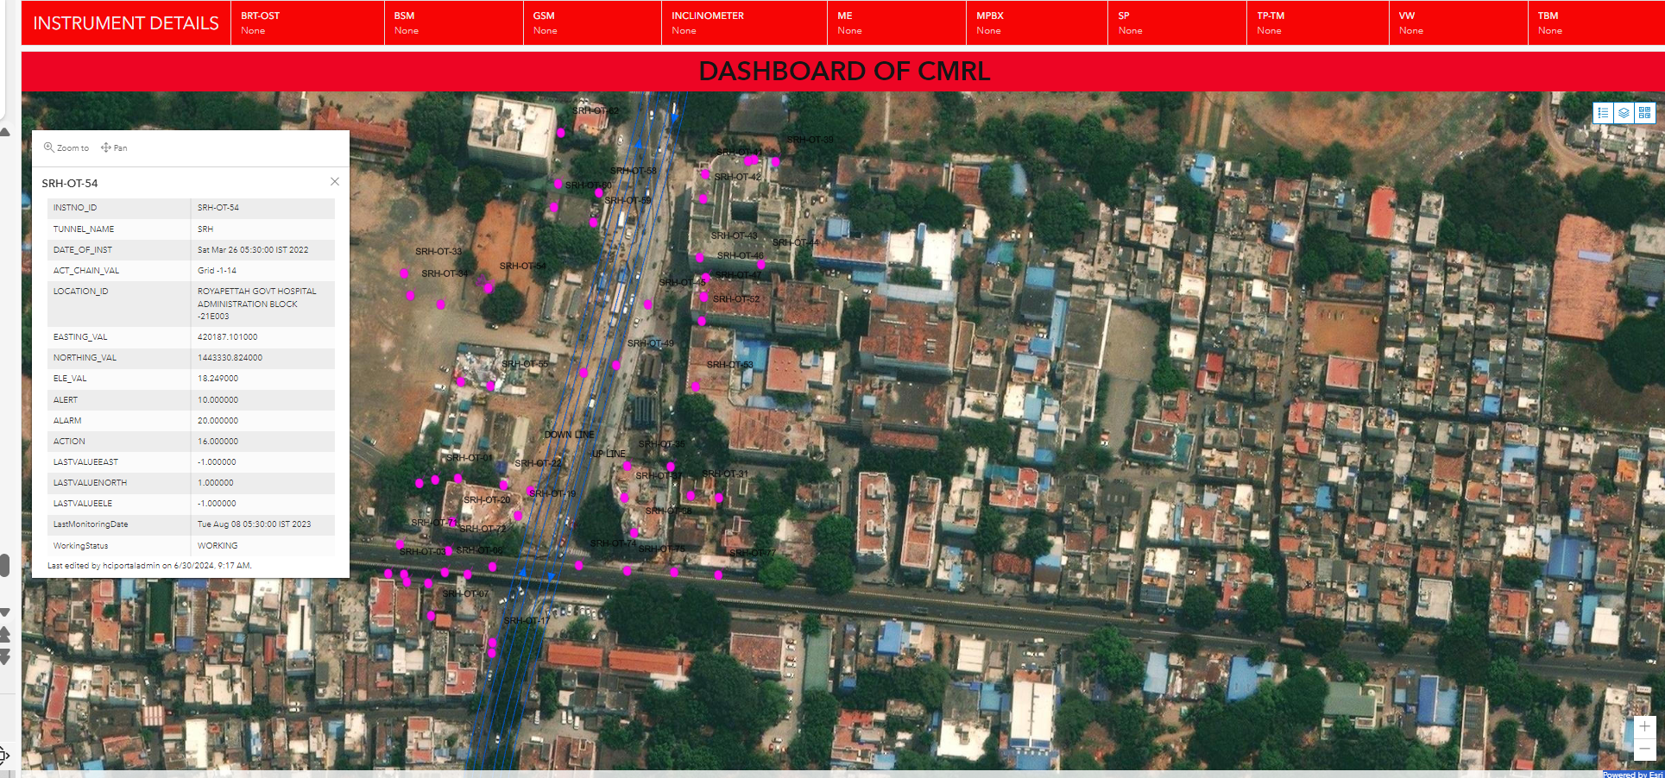
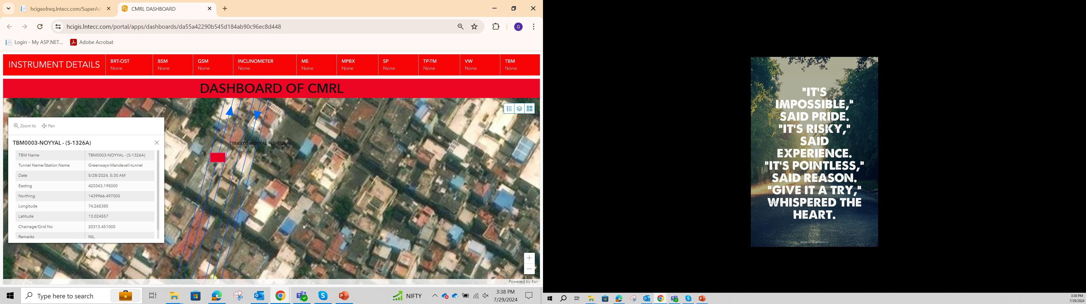
Notes:
As the Geofreq was integrated with the GIS, it shows all the instrumental location along with the TBM live position on a real time basis. This also enables the user to visualize the live data in the form of pop ups. %%TTS_FEMALE%

Slide 10
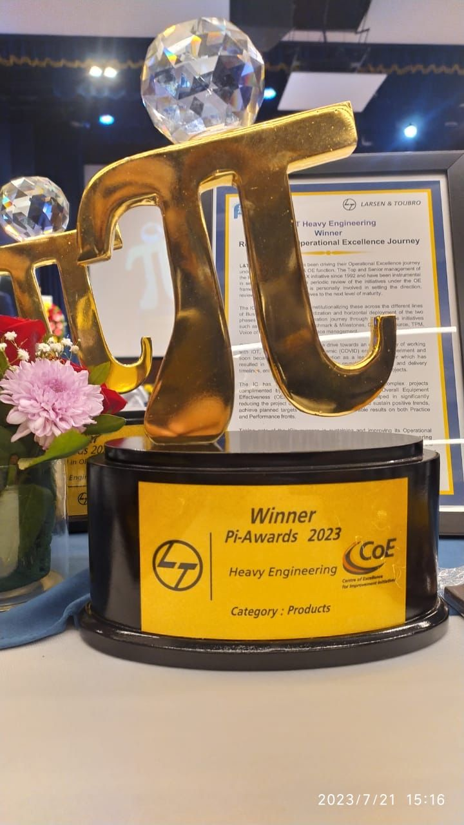
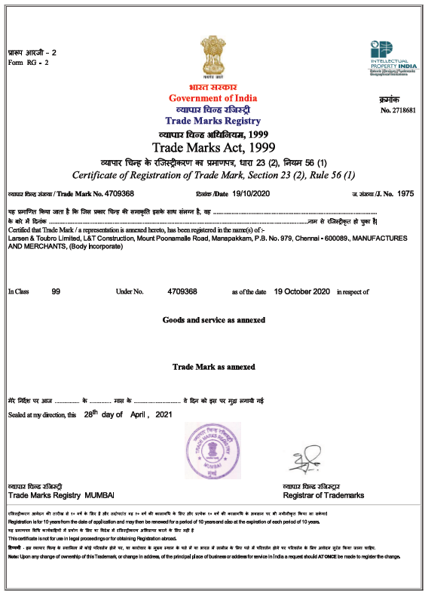
Notes:
This Geofreq web portal has been awarded the prestigious Golden PI Award by L&T and holds, trademark and copyright certificates. TTS_FEMALE%

Slide 11
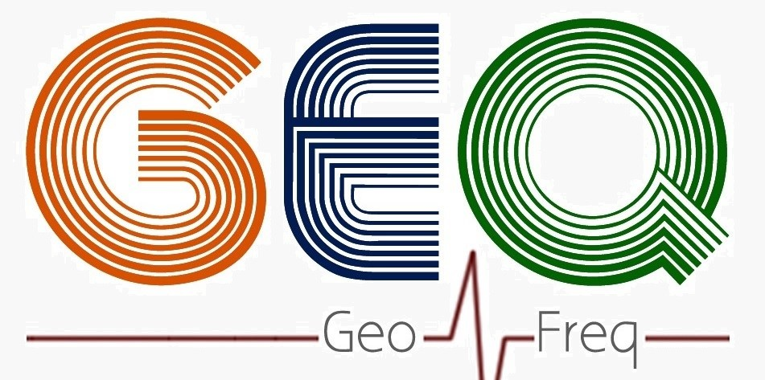
Notes:
That is the brief about Geofreq web portal. %%TTS_FEMALE%

Slide 12


THANK YOU
EDRC GEOTECH
Notes:
Thank you for watching. %%TTS_FEMALE%

