Slide 1
Global Trends on Nutrition
From the perspectives of agriculture
Notes:
Global Trends on Nutrition
From the perspectives of agriculture

Slide 2
Food, nutrition and Environment, international dialog during past 70 years
Single sector approach
Food security
Rural development
Competition & trade-off
Global environmental issue
Systemic approach
Food system
Planetary health diet
Malnutrition
~ 1980
1990 ~ 2000
2010 ~
Targeting best performance
Targeting optimal performance
Notes:
In this slides, I am going to talk about global trend of international dialogue on food, nutrition and environment during last 70 years.
This trend is classified into roughly three phases, transit from simple single sector approach toward more complex systemic approach.
This is a reflection of the problem we faced in each period of time and efforts trying to find solution.

Slide 3
Contents
History of global environmental issue
History of food security concept
Toward systemic approach
Food system and planetary health diet
Notes:
This is four main contents explaining each stage of transition as explained in the previous slides.
1. History of global environmental issue
2. History of food security concept
3. Toward systemic approach
4. Food system and planetary health diet

Slide 4
1. History of global environmental issue
Notes:
1. History of global environmental issue

Slide 5
Overview of international dialogue about global environmental issue and agriculture
Notes:
Overview of international dialogue about global environmental issue and agriculture.

Slide 6
Recognition about global environmental issue
1970s-1980s
1972: The limits to growth - Club of Rome
  If the present growth trends in world population, industrialization, pollution, food production, and resource depletion continue unchanged, the limits to growth on this planet will be reached sometime within the next one hundred years
1980s’: new phase of environmental pollution
  Point source: local issue, specific entity responsible
  Nonpoint source: regional/global issue, general public also responsible for pollution
Notes:
Initiation of global dialog about overall lifestyle of modern human being and destiny of earth can be tracked back to 1970’s. Thorough its publication, “The limits of Growth”, “Club of Rome” published a cautiously article on current mode of human lifestyle which heavily relying on non-renewable resources.
After around ten years, the concept of environmental pollution introduced new aspect, non-point source. Before this time, pollution problem was more simple. In most cases, geographic scale was as small as town or community, polluter and victim ware clearly identified. This is a case of point source pollution.
However after introduction of non-point source, we came to understand that our lifestyle itself is leading pollution, and geographic scale is much bigger than traditional case of pollution.

Slide 7
1990s: establishment of the concept of “sustainable development”
1990s
Traditional mode of agriculture
Unsustainable
mode
Irreversible env. impact
Rio-summit
1992
Slash-and-burn
Nomadic grazing
Rangeland farming
Over-grazing
GHG emission
Soil degradation
Biodiversity loss
UNFCCC
UNCBD
UNCCD
Over-cultivation
Deforestation
Sustainable development concept
Population pressure
Economic development in developing nations
Due to population pressure, regenerative capacity of traditional agricultural ecosystem was deteriorated in rangeland
Sustainable intensification in prime land was one possible direction to refrain further expansion of agriculture pressure in fragile rangeland ecosystem
Notes:
In line with expansion of the concept of pollution, experts start accumulating evidences regarding relationship between traditional mode of agriculture and global environmental damage at the time of late 1980s.
Traditional mode of agriculture was sustainable during long human history, however due to increasing population pressure and economic competition of natural resources, environmental pressure reached to the state that normal environmental regeneration process cannot catch up with.
These include over-grazing, over-cultivation, and deforestation which results in three global environmental problem, GHG emission, Soil degradation, and biodiversity loss.
To solve the situation, three international convention was agreed among leaders from over 180 countries at Rio-summit in 1992, namely, UN Framework Convention for Climate Change, UN Convention for Bio-Diversity and UN convention for combatting desertification.
Through these process one of the most important concept for international development was proposed, that is, the concept of sustainable development. This concept is further deepened and reflected into global agenda now. Sustainable Development Goal.

Slide 8
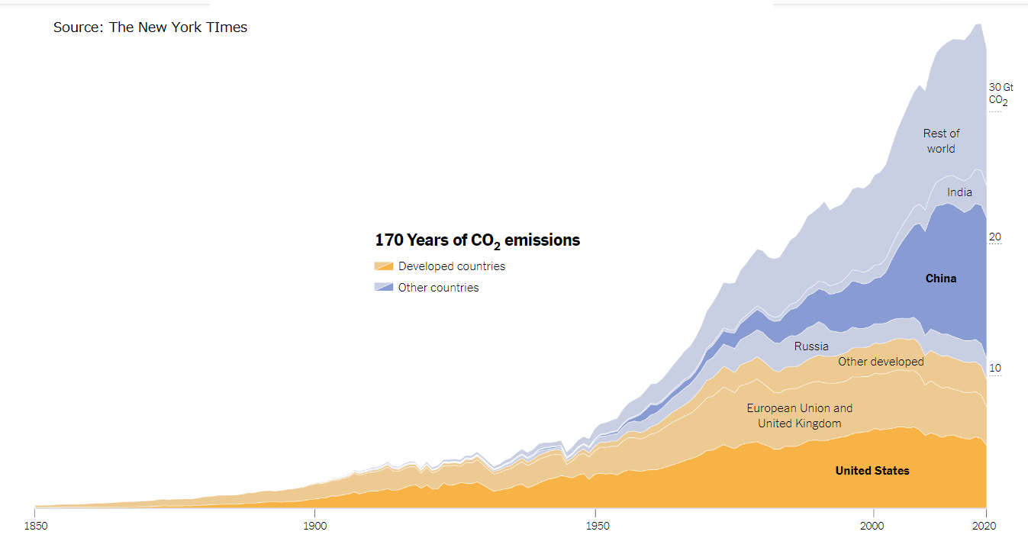
Historical CO2 emission by country
Rio-summit
1992
Notes:
At the time of Rio-summit, one of the key argument was, how to balance role and responsibility among industrial nations and developing nations.
As you can clearly see in the graph, amount of GHG emission was almost same between industrialized nation and developing nation. However if we look back historical accumulation, majority of emission have been done by industrialized nations. In fact, wasting non-renewable natural resources was key economic model of development at least up to 1980s.
Under that situation, to carefully balance the role and responsibility, international community introduced new concept, so called, “Common But Differentiated Responsibility”. This meals all the country in the world have common responsibility, but in considering historical, cultural situation and historical background, extent of the duty each country will shoulder may different.

Slide 9
2000s: two-sided nature of agriculture
2000s
Negative aspect
  Land use change for agriculture development
  CH4 from Enteric fermentation
    Grazing vs. Feedlot
  N2O, CH4 from manure
  CH4 from paddy field
  N2O from fertilizer application
Negative aspect
Positive aspect
  Carbon storage
  afforestation, reforestation
  Carbon storage
  farmland management
  Secondary habitat
  sustainable forest management
  grassland
  paddy field
Positive aspect
Notes:
Since Rio-summit, researcher and experts have been continuously updating knowledge and evidence about both positive and negative aspect of agriculture to global environmental issue. Negative aspects includes GHG emission related to agriculture practices and biodiversity loss due to land use change. Positive aspects includes function of carbon storage of well managed farmland, and role of farmland as secondary habitat of wild life such as wetland.

Slide 10
What is environment friendly diet?
Notes:
What is environment friendly diet?

Slide 11
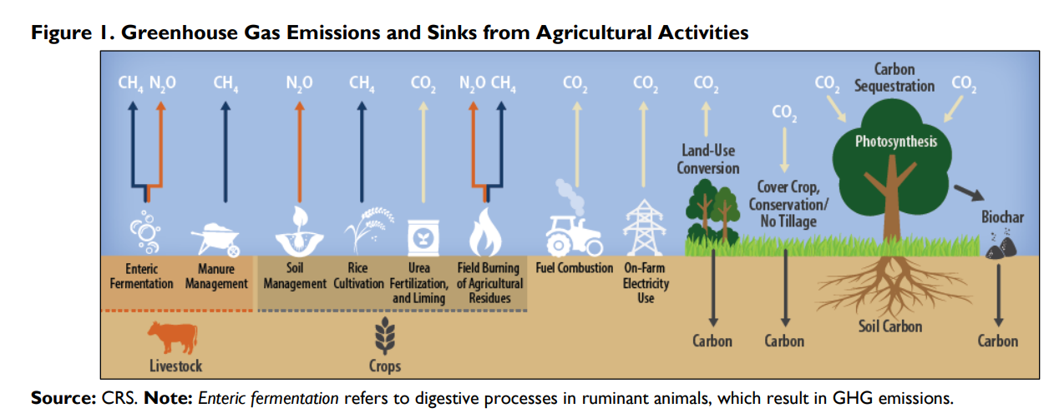
Environmental target and causality for environmental impact
Notes:
As explained in the previous section, there are number of positive and negative environmental impact from agriculture. Even the case of GHG emission, major technical area includes enteric fermentation and manure management for livestock, fertilizer management from farmland, methene emission control from paddy field, fuel and energy use for machinery, and carbon storage through forest and land management.
Let’s see the contribution of each technical area in the following slide..

Slide 12
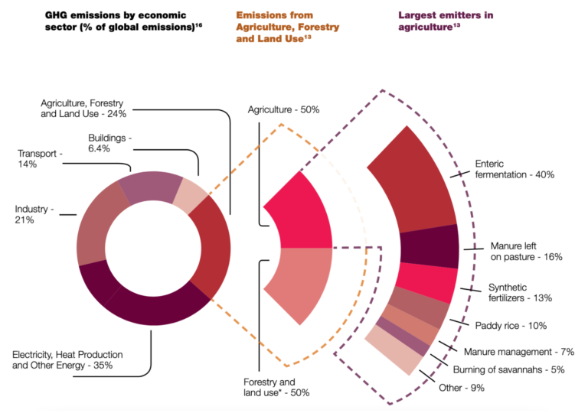
AgLED: A new CCAFS resource for understanding low-emissions development in agriculture
Notes:
This pie-chart, shows share of GHG emission under different type of economic activities. We can see that the biggest emission comes from heat and energy sector accounts for 35% of total GHG emission. Agriculture and forestry sector is a second biggest sector, which accounts for 25% of total emission.
When further disaggregated, half of the emission is from forestry and remaining half is from agriculture. Within agriculture sector, enteric fermentation hold largest share of 40%, followed by manure management as 16%, chemical fertilizer management as 13%, and methene emission from paddy field as 10%.

Slide 13
How to mitigate negative environmental impact of FVC
 | Dietary change | Sustainable intensification | Reduce food loss & waste
Enteric fermentation: CH4, N2O | ++ | Improved feed conversion, antibiotics, bovine somatotropin (bST), propionate precursors, antimethanogens, and intensive grazing | +
Manure management: CH4, N2O | ++ | Incorporation of small-scale or large-scale anaerobic digesters | +
Soil nutrient management: N2O, CH4 |  | changes in fertilizer application : split fertilization, 100% crop residue incorporation, nitrification inhibitors, and reducing nitrogen fertilizer applications by 20% | +
Land use change |  | Zero future land conversion of natural ecosystems into farmland | +
Notes:
Based on the finding, possible mitigation measures are also being investigated.
In 2021, LANCET summarized those technologies in its publication, EAT-LANCET. It proposes to minimize negative environmental impact coming from current dietary habit under three strategies, (1) dietary change, (2) sustainable intensification technology, (3) reduction of food loss and waste. First and third strategy simply try to reduce negative environmental impact by reducing total consumption. Second strategy is focusing on technical innovation to reduce GHG emission while improving overall productivity. Number of technologies have been proposed, verified and demonstrated for extension.
In this slide, key technologies are summarized for four technical area, enteric fermentation, manure management, chemical fertilizer management, and land use change.

Slide 14
How to mitigate negative environmental impact of FVC
 | Dietary change | Sustainable intensification | Reduce food loss & waste
Rice cultivation: CH4, N2O |  | nutrient management (reduced or optimized nitrogen fertilizer application, use of slow release fertilizer, application of nitrification inhibitors, switching from urea to ammonium sulfate), residue management (100% incorporation), water management (midseason drainage, alternate wetting and drying, switching from irrigated to dryland rice), dry seeding, tillage strategies, and combinations of these activities | +
Biodiversity |  | Adopt half earth strategy (50% protected area) CBD: Protected area 30% in 2030, sustainable biomass resource utilization | +
Water resource |  | Allocate 90% of renewable water to food production Reduce water loss up to 20% Uneven resource availability makes serious challenge
Notes:
In this slide, technologies are summarized for three technical area, rice cultivation, biodiversity, and water resource.

Slide 15
2. History of food Security concept
Notes:
2. History of food Security concept
Now In this section, I am going to explain historical transition of international food security dialogue.

Slide 16
Transition of “Food Security Concept”
- from volume to quality, and further expansion…
Year | Keyword | Scope of food security / nutrition
1974 | Availability | availability at all times of adequate world food supplies of basic foodstuffs to sustain a steady expansion of food consumption and to offset fluctuations in production and prices
1983 | Affordability | …the ultimate objective of world food security should be to ensure that all people at all times have both physical and economic access to the basic food they need.
1996 | Quality | …access to sufficient, safe and nutritious food which meets their dietary needs and food preferences for an active and healthy life
2015 | Expansion of scope of malnutrition | By 2030, end all forms of malnutrition, including achieving, by 2025, the internationally agreed targets on stunting and wasting in children under 5 years of age…
Volume
Equity
Quality
Concept expansion
Systemic approach
Notes:
Currently, there are over 200 of definitions for “food security”. However by selecting key agreement among senior officials from the government, we can capture the transition of the food security concept itself.
During 1960 to 1970s when number of countries were facing serious hunger, the core concept of food security was “food availability”. Key target in agriculture policy was, how to increase productivity. Green revolution was initiated during this period. Rapid productivity improvement of three major staples, wheat, rice, and maize significantly contributed to increase of staple supply especially in Asian and Latin American countries.
However in 1980s, after dramatic growth in staple productivity, we could still observe hunger in number of countries. People started to realize that food availability is one issue, but there is another critical barrier for food security, that is, food affordability. Accessibility was added as another key issue for food security.
In 1990s, when we come to see steady progress in hunger reduction, we understand that even population who avoid serious food insecurity, often fell into malnourished state due to low quality of diet. Quality of diet was then added as key issue for food security.
In 2015, global development target was updated from Millennium Development Goal to Sustainable Development Goal. One of key change in relation to food and nutrition is MDG goal 1 and SDG goal2. During MDG, food security target only define prevalence of undernourishment, acronym as POU. In this case, POU count only number of hunger population. While in case of SDG, the target is expanded as “to eliminate all forms of malnutrition”, which cover not only serious hunger, but also obesity, micronutrient deficiency, chronic undernutrition and so on.

Slide 17

World Food Summit
Rome, 13 – 17 November 1996
Definition of food security
Food Security exists when all people, at all times, have physical, social, and economic access to sufficient, safe and nutritious food which meets their dietary needs and food preferences for an active and healthy life.
© FAO, 1996
Notes:
Probably one of the most known current definition of food security is the one agreed in 1996 at World Food Summit held in Rome.
Food Security exists when all people, at all times, have physical, social, and economic access to sufficient, safe and nutritious food which meets their dietary needs and food preferences for an active and healthy life.

Slide 18
From 50s up to 90s
During 1950s, many country were at the risk of serious hunger. One of the key issue for development was “hunger reduction”
After green revolution in 1960s-1970s, world grain supply have been relatively excess. International price decreased accordingly
Nevertheless, the world still see great number of population suffer from hunger and we come to recognize hunger as a matter of disparity during late 1970s – 1980s.
By mid-80s, symptom of food security were investigated deeply and time dimension were added (chronic and acute food insecurity)
Furthermore, food security debate come to emphasize quality aspect of diet in 90s
Volume
Equity
Quality
Concept expansion
Systemic approach
Notes:
Now I am going to explain why the concept of food security evolved by expanding its focus to cover volume, equity, and quality.
During 1950s, many country were at the risk of serious hunger. One of the key issue for development was “hunger reduction”
After green revolution in 1960s-1970s, world grain supply have been relatively excess. International price decreased accordingly
Nevertheless, the world still see great number of population suffer from hunger and we come to recognize hunger as a matter of disparity during late 1970s – 1980s.
By mid-80s, symptom of food security were investigated deeply and time dimension were added (chronic and acute food insecurity)
Furthermore, food security debate come to emphasize quality aspect of diet in 90s

Slide 19
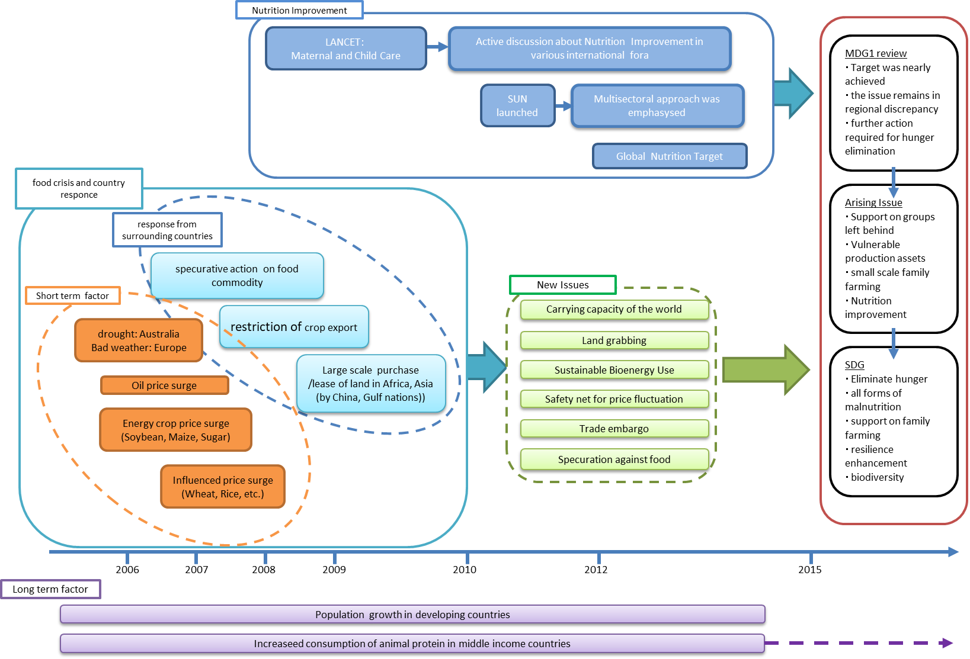
What happened during last decade? (2007 - now)
Notes:
In this slide, I tried to draw overall picture that explain an incident occurred during 2007-2009 and follow up discussion, which made a significant impact on international food and nutrition security dialogue.
In the next slide, I summarize what happened during 2007-2009 and what key question was triggered based on this experience. These explanation covers big box on left side of the slide, plus small box next to it connected through blue arrow, with a set of green label.

Slide 20
Food crisis and following debate
In 2007/2008, however, world grain stock level reached lowest level in 30 years. This was caused by
  oil price surge, bad weather in Australia and Europe, rapid demand growth of energy crop for bioethanol, biodiesel,
This experience raised multiple issues to international agricultural community including
  Carrying capacity of the world
  Sustainable use of bioenergy
  Responsible agricultural investment
  Monitoring / regulating speculation, trade embargo
  Resilience to the price fluctuation / natural calamity
Volume
Equity
Quality
Concept expansion
Systemic approach
Notes:
In 2007/2008, however, world grain stock level reached lowest level in 30 years. This was caused by
oil price surge, bad weather in Australia and Europe, rapid demand growth of energy crop for bioethanol, biodiesel,
This experience raised multiple issues to international agricultural community including
Carrying capacity of the world
Sustainable use of bioenergy
Responsible agricultural investment
Monitoring / regulating speculation, trade embargo
Resilience to the price fluctuation / natural calamity

Slide 21
Remarkable progress in nutrition agenda
It was well understood that nutrition and food security were non-divisible component. However, it was not effectively harmonized in implementation
In 2008, LANCET released series of scientific papers to alarm limited support in Nutrition and science based evidence on various nutrition intervention
The message received great attention from international community including G8 / G20. Number of initiatives have been launched including Scaling Up Nutrition, established in 2010
SUN focused on “First 1000 days”, “13 prioritized nutrition intervention”, “multi-sector approach including Agriculture, Health, Hygiene, and Education”
In 2013, Six Global Nutrition Target was adopted by WHO
Volume
Equity
Quality
Concept expansion
Systemic approach
Notes:
Then, I am going to explain remaining part of the figure in the previous slide. It is about what have been discussed among global health experts during almost same period.
It was well understood that nutrition and food security were non-divisible component. However, it was not effectively harmonized in implementation
In 2008, LANCET released series of scientific papers to alarm limited support in Nutrition and science based evidence on various nutrition intervention
The message received great attention from international community including G8 / G20. Number of initiatives have been launched including Scaling Up Nutrition, established in 2010
SUN focused on “First 1000 days”, “13 prioritized nutrition intervention”, “multi-sector approach including Agriculture, Health, Hygiene, and Education”
In 2013, Six Global Nutrition Target was adopted by WHO

Slide 22
Identified challenges in MDG → toward SDG
MDG1 review
  Target was nearly achieved
  Issue remains in regional discrepancy
  Further action required for hunger elimination
Arising Issues
  Support on groups left behind
  Vulnerable production assets
  Small scale family farming
  Nutrition improvement
SDGs
  Eliminate hunger
  All forms of malnutrition (acute malnutrition, chronic malnutrition, overnutrition)
  Support on family farming (no one left behind)
  Resilience enhancement (no one left behind)
  Biodiversity
Volume
Equity
Quality
Concept expansion
Systemic approach
Notes:
Finally, all the discussion explained last few slides were summarized and reflected as much as possible in the process of Sustainable Development Goal dialogue.
Dialogue on SDG started from the review of achievement of MDG. In terms of MDG goal1, there were three key findings. (1) Target to halve POU was nearly achieved
, (2) however, issue still remains as regional discrepancy, and (3) Further action required for hunger elimination
To overcome remaining issue, disparity, several focus needs to be emphasized. (1) support on groups left behind including small scale farming household, (2) how to improve vulnerable production assets.
In addition, in order to reflect recent progress on global dialogue on nutrition, it was important to expand the scope from only hunger into improvement of “all forms of malnutrition”
As a result, several key concept were integrated in SDG goal2 as follows,
Elimination of hunger
To Cover all forms of malnutrition, including acute malnutrition, chronic malnutrition, overnutrition
Support on family farming
Support resilience enhancement, which is a common challenge of current vulnerable population

Slide 23
3. Toward systemic approach
Notes:
3. Toward systemic approach
Now I am going to explain final part of this video, about systemic approach, which become increasing popular during just last a few years.

Slide 24
Competition & trade-off
Notes:
Competition & trade-off

Slide 25
Competition and trade off between three key issue
Dietary transition
Nutrition
Environment
Food security
Dietary transition and economy
Livestock farming and
GHG/Biodiversity
Growing population
Climate change &
Biodiversity
Land resource
Water resource
GHG emission
Biodiversity
Notes:
Now, let’s start from explaining what is systemic approach and why we need it.
In the very first slide, I explained about global trend of international dialogue on food, nutrition and environment. It can be divided into three phase, single sector approach, competition and trade off, and systemic approach.
In the earlier days, agriculture sector try to achieve different objective focusing on single target. However, experts started to realize that single sector approach may cause unexpected negative or positive impact to non-target. Then we start considering multiple objective at one time, to make optimal balance among different approaches.
Typical example of unexpected negative impact is, relationship between nutrition, environment, and agriculture. As it was already explained, if we focus only on production expansion, it gives negative irreversible impact to global environment. If we focus on balanced food supply, increased supply of animal products especially for developing world, it will again give serious damage to global environment. There is also competition between food security and nutrition improvement. Because some group of people suffer from hunger or acute malnutrition which stable supply of dietary energy is essential component, while other group of people suffer chronic malnutrition or micronutrient deficiency which diversified, balanced diet play a critical role.
Systemic approach is a way to identify optimal balance among set of different policy target.

Slide 26
2010s: systemic design for sustainability
2010s
Through the course of international dialogue on global environmental issue (i.e. SDG, climate change, biodiversity, etc.), it was identified that various human activities, deeply connecting each other, giving positive and negative impact to the environment
Systemic approach was taken to clarify complex interrelationship among various human activities and find out optimal balance among them
Volume
Equity
Quality
Concept expansion
Systemic approach
Notes:
Through the course of international dialogue on global environmental issue (i.e. SDG, climate change, biodiversity, etc.), it was identified that various human activities, deeply connecting each other, giving positive and negative impact to the environment
Systemic approach was taken to clarify complex interrelationship among various human activities and find out optimal balance among them

Slide 27
Towards systemic approach
Expansion of the scope of food & agriculture related issues
2015: Sustainable Development Goal (hunger → nutrition)
2019: EAT-LANCET (food, health and environment)
2021: Food System Summit (expand boundaries)
Traditional domain (up to MDG)
Recent update (SDG and after)
Hunger reduction
Economic development
Hunger elimination
Economic development
All form of malnutrition
Minimize negative environmental impact
Optimize Linkage among Agriculture, Nutrition, and Earth
Notes:
During last decade, integration of food security and nutrition have shown remarkable progress. And now, experts tries to integrate environment in this framework through application of systemic approach. This direction became clear during last a few years through Food System Summit, N4G, and publication like EAT-LANET.

Slide 28
What is planetary health diet?
Notes:
What is planetary health diet?
Now before closing, I am going to introduce planetary health diet quickly, the concept proposed by the publication titled EAT-LANCET in 2021.

Slide 29
Three fundamental questions in food, nutrition and environment
Are we eating healthy? →
Is our diet harming environment? →
Can earth satisfy growing food demand in a sustainable manner?
  →
No
Yes
Only if we could overcome set of challenges
Notes:
Key concept of planetary health diet is to recommend optimal diet balance in considering not only nutrition, but also impact of dietary culture to global environment.
The report conduct meta-analysis using existing scientific literature to capture latest reliable figure regarding relationship between dietary culture, nutrition, health, and environment. And based on the result of this meta-analysis, planetary health diet is summarized as set of recommendation of daily recommended intake of key food groups.
The result of meta-analysis clearly shows that current dietary culture is not healthy enough in most of country/region. It also clarify current dietary culture is giving irreversible environmental impact. Lastly, it conduct several scenario analysis to identify possible pathway for human being to ensure healthy diet and lifestyle while maintaining environmental sustainability.

Slide 30
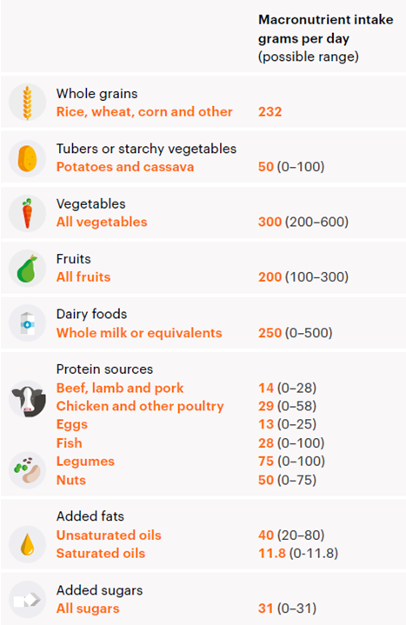
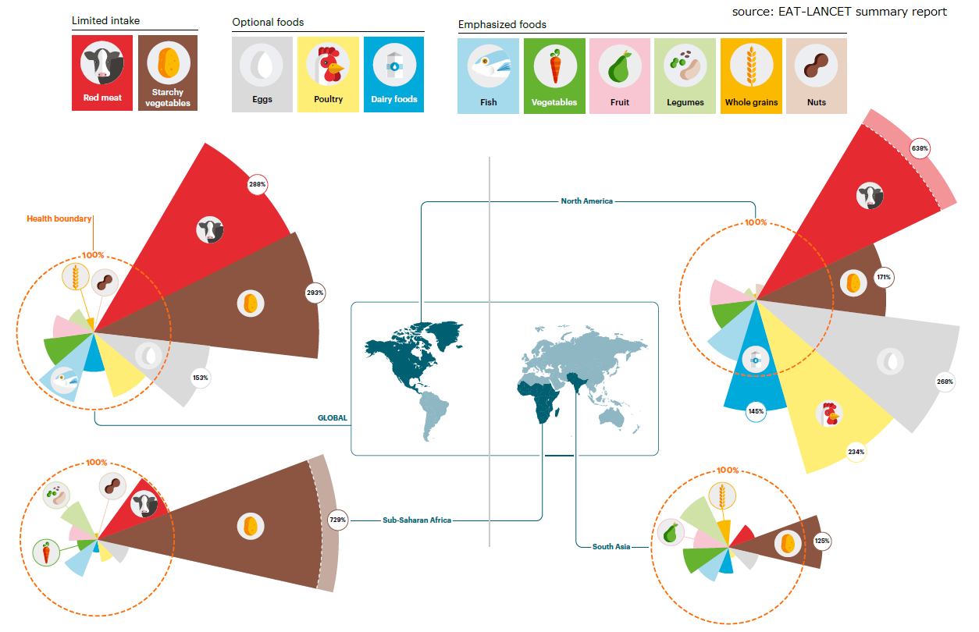
Dietary recommendation and current status
Notes:
In the left side, you can see for each nine food category, recommended daily intake is shows in gram-per-capita-per-day. This is a recommended value determined based on existing scientific literature about nutrition and environment.
In the right side, you can see pie-chart which compare these recommendation and actual food supply in each region. There is very big difference by region, oversupply and undersupply by different commodity group. Each region is unique, as well as not complying planetary health diet at all.

Slide 31
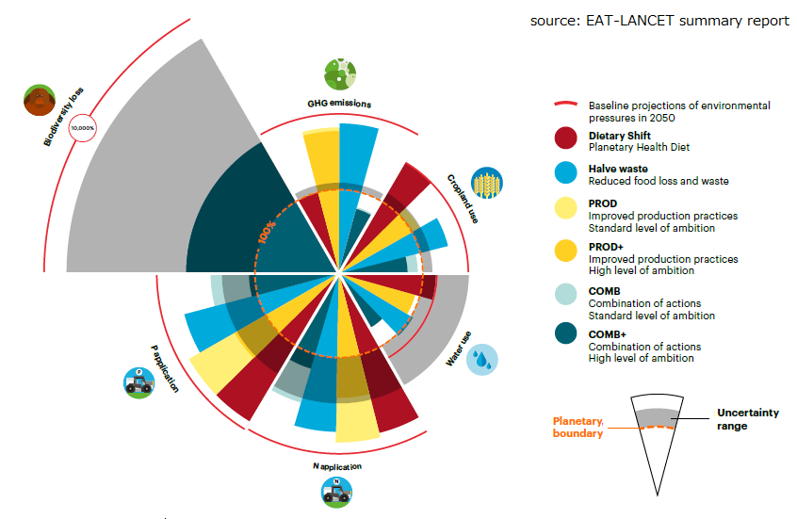
Environmental target and six future scenario
Notes:
This chart show environmental impact of six scenario with different technology option. The scenario includes (1) Dietary shift, which follow planetary health diet, (2) Halve waste, which reduce food loss and waste by half, (3) PROD, adoption of high yielding technology. (4) PROD+, adoption high yielding technology more intensively, (5) COMB, adoption of technology combination including high yielding, GHG emission reduction and other, (6) COMB+, more intensive application of COMB
Six kinds of environmental impact is verified in this assessment, which includes biodiversity loss, GHG emission, land use change, fertilizer management, water usage and other.
Hight of each pie indicates the extent of damage to the environment. Red line set for each environmental category is border line for sustainability.
As you can see, under most of six environmental category, only COMB+ option can fit within border line.

Slide 32
Possible actions to harmonize competition and trade-offs
Notes:
Possible actions to harmonize competition and trade-offs

Slide 33
Three key approaches to create synergetic impact
Dietary changes towards healthy diets
Technological and management-related changes in food production (sustainable intensification)
Reductions in food loss and waste
Source: EAT-LANCET summary report
Notes:
As a conclusion of their analysis, EAT-LANCET propose three key strategy to minimize competition and trade-offs, while enhance synergy and impact among food security-nutrition-environment triangle.
Dietary changes towards healthy diets
Technological and management-related changes in food production (sustainable intensification)
Reductions in food loss and waste

Slide 34
Shunichi NAKADA
Nakada.Shunichi.2@jica.go.jp
Thank you very much!
Any question / feedback?
Notes:
Thank you very much!

