Slide 1
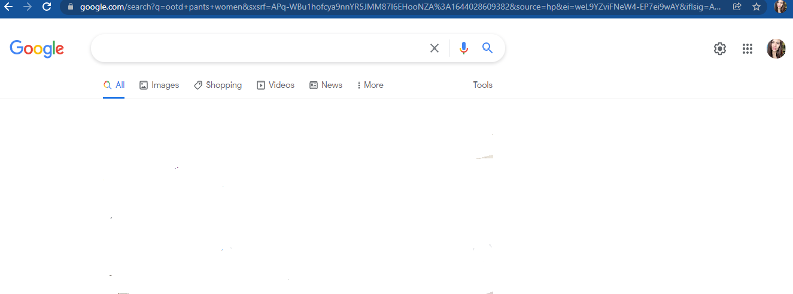

OBJECTIVES
MOST ESSENTIAL LEARNING COMPETENCIES
Analyse the nature, dimensions , types and consequences of Power.
At the end of the module, learners should be able to :
a. Define what is power.
b. Identify the types and sources of powers
c. Recognize the vital role of power in social and political dimensions. .

Slide 2

1.The political ideology focuses on idea that the status quo or the current situation is the best one is called?
Answer : CONSERVATISM
2. The ideology that aims to define and establish the political , economic ,personal and social equality of the sexes or gender is called?
Answer: FEMINISM

Slide 3
3. _________ views that human beings must be given to choose their leaders and government officials.
Answer : LIBERALISM
4. This political ideology has contrasting views of the state.
Answer : SOCIALIM
5. Ideology that rejects state outright
Answer : Anarchism.

Slide 4


Slide 5
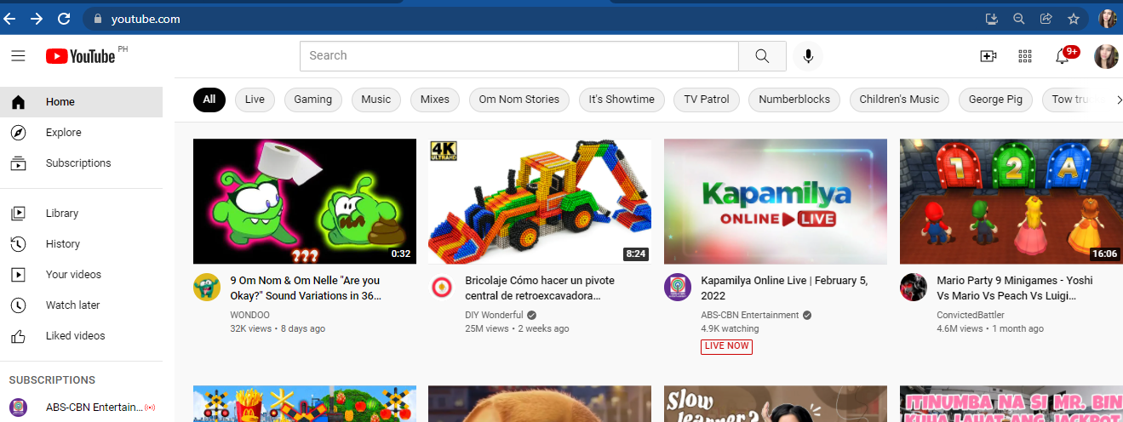
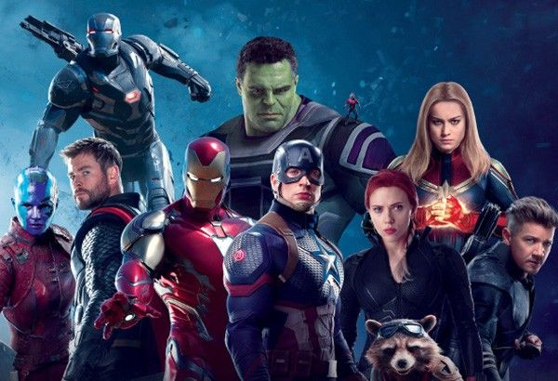
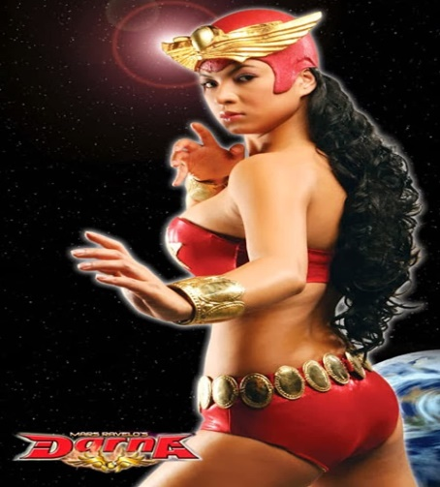
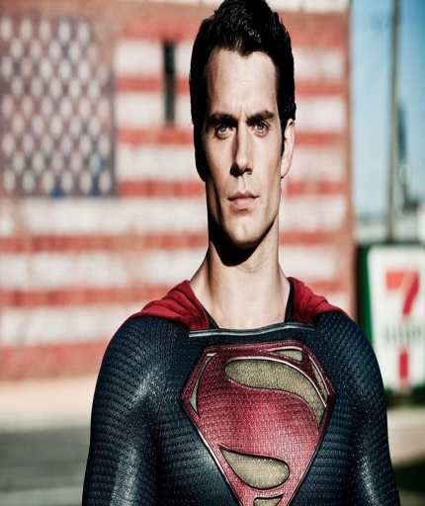

SUPERHERO/SUPERHEROES
AVENGERS
DARNA
SUPERMAN
LASTIKMAN

Slide 6


Slide 7
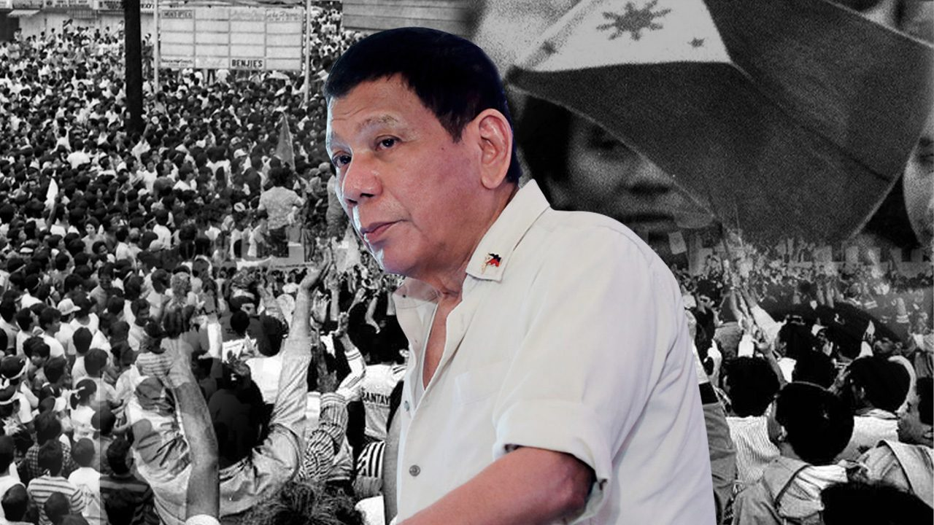
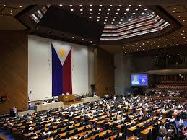

Slide 8
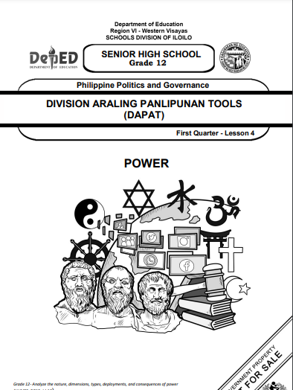

Slide 9
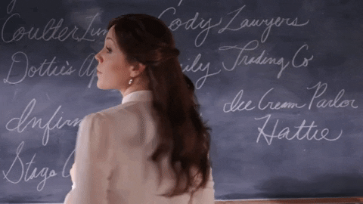
POWER
NATURE
DIMENSION
TYPES
CONSEQUENCES
MEANING OF POWER

Slide 10

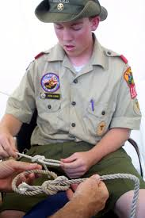
CHECK YOUR KNOWLEDGE
Before we start on this journey ,let us check what you already know about the concepts that you are about to learn.
TASK1 : EXPLAIN IT!
Directions : Explain how power is exercised in the following situations. Write the answers in your activity notebook.
SITUITION 1 : A boy scout leader teaching knot tying in his troupe .
POSSIBLE ANSWER :
Because of his expertise in tying the knot he could be able to teach and has the power to help his troupe to tie the knot.

Slide 11


Situation 2 : A teacher assisting her class to
work on their groups task.
POSSIBLE ANSWER:
The teachers job is to facilitate and teach her students and by her duty and position she could be able to assist the learners and has a power to tell the students to work as a group.

Slide 12
Situation 3 : War between Russia and Ukhraine.

Slide 13
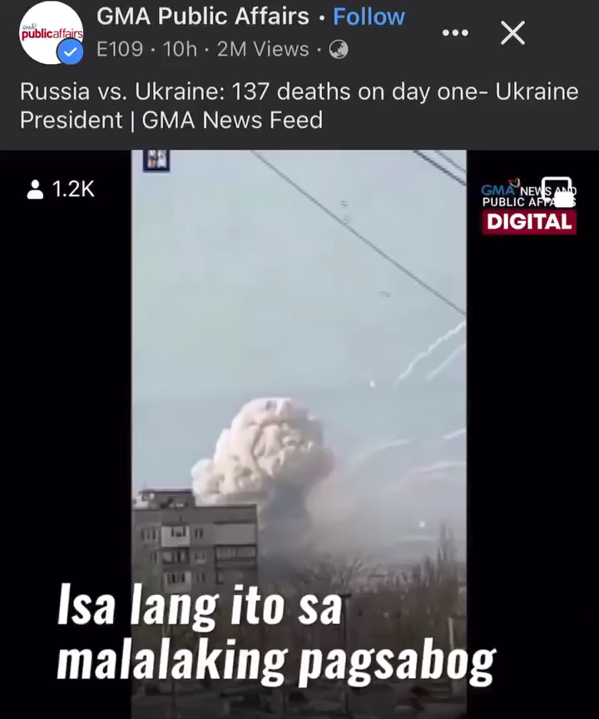

Slide 14
Situation 3 : War between Russia and Ukhraine.
Answer : A powerful example of POWER indeed . A power to take away or punish someone for non-compliance, It can also be said that Vladimir Putin the current president of Russia had a great power to invade and command his allies to go on war against the Ukraine country.
https://www.bbc.com/news/world-europe-56720589

Slide 15
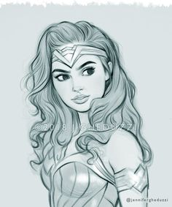

Task 2 : #SUPERHERO !
Direction : Choose one from the two activities below , and answer the questions that follow. Write your answer in your activity notebook.
Activity A : Choose your superhero costume using the available materials at home . Take a selfie and post it in your Facebook account or paste it on your notebook.
Activity B: Identify your superhero and daw him or her on your notebook .
QUESTIONS :
Why did you choose that superhero?
What characteristic does he or she posseswhich make him or her a superhero?

Slide 16
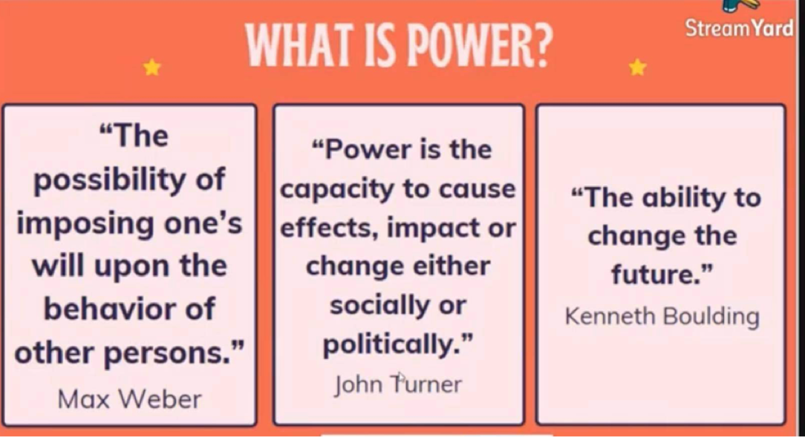

Slide 17

NATURE OF POWER
POWER CAN BE DEFINED IN MANY WAYS .
POWER OVER
POWER TO
POWER WITH
Ability to dominate ones person
This type of power is built on force, coercion, domination and control and fear.
This form power is a definite resource that can be held by individuals, and that some people have power and some people do not.
The ability of something to do ones own.
Intellect, knowledge , stamina,, etc
Ability to work with other, get something done by cooperation's.
Consensus.

Slide 18
NATURE OF POWER
POWER CAN BE DEFINED DIN MANY WAYS .
POWER WITHIN
Power within is related to a person’s “sense of self-worth and self-knowledge; it includes an ability to recognize individual differences while respecting others
Power within involves people having a sense of their own capacity and self-worth.
Power within allows people to recognize their “power to” and “power with”, and believe they can make a difference

Slide 19

DIMENSIONS OF POWER
PHYSICAL POWER
INFORMANATIOL
POWER
EMOTIONALL
POWER
• derived from
physical advantage
• you have the control
over things
• comes from strength
and skill or in a form
of having weapons
• positive use of this
power is to defend
and not to harm.
derived from
knowledge
• the power to
control the access
of information
where others do
not have
• positive use of this
power is to inform
and to teach
is using the emotion to get
what you want
• can be manifested through
to ones’ charm and appeal
to others
• captivates others through
the way one speaks or
though body language
• . Positive use of this power
is to comfort or nurture and
to respond to calls for help.

Slide 20
Legitimate Power.
This power is relative to the power of the position and duties
of the holder of the position within an organization.
POSITIONAL POWER –FORMAL POWER
Example, a policeman can arrest a citizen, a teacher can give grades,
and a boss can assign a project.
2. Reward Power.
This power depends on the ability of the power holder to confer
something of value. It refers to the degree which a person can give others a reward, fective if abused.
TYPES OF POWER
In 1959, John French and Bertram Raven described five types of power

Slide 21
3. Expert Power.
This power is derived from the power holder’s specific skills or
expertise and the need of the organization for those skills and expertise.
4. Referent Power.
This power comes from the power holder’s ability to persuade
others, influence them, and build loyalty.
5. Coercive Power.
This power stems from the power holder’s ability to punish or
apply negative influences.
TYPES OF POWER
In 1959, John French and Bertram Raven described five types of power

Slide 22
Compliance.
Refers to the situation where a person is too willing to obey a
legitimate and polite request which is perceived to be within the scope of power of a leader.
2. Commitment.
Refers to the trust and emotional pledge that produces desirable
outcome. Expert and referent powers produce commitment.
3. Resistance.
It is most likely the result when coercive power is employed by the
leader.
CONSEQUENCES OF POWER
It refers to the effects of the exercise of power and may result in either progress
or moral and cultural decline in society.

Slide 23
YOUR LEARNINGS
Task 5: POWER VIBES
The usual idea of power is the ability for influence and that influence is based on the control of resources cherished and wanted by others.
It means that the basis of power is dependence. Others presents power as based on persuasion, authority, and coercion.
For you to be able to evaluate the nature dimensions, types, deployment, and consequences of power, read the following article

Slide 24
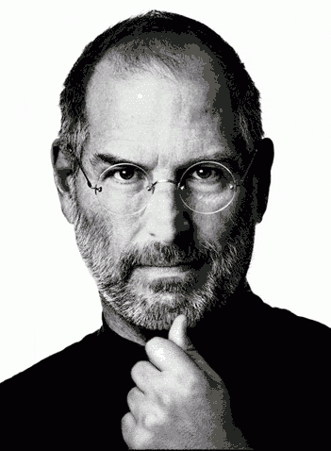
Focus on Power: The Case of Steve Jobs
By Leah Sheppard
In 2007, Fortune named Steve Jobs the “Most Powerful Person in Business.” In
2009, the magazine named him “CEO of the Decade.” Jobs, former CEO of Apple Inc.
(NASDAQ: AAPL), transformed no fewer than five different industries: computers,
Hollywood movies, music, retailing, and wireless phones. His Apple II ushered in the
personal computer era in 1977, and the graphical interface of the Macintosh in 1984 set the
standard that all other PCs emulated. His company Pixar defined the computer-animated
feature film. The iPod, iTunes, and iPhone revolutionized how we listen to music, how we
pay for and receive all types of digital content, and what we expect of a mobile phone

Slide 25
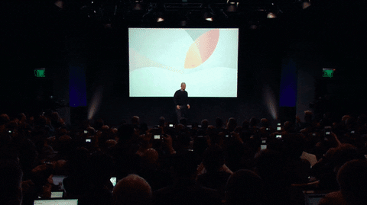
HOW DID HE DO IT?
LEGITIMATE
EXPERT
REWARD
INFORMATION
COERCIVE
REFERENT

Slide 26
1. Legitimate power. This is power imbued by the organization. For example, a manager has
legitimate power over his or her subordinates.
2. Expert power. This is power that comes from having unique or specialized expertise or
skill. Jobs was renowned for being able to think of markets and products for needs that
people didn’t even know they had.
3. Reward power. This is the power to reward others, for example through bonuses or
promotions. As one of the richest individuals in the United States, Jobs had reward power
both within and outside Apple.
4. Information power. This is power that comes from having information that others need.
Jobs was able to leverage information in each industry he transformed.
5. Coercive power. This is the power to punish others, should they not comply with what you
ask.
6. Referent power. This is power that comes from being liked and respected

Slide 27

Those who worked with him said Jobs was very hard to please. However, they also
say that this meant that Apple employees worked hard to win his approval. Cordell Ratzlaff,
who worked closely with Jobs on OS X for 18 months, said. “I learned a tremendous amount
from him.” Jobs’s ability to persuade and influence was called a “reality distortion field.” As
Bud Tribble put it, “In his presence, reality is malleable. He can convince anyone of
practically anything.” Hertzfeld described his style as “a confounding mélange of a
charismatic rhetorical style, an indomitable will, and an eagerness to bend any fact to fit the
purpose at hand. No other high-tech impresario could walk into the annual sales meeting of
one of his fiercest rivals and get a standing ovation,” which is what Jobs got in 2002 from
Intel Corporation .
Jobs’s power was not infallible—he was ousted from his own company in 1987 by
the man he hired to help him run it. But he returned in 1997 and brought the company back
from the brink of failure

Slide 29
Directions: Answer the questions and write them on your activity notebook.
Who is Steve Jobs? How would you describe him?
POSSIBLE ANSWER: Steve Jobs was a charismatic pioneer of the personal computer era. With Steve Wozniak, Jobs founded Apple Inc, he is a man of great mind and power to persuade and influence people. In some ways he has been misunderstood because of his expertise in his field he was able to use it as a power to command and convince anyone of practically anything.
2. What are the bases of powers of Steve Jobs?
POSSIBLE ANSWER : The usual idea of power is the ability for influence and that influence is based on the control of resources cherished and wanted by others

Slide 30
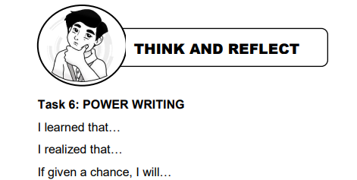
I learned that there are different meanings of power and it is in line with its nature, dimensions and sources , I also learned that even the power could give consequences based on how we use it .
I realized that power is not only for superheroes that we have known before but it could be also attached in the concept that occupied a position that is in lined with politics and Power can be considered good or bad and it is best manifest on how government work.
If given a chance to have a power, I will use it in right , I will also use it to help people and influence people to do the same, and I will use my power to crate a harmonious relationship to one another.

Slide 31

TEST YOUR KNOWLEDGE
Task 7: Power Test!
Directions: If you are the president of the country how will you use your power in the
situations listed below? Identify what type and dimension of power will
you used. Choose one situation and write the answers in your activity
notebook.
1. New People’s Army (NPA) attacked an Army headquarter
2. China occupied an island in the West Philippine Sea
3. Country faced a pandemic that threatens people’s lives

Slide 32

China occupied an island in the West Philippine Sea
It could be possible the type of power is Coercive power that stems from the power holder’s which is china the ability to punish or apply negative influences, It includes the ability to withhold rewards and relies on
threats, bullying, and “or else” language. It refers to the power to take something.
The dimension would be a Physical Power , knowing China is one of the biggest and Powerful country in the world , it comes from strength andability to control things, its skills and forms of having weapon, however this dimension should eb use in positive way not otherwise harm people.

Slide 33


