Slide 1

Internship presentation on
“Cyber Security”
At
The Cyber Defender
Submitted By,
Jesal Patel
Enroll No: 190413116007
LY IT-1

Slide 2
Contents:
Introduction to Cyber Defender
Details of Internship work
What I learned?
Certificate

Slide 3

Introduction to Cyber Defender
Cyber Defender is a Information Security Firm situated at Noida, Uttar Pradesh. It is India’s upcoming organization in the field of Information and Cyber Security.
Cyber Defender is an Information Security firm providing Cyber Security Services and Consultancies like Web & Mobile based Application Penetration Testing, Infrastructure & Network Audits, Customized tailor made Cyber Security courses to clients as per their requirements in Digital Forensics & Cyber Crime Investigations.

Slide 4
Details of Internship work:
Five Weeks Internship
Week 1:
Some details of company profile and their services provided.
Website task for penetration testing and bug hunting were given.
How client websites are introduced and tasks are given.
Brief introduction on various security tools and methodology.

Slide 5
Week 2 And 3:
Web Domains – https://coinflex.com/ & notes.finance/ were given for
Penetration testing & Bug Hunting.
Found basic informative security flaws in notes.finance/
Understood the backend & frontend technologies used in web domains.
Tried various methods of finding vulnerabilities.
Tried Data-store attacks SQL injection on Admin Panel
of the coinflex.com/
Tried user attacking vulnerabilities.

Slide 6
Week 4:
New Website – https://coinpayments.com/ were given for testing.
Mapped the website contents & discovered contents and technologies used by the website.
Found a Broken Authentication vulnerability.
Created a Bug Report on Vulnerability exploitation of Session Hijacking with 2-Factor Authentication(2FA) Bypass.
Week 5:
Found a Back-end component vulnerability.
Created a Bug Report on OS Command Injection vulnerability.
New Website – www.spike.now/ was given for penetration testing.
Continued testing for Access controls, Data Stores & Back-end
components.

Slide 7
What I learned ?
Technical Skills :
Professional Cyber Security Analyst Methodologies
Different types of Website testing methodologies
Phases of Website Penetration Testing
Different tools for Bug hunting
Latest Trends and Updates in Cyber Security
Soft Skills :
Time management
Communication skills
Task & Problem solving

Slide 8
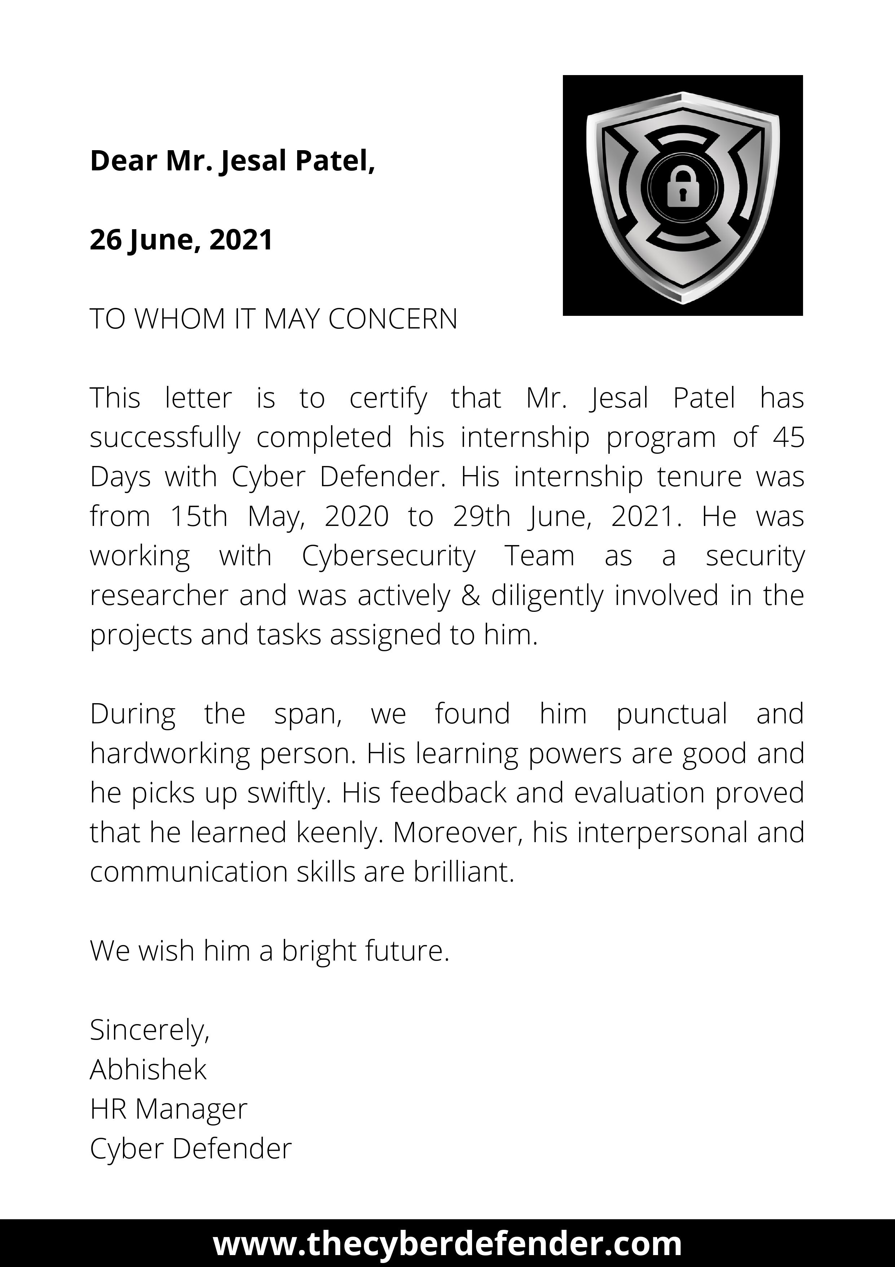

Slide 9
Thank You

