Slide 1


SMART INDIA HACKATHON 2025
TITLE PAGE
Problem Statement ID –
Problem Statement Title-
Theme-
PS Category- Software/Hardware
Team ID-
Team Name (Registered on portal)

Slide 2






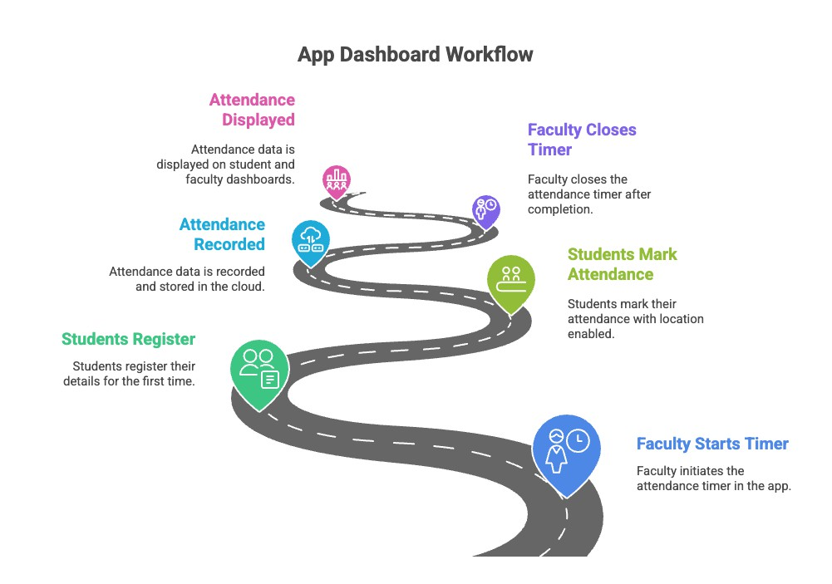


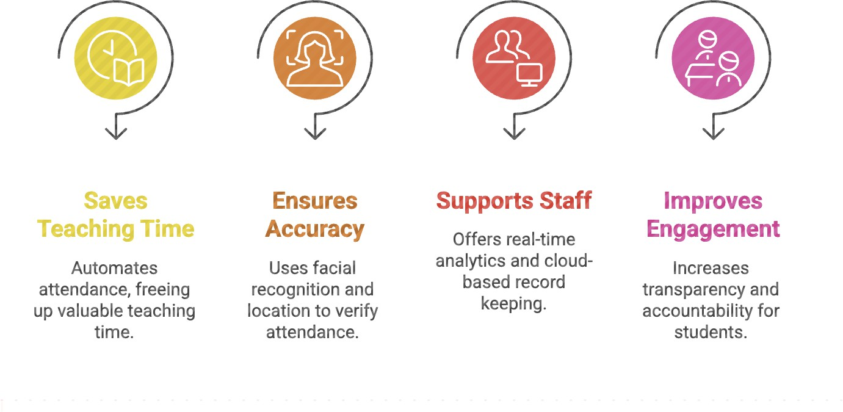
Proposed Solution
IDEA TITLE
TechnoVedah
We propose a Smart Attendance Mobile App with three UIs (Student ,Teacher, Admin):
Teacher UI → Start/stop attendance timer, location lock, live
count of marked students.
Student UI → One-time registration with face recognition + location-based attendance marking + attendance dashboard.
  Admin UI → Cloud-based analytics and department-wise
records.
Problem Statement
Manual attendance in colleges is slow, inaccurate, and allows proxy entries, causing problems in academic processes.
Our Model Promises

Slide 3
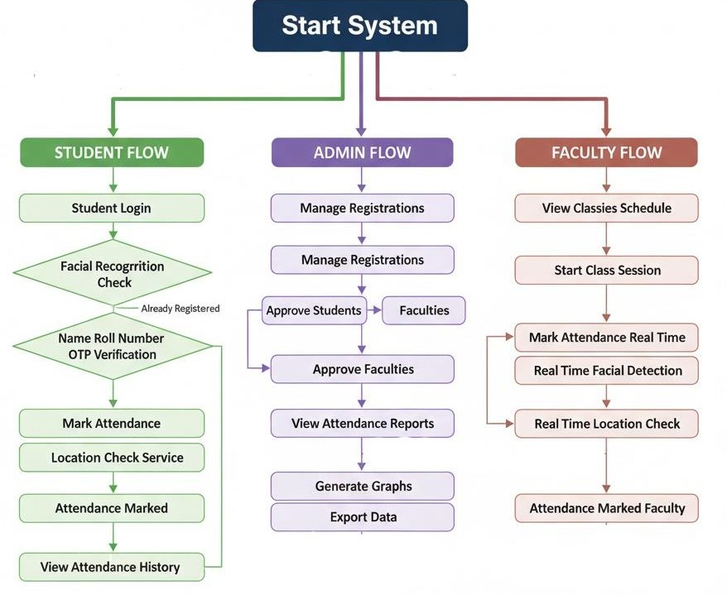

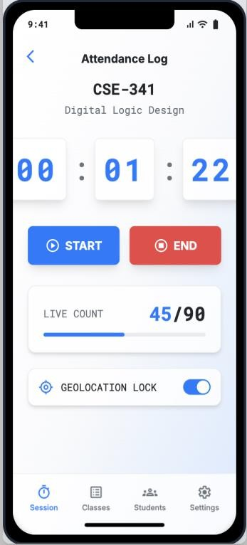
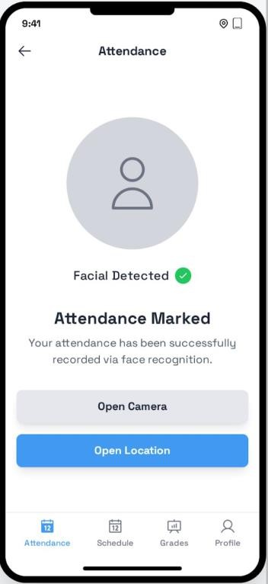
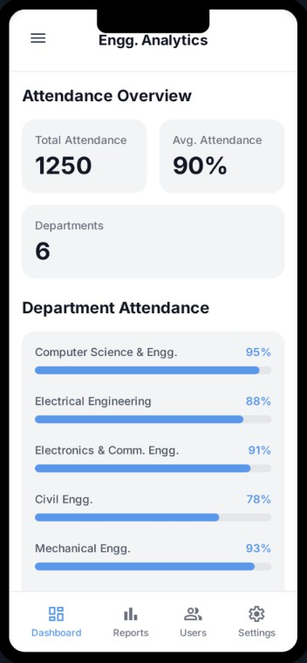





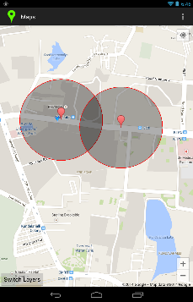




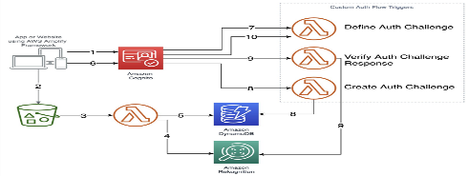


TECHNICAL APPROACH
TechnoVedah
Design Prototype
Technology Used
React Native Node.js Figma
OpenCV / Mediapipe
AWS Recognition Chart.js
Google Maps API Geo-fencing API. AWS / Google Cloud AWS S3
MongoDB Atlas MySQL/PostgreSQL

Slide 4
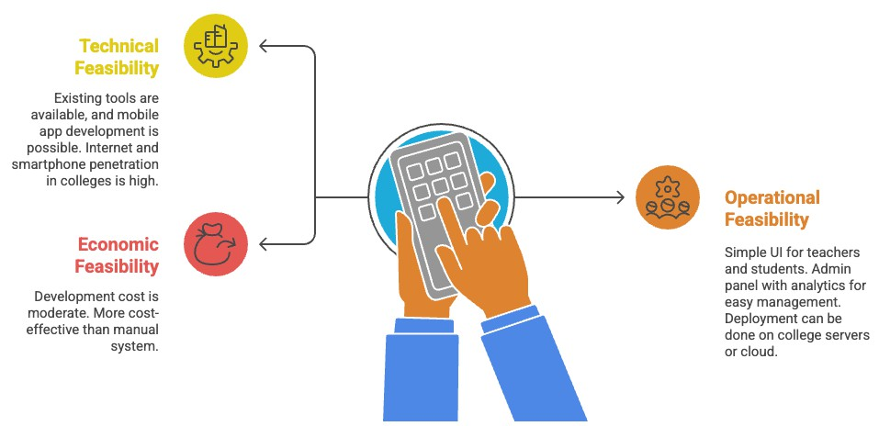




FEASIBILITY AND VIABILITY
ANALYSIS OF THE FEASIBILITY OF THE IDEA
Techno
vedah
Potential Challenges
Technical limitations in facial recognition accuracy under poor lighting or low-quality cameras.
  GPS/location accuracy issues indoors, leading to false
Strategies to Overcome Challenges
Use robust AI/ML models (OpenCV, AWS Recognition) for reliable facial recognition.
  Apply geo-fencing + Wi-Fi validation to improve
location accuracy.
Implement cloud-based scaling (AWS/GCP) with load balancing for large classes.
Encrypt all student data and comply with data privacy
policies (e.g., GDPR-like guidelines).
negatives.
Scalability bottlenecks if many students attempt to mark attendance at the same time.
  Concerns around data security & privacy of facial
recognition data.
    Internet dependency in rural/remote areas.

Slide 5
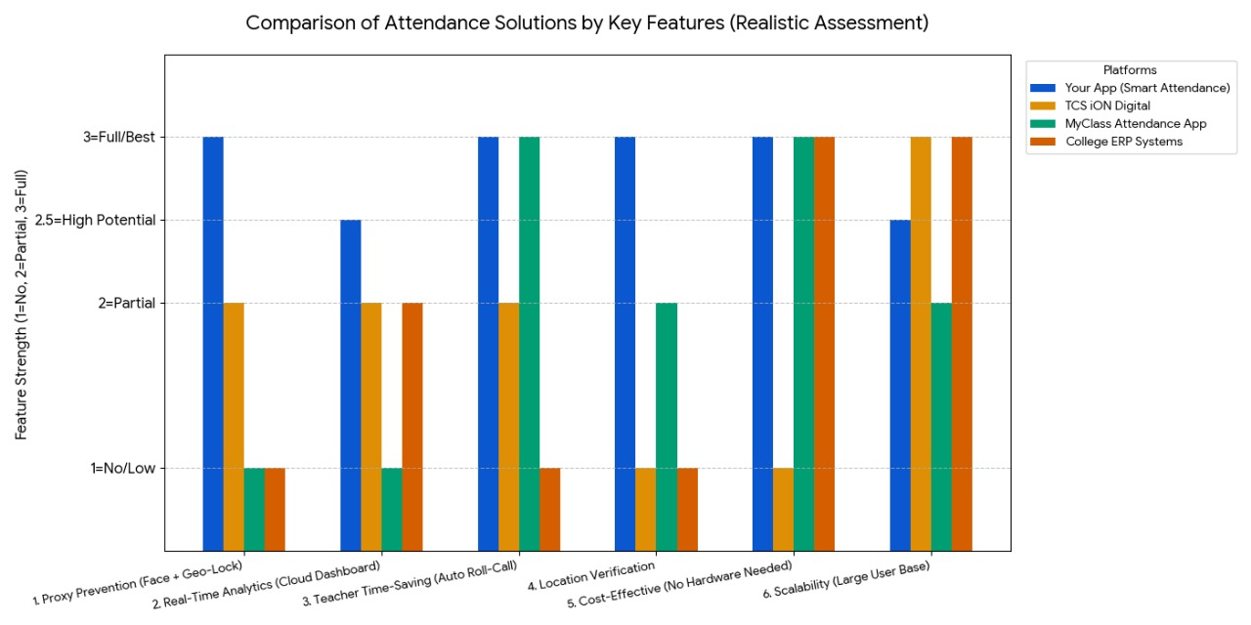
IMPACT AND BENEFITS
Techno
Vedah
IMPACT
On Students: Proxy attendance will be eliminated, ensuring a fair and transparent system.
On Teachers: Saves time spent on manual roll-calls, increasing valuable teaching time
On Institutions: Provides an automated cloud record, simplifying audit, accreditation, and report generation..
BENEFITS
Accuracy & Security: Face Recognition and Geo-location Lock ensure exact attendance, making cheating impossible.
Time-Saving: Saves 5–10 minutes daily, yielding a huge cumulative benefit over the semester.
Data-driven Insights: Cloud analytics help in performance tracking and drop-out prevention
Cost-effective: Eliminates the need for paper, registers, and manual processing.

Slide 6
RESEARCH AND REFERENCES
Details / Links of the reference and research work

Slide 7
IMPORTANT INSTRUCTIONS
Please ensure below pointers are met while submitting the Idea PPT:
Kindly keep the maximum slides limit up to six (6). ( Including the title slide)
Try to avoid paragraphs and post your idea in points /diagrams / Infographics /pictures
Keep your explanation precise and easy to understand
Idea should be unique and novel.
You can only use provided template for making the PPT without changing the idea details pointers (mentioned in previous slides).
You need to save the file in PDF and upload the same on portal. No PPT, Word Doc or any other format will be supported.
Note - You can delete this slide (Important Pointers) when you upload the details of your idea on SIH portal.

