Slide 1
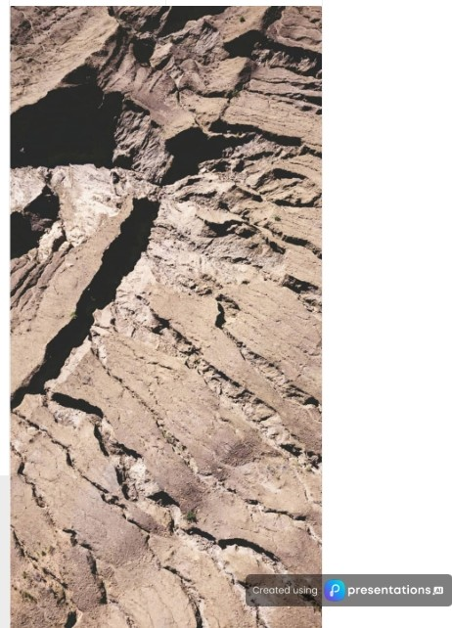
Exploration Techniques: Unveiling the Earth's Secrets
This presentation delves into various exploration techniques, including geological, geophysical, geochemical, and drilling methods, highlighting their advantages, applications, and challenges in locating natural resources and understanding geological formations.
Don Ernest Padilla

Slide 2

Exploration Techniques in Geological Studies
An Overview of Geological Exploration Methods and Their Applications
Geological mapping identifies
mineral deposits. This technique is essential for informing mining operations and
conducting thorough environmental assessments.
II
Direct observation reveals Earth's processes.
Observing geological features enables a deeper understanding of the natural processes that shape our planet's landscape.
m-
Outcrop studies enhance geological knowledge. Investigating exposed rock formations helps in understanding geological history and resource
potential.
El
Sampling provides material insights.
Collecting rocks and sediments allows for detailed analysis of
日
-
Earth's structure and resources.

Slide 3
Project Name
Location
Resource Type
Real-World Applications of Geological Techniques
KGHM Polska Mied之S.A.
Poland
Copper, Silver
Exploring successful mining projects using geological methods
Mount Polley Mine
Canada
Gold, Copper
-

Slide 4
Direct Observation enhances data accuracy.
Provides firsthand data on rock types and structures, ensuring reliable information for further analysis.
Exploring the Advantages of Geological Exploration
Detailed Analysis of features is possible.
Allows comprehensive studies of geological features and formations, contributing to informed decision-making in exploration.
^{Cost-Effective initial} Often less expensive than other techniques,
assessments available.
making it a smart choice for resource identification and initial evaluations.
Understanding the Key Benefits of Geological Exploration in Resource Management
Minimal Environmental Impact during exploration.
Can be conducted with minimal disturbance to the environment, promoting sustainable exploration practices.
-

Slide 5
Geophysical Exploration Techniques Overview
Understanding the Methods for Mapping Subsurface Structures in Geology
苞 | 胫礼 | 今。 | 匾． | 回＿
Geophysical | Exploration | Non-invasive | Seismic Reflection | Resource Location
Exploration | Techniques | Methods | Commonly used in oil | Helps in locating
Utilizes physical | Includes seismic | These techniques allow | and gas exploration, | valuable resources by
properties of the Earth | reflection, magnetic | for mapping geological | providing critical data | providing insight into
to identify subsurface | surveys, and electrical | formations and locating | on subsurface geology | the geological
structures effectively. | resistivity methods to analyze geological | resources without direct sampling of the | to inform drilling decisions. | structure beneath the Earth's surface.
 | formations. | ground.
-

Slide 6
Diverse Applications of Geophysical Techniques in Exploration
Exploring the use of geophysical methods in various sectors
|。ilandGasExplorauon
I I
Mineral Exp|oration
EnvironmentaIStudies
I
Seismic Surveys
Magnetic Surveys
Electrical Resistivity
Reservoir Characterization
Gravity Surveys
SiteCharacterization
Subsurface Mapping
Geophysical Modelling
Pollution Monitoring
Risk Assessment
Cost Efficiency
Sustainability Assessment
＿

Slide 7
今。
Non-Invasive | Exploration | Techniques
Reduces environmental disturbance.
同
Cost-Effective Solutions
Exploring the Benefits of Geophysical Exploration Techniques
Less expensive than drilling methods.
。
。
。。
困
B
d_{a}
C
ra ar
_{g}e
_{A} ．
f
a y
r
e_{v}
re
_
k_{c}
_{q}u
s_{r}
_{a}r
s_{a}
e_{v}
_{g}e
e
Understanding the advantages of non-invasive and cost-effective exploration methods in mining
冈
Real-Time Data Collection
Immediate insights into conditions.
““. .il
“.
_{i}a
r
_{f}0
。．
。_{部}
E C
t
_{R}e e
_{E}x
s
se
n
Sou p_{x}l o
re ra
e tio
p
t
ra
n
.cl
_{i}n a
t_{s}
a
_{a}g
_{r}u
e
r
y
n
,,,, p、·presentations.CJ

Slide 8
Understanding Geochemical Exploration Techniques in Mining
An Insight into Soil, Water, and Rock Sample Analysis for Mineral Detection
Geochemical exploration involves analyzing samples.
This technique focuses on the analysis of soil, water, and rock samples to detect the presence of minerals and metals. By examining these materials, geologists can infer the potential for valuable resources underground.
Key techniques used in geochemical exploration.
P「ominent methods include soil sampling, stream sediment analysis, and geochemical assays. These advanced techniques are essential for identifying mineralization and assessing resource potential in various geological settings.
Identifying mineralization through exploration.
Geochemical exploration plays a crucial role in identifying areas with potential mineralization. This identification helps in targeting locations for further exploration and extraction of valuable resources.
Importance in gold exploration.
Geochemical surveys are particularly vital in gold exploration. By analyzing trace elements in soil, geologists
-
can suggest the proximity of nearby gold deposits, guiding exploration efforts.

Slide 9

Case Studies in Geochemical Techniques
for Mining
Pine Point Mine
Canada
Lead, Zinc
Exploring successful applications of geochemical methods in real-world mining projects
Australia
Gold
-

Slide 10

Understanding the Advantages of Geochemical Exploration
Exploring the benefits of geochemical methods in mining and resource identification
HighSensitivity Geochemical exploration can detect low concentrations of minerals, making it ideal for
early-stage exploration.
Cost-Effective Approach
This method is generally less expensive than drilling, allowing for the coverage of large areas efficiently.
Comprehensive Geochemical Data It provides valuable information about the geochemical landscape, which aids in resource
identification.
EnvironmentallyFriendly
Geochemical exploration is non-invasive, requiring minimal disturbance to the environment, making it sustainable.
-

Slide 11

An Overview of Drilling Exploration Techniques
Understanding core sampling methods in geological studies and their applications.
Core Sampling
Extracts direct geological data.
Rotary Drilling
Common method for drilling.
Geological Insights Reveals subsurface geology.
Diamond Drilling
Percussion Drilling Uses rapid impacts to drill.
High-quality core samples.
-

Slide 12
I厅齐 ， 1；习
Project Name
Real-World Applications of Drilling Techniques
Olympic Dam
Australia
Copper,
Uranium
Explo「Ing drilling exploration techniques in mining and oil
extraction
ExxonMobil
Gulf of
Oil
Offshore
Mexico
-

Slide 13


Challenges in Mining Exploration Techniques
Addressing environmental, cost, and data issues in exploration practices
Environmental Concerns
Drilling disrupts ecosystems; management
needed.
已3
High Costs
Advanced tech and surveys can be expensive.
Sustainable Practices Needed
Addressing challenges is crucial for
sustainability.
Data Limitations
Technological Dependence Advanced tools limit smaller company access.
Geophysical methods may lack completeness
-

Slide 14
Emerging Technologies in Exploration Techniques
Exploring the integration of Al, remote sensing, and integrated approaches for efficient exploration
Artificial Intelligence revolutionizes data analysis.
Al enhances data processing capabilities, allowing for better predictive modeling and accuracy in explo「ation results.
Remote Sensing improves resource mapping.
With advanced remote sensing technologies, exploration teams can efficiently monitor and map resources from afar, ensuring more precise evaluations.
Integrated Approaches foster comprehensive analyses.
By combining various exploration techniques, teams can achieve a holistic view of potential resource sites, leading to more informed decision-making.
Efficiency is significantly enhanced through technology. The integration of advanced technologies promises to streamline exploration processes, reducing time and increasing productivity in the field.
Cost Reduction through modern techniques.
Advanced exploration techniques not only improve accu「acy but also help in significantly reducing operational costs associated with traditional methods.
Minimized Environmental Impact is crucial.
With better technologies, exploration companies can minimize their ecological footprint, ensuring sustainable practices in resource extraction.
-

Slide 15
Join us in advocating for responsible exploration practices
Exploration techniques are essential for uncovering our planet's resources and geology. Employing methods such as geological, geophysical, geochemical, and drilling exploration helps us manage natural resources effectively while embracing new technologies for sustainable practices is vital in our evolving landscape.

