Slide 1
HISTORY OF TELECOMMUNICATIONS
DUROJAIYE PEACE OLUWASEYI
15CH03729
MIS

Slide 2
HISTORY OF TELECOMMUNICATIONS
Telecommunication is defined as the science and technology of communication over a distance. The ability to convey information quickly, accurately, and efficiently has always been one of the main focuses driving human innovation. From prehistoric man with their signal fires to the smartphone-wielding high-powered executives of today, communication still remains a key for survival and success.
The new generation is likely to find it funny, it is indeed funny if we compare it to the technology that we have today, as everyone has their phone, their accounts, their own skype, google, facetime accounts. The old telephonic system, which was once expensive, has now become obsolete, as the advanced telephonic system has overtaken. The history of telecommunication illustrates this never-ending push for progress as it steadily parallels human growth, becoming more widespread and efficient as the development of modern civilization unfolds.
Notes:
HISTORY OF TELECOMMUNICATIONS
Telecommunication is defined as the science and technology of communication over a distance. The ability to convey information quickly, accurately, and efficiently has always been one of the main focuses driving human innovation. From prehistoric man with their signal fires to the smartphone-wielding high-powered executives of today, communication still remains a key for survival and success.
The new generation is likely to find it funny, it is indeed funny if we compare it to the technology that we have today, as everyone has their phone, their accounts, their own skype, google, facetime accounts. The old telephonic system, which was once expensive, has now become obsolete, as the advanced telephonic system has overtaken. The history of telecommunication illustrates this never-ending push for progress as it steadily parallels human growth, becoming more widespread and efficient as the development of modern civilization unfolds.

Slide 3
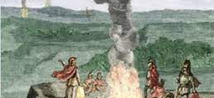
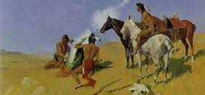
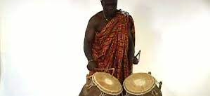
PRE-HISTORIC
Man's first attempts at distance communication were extremely limited. Prehistoric man relied on fire and smoke signals as well as drum messages to encode information over a limited geographic area as they attempted to contact neighboring clans.
Talking drums were used by natives in Africa, New Guinea, and South America, and smoke signals in North America and China. Contrary to what one might think, these systems were often used to do more than merely announce the presence of a camp.
These signals also needed to have very simple, pre-decided meanings like "safe" or "danger" or "victory" or could be used as a form of alarm system in order to alert prehistoric clans to predators or invading clans.
Notes:
PRE-HISTORIC
Man's first attempts at distance communication were extremely limited. Prehistoric man relied on fire and smoke signals as well as drum messages to encode information over a limited geographic area as they attempted to contact neighboring clans.
Talking drums were used by natives in Africa, New Guinea, and South America, and smoke signals in North America and China. Contrary to what one might think, these systems were often used to do more than merely announce the presence of a camp.
These signals also needed to have very simple, pre-decided meanings like "safe" or "danger" or "victory" or could be used as a form of alarm system in order to alert prehistoric clans to predators or invading clans.

Slide 4
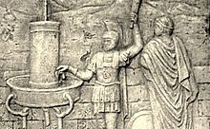
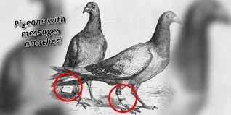
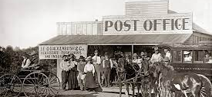
BEFORE COMMON ERA BCE
In the 4th century BCE, the hydraulic semaphore was designed in ancient Greece as a method of communication, and it was vital during the first Punic War. Very much like early smoke signals or beacons, it involved a network of identical containers on separate hills, each with a vertical rod floated in it. These rods would have predetermined codes inscribed at various intervals. Someone who wished to communicate would signal another with a torch; they would synchronize and then simultaneously open their spigots and drain the water until it was at the desired code. This system also had the same limitations as smoke signals - the messages had to be pre-determined prior to sending them.
Persia and Syria are credited with establishing the first pigeon messaging system around the 5th century BCE due to the discovery that pigeons have an uncanny ability to find their way back to their nests regardless of the distance.
Cyrus the Great was a Persian emperor. He is credited as having established the first postal system in the history of the world. Other ancient powers like Egypt, Rome, and China eventually built their own postal systems later on.
Notes:
BEFORE COMMON ERA BCE
Persia and Syria are credited with establishing the first pigeon messaging system around the 5th century BCE due to the discovery that pigeons have an uncanny ability to find their way back to their nests regardless of the distance.
Cyrus the Great was a Persian emperor. He is credited as having established the first postal system in the history of the world. Other ancient powers like Egypt, Rome, and China eventually built their own postal systems later on.
In the 4th century BCE, the hydraulic semaphore was designed in ancient Greece as a method of communication, and it was vital during the first Punic War. Very much like early smoke signals or beacons, it involved a network of identical containers on separate hills, each with a vertical rod floated in it. These rods would have predetermined codes inscribed at various intervals. Someone who wished to communicate would signal another with a torch; they would synchronize and then simultaneously open their spigots and drain the water until it was at the desired code. This system also had the same limitations as smoke signals - the messages had to be pre-determined prior to sending them.

Slide 5
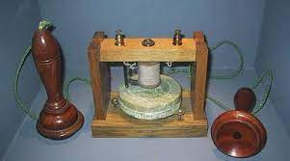
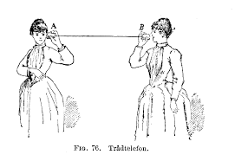
1672: First experimental acoustic (mechanical) telephone
Robert hooke is first credited with creating an acoustic telephone in 1672. Hooke discovered that sound could be transmitted over wire or string into an attached earpiece or mouthpiece.
Notes:
1672: First experimental acoustic (mechanical) telephone
Robert hooke is first credited with creating an acoustic telephone in 1672. Hooke discovered that sound could be transmitted over wire or string into an attached earpiece or mouthpiece.

Slide 6
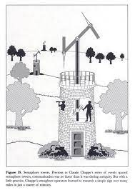
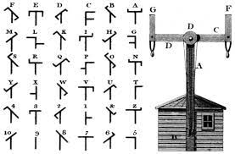
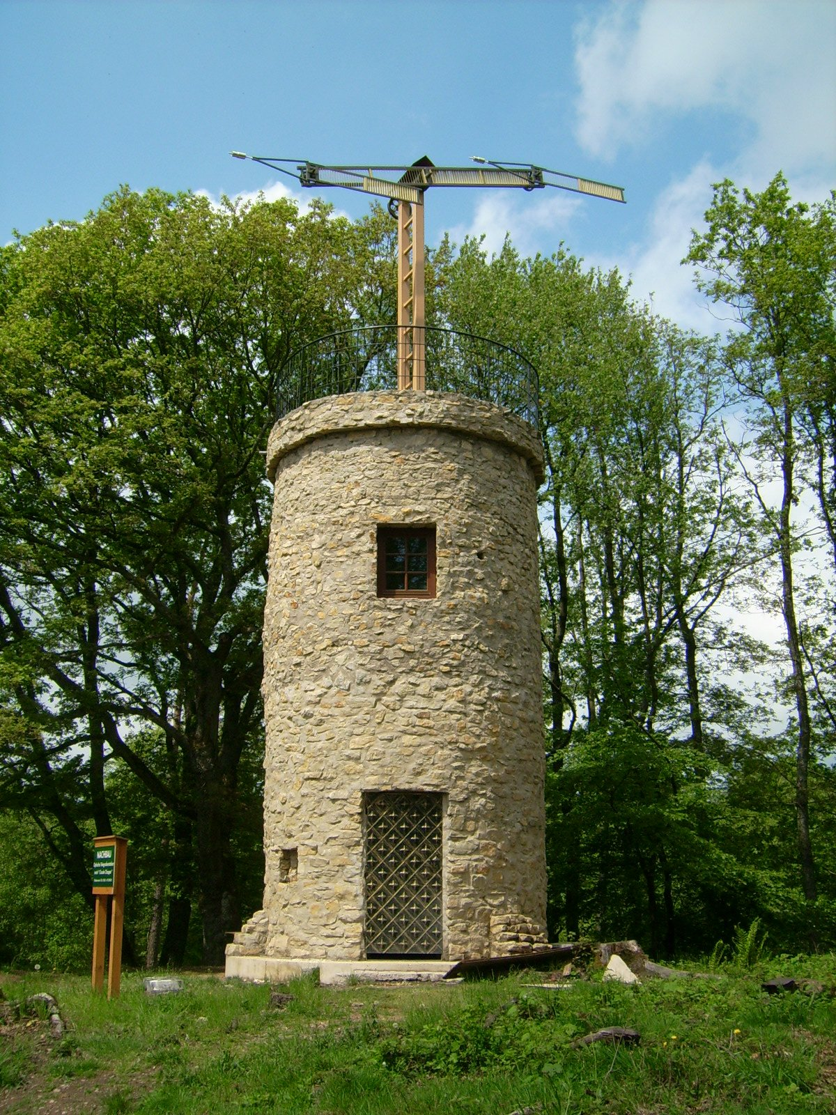
1790: Semaphore lines (optical telegraphs)
Using the maritime flag semaphore as a starting point, the chappe brothers, two french inventors, created the first optical telegraph system in 1790. The optical telegraph was a system of pendulums set up somewhere high like on a tower or the top of a town clock. The telegraph would swing its mechanical arms around and sign messages from one tower to the next. It was the first telecommunications system in europe.
Notes:
1790: Semaphore lines (optical telegraphs)
Using the maritime flag semaphore as a starting point, the chappe brothers, two french inventors, created the first optical telegraph system in 1790. The optical telegraph was a system of pendulums set up somewhere high like on a tower or the top of a town clock. The telegraph would swing its mechanical arms around and sign messages from one tower to the next. It was the first telecommunications system in europe.

Slide 7
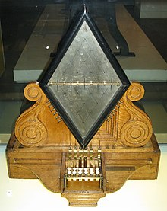
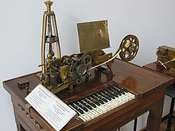
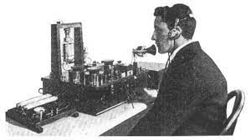
1838: Electrical telegraph
Samuel B. Morse had been working on the idea of a recording telegraph with friends Alfred Vail and Leonard Gale. They discovered that when connecting two model telegraphs together and running electricity through a wire, you could send messages by holding or releasing the buttons in a series of intervals. This became known as Morse code and lay the foundation for modern land-line phones.
Notes:
1838: Electrical telegraph
Samuel B. Morse had been working on the idea of a recording telegraph with friends Alfred Vail and Leonard Gale. They discovered that when connecting two model telegraphs together and running electricity through a wire, you could send messages by holding or releasing the buttons in a series of intervals. This became known as Morse code and lay the foundation for modern land-line phones.

Slide 8
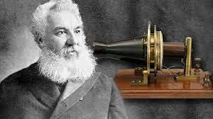
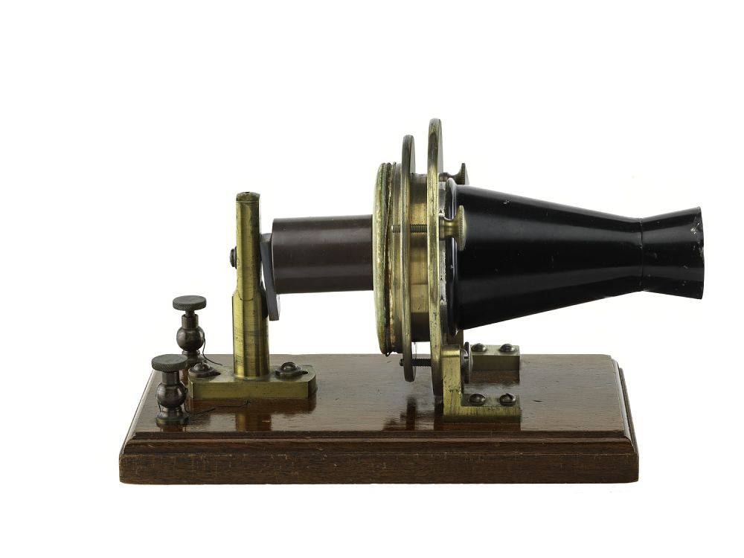
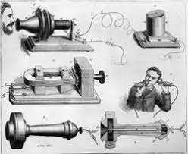
1876: Telephones
The year 1876 was a big one for Alexander Graham Bell. Having come to the U.S. as a teacher for the deaf, he had been trying to figure out a way to transmit speech electronically. Despite little support from his friends, he successfully invented the telephone in March of 1876.
Notes:
1876: Telephones
The year 1876 was a big one for Alexander Graham Bell. Having come to the U.S. as a teacher for the deaf, he had been trying to figure out a way to transmit speech electronically. Despite little support from his friends, he successfully invented the telephone in March of 1876.

Slide 9
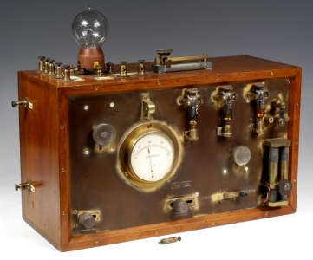
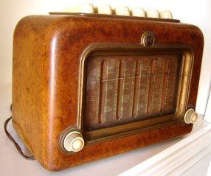
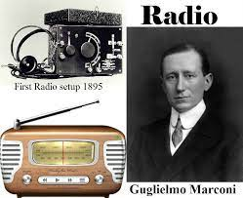
1896: Radio
Undaunted by his defeat in the U.S. courts, Marconi kept working on his own versions of wireless transmission of sound. In 1896, he sent his first long-distance wireless transmission. The signal was sent over a distance of 2 kilometers. The recipient of this signal waved a white kerchief to show that it had been received. This earned Marconi a place in the history books as the man who gave us the first radio.
Notes:
1896: Radio
Undaunted by his defeat in the U.S. courts, Marconi kept working on his own versions of wireless transmission of sound. In 1896, he sent his first long-distance wireless transmission. The signal was sent over a distance of 2 kilometers. The recipient of this signal waved a white kerchief to show that it had been received. This earned Marconi a place in the history books as the man who gave us the first radio.

Slide 10
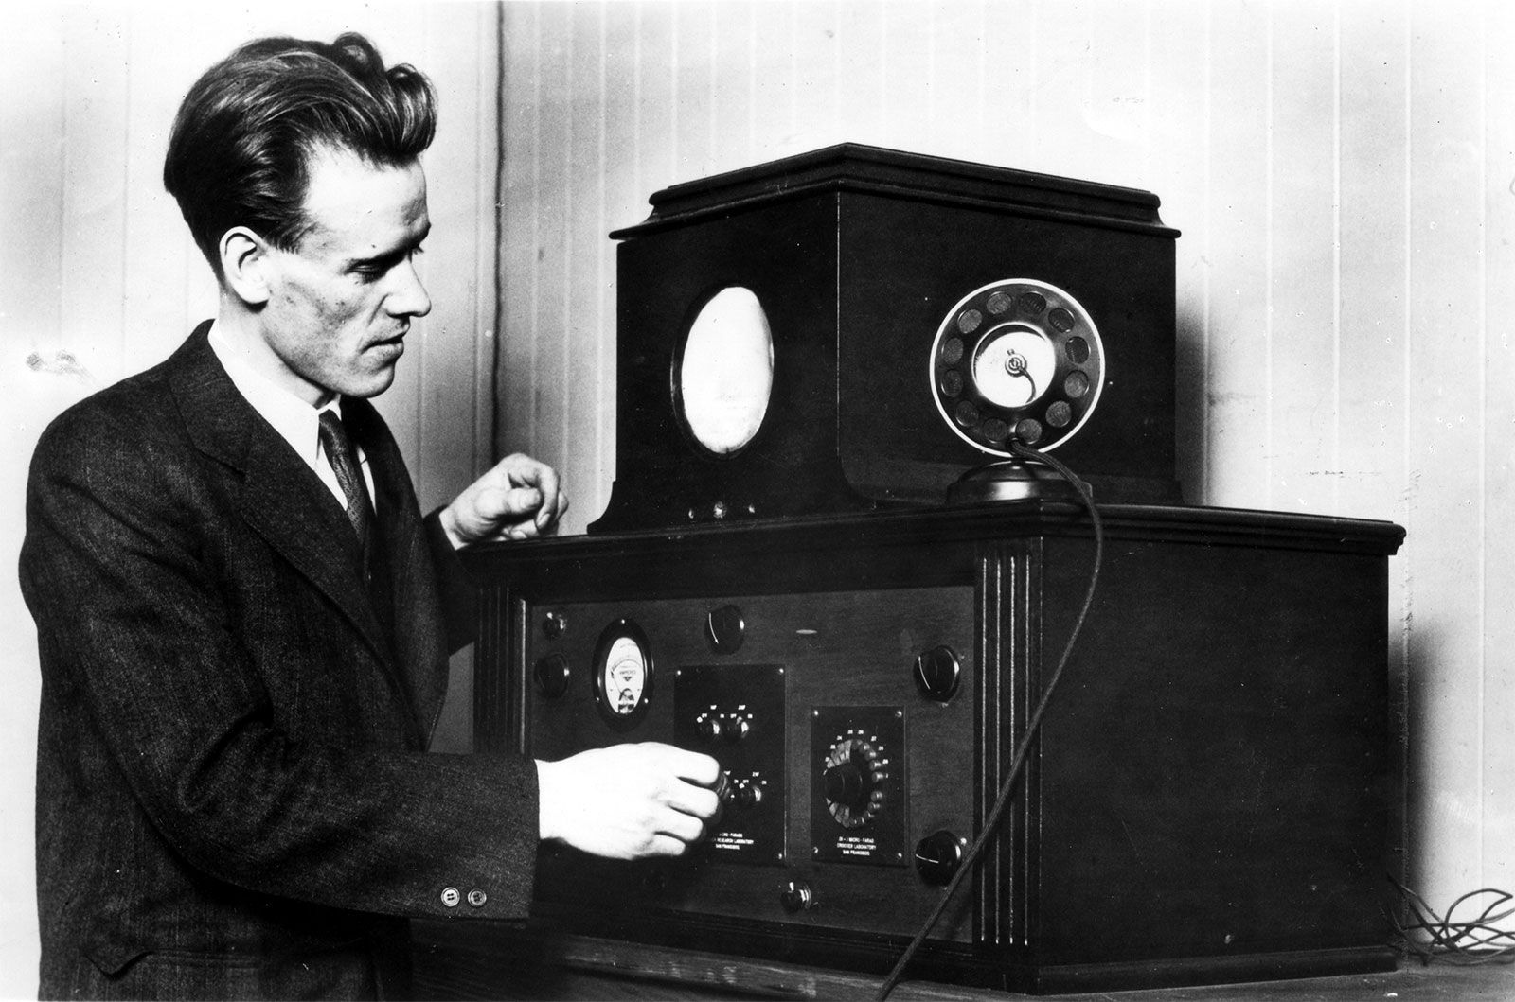
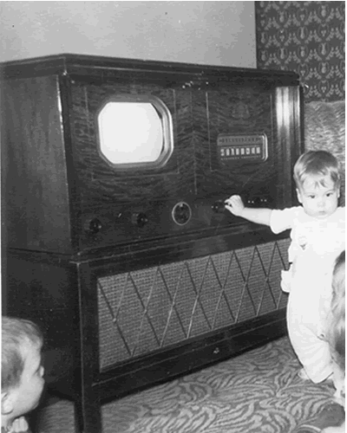
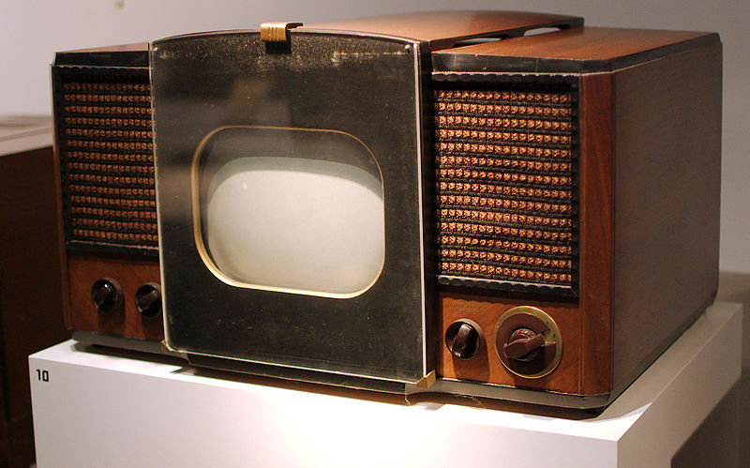
1927: Television
Phillip T. Farnsworth made media history on September 7, 1927, when he demonstrated the first working television set. He had been working on a method to transmit images: What he discovered was that you could encode radio waves with an image and then project them back onto the screen. This gave us the first television prototype.
Notes:
1927: Television
Phillip T. Farnsworth made media history on September 7, 1927, when he demonstrated the first working television set. He had been working on a method to transmit images: What he discovered was that you could encode radio waves with an image and then project them back onto the screen. This gave us the first television prototype.

Slide 11
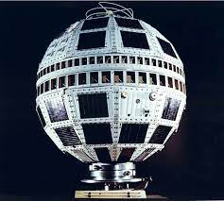
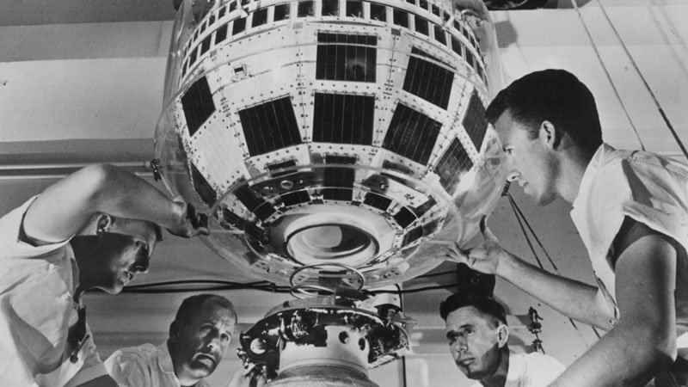
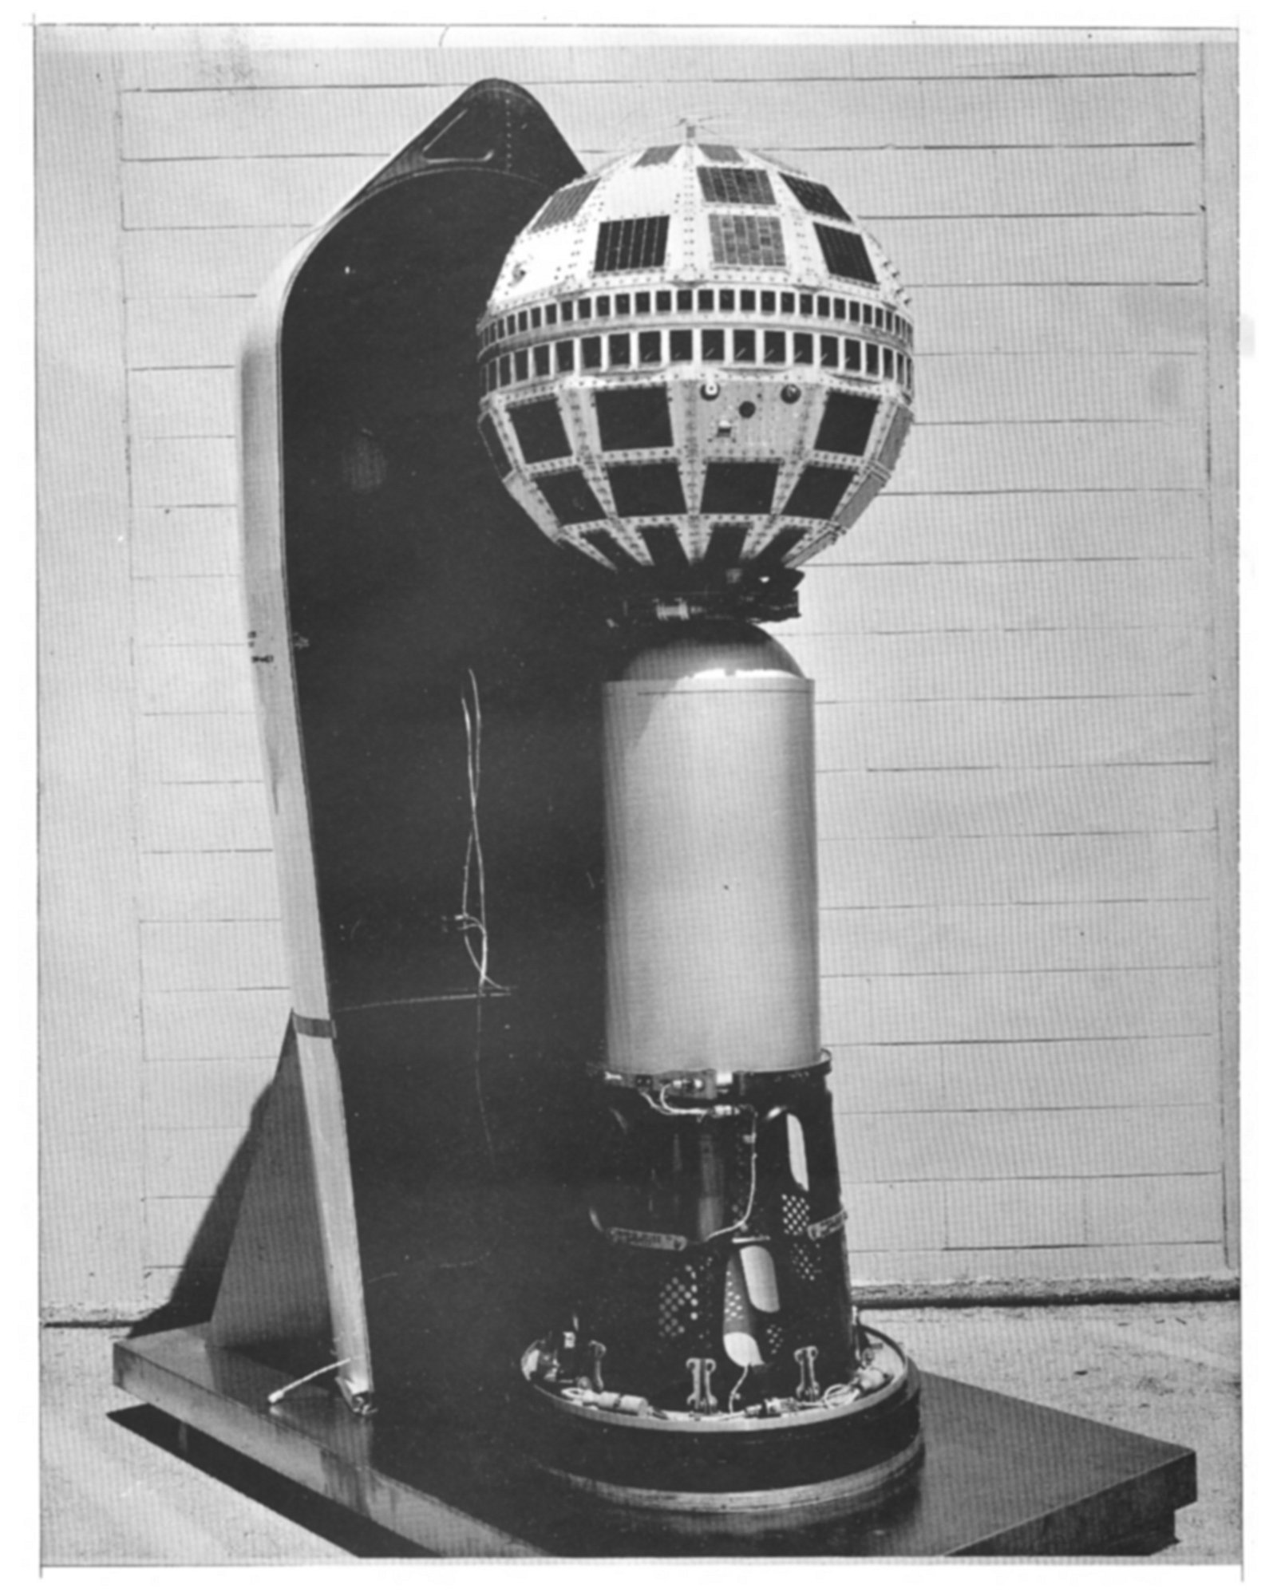
1962: Commercial telecommunications satellite
The Communications Satellite Act was officially passed in 1962, allowing telecommunications to finally go into space. AT&T was in the process of constructing their satellites, and two short years later, they would have put six telecommunications satellites into orbit.
Notes:
1962: Commercial telecommunications satellite
The Communications Satellite Act was officially passed in 1962, allowing telecommunications to finally go into space. AT&T was in the process of constructing their satellites, and two short years later, they would have put six telecommunications satellites into orbit.

Slide 12
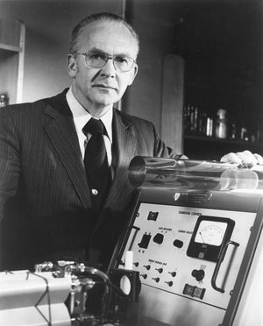
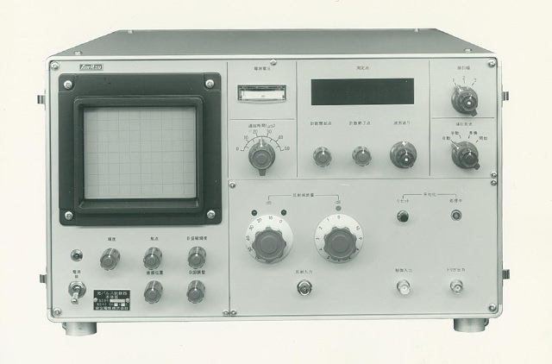
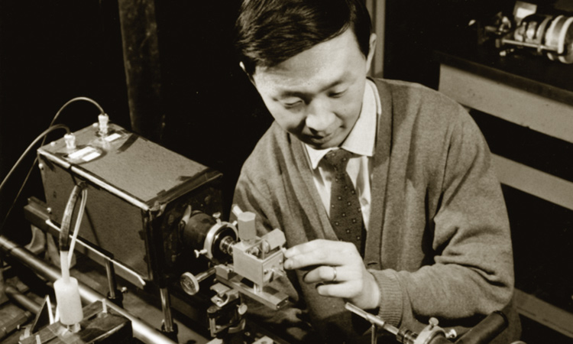
1964: Fiber-optic telecommunications
In 1964, Charles Kao and George Hockham published a paper that proved that fiber-optic communication could be possible as long as the fibers used to transmit the information were free of impurities. This discovery reopened the door Alexander Graham Bell had first created with his photophone, allowing sound to be transmitted over beams of light.
Notes:
1964: Fiber-optic telecommunications
In 1964, Charles Kao and George Hockham published a paper that proved that fiber-optic communication could be possible as long as the fibers used to transmit the information were free of impurities. This discovery reopened the door Alexander Graham Bell had first created with his photophone, allowing sound to be transmitted over beams of light.

Slide 13
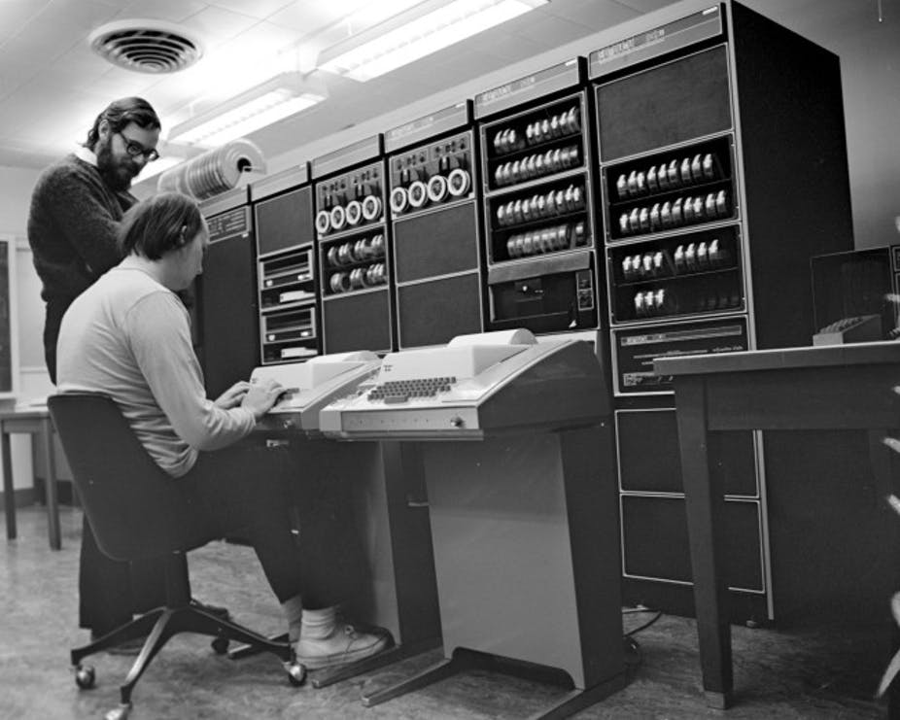
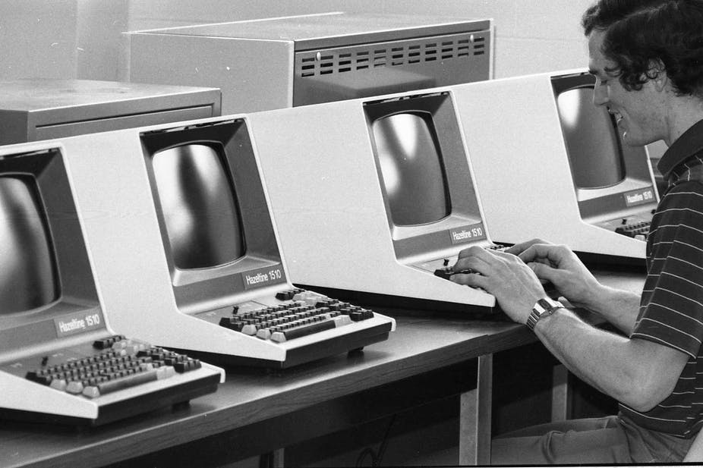
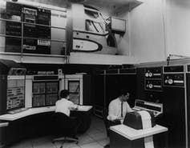
1969: Computer networking
In October of 1969, the first data traveled between nodes of the ARPANET, a predecessor of the Internet. This was the first computer network and was invented by Charley Kline and Bill Duvall.
Notes:
1969: Computer networking
In October of 1969, the first data traveled between nodes of the ARPANET, a predecessor of the Internet. This was the first computer network and was invented by Charley Kline and Bill Duvall.

Slide 14
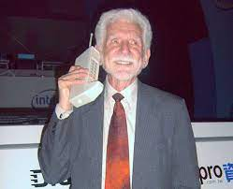
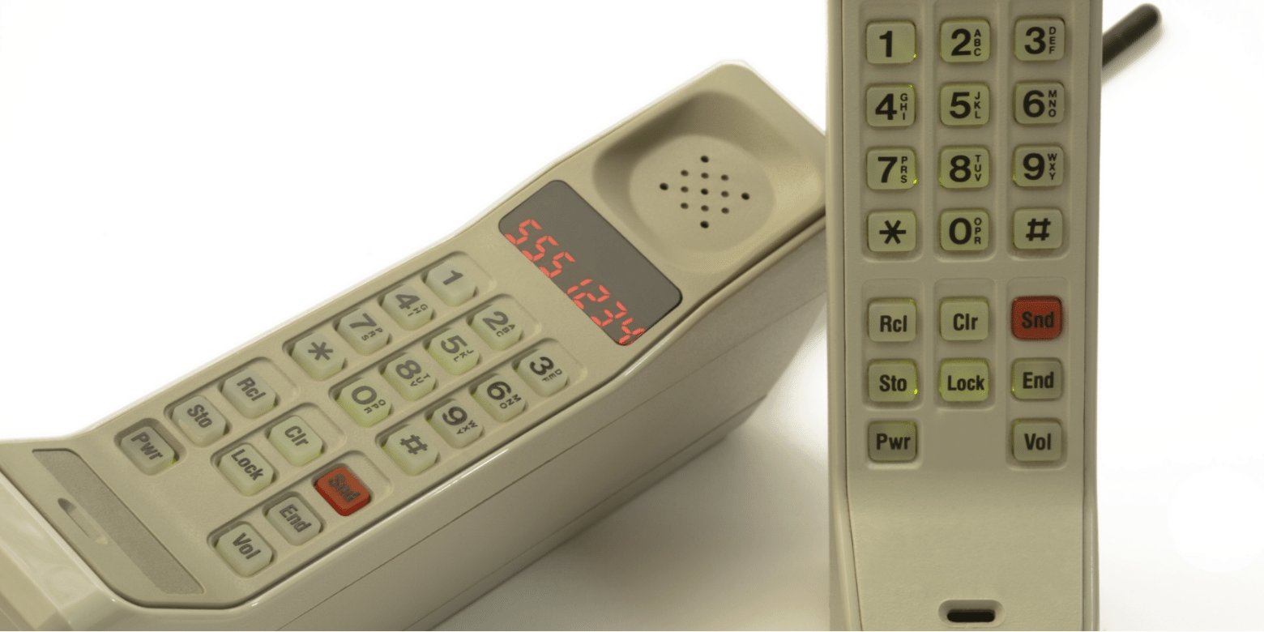
1973: First modern-era mobile phone
Inventor Martin Cooper placed the first cellular mobile call in 1973 to his rival at Bell Labs, Joel Engel. The first mobile phone had a maximum talk time of 30 minutes, and it took a year for the battery to recharge. The phone would eventually be a prototype for Motorola's first mobile phones.
Notes:
1973: First modern-era mobile phone
Inventor Martin Cooper placed the first cellular mobile call in 1973 to his rival at Bell Labs, Joel Engel. The first mobile phone had a maximum talk time of 30 minutes, and it took a year for the battery to recharge. The phone would eventually be a prototype for Motorola's first mobile phones.

Slide 15
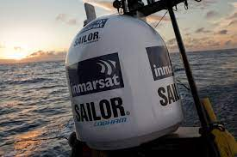
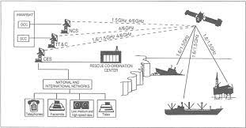
1979: INMARSAT ship-to-shore satellite communications
The year 1979 was a big leap forward for maritime communications. The International Maritime Satellite Organization (INMARSAT) was established to provide marine vessels with reliable communication for increased safety and communication for sailors and passengers who needed to speak to someone on shore.
Notes:
1979: INMARSAT ship-to-shore satellite communications
The year 1979 was a big leap forward for maritime communications. The International Maritime Satellite Organization (INMARSAT) was established to provide marine vessels with reliable communication for increased safety and communication for sailors and passengers who needed to speak to someone on shore.

Slide 16
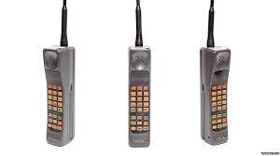
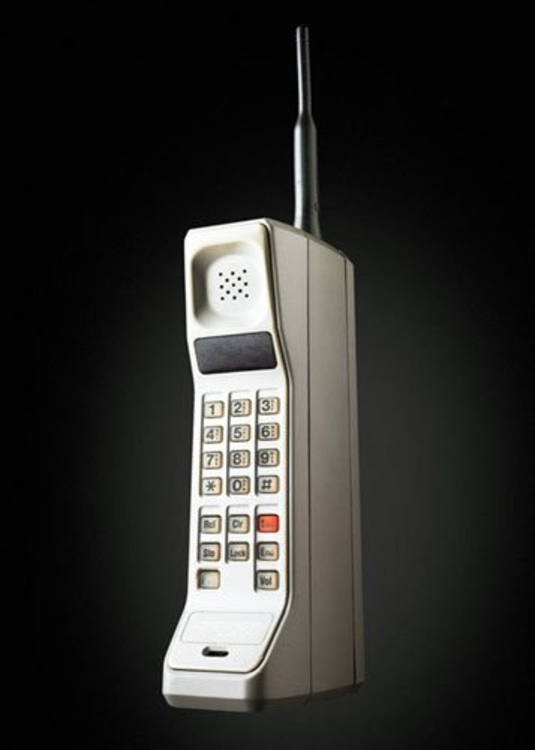
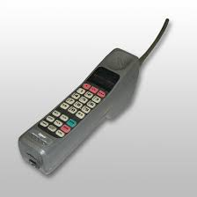
1981: First mobile phone network
The first commercially automated cellular network was launched in Japan in 1981. The network was originally launched only in Tokyo in 1979 and then was expanded. Simultaneously, the Nordic Mobile Telephone system was also established in Denmark, Finland, Norway, and Sweden.
Notes:
1981: First mobile phone network
The first commercially automated cellular network was launched in Japan in 1981. The network was originally launched only in Tokyo in 1979 and then was expanded. Simultaneously, the Nordic Mobile Telephone system was also established in Denmark, Finland, Norway, and Sweden.

Slide 17
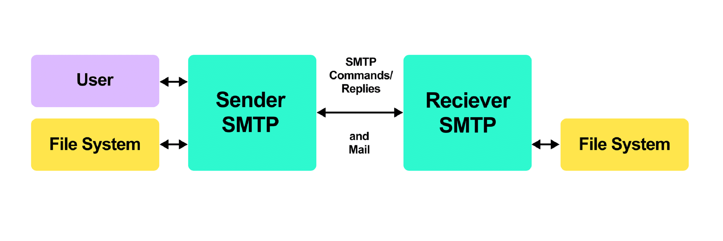
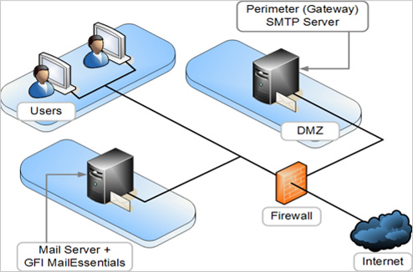
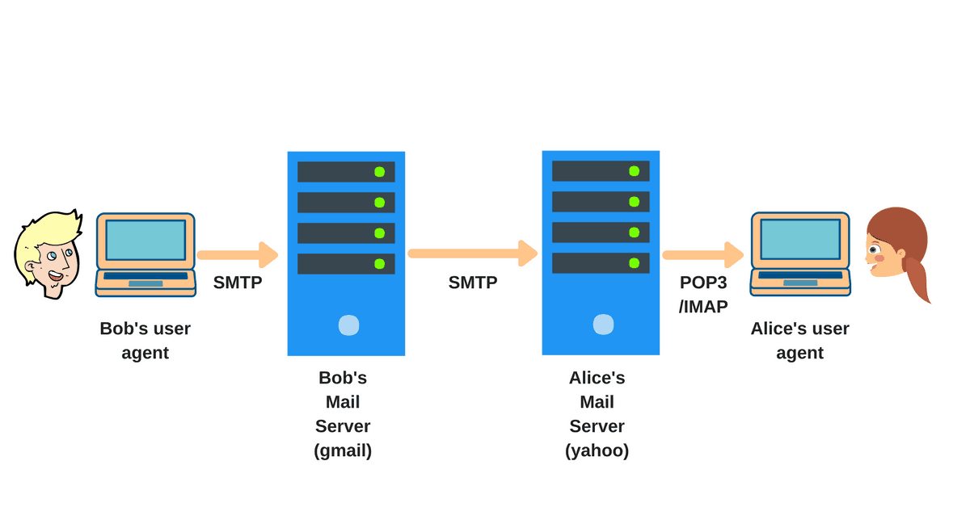
1982: SMTP email
Prior to 1982, the Internet was highly secure and comprised of limited network clusters between military, corporate, and some university research facilities. In 1982, Jonathan Postel wrote the Simple Mail Transfer Protocol and shifted the focus of the Internet from security to reliability using the networks as relay stations to send electronic mail to the recipient through cooperative hosts.
Notes:
1982: SMTP email
Prior to 1982, the Internet was highly secure and comprised of limited network clusters between military, corporate, and some university research facilities. In 1982, Jonathan Postel wrote the Simple Mail Transfer Protocol and shifted the focus of the Internet from security to reliability using the networks as relay stations to send electronic mail to the recipient through cooperative hosts.

Slide 18
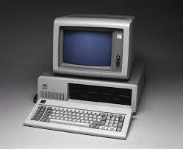
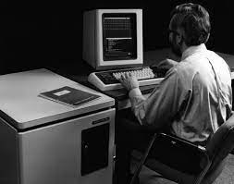
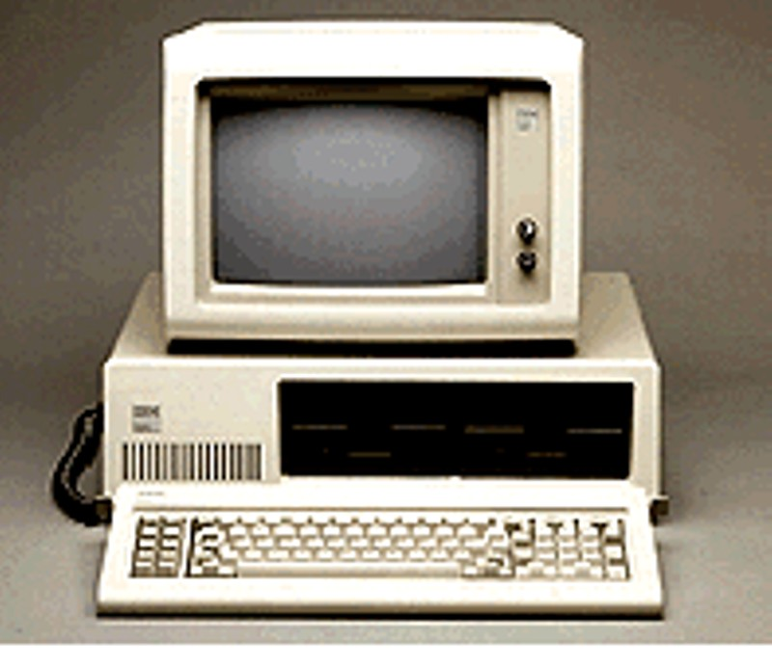
1983: Internet
On January 1, 1983, the Internet was officially born. ARPANET officially switched its old network control protocols (NCP) and Transmission Control Protocol/Internet Protocol (TCP/IP) became standard.
Notes:
1983: Internet
On January 1, 1983, the Internet was officially born. ARPANET officially switched its old network control protocols (NCP) and Transmission Control Protocol/Internet Protocol (TCP/IP) became standard.

Slide 19
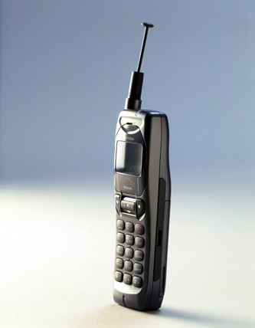
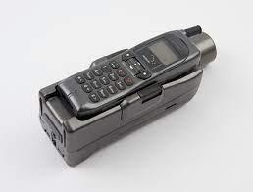
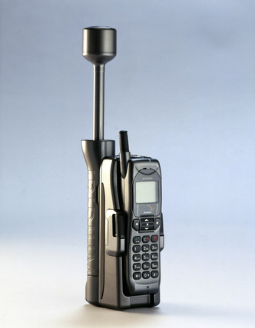
1998: Mobile satellite hand-held phones
The first canopy of 64 satellites was put into place by a company called Iridium in 1998. They also produced the first hand-held satellite phones, which were smaller and less cumbersome than the earlier "bag" phones. This revolutionized mobile telecommunications and would lead to the modern smartphone.
Notes:
1998: Mobile satellite hand-held phones
The first canopy of 64 satellites was put into place by a company called Iridium in 1998. They also produced the first hand-held satellite phones, which were smaller and less cumbersome than the earlier "bag" phones. This revolutionized mobile telecommunications and would lead to the modern smartphone.

Slide 20
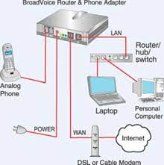

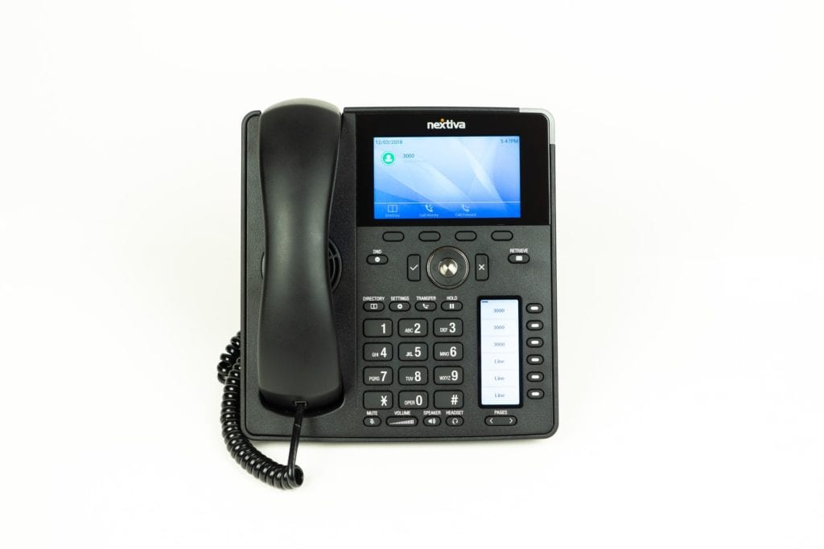
2003: VoIP Internet telephony
In 2003, phone calls were now capable of being transmitted over a computer through Internet protocols. This meant that long-distance charges were not applicable, as callers would use already-established computer networks.
Notes:
2003: VoIP Internet telephony
In 2003, phone calls were now capable of being transmitted over a computer through Internet protocols. This meant that long-distance charges were not applicable, as callers would use already-established computer networks.

