Slide 1

Disk Scheduling Algorithms

Slide 2
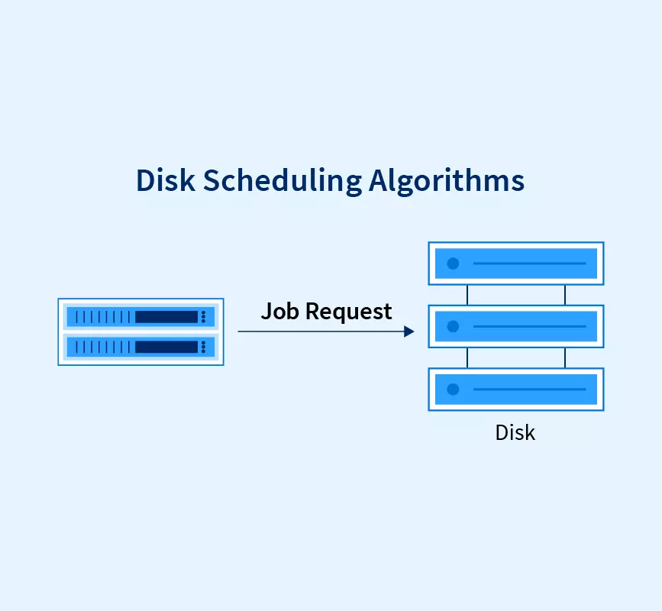
Disk Scheduling
Disk scheduling is done by operating systems to schedule I/O requests arriving for the disk. Disk scheduling is also known as I/O Scheduling.

Slide 3
Types Of Disk Scheduling algorithms
1.FCFS (First Come First Serve)
2.SSTF (Shortest Seek Time First)
3.SCAN (Elevator Algorithm)
4.C-SCAN (CIrcular SCAN)

Slide 4
FCFS (First Come First Serve)
FCFS is the simplest of all Disk Scheduling Algorithms. In FCFS, the requests are addressed in the order they arrive in the disk queue.
Ex:-
Suppose the order of request is- (82,170,43,140,24,16,190) And current position of Read/Write head is: 50

Slide 5
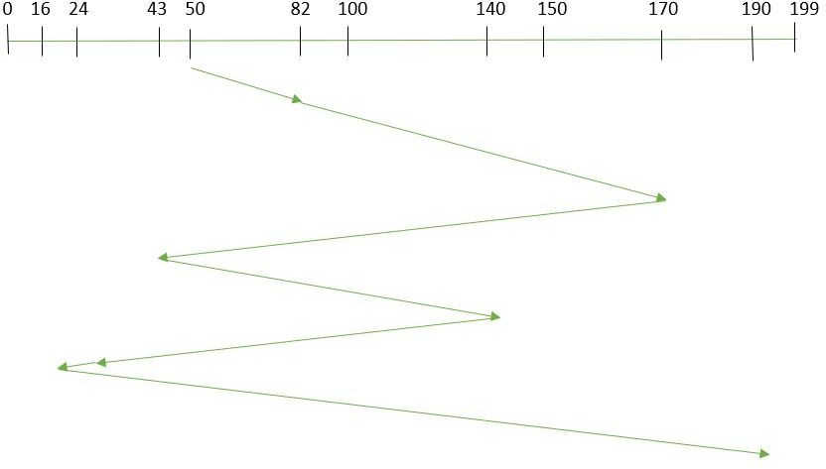
So, total overhead movement is
(82-50)+(170-82)+(170-43)+(140-43)+(140-24)+(24-16)+(190-16) = 642

Slide 6
Advantages of FCFS :-
1.Every request gets a fair chance
2.No indefinite postponement
Disadvantages of FCFS
1.Does not try to optimize seek time
2.May not provide the best possible service

Slide 7
SSTF (Shortest Seek Time First)
In SSTF (Shortest Seek Time First), requests having the shortest seek time are executed first. So, the seek time of every request is calculated in advance in the queue and then they are scheduled according to their calculated seek time. As a result, the request near the disk arm will get executed first. SSTF is certainly an improvement over FCFS as it decreases the average response time and increases the throughput of the system.
EX:-
Suppose the order of request is- (82,170,43,140,24,16,190) And current position of Read/Write head is: 50

Slide 8
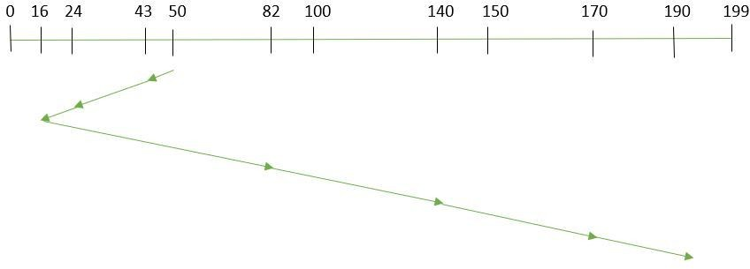
So, total overhead movement is
(50-43)+(43-24)+(24-16)+(82-16)+(140-82)+(170-140)+(190-170) =208

Slide 9
Advantages of Shortest Seek Time First
1.The average Response Time decreases 2.Throughput increases
Disadvantages of Shortest Seek Time First
1.Overhead to calculate seek time in advance Can cause Starvation for a request if it has a higher seek time as compared to incoming requests.
2.The high variance of response time as SSTF favors only some requests.

Slide 10
SCAN (Elevator Algorithm)
In the SCAN Algorithm the disk arm moves in a particular direction and services the requests coming in its path and after reaching the end of the disk, it reverses its direction and again services the request arriving in its path. So, this algorithm works as an elevator and is hence also known as an elevator algorithm. As a result, the requests at the midrange are serviced more and those arriving behind the disk arm will have to wait.
Ex:-
Suppose the requests to be addressed are-82,170,43,140,24,16,190. And the Read/Write arm is at 50, and it is also given that the disk arm should move “towards the larger value”.

Slide 11
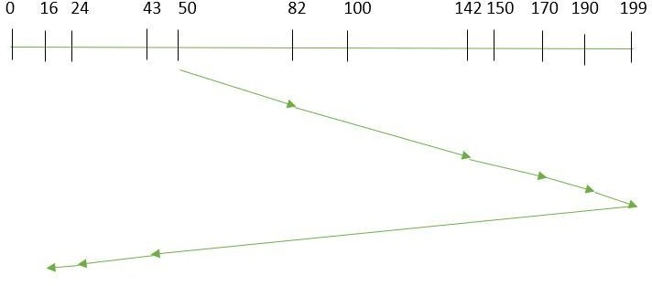
So, total overhead movement is
(199-50) + (199-16) = 332

Slide 12
Advantages of SCAN
1.High throughput.
2.Low variance of response.
3.time Average response time.
Disadvantages of SCAN
1.Long waiting time for requests for locations just visited by disk arm.

Slide 13
C-SCAN (CIrcular SCAN)
In the SCAN algorithm, the disk arm again scans the path that has been scanned, after reversing its direction. So, it may be possible that too many requests are waiting at the other end or there may be zero or few requests pending at the scanned area.
These situations are avoided in the CSCAN algorithm in which the disk arm instead of reversing its direction goes to the other end of the disk and starts servicing the requests from there. So, the disk arm moves in a circular fashion and this algorithm is also similar to the SCAN algorithm hence it is known as C-SCAN (Circular SCAN).

Slide 14
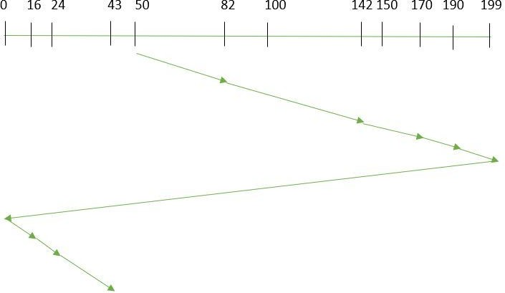
Ex:-
Suppose the requests to be addressed are-82,170,43,140,24,16,190. And the Read/Write arm is at 50, and it is also given that the disk arm should move “towards the larger value”.
So, the total overhead movement (total distance covered by the disk arm) is calculated as:
(199-50) + (199-0) + (43-0) = 391

