Slide 1
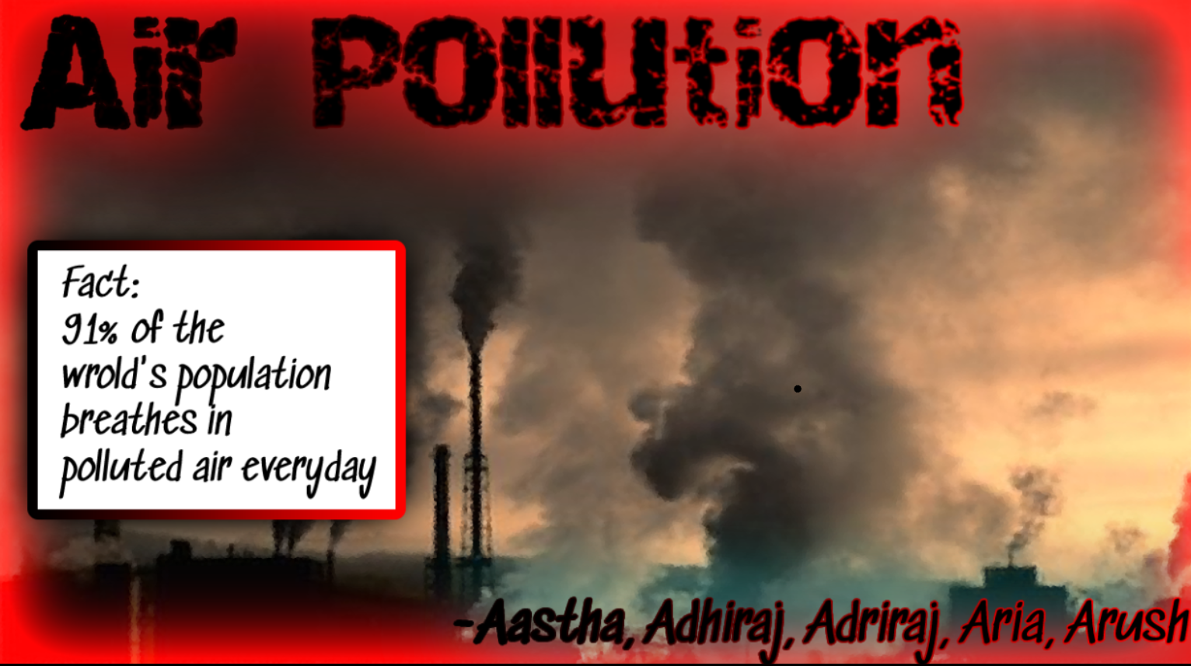

Slide 2
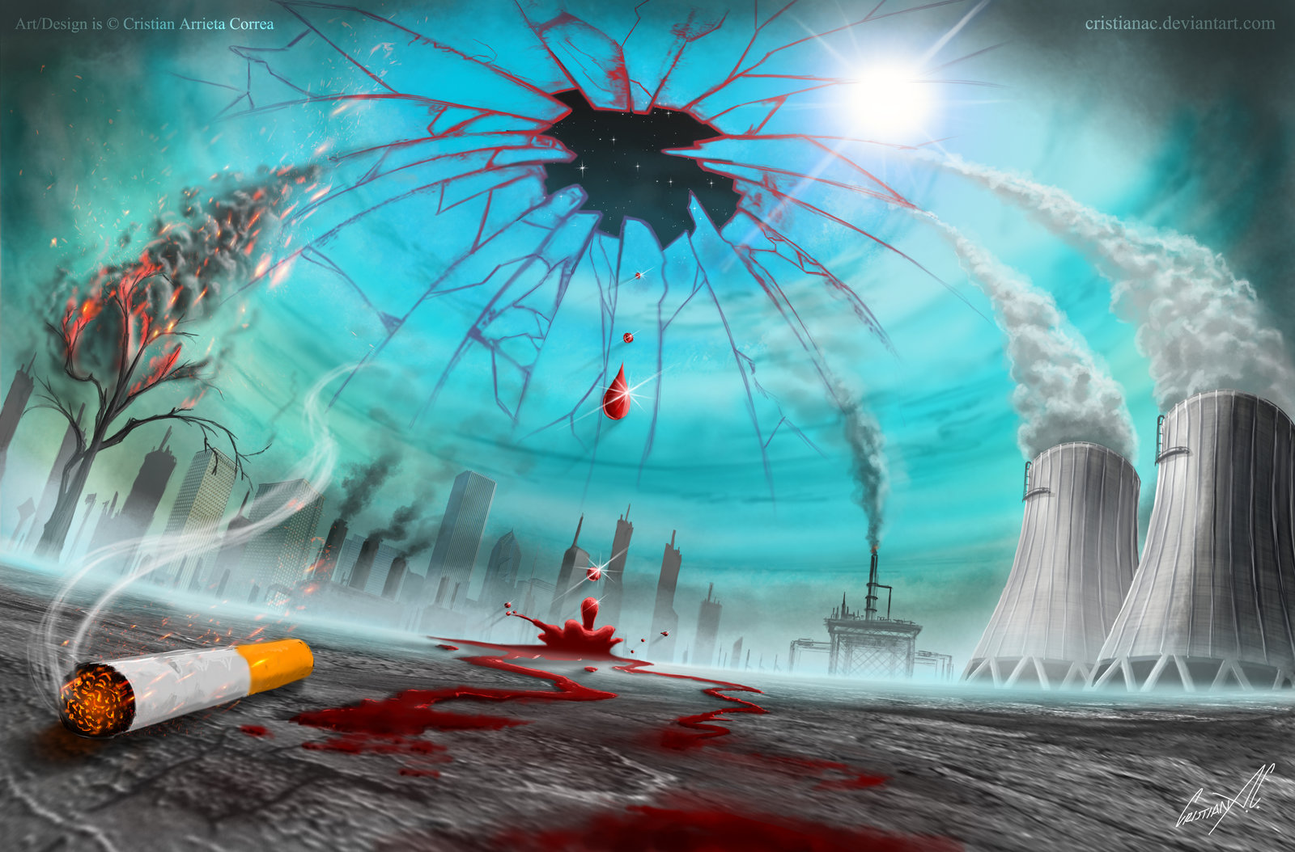
What is air pollution?
Air pollution refers to the release of pollutants into the air—pollutants that are detrimental to human health and the planet. According to the World Health Organization (WHO), each year air pollution is responsible for nearly seven million deaths around the globe. There is nothing more crucial for life than air, and yet because of air pollution, a simple act of breathing contributes to 7 million deaths every year, according to the World Health Organization (WHO). In addition, the global health body informed that almost all the global population (99%) breathe air that exceeds WHO guideline limits containing high levels of pollutants, with low- and middle-income nations suffering from the highest exposures. Experts across the globe have stated that both long-term and short-term exposure to air pollution can result in heart disease, stroke, diabetes, pneumonia, chronic obstructive pulmonary disease exacerbation, and other serious health problems. Wondering what is the solution, as one can’t stop breathing. There are a few things that can be done to avoid the health risks of air pollution.

Slide 3
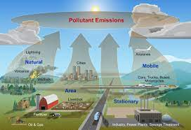
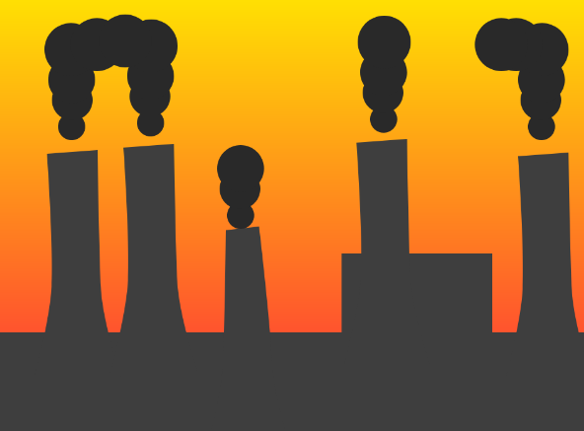
Causes of air pollution
Some of the things that cause air pollution are listed below:-
Burning fossil fuels
Wildfires
Open Burning of Garbage Waste
Smoking
Industries that release gas into the air
Construction
Demolition

Slide 4
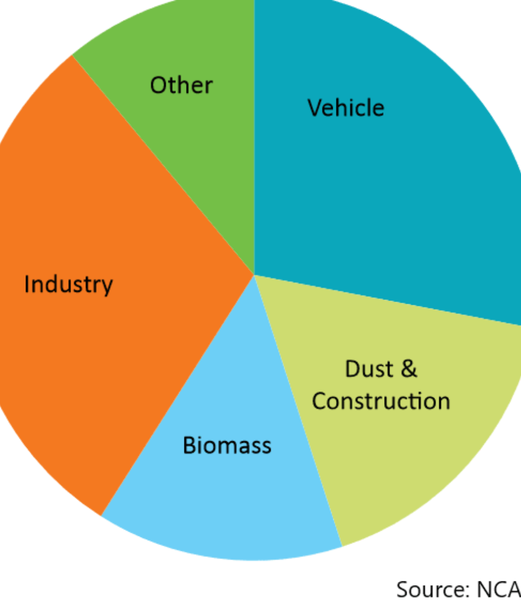
The pie chart on what causes so much air pollution

Slide 5
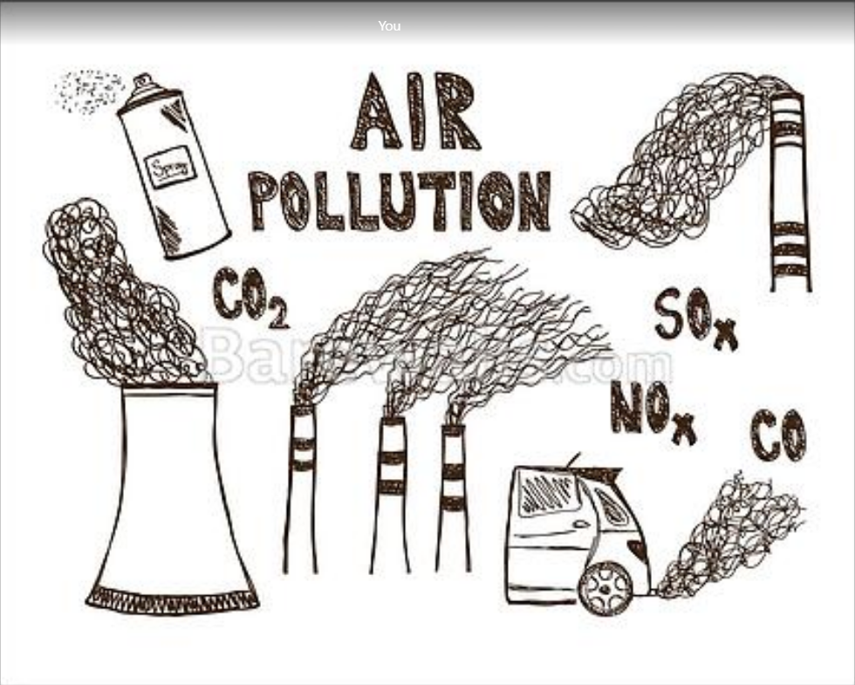
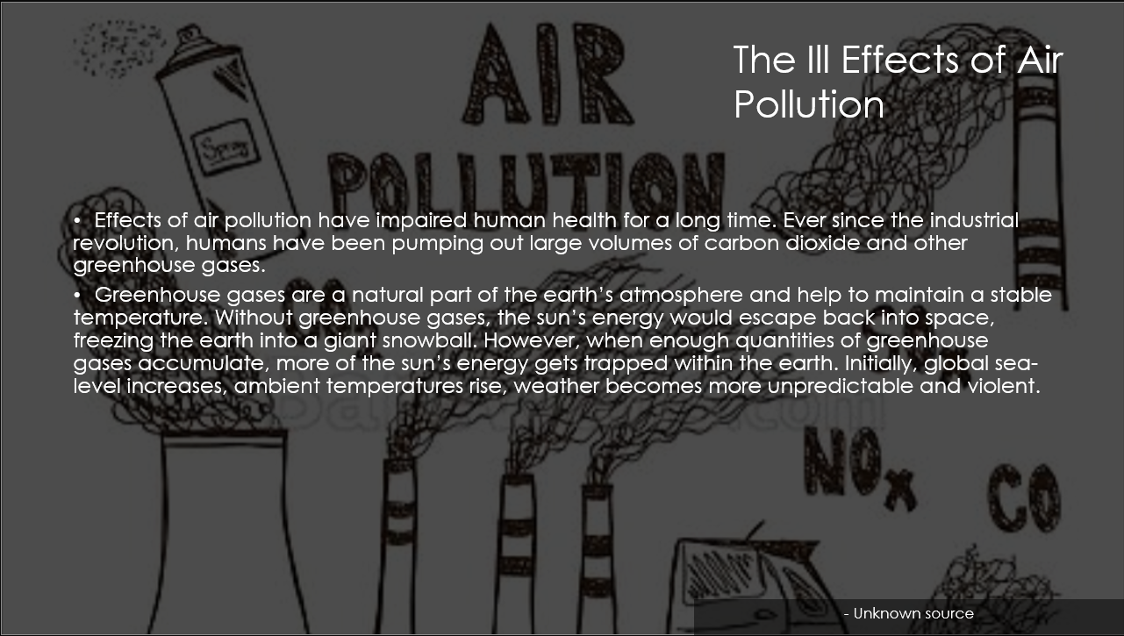
Top Pollution Rates and The Ill Effects of Air Pollution
Effects of air pollution have impaired human health for a long time. Ever since the industrial revolution, humans have been pumping out large volumes of carbon dioxide and other greenhouse gases.
Greenhouse gases are a natural part of the earth’s atmosphere and help to maintain a stable temperature. Without greenhouse gases, the sun’s energy would escape back into space, freezing the earth into a giant snowball. However, when enough quantities of greenhouse gases accumulate, more of the sun’s energy gets trapped within the earth. Initially, global sea-level increases, ambient temperatures rise, weather becomes more unpredictable and violent.
- Unknown source

Slide 6
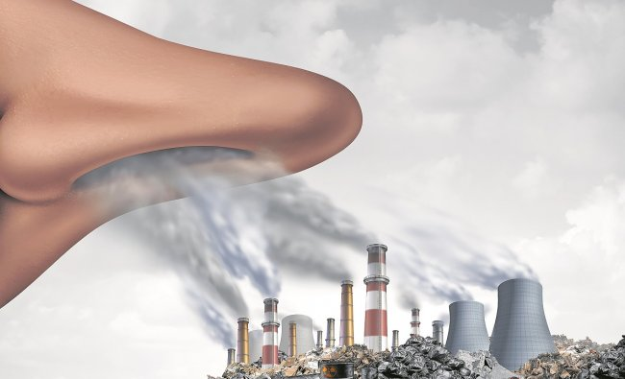
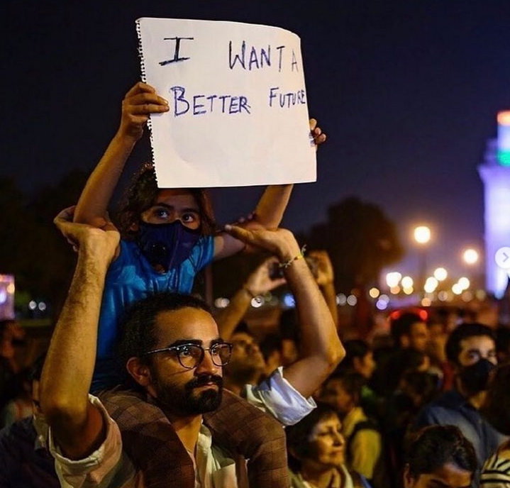
FAMOUS PEOPLE WHO FOUGHT AGAINST THIS
Hollywood actor and an environment activist Leonardo DiCaprio has shared images of the latest protest held in Delhi against rising air pollution-- on his Instagram feed. DiCaprio reposted images about the protest on November 5 where 1500 people participated. Within 20 hours of the actor posting the image, there were over 7 lakh likes on it

Slide 7
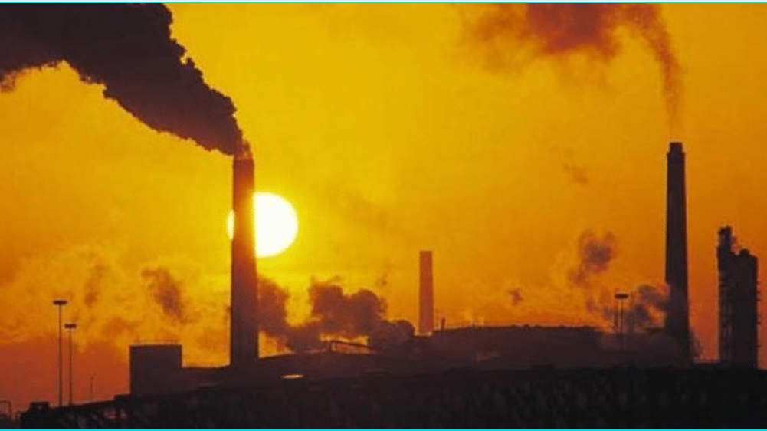
Thank you
- Aastha, Adhiraj, Adriraj, Aria, Arush. Aryan

