Slide 1
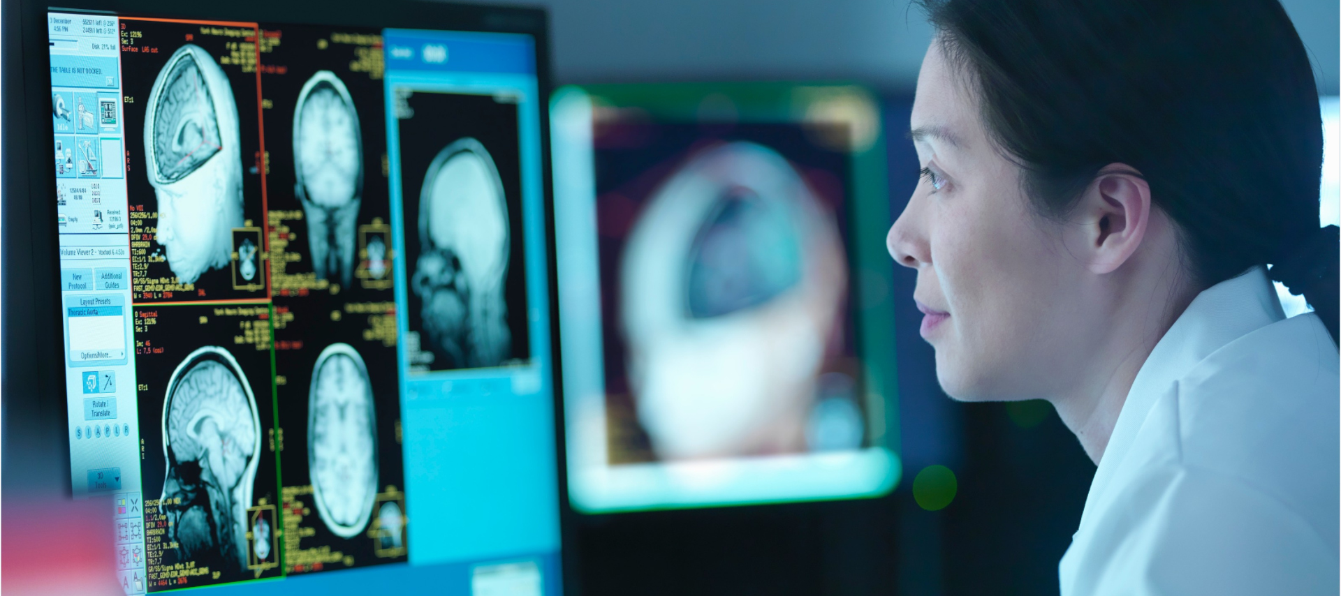
Chapter 15
Neuropsychology
Copyright © 2019 Cengage Learning. All Rights Reserved.
Fourth Edition
This Photo by Unknown Author is licensed under CC BY

Slide 2
Learning Objectives (1 of 2)
Describe the responsibilities and assessment methods of the neuropsychologist.
Explain the major characteristics of Alzheimer’s disease, vascular disease, traumatic brain injury, substance/medication-induced neurocognitive disorders, HIV-associated neurocognitive disorder, and prion diseases

Slide 3
Learning Objectives (2 of 2)
Describe the features of tumors, infections, epilepsy, multiple sclerosis, and migraine headaches
Explain the basic principles that predict recovery from brain damage
Describe the major methods used to treat neurocognitive disorders

Slide 4
What Is Neuropsychology?
A specialty field within clinical psychology that seeks to understand and treat patients with cognitive impairments resulting from:
  Aging
  Disease
  Injury

Slide 5
Who are the Neuropsychologists?
Licensed doctoral level clinical psychologists who complete specialized training
Often work in collaboration with neurologists

Slide 6
Neuropsychological Assessment
Goal is to develop an informed treatment plan
Choice of methods depends on the issues involved
Standardized tests
  Comparisons with population
  Comparisons with abilities unaffected by condition
  IQ tests
  Halstead-Reitan battery
Condition might affect test performance (e.g., pain, fatigue, medications)

Slide 7
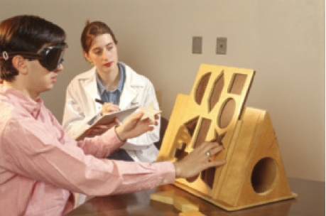
Neuropsychological Testing
Notes:
Figure 15.1 Neuropsychological Testing Standardized tests are an important part of a neuropsychological assessment.

Slide 8
Neurocognitive Disorders
Described in the Diagnostic and Statistical Manual of Mental Disorders (DSM 5; APA, 2013)
Diagnosed when a patient experiences a decline in functioning in one or more cognitive domains after a known challenge to the nervous system
  Attention
  Executive function
  Learning and memory
  Perception and movement
  Social cognition

Slide 9
Alzheimer’s Disease (1 of 4)
A neurodegenerative condition associated with aging that results in dementia
Probable Alzheimer’s disease is diagnosed on the basis of:
  Genetic testing or family history
  Clear evidence of learning and memory impairments
  A steady, gradual loss of cognitive function without plateaus

Slide 10
Alzheimer’s Disease (2 of 4)
Diagnostic methods
  Autopsy
  Biomarkers in CSF and blood
  PET and MRI scanning
Alzheimer’s disease risk increases with age
Genetics
  The e⁴ variant of the APOE gene
    People with two copies of e⁴ are 15 times more likely to develop Alzheimer’s disease as people who do not have an e⁴ allele.
    Exercise interacts with genotype

Slide 11
Alzheimer’s Disease (3 of 4)
  Can be inherited as a dominant trait due to mutations in either the APP, PSEN1, or PSEN2 genes
Atrophy of the cerebral cortex and neurodegeneration
  Neurofibrillary tangles and tau proteins
  Beta amyloid protein plaques
Oxidative stress
Disruption of microRNAs
Characteristic pattern of brain damage
  Transneuronal degeneration

Slide 12
Alzheimer’s Disease (4 of 4)
  Decreased connectivity within the default mode network (DMN)
Treatments
  Experimental antibodies targeting beta amyloid clear plaques
  Approved treatments slow down, but do not reverse the course of the disease
  Increasing seafood and omega-3 fatty acid intake
  Acetylcholinesterase inhibitors
  Use of antipsychotics is associated with earlier death

Slide 13
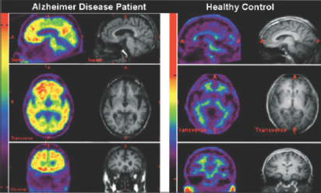
PET Scans for Amyloid
Notes:
Figure 15.2 PET Scans for Amyloid
A useful adjunct to other diagnostic procedures in cases of suspected Alzheimer’s disease is a PET scan that identifies amyloid in the brain. As you can see in this image, the scan of a patient with Alzheimer’s disease shows much more amyloid (the brightly colored areas) than the scan of the healthy person.

Slide 14
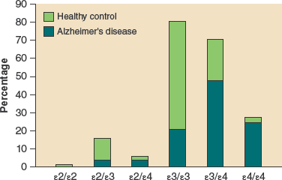
APOE Alleles and the Risk for Alzheimer’s Disease
Notes:
Figure 15.3 APOE Alleles and the Risk for Alzheimer’s Disease This image compares the relative frequency of Alzheimer’s disease among people with the six possible allele combinations for the APOE gene. Having one or two copies of the ε4 allele of the APOE gene increases a person’s risk for Alzheimer’s disease. The ε3 allele is the most common form of APOE and does not seem to impact risk for Alzheimer’s disease one way or the other. The least common form of APOE, the ε2 allele, appears to convey some protection from Alzheimer’s disease.
Source: https://www.google.com/patents/WO1994009155A1?cl=en

Slide 15
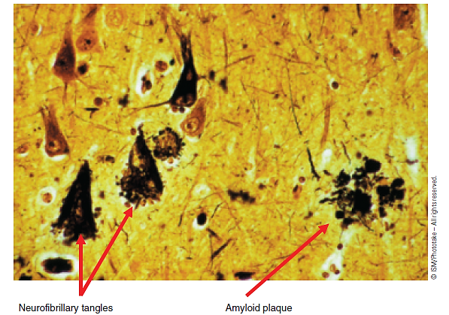
Alzheimer’s Disease Produces Structural Abnormalities in Neurons
Notes:
Figure 15.4 Alzheimer’s Disease Produces Structural Abnormalities in Neurons
This image illustrates the abnormal structural effects of Alzheimer’s disease on neurons. The cone-shaped elements are neurofibrillary tangles, and the brown clumps are amyloid plaques found in the brain of a patient who died from Alzheimer’s disease.
© ISM/Phototake – All rights reserved.

Slide 16
Vascular Disease (Stroke) (1 of 2)
Neurons are totally dependent on the blood supply for oxygen
A stroke occurs when the brain’s blood supply is interrupted by either:
  Cerebral hemorrhage
    Hypertension
    Aneurysms
  The sudden blockage of a blood vessel
    Results in ischemia (low oxygen levels)
    Infarct (area of dead neural tissue)
    Transient ischemic attacks (TIA)
    Thrombosis vs. embolism

Slide 17
Vascular Disease (Stroke) (2 of 2)
Excess glutamate release produces neural damage through excitotoxicity
Neuronal cell death occurs immediately after a stroke, but prompt medical attention can save the neurons and glia in the penumbra
  Use of drugs that reduce blood clotting
  Mechanical devices inserted into blood vessels
  Histone deacetlyase (HDAC) inhibitors
  Surgery
  Physical activity

Slide 18
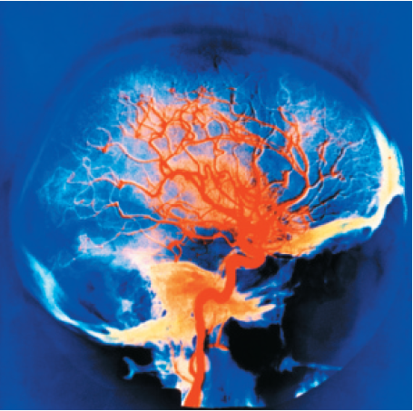
The Brain’s Blood Supply
Notes:
Figure 15.5 The Brain’s Blood Supply
Due to the brain’s enormous need for oxygen, it is supplied by a rich network of blood vessels. Interruptions to this supply produce rapid changes in brain function and, potentially, infarct and death.
CNRI/Science Source

Slide 19
Characteristics of Types of Strike
Type of Stroke | Causes | Outcomes
Hemorrhage (about 20% of cases) | High blood pressure Vascular abnormalities | Frequently fatal
Ischemia (about 80% of cases) | Arteriosclerosis Blood clots | Infarct of varying size Changes in consciousness, sensation, and movement
Notes:
Table 15.1 Characteristics of Types of Strike

Slide 20
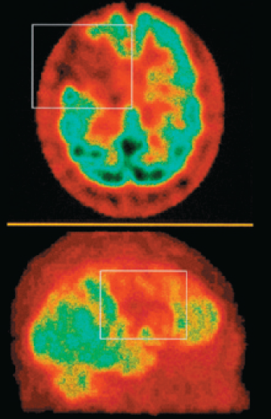
Brain Infarct
Notes:
Figure 15.6 Brain Infarct
When an area of the brain is deprived of oxygen for a sufficient amount of time, cells begin to die. The area of dead tissue is referred to as an infarct. In this image, the patient suffered a fatal infarct in the right frontal lobe.
James Cavallini/Science Source

Slide 21
Traumatic Brain Injury (TBI) (1 of 3)
Physical damage to the brain
Open head injuries
  Penetration of skull
  Worst consequences when injury affects:
    Ventricles
    Both hemispheres
    Multiple lobes of the brain
Closed head injuries (concussions)
  Blow to the head
  Coup, countercoup

Slide 22
Traumatic Brain Injury (TBI) (2 of 3)
  Subdural hematoma
  White matter damage
Military TBI
  Can combine open and closed injuries
  Can differ from civilian TBI
    Severe swelling
    Disruption of blood-brain barrier
    Damage to blood supply
Outcomes of TBI
  Most individuals recover from concussion in a few weeks

Slide 23
Traumatic Brain Injury (TBI) (3 of 3)
  Neurocognitive disorder due to traumatic brain injury
  Repeated TBI is especially damaging
    Dementia pugilistica
    Interactions with e⁴ allele
Treatments for TBI vary widely
  Medications that inhibit glutamate
  Medications that enhance dopamine activity
  Norepinephrine reuptake inhibitors
  Patient and family education
  Virtual reality

Slide 24
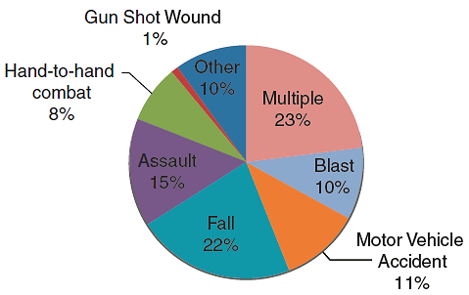
Sources of Military TBI
Notes:
Figure 15.7 Sources of Military TBI
The 7 percent of U.S. combat veterans experiencing TBI as a result of serving in Iraq and Afghanistan between 2004 and 2009 were injured in a variety of situations.

Slide 25
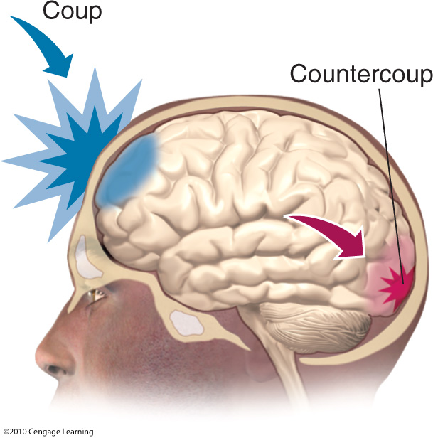
Coup and Countercoup
Notes:
Figure 15.8 Coup and Countercoup
In concussions, the coup, shown here in blue, is an injury that occurs at the site of the blow. When the blow pushes the brain in the opposite direction, a second area of injury occurs, known as the countercoup, shown here in red.

Slide 26
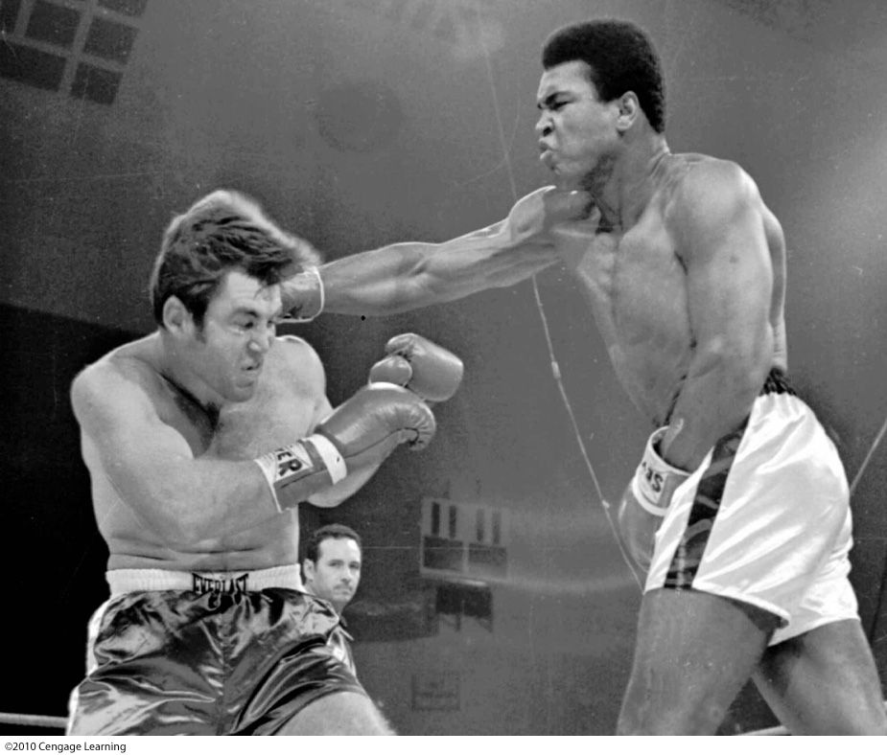
Boxers Risk Repeated Head Injuries
Notes:
Figure 15.9 Boxers Risk Repeated Head Injuries
Boxer Jerry Quarry, shown on the left fighting Muhammad Ali, developed traumatic brain injury (TBI) as a result of repeated concussions. This type of TBI causes slurred speech, memory impairment, lack of coordination, personality changes, and a Parkinson-like syndrome.
AP Images

Slide 27
Substance/Medication-Induced Neurocognitive Disorder (1 of 2)
Results from drug use that produces symptoms of neurocognitive disorder outside of intoxication and withdrawal
Likely drugs: Alcohol, cocaine, methamphetamine, opioids, phencyclidine (PCP), sedatives, hypnotics, antianxiety drugs, and solvents
Individuals who begin abstinence prior to age 50 years recover more effectively

Slide 28
Substance/Medication-Induced Neurocognitive Disorder (2 of 2)
Methamphetamine
  Increases risk of cardiovascular accidents
  Damages blood-brain barrier
Alcohol
  Nutritional deficits
  Korsakoff syndrome

Slide 29
HIV-Associated Neurocognitive Disorder (HAND)
Neurological symptoms result directly or indirectly from HIV or other opportunistic infections
HIV does not target neurons; therefore, the virus causes cell death indirectly
The initial symptoms are relatively mild: Difficulty concentrating, forgetfulness, decreased work productivity, low sex drive, social withdrawal, general apathy
Later symptoms: imbalance, clumsiness, weakness, memory loss and language impairment
Contemporary antiretroviral treatments

Slide 30
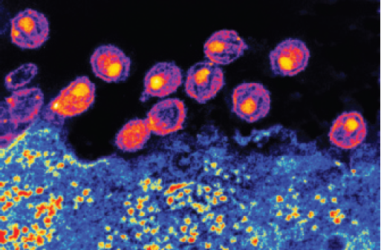
HIV Viral Particles Bud from an Infected Cell
Notes:
Figure 15.10 HIV Viral Particles Bud from an Infected Cell
In cases of HAND, many cells containing the HIV virus can be observed. In the image shown here, the particles budding from an infected cell burst, leading to further spreading of the virus within the brain.
Scott Camazine/Alamy

Slide 31
Prion Diseases (1 of 2)
Transmissible Spongiform Encephalopathies (TSEs)
  Bovine spongiform encephalopathy (BSE) or mad-cow disease
  Creutzfeldt-Jakob disease (CJD)
  Kuru
  Fatal familial insomnia
Progression: psychological disturbances, loss of cognitive function, motor disturbances, death
Prions and TSEs
  Role of abnormal form of prion protein
  PrP^{c} (normal protein) and PrP^{sc} (abnormal protein)

Slide 32
Prion Diseases (2 of 2)
Unraveling the TSE mystery
  Scrapie in sheep and goats in 18th century England
  CJD was first described in the 1920s
  Kuru in the Fore people of New Guinea described in the 1950s; linked to cannibalistic burial rituals
BSE and new variant Creutzfeldt-Jakob disease (vCJD)
  Led to ban on animal carcasses in livestock feed

Slide 33
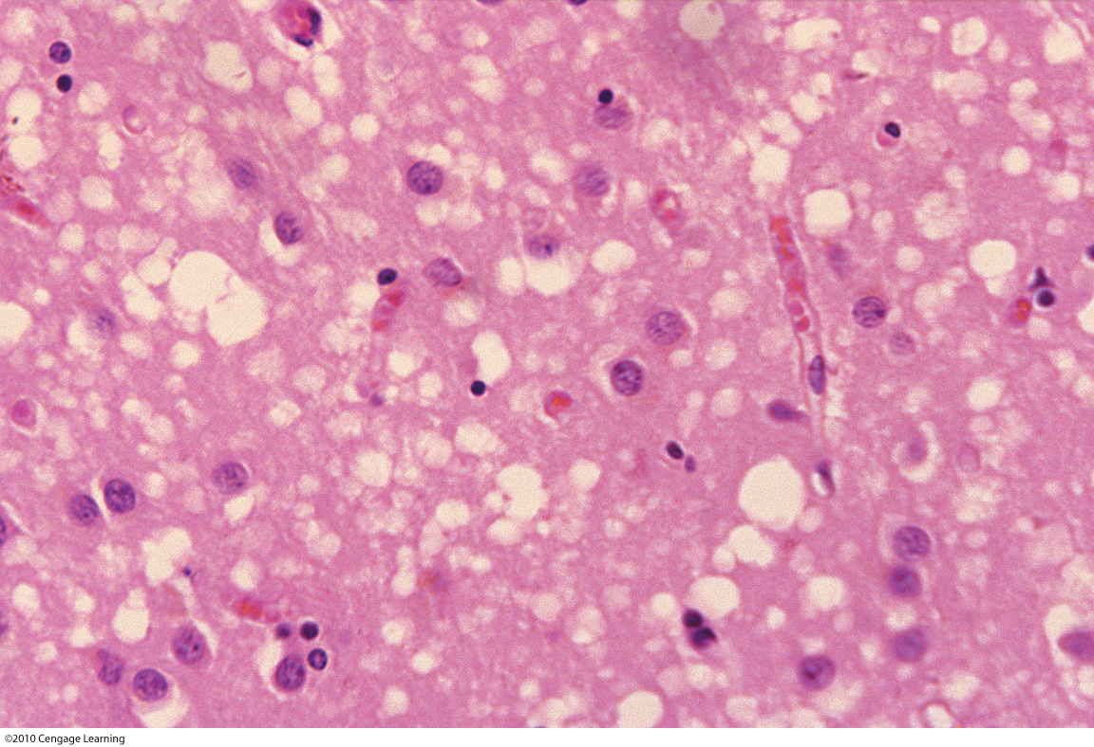
Bovine Spongiform Encephalopathy (“Mad-Cow” Disease)
Notes:
Figure 15.11 Bovine Spongiform Encephalopathy (“Mad-Cow” Disease)
This image shows the characteristic damage to the brain that gives the TSEs the name spongiform.

Slide 34
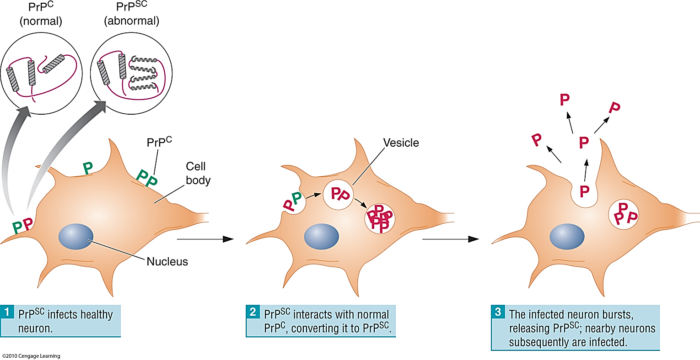
Prion Proteins Have Normal and Abnormal Forms
Notes:
Figure 15.12 Prion Proteins Have Normal and Abnormal Forms
It appears that the abnormal PrP (shown in red) can change the structure of normal PrP (shown in green) with which it comes into contact, spreading the condition throughout the nervous system.

Slide 35
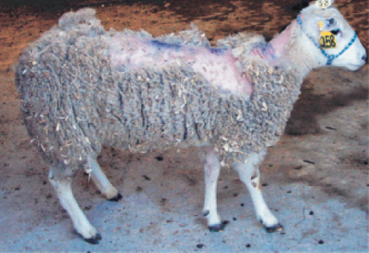
A Sheep with Scrapie
Notes:
Figure 15.13 A Sheep with Scrapie
Scrapie, a TSE affecting sheep and goats, was first observed 300 years ago in England. The condition was named after the fact that afflicted sheep scraped themselves
against other objects, removing much of their wool.
Michele Crocheck, USDA, APHIS, VS, NVSL

Slide 36
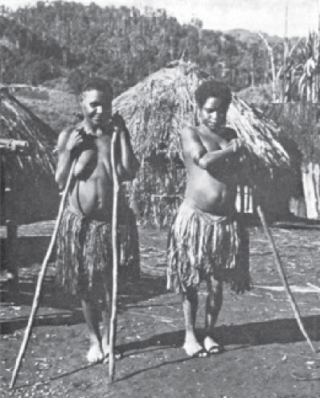
Kuru Occurred among the Fore of New Guinea
Notes:
Figure 15.14 Kuru Occurred Among the Fore of New Guinea
This photograph of two Fore women with kuru was among Gadjusek’s original field study photos taken in 1960. Both women required the use of a stick to stand, and they died within six months.

Slide 37
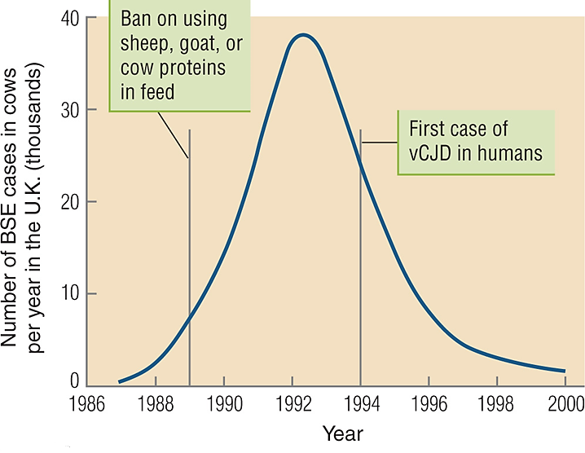
Time Course of the BSE Epidemic in the United Kingdom
Notes:
Figure 15.15 Time Course of the BSE Epidemic in the United Kingdom
Steps that have been taken against the BSE epidemic in the United Kingdom are working. The use of sheep, goats, or cattle in animal feed has been banned, and cattle exports to other countries ceased. These data reflect the long incubation periods of TSEs. The benefits of the new feeding practices did not show until several years had passed. In addition, the first related case of vCJD was diagnosed several years after the disease in cattle had been identified and addressed.

Slide 38
Neurocognitive Disorders Due to Other Medical Conditions
The neurocognitive disorder section of the DSM-5 lists “other medical conditions” as:
  Brain tumors, hydrocephalus, oxygen deficits following cardiac arrest, endocrine conditions, nutritional conditions, infectious diseases, immune disorders, kidney failure, metabolic conditions, epilepsy, and multiple sclerosis

Slide 39
Brain Tumors (1 of 3)
Tumors: Independent growths of new tissue that lack purpose
  Primary tumors of the brain
    Rare
    Causes unknown, but radiation is a risk
  Secondary tumors
    Arise from glial cells, meninges, and ependymal cells
    Most common type of tumor until age 19
  Malignant versus benign tumors

Slide 40
Brain Tumors (2 of 3)
Symptoms of brain tumors
  Pressure in the skull
  Headache, vomiting, double vision, reduced heart rate, reduced alertness, and seizures
  Specific disruptions related to location
Types of tumors
  Gliomas (>70% of brain tumors)
  Meningiomas
  Grades I to IV

Slide 41
Brain Tumors (3 of 3)
Treatment for tumors
  Surgical removal
  Whole brain radiation
  Stereotaxic radiosurgery
  Ultrasound therapy
  Chemotherapy limited by blood-brain barrier
  Thalidomide to starve tumors of blood supply
  Experimental delivery of stem cells with anticancer genes

Slide 42
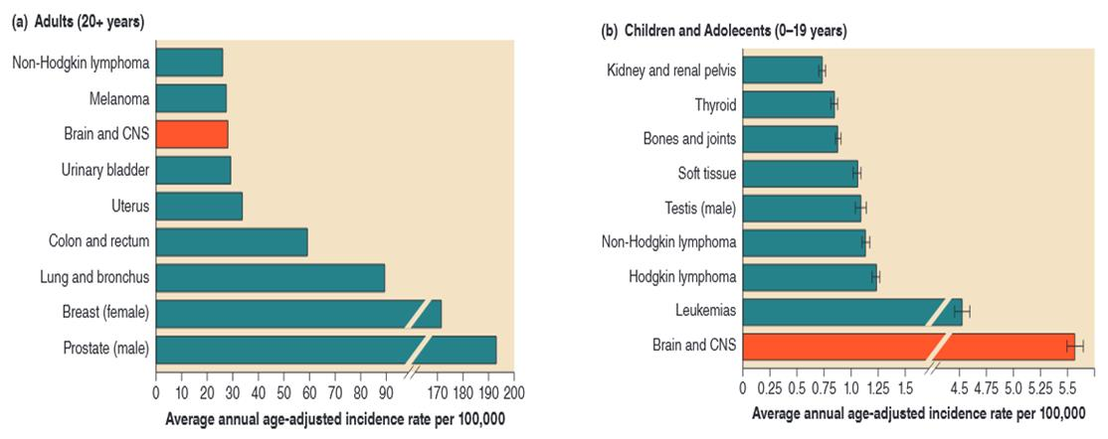
Brain and CNS Tumors and Age
Notes:
Figure 15.17 Brain and CNS Tumors and Age
Among children and youth under the age of 19 years, tumors of the brain and central nervous system are the most common type of tumor. Among adults ages 20 and older, however, brain and central nervous system tumors are bypassed by prostate (in men), breast, lung, colon, uterine, and urinary tumors.
and central nervous system tumors diagnosed in the United States in 2008-2012. Neuro-oncology, 17(suppl 4), iv1-iv62.

Slide 43
Infections
Neurocysticercosis (pork tape worm eggs)
  Does not result from pork consumption
  Produces partial seizures
Encephalitis: inflammation of brain after viral infection
  Primary vs. secondary encephalitis
  Zika virus and microcephaly
  Herpes simplex
Meningitis: inflammation of meninges
  Bacterial meningitis
  Viral meningitis: most common, least dangerous
  Fungal meningitis is rare

Slide 44
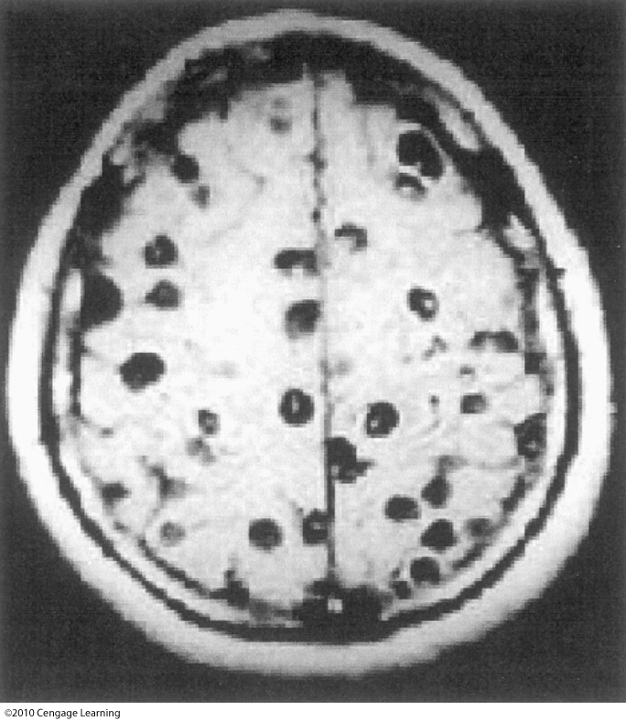
Complicated Neurocysticercosis Involves Multiple Infections in the Brain
Notes:
Figure 15.18 Complicated Neurocysticercosis Involves Multiple Infections in the Brain
Simple neurocysticercosis usually involves a single cyst and is typical of cases that occur in areas of the world in which the condition is not well established. In the case depicted here, multiple cysts have occurred. These complicated cases usually occur in areas in which the condition is common.

Slide 45
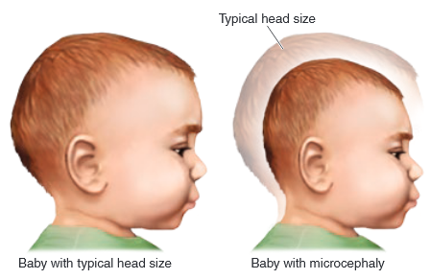
The Zika Virus and Microcephaly
Notes:
Figure 15.19 The Zika Virus and Microcephaly
Symptoms of the Zika virus in otherwise healthy adults are not particularly worrisome, but if a pregnant woman contracts the virus, her child might display microcephaly. Microcephaly, which can also be caused by exposure of the fetus to environmental toxins, drugs and alcohol, and other infections (cytomegalovirus, rubella, and varicella), is associated with impaired cognitive development, delays in speech and motor functions, and hyperactivity.

Slide 46
Epilepsy (1 of 2)
A seizure is an uncontrolled electrical disturbances in the brain correlated with changes in consciousness
Partial seizures
  Simple: no change in consciousness
  Complex: altered consciousness
  Focal area
  Aura
  Paroxysmal depolarizing shift (PDS)

Slide 47
Epilepsy (2 of 2)
Generalized seizures
  Symmetrically affect both sides of brain
  No focal area
  Activation of circuits connecting the thalamus and cortex
  Tonic-clonic (grand mal)
  Absence (petit mal)
Treatment for epilepsy
  Antiepileptic drugs (usually GABA agonists)
  Surgery
  Ketogenic diet in children

Slide 48
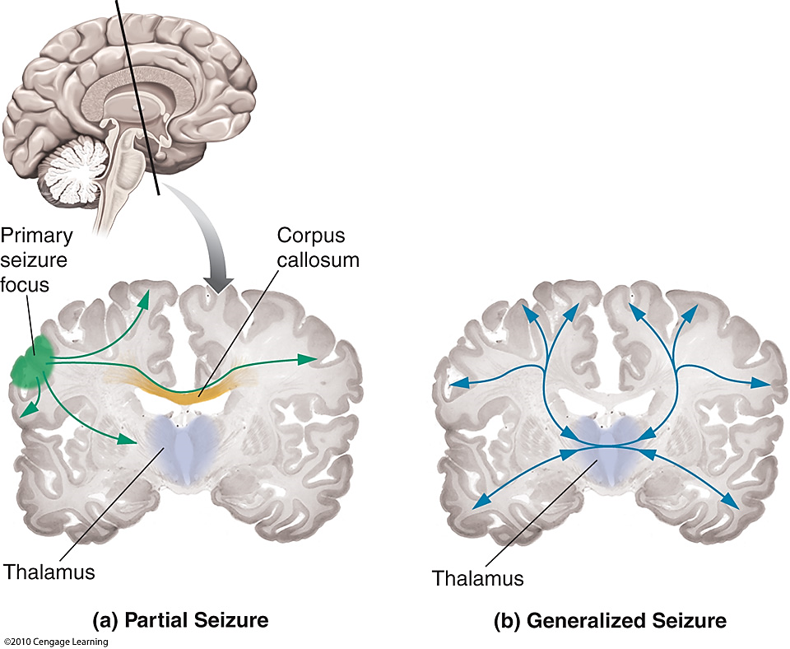
Pathways for the Spread of Partial and Generalized Seizures
Notes:
Figure 15.20 Pathways for the Spread of Partial and Generalized Seizures
(a) Partial seizures originate in a focus and spread to cortical and subcortical structures. (b) Generalized seizures do not originate in a focus. Once they begin, generalized seizures spread through the brain symmetrically via connections between the thalamus and cortex.

Slide 49
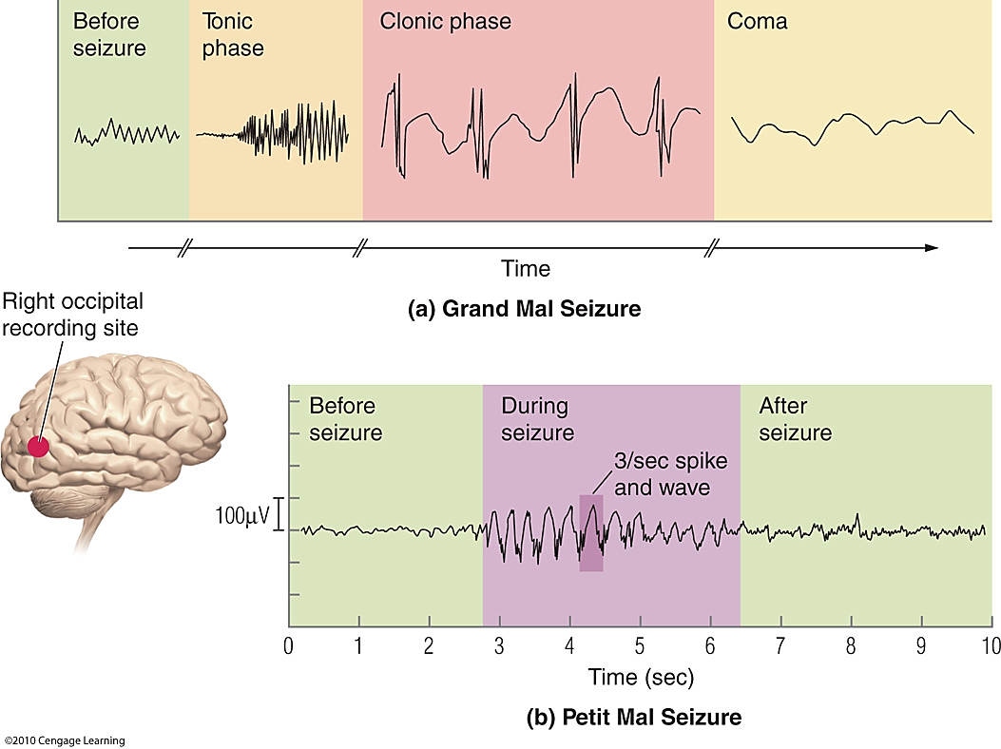
EEG Recordings during Generalized Seizures
Notes:
Figure 15.21 EEG Recordings During Generalized Seizures
In the upper image, we see recordings made during the stages of a tonic-clonic seizure. The lower image shows recordings made during an absence seizure. These recordings illustrate the characteristic “3/sec spike and wave” pattern that generally accompanies this type of seizure.

Slide 50
Multiple Sclerosis (1 of 2)
Autoimmune condition
  Immune system attacks the oligodendrocytes
  Demyelination of axons
  Affects white matter in different locations
Possible causes
  Modest heritability
  Exposure to viruses (e.g., Epstein-Barr)
  Lack of vitamin D due to lack of sunlight

Slide 51
Multiple Sclerosis (2 of 2)
Treatment
  Medications slow progression of the disease
  Quit smoking
  Increase exercise

Slide 52
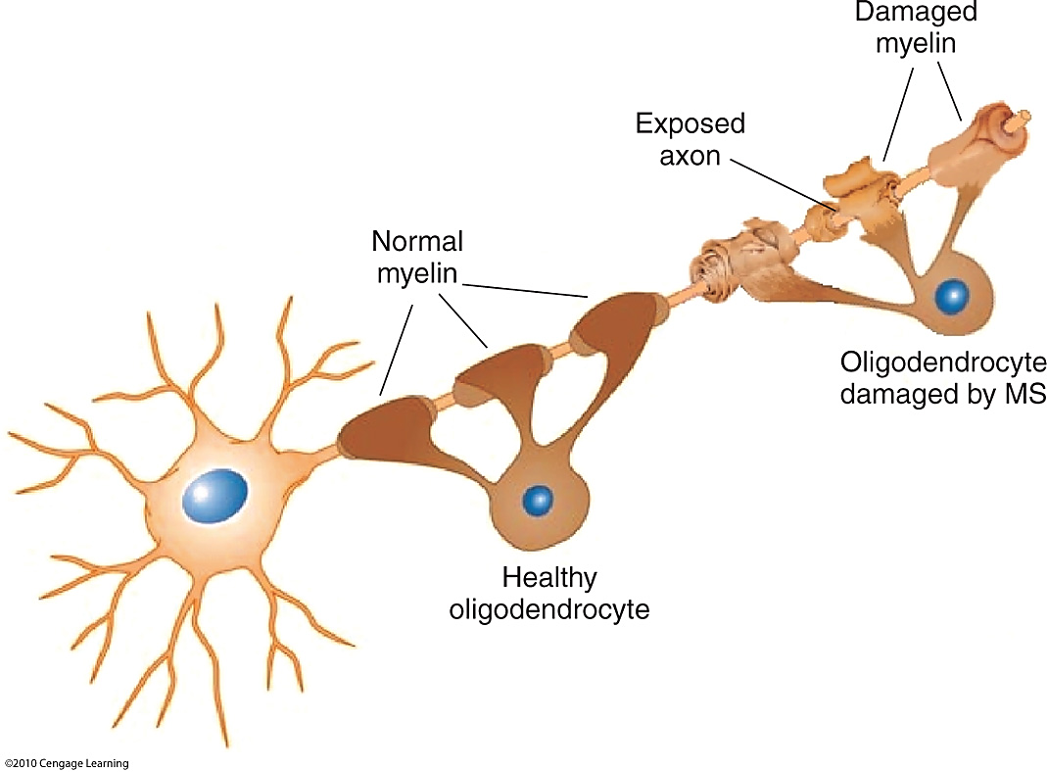
Multiple Sclerosis Damages Myelin
Notes:
Figure 15.22 Multiple Sclerosis Damages Myelin
In cases of multiple sclerosis, the body’s immune system attacks the oligodendrocytes myelinating axons of some central nervous system neurons. Consequently, electrical signals are not transmitted efficiently, leading to a variety of cognitive, sensory, and motor deficits.

Slide 53
Migraines
Symptoms of excruciating head pain, nausea, and vomiting for 4–72 hours
Risk is much higher for women than for men
Migraine generator located in brainstem
  Trigeminovascular system
  Calcitonin gene-related peptide (CGRP)
  Produces increased blood flow and pain
Treatments
  Triptans prevent release of CGRP
  Botox injections
  Behavioral adjustments

Slide 54
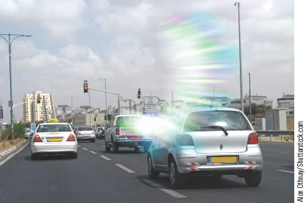
Migraine Aura
Notes:
Figure 15.23 Migraine Aura
Many patients with migraine experience an aura, or period of sensory distortion, prior to a headache.

Slide 55
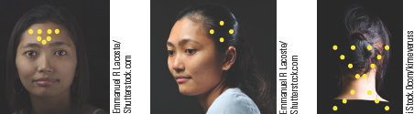
Botox Injections for Migraine Headaches
Notes:
Figure 15.24 Botox Injections for Migraine Headaches
Migraine headaches are typically treated with medication, but Botox injections (see Chapter 4) near certain peripheral nerves provide relief for some individuals. The botulinum neurotoxin interferes with synaptic vesicle fusion (see Chapter 3), which in turn prevents effective release of a number of neurochemicals associated with pain.

Slide 56
Plasticity and Recovery (1 of 2)
Reactive neuroplasticity
  The development of new neurons and the growth of axons, dendrites, and new synapses
  Takes place within days or weeks
Experience-dependent neuroplasticity
  Changes due to learning
  Depends on growth and strengthening of synapses
  Logical target of rehabilitation
  Timeline can span many years

Slide 57
Plasticity and Recovery (2 of 2)
Kennard Principle
  Recovery from brain damage is related to developmental stage
  Younger brains reorganize more effectively than older brains
  Applies to language functions but not all cognitive functions
Language recovery is more extensive than other cognitive processes

Slide 58
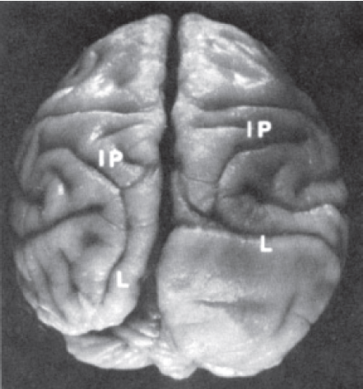
Reorganization Occurs Following Brain Damage
Notes:
Figure 15.25 Reorganization Occurs Following Brain Damage
The left occipital lobe was surgically removed from the brain of this monkey 83 days after conception. The resulting reorganization can be seen in the differences between the right and left inferior parietal lobule. The boundaries of this gyrus are the intraparietal sulcus (labeled IP in the image) and the lunate sulcus (labeled L). The right-hemisphere inferior parietal lobule is normal. The left-hemisphere inferior parietal lobule appears to be nearly twice normal size, extending nearly to the back of the brain.

Slide 59
Cognitive Reserve
Some people are less impacted by brain injury or neurodegenerative processes than others
  Brain size, number of synapses
  Coping with damage by using cognitive networks in more flexible ways
Behavioral outcomes do not always correlate with extent of brain damage
Variables linked to cognitive reserve
  IQ
  Educational and occupational status
  Engagement in enriching leisure activities

Slide 60
Rehabilitation for Neurocognitive Disorders
Rehabilitation means “to restore to good health”
Three factors to address
  Changes to cognitive abilities
  Emotional changes
  Physical correlates
Methods for improving cognitive function
  Cognitive (top down) approach
  Functional (specific tasks) approach
Virtual reality (VR) therapy
  Patients participate without expensive staff
  “Wii-hab”

Slide 61
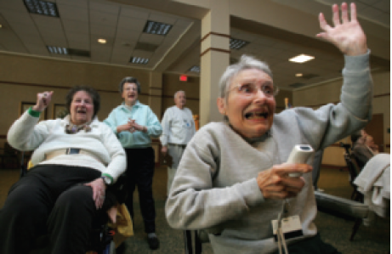
“Wii-Hab”
Notes:
Figure 15.26 “Wii-hab”
The use of commercial motion-sensing gaming systems allows people to augment their rehabilitation programs and have fun at the same time. This senior takes her tennis game very seriously.

