Slide 1


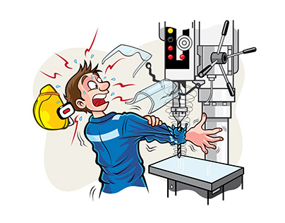
Introduction
Welcome to this presentation on safety procedures for machine shop, fabrication shop, winding shop, wiring and assembly shop operators. Working in a shop floor is a rewarding experience, but its important to remember that it can also be a dangerous environment. By following these safety procedures, you can help prevent accidents and injuries.
Let's work together, work smart, work safe, and work proud!

Slide 2
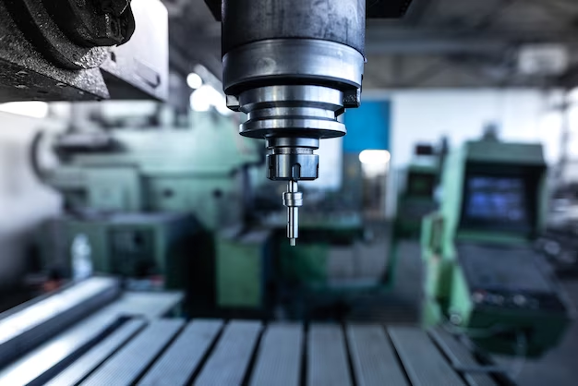

MACHINE SHOP
SAFETY PROCEDURES

Slide 3

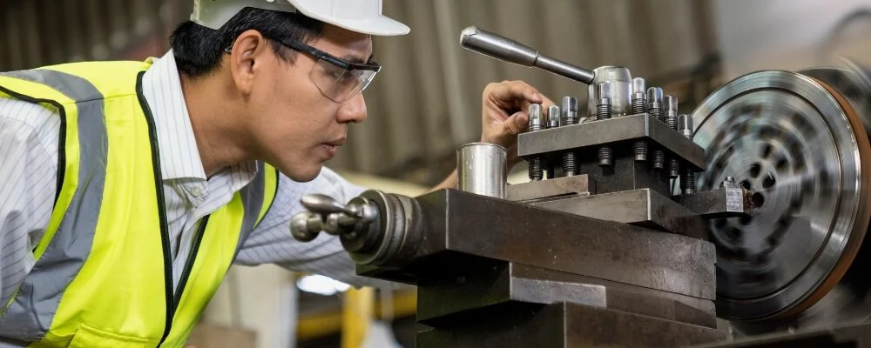

Lathe Machine:
Securely clamp workpieces in the chuck.
Use the correct guards and shields.
Keep safe distance from the machine when it is running.
Never reach across the rotating workpiece.
Wear close-fitting clothing, tie back long hair, and remove any jewelry that could get caught in the machine.
Never leave the machine unattended while it is running.

Slide 4
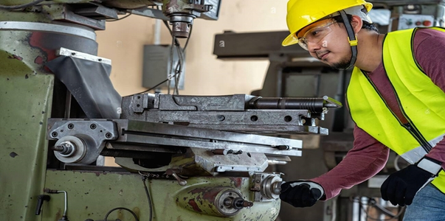
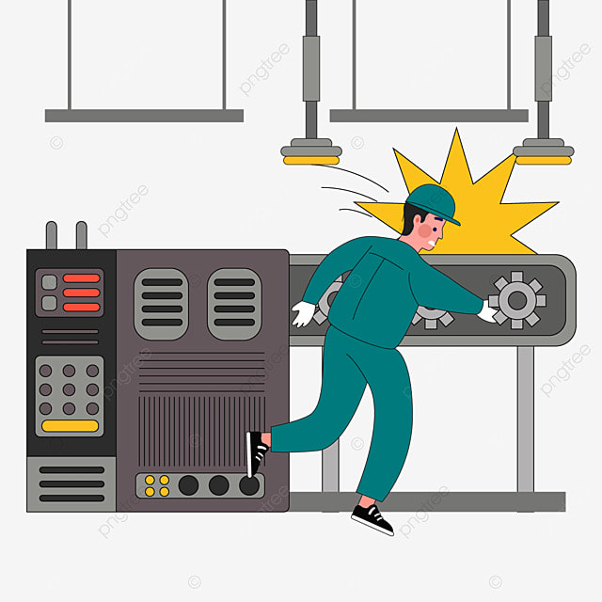
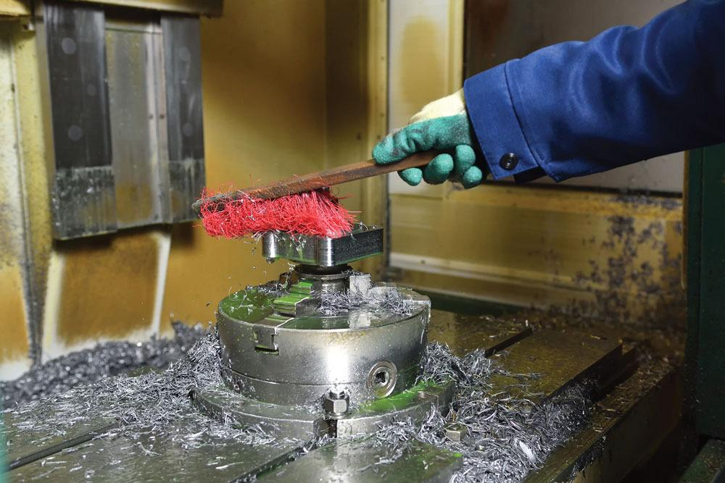
DRO Milling Machine:
Use the correct feed rates and cutting speeds.
Do not overload the machine.
Be aware of the cutter path and keep your hands away from it.
Securely clamp the workpiece to the table.
Wear safety glasses, hearing protection & gloves.
Avoid placing your hands or fingers near the cutting tool.

Slide 5
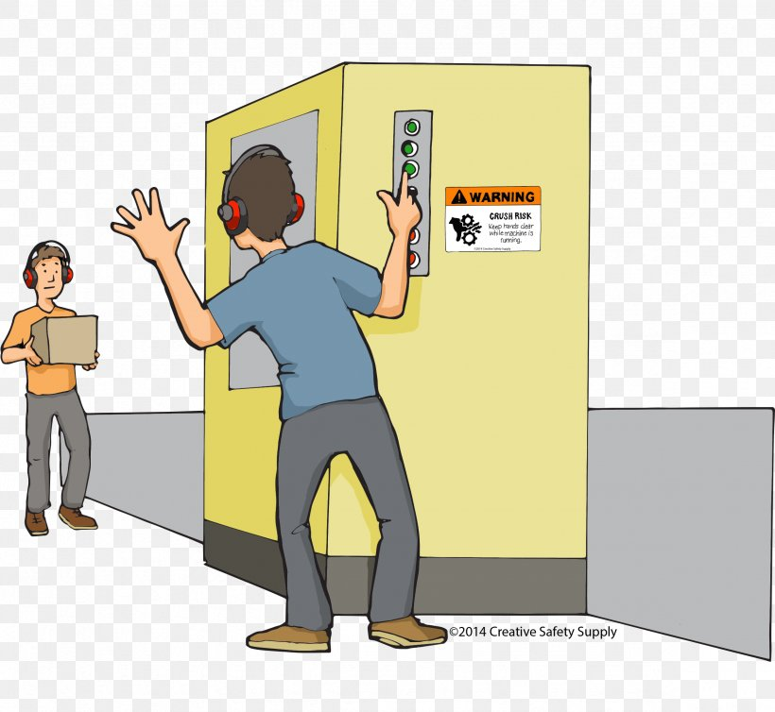
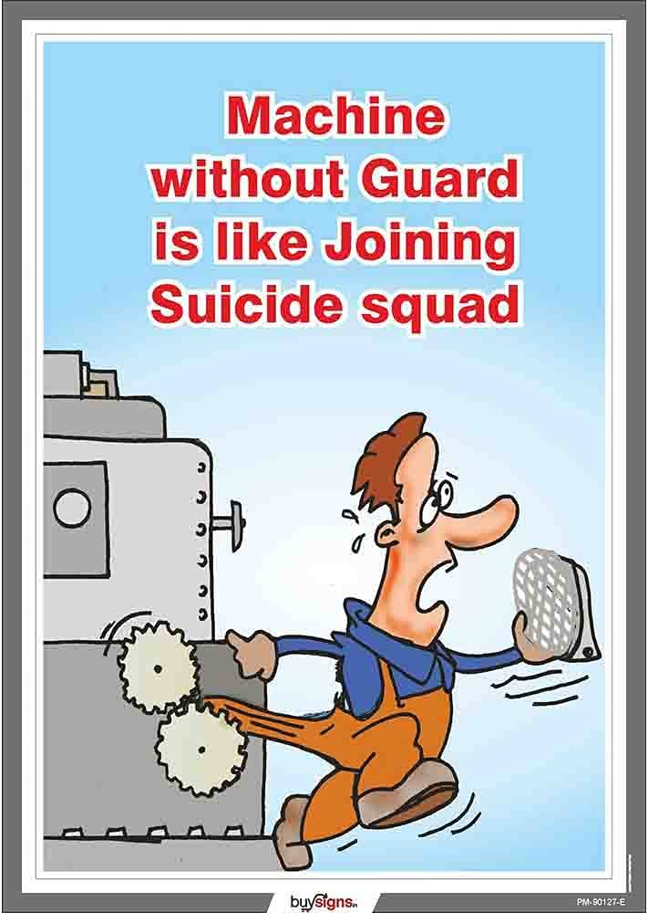
Rough Milling Machine:
Wear heavy gloves and a face shield when working with rough materials.
Use brush to clean harmful particles.
Be careful not to snag your clothing on the rotating parts.
Never stand directly in front of the machine.
Wait until the machine comes to a complete stop, before making any adjustments or clearing away chips.

Slide 6
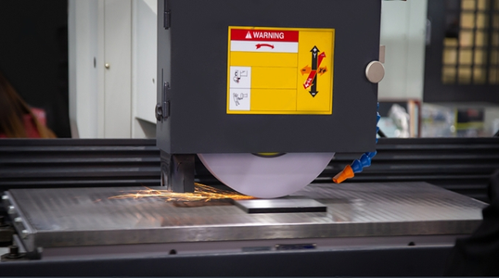

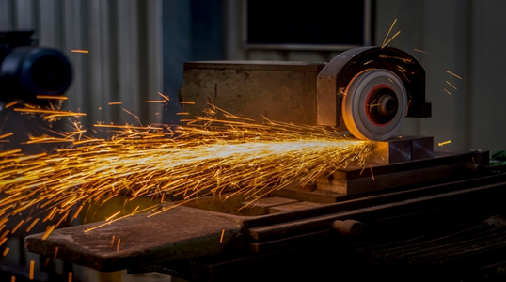
Hydraulic Grinding Machine:
Use the correct grinding wheel for the job.
Dress the grinding wheel before use.
Keep safe distance from the grinding wheel when it is running
Keep your hands away from the grinding area.
Turn off the machine immediately if anything goes wrong

Slide 7
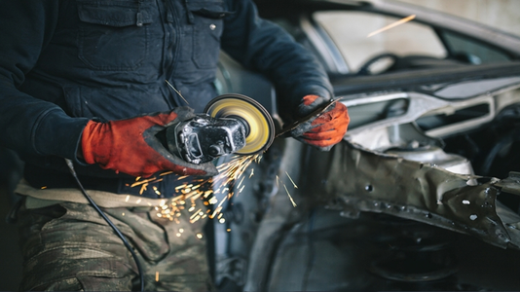
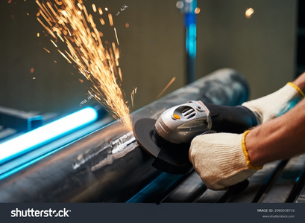

Hand Grinding Machine:
Securely mount the grinding wheel.
Check for cracks or chips in the wheel, and ensure it's securely mounted.
Use the correct eye protection and hand protection.
Do not force the grinding wheel.
Be aware of the sparks and flying debris.
Hold the grinder with both hands, using the auxiliary handle for better control.

Slide 8
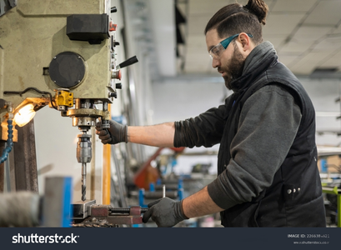
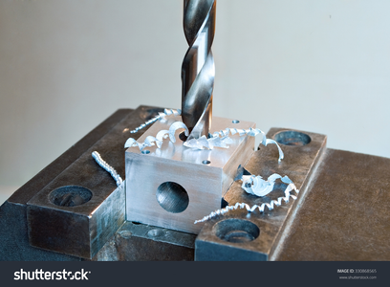
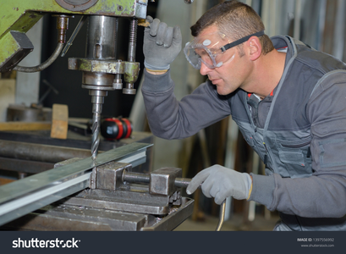
Drilling Machine:
Use the correct drill bit for the material.
Securely clamp the workpiece.
Use a drill stop to prevent the drill from breaking through the workpiece.
Do not wear loose clothing or jewelry that could get caught in the drill.
Be aware of your surroundings.

Slide 9

FABRICATION SHOP
SAFETY PROCEDURES

Slide 10
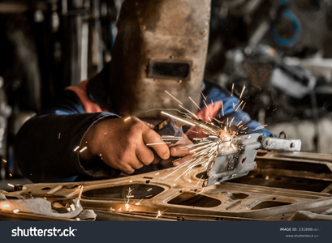
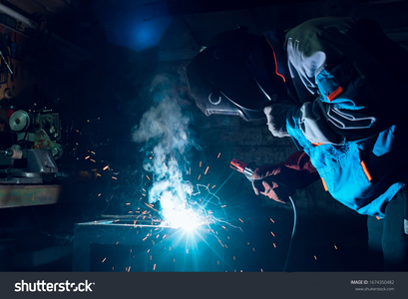
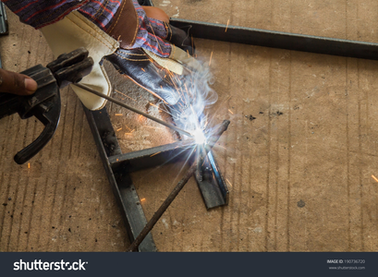
Welding Machine:
Ensure the welding machine and torch are in good working condition.
Have a fire extinguisher readily available and know how to use it.
Wear a welding helmet with the appropriate shade lens to protect your eyes from the arc flash.

Slide 11
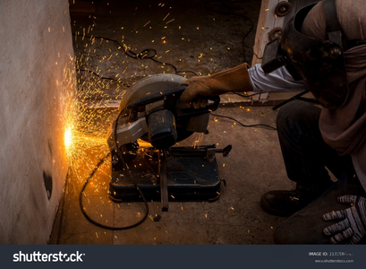
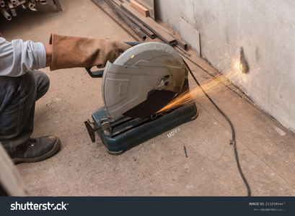

Chop Saw Cutter :
Always wear eye protection and gloves.
Inspect the blade and guard for damage before use.
Secure the material firmly before cutting.
Never reach over or under the blade while it is running.
Use the correct blade for the material being cut.

Slide 12
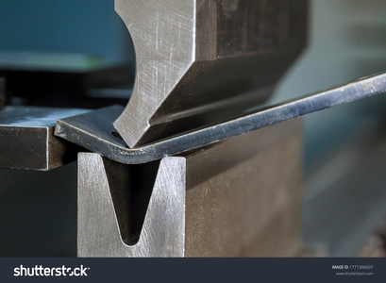
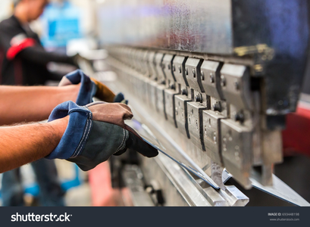
Manual Bending Machine:
Set the ram height and stroke to the appropriate settings for the job.
Make sure the dies are properly aligned and securely installed in the press.
Do not lean over the machine or reach under the ram while it is in motion.
Never place your hands or fingers between the dies or under the ram when the press is in operation.
Do not overload the press.

Slide 13

WIRING & ASSEMBLY SHOP
SAFETY PROCEDURES

Slide 14
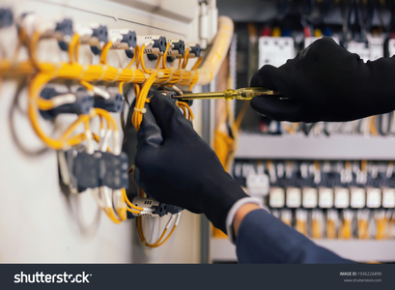
Wiring:
Before starting work, check for damage, sharp edges, or burrs on panels and trays.
Avoid pulling or twisting wires excessively.
Make secure and proper terminations using appropriate tools and connectors.
Work with a partner: Never work alone on energized electrical systems.
Secure wires properly, prevent loose wires and potential hazards

Slide 15
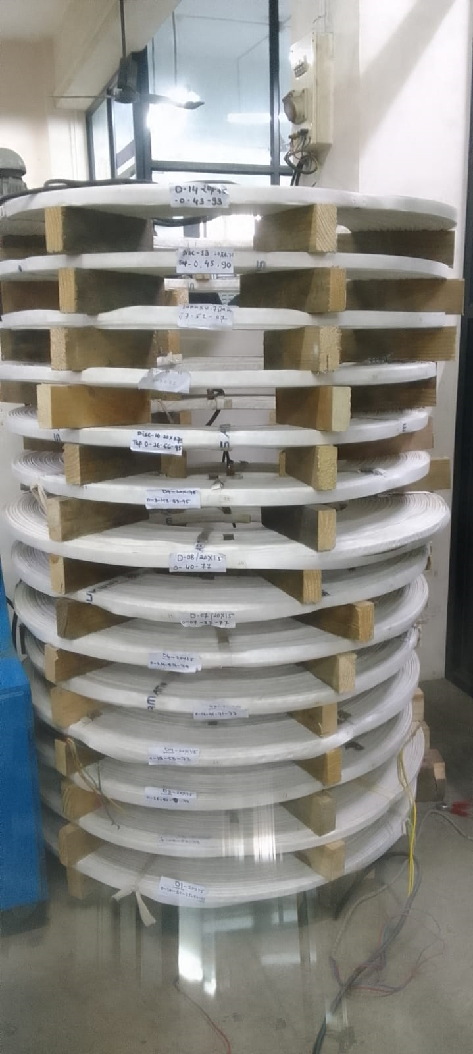
WINDING SHOP
SAFETY PROCEDURES

Slide 16
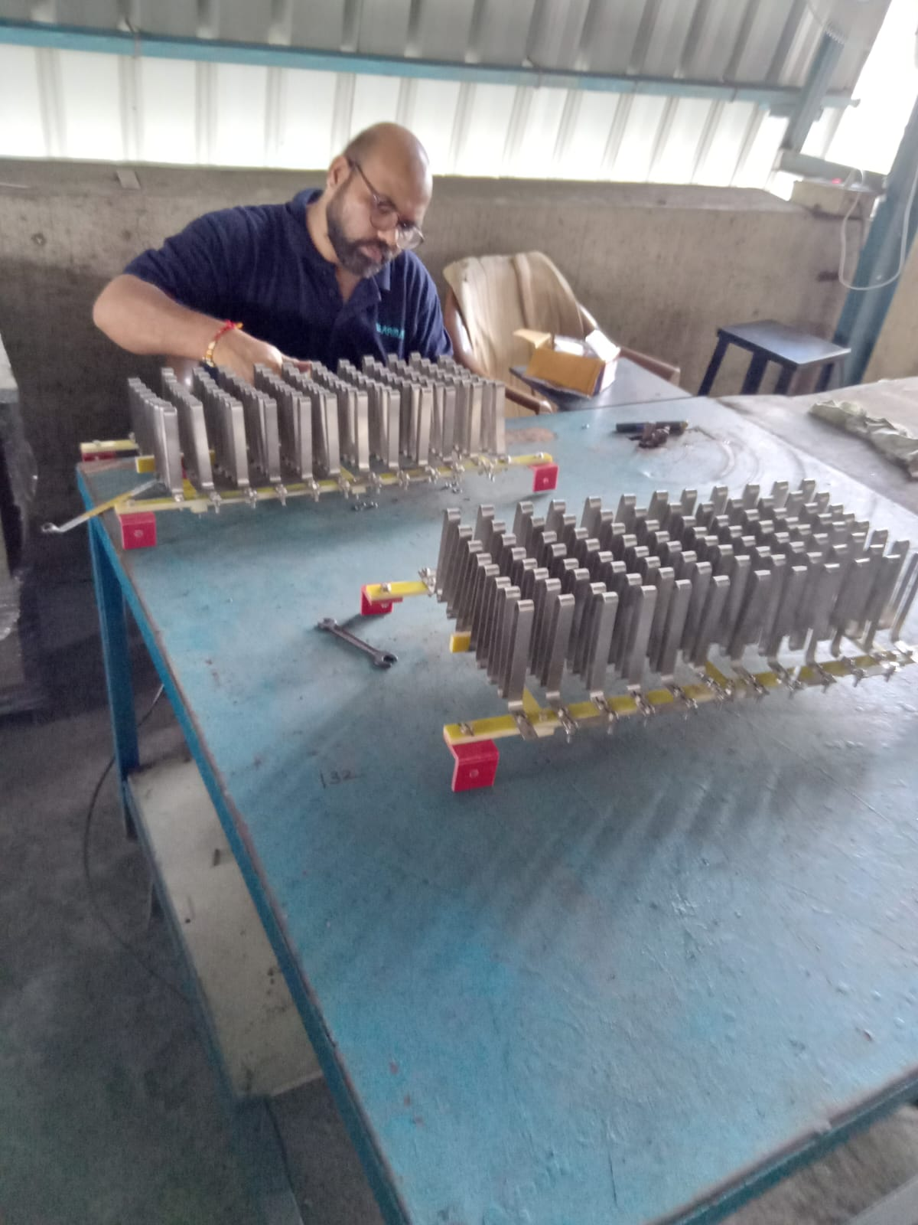
Resistor Winding:
Always wear appropriate personal protective equipment, this includes safety glasses, gloves, shoes.
While operating resistor making machine, pay close attention to the machine's operation.
Ensure it's fully stopped before making any adjustments or clearing Resistor Making Machine.

Slide 17

Reactor Winding:
Always wear appropriate personal protective equipment, this includes safety glasses, gloves, shoes.
While operating reactor machine, pay close attention to the machine's operation.
Wear safety glasses with appropriate shade lenses to shield your eyes from harmful UV radiation, sparks and spatter while brazing.
Be aware of your surroundings and potential hazards.

Slide 18
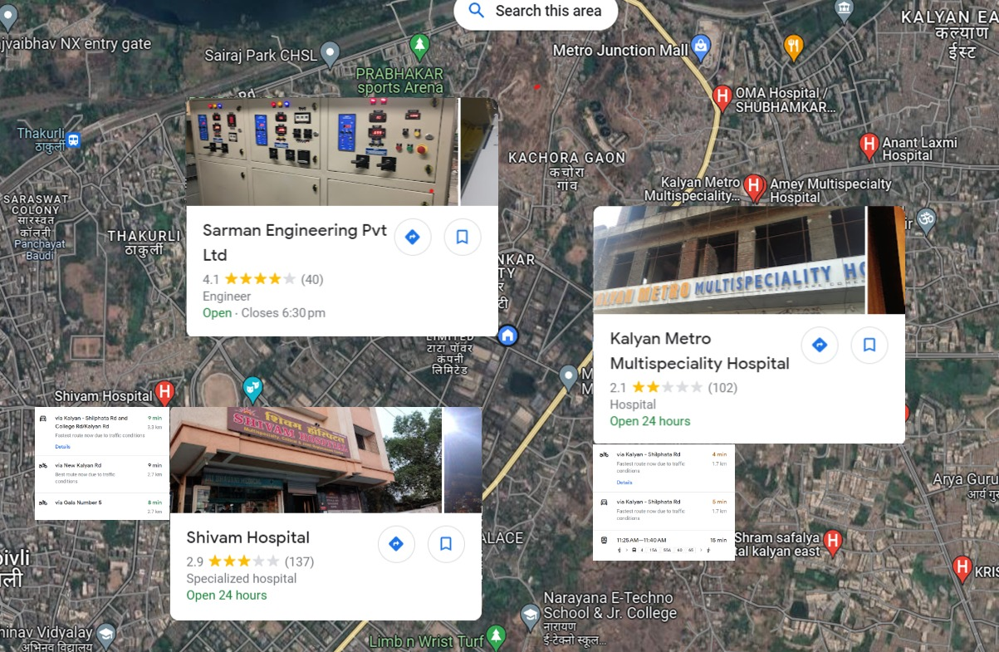
Nearest Multi-specialist hospitals to the SARMAN

Slide 19
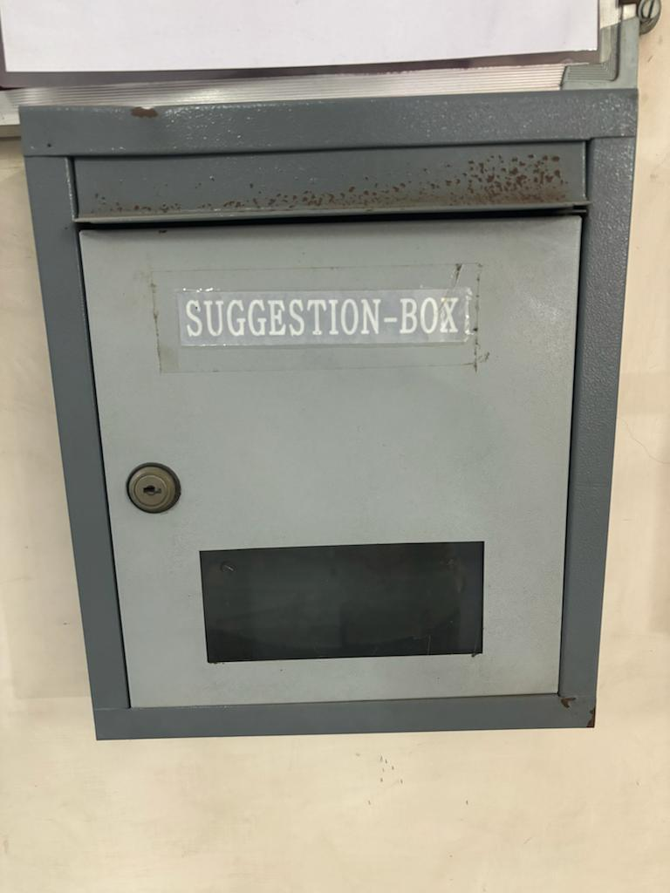
Your suggestions are welcome, kindly give your suggestions through suggestion box placed near project cabin.

Slide 20
THANK YOU
THANK YOU

