Slide 1
LWCW 2022
PENGURUSAN DAN ANALITIK DATA
Australia
AHLI KUMPULAN BIL | NAMA | NO.MATRIK
1. | PUIRSEEN PEREIRA | A183383
2. | KALAIIVANII KRISHNAN | A183382
3. | YANG LOK LEE | A183387
4. | THANASRIY CHANDRAN | A183381

Slide 2

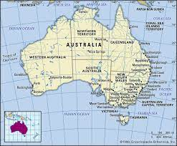
LATAR BELAKANG NEGARA
Australia , secara rasminya dipanggil Komanwel Australia, ialah sebuah negara di Hemisfera Selatan yang terdiri daripada tanah besar yang merupakan benua yang terkecil di dunia, dan sebilangan pulau di Lautan Selatan, Hindi, dan Pasifik .
Tanah besar Australia telah dihuni sejak 60.000 tahun lagi oleh orang-orang asli Australia.
Population Australia ialah 20.6 million.
Australia telah mengekalkan sistem politik demokratik liberal
ndaraya-bandarya tepi pantai seperti Sydney, Melbourne, Brisbane, Adelaide, dan Perth.

Slide 3
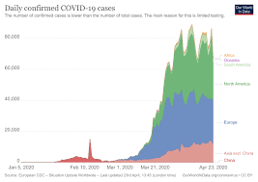
2.0 POLA KES COVID -19
Bilangan Kes Berdasarkan Populasi
Keseluruhan bilangan kes Covid-19 di Austaralia berdasarkan populasi penduduk adalah sebanyak k 170,458 kes Covid-19 telah dilaporkan di Australia termasuk 1,734 meninggal dan lebih kurang 25,917 kes aktif .
Wilayah yang mencatatkan kes covid-19 tertinggi adalah Victoria iaitu sebanyak 91217

Slide 4
POLA KES COVID -19
Tarikh pertama kes jangkitan dan kematian
Menurut Pertubuhan Kesihatan Dunia (World Health Organization) menyatakan kes pertama jangkitan covid-19 di Australia telah disahkan oleh pegawai kesihatan Victoria pada 25 Januari 2020
Pesakit merupakan seorang lelaki warganegara China yang datang ke Melbourne dari Guandong, China pada 19 Januari 2021.
Menurut Ketua Pegawai Kesihatan Austaralia Barat,mengesahkan bahawa pada 1 Mac 2020 terdapat seorang lelaki berumur 78 tahun meningal dunia akibat Covid-19

Slide 5
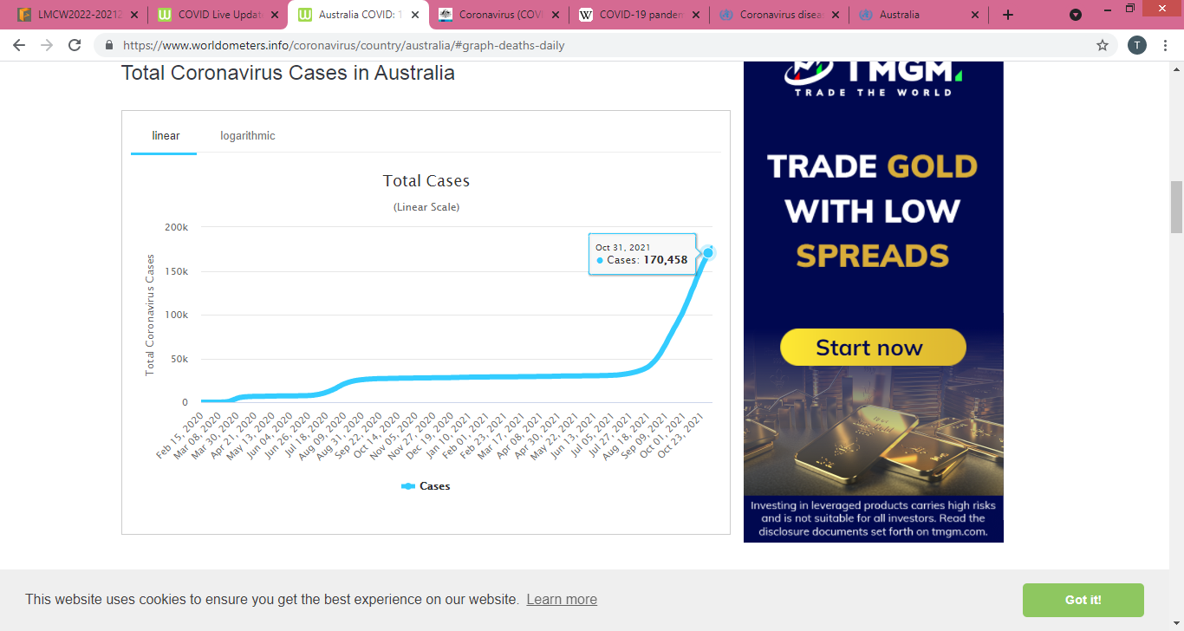
POLA KES COVID -19
Analisa Kes Keseluruhan mengikut bulan
Pada bulan Oktober 2021, kes dilaporkan mula meningkat melebihi 2,000 setiap hari
Pada 01 Oktober 2021 sebanyak 2,048 kes telah dilaporkan dan sepanjang minggu pertama kes paling banyak yang dicatatkan ialah 2,389 kes
Kes paling tinggi yang dilaporkan ialah pada 14 Oktober 2021 iaitu sebanyak 2,688

Slide 6
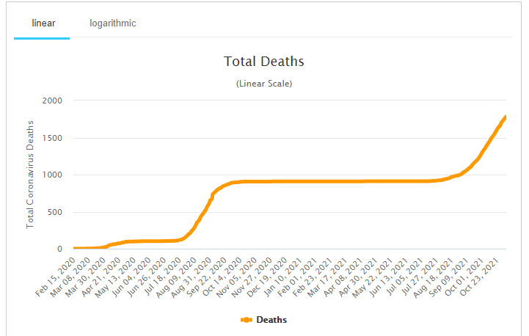
POLA KES COVID -19
Analisa Kes kematian
Kumulatif kes kematian di Australia mula memasuki empat angka pada awal bulan September dan pada awal bulan Oktober angka mula meningkat melebihi 1,300.
Pada hari pertama hingga akhir bulan Oktober kumulatif kes kematian COVID-19 terus meningkat sehingga mencapai 1,734 kematian pada 31 Oktober 2021

Slide 7
3.0 Polisi kerajaan mengawal pandemik covid-19
Pada 1 Februari 2020, Australia melarang kemasukan warga asing yang pernah ke tanah besar China dan mengarahkan warganegara yang pulang yang telah berada di China mengasingkan diri selama 14 hari.
Australia kemudiannya mengenakan larangan ke atas Iran (1 Mac), Korea Selatan (5 Mac) dan Itali (11 Mac). Mulai 16 Mac, semua pelancong yang tiba atau pulang ke Australia perlu dikuarantin selama 14 hari. Kegagalan untuk mengasingkan boleh mengakibatkan denda $11,000 hingga $50,000 dan kemungkinan hukuman penjara, bergantung kepada negeri. Kapal persiaran juga dilarang berlabuh di negara itu selama 30 hari. Pada 20 Mac, Australia menutup sempadannya kepada semua bukan pemastautin dan bukan Warganegara Australia.
Sehingga Mac 2020, 62 peratus daripada lebih 3,000 kes koronavirus di Australia adalah orang yang pulang dari luar negara.
Sempadan antara negeri mula ditutup pada 19 Mac dan Tasmania mengenakan kuarantin mandatori 14 hari untuk semua pengembara "tidak penting", termasuk penduduk yang pulang. Pada 24 Mac, Australia Barat, Australia Selatan dan Wilayah Utara menutup sempadan mereka dan semua ketibaan rentas negeri mesti dikuarantin selama 14 hari.
Pada 11 April, Queensland melarang ketibaan rentas negeri, dengan hanya penduduk Queensland dan orang yang "diketepikan" dibenarkan masuk. Pada 8 Julai, kerajaan Victoria dan NSW bersama-sama menutup sempadan selepas sejumlah besar kes di bahagian Melbourne.

Slide 8
Polisi kerajaan mengawal pandemik covid-19
pada 2 Julai, semua ketibaan antarabangsa ke Melbourne telah digantung.Pada 9 Julai, pemimpin negeri dan wilayah lain bersetuju untuk mengurangkan penerbangan dan ketibaan ke Australia daripada 8,000 kepada 4,000 seminggu untuk meringankan beban sistem kuarantin hotel.
Pada 29 Januari 2021, keupayaan warga Australia yang terperangkap di luar negara untuk pulang semakin terjejas apabila UK mengharamkan penerbangan terus dari Emiriah Arab Bersatu (UAE) atas kemungkinanpenyebaran varian COVID-19 Afrika Selatan. Kedua-dua syarikat penerbangan Etihad dan Emirates adalah berpangkalan di UAE.
Perintah berkurung semalaman telah diperkenalkan di Victoria pada 2 Ogos 2020, dilanjutkan pada 13 September dan digantung pada 27 September. Seorang hakim Mahkamah Agung telah memutuskan perintah berkurung adalah sah.
Pada 18 Mac 2020, Australia mengisytiharkan kecemasan biosekuriti manusia kerana ancaman terhadap kesihatan manusia yang ditimbulkan oleh pandemik COVID-19, berikutan mesyuarat Majlis Keselamatan Negara, Menteri Kesihatan melarang kapal persiaran antarabangsa memasuki pelabuhan Australia. Larangan itu akan berlangsung sehingga 17hb seawal Disember 2021. Kabinet Negeri bersetuju pada 20 Mac untuk peraturan berkurung sosial sebanyak empat meter persegi (43 kaki persegi) bagi setiap orang di mana-mana ruang tertutup, yang akan dikuatkuasakan melalui undang-undang negeri dan wilayah.
Pada 22 Mac 2020, kerajaan NSW dan Victoria mengenakan penutupan mandatori perkhidmatan yang tidak penting, manakala kerajaan Australia Barat dan Australia Selatan menguatkuasakan penutupan sempadan.
Polisi kerajaan mengawal pandemik covid-19

Slide 9
3.2 Implementation of vaccination programs at the National level

Slide 10
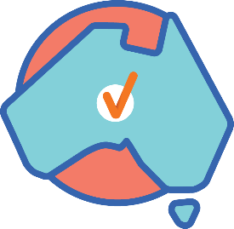

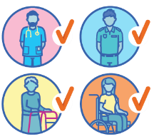
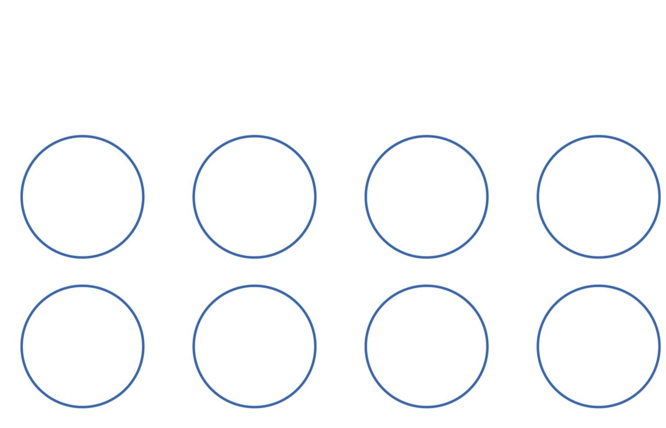


Total vaccine doses
42,598,706 total vaccine doses administered nationally as at 30 December
Data as at: 30 Dec 2021
19,456,324
dose
94.4%
+160,279
recorded in the last 24 hours
of people over the age of 16 have had at least one dose
18,845,485
NSW
13,699,859
(+38,138 daily increase)
VIC
11,312,029
(+30,301 daily
increase)
QLD
8,223,175
(+40,151 daily increase)
WA
4,091,426
(+28,797 daily increase)
people are fully vaccinated
91.4%
of people over the age of 16 are fully vaccinated
2,380,356
people over the age of 16 who have received more than two doses
TAS
937,239
(+3,216 daily increase)
SA 2,875,069
(+15,964 daily increase)
ACT 1,039,335
(+2,409 daily increase)
NT 420,574
(+1,303 daily increase)
*Administration state breakdown indicates state in which a vaccine was administered
**Overall dose count includes instances of more than two doses per person in a small number of cases.
Source: Australian Immunisation Register
10

Slide 11
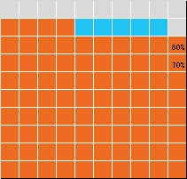
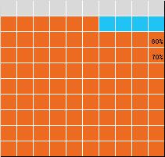
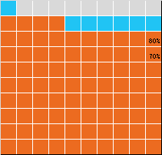
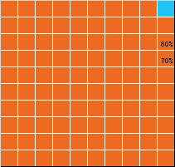
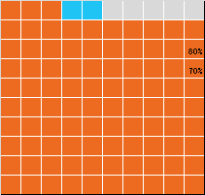
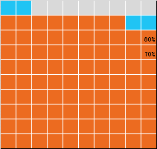
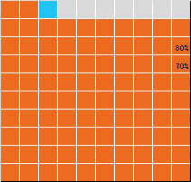

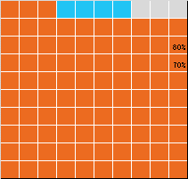
Vaccinations by state of residence
NT
89.2% 1st dose
84.3% 2nd dose
QLD
90.7% 1st dose
86.6% 2nd dose
Data as at: 30 Dec 2021
First doses
Age | Today | 4 weeks ago | 8 weeks ago
16+ | 94.4% | 93.0% | 89.5%
50+ | >95% | >95% | >95%
70+ | >95% | >95% | >95%
WA
91.5% 1st dose
84.1% 2nd dose
ACT
95% 1st dose
95% 2nd dose
NSW
95% 1st dose
93.6% 2nd dose
Fully vaccinated
Age | Today | 4 weeks ago | 8 weeks ago
16+ | 91.4% | 88.0% | 80.3%
50+ | >95% | 94.7% | 88.8%
70+ | >95% | >95% | 93.6%
SA
92.3% 1st dose
88.0% 2nd dose
VIC
93.8% 1st dose
92.4% 2nd dose
TAS
95% 1st dose
93.0% 2nd dose
*Residential state may differ from the state in which a vaccine was administered
11

Slide 12
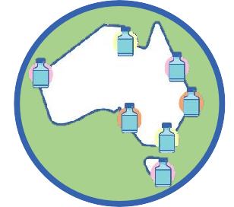

Commonwealth and Jurisdiction vaccine doses administered
42,598,706 total vaccine doses administered nationally as at 30 December
+ 160,279 recorded in the last 24 hours
Data as at: 30 Dec 2021
16,992,379
doses administered by state
and territory facilities
+ 39,131
recorded in the last 24 hours
NSW | Jurisdictions | Commonwealth
Cumulative | 4,386,217 | 9,313,642
Daily increase | 4,251 | 33,887
TAS | Jurisdictions | Commonwealth
Cumulative | 492,281 | 444,958
Daily increase | 641 | 2,575
25,606,327
doses administered by
commonwealth facilities
+ 121,148
VIC | Jurisdictions | Commonwealth
Cumulative | 4,936,981 | 6,375,048
Daily increase | 3,808 | 26,493
SA | Jurisdictions | Commonwealth
Cumulative | 1,341,368 | 1,533,701
Daily increase | 6,044 | 9,920
QLD | Jurisdictions | Commonwealth
Cumulative | 3,238,908 | 4,984,267
Daily increase | 11,813 | 28,338
ACT | Jurisdictions | Commonwealth
Cumulative | 532,425 | 506,910
Daily increase | 998 | 1,411
recorded in the last 24 hours
24,433,126 total vaccine doses administered in primary care settings 1,173,201 total vaccine doses
administered in aged care and disability settings
WA | Jurisdictions | Commonwealth
Cumulative | 1,818,182 | 2,273,244
Daily increase | 10,999 | 17,798
NT | Jurisdictions | Commonwealth
Cumulative | 246,017 | 174,557
Daily increase | 577 | 726
Source: Australian Immunisation Register
12

Slide 13
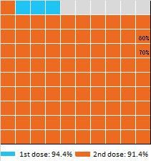
Vaccine milestone charts
Data as at: 30 Dec 2021
Doses Administered by Week
Doses by administration month and vaccine type
AZ - Vaxzevria Pfizer Moderna
2,500,000
7,000,000
6,000,000
5,000,000
4,000,000
3,000,000
2,000,000
1,000,000
2,000,000
1,500,000
1,000,000
500,000
0
Feb
Mar
Apr
May
Jun
Jul Month
Aug Sep
Oct
Nov Dec
22-Feb 1-Mar 8-Mar 15-Mar 22-Mar 29-Mar 5-Apr 12-Apr 19-Apr 26-Apr 3-May 10-May 17-May 24-May 31-May 7-Jun 14-Jun 21-Jun 28-Jun 5-Jul 12-Jul 19-Jul 26-Jul 2-Aug 9-Aug 16-Aug 23-Aug 30-Aug 6-Sep 13-Sep 20-Sep 27-Sep 4-Oct 11-Oct 18-Oct 25-Oct 1-Nov 8-Nov 15-Nov 22-Nov 29-Nov 6-Dec 13-Dec 20-Dec
Doses Reported
Eligible population percentage coverage
5 days
387,976
7 days
521,910
10 days
1,138,075
14 days
1,710,946
28 days
3,112,773
*Sourced from the Australian Immunisation Register.
*Each square represents 1% of the national population. Squares are filled as milestones are achieved.
13

Slide 14
Doses by age and sex
First and second doses by age and sex
 | 16+ | 50+ | 70+ | 12-15
Dose 1 | 94.36% (19,456,324 doses / 20,619,959 people) | 98.61% (8,628,121 doses / 8,749,703 people) | >99% (3,002,961 doses / 2,934,706 people) | 79.42% (988,022 doses / 1,243,990 people)
Dose 2 | 91.39% (18,845,485 doses / 20,619,959 people) | 96.65% (8,456,724 doses / 8,749,703 people) | >99% (2,938,998 doses / 2,934,706 people) | 73.18% (910,352 doses / 1,243,990 people)
Data as at: 30 Dec 2021
Dose 1
Dose 2
Population
95+
90-94
85-89
80-84
75-79
70-74
65-69
60-64
55-59
50-54
45-49
40-44
35-39
30-34
25-29
20-24
16-19
12-15
Dose 1
54,569 (>99%)
165,120 (>99%)
326,867 (>99%)
542,913 (>99%)
816,302 (>99%)
1,097,190 (>99%)
1,235,667 (98.2%)
1,397,930 (97.3%)
1,456,040 (93.6%)
1,535,523 (98.1%)
1,532,606 (91.4%)
1,566,565 (96.7%)
1,736,109 (94.6%)
1,751,327 (91.0%)
1,687,693 (88.5%)
1,485,459 (86.8%)
1,068,444 (89.4%)
988,022 (79.4%)
Dose 2
50,779 (96.0%)
157,742 (>99%)
316,490 (>99%)
531,067 (>99%)
802,587 (>99%)
1,080,333 (97.8%)
1,215,302 (96.6%)
1,372,598 (95.5%)
1,428,214 (91.8%)
1,501,612 (96.0%)
1,493,511 (89.1%)
1,519,644 (93.8%)
1,674,406 (91.2%)
1,676,356 (87.1%)
1,605,016 (84.2%)
1,409,728 (82.3%)
1,010,100 (84.5%)
910,352 (73.2%)
Female
Male
>99%
>99%
98.5%
>99%
>99%
>99%
>99%
>99%
>99%
>99%
97.8%
>99%
98.7%
98.4%
Age
96.5%
98.0%
92.4%
94.7%
97.0%
>99%
90.8%
91.9%
94.1%
96.1%
97.0%
94.6%
90.3%
87.3%
91.0%
88.6%
87.3%
90.9%
80.3%
87.7%
78.5%
85.5%
 |  |  |  | 1m | 0.8m 0.6m |  | 0.4m 0.2m Population (p | 0m 0.2m ercentages are fi | 0.4m 0. rst dose) | 6m 0.8m 1m
 | AUS | ACT | NSW | NT | QLD |  | SA | ^{TAS} DOH (A | ustralia^{V}n^{IC}Immunisatio | n Regist^{W}er^{A}), ABS (Population)
16 and over - dose 1 | 19,456,324 | 347,186 | 6,237,395 | 170,021 | 3,728,918 |  | 1,329,015 | 430,208 | 5,074,440 | 1,935,285
16 and over - dose 2 | 18,845,485 | 342,325 | 6,144,349 | 160,645 | 3,561,559 |  | 1,268,272 | 409,580 | 4,997,681 | 1,778,973
16 and over - population | 20,619,959* | 344,037 | 6,565,651 | 190,571 | 4,112,707 |  | 1,440,400 | 440,172 | 5,407,574 | 2,114,978
16 and over % with dose 1 | 94.36% | >99% | 95.00% | 89.22% | 90.67% |  | 92.27% | 97.74% | 93.84% | 91.50%
16 and over % with dose 2 | 91.39% | >99% | 93.58% | 84.30% | 86.60% |  | 88.05% | 93.05% | 92.42% | 84.11%
50 and over - dose 1 | 8,628,121 | 134,470 | 2,782,097 | 56,712 | 1,691,044 |  | 653,770 | 215,736 | 2,182,700 | 855,437
50 and over - dose 2 | 8,456,724 | 132,915 | 2,749,828 | 54,954 | 1,648,323 |  | 634,924 | 209,983 | 2,155,405 | 819,687
50 and over - population | 8,749,703 | 127,802 | 2,807,793 | 62,280 | 1,758,855 |  | 674,384 | 220,036 | 2,211,211 | 885,370
50 and over % with dose 1 | 98.61% | >99% | >99% | 91.06% | 96.14% |  | 96.94% | 98.05% | 98.71% | 96.62%
50 and over % with dose 2 | 96.65% | >99% | 97.94% | 88.24% | 93.72% |  | 94.15% | 95.43% | 97.48% | 92.58%
70 and over - dose 1 | 3,002,961 | 43,936 | 985,555 | 11,684 | 580,317 |  | 244,616 | 79,190 | 754,693 | 281,381
70 and over - dose 2 | 2,938,998 | 43,278 | 970,770 | 11,315 | 566,139 |  | 237,297 | 76,929 | 742,561 | 271,408
70 and over - population | 2,934,706 | 39,946 | 962,606 | 12,343 | 577,767 |  | 240,514 | 77,155 | 743,519 | 280,281
70 and over % with dose 1 | >99% | >99% | >99% | 94.66% | >99% |  | >99% | >99% | >99% | >99%
70 and over % with dose 2 | >99% | >99% | >99% | 91.67% | 97.99% |  | 98.66% | >99% | >99% | 96.83%
12 to 15 - dose 1 | 988,022 | 19,737 | 318,172 | 9,988 | 189,572 |  | 61,953 | 20,758 | 271,483 | 88,955
12 to 15 - dose 2 | 910,352 | 19,083 | 305,224 | 8,630 | 168,852 |  | 54,813 | 18,589 | 257,967 | 71,052
12 to 15 - population | 1,243,990 | 19,693 | 390,330 | 13,060 | 270,146 |  | 82,747 | 26,308 | 308,611 | 132,869
12 to 15 % with dose 1 | 79.42% | >99% | 81.51% | 76.48% | 70.17% |  | 74.87% | 78.90% | 87.97% | 66.95%
12 to 15 % with dose 2 | 73.18% | 96.90% | 78.20% | 66.08% | 62.50% |  | 66.24% | 70.66% | 83.59% | 53.48%
*National population will not equal sum of listed jurisdictions due to a small number of people counted in national population residing in some 'other' territories. Sum of state doses will not add to national total as some records
are unable to be geocoded to a State or Territory.
Doses sourced from Australian Immunisation Register, population from ABS ERP June 2020

Slide 15


Data as at:
28 Dec 2021
Updated weekly
Aboriginal and Torres Strait Islander peoples
Number of people vaccinated
Data as at:
11 Oct 2021
Updated weekly
415,514
people over the age of 16 have had at least one dose
78.8%
of people over the age of 16 have had at least one dose
374,181
people over the age of 16 are fully vaccinated
71.0%
of people over the age of 16 are fully vaccinated
173 Ab ₀# | original 50 | commu 27 | nity cont 41 | rolled 12 | health se 3 | rvices ( 21 | ACCHS) 19
ACT | NSW | NT | QLD | SA | TAS | VIC | WA
Medicare Address State## | Individuals Dose 1 | Individuals Dose 1 % | Individuals Dose 2 | Individuals Dose 2 %
Australian Capital Territory | 4,953 | 90.7% | 4,800 | 87.9%
New South Wales | 137,647 | 86.2% | 133,561 | 83.7%
Northern Territory | 39,591 | 84.2% | 34,497 | 73.4%
Queensland | 108,070 | 75.4% | 93,797 | 65.4%
South Australia | 18,694 | 73.6% | 16,211 | 63.8%
Tasmania | 14,416 | 84.9% | 13,336 | 78.5%
Victoria | 35,757 | 88.6% | 34,561 | 85.6%
Western Australia | 42,332 | 66.4% | 32,420 | 50.8%
Unknown/Other Territories | 14,054 | 56.0% | 10,998 | 43.8%
Totals | 415,514 | 78.8% | 374,181 | 71.0.%
42,469
(59.4%)
people aged 12-15 years
have had at least one dose
Source: Australian Immunisation Register
*Identifying as Aboriginal and Torres Strait Islander is optional and the estimated population may be under reported.
**Includes all Aboriginal and Torres Strait Islander peoples who have received a vaccination, not limited to those administered in an ACCHS setting
#ACCHS in the ACT are currently operating as a Commonwealth Vaccine Clinics so not included to avoid double counting
##The above table includes all identified Aboriginal and Torres Strait Islander people who are aged 16 and above by their state of residence.

Slide 16
Aboriginal and Torres Strait Islander peoples
Number of people vaccinated by age
Data as at:
28 Dec 2021
Updated weekly
70+
60-69
50-59
40-49
30-39
20-29
16-19
12-15
0
20,000
40,000 60,000
Individuals Dose 1 Only
80,000
100,000 120,000
Individuals Remaining (AIR)
140,000
160,000
Individuals Fully Vaccinated
Source: Australian Immunisation Register
Doses sourced from Australian Immunisation Register, population from ABS ERP June 2020

Slide 17


Data as at: 30 Dec 2021
Commonwealth primary care
Primary care vaccine administration sites
24,433,126 total vaccine doses administered primary care settings as at 30 December
+ 121,010 recorded in the last 24 hours
5,674 | 137 | 173 | 3,472
GPs | CVCs | ACCHS | Pharmacies
NSW
8,800,833
(+33,757 daily increase)
VIC | QLD | WA
6,114,912 | 4,746,855 | 2,171,656
(+26,580 daily | (+28,586 daily | (+17,616 daily
increase) | increase) | increase)
SA | ACT | NT
1,463,851 | 380,795 | 155,013
(+9,855 daily | (+1,434 daily | (+737 daily
increase) | increase) | increase)
Primary care vaccinations by provider type
 | Doses administered | Daily increase | 7 day increase
General Practice* includes other Commonwealth | 21,251,250 | 61,976 | 189,171
Pharmacy | 3,181,876 | 59,034 | 184,733
TAS
430,036
(+2,504 daily increase)
doses administered to persons
169,175residing in other territories or with
missing residential information
*General practice includes Commonwealth Vaccination Clinics, Aboriginal Community Health Centres, Royal Flying Doctor Service and other Commonwealth vaccination facilities
Source: Australian Immunisation Register

Slide 18

Commonwealth aged care and disability doses administered
Data as at: 30 Dec 2021
1,173,201
(+ 138 last 24 hours)
Total vaccine doses administered in aged care and disability facilities as at 30 December
Number of doses administered as part of the Commonwealth aged and disability care rollout
NSW | VIC | QLD | WA
537,675 | 218,266 | 183,266 | 84,604
(+19 daily | (+82 daily | (+73 daily | (+8 daily
increase) | increase) | increase) | increase)
TAS 21,096 | SA 78,145 | ACT 15,350 | NT 6,645
(+1 daily increase) | (+3 daily increase) | (+5 daily increase) | (-6# daily increase)
 |  |  | doses administered to persons
*Sourced from the Australian Immunisation Register. Includes all persons vaccinated at participating residential aged care, disability and related industry settings.
**State level breakdown indicates the residential location and may not align to the state in which the vaccination occurred.
# Numbers are calculated as difference in daily cumulative reported numbers to allow for historical corrections in all data sources. This can occasionally result in negative numbers, such as for QLD, TAS and NT, where historical details about doses have been updated.
28,154
residing in other territories or with missing residential information
Source: Australian Immunisation Register

Slide 19
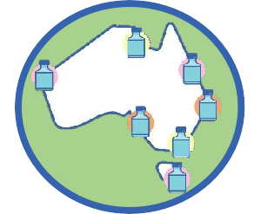
Jurisdiction administered
Data as at: 30 Dec 2021
Total vaccine doses administered in State and Territory clinics as at 30 December
16,992,379 total vaccine doses administered
in State and Territory clinics as at 30 December
+ 39,131 recorded in the last 24 hours
+ 147,139 recorded in the last 7 days
ACT
NSW
NT
VIC
4,936,981
(+3,808 daily increase)
QLD
3,238,908
(+11,813 daily increase)
WA
1,818,182
(+10,999 daily increase)
NSW
4,386,217
(+4,251 daily increase)
QLD
SA
TAS
VIC
TAS
492,281
(+641 daily increase)
SA
1,341,368
(+6,044 daily increase)
ACT
532,425
(+998 daily increase)
NT
246,017
(+577 daily increase)
WA
0
2,000,000
AZ - Vaxzevria
4,000,000 6,000,000
Pfizer Moderna
*Sourced from the Australian Immunisation Register and self-reported data. Numbers are calculated as difference in daily cumulative reported numbers to allow for historical corrections in all self-reported data sources.
Source: Australian Immunisation Register

Slide 20
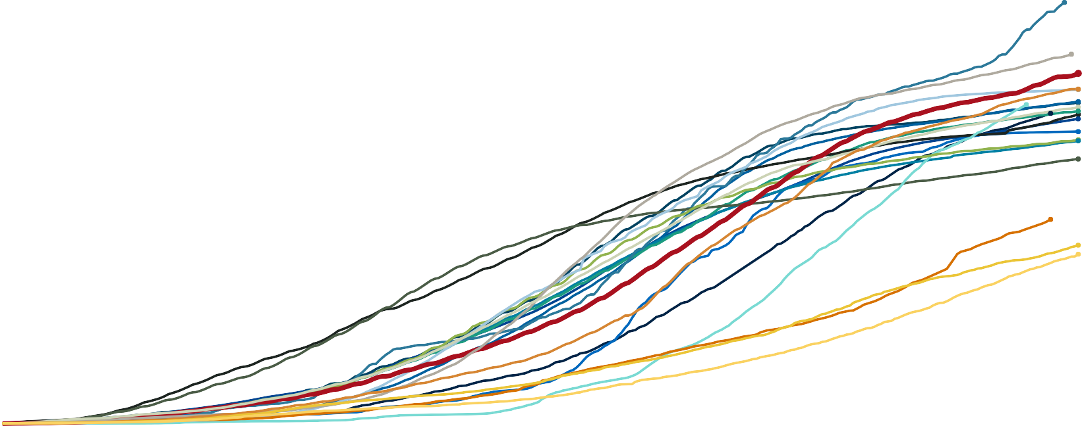
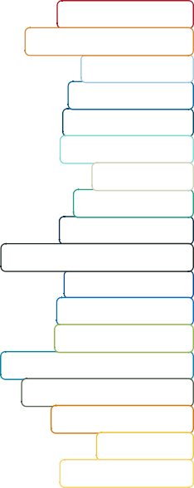
Doses at equivalent stages of rollout (Day 311)
Data as at: 30 Dec 2021
200
South Korea: 199.3
Malaysia: 174.8
Australia: 165.8
New Zealand: 158.3
Japan: 158.1
Canada: 152.4
Belgium: 151.9
Vietnam: 151.0
Italy: 149.7
France: 147.9
Thailand: 146.8
United Kingdom: 146.3
Sweden: 144.2
Sri Lanka: 138.2
Germany: 134.3
European Union: 133.8
United States: 125.2
Philippines: 96.6
India: 84.4
Indonesia: 80.1
Total Vaccinations Per Hundred
150
100
50
0
0
25
50
75
100 125 150 175 200 225 250 275 300 311
Days since first vaccination
Note: From 15 September 2021, data for Australia includes all doses administered to people 12 and over. Prior to 15 September, data was for 16 and over
Due to data revisions, Singapore has been removed from the chart Source: Department of Health (Australia), Our World in Data (international)
Latest data: 30 December

Slide 21
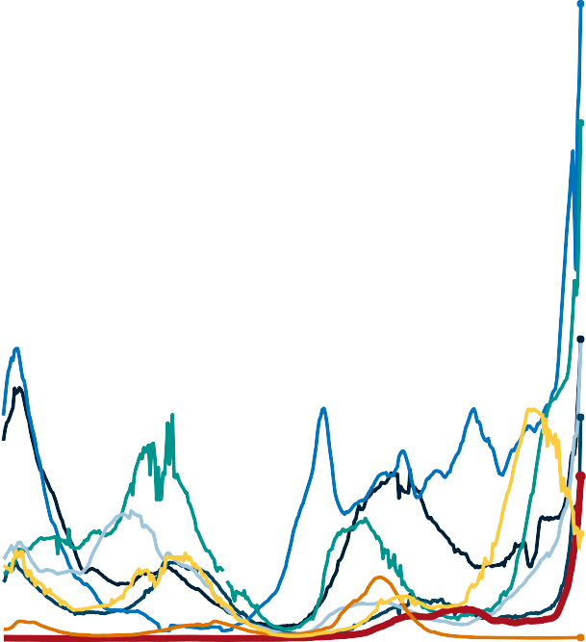

International data – COVID-19
Data as at: 30 Dec 2021
New daily cases per million in 2021, Australia and G7 countries
Smoothed - 7 day average
COVID-19 deaths in past 7 days - Australia and select countries
2,000
10,823
United Kingdom: 1,918
1,500
France: 1,557
Cases per million people
1,000
Italy: 904
United States: 904
Canada: 668
500
Australia: 489
1,854
2,101
Germany: 316
1,256
1,626
1,014
133
141
176
200
207
325
440
517
0
Japan: 2
2
8
9
38
47
51
Jan
2021
Jul
Jan
2022
Source: OWID Data downloaded: 31 Dec 2021 08:12
Latest data: 29 Dec 2021
Source: OWID Data downloaded: 31 Dec 2021 08:12
Latest data: 29 Dec 2021

Slide 22
3.3 Reflection: The Effectiveness of Policy in Dealing with the COVID-19 Pandemic

Slide 23
A whole of government response
When a major health issue like COVID-19 faces the country work with state and territory governments to:
share information so they can provide the best possible care
ensure the response is consistent and integrated across the country.
The whole of government response aims to:
minimise the number of people becoming infected or sick with COVID-19
minimise how sick people become and the mortality rate
manage the demand on our health systems
help citizen to manage their own risk and the risk to their family and community
make COVID-19 vaccines available to everyone in Australia.
Vaccine rollout
They are working hard to ensure everyone aged 12 years and over in Australia has access to a COVID-19 vaccine.

Slide 24
Oral treatments
The first oral treatments for COVID-19 in Australia, Lagevrio (molnupiravir) and Paxlovid (nirmatrelvir + ritonavir), were provisionally approved by the Therapeutic Goods Administration (TGA) on 18 January 2022.
The advantage of these oral medications is that many people will be able to receive treatment for COVID-19 in their own homes without the need to travel to hospital for treatment as an inpatient.
Operation COVID Shield
Operation COVID Shield works to ensure public confidence in the Australian COVID-19 vaccine rollout, and to ensure as many Australians are vaccinated as early as possible.
Rapid antigen test (RAT) distribution
The Australian Government is ensuring RATs are available to the people who need them most, to curb the spread of infection in communities and identify new COVID-19 cases quickly.
Funding of $250 million will be allocated for the continued distribution of RATs to:
Residential Aged Care facilities
Aboriginal Controlled Community Health Services
GP-led Respiratory Clinics

