Slide 1
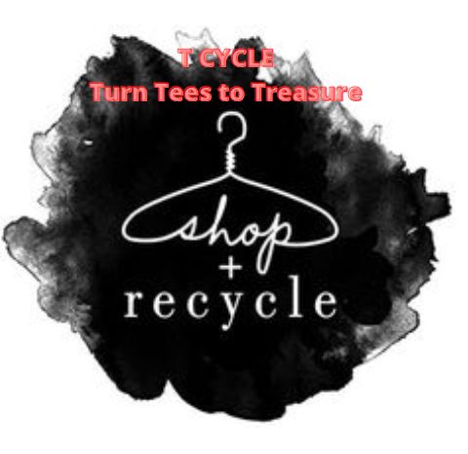
T -Cycle
Turn Tees To Treasure

Slide 2
Introduction
T-cycle is a revolutionary company concept however there are several closely relator rivals who are performing excellent in terms of revenue and brand awareness across Australian and globe.
The sales of second-hand fashion retailers have been dramatically rising in Australia and globally. According to the 2020 resale study issued by ThredUp which is a US based charity shop, the second-hand market encompassing both online and instore is anticipated to reach $36 billion in 2024 and quadruple by 2029 (Masige, 2020).
The report is based on the drafting of a business plan for an second hand clothes shop for the purpose of raising capital. T-cycle is a revolutionary company concept however there are several closely relator rivals who are performing excellent in terms of revenue and brand awareness across Australian and globe.
The sales of second-hand fashion retailers have been dramatically rising in Australia and globally. According to the 2020 resale study issued by ThredUp which is a US based charity shop, the second-hand market encompassing both online and instore is anticipated to reach $36 billion in 2024 and quadruple by 2029 (Masige, 2020). Australia has a large population of female residents. A startup firm is required to create and carry out a broad variety of tasks.business methods for the successful and efficient start-up of a company As a result, the study includes the most importantbusiness tactics that were engaged in the continuance of a company The key tactics that have been addressed include the following:
For both the starting and ongoing operations, sales and marketing, operational and financial planning are necessary.the continuation of the business T Cycle Store will be the name of the firm.
Clothing, shoes, and accessories are available for purchase online, and are targeted specifically towards the female population of Australia. TheIn addition, the research discusses the techniques used in luring women to its stylish and upscale establishments.Products and services that are fashionable.

Slide 3
SWOT Analysis
Strength
• Low-cost apparel goods such as pillows, cushions, and blankets made from recycled clothing.
• T-cycle makes use of what they already have rather than developing new things that need a large amount of nonrenewable resources, and the process of creating a product is ecologically beneficial.
• T-cycle has a revolutionary business concept involving the conversion of old clothing into various needed items via the use of shredding machinery.
Opportunities
• Raise awareness about the importance of recycling and reusing.
• Inspire consumers to adopt a more sustainable and healthy apparel purchase behaviour, which will immediately contribute to a more sustainable and healthy environment.
• Because of the wonderful objective and ideals of T-cycle, it has a great chance of receiving financial and advisory assistance from non-profit organisations and governmental agencies.
Weakness
• Being a fresh concept, it has the potential to be a huge success on the market; yet, there are unknown implications and a possible risk of loss owing to company management problems.
• There are just a few concepts and ideas for the present and future fashion trends.
• Recycling practises that are traditional. People, for example, may develop an emotional tie to the things they are wearing.
Threat
• Economic manipulation and change in laws in a chaotic globe.
• A greater danger of relying on direct financing from other corporations while also having less control over this
• Alternative apparel retailers such as Ikea and Kmart have been able to meet the needs of their customers by offering higher-quality items at lower prices.

Slide 4
Porter’s 5-forces
Threat of Entrants | Threat of substitute Products | Bargaining Power of Buyers | Bargaining Power of Suppliers | Rivalry Among Existing Competitors
However, the industry that T-cycle incorporated is novel and limited. The operational cost of business set up and strategies could be achievable and there is medium risk of new entrants in this business. Likewise, the current world is focusing on environmental conservation and our idea could be a vision for other new start up corporations. | T-cycle products incudes pillows, cushions and blankest which are easily accessible on stores such as H &M and Kmart. However, the meaningful impact to environment and cheaper price would make T-cycle’s substitutes products threat low. Additionally, people are reusing their old clothes as another form of clothes by recycling. | Although having great vision of T-cycle, being a new business must rely on customer’s satisfaction and cheaper price. The bargaining power of T-cycle is between medium and low because the price is already cheaper, and company has a great vision of recycling old clothes. T-cycle would need to bring more variation on its product and try to higher qualities by adding materials as silk and cotton with old, shredded clothes. | The bargaining power of suppliers for T-cycle is medium because they collect the unwanted old clothes that has not been used properly. People would be more satisfied due to that solution because there has been poor management of old, unwanted, and seasonal clothes. | The shredding equipment and innovative idea of recycling old clothes is unique and novel in Australian recycle market. The competition is relatively low for T-cycle however, the brand recognition and marketing would be a major concern for T-cycle.

Slide 5
Situation Analysis (Problem Statement)
Because of the covid pandemic, overall income will drop by 24 percent, to 5.9 billion pounds, from January to September 2020. (Mintel, 2020).
Due to the covid epidemic, T cycle does not spend as much in marketing. There has been a consistent rise in online buying activities as a consequence of the pandemic.
T cylce does not participate in online shopping because to poor profit margins and high shipping costs, especially when considering the profitability of low-cost apparel. (Mintel,2020)

Slide 6
Inventory
There must be sufficient storage space and organisation of the requisite amounts of goods in the storeroom. The failure to achieve the levels of profitability necessary as a result of inadequate stocks is a major problem. The fact that the apparel they have selected is out of stock or unavailable at the time they demand will not sit well with those who have placed an order online. As a result, it must meet all of the needs and requirements for the upkeep of inventories and inventory records (Bergh 1\2016).The owners should also give consideration to the possibility of giving discounts near the season's end in order to transfer the excess inventory that has resulted as a consequence of the narrowing of profit margins.They must use caution in setting the prices of the items in such a way that the shop will benefit from the sale of the products. Due to the fact that this is a new company, the owners may also have to negotiate with clothes wholesalers in order to set up a scheme for purchasing back the leftover clothing stock that is now in the firm (Nielsen 2015)

Slide 7
Finance
The following are the most important aspects in developing a financial plan:
Maintaining a profit margin of around 15 to 20 percent while also paying careful attention to daily expenses as well as the cost of products sold are all important considerations.
The goal is to turn inventory around about five times while still generating revenue.
Through the use of social media and other forms of advertising, it is possible to increase awareness while also increasing sales.

Slide 8
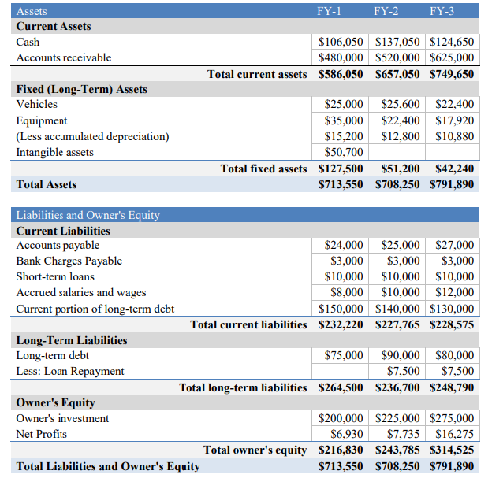
Balance Sheet

Slide 9
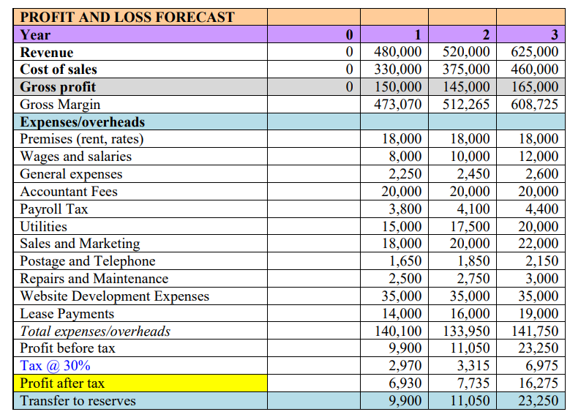
Profit and loss Forecast

Slide 10
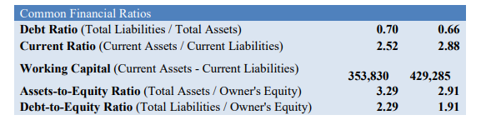
Common Financial Ratio Forecast

Slide 11
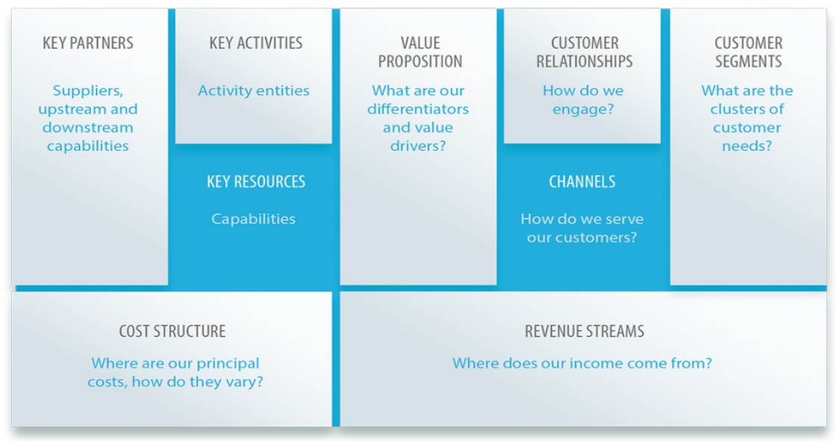
Buisness model

Slide 12
Competitive Strategy & Positioning
T-cycle is a revolutionary company concept however there are several closely relator rivals who are performing excellent in terms of revenue and brand awareness across Australian and globe.
The sales of second-hand fashion retailers have been dramatically rising in Australia and globally. According to the 2020 resale study issued by ThredUp which is a US based charity shop, the second-hand market encompassing both online and instore is anticipated to reach $36 billion in 2024 and quadruple by 2029 (Masige, 2020).
Similarly, a designer named Christopher Raeburn has established a new collection shop called Raeburn by gathering leftover military goods from the U.K and Europe which has formed following results of COVID-19 and environmental concerns (Conti, 2020).
There is a vast potential market for the recycle business and competitive strategy analysis would enable T-cycle to fulfil its aim

Slide 13
PESTLE (Political, Economic, Social, Technological, Legal and Environmental) analysis:
• Political: The recent Russian invasion of Ukraine has resulted in a steady rise in the price of coal, which has resulted in higher power costs (Foley, 2022). It has had a direct impact on the power bills created by companies such as recycling, retail, and others, which will result in a fall in sales income as a result. There have been various nations who have had disagreements with Australia's political government in the past. The possibility for political unrest between China and Australia would be a huge source of worry for present and prospective Australian businesses, such as T-cycle, in particular.reinvent itself with a new campaign that the new vi. generation can relate with, and encourage them to take the initiative to make a better future for themselves and their families.the organisation should reinvent itself with a fresh campaign that the new viii. generation can relate with, and empower them to take the initiative to make a better future a reality.One of the charity organisations that helps people via strategically focused programmes that include helping the homeless, providing elderly care, disaster recovery, providing emergency assistance, and providing youth support, among other things, is one that operates under a multinational approach.
• Economic: Following the emergence of covid-19, several companies have discovered alternate methods of producing revenue for their operations. The present Australian economy is stronger than it will be in 2021 as a result of financial backing being made available to businesses. The adoption of digital currencies such as bitcoin and NFT might be a game-changing factor for Australian businesses. T-cycle should take into account the most recent trends in people's purchasing habits while designing their recycled garments, as well as picturing their outstanding social message and being current with the internet world.
• Social: The recycling industry is backed by society, and individuals have made contributions to the consumption of recycled clothing as well as to the encouragement of organisations such as Vinnies and the Salvation Army, among others. The Australian government is permitting a maximum number of overseas students and immigrants to enter the country in order to boost the country's economy and talent resources. The diverse population of Australia may have a variety of cultural backgrounds and approaches to depicting the concept of the T-cycle. T-cycle should perform a thorough examination of current immigration rules, as well as an awareness of how a diverse population approaches the company, in order to build brand and product recognition for their products
.• Technological: Retail sectors in Australia have been concentrating on internet commerce and strengthening the platforms as a result of the covid-19 epidemic. The CEO (Chief executive officer) of Thredup, James Reinhart, has anticipated tremendous increase in online purchasing, particularly among young people. 2022) (Grimmer and Grimmer, 2002). Currently, the working environment may be anywhere from an office to a remote location, and cryptography is becoming more popular in Australia. As a result, T-cycle should include contemporary artificial intelligence and machine learning, as well as the use of internet platforms and digital marketing strategies.
• Legal: The Australian business model has been enshrined in Australian business and environmental legislation, as well as the Privacy Act, in order to foster an ethical business climate and safeguard society. T-cycle should always be kept up to date with the most recent regulations since Australian legislation may change at any time. For example, under the Privacy Act personal storage, T-cycle is required to explain the use of sensitive information and to indicate the date and time of disclosure. Given the dramatic nature of T-objective, cycle's it should preserve the company's identify, and they should adhere to the standards set out by Australian law and regulations.
• Environmental: It is anticipated that the rising number of retailers that recycle old garments, as well as their online presence, would see a considerable growth as a result of the improvement in the environment (Grimmer, and Grimmer, 2022). Although there has been waste of garments from such charity stores, T-cycle aims to fill the void by turning them into items such as pillows and cushions, which they sell online. The recent flooding in Sydney is an illustration of climate change's effects, and T-cycle should take such an incidence into consideration as a possible future hazard. Additionally, the garments are utilised according to the season, and T-cycle must examine the quantity of manufacturing and suppliers in Australia in order to keep up with the changing weather there.

Slide 14
Recommendation
• Further segmentation in order to find and create new product lines
• Development of an online platform (e-commerce website)
• Gathering market knowledge
• Obtaining endorsements
• Visual Merchandising and the application of technology into retail establishments

Slide 15
Reference
Barney, J. B., and Hesterly, W. (2015). Strategic management and competitive advantage concepts and cases. Pearson.
Bergh, D. D., Aguinis, H., Heavey, C., Ketchen, D. J., Boyd, B. K., Su, P., ... and Joo, H. (2016). Using meta‐analytic structural equation modeling to advance strategic management research: Guidelines and an empirical illustration via the strategic leadership‐performance relationship. Strategic Management Journal, 37(3), 477-497.
Bettis, R. A., Gambardella, A., Helfat, C., and Mitchell, W. (2015). Qualitative empirical research in strategic management. Strategic Management Journal, 36(5), 637-639.
Eden, C., and Ackermann, F. (2013). Making strategy: The journey of strategic management. Sage. Goetsch, D. L., and Davis, S. B. (2014). Quality management for organizational excellence.
Upper Saddle River, NJ: pearson. Harrison, J. S., and John, C. H. S. (2013). Foundations in strategic management. Cengage Learning.
Hollensen, S. (2015). Marketing management: A relationship approach. Pearson Education.
Monroe, K.B., Rikala, V.M. and Somervuori, O., 2015. Examining the application of behavioral price research in business-to-business markets. Industrial Marketing Management, 47, pp.17-25. Nielsen, L., 2015. Product Positioning and Differentiation Strategy. Hearst Newspapers.
Pitta, D. & Gurau, C. (2012) ‘A life-stage analysis of consumer loyalty profile: comparing Generation X and Millennial consumers’, Journal of consumer Marketing, 29(2), p.103-113.
Porter, M. (1980) Competitive Strategy. Free Press • Porter, M. E. (2008) Competitive strategy: Techniques for analysing industries and competitors. London: Simon and Schuster.
Reuters. (2014). Primark Plans US Expansion, But Will They Succeed? Available:http://www.businessoffashion.com/2014/07/primark-next-stop-usa.html. Last accessed 3rd June 2021.
Ross, J and Harradine, R. (2010). Value brands: cheap or trendy? Journal of Fashion Marketing and Management. 14 (3), 350-366.
The Economist (2015) Faster, cheaper fashion. Available at: http://www.economist.com/news/business/21663221-rapidly-rising-super-cheap-irish-clothesretailerprepares-conquer-america-rivals-should (Accessed: 5 June 2021).
Thompson, R. (2014) Why power over retail tech is shifting from CIOS. Retail Week. P36
Verdict. (2013). VERDICT VIEW: Should Primark make the leap to online? Available:http://about.datamonitor.com/media/archives/6555. Last accessed 20th June 2021

