Slide 1


NEHRU INSTITUTE OF ENGINEERING AND TECHNOLOGY
(Autonomous)
An ISO 9001:2015 and 14001:2015 Certified Institution,
Affiliated to Anna University, Chennai, Approved by AICTE, New Delhi &
Recognized by UGC with 2(f) & 12 (B), Re- accredited by NAAC “A+”
NBA Accredited UG Courses: AERO| CSE| ECE| EEE| MECH| MCT
Nehru Gardens, T.M. Palayam, Coimbatore- 641 105
MULTI-POSE HUMAN FACE MATCHING SYSTEM USING DEEP LEARNING AND YOLO-V5
Batch Number : 12 Internal Guide :Ms.S.Priya
Batch Member & Reg. No.:
M.Karthik-721421104032 (Team Leader)
S.Manikandan-721421104034
M.Vicky-721421104059
M.Sethuram-721421104043
Notes:
Good day everyone. Today, we are presenting our project titled Multi-Pose Human Face Matching System Using Deep Learning and YOLO-V5. Our team comprises M. Karthik, S. Manikandan, M. Vicky, and M. Sethuram, under the guidance of Ms. S. Priya from the Computer Science and Engineering Department of Nehru Institute of Engineering and Technology.

Slide 2

Abstract
Human face matching across varying poses remains a significant challenge in the field of computer vision, especially for applications involving security, identity verification, and surveillance.
This project presents a Deep Learning-based multi-pose human face matching system that leverages the YOLO-V5 (You Only Look Once) algorithm for efficient and accurate face detection and recognition across multiple poses.
The system is designed to identify and match faces in diverse orientations, including front, left, right, down, and up poses, ensuring robust performance even under challenging viewing conditions
Notes:
The objective of our project is to address challenges in human face matching across varying poses, which is crucial in applications like security and identity verification. We introduce a deep learning-based system using the YOLO-V5 algorithm to efficiently detect and match faces across multiple orientations.

Slide 3
Objective(s)
To develop an efficient deep learning-based system capable of detecting and matching human faces across various poses (front, left, right, up, and down) using MATLAB and the YOLO-V5 algorithm.
To ensure robust face detection and recognition under multi-pose conditions, enhancing the accuracy of face matching for applications in surveillance, authentication, and identity verification systems.
To improve real-time performance for matching human faces across different angles and positions, minimizing false positives and negatives, and increasing the system's adaptability in dynamic environments.
12-02-2025
Notes:
Our primary goals include developing a system capable of recognizing faces in multiple orientations, ensuring robustness in face detection, and improving real-time performance to reduce errors and enhance adaptability.

Slide 4
Introduction
Face recognition systems have gained significant attention in recent years due to their applications in security, surveillance, and authentication systems.
However, traditional face recognition models often face challenges when dealing with variations in face poses, which can lead to decreased accuracy.
To address this limitation, the proposed system introduces a Deep Learning-Based Multi-Pose Human Face Matching System using the YOLO-V5 algorithm for robust and efficient face detection and matching.
This system leverages MATLAB image processing to detect and recognize human faces in various orientations, such as front, left, right, down, and up poses, ensuring that facial recognition is accurate even with pose variations.
12-02-2025
Notes:
Traditional face recognition systems often struggle with pose variations. To overcome these limitations, we propose a deep learning-based system integrated with YOLO-V5 and MATLAB image processing to detect and recognize faces from various angles.

Slide 5
Existing System and Disadvantages
Description
The existing method is presents a multi-pose facial expression recognition system based on a generative adversarial network (GAN) utilizing MATLAB for image processing.
The GAN is designed to normalize and generate frontal facial expressions from multiple poses, allowing robust recognition across varied orientations.
The system preprocesses facial images using landmark detection and alignment, followed by expression augmentation through the GAN.
The generated frontal views are fed into a convolutional neural network (CNN) for classification into predefined emotion categories.
12-02-2025
Notes:
Existing systems rely heavily on generative adversarial networks or GANs. While they can generate frontal views from multi-pose inputs, they suffer from training difficulties, mode collapse, inconsistency, and potential overfitting.

Slide 6
Existing System and Disadvantages
Disadvantages
Training Challenges – GANs are hard to train due to instability and hyperparameter tuning requirements.
Mode Collapse – The generator may produce limited variations instead of diverse outputs.
Inconsistency – Training results can be unpredictable and inconsistent
Overfitting Risk – GANs may overfit small or non-diverse datasets, reducing their generalization ability.
12-02-2025
Notes:
These drawbacks limit their real-world applicability.

Slide 7
Proposed System and Advantages
The Proposed system is designed to identify and match human faces across multiple poses using deep learning techniques.
The core components include face detection, pose classification, and face matching using the YOLO-V5 algorithm and MATLAB image processing tools.
The system is designed to handle the challenge of matching faces captured from different angles (multi-pose).
Utilize MATLAB’s Image Processing for initial image handling and image preprocessing, feature extraction, and interfacing with the deep learning model.
Preprocess the images to enhance detection accuracy by resizing, normalizing, and possibly augmenting the input data with techniques like flipping and rotation.
Apply image filtering and transformation to reduce noise and improve face detection.
12-02-2025
Notes:
Our proposed system leverages YOLO-V5 for faster and more accurate face detection. By combining MATLAB’s preprocessing capabilities with deep learning models,

Slide 8
Proposed System and Advantages
Advantages
The system handles multiple face orientations (front, left, right, up, and down), ensuring adaptability to real-world scenarios.
YOLO-V5 enables fast and efficient real-time face detection, crucial for security, surveillance, and interactive applications.
This multi-pose system enhances security by accurately identifying individuals in various positions, improving safety
12-02-2025
Notes:
We enhance accuracy even under challenging conditions such as occlusions or lighting changes.

Slide 9
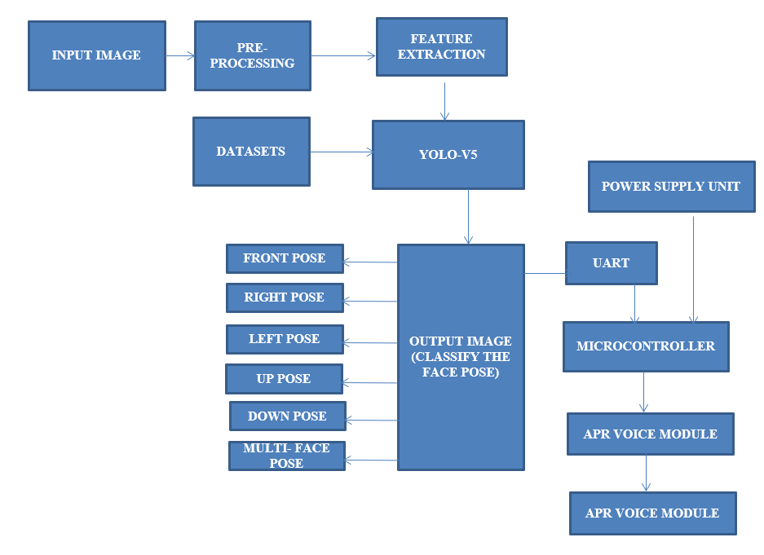
Proposed System/ ARCHITECTURE
12-02-2025
Notes:
This slide illustrates the system architecture. It outlines how image acquisition, preprocessing, and face detection modules interact within our framework to support real-time multi-pose recognition.

Slide 10
Hardware and Software Requirements
Hardware Requirements
POWER SUPPLY UNIT
ARDUINO MICROCONTROLLER
APR VOICE MODULE
SPEAKER
Pc Specifications
PROCESSOR : Intel/Pentium
OS : Windows 10
RAM : 4GB
SYSTEM TYPE : 64-bit
12-02-2025

Slide 11
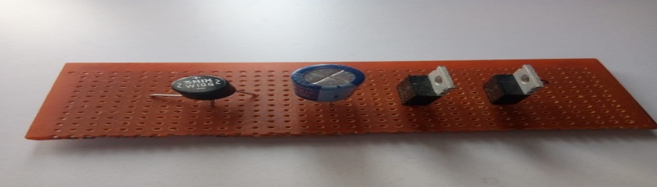
Power supply unit
An AC powered linear power supply usually uses a transformer to convert the voltage from the wall outlet (mains) to a different, usually a lower voltage.
If it is used to produce DC, a rectifier is used. A capacitor is used to smooth the pulsating current from the rectifier.
Some small periodic deviations from smooth direct current will remain, which is known as ripple.
These pulsations occur at a frequency related to the AC power frequency (for example, a multiple of 50 or 60 Hz).
12-02-2025
Notes:
The system includes several hardware components such as the power supply unit, Arduino Uno, APR voice module, and speaker. Each part plays a role in either image acquisition, signal processing, or output delivery

Slide 12
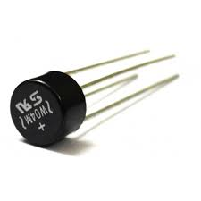
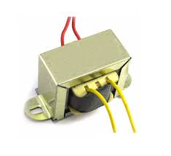
Power supply unit
Step Down Transformer
Input Voltage: 230V AC.
Output Voltage: 12V, 12V or 0V.
Output Current: 1 Amp.
Bridge Rectifier
Input Voltage: 12 V AC.
Output Voltage: 12V DC
12-02-2025

Slide 13
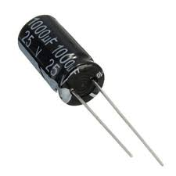
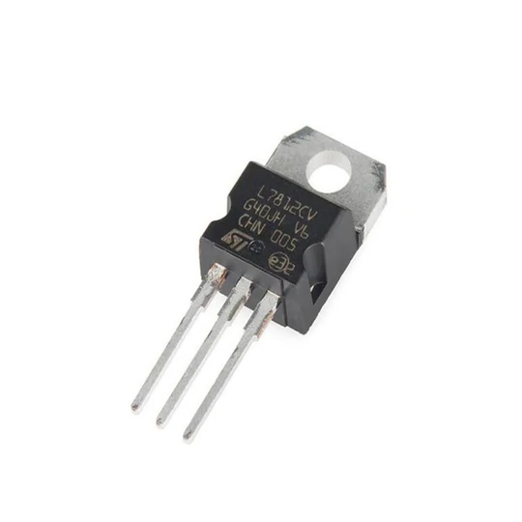
Power supply unit
Capacitor
It filters the unwanted ac signal .
Capacitance: 1000µF
Rated Voltage: 25.0V
Diameter: 10.0mm
Tolerance: ±20%
Voltage Regulator: 7812
Input Voltage Min:12V
Input Voltage Max:35V
Output Current:1.5A
Output Voltage:12v
12-02-2025

Slide 14
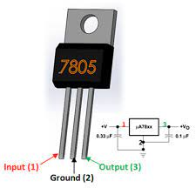
Power supply unit
7805 Voltage Regulator
Three Terminals
Input voltage range 7V- 35V
Output voltage: 5V
Output Current :1A
12-02-2025

Slide 15
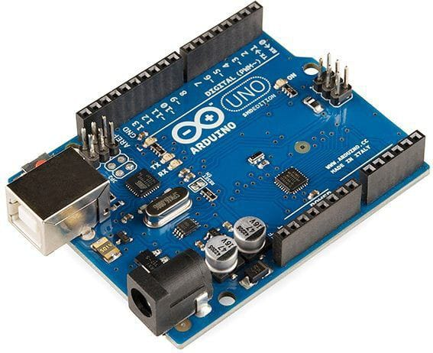
Arduino uno
The Arduino Uno is a popular open-source microcontroller board.It's based on the ATmega328P microcontroller and has 14 digital I/O pins.The board is widely used in education, research, and industry due to its ease of use and flexibility.
SPECIFICATIONS:
Processors: • CPU: ATmega328P 8-bit AVR RISC-based microcontroller operating at 16 MHz, capable of up to 20 MIPS • Memory: 32 KB flash memory (0.5 KB used by bootloader), 2 KB SRAM, 1 KB EEPROM • USB Interface: ATmega16U2 microcontroller for USB-to-serial communication • Operating Voltage: 5V (regulated), with input voltage range from 7–12V (via barrel jack or Vin pin)
12-02-2025

Slide 16
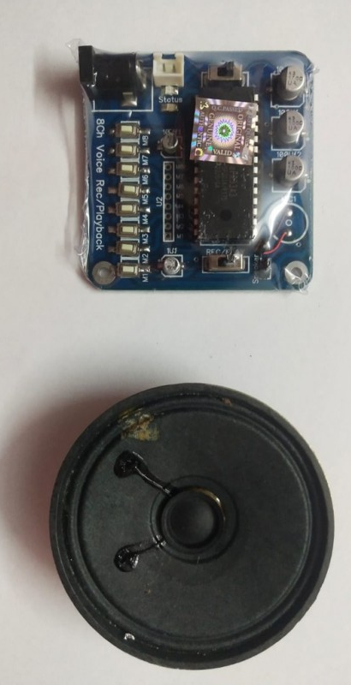
APR VOICE MODULE & SPEAKER
APR9600 is a low-cost high performance sound record/replay IC incorporating flash analogue storage technique. Recorded sound is retained even after power supply is removed from the module. The replayed sound exhibits high quality with a low noise level. Sampling rate for a 60 second recording period is 4.2 kHz that gives a sound record/replay bandwidth of 20Hz to 2.1 kHz. However, by changing an oscillation resistor, a sampling rate as high as 8.0 kHz can be achieved. This shortens the total length of sound recording to 32 seconds.
12-02-2025

Slide 17
Software Requirements
TOOL : MATLAB 2014a
TOOL BOX : Image Processing Tool Box
12-02-2025

Slide 18
  MATLAB
12-02-2025
Notes:
For our software stack, we used MATLAB 2014a, focusing on its Image Processing Toolbox to support data preparation, feature extraction, and model interfacing.

Slide 19
MODULES
  IMAGE ACQUISITION
  IMAGE PRE-PROCESSING
  IMAGE ANALYSIS
12-02-2025
Notes:
Our system modules include Image Acquisition, Pre-Processing, and Image Analysis. Image acquisition converts real-world visuals into digital data. Preprocessing enhances image quality, and image analysis extracts meaningful patterns for recognition.

Slide 20
IMAGE ACQUISITION
Image Acquisition is the first step in any image processing system. The general aim of any image acquisition is to transform an optical image (real-world data) into an array of numerical data which could be later manipulated on a computer.
Image Acquisition is achieved by suitable camera. We use different cameras for different application.
If we need an X-Ray image, we use a camera (film) which is sensitive to XRays.
If we want Infra Red image, we use cameras which are sensitive to InfraRed radiations.
The image is captured by a sensor (eg. Camera), and digitized if the output of the camera or sensor is not already in digital form, using analogue-to-digital convertor
12-02-2025

Slide 21
IMAGE PRE-PROCESSING
Image preprocessing are the steps taken to format images before they are used by model training and inference. This includes, but is not limited to, resizing, orienting, and color corrections
The aim of pre-processing is an improvement of the image data that suppresses unwilling distortions or enhances some image features important for further processing, although geometric transformations of images (e.g. rotation, scaling, translation) are classified among pre-processing methods here since similar
12-02-2025

Slide 22
IMAGE ANALYSIS
Image analysis is the extraction of meaningful information from images; mainly from digital images by means of digital image processing techniques.
Image analysis tasks can be as simple as reading bar coded tags or as sophisticated as identifying a person from their face.
12-02-2025

Slide 23
Conclusion
The system successfully handles multi-pose detection (front, left, right, down, and up poses), overcoming challenges related to facial orientation, occlusion, and lighting.
The use of YOLO-V5 allows for real-time face detection and matching with high precision, making it suitable for applications in security, surveillance, and biometric authentication systems.
This project validates the effectiveness of deep learning models, specifically YOLO-V5, for handling diverse facial poses, ensuring robustness in face recognition systems.
The integration of MATLAB for image processing further enhances the system’s adaptability and real-world implementation.
12-02-2025
Notes:
In conclusion, our system achieves accurate face recognition across various poses using YOLO-V5 and MATLAB. It addresses limitations in existing methods and holds promise for applications in security and biometric verification.

Slide 24
REFERENCES
Y. Kortli, M. Jridi, A. A. Falou, and M. Atri, ‘‘A novel face detection approach using local binary pattern histogram and support vector machine,’’ in Proc. Int. Conf. Adv. Syst. Electric Technol. (IC_ASET), Mar. 2018, pp. 28–33.
I. Adjabi, A. Ouahabi, A. Benzaoui, and A. Taleb-Ahmed, ‘‘Past, present, and future of face recognition: A review,’’ Electronics, vol. 9, no. 8, p. 1188, Jul. 2020.
X. Sun, P. Wu, and S. C. H. Hoi, ‘‘Face detection using deep learning: An improved faster RCNN approach,’’ Neurocomputing, vol. 299, pp. 42–50, Jul. 2018.
M. Bizjak, P. Peer, and Ž. Emeršic, ‘‘Mask R-CNN for ear detection,’’ in Proc. 42nd Int. Conv. Inf. Commun. Technol., Electron. Microelectron. (MIPRO), May 2019, pp. 1624–1628.
D. Li, Z. Li, R. Luo, J. Deng, and S. Sun, ‘‘Multi-pose facial expression recognition based on generative adversarial network,’’ IEEE Access, vol. 7, pp. 143980–143989, 2019.
12-02-2025
Notes:
We have referred to several research publications in the areas of deep learning, face recognition, and image processing, which have significantly informed and validated our approach.

Slide 25
Thank You !!!
16-05-2023
Notes:
Thank you for your attention. We welcome any questions you may have regarding our project

