Slide 1


Slide 2
Time Travel Story

Slide 3
A time machine?
Leo finds a miniature time machine in his bedroom.

Slide 4
He sees future him… he was tiny and there was a girl… whose name seemed to be…Jaya

Slide 5
Leo decides with Jaya to stop time temporarily…

Slide 6
They enter thrilling and dangerous world….
Will they ever return to the present???

Slide 7
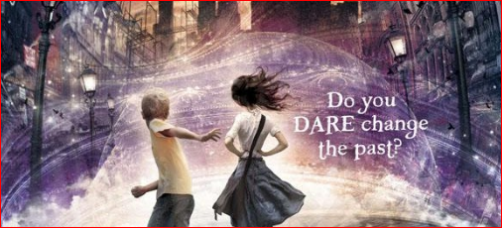

Slide 8
It isn’t just science fiction…
It is fantasy as well…

Slide 9
Do you dare change the past???

Slide 10

A Novel by
Polly Shulman
Visit: ebooks.com

Slide 11
Book Trailer By:
Adriel derek Dsouza 7 h

