Slide 1







BA (Hons) Business Management
BUS5023 – Digital and Social Media Marketing
Part 2 – Presentation: Social Media Audit and Campaign Plan
STU134793
2000 Words

Slide 2
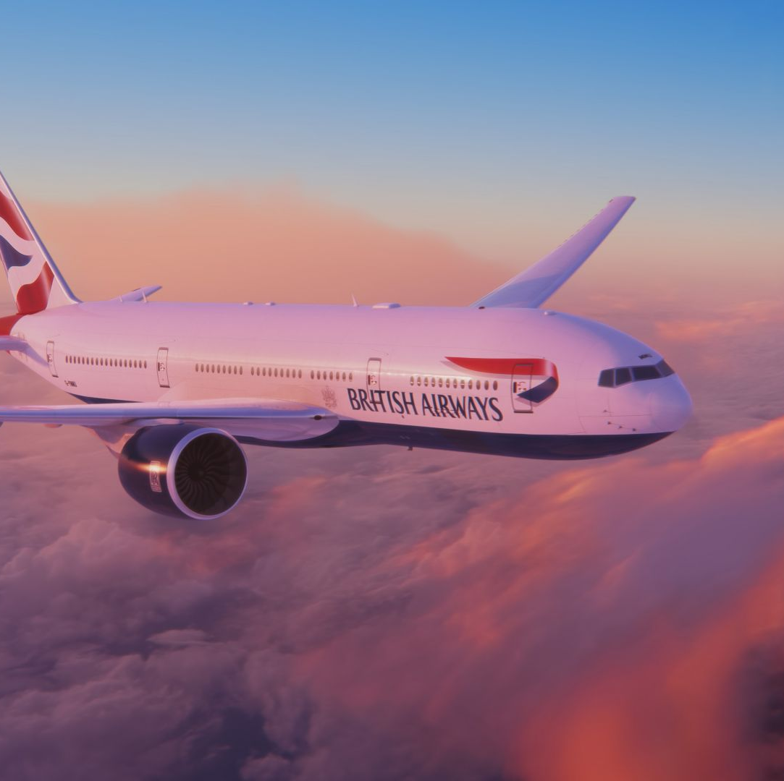
Social Media Audit and Campaign Plan for British Airways
Overview:
The presentation supports all-inclusive audit of British Airway’s existing social media presence and outlines a strategic campaign plan aimed to accouraging engagement, brand awareness and customer loyalty.
Objective of campaign:
To improve British Airway’s social media services effectively to engaging with the target audience, improve brand visibility and drive passenger’s engagement.
Campaign scope:
The campaign will explore major social media channels including Facebook, Instagram, Twitter and LinkedIn.
Notes:
Social Media Audit and Campaign Plan for British Airways
Overview:
The presentation supports all-inclusive audit of British Airway’s existing social media presence and outlines a strategic campaign plan aimed to accouraging engagement, brand awareness and customer loyalty.
Objective of campaign:
To improve British Airway’s social media services effectively to engaging with the target audience, improve brand visibility and drive passenger’s engagement.
Campaign scope:
The campaign will explore major social media channels including Facebook, Instagram, Twitter and LinkedIn.
%%TTS_MALE%

Slide 3
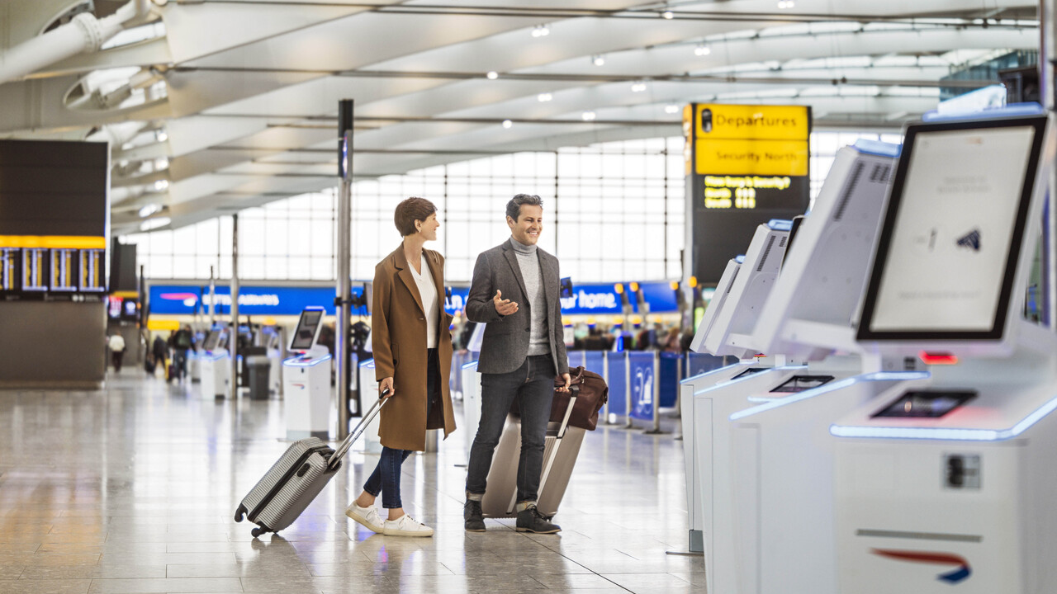
Example of customer persona for British Airways social media campaign
Persona overview: Emma, 35 years old, London, UK, professional in marketing.
Interests and Social media habits: Travel, luxury experiences, sustainability, active on Instagram and LinkedIn, likes travel blogs, and shares vacation photos.
Market segmentation:
Frequent business travellers that flying for work-related purposes.
Leisure travellers are usually families, couples and solo travellers.
Luxury travellers are mostly premium customers that are seeking high end travel experiences.
Eco-conscious travellers are concerned about the sustainability in their travel plans.
Customer needs and pain points:
Frequent business travellers are flawless booking and perfect in-flight experience.
Leisure travellers are exploring for affordable pricing, travel tips and unique experiences.
Luxury travellers are expecting VIP services, exclusive deals and first-class experiences.
Eco-conscious travellers are hoping the airline is commitment to sustainability and eco-friendly travel choices.
Notes:
Example of customer persona for British Airways social media campaign
Persona overview: Emma, 35 years old, London, UK, professional in marketing.
Interests and Social media habits: Travel, luxury experiences, sustainability, active on Instagram and LinkedIn, likes travel blogs, and shares vacation photos.
Market segmentation:
Frequent business travellers that flying for work-related purposes.
Leisure travellers are usually families, couples and solo travellers.
Luxury travellers are mostly premium customers that are seeking high end travel experiences.
Eco-conscious travellers are concerned about the sustainability in their travel plans.
Customer needs and pain points:
Frequent business travellers are flawless booking and perfect in-flight experience.
Leisure travellers are exploring for affordable pricing, travel tips and unique experiences.
Luxury travellers are expecting VIP services, exclusive deals and first-class experiences.
Eco-conscious travellers are hoping the airline is commitment to sustainability and eco-friendly travel choices.
%%TTS_MALE%

Slide 4

Social media campaign objectives
Improve brand awareness:
Goal: Increase visibility of British Airways against target audiences, for example younger travellers and eco-conscious individuals.
Explore metrics and KPIs:
Image and reach on Facebook and Instagram.
Increase in followers across all services.
Relationship rates with customers for example, likes, shares and comments.
Drive Engagement:
Goal: Adopt larger relationship with users through interactive content for example, polls, contests and user-generated content, (UGC).
Explore metrics and KPIs:
Increase amount of user's interactions for example, comments, shares and UGC submissions.
Applications in contests or challenges.
Promote sustainable travel:
Goal: Outline British Airway’s commitment to sustainability in the airline's operations and convince customers to pick eco-friendly traveling chooses.
Explore metrics and KPIs:
Relationship with sustainability-focused posts.
Improve in flow to sustainability-related pages on their websites.
Increase of mentions of British Airway’s green foot initiatives across social media.
Notes:
Social media campaign objectives
Improve brand awareness:
Goal: Increase visibility of British Airways against target audiences, for example younger travellers and eco-conscious individuals.
Explore metrics and KPIs:
Image and reach on Facebook and Instagram.
Increase in followers across all services.
Relationship rates with customers for example, likes, shares and comments.
Drive Engagement:
Goal: Adopt larger relationship with users through interactive content for example, polls, contests and user-generated content, (UGC).
Explore metrics and KPIs:
Increase amount of user's interactions for example, comments, shares and UGC submissions.
Applications in contests or challenges.
Promote sustainable travel:
Goal: Outline British Airway’s commitment to sustainability in the airline's operations and convince customers to pick eco-friendly traveling chooses.
Explore metrics and KPIs:
Relationship with sustainability-focused posts.
Improve in flow to sustainability-related pages on their websites.
Increase of mentions of British Airway’s green foot initiatives across social media.
%%TTS_MALE%

Slide 5
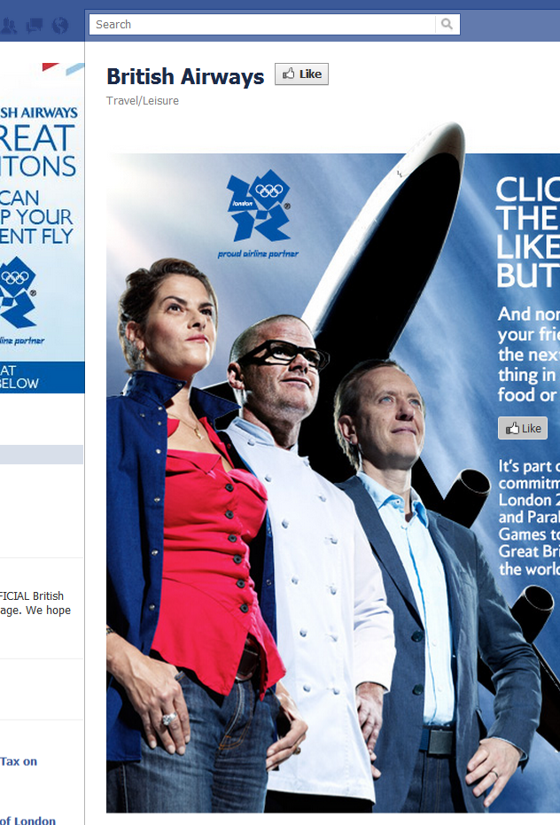
Social media strategies to success of British Airways objectives
User-Generated Content (UGC):
Engage passengers to share their travel experiences with the airline by using a certain hashtags.
Offer reward UGC application with discounts, shoutouts or the chance to win free tickets.
Storytelling:
Offer customers to showcase their stories like behind the scenes content from the airline and testimonials that outline the brand values.
Showcase the passenger’s journeys from the booking to landing and pinpoint in how the airline made sure that all operations have run smooth, comfortable and sustainable.
Interactive content:
Offer contest that motivates customers to engage directly with the airline for example, “Dream Travel Destination” competition.
By providing polls and quizzes to educate customers about the airline’s services, sustainability efforts and new routes.
Paid advertising:
Adopt a targeted Instagram and Facebook adverts that are aimed at certain demographics for example, business travellers, eco-conscious customers or families.
Outline key promotions, exclusive deals and sustainable travel choses.
Notes:
Social media strategies to success of British Airways objectives
User-Generated Content (UGC):
Engage passengers to share their travel experiences with the airline by using a certain hashtags.
Offer reward UGC application with discounts, shoutouts or the chance to win free tickets.
Storytelling:
Offer customers to showcase their stories like behind the scenes content from the airline and testimonials that outline the brand values.
Showcase the passenger’s journeys from the booking to landing and pinpoint in how the airline made sure that all operations have run smooth, comfortable and sustainable.
Interactive content:
Offer contest that motivates customers to engage directly with the airline for example, “Dream Travel Destination” competition.
By providing polls and quizzes to educate customers about the airline’s services, sustainability efforts and new routes.
Paid advertising:
Adopt a targeted Instagram and Facebook adverts that are aimed at certain demographics for example, business travellers, eco-conscious customers or families.
Outline key promotions, exclusive deals and sustainable travel choses.
%%TTS_MALE%

Slide 6

Seven-day content plan calendar for social media campaign
Monday
Instagram. Customer testimonial post that showcasing a family trip to a high traffic destination. To Improve motivation with personal stories.
Tuesday
Twitter. Run a poll about the high traffic travel spots for business professionals. To increase the interaction and insights.
Wednesday
Facebook. Post articles to share about British Airway’s sustainability efforts. Increase awareness on sustainability.
Thursday
LinkedIn. Share about British Airway’s new professional travel packages and benefits. Motive business travelers and promote business to business services.
Friday
Instagram stories. Offer behind-the-scenes tour of a British Airway’s flight experience. Personalize the brand and share the luxury services offered.
Saturday
Twitter. The support of User-generated content to post featuring a passenger’s holiday photo with a certain caption.
Sunday
Facebook or Instagram. Run a contest like, “Win a free round-trip ticket”. Motivate the customers to feel excitement and improve user participation.
Notes:
Seven-day content plan calendar for social media campaign
Monday
Instagram. Customer testimonial post that showcasing a family trip to a high traffic destination. To Improve motivation with personal stories.
Tuesday
Twitter. Run a poll about the high traffic travel spots for business professionals. To increase the interaction and insights.
Wednesday
Facebook. Post articles to share about British Airway’s sustainability efforts. Increase awareness on sustainability.
Thursday
LinkedIn. Share about British Airway’s new professional travel packages and benefits. Motive business travelers and promote business to business services.
Friday
Instagram stories. Offer behind-the-scenes tour of a British Airway’s flight experience. Personalize the brand and share the luxury services offered.
Saturday
Twitter. The support of User-generated content to post featuring a passenger’s holiday photo with a certain caption.
Sunday
Facebook or Instagram. Run a contest like, “Win a free round-trip ticket”. Motivate the customers to feel excitement and improve user participation.
%%TTS_MALE%

Slide 7
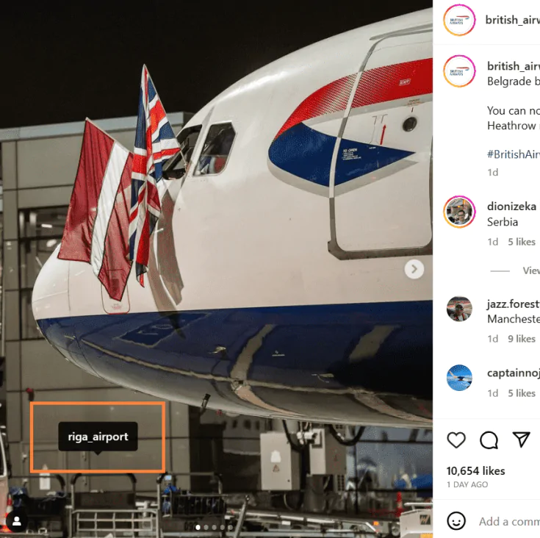
Examples of campaign visuals
Paid Instagram adverts:
Eye catching Instagram advert to showcasing British Airway’s luxury services, for example first-class seating, with call to action leading to booking page.
Original Facebook post:
The support of user-generated content to post featuring with amazing photo of a destination provided by the airline, highlighting both the company and destination, with a certain hashtag.
Notes:
Examples of campaign visuals
Paid Instagram adverts:
Eye catching Instagram advert to showcasing British Airway’s luxury services, for example first-class seating, with call to action leading to booking page.
Original Facebook post:
The support of user-generated content to post featuring with amazing photo of a destination provided by the airline, highlighting both the company and destination, with a certain hashtag.
%%TTF_MALE%

Slide 8
References List
All these cite are from relevant sources, for example data, articles, case studies and other materials to support of creation of the campaign plan.
Smith, J, (2023). The future of airline marketing. Marketing Journal, 32(4), 45-60. [Book].
British Airways, (2024). Sustainability initiatives, [Online]. Available from:
https://www.britishairways.com/content/information/about-ba/ba-better-world/planet
Edelman, R, (2023). The impact of trust on brand loyalty. [Online]. Available from:
https://www.edelman.com/trust/2023/trust-barometer/special-report-brand-trust
Merrill, R & Taylor, T, (2022). Social media marketing for travel brands: best practices and case studies. Journal of digital marketing, 47(3), 88-103.
Statista, (2024). Social media usage statistics in the UK 2024. [Online]. Available from:
https://www.statista.com/statistics/507392/uk-number-and-penetration-rate-of-internet-and-mobile-internet-users/#:~:text=UK%3A%20digital%20population%20January%202024&text=As%20of%20January%202024%2C%20the,percent%20of%20the%20total%20population.
Notes:
References List
%%TTS_MALE%

