Slide 1

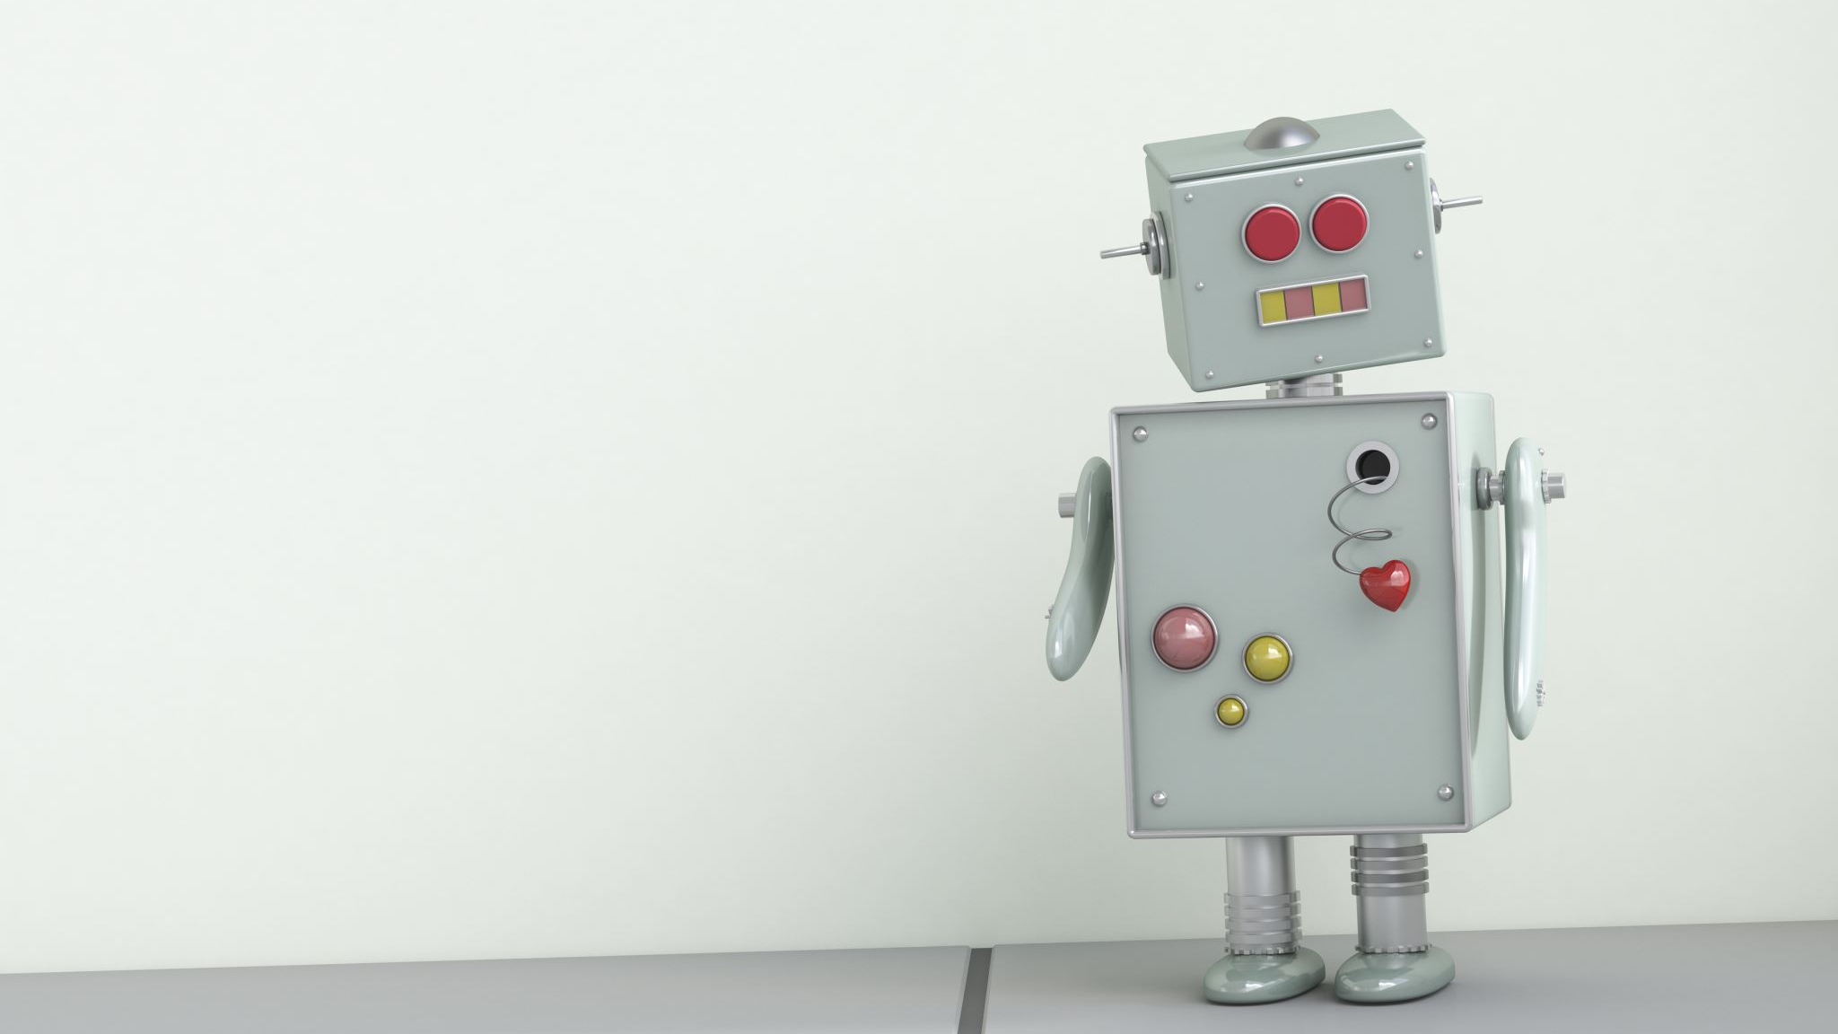
Why are Bots Created?
Notes:
Broadly speaking, social media bots are automated programs used to engage in social media. These bots behave in an either partially or fully autonomous fashion, and are often designed to mimic human users. While benevolent social media bots exist, many social media bots are used in dishonest and nefarious ways. Some estimates suggest that these malicious bots make up a sizable percentage of all accounts on social media.

Slide 2

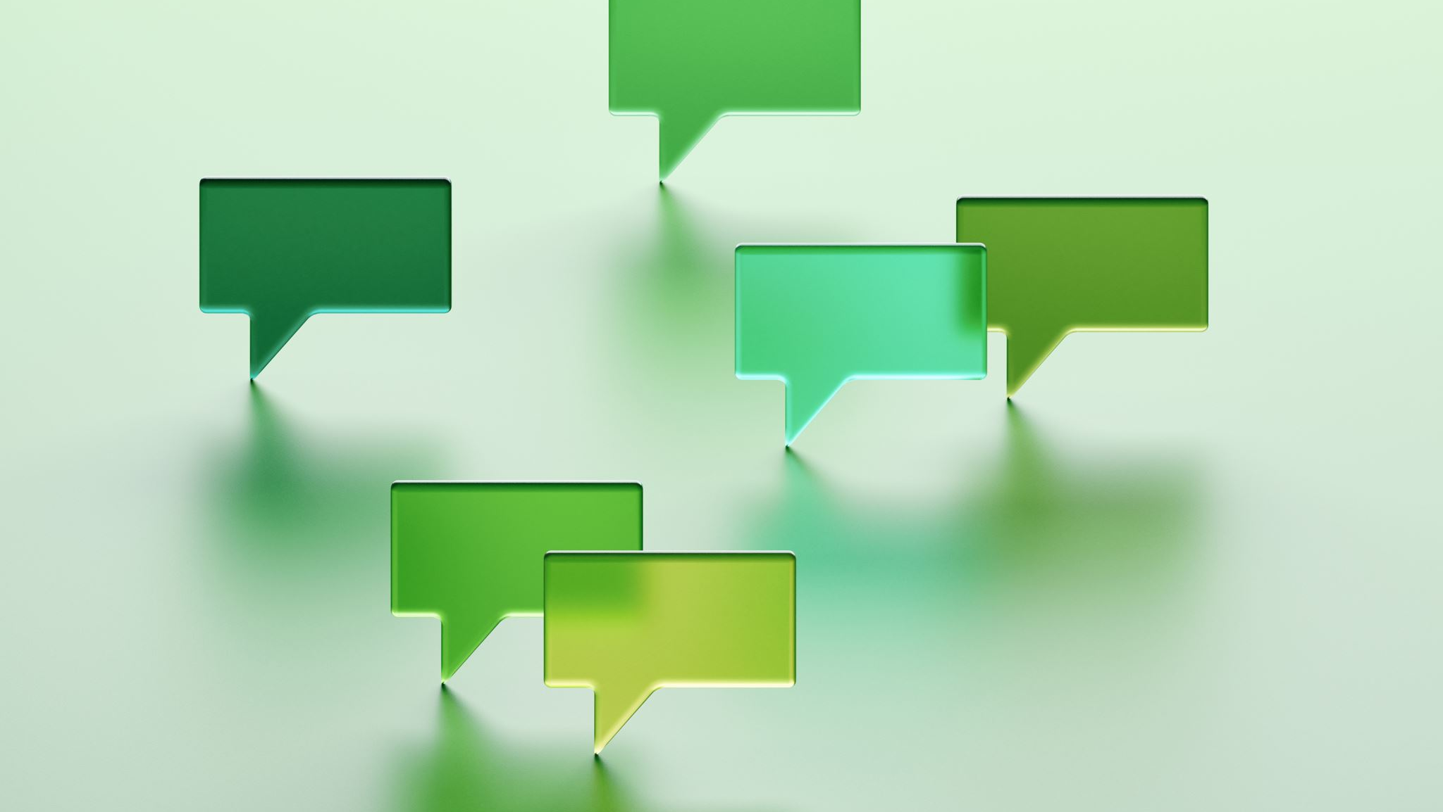
What are social media bots used for?
Notes:
Some social media bots provide useful services, such as weather updates and sports scores. These ‘good’ social media bots are clearly identified as such and the people who interact with them know that they are bots. However a large number of social media bots are malicious bots disguised as human users.

Slide 3



Malicious social media bots can be used for a number of purposes
Notes:
Malicious social media bots can be used for a number of purposes:

Slide 4
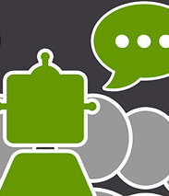
Artificially amplifying the popularity of a person or movement
A person or organization with millions of social media followers can be seen as important or influential. A primary use case of social media bots is to boost the apparent popularity of other accounts. These follower bots can be bought and sold on the black market, with more convincing bots fetching a higher price.
This Photo by Unknown author is licensed under CC BY-SA.
Notes:
Artificially amplifying the popularity of a person or movement: A person or organization with millions of social media followers can be seen as important or influential. A primary use case of social media bots is to boost the apparent popularity of other accounts. These follower bots can be bought and sold on the black market, with more convincing bots fetching a higher price.

Slide 5
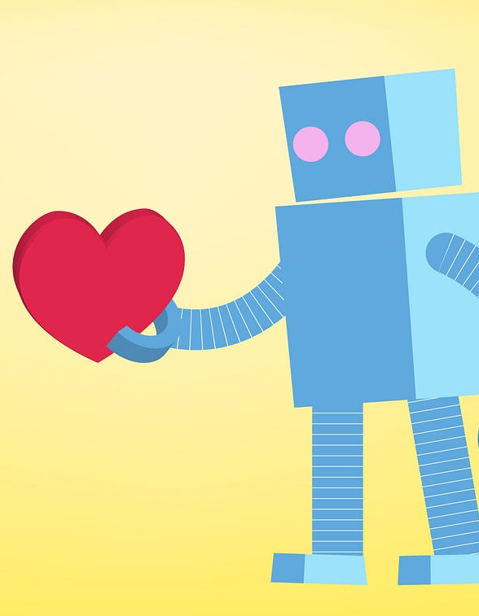
Influencing Elections
A study by First Monday, a peer-reviewed journal found that in the day before the 2016 U.S. presidential election, as much as 20% of political discussion on social media was generated by about 400,000 social media bots.
This Photo by Unknown author is licensed under CC BY.
Notes:
Influencing Elections: A study by First Monday, a peer-reviewed journal found that in the day before the 2016 U.S. presidential election, as much as 20% of political discussion on social media was generated by about 400,000 social media bots.

Slide 6

Manipulating Financial Markets
Social media bots can also be used to influence financial markets. For example, bot accounts can flood social media with manufactured good or bad news about a corporation, in an attempt to manipulate the direction of stock prices.
Notes:
Manipulating Financial Markets: Social media bots can also be used to influence financial markets. For example, bot accounts can flood social media with manufactured good or bad news about a corporation, in an attempt to manipulate the direction of stock prices.

Slide 7
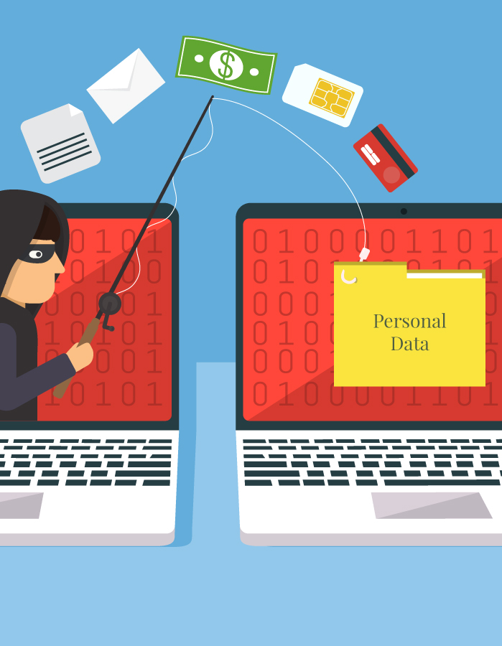
Amplify Phishing Attacks
Phishing attacks rely on an attacker gaining their victim’s confidence. Fake social media followers and social engagement can help convince a victim that their scammer can be trusted.
This Photo by Unknown author is licensed under CC BY.
Notes:
Amplify Phishing Attacks: Phishing attacks rely on an attacker gaining their victim’s confidence. Fake social media followers and social engagement can help convince a victim that their scammer can be trusted.

Slide 8
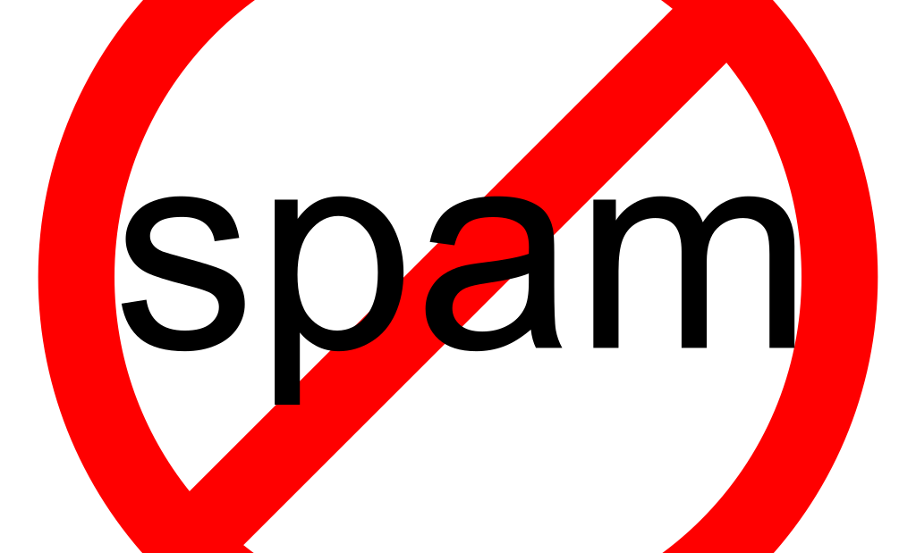
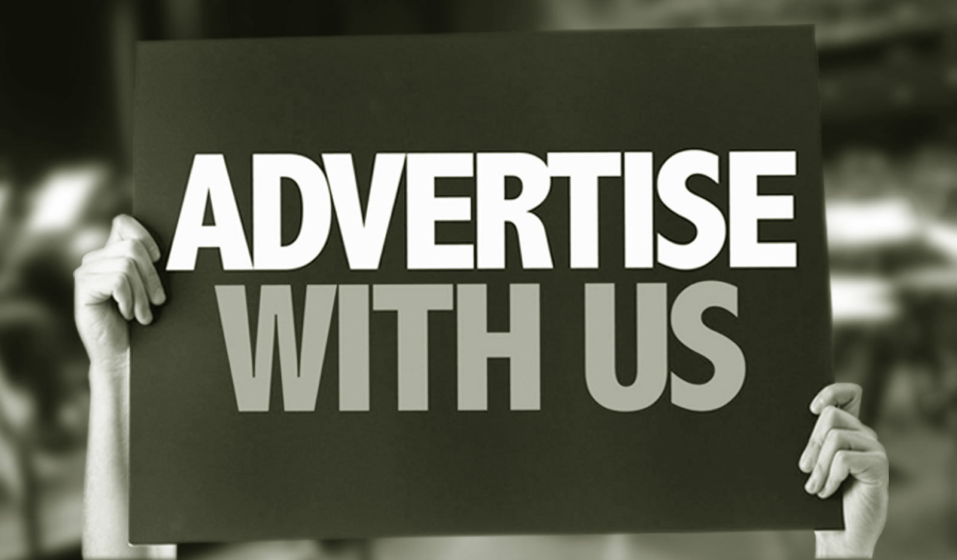
Spreading Spam
Social media bots are often used for illicit advertising purposes by spamming the social web with links to commercial websites.
This Photo by Unknown author is licensed under CC BY-NC.
This Photo by Unknown author is licensed under CC BY-SA.
Notes:
Spreading Spam: Social media bots are often used for illicit advertising purposes by spamming the social web with links to commercial websites.

Slide 9
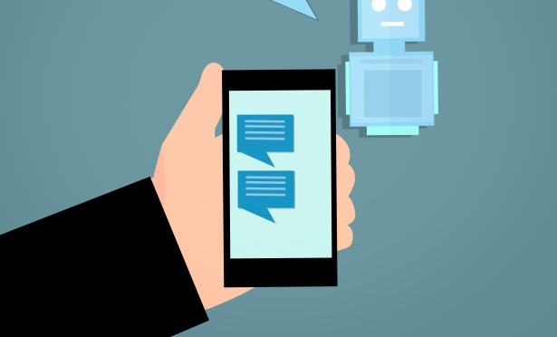
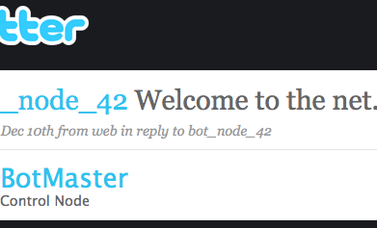
Shutting Down Free Speech
During the 2010-2012 Arab Spring movement, government agencies used Twitter bots to overwhelm social media feeds. These bots were used to deliberately push down the messages of protestors and activists.
This Photo by Unknown author is licensed under CC BY-SA-NC.
Notes:
Shutting Down Free Speech: During the 2010-2012 Arab Spring movement, government agencies used Twitter bots to overwhelm social media feeds. These bots were used to deliberately push down the messages of protestors and activists.

