Slide 1

Why Choose…

Slide 2
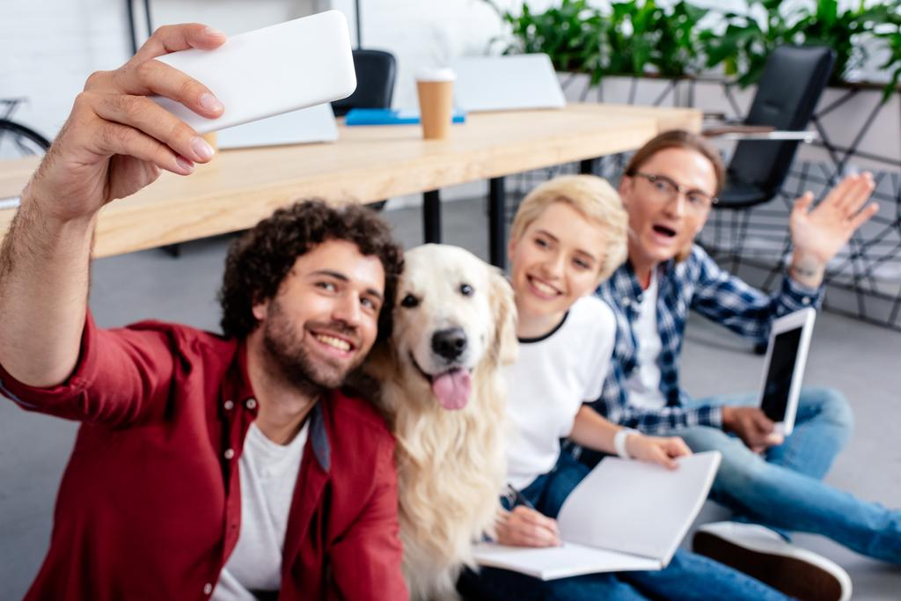

A Character
What do they want?
These are young professionals with office jobs that keep them out of the office 8+ hours a day, away from their dogs.

Slide 3

Has a Problem
Villain
Office jobs
Internal
Feeling like a bad pet owner
External
Having a lonely pet at home
Philosophical
Having to go to work and leave the dog is a drag

Slide 4
And meets a guide
Empathy
Having to go to the office to work a job is hard, and no one wants to leave the dog by themselves
Authority
I have had dogs for 28 years and I have hired knowledgeable and caring dog owners. I help show our knowledge on Facebook with dog fun facts during the week.

Slide 5
Who gives them a plan
Process
Hiring dog walkers means that your dog has a companion during the day. It helps break up the long work day for the dog and let’s them not be alone all day.
Agreement
The dog owner doesn’t have to worry about their dog feeling lonely because they have a trusted friend come and give them a walk during the day. The dog is taken care of and the owner gets to work.

Slide 6
And calls them to action
Direct
Hiring Woof Woof dog walkers is a great way to both take care of your pet and work at an office during the week.
Transitional
Woof Woof dog walkers knows that it will help lonely dogs during the day. We take a picture of the dog and send it to the owner, so that they know that their dog is taken care of.

Slide 7
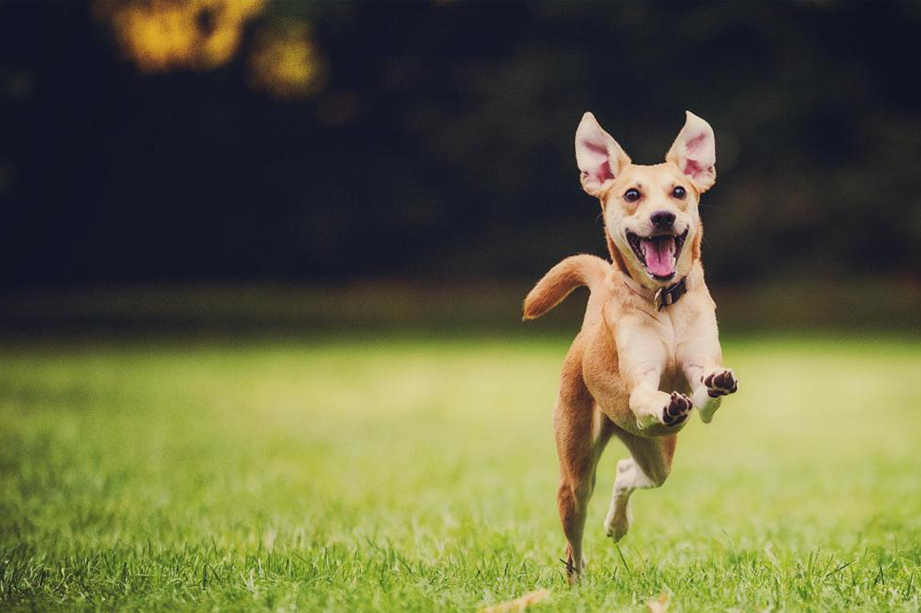
That helps them avoid failure
The dog is no longer alone for 8+ hours a day.
The dog gets enough exercise and stimulation.
The owner doesn’t feel like a failure, because the dog is taken care of.

Slide 8
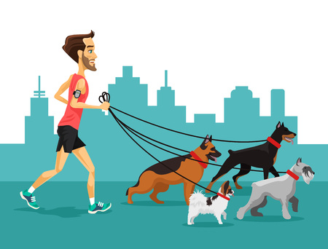
Woof Woof dog walkers is here to help you with all your doggy’s needs.

