Slide 1

INTER DISCIPLINARY PROJECT

Slide 2
Contents
The Great Depression
What was the Great Depression?and its effects.
Causes of The Great Depression
India and the Great Depression
The Early post war years –
Role of Roadways, Railways, Waterways and Airways in building the national economy.
Impact of Globalization in India

Slide 3
The Great Depression
What was The Great Depression? And Its effects.
It was the worst economic crisis of the century. The Great Depression also effected India which was known as the best sector of agriculture and other service goods
Over 13 million people unemployed which was around 3% of the worlds population.
Farmers lost their crops due to drought and was termed as Dust Bowl, they forcefully gave their consumable items to pay off their debts.
Many lost their homes and their livelihood.

Slide 4

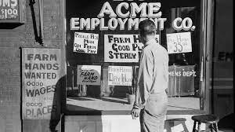
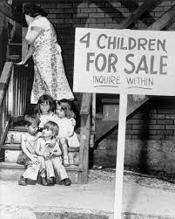
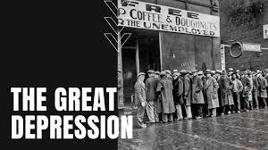

Slide 5
The Great Depression was a period of hard times for the U.S from 1929 to 1941and has cause many economic conditions of the late 1920s.
The impact of the stock market crash resulted in panic among the investors in Wall street, wiping out almost 30billion$ from the stock market which cause the crashing of financial institutes such as banks.
It is said that around 5000 banks went bankrupt after the stock market crash in 1929.

Slide 6
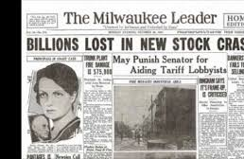

There was a significant drop in consumer spending and investments that cause major decline in industrial output and laid of employees from companies.
The unemployment rate has risen to 25% and the GDP of USA has contracted to half of its value due to Deflation.

Slide 7
Causes and Effects of The Great Depression
Tight monetary policies adapted by the Central Bank of America.
Stock market crash of 1929
The Failure of Banks, which was the impact of stock market crash as more people withdrew their savings from banks leading to closure
Reduction of purchases due to diminished savings.
The passing of Smoot-Hawley Tariff or the Tariff Act of 1930 imposed high taxes on imported goods.

Slide 8
As a retaliation for the same, trade markets imposed high taxes made in the USA which resulted in the decline of the World Trade centre by Two-Thirds.
Prosperity in the USA during the 1920s created a cycle of higher employment and incomes. It led to the rise in consumption and demands. More investment and more employment created tendencies of speculations which led to the Great depression.
Unequal distribution of wealth, Over Production etc.

Slide 9
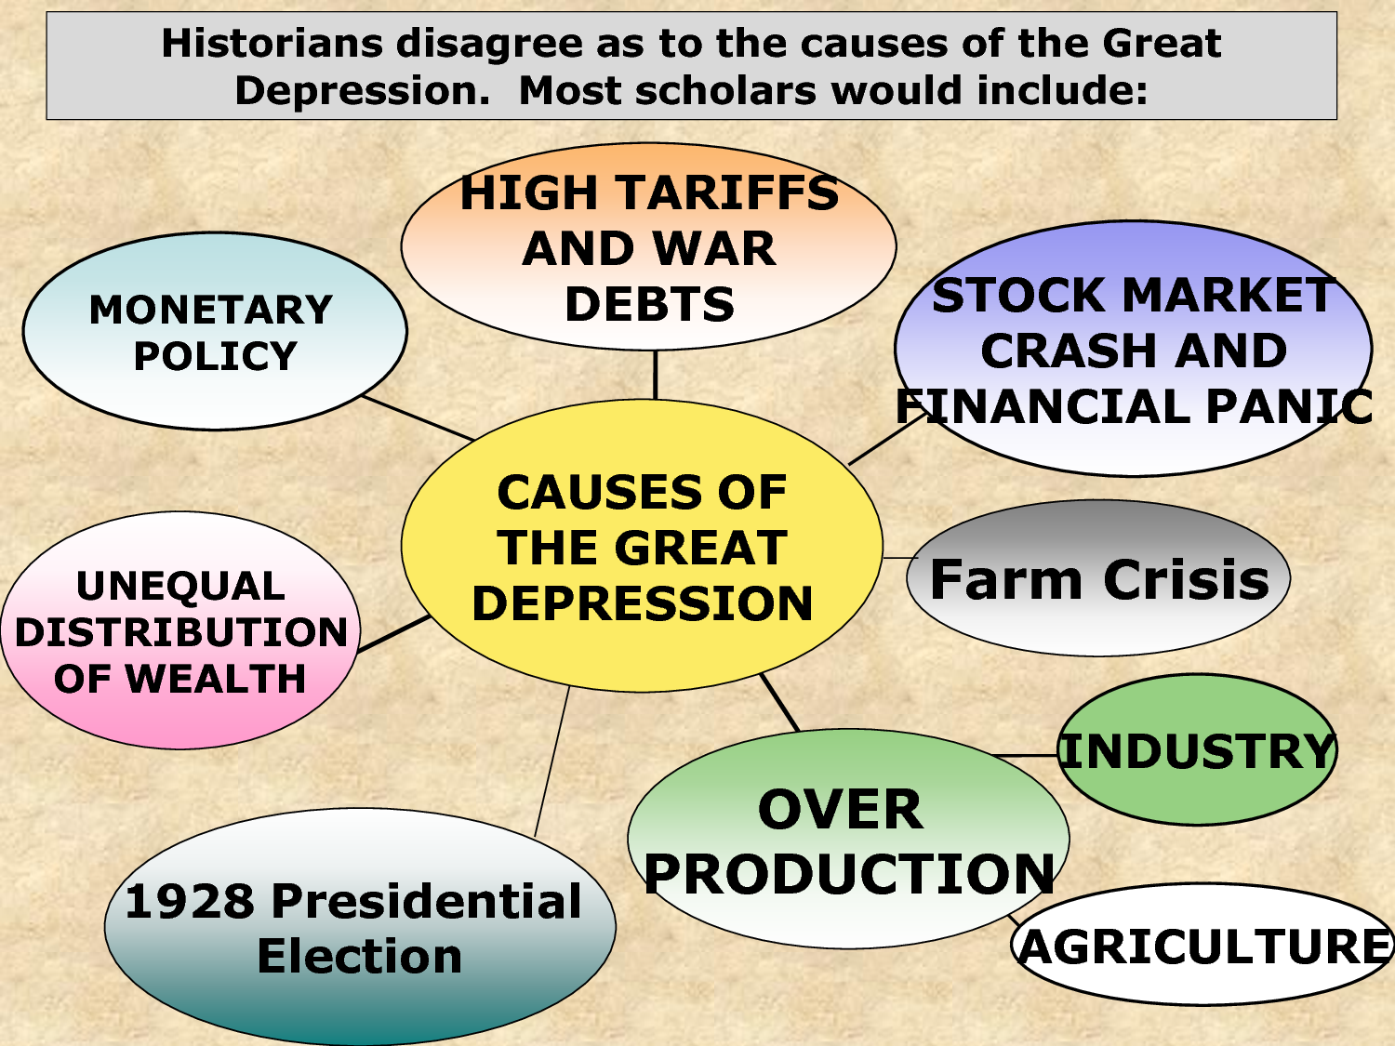

Slide 10
India and The Great Depression
The Great Depression immediately affected Indian trade. Indias exports and imports nearly halved between 1928 and 1934. As international prices crashed, prices in India also plunged.
Between 1928 and 1934, wheat prices in India fell by 50 per cent. Peasants and farmers suffered more than urban dwellers. Though agricultural prices fell sharply, the colonial government refused to reduce revenue demands.
Peasants producing for the world market were the worst hit.

Slide 11
The depression proved less grim for urban India. Because of falling prices, those with fixed incomes such as urban landowners who received rents and middle-class salaried employees, now found themselves better off as everything cost less.
Industrial investment also grew as the government extended tariff protection to industries.
Exports collapsed by 60%
Peasant couldn’t pay debts and were forced to sell gold and jewelery which made india an gold exporter.
It has also recovered British Economy rapidly than before

Slide 12
The Early Post War Years-
Roadways
India has 2nd largest road network in the world (after the USA). The importance of roadways can be gauged from the fact that 65% of freight traffic and 85% of passenger traffic is carried through roads
We can claim that the road network in India is a developed one if we look at the road density which is 142.68 km per 100 square km in the country, and this figure makes India the number one country in the world.
Movement of goods and services can be done through three important domains of the earth that is, land, water and air. India has one of the most extensive road networks on the planet. In India, roadways have preceded railways.

Slide 13
In India Roadways are classified into 6 :-
Golden Quadilateral Super Highways:-
The public authority dispatched a significant road improvement project connecting India’s top four metropolitan cities Delhi-Kolkata-Chennai-Mumbai and Delhi by six-path Super Highways
It includes:nThe North-South corridors linking Srinagar (Jammu & Kashmir) and Kanniyakumari (Tamil Nadu), and East-West Corridor connecting Silchar (Assam) and Porbander (Gujarat)

Slide 14
National Highways:-
It links extreme parts of India and is the primary road system
The Central Public Works Department (CPWD) laid and kept up with these
Various significant National Highways run in North-South and East-West headings
The chronicled Sher-Shah Suri Marg is called National Highway No.1 between Delhi and Amritsar
State Highways:-
These are roads connecting a state capital with various area base camps
The State Public Works Department (PWD) assembled and stayed aware of these roads in State and Union Territories

Slide 15
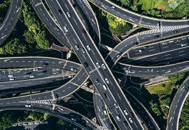
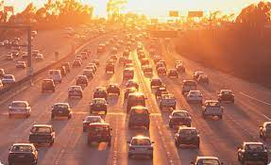
Border Roads:-
The Border Roads Organization (Government of India undertaking) builds and keeps up with roadways in the lining spaces of India.
This association was set up in 1960 to improve the streets of key significance in the Northern and North-Eastern line regions.

Slide 16
District Roads:-
These roads associate the central area command with different spots of the region
The Zila Parishad keeps up with these streets
Other Roads:-
These incorporate country streets, which connect rural regions with towns
These streets got extraordinary force under the Pradhan Mantri Grameen Sadak Yojana
Under this plan, extraordinary arrangements are made, so every town in the nation is connected to a significant city by the entire motorable street season

Slide 17
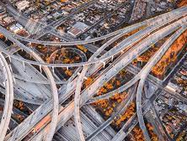
Importance of Roadways
Low construction cost
Ease of movement, easily navigable
Econimical for brief distance and affordable.
Low Handling cost
It gives a connection to all other Transports

Slide 18
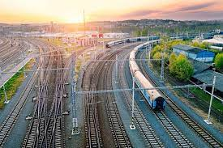
Railways
The Indian Railways is the country's lifeline. It is not just a passenger and freight transporter, but also a social welfare organization, thanks to its extensive network spanning the length and width of India. The Indian Railways started operating on April 16, 1853. Indian Railways (IR) operates the world's fourth-longest rail network. It has a 1,23,236 kilometer network and around 21,000 trains that transport 23 million passengers and 3 million tonnes of freight per day.
India's railway network is the fourth largest in the world and the second-largest in Asia.

Slide 19
Lord Dalhousie dedicated the country's first passenger train, which traveled between Bombay's Bori Bunder station and Thane on April 16, 1853. Three steam locomotives, the Sahib, Sindh, and Sultan, pulled the 14-car train.
The distribution pattern of the Railway network in the country has been largely influenced by physiographic, economic and administrative factors.
Northern Plains : The growth of railwaysis due to the level of terrain, high population density, and abundantagricultural resources.• Peninsular region: In the peninsularregion, railway stretches are builtthrough low hills, gaps, or tunnels.• Desert of Rajasthan: It is difficult toconstruct railway lines on the sandyplain of western Rajasthan.• The contiguous stretch of Sahyadri(Western Ghats) could be crossed onlythrough gaps or passes.

Slide 20
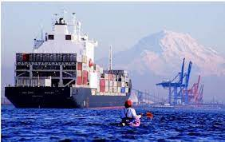
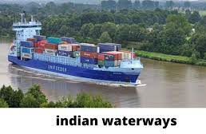
Waterways
Waterways are the cheapest mode of transport, and it is also eco-friendly, as does minimum pollution.
Waterways are used to transport people and very bulky goods.
International trade happens through waterways by use of seaports.
Also, we can use waterways for internal transport, that is, within the country. It is called inland waterways

Slide 21
National Waterways and Sea Ports
The Ganga river between Allahabad and Haldia (1620 km)
The Brahmaputra river between Sadiya and Dhubri (891 km)
The West-Coast Canal in Kerala (Kottapurma-Komman, Udyogamandal and Champakkara canals-205 km)
The other viable inland waterways include the Godavari, Krishna, Barak, Sunderbans, Buckingham Canal, Brahmani, East-west Canal, and Damodar Valley Corporation Canal.
Vishakhapatnam is the deepest landlocked and well-protected port
Marmagao port (Goa) is the premier iron ore exporting port of the country.
Kandla in Kuch was the first port developed soon after Independence to ease the volume of trade on the Mumbai port

Slide 22
AirWays
The air transport was nationalised in 1953. On the operational side, Indian Airlines, Alliance Air (subsidiary of Indian Airlines), private scheduled airlines and non- scheduled operators provide domestic air services.
Air India provides international air services. Pawanhans Helicopters Ltd. Provides helicopter services to Oil and Natural Gas Commission in its off- shore operations, to inaccessible areas and difficult terrains like the north-eastern states and the interior parts of Jammu and Kashmir, Himachal Pradesh and Uttaranchal.
Indian Airlines operations also extend to the neighbouring countries of South and south-east Asia and the Middle east. It can cover very difficult terrains like high mountains, dreary deserts, dense forests and also long oceanic stretches with great ease.

Slide 23
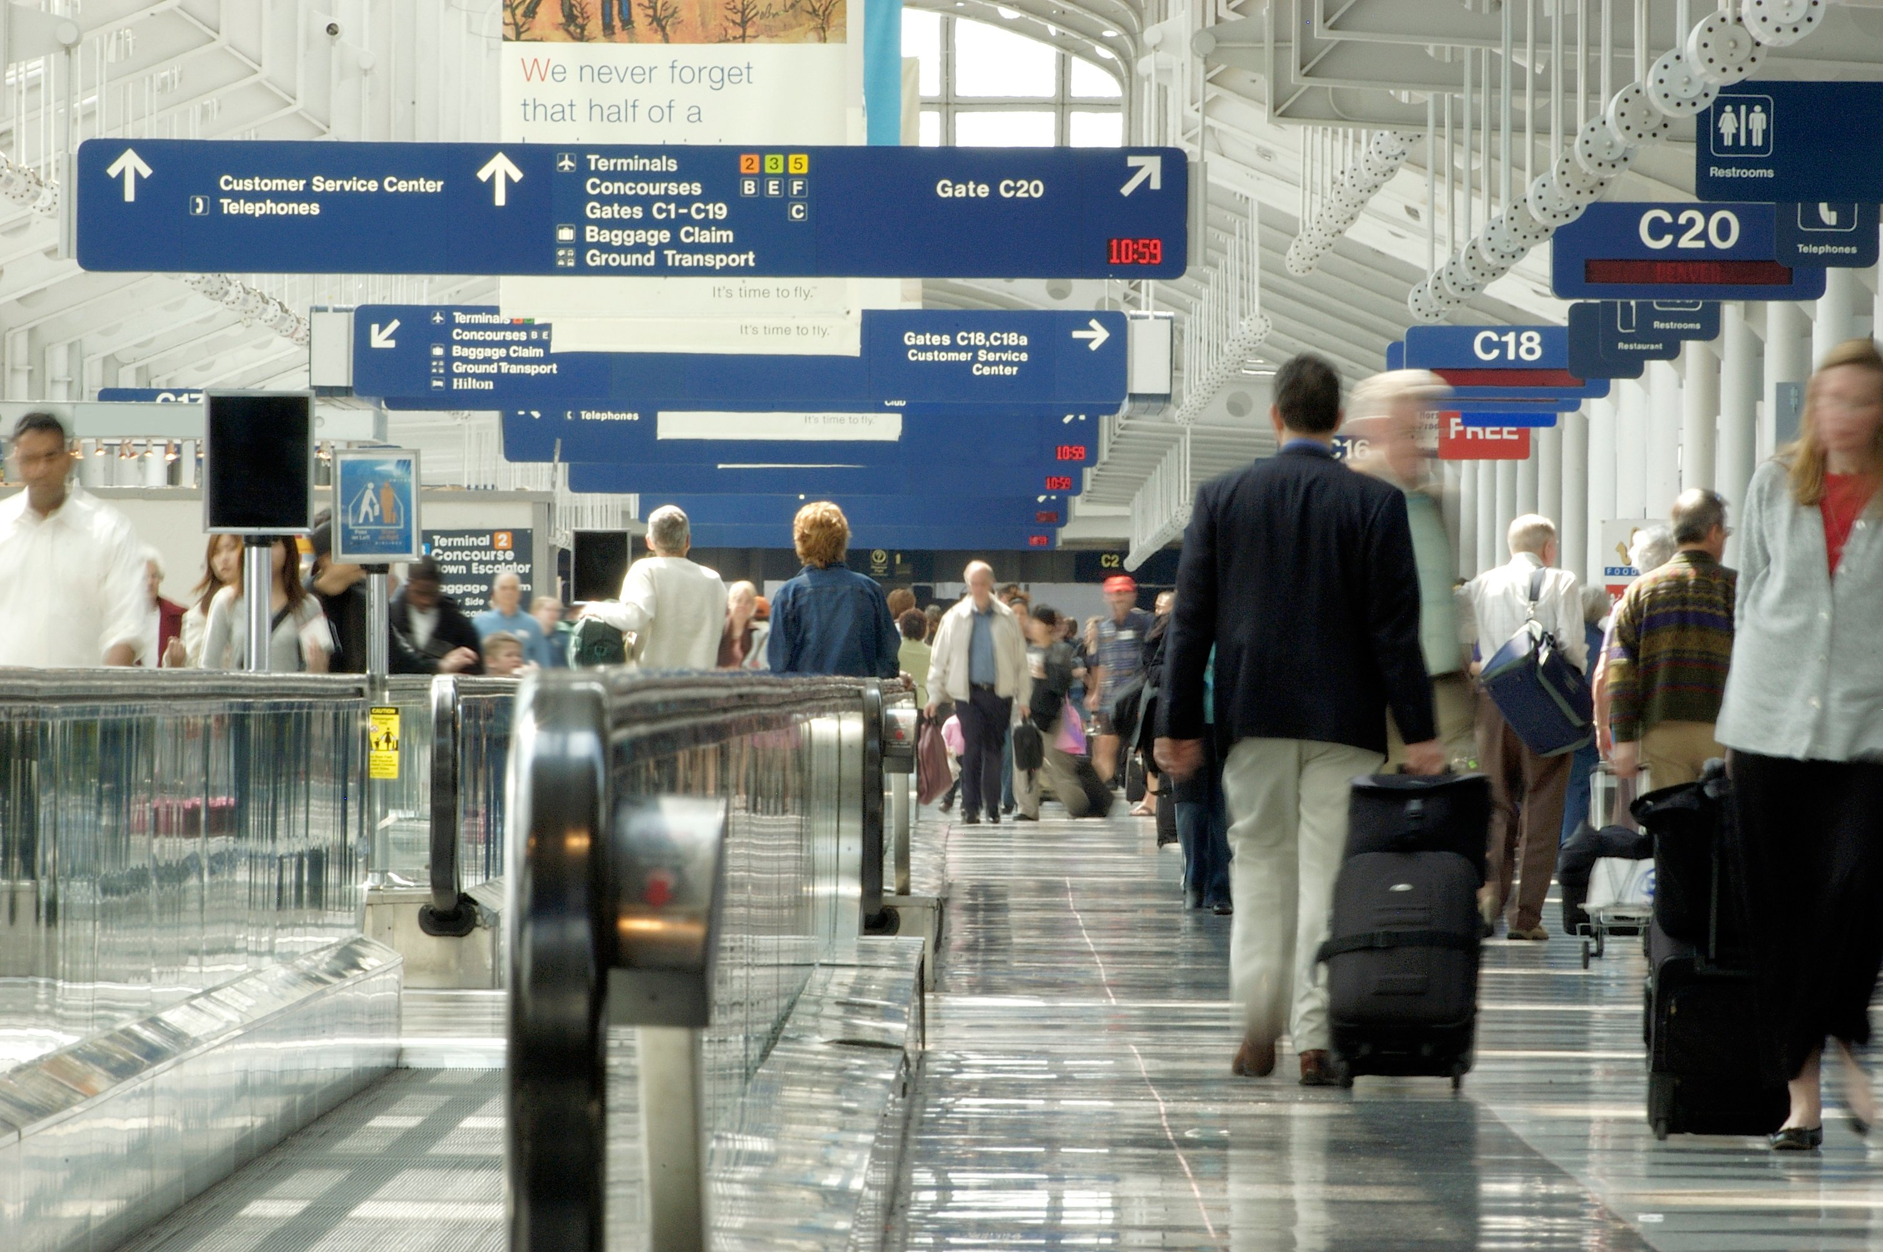
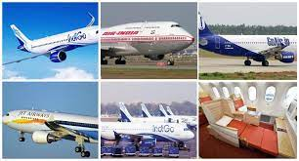

Slide 24
Impact of Globalization in India
India is one of the countries that succeeded significantly after the initiation and implementation of globalization
The growth of foreign investment in the field of corporate, retail, and the scientific sector is enormous in the country.
It also had a tremendous impact on the social, monetary, cultural, and political areas. In recent years, globalisation has increased due to improvements in transportation and information technology. With the improved global synergies, comes the growth of global trade, doctrines, and culture.
Creation of new jobs – Globalisation has created new jobs in order to reduce the unemployment rate to an extent.

Slide 25
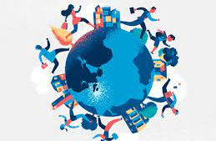
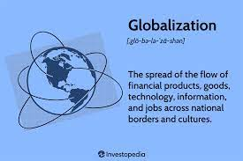
A host of accounting, administrative tasks, data entry and engineering is now being done at a lesser cost in India.
Creation of new opportunities – Globalisation has created new opportunities for Indian companies, mainly providing services for IT companies.
The development of Indian companies as multinational- Several top Indian companies like Infosys, Ranbaxy Tata Motors, has been able to get benefit from the increased competition.

Slide 26


CLASS –XE
Presented by-
Charan
Kiran
Edwin
Meeran
Abha
Akshita

