Slide 1

Information Technology
Notes:
Introduction to IT Induction %%TTS_MALE%

Slide 2

Agenda
Organogram
Infrastructure Setup
IT Policy Overview
4. Escalation Contacts
Notes:
Organogram
Infrastructure Setup
IT Policy Overview
Escalation Contacts %%TTS_MALE%

Slide 3
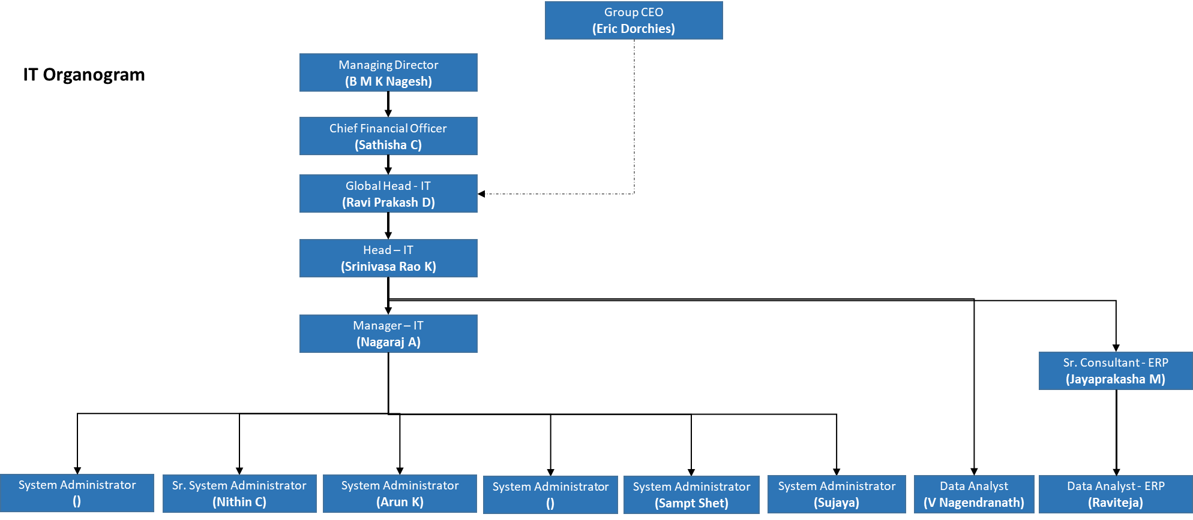
Organogram
Notes:
Certainly! Here is the explanation of the IT organization structure as depicted in the organogram:
**Top Management:**
** Group CEO (Eric Dorchies)
**Managing Director (B M K Nagesh):** The highest authority in the company, overseeing all operations including IT.
**Chief Financial Officer (Sathisha C):** Handles the financial aspects of the company, ensuring financial health and resource allocation.
**IT Leadership:**
**Global Head – IT (Ravi Prakash D):** Leads the global IT strategy and operations, ensuring alignment with business goals.
**Deputy. General Manager – IT (Srinivasa Rao K):** Assists the Global Head in managing IT operations and strategies, providing support in decision-making and execution.
**IT Management:**
**Manager - IT (Nagaraj A):** Manages the day-to-day IT operations and teams, ensuring smooth functioning and addressing any issues that arise.
**Specialized Roles:**
**Sr. Consultant - ERP (Jayaprakasha M):** Manages Enterprise Resource Planning (ERP) systems, ensuring they meet business requirements and operate efficiently.
**Data Analyst (V Nagendranath):** Analyzes data to provide insights and support decision-making processes.
**Data Analyst (Raviteja):** Manages Enterprise Resource Planning (ERP) systems, ensuring they meet business requirements and operate efficiently.
**System Administration Team:**
** We have a dedicated system administration team across all the factories to ensure the smooth operation and security of all our technological infrastructure.
**Senior System Administrator (Nithin C):** Manages and maintains IT systems, ensuring their optimal performance.
**System Administrator (Arun K):** Similar role focusing on maintaining IT infrastructure.
**System Administrator (Sampath Shet):** Provides support in managing IT systems and addressing any issues.
**System Administrator (Sujay):** Assists in the maintenance and management of IT infrastructure.
This structure outlines the hierarchy and roles within the IT department, ensuring clear responsibilities and efficient management of IT resources and operations. %%TTS_MALE%

Slide 4
ERP
Industry Specific Software
BI
Dashboards
Web based
Tight integration between modules
MES Applications
  D1 planning tool for production planning
  Optacut for Cutting tracking
  Optafloor for production tracking
Notes:
The software that we use is WFX
World Fashion Exchange (WFX) software, which is specifically designed for the garment industry.
Industry-Specific Software:
It is industry specific software tailored to meet the unique needs of the industry.
Business Intelligence (BI):
Incorporates tools for analyzing data and providing actionable information.
Helps in making informed business decisions based on data-driven insights.
Web-Based:
Accessible through web browsers.
Ensures accessibility from any location with internet access, promoting remote work and collaboration.
Tight Integration Between Modules:
Ensures seamless communication and data flow between different functional areas of the business.
Enhances efficiency and reduces data redundancy and errors.
MES Applications :
D1 planning tool for production planning
Optacut for Cutting tracking
Optafloor for production tracking %%TTS_MALE%

Slide 5
Infra Setup
Virtualized Infrastructure
High level of redundancy
SDWAN Network Connectivity
Notes:
Infrastructure
Virtualized Infrastructure refers to the use of virtualization technology to create a flexible and efficient I T environment. It involves running multiple virtual machines (VMs) on a single physical server, allowing better utilization of hardware resources and simplifying management.
High Level of Redundancy
Redundancy is a critical aspect of I T infrastructure to ensure high availability and reliability. It involves duplicating critical components or functions of a system to provide a backup in case of failure.
SDWAN Network Connectivity
SD-WAN (Software-Defined Wide Area Network) is a modern approach to managing and optimizing wide area networks. It securely connects different branches, data centers, and cloud services over multiple types of connections—like MPLS, broadband, or LTE.

Slide 6
Generic
Approved copy of the IT Policy document is available at People Strong HRIS Website
SOFTWARE COPYRIGHT COMPLIANCE
Intellectual Property laws, such as Copyright and Patent laws in countries make unauthorized copying, altering, misuse, tampering, sharing, distribution or other exploitation of a piece of software illegal. If caught using illegal copies of software, or if held to have indulged in any of the aforesaid activities, the organization may face not only a civil suit, but also AIPL directors, management and individual users may be charged with monetary and criminal liabilities as well, including imprisonment. In the event of such prosecution, the harm to the good name and credentials of the company and the said individuals is immeasurable and irreparable.
Notes:
Generic
Approved copy of the IT Policy document is available at
People Strong HRIS
Which will we explained to you by one by one

Slide 7
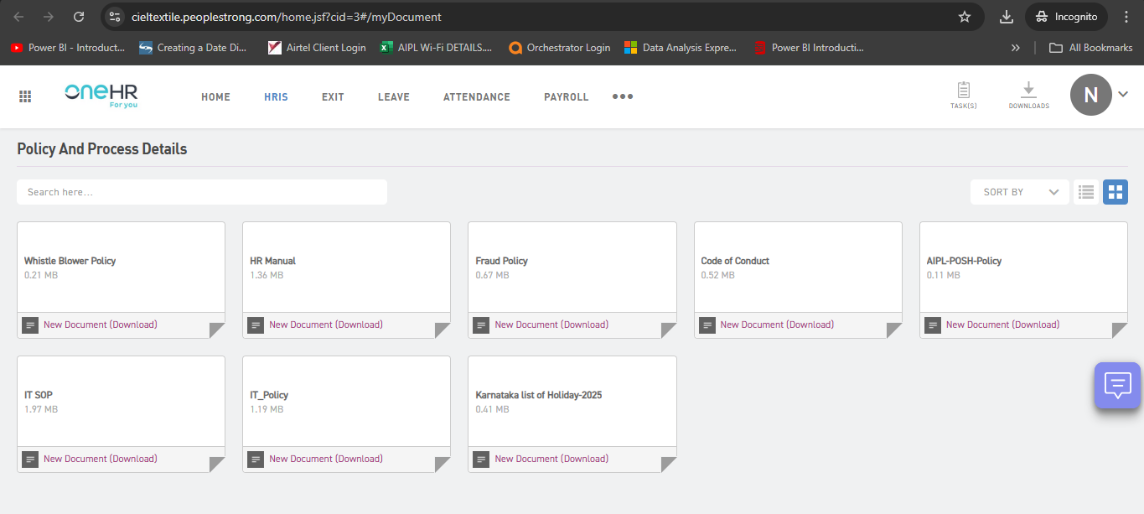
PeopleStrong HRIS Application Policy window
Notes:
PeopleStrong HRIS Application Policy window to review the policy for reference

Slide 8
Software Management
All ownership and control of software shall vest in the company and no user shall claim or exercise any rights in connection with the same. The user is merely permitted to use the software as permitted by the company for the purposes of the company.
Users are not authorized to make any copies of software, or to alter, tamper, share, distribute or otherwise exploit the software under any circumstances.
User shall not install any software on AIPL equipment, without the prior written approval, that requires anyone time, monthly or deferred payment. Should the User install such software, any and all costs relating to the payment of the same shall be paid for solely by the User.
No user will hand over any company's information or data (confidential and restricted) and software to any outsiders, including clients and customers until authorized in writing by Head - IT / Finance Controller / Managing Director.
Notes:
Software Management
All ownership and control of software shall vest in the company and no user shall claim or exercise any rights in connection with the same. The user is merely permitted to use the software as permitted by the company for the purposes of the company.
Users are not authorized to make any copies of software, or to alter, tamper, share, distribute or otherwise exploit the software under any circumstances.
User shall not install any software on AIPL equipment, without the prior written approval, that requires anyone time, monthly or deferred payment. Should the User install such software, any and all costs relating to the payment of the same shall be paid for solely by the User.
No user will hand over any company's information or data (confidential and restricted) and software to any outsiders, including clients and customers until authorized in writing by Head – IT / Finance Controller / Managing Director. %%TTS_MALE%

Slide 9
Access Control Management
  It is a criminal offence under the IT Act 2000 to deliberately attempt to access a system to which you do not have the authority.
  Logins to and use of the IT resources will be logged and monitored. Software checks will be done yearly in remote PC's, which also may include physical verification.
  All system-level and user-level passwords must be minimum of of 8 characters with combination of alpha numeric and a special character changed at least for every 90 days. System would also be configured to force the user level password change every 90 days.
  System will be configured to lock the user login account after 3 unsuccessful login attempts
  System will be configured to lock the computer after 15 minutes of in-activity.
  If you suspect that an account has been compromised, report the incident to IT helpdesk and do change all the passwords if the account is assigned to you alone.
Notes:
Access Control Management
It is a criminal offence under the IT Act 2000 to deliberately attempt to access a system to which you do not have the authority.
Logins to and use of the IT resources will be logged and monitored. Software checks will be done yearly in remote PC's, which also may include physical verification.
All system-level and user-level passwords must be minimum of 8 characters with combination of alpha numeric and a special character changed at least for every 90 days. System would also be configured to force the user level password change every 90 days.
System will be configured to lock the user login account after 3 unsuccessful login attempts
System will be configured to lock the computer after 15 minutes of in-activity.
If you suspect that an account has been compromised, report the incident to IT helpdesk and do change all the passwords if the account is assigned to you alone. %%TTS_MALE%

Slide 10
User Account Management
Every new user account creation must be authorized by HR department / HOF and the authorization form must at least contain the following information and sent to IT helpdesk through a mail to respective IT Team.
In case of common UID, the entire group/Department shall be held jointly and collectively responsible, if there is any violation or breach of the IT Policy.
UID shall be suspended if the user is not accessing his / her systems for more than 60 days or upon retirement of the user. The same shall be deleted after 3 months with prior approval of Head - IT
UIDs relating to terminated employees shall be disabled immediately upon receiving the communication from HR department and with authorization from Head - IT after successful backup.
MD will have every right to go-through the user's data at any point of time.
Back up of data from Laptops/desktops will not be taken. Please store all important official data onto the central file server.
Notes:
User Account Management
Every new user account creation must be authorized by HR department / HOF and the authorization form must at least contain the following information and sent to IT helpdesk through a mail to respective IT Team.
In case of common UID, the entire group/Department shall be held jointly and collectively responsible, if there is any violation or breach of the IT Policy.
UID shall be suspended if the user is not accessing his / her systems for more than 60 days or upon retirement of the user. The same shall be deleted after 3 months with prior approval of Head – IT
UIDs relating to terminated employees shall be disabled immediately upon receiving the communication from HR department and with authorization from Head – IT after successful backup.
MD will have every right to go-through the user's data at any point of time.
Back up of data from Laptops/desktops will not be taken. Please store all important official data onto the central file server%%TTS_MALE%

Slide 11
Email
IT shall configure an email address after receiving the details from HR for new joiners and from respective HOD/HOF for present employees for official communication. Normal process of email address allocation will be as firstnamelastname@aquarelleindia.com subject to the availability
User should avoid sending greetings towards festivals and New Year. If any such email is received, user should not reply and should delete the email without opening the mail or attachment. This needs to be followed strictly to avoid chocking of internal bandwidth as well as external threats.
Usage of AIPL's email system in any way that may be interpreted as insulting, disruptive or offensive by any other person, or company, or which may be harmful to AIPL morale should be avoided.
Forwarding of chain letters internally and sending messages to, multiple destinations will be considered as 'spamming', which is an illegal activity in India and many countries.
Owner of the email address will be considered as the author for all the messages originating from his / her email address. So users must ensure confidentiality of login credentials.
Notes:
Email
IT shall configure an email address after receiving the details from HR for new joiners and from respective HOD/HOF for present employees for official communication. Normal process of email address allocation will be as firstnamelastname@aquarelleindia.com subject to the availability
User should avoid sending greetings towards festivals and New Year. If any such email is received, user should not reply and should delete the email without opening the mail or attachment. This needs to be followed strictly to avoid chocking of internal bandwidth as well as external threats.
Usage of AIPL's email system in any way that may be interpreted as insulting, disruptive or offensive by any other person, or company, or which may be harmful to AIPL morale should be avoided.
Forwarding of chain letters internally and sending messages to, multiple destinations will be considered as 'spamming', which is an illegal activity in India and many countries.
Owner of the email address will be considered as the author for all the messages originating from his / her email address. So users must ensure confidentiality of login credentials%%TTS_MALE%

Slide 12
Internet
Use of the internet makes communication more efficient. However, internet service remains AIPL property, and therefore must be used primarily for official purposes. Any unauthorized or improper use of e mail or the Internet is not acceptable and will not be permitted. Restricted access to the internet will be provided to all users to assist them in the performance of their jobs. Wherever access is provided, usage should be limited to official business purposes only.
It is assumed that users will not browse immoral sites or objectionable sites or sites giving malicious content or any other sites forbidden by the Government of India. If any instance of violation of this is found, the individuals involved will be liable for the consequences.
IT will monitor all the activities of users on Internet and may be reported.
Notes:
Internet
Use of the internet makes communication more efficient. However, internet service remains AIPL property, and therefore must be used primarily for official purposes. Any unauthorized or improper use of e mail or the Internet is not acceptable and will not be permitted. Restricted access to the internet will be provided to all users to assist them in the performance of their jobs. Wherever access is provided, usage should be limited to official business purposes only.
It is assumed that users will not browse immoral sites or objectionable sites or sites giving malicious content or any other sites forbidden by the Government of India. If any instance of violation of this is found, the individuals involved will be liable for the consequences.
IT will monitor all the activities of users on Internet and may be reported. %%TTS_MALE%

Slide 13
Laptop/ Data Card/Accessories
ELIGIBILITY: General Managers and above.
Any other staff recommended by MD / Finance Controller / HOF with justification and approval of Head – IT.
Make, Model and specifications would be decided by IT team after analyzing the user's requirements.
User is responsible for the upkeep of the asset. In case of damage or loss arising out of negligent usage, the user is liable to pay the value of repairs of the asset. The laptops would need to be submitted for periodic physical verification as may be required from time to time.
In an unfortunate event of loss / theft of the laptop, the user is responsible to lodge FIR with concerned Police Station and also report the incident immediately to Finance department under intimation to the IT Department and User's reporting authority. The user is also responsible to follow all the other norms as stipulated by IT/Finance department in regard to such (theft) incidents.
In the event a claim on the lost / stolen item is not entertained by the insurance company for any reason in whole or in part, the employee will be liable to pay the differential value to the company. The IT /Finance department on a case-to-case basis will determine the value after considering the insurance claim amount received, if any.
Notes:
Laptop/ Data Card/Accessories
ELIGIBILITY: General Managers and above.
Any other staff recommended by MD / Finance Controller / HOF with justification and approval of Head – IT.
Make, Model and specifications would be decided by IT team after analyzing the user's requirements.
User is responsible for the upkeep of the asset. In case of damage or loss arising out of negligent usage, the user is liable to pay the value of repairs of the asset. The laptops would need to be submitted for periodic physical verification as may be required from time to time.
In an unfortunate event of loss / theft of the laptop, the user is responsible to lodge FIR with concerned Police Station and also report the incident immediately to Finance department under intimation to the IT Department and User's reporting authority. The user is also responsible to follow all the other norms as stipulated by IT/Finance department in regard to such (theft) incidents.
In the event a claim on the lost / stolen item is not entertained by the insurance company for any reason in whole or in part, the employee will be liable to pay the differential value to the company. The IT /Finance department on a case-to-case basis will determine the value after considering the insurance claim amount received, if any. %%TTS_MALE%

Slide 14
Asset Management
All purchases related to IT ( Software, Hardware, Licenses etc) will have to be routed through IT .
The User shall be responsible for ensuring that all AIPL equipment is returned to back to AIPL, either at the request of AIPL, or upon the User's association with AIPL, for which the equipment was issued, being concluded.
If the User is found" Absconding" or "intentionally fails to turn up after the acceptance of the employment", in such case the HR shall immediately send a notification to the IT Department of such Users along with the details of the equipment allotted to them. Based on the report received from the IT Department thereupon, the HR shall immediately file an FIR with the jurisdictional Police Station.
Inventory of hardware and software assets (including licenses) is physically audited periodically at least once in a year by IT. Deviations of the inventory, if any are to be regulated by IT.
Notes:
Asset Management
All purchases related to IT ( Software, Hardware, Licenses etc) will have to be routed through IT .
The User shall be responsible for ensuring that all AIPL equipment is returned to back to AIPL, either at the request of AIPL, or upon the User's association with AIPL, for which the equipment was issued, being concluded.
If the User is found" Absconding" or "intentionally fails to turn up after the acceptance of the employment", in such case the HR shall immediately send a notification to the IT Department of such Users along with the details of the equipment allotted to them. Based on the report received from the IT Department thereupon, the HR shall immediately file an FIR with the jurisdictional Police Station.
Inventory of hardware and software assets (including licenses) is physically audited periodically at least once in a year by IT. Deviations of the inventory, if any are to be regulated by IT. %%TTS_MALE%

Slide 15
Escalation Contacts
For Any Queries or concern related to IT
Email: it@aquarelleindia.com itdesk@aquarelleindia.com
Help desk portal - https://itdesk.aquarelleindia.com
Below is the IT Support contact details at locations
Head Office
Nithin
Jayaprakasha / Raviteja (ERP)
Factories
Contact Person Sujay for Banneragatta and Palamaner
Contact Persons Arun And Sampt in Malavalli
1st Level Escalation Contacts
Nagaraj – 7829116293
2nd Level Escalation Contacts
Srinivasa Rao – 77609 72676
Ravi Prakash - 9901120741
Notes:
For any IT Query or concern you can reach out at
Email: it@aquarelleindia.com itdesk@aquarelleindia.com
Help desk portal - - https://itdesk.aquarelleindia.com
IT Support contact details at locations
HO
Nithin
Jayaprakasha / Raviteja (ERP)
Factories
Sujay for Bannergatta and Palamaner
Arun And Sampth in Malavalli
1st Level Escalation Contacts
Nagaraj – 7829116293
2nd Level Escalation Contacts
Srinivasa Rao – 77609 72676
Ravi Prakash %%TTS_MALE%

Slide 16
THANK YOU
Notes:
We appreciate your time and attention during this IT induction session. Your understanding of our infrastructure setup and its components is crucial for the seamless operation and success of our organization. If you have any questions or need further assistance, please do not hesitate to reach out to the IT team. %%TTS_MALE%

