Slide 1

Elgin Orchards Induction
2025

Slide 2

INDEX
Opening & Welcoming – Marco
Quality Management System (Food Safety) – Keisha
Transport
Health & Safety / WCA’s – Faizel
Employment Equity
Disciplinary Policy
Sick leave Policy
Grievance Policy
Retirement Benefit
Maternity Benefit
Funeral Benefit
General Discussions

Slide 3
Opening & Welcoming - Marco
Attendance Register
Packhouse Rules

Slide 4
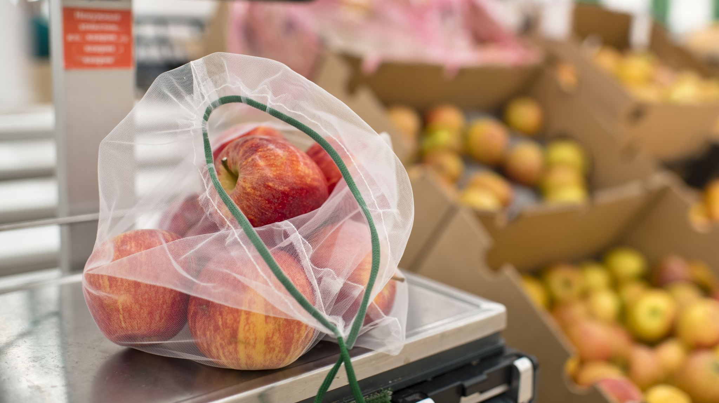
QUALITY MANUAL SYSTEM
FOOD SAFETY

Slide 5





Important Concepts
Bacteria
Bacteria are very small organisms that live on living organisms including human beings. Some of these bacteria can cause disease or even death.
Allergens
These are components in food that can cause sickness or even death when ingested by certain allergic individuals.
Foreign Objects
These are physical objects that can contaminate products with bacteria or cause choking and/or damage to a person when ingested. Foreign objects include glass, hard plastic, plasters, pens, knives, sticky tape, rings, screws etc.

Slide 6

Personal Protective Clothing (PPE)
What is PPE
Personal Protective Clothing (PPE) is the clothes you wear over your personal clothing when entering a production environment.
Why is it important in the Food Safety Industry?
PPE protects the wearer from the production environment e.g., closed shoes
PPE protects the consumer by preventing contamination of product with foreign objects, allergens and bacteria.

Slide 7
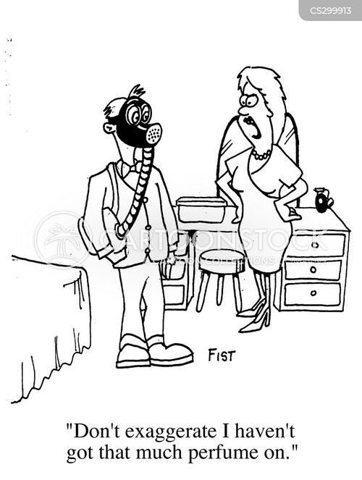


EO Hygiene Cosmetic
No excessive amount of makeup is allowed in the packhouse
No false nails, nail art or eyelashes are allowed (visitors with false nails should wear gloves).
No strong/overpowering scent/perfume/cologne

Slide 8
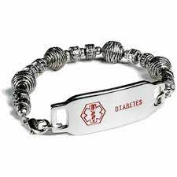
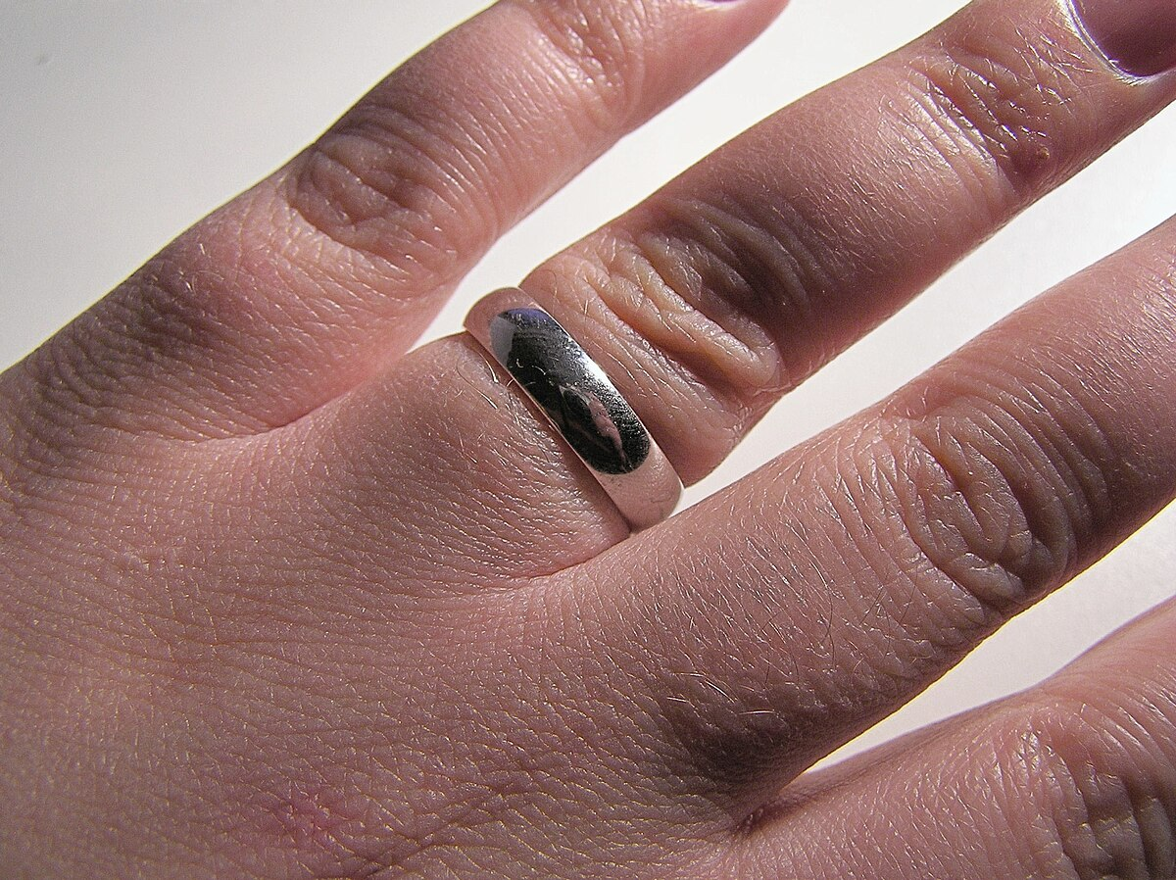
Jewellery
Employees may not wear any jewellery except for a single plain wedding ring (without decorations e.g., diamonds, gemstones etc.) and/or a medical bracelet.
Medical alert bracelets needs to be reported to management.

Slide 9
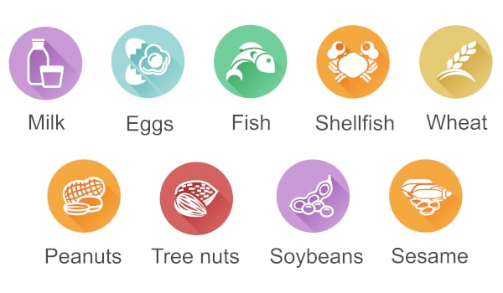
Allergen Policy
There are components in food called “ Allergens” that can cause sickness or even death
Small traces of these allergens on your hand or clothing can have life threatening effects.
Therefore, it is critically important to wash your hands after eating to prevent that small traces of these allergens end up on fruit.

Slide 10

Rules for Good Housekeeping
Always clean as you go
Any fruit picked up off the floor must be thrown away
Keep your workstation neat and clean
NO fruit or boxes allowed on the floor!
Use cleaning equipment according to colour coding & hang cleaning equipment on designated hooks not in use

Slide 11
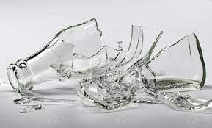
Broken glass/ Hard Plastic
No glass items (i.e., glass cooldrink bottles, mirrors etc.) may be brought into the packhouse.
Report broken glass/hard plastic to the area supervisor.
Foreign Object

Slide 12
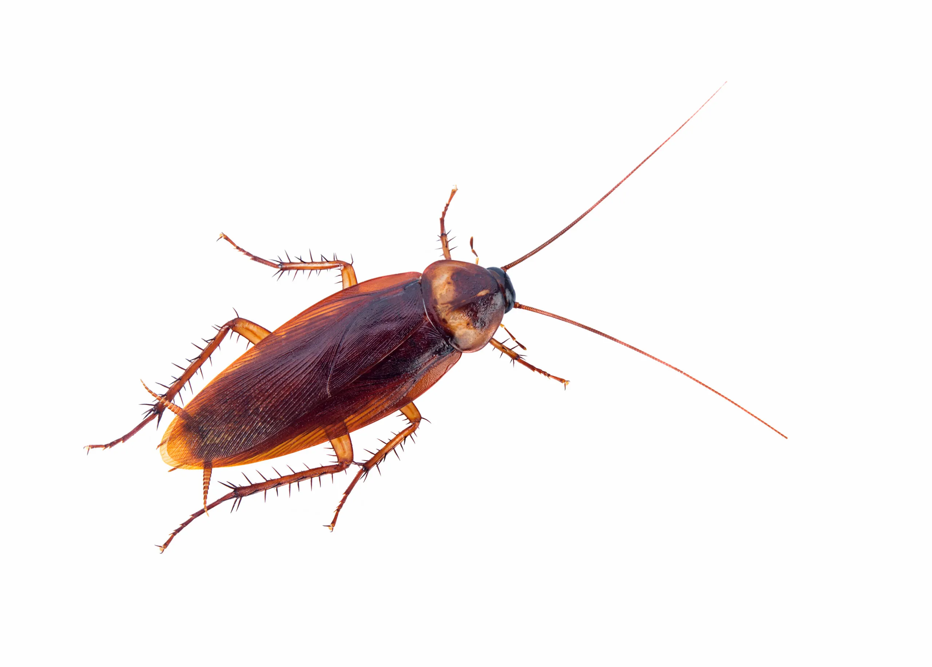
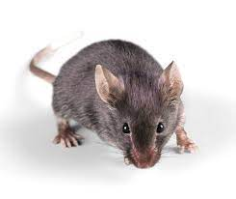
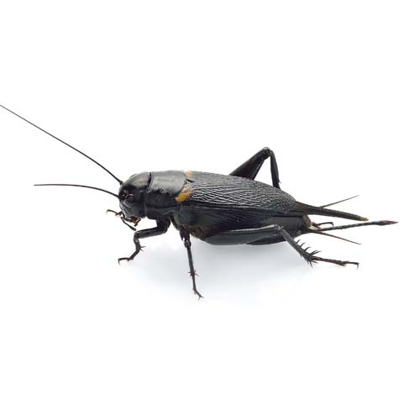
Pest Control
Report any pest activity to the area supervisor / QA Manager
Pests Include:
Mice/ Rats
Cockroaches
Crickets

Slide 13


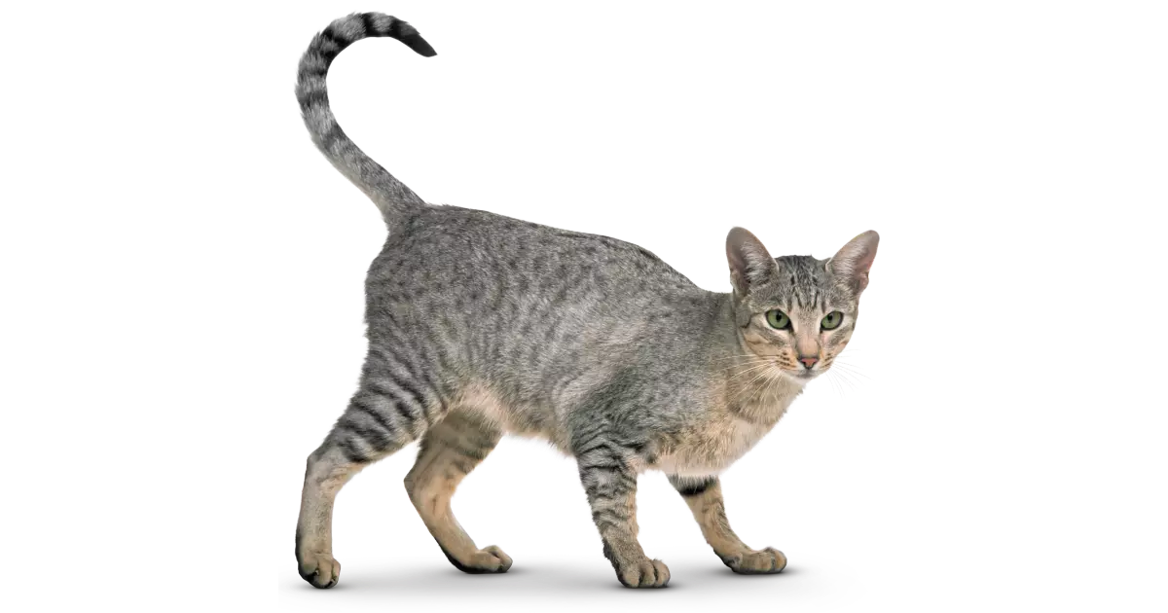
Animals
Animals are not allowed on site.
Please report any sightings of:
Dogs
Cats
Birds

Slide 14


Smoking in designated areas

Slide 15
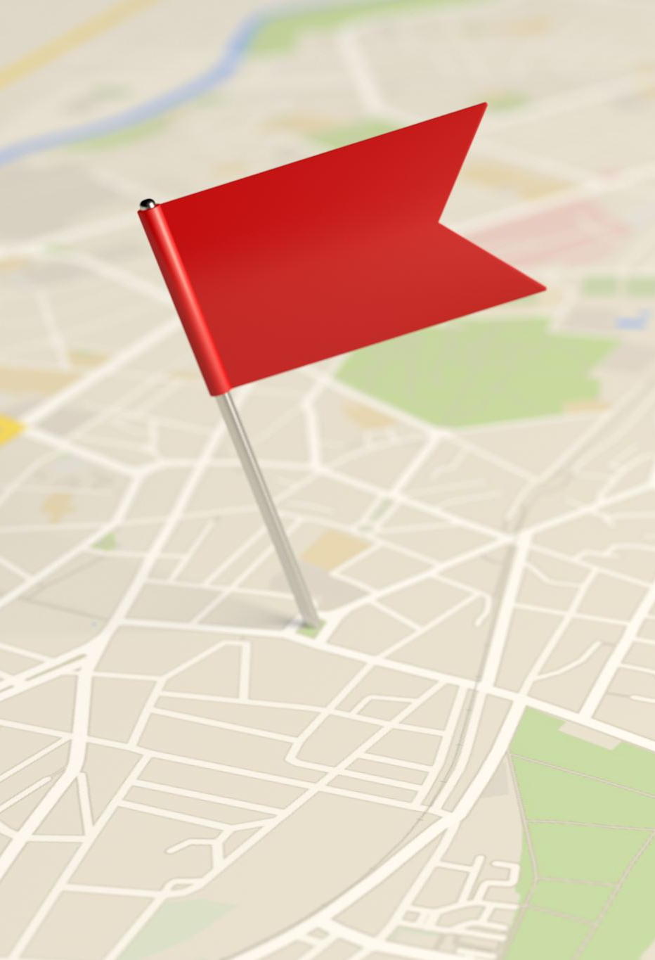
Evacuation Chart
Evacuation Procedure M:\QC\2025 QMS (TFS&BRC) for Packshed\2025 Integrated Management Systems\HPR\EPP001 Evacuation Procedure & Plan V0. Signed docx.pdf
Evacuation Chart N:\HR\SIZA\2021 SIZA\Packhouse Evacuation Plan.xls

Slide 16
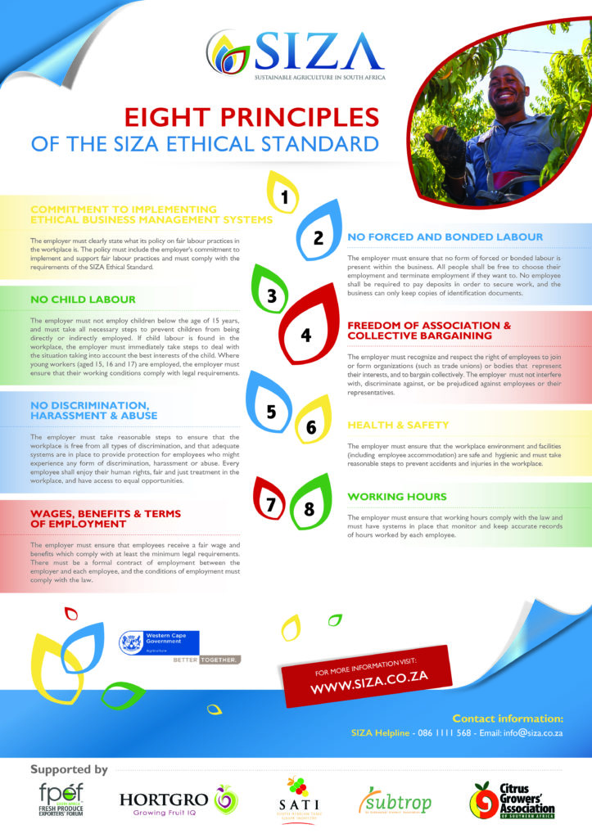
SIZA
Eight (8) Principles
Commitment to implementing ethical Business Management Systems
No Force and Bonded Labour
No Child Labour
Freedom of Association & Collective Bargaining
No Discrimination, Harassment & Abuse
Health & Safety
Wages, Benefits & terms of Employment
Working Hours

Slide 17
Transport
Transport serves an important foundation to any supplier.
It not only allows for workers to be brought to the site but also includes broader movement of machinery and vehicles.

Slide 18
Transport Policy

Slide 19
Health & Safety / WCA’s - Faizel

Slide 20
Employment Equity

Slide 21
Disciplinary Policy

Slide 22
Sick Leave Policy

Slide 23
Grievance Policy

Slide 24
Retirement Benefit

Slide 25
Maternity Benefit

Slide 26
Funeral Benefit

Slide 27
General Discussion
Attendance Bonus

