Slide 1

Promo Your World

Slide 2
About US
PromoYourWorld.ca has the best selection of promotional items, team uniforms, apparel, banners, and corporate gifts. Let us earn your business with our 1st class service and low prices. Our mission is to make your promotion the best it can be! We want you to get your products on time and at the best possible price!

Slide 3
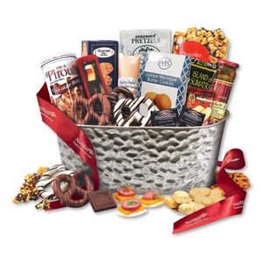
custom promotional products
PromoYourWorld is your one-stop shop for promotional products and business gifts. Our extensive range of promo products will ensure you find something to suit your requirements. With 1000s of selections, PromoYourWorld offers branded merchandise to fulfill all of your needs.

Slide 4
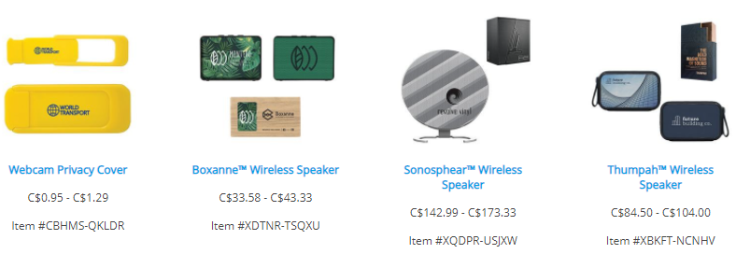
Our Technology

Slide 5
Contact US
Address
9400 St-Laurent Ste 206
Montreal, QC H2N 1P3
Email
sales@promoyourworld.ca
Phone
514-934-6099
Website
https://www.promoyourworld.com

