Slide 1


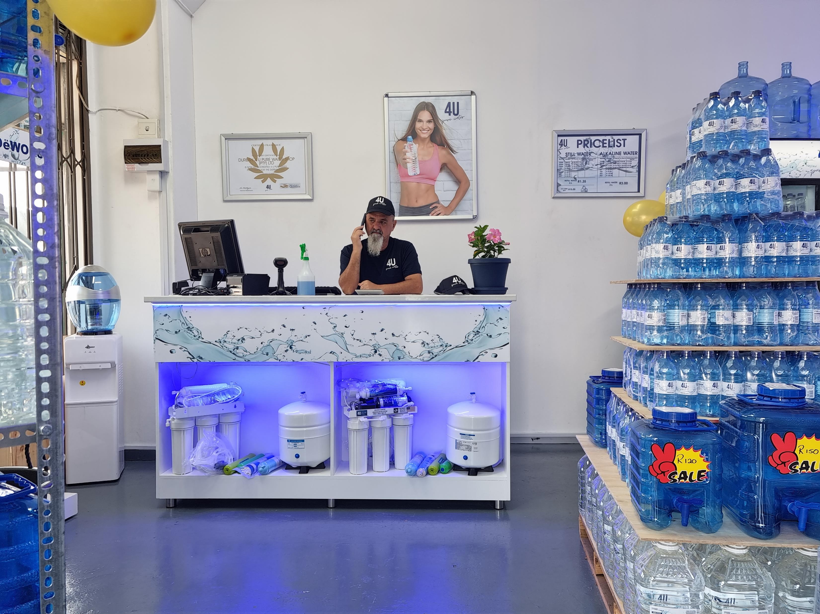
We are passionate about pure water…
Notes:
Good morning, everyone! Today, I'd like to tell you a bit about 4 U Pure Water Franchising, our innovative and reliable water purification systems and services. We pride ourselves on providing a complete package with a standard of excellence to anyone who needs clean and pure water. So, sit back and explore with me to get a better understanding of what we can offer.

Slide 2
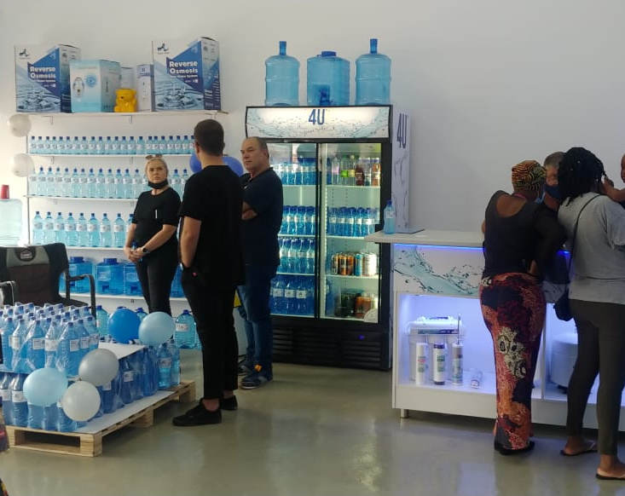
4 U Pure Water Head Office are specialists in everything water.
We Know how to:
4 U Pure Water refill and bottling business in a retail as well as factory environment.
Industrial water purification Industrial Bio Plus 10 manufacturing
High speed filling line manufacturers of all beverage and water products
PET bottle manufacturers PET bottle blowing machine manufacturers.
Injection moldings equipment
4 U Pure Water HQ has adapted an inhouse manufacturing policy to bring new entrepreneurs into the market in the most sustainable manner possible.
All components of a 4 U Pure Water business model are manufactured by us, and we therefore maintain a flexibility to be able to customize what suits the area of operation and not just a one size fits all approach.
4 U Pure Water HQ bases all our decisions on 3 pillars, these pillars govern our everyday operations of how we can best serve our grantees. Grantees in the market must be competitive to the competition on the following:
Pillar 1 – Clean look and quality competitive.
Pillar 2 –Price competitive
Pillar 3 – Unique Brand competitive
We are passionate about pure water…
Notes:
4 U Pure Water Head Office are specialists in everything water.
We Know how to:
4 U Pure Water refill and bottling business in a retail as well as factory environment.
Industrial water purification Industrial Bio Plus 10 manufacturing
High speed filling line manufacturers of all beverage and water products
PET bottle manufacturers PET bottle blowing machine manufacturers.
Injection moldings equipment
4 U Pure Water HQ has adapted an inhouse manufacturing policy to bring new entrepreneurs into the market in the most sustainable manner possible.
All components of a 4 U Pure Water business model are manufactured by us, and we therefore maintain a flexibility to be able to customize what suits the area of operation and not just a one size fits all approach.
4 U Pure Water HQ bases all our decisions on 3 pillars, these pillars govern our everyday operations of how we can best serve our grantees. Grantees in the market must be competitive to the competition on the following:
Pillar 1 – Clean look and quality competitive.
Pillar 2 –Price competitive
Pillar 3 – Unique Brand competitive

Slide 3
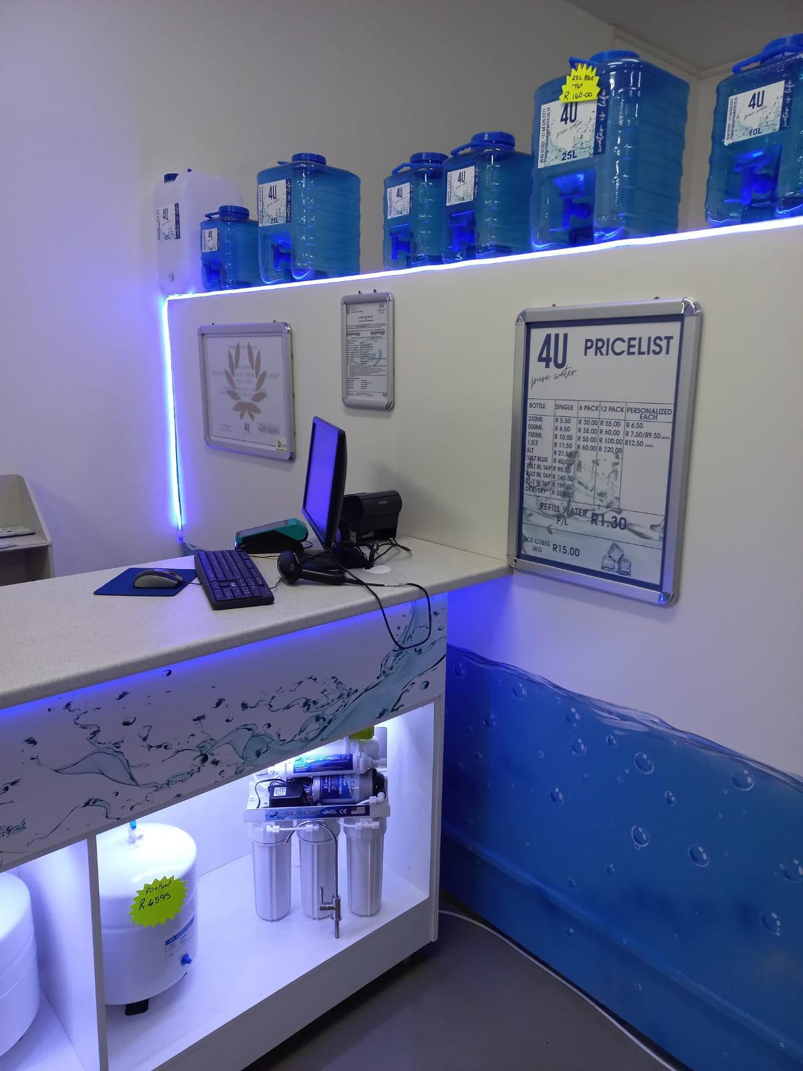
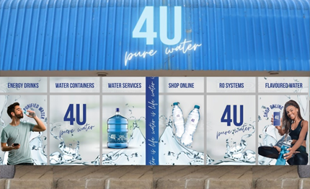
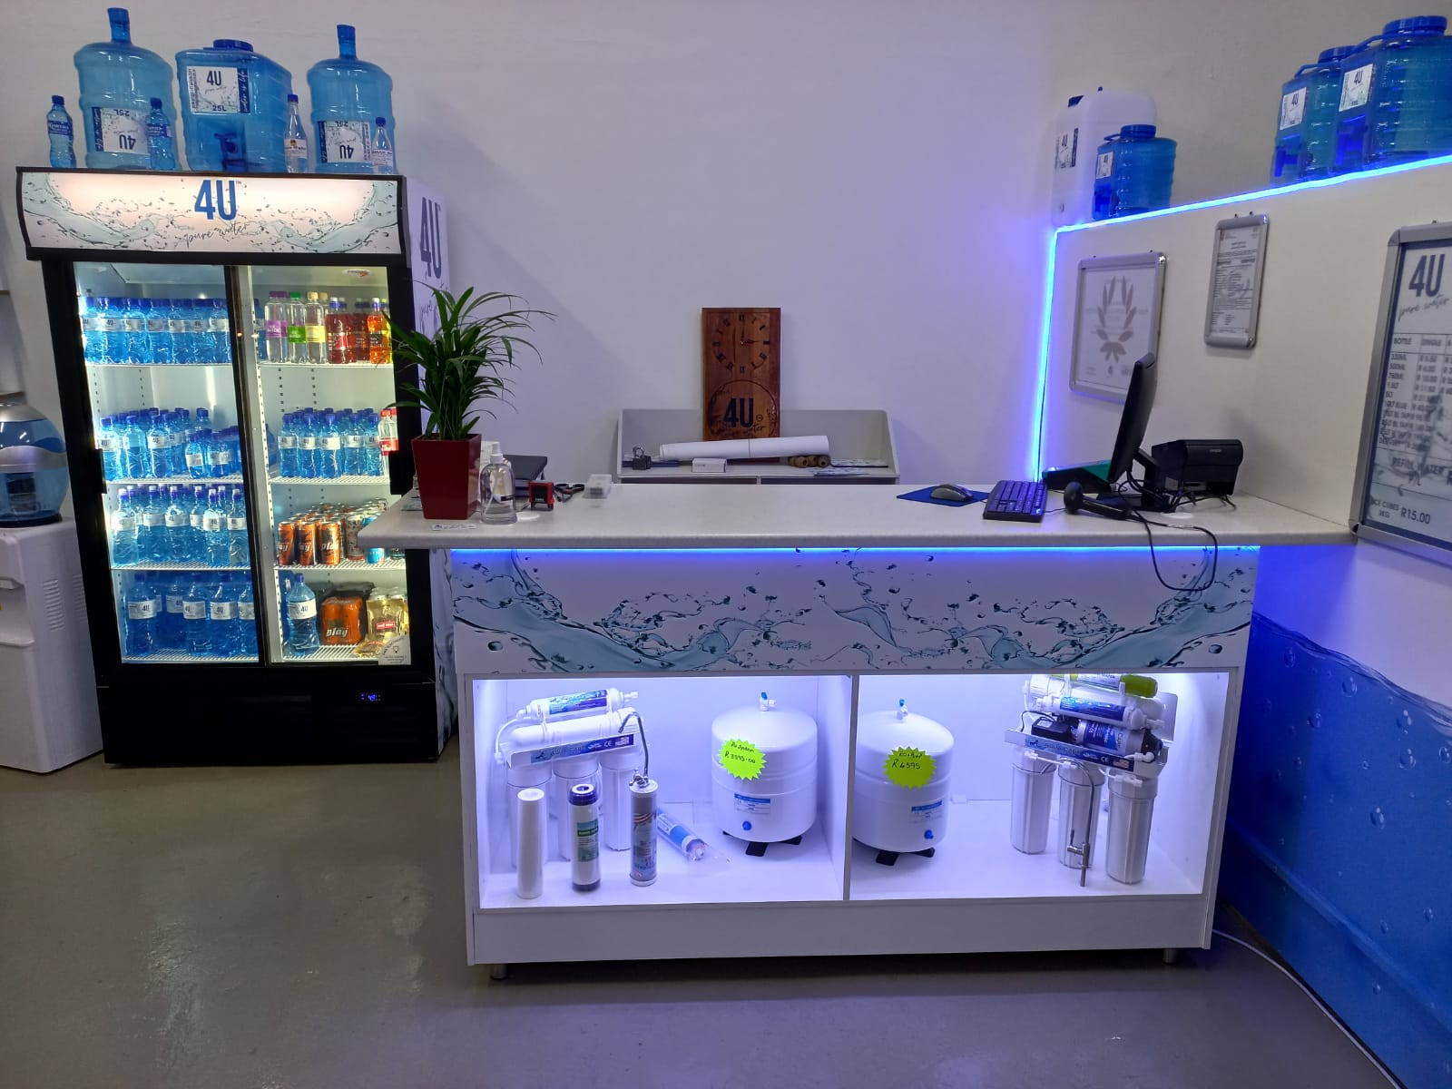
Window branding . Overhead signage . branded counter with display shelves . Double door branded fridge . Some shop fitting . IQ lite POS software . PC. Cash drawer. Scanner. 4 A0 clip frames and informational posters . 4 A0 clip frames and posters of people enjoying your water. Serving kiosk branded with energy saving downlights, Formica tops, aluminium support poles, 3 tap stainless steel tap table . Surgical grade hoses for dispensing . High quality branded shark fin banner, pop up, X banner
Front of Shop
Notes:
Window branding . Overhead signage . branded counter with display shelves . Double door branded fridge . Some shop fitting . IQ lite POS software . PC. Cash drawer. Scanner. 4 A0 clip frames and informational posters . 4 A0 clip frames and posters of people enjoying your water. Serving kiosk branded with energy saving downlights, Formica tops, aluminium support poles, 3 tap stainless steel tap table . Surgical grade hoses for dispensing . High quality branded shark fin banner, pop up, X banner

Slide 4
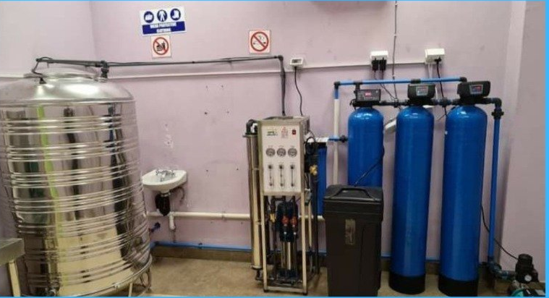
The 4 U Pure Water Standard shop offers a complete package with the standard of excellence.
This is our top of the range, fully fitted water shop that offers the client a beautiful environment to shop and the franchisee the ultimate environment to render quality service.
The Standard Shop also projects our trendy brand in a modern designed shop fit and state of the art purification plant. 4000 Reverse Osmosis plant Water softeners with auto circulation heads . Prefiltration with carbon . Mineral reintroduction cartridges . Pressure pumps with pump controller . 3 stage air dryer . Storage tanks 1 x 1000L . Electrical distribution board with soft start electrical components . All solenoids . wiring , fitting and installation . Second 3 tap dispensing table with surgical grade hoses . Wrapping station for case wrapping
Back of Shop
Facebook/4upurewater, 4upurewater.co.za, Instagram - 4u_purewater 4upurewater@gmail.com 0823528013
Notes:
At 4 U Pure Water, we understand the importance of providing water that meets the highest quality standards. We have equipped our shop with the latest in purification technology, including a 4000 reverse osmosis plant, water softeners with auto circulation heads, pre-filtration with carbon, mineral reintroduction cartridges, pressure pumps with pump controllers, 3-stage air dryer, and 1000-liter Stainless steel storage tanks. Our shop has been designed to ensure performance and top-notch quality across all facets. When you invest in the 4 U Pure Water Standard Shop, you can rest assured that you're getting the best of the best..

Slide 5
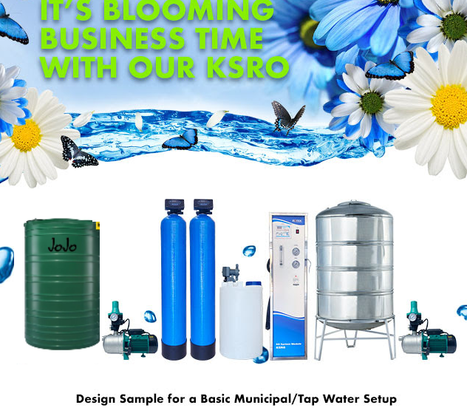
Your plant layout
Notes:
We take pride in our plant layout at 4U Pure Water. Our state of the art facility enables us to offer you the highest quality pure water. Our indoor plant space is full of items to give you the perfect water. Get in touch with us on our social media platforms or contact us for more details..

Slide 6
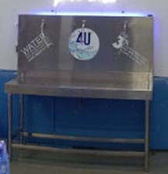

By adding the following Increase your business income
Add the below options to your 4 U Pure business package to increase your basket size for extra income and GP. The below added products add amazing value to your clients.
4 U Pure ICE | 4 U Pure Sparkling | 4 U Pure Juice Sachets | 4 U Pure Juice refill
1. 240kg to 320kg Ice on 24 hour cycle | 1. 3 Tap dispensing table | 1.makes2000 x 500ml or 250ml juice sachets per hour | 1.Flavours Orange, Tropical, Fruit and Vitamins
2. Scotsman ice machine | 2. Specialised carbonation dispensing taps | 2.Main flavour is guava | 2.100% juice with cells
3. 500L catchment bin | 3. Chiller Agitator | 3.Main demographic is lower income & schools | 3.Main demographic is MID to HIGH income groups
4. Fed with 4 U Pure water from plant | 4. Agitator
5. Purified Bio Plus ice | 5. Release valves
6. 1kg, 2kg, 3kg & 5kg bags branded | 6. Pressure gauges
 | 7. 180 bottles per hour
Notes:
Our 4 U Pure range of products can be added to your 4 U Pure Water business package to help increase your basket size and give your clients a unique value. We use pure water from our plant in our ICE, Sparkling Water, Juice Sachets, and Juice Refill. Our 500L catchment bin provides the water for our Scotsman ice machine and chiller agitator, which can produce up to 500ml or 250ml juice sachets in an hour. Our agitator also produces Bio Plus ice in 1kg, 2kg, 3kg and 5kg bags, all branded with 4 U Pure logo. Our specialised carbonation dispensing taps allow for up to 180 bottles of guava flavour to be produced in an hour. Enhance the value of your business by incorporating these unique products into your 4 U Pure Water business package..

Slide 7

4 U Pure Water Business Model Package Pricing
Full license 4 U Pure Water Retail business, as per page 7: R 420600,00 excluding VAT. This is the base package to open a 4 U Pure Water business – completely TURNKEY
Please note that you need an additional R120 000 for operating capital, which will include your premises rental, deposit and opening stock order. Add the below options to your 4 U Pure business package to increase your basket size for extra income and GP. The below added products add amazing value to your clients.
4 U Pure ICE | 4 U Pure Juice Sachets | 4 U Pure Juice refill | 4 U Pure Sparkling | 4 U Pure Alkaline
Full licence 4 U Pure Water Retail business as per page 6: R 425 600,00 excl VAT ADD ice production: R 75 700.00 excl VAT | Full licence 4 U Pure Water Retail business as per page 6. ADD juice sachets: R 135 000.00 excl VAT | Full licence 4 U Pure Water Retail business as per page 6: R 425 600,00 excl VAT juice refill: production: R 75 700.00 excl VAT R 64 000.00 excl VAT | Full licence 4 U Pure Water Retail business as per page 6:ADD Sparkling water: R 68 900.00 excl VAT | Full licence 4 U Pure Water Retail business as per page 6:ADD Bio Plus 10 R 68 900.00 excl VAT
Training provided: Brand . Sales and marketing with scripted dialog . Product and production knowledge
Notes:
At 4 U Pure Water, we are dedicated to delivering high-quality, cutting-edge products to our customers. Our business model includes a complete licensure package, with prices beginning at 420600 Rand. Additionally, we offer optional extras such as 4 U Pure Ice, 4 U Pure Juice Sachets, 4 U Pure Juice Refill, 4 U Pure Sparkling and 4 U Pure Alkaline for an even bigger boost in basket size and GP. To make sure our clients get the most from our products, we provide brand, sales and marketing tutoring, scripted dialogue, product expertise, and production knowledge. An additional 120000 Rand will be required for operating capital, covering premises rental, deposit and opening stock order. Options include: 4 U Pure Ice (75700 Rand), 4 U Pure Juice Sachets (135000 Rand), 4 U Pure Juice Refill (64000.00 Rand), 4 U Pure Sparkling Water (68900 Rand) and 4 U Pure Bio Plus 10 (68900 Rand). All these options excluding VAT It can also help you increase your basket size and gross profit..

Slide 8
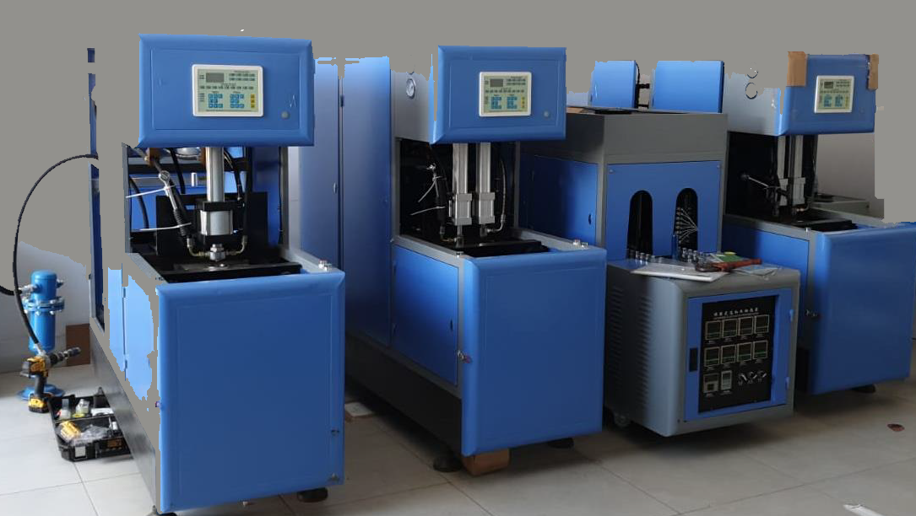
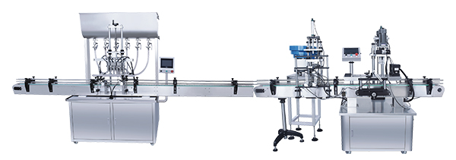
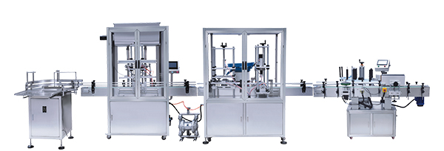
4 u pure water – in a factory set up
Notes:
Have you been searching for the purest drinking water available? Look no further than 4u Pure water. Our factory is state of the art, allowing us to guarantee the highest quality pure water. To find out more or to ask questions about our products, simply get in touch with us via social media, email, or phone. Contact us now to enjoy the purity of 4u Pure water.

Slide 9
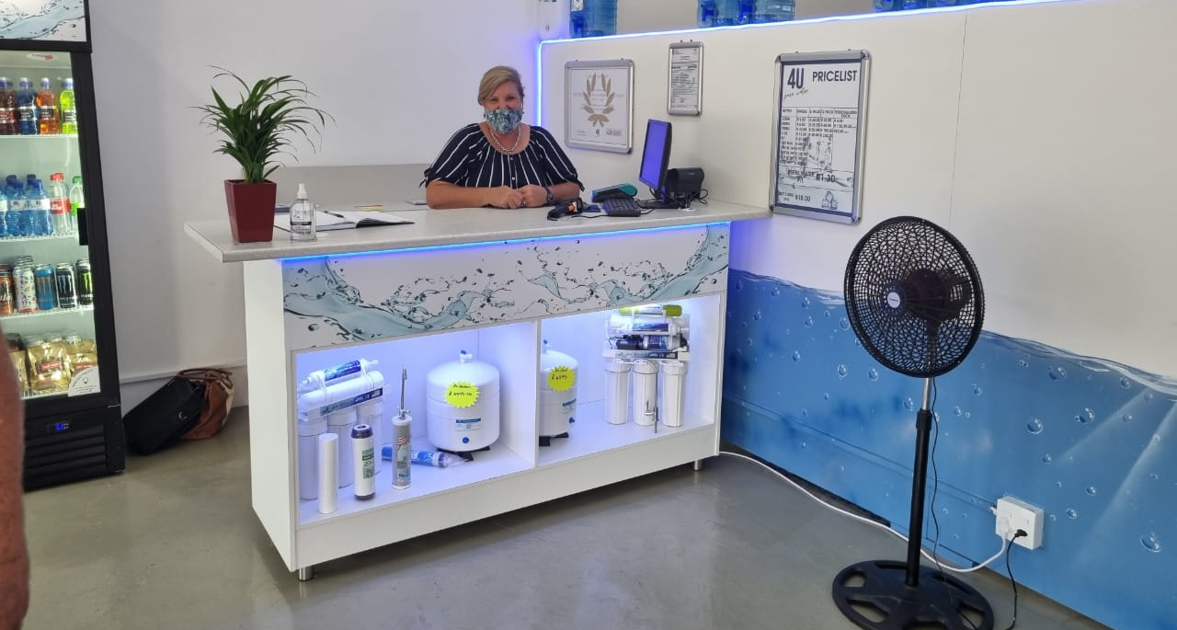
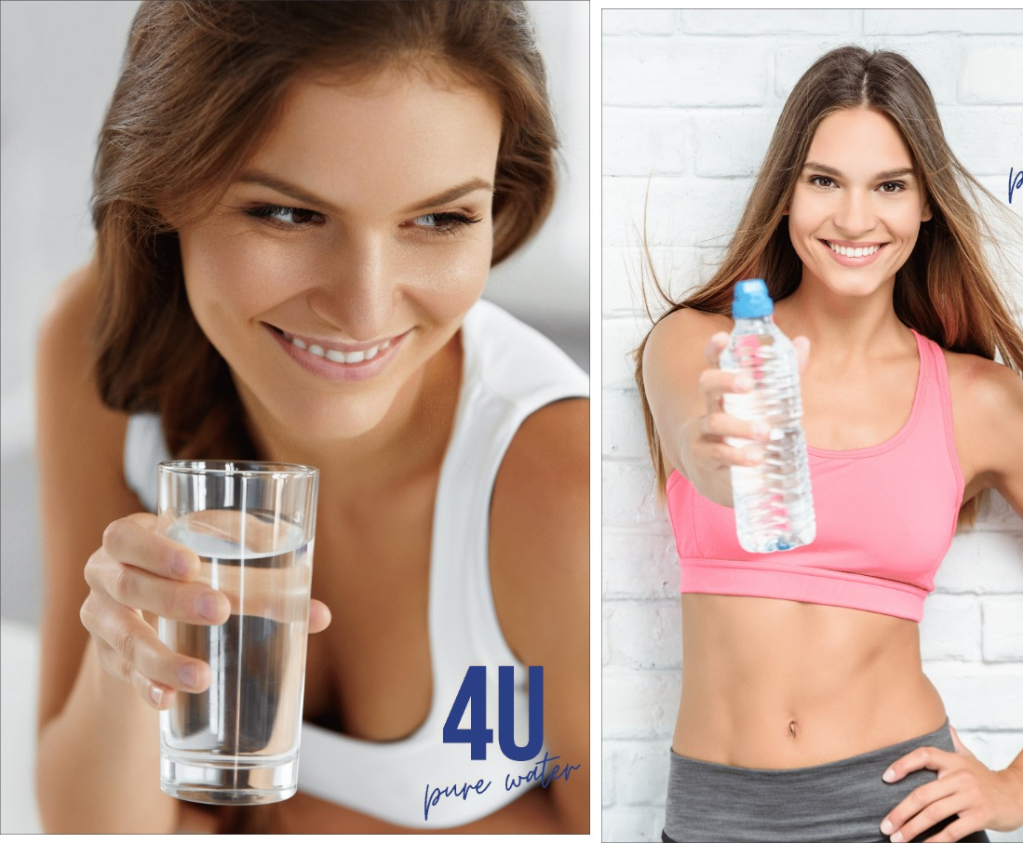
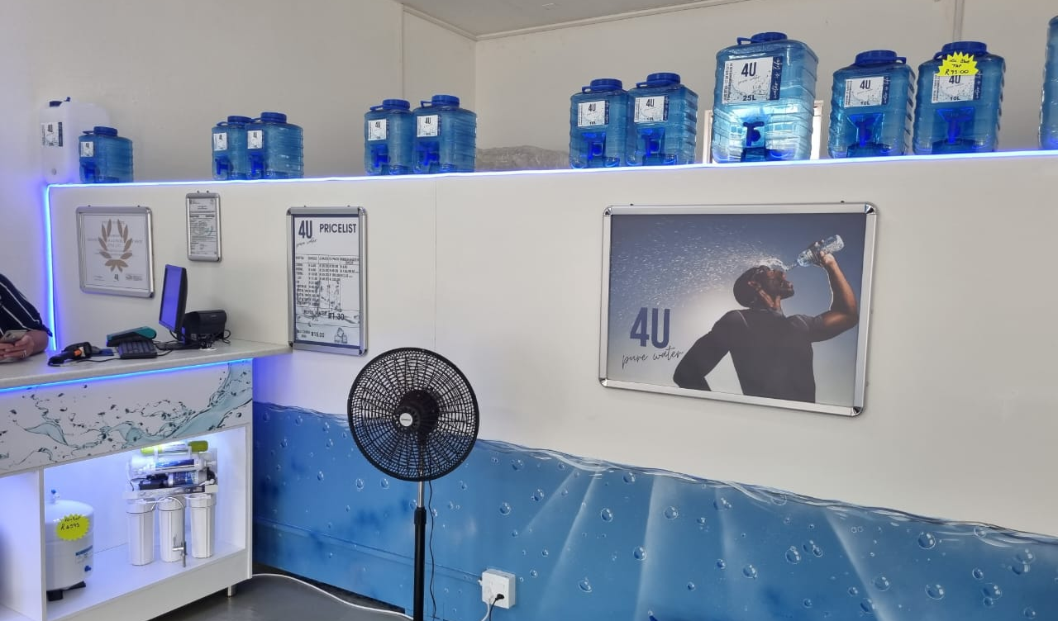
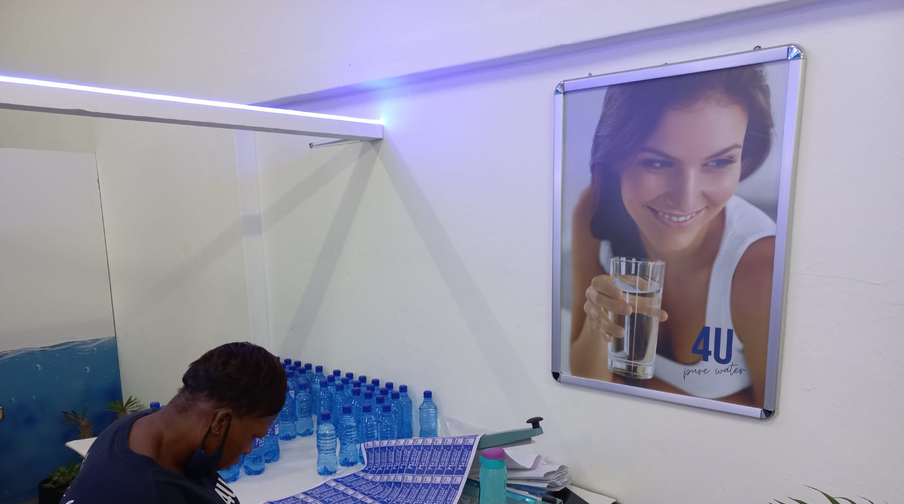
Store look
Notes:
At 4U Pure Water, we care about the environment and sustainability. We are committed to using re-usable and eco-friendly packaging to reduce our footprint and save the planet." At 4U Pure Water, we're passionate about making sure everyone has access to clean, safe, and high-quality water. We understand that when it comes to sustainable practices, the environment takes priority. That's why we are committed to using re-usable and eco-friendly packaging, ensuring that our impact on the planet is minimal. Through these efforts, we strive to make sure that everyone can benefit from our pure, natural water.

Slide 10
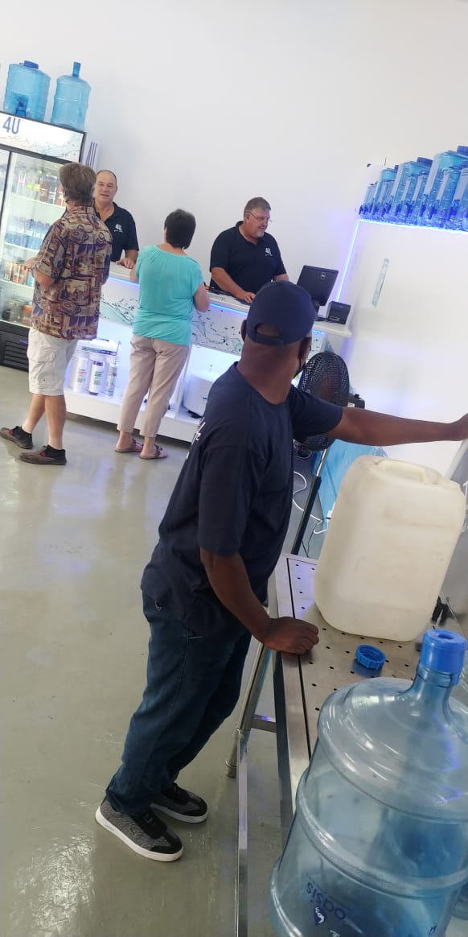
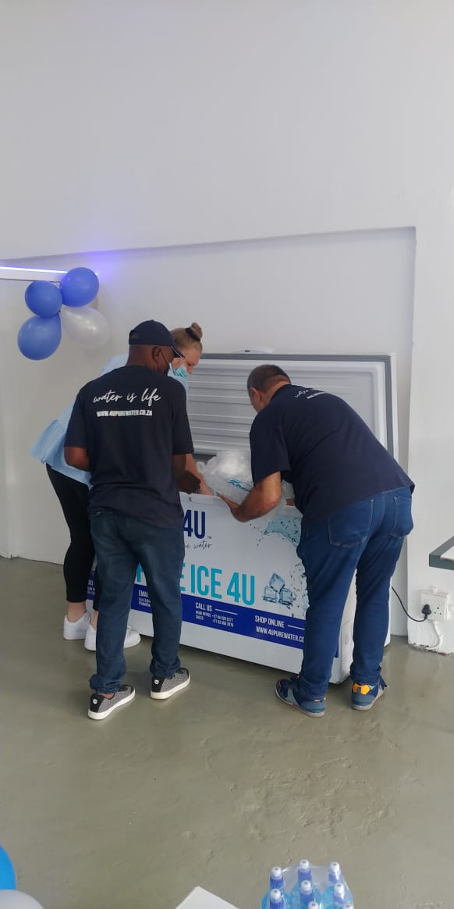
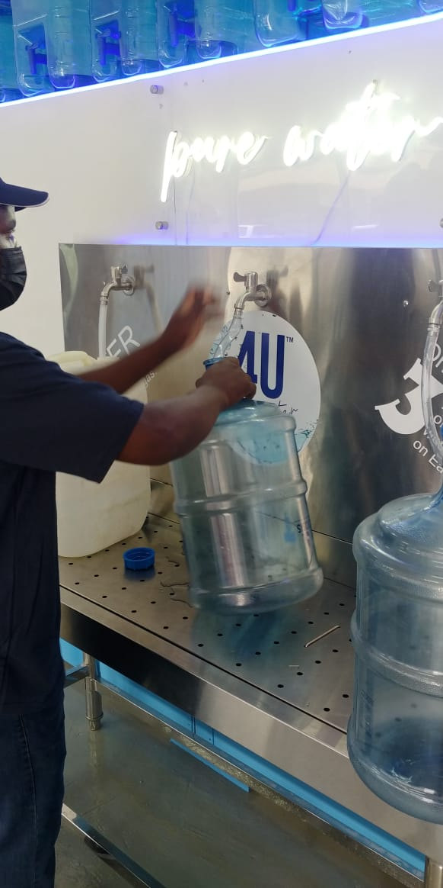
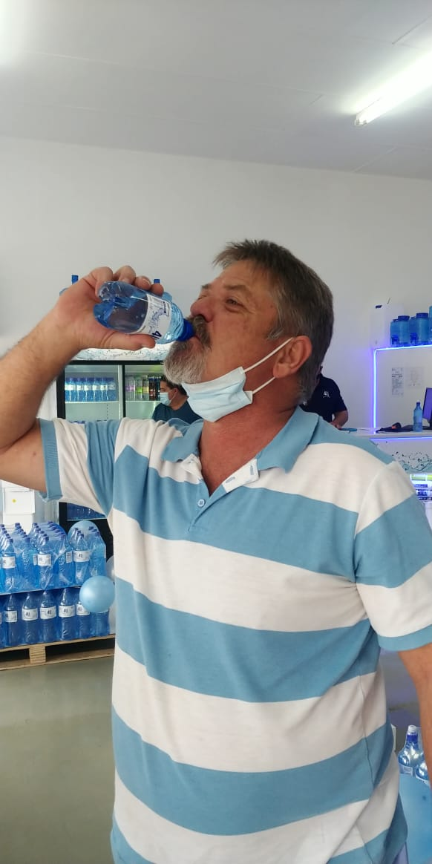
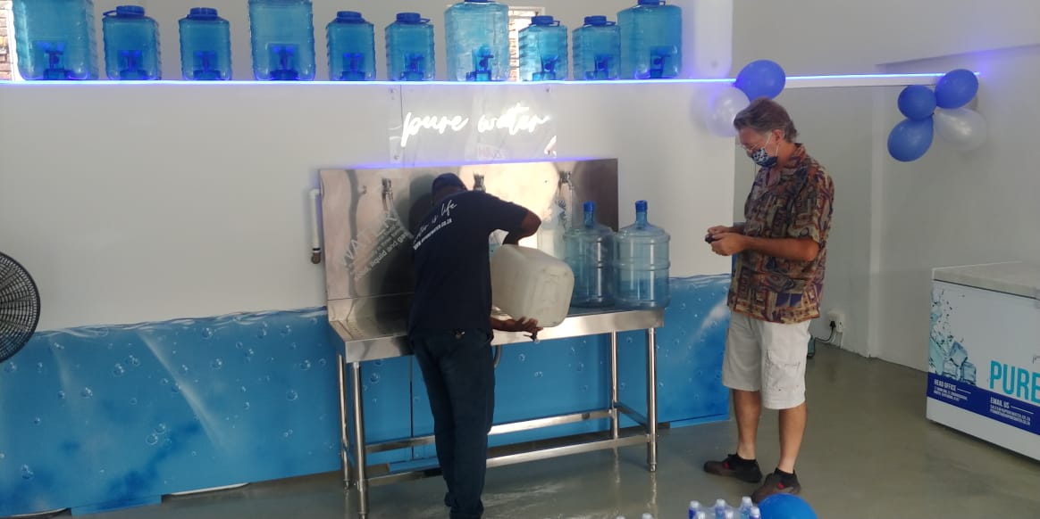
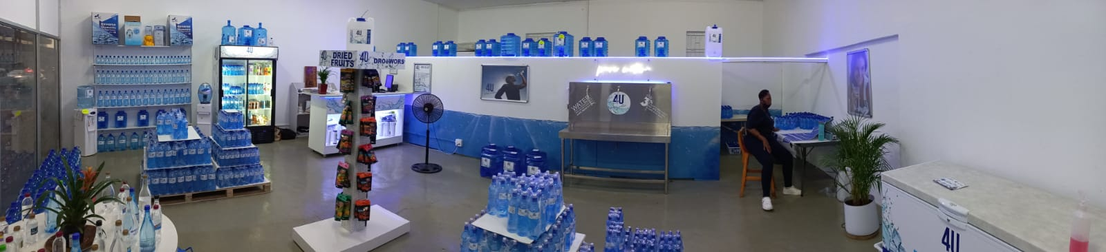
training of staff filling and rapping
Store look and feel
Facebook/4upurewater, 4upurewater.co.za, Instagram - 4u_purewater 4upurewater@gmail.com 0823528013
Notes:
Dedicated to providing you with the highest-quality water, our team undergoes rigorous training of staff to uphold the highest standards of safety and quality when filling and wrapping our products. For more information about our products and services, connect with us on the social media platforms, visit our website, or contact us via email or phone. We serve you with pleasure.

Slide 11
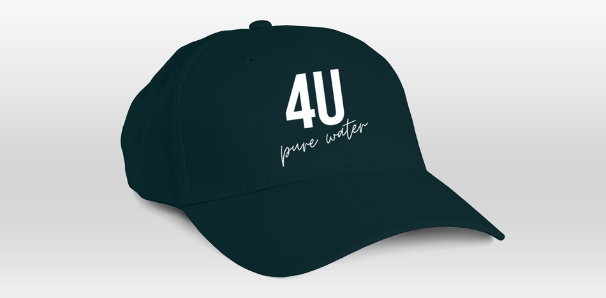
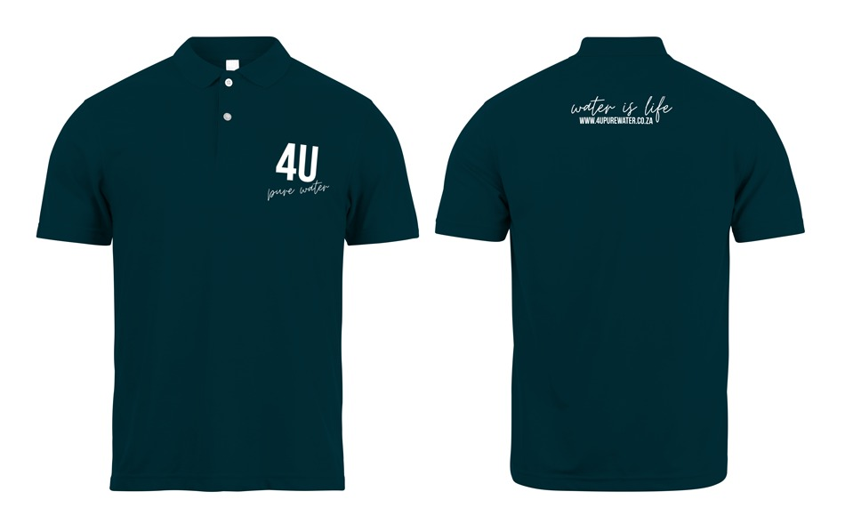
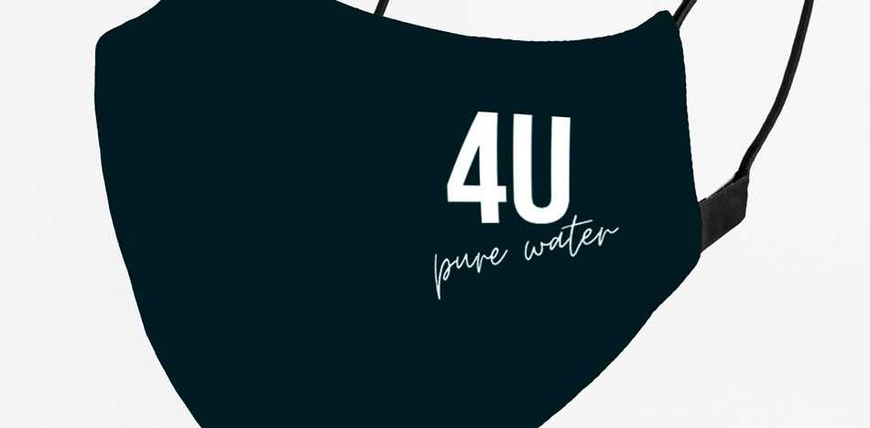
UNIFORMS
Notes:
At 4U Pure Water, we understand that uniforms are an important part of our business. We have created a wide range of stylish and practical uniforms for our employees. Our uniforms are designed to be comfortable and professional, ensuring that our staff is always looking their best. We also offer a range of promotional items, such as hats and t-shirts, for our customers to show their support for our brand. With our social media accounts, website, email address and contact number, our customers can easily get in touch and follow us to stay up-to-date on our products and services.

Slide 12
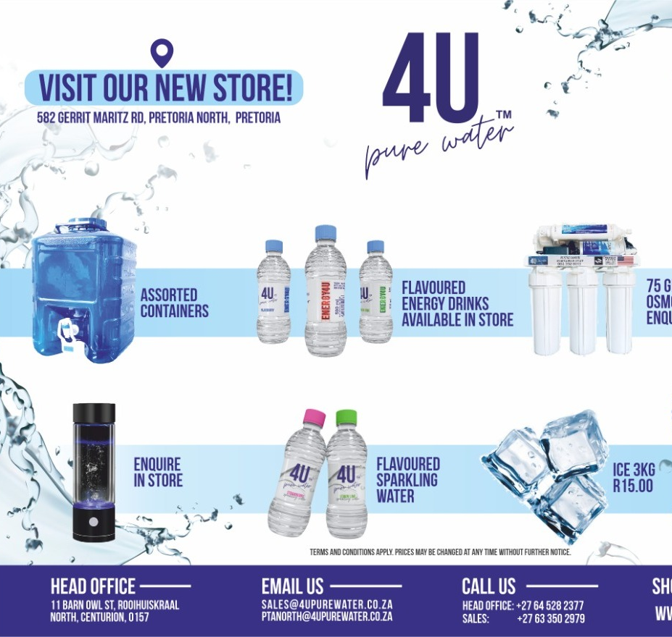
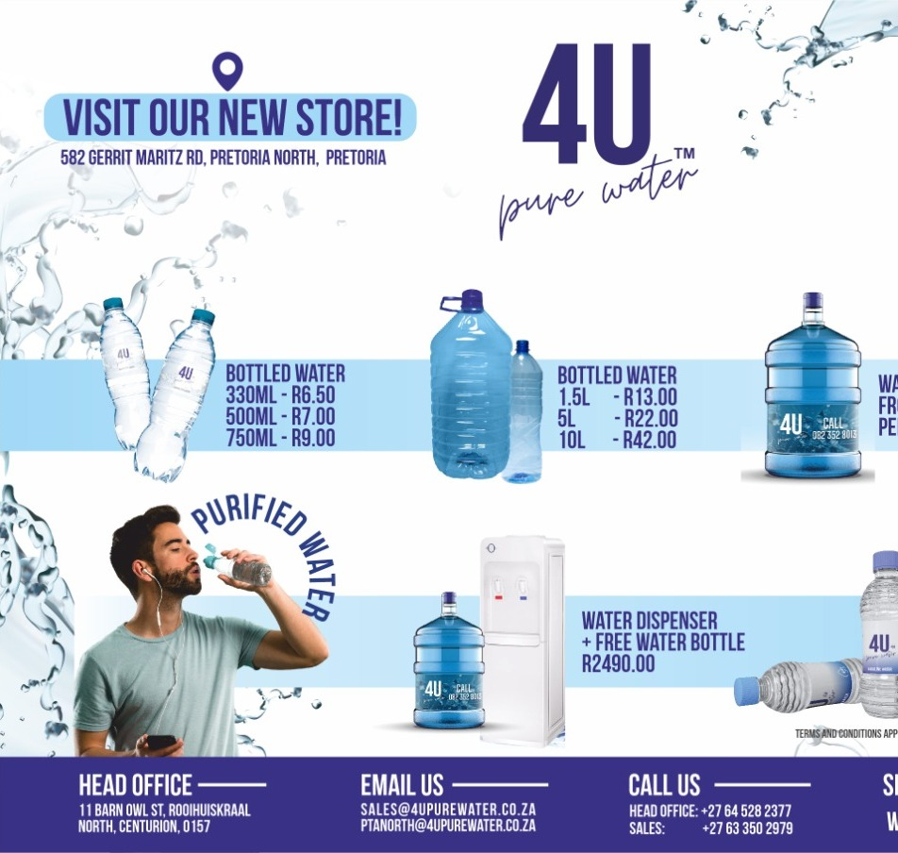
Notes:
Pursue the highest quality for yourself and your family with 4U Pure Water! Our comprehensive marketing campaign includes presence on Facebook, Twitter, Instagram and the web, each with a distinct focus and custom offerings. Reach out to us at any of our various channels, or contact us directly via email or phone. With 4U Pure Water, you can be sure that you are doing right by yourself and your environment.

Slide 13
END THANK YOU
Notes:
END THANK YOU

