Slide 1
Organizational and Personal HR Development Plan
Anne Dillard
College of Nursing and Healthcare Professionals
Grand Canyon University
HRM-635-0500; Acquiring, Developing and Leveraging Human Capital
Dr. McGlory
December 20,2023

Slide 2

Acquiring, Developing and Leveraging Human Capital:Strategies/pro’s and con’s/outcomes
Employee retainment starts during the recruiting new hires process: solid assessment tool testing provides reliable data, this needs to be considered
For long-term goals.
Diversity in the workplace is proven to increase productivity, performance and innovation
Use data driven interviewing process, standardized and unbiased questions
Companies who are progressively thinking of their future offer competitive salarys, with added rewards packages and other employee incentives to draw in new employees who have high quality talents
It is proven that increasing employee morale, appreciation will build a stronger work place culture with employees who are engaged, when employees are engaged they will think long-term career goals with the company
Employees are the number one biggest assest within an organization, they directly impact the success and growth a company experiences
HR departments are more involved with employee satisfaction and innovated ways of achieving these goals
ho
This Photo by Unknown Author is licensed under CC BY-SA-NC
Notes:
This presentation is the result of an accumulation of my perception of the different stages of acquiring, developing and leveraging human capital, and what roles HR and management have in making this a successful process and identifying issues with the process that can be improved upon to continued success of the company and the workplace culture that is created with the employee being at the center of all goals for success, professional growth, performance improvement and reviews, employee incentives, appreciation and engagement being the number one goal of the company’s success. The Performance Management Process starts with the goal of increased employee retention, performance and engagement, this begins with the recruiting/Onboarding process (Bachmann, 2020).

Slide 3
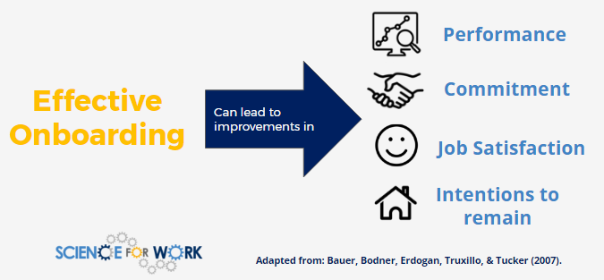
Current Systems for Hiring: Pro’s
Strategic onboarding process is the foundation of employee satisfaction and retention.
Onboarding Must have 4C’s:
Compliance activities and focus, the employee may need assistance navigating benefits, policies, company expectations, and the work culture.
Clarification activities are when the new hire learns about their job role and responsibilities. Needs to enhance the new hires understanding of the company’s mode of operation.
Culture is a vital aspect of onboarding, this is a focus on providing the new hire with a sense of organizational “norms” values,mission and vision goals, attitudes that are shared in the workplace.
Connection, assigning an onboarding “buddy” helps build the proper connection with others in the workplace.
Notes:
Studies show that a strategic and effective onboarding process is essential for employee retention, and company’s success (Bachmann, 2020). In order for the onboarding process to be effective it must have certain qualities and structured steps that are adhered too. These qualities were coined the 4C’s of a successful onboarding process (Buchmann, 2020). The 4C’s or 4 pillars (as they are sometimes called) are compliance, clarification, culture and connection; during the compliance process the new employee learns about the company’s culture and their expectations on ethical behavior, safety procedures, they also will establish the employee benefits , policies and how they relate to their new role will also be discussed, the next stage of the process is clarification; this is where the new employee has their job role and responsibilities clearly explained, key performance metrics will be discussed as well, this is usually a meeting with your manager, culture is also a relevant aspect of effective onboarding, the organizational “norms” should be shared with the new employee along with expectations of supporting the established culture in the workplace, this is the values, mission, vision, belief systems, attitudes and assumptions that are displayed among the workforce, and the last important C is connection; it is savvy and smart to assign the new employee a “ buddy” for this step (Bachmann, 2020). This is an employee who will assist the new hire in making connections with other workers, and they will also be able to explain the teamwork methods that are in place, this will support the new employee to build immediate rapport with co-workers and achieve company goals with a clear understanding (Buchmann, 2020).

Slide 4

Current Systems for Hiring: Con’s
Undefined company goals and role expectations.
Lack of leader feedback.
Weak training.
Inadequate ongoing support.
Effects from poor onboarding process:
High turnover rates.
Productivity losses.
Company reputation damage.
This Photo by Unknown Author is licensed under CC BY-SA
Notes:
In the same way an effective onboarding process can have an impact on employee satisfaction and long-term employment, a bad employee onboarding can impact in a negative way (Jones, 2022). Employee onboarding is a process that integrates a new employee into the organization, and this is vital on keeping new employees (Jones, 2022). When onboarding is done strategically, is engaging and supportive of the new employee transitioning into the workplace culture, new job role , and understands the company’s key performance goals, the new employee is more satisfied, productive, committed and motivated (Jones, 2022). A bad employee onboarding is the opposite of a strategic and effective one. Bad onboarding processes have unclear and undefined company goals, job role expectations and responsibilities, lack of leaders feedback, weak training styles, and inadequate or non-existent ongoing new employee support (Jones, 2022). As one might expect this type of onboarding process impacts employee turnover (increases), productivity losses do to the new employee not understanding their role along with poor training, as might be expected when new employees do not feel supported and included in a new work environment they will quit, and possibly spread negative reviews about the company, leading to the company’s reputation being damaged with the public (Jones, 2022).

Slide 5
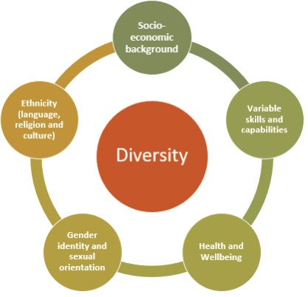
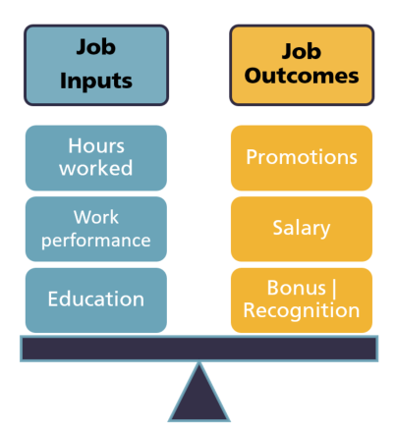
Leveraging Diversity to Improve Performance Outcomes:
Focus on employees strengths to build employee engagement
Hire a diverse group of employees in order to experience the full potential of your human capital asset
Develop a work culture that is inclusive, and makes employees feel safe and that they belong
Company leaders should be honest and authentic communicators with their employees
More frequent performance evaluations are proven to be more effective in motivating employees to obtain goals that will be in alignment with the company’s mission and goals
Notes:
According to (Holger, 2019) the companies who make diversity and inclusion a must in their workforce have a competitive edge over their competitors who do not have the same progressive work environments. Ensuring that the company hires all kinds of people (races, skin colors, genders), brings a new level of innovation into the culture of the workforce. When a WSJ analyst conducted a study into the top performing companies in the corporate world they all had large numbers of diverse employees and inclusivity was prominent, this was reported to be what made these companies more successful, and innovative, it has been said that that diversity helps create long-term shareholder value (Holger, 2019). Analysts agree that diversity can help fuel innovation, which is critical to success in a fast-changing world where technological disruption has become the norms (Holger, 2019).

Slide 6
Professional development
Frequent acts shown of appreciation
Total rewards packages
Show authentic caring when giving performance reviews
Appreciate all people for who they are to God
Build a positive work place culture and ensure it is maintained and continues to grow
Clear rules of ethical work place behavior expectations
Encourage a safe and inclusive environment respecting each other
When employees feel valued and that they are heard by their leaders their motivation to perform at the highest quality is increased
Successful Companies Have Satisfied Employees:
Notes:
The most successful companies in todays market are progressive visionary’s, whose leaders collaborate with a strategic HR department, to develop a performance management process that puts the employees at the fore-front (Deloitte, 2017). These companies have realized the past way of prioritizing focus on the shareholders first , then the customers second, and putting the employees last is actually backwards (Deloitte, 2017). They soon realized if the company’s focus changed to the employees first (the largest asset in any company) they in turn take care of the customers, (who) in turn take care of the shareholders , and what happened was increased employee productivity, satisfaction, engagement, performance, productivity and long-term careers with the company, all of this in turn increased profits and success of the company (Deloitte, 2017).

Slide 7


Building an HR Department for Success:
Notes:
In todays market in order for companies to be successful, they need an HR department of savvy, and progressively thinking individuals. It is necessary for HR to develop a strategic HR management plan that treats employees like human capital a asset in the company (Conroy & Rudder, 2023). Considering a strategic approach to HR management is increasingly important in our changing world. Creating a strategic human resource management plan can ensure you have a pipeline to qualified employees as time goes on, ensuring the sustainability of the business (Conroy & Rudder, 2023). Traditional HR weighed inputs more heavily than outputs, for instance their focus was on following compliance standards, regulations and processes, managing benefits packages, running payroll, hiring new talent and managing day-to-day employee relations (Conroy & Rudder, 2023). Strategic HR focuses on supporting organizational goals, metrics like employee engagement and profit per employee, still considering the other inputs, but in strategic HR the focus is on outputs (Conroy & Rudder, 2023).

Slide 8
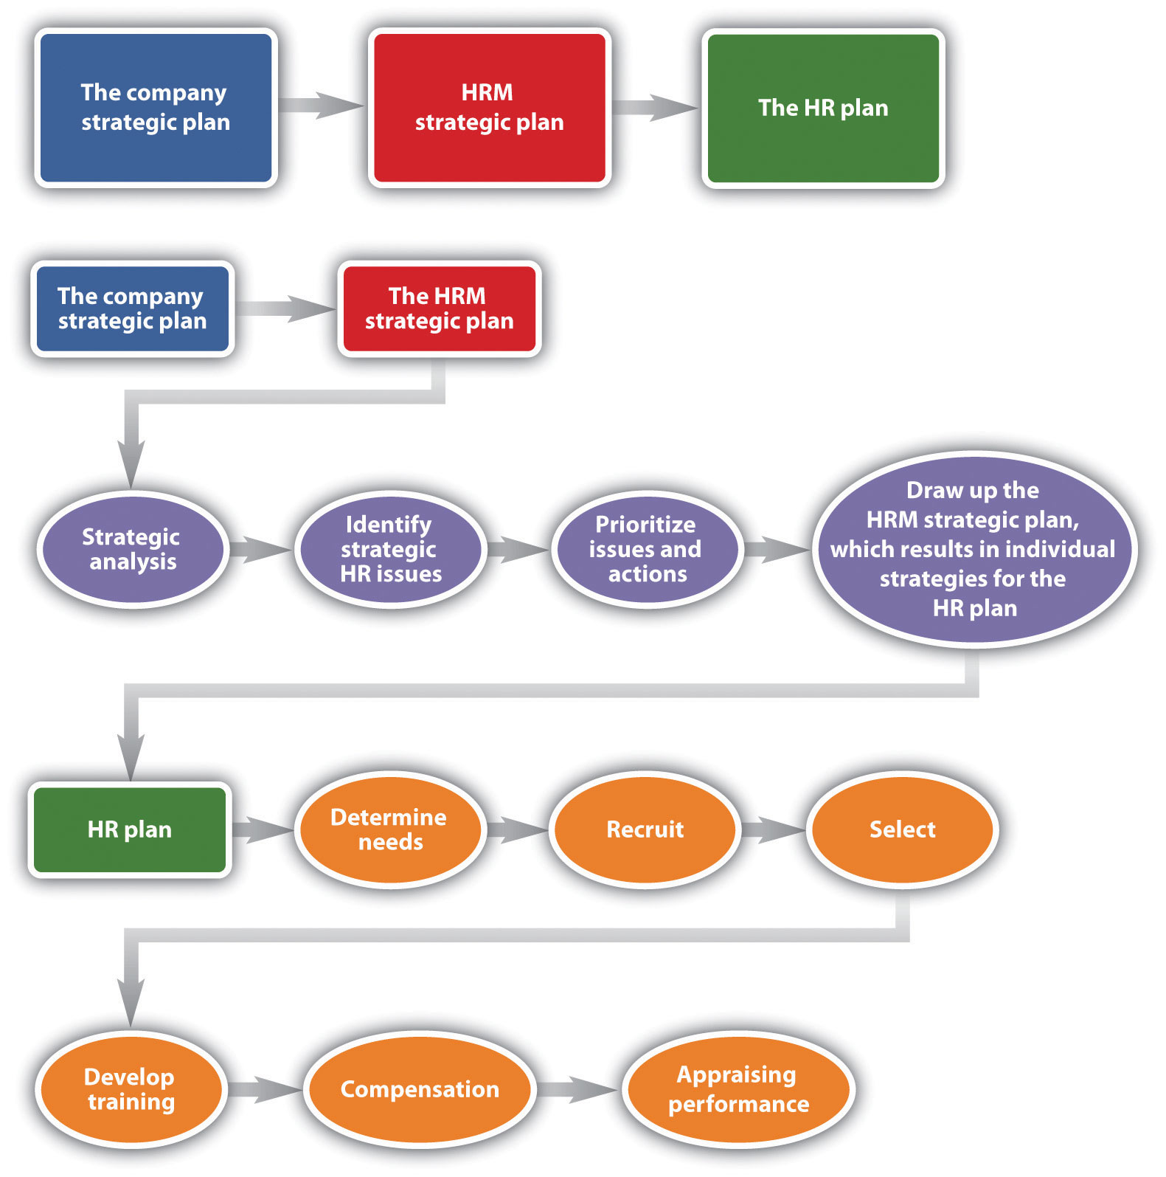
Integrating HR personnel with the Company
Christian Worldview Benefits:
Develop initiatives that enhance employee happiness, and encourages employees to succeed.
Uses their role in HR to honor God by cultivating a culture that encourages love for others to achieve God’s purpose.
Concerned with personnel engagement in the workplace, because they are focused on helping others with cultivation and service.
Develops a religiously based code of ethics that serve’s as the moral compass for company’s culture.
Develops methods to ensure that the employees feel safe, and cared for at the workplace and that participate in meaningful tasks that will motivate the employee to stay long-term.
This Photo by Unknown Author is licensed under CC BY-NC-ND
This Photo by Unknown Author is licensed under CC BY-SA-NC
Notes:
We have discussed the traditional HR role and the more current strategic HR role. HR professionals who treat people with dignity, helping them grow and become empowered, gaining knowledge and skills, and offering compensation packages that are ahead of rewards than the competitors can all be said to be Godly principles even if the company’s leaders do not know God (O’Brien, 2019). When a true follower of Jesus is in an HR role they bring a whole unique perspective to employee management, they believe each person is created in God’s image and should be treated this way, they also see that each person has been gifted by God with unique abilities and skills, and that all are loved by God and bought with the price of his son’s death on the cross (O’Brien, 2019). When the HR professional has these views and the company does as well, it creates a powerful work environment for faith-oriented decisions, attitudes and outcomes that show compassion and empathy to employees, this impacts the rise of employee satisfaction, because they feel valued, heard and accepted (O’Brien, 2019).

Slide 9
Recommendations for Leaders to make sound decision choices:
Open minded and has a collaborative mind-set.
Communicates clearly and listens attentively to feedback.
Know your role as a leader and make wise decisions when planning being transparent to employees about your choices.
Accepts counsel and ideas of others, gathering as many ideas to chose quality options.
Have a clear sense of ethics that show company values and upholds these qualities.
Always review the legal ramifications of choices before implementing them.
Display empathy for others when making decisions, and be concerned with how these decisions are going to affect them.
The best decisions involve a mix of knowledge, intuition, and a willingness to take a bit of a risk.
Notes:
Business leaders have the ability to cause their company to succeed or fail by the types of decisions they make (Onley, 2019). According to (Onley, 2019), there is a 95% correlation between companies that excel at effective decision-making and those with strong financial performance. Signs of a good leader who has sound decision making skills are; open-minded, listening and considering others ideas and feedback (Onley, 2019). Leaders who remain transparent in how they make decisions, and the reasons behind why they made the decisions they did (Onley, 2019). The best leaders use tools such as checklists, set deadlines, gather many options, weighs the cost of decisions before there made, leads with values, and understands that his employees need to see him in action (Onley, 2019). It has been said that the best decision makers are the ones who have a mix of knowledge, empathy, intuition, and a willingness to take a risk (Onley, 2019).

Slide 10
HR Personal Development Plan:
Focus on goals that build relationships within the workplace.
Translate business strategy to people strategy.
Focus methods on cultivating a cultural awareness in the workplace, supporting work ethics and company’s mission and vision goals.
Develop employee training to meet company’s expectations.
Performance reviews with employees regularly, to keep on track to achieve goals.
Helps employees identify their strengths and weaknesses and guides them in obtaining the necessary learning and resources needed to further their development.
Is aware of discrimination laws and equal employment opportunities, overseeing that they are adhered to by the company, and unconscious bias is monitored.
Encourages and supports a diverse workforce, supporting employees innovation and ideas, always gathering feedback in order to better align company goals and employee engagement.
Ensures that ethical behavior is being displayed by all.
Develops employee goals with the purpose to empower and grow them with in the company considering long-term goals and employment.
Notes:
HR professionals are very adept at pairing the right person to the right job, other areas that are necessary to develop a plan that is successful is to be able to identify strengths and weaknesses and guide employees to the right resources that will empower them and motivate them to increased performance (Zeidner, 2022). When developing an HR plan, it is necessary to keep leadership requirements in mind, and translate business strategy into people strategy, cultivating a cultural awareness in the workforce, develop flexible training opportunities for professional growth, gather feedback, and assist in helping set attainable goals among the workforce (Zeidner, 2022).

Slide 11
References:
Buchmann, J. (2020). The 4C’s of Onboarding: Achieve a Hitch Free Integration Into A New Company. https://introdusapp.com/4c’s-of-onboarding/.
Conroy, B. & Rudder, A. (2023). Strategic Human Resource Management: The Ultimate Guide. https://www.usatoday.com/money/blueprint/business/hr-payroll/strategic-human-resource-management/.
Deloitte. (2017). Building a Better Employee Experience. https://deloitte.wsj.com/cmo/building-a-better-employee-experience-1502337738/.
Holger, D. (2019). The Business Case for More Diversity. https://www.wsj.com/articles/the-business-case-for-more-diversity-11572091200/.
Jones, R. (2022). The Impact Of Bad Employee Onboarding. https://www.trainingfolks.com/the-impact-oHf-bad-employee-onboarding/.
O’Brien, R. (2019). Human Resource Management Through A Spiritual Lens. https://businessasmission.com/human-resource-management-through-a-spiritual-lens/.
Onley, D. (2019). How Leaders Can Make Better Decisions. https://www.shrm.org/hr-today/news/hr-magazine/2019/how-leaders-can-make-better-decisions/.
Zeidner, R. (2022). How HR Professionals Can Use An Individual Development Plan. https://
www.shrm.org/hr-today/news/hr-magazine/2022/pages/individual-development-plans.aspx/.

