Slide 1


Welcome to "Learn English with Joy"
Engage kids ages 6-10 in fun English learning. Interactive, visual, and entertaining content. Build foundational speaking, reading, and writing skills.
by Zayda Ahmed

Slide 2




Introduction: Why Learn English?
English is spoken by 1.5 billion globally. Discover the career, cultural, and communication opportunities. Help kids connect with the world early.
Career
Culture
Communication

Slide 3
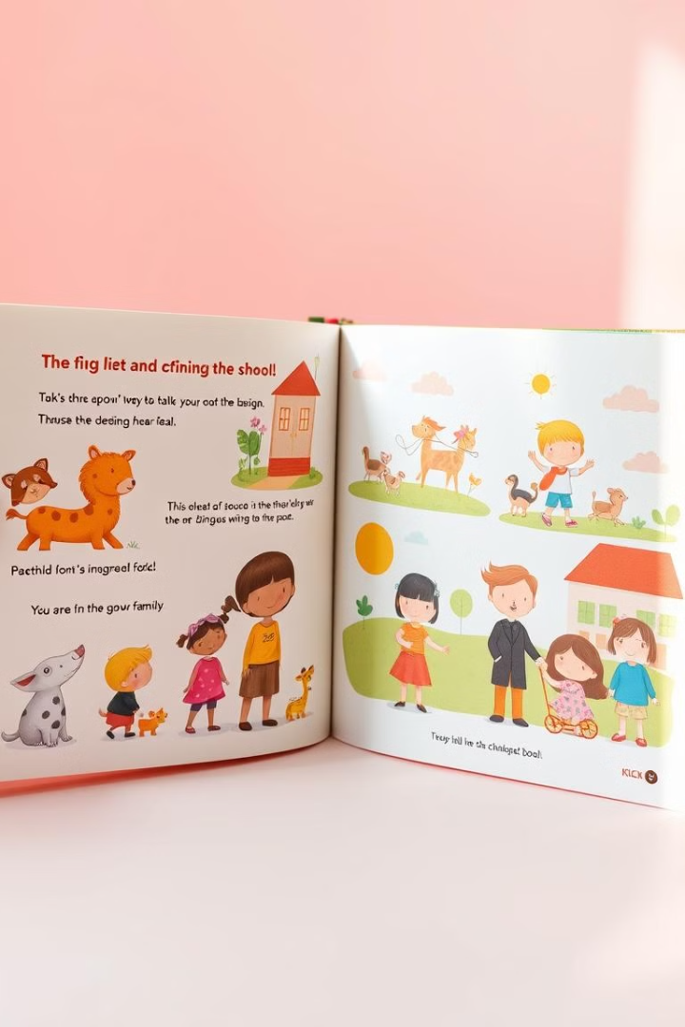
Structure of the Book
15 themed units: School, Animals, Family, etc. The book focuses on vocabulary, grammar, and conversation skills. It also includes colorful illustrations and interactive exercises.
1
Themed Units
2
Skills Focus
15 unique sections.
Vocabulary, grammar, conversation.
3
Interactive Content
Colorful illustrations and exercises.

Slide 4
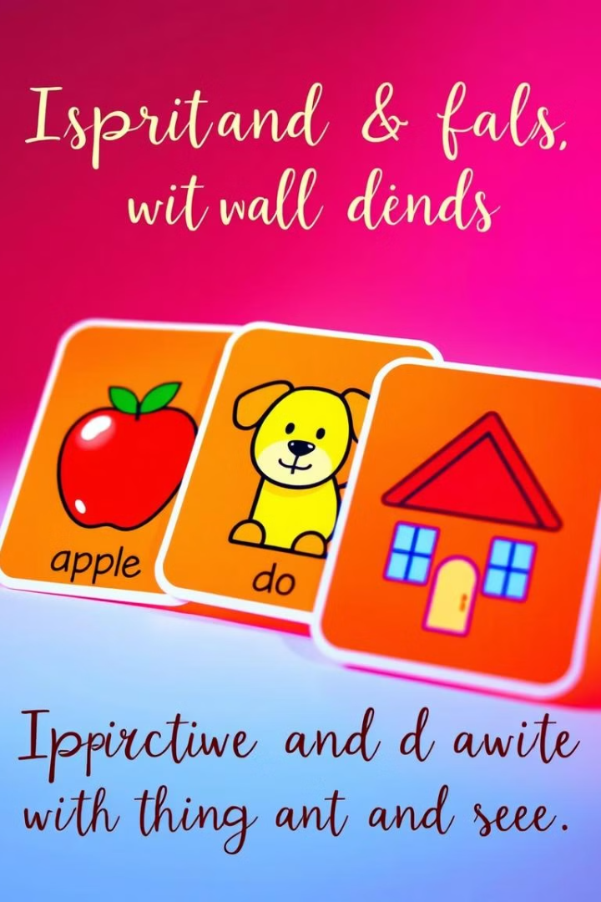
Engaging Vocabulary Lessons
Visual flashcards with common words (e.g., apple, dog, house). The lessons also include phonetic guides for simplified pronunciation. Fun matching games and fill-in-the-blank activities.
Visual Flashcards
Phonetic Guides
Matching Games

Slide 5




Grammar Made Simple
Everyday examples like "I am, You are, We are." Simple exercises: Sentence building and "Spot the Mistake." Gradual progression: Nouns, verbs, adjectives.
Examples
I am, you are, we are.
Exercises
Sentence building.
Progression
Nouns, verbs, adjectives.

Slide 6
Interactive Content for Readers
Fun stories with characters to learn contextually. Dialogues for kids to practice conversational English. Workbook-style questions for deeper engagement.
Contextual Learning
Conversational Practice
Fun stories.
Dialogues for kids.

Slide 7



Building Confidence through Activities
Singing nursery rhymes for vocabulary practice. Role-playing dialogues: Ordering food, asking directions. End-of-chapter rewards: Stars or certificates.
Role-Playing
2
Ordering food, directions.
Singing
1
Nursery rhymes for vocabulary.
Rewards
3
Stars or certificates.

Slide 8

Conclusion: Creating Confident Learners
Inspire kids to learn and love English. Support parents and teachers with user-friendly content. Build a foundation for lifelong language skills.
Inspire Learning
Support Users
Build Skills

