Slide 1
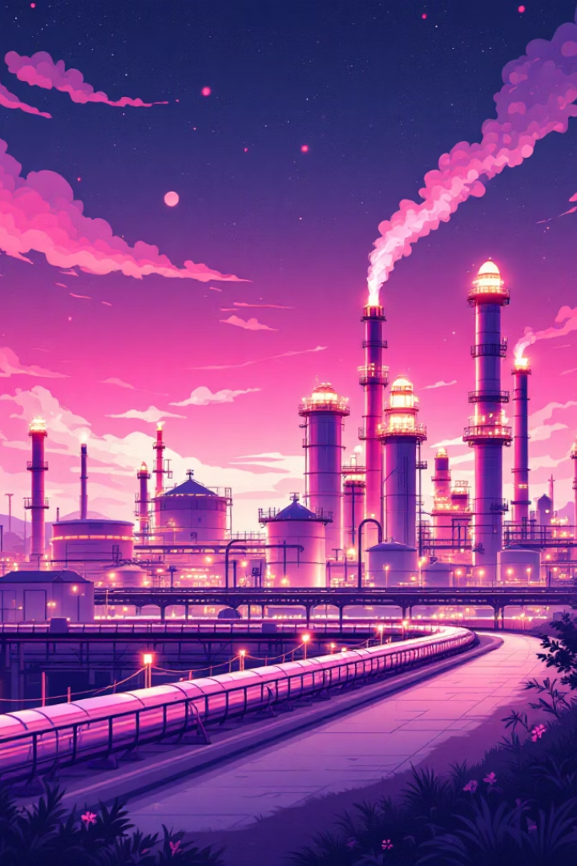
The Petroleum Industry
Industrial Chemistry Explained
Your fuel, plastics, medicines, even your phone… all come from one dark liquid deep underground. Welcome to the petroleum industry, where industrial chemistry transforms crude oil into the products that power modern life.

Slide 2
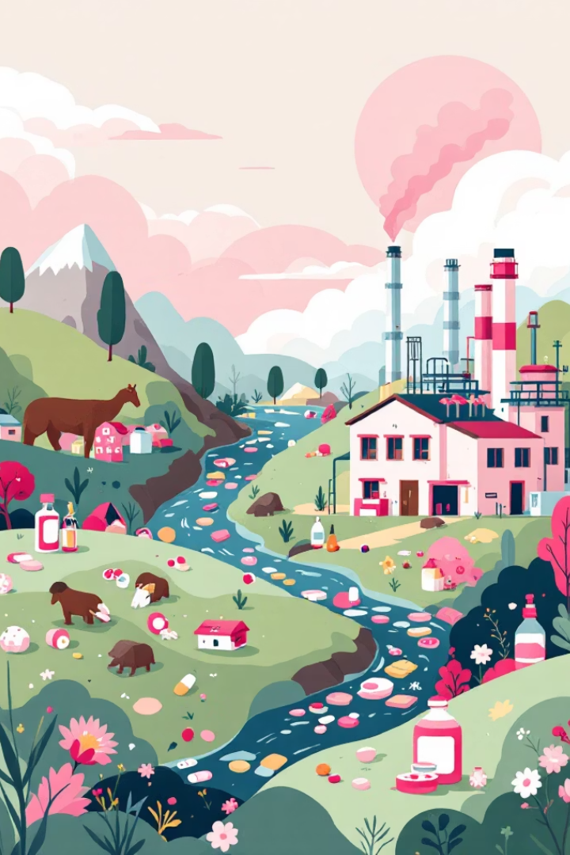

INTRODUCTION
What is the Petroleum Industry?
The petroleum industry is a cornerstone of modern industrial chemistry. It encompasses the entire global process of exploring for, extracting, refining, transporting, and marketing petroleum products.
This intricate network focuses on converting raw crude oil into a vast array of useful materials that fuel our transportation, drive industries, and underpin virtually every aspect of our daily lives, from energy to materials.

Slide 3

RAW MATERIALS
Crude Oil: The Earth's Black Gold
The primary raw material for this massive industry is crude oil. This thick, black, viscous liquid is a complex mixture of hydrocarbons. It's a fossil fuel, meaning it was formed over millions of years from the remains of ancient marine organisms, plants, and animals.
These organic materials were subjected to immense heat and pressure deep within the Earth's crust, transforming them into the energy-rich substance we call crude oil. In its raw form, crude oil is almost useless; its true value is unlocked only when industrial chemistry transforms it into various refined products.

Slide 4
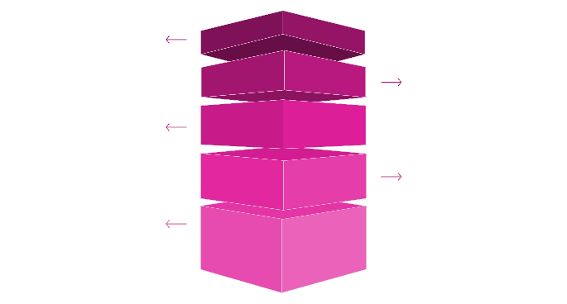
CORE PROCESSES
Fractional Distillation: The First Separation
Top: Refinery Gas
Lowest boiling point; collected at the column top.
Petrol Layer
Light fraction; condenses near the upper section.
Kerosene Tier
Mid-range boiling point; collected mid-column.
Diesel Section
Higher boiling point; condenses below kerosene.
Bottom: Bitumen
Highest boiling point; remains as heavy residue.
The initial and most crucial step in crude oil refining is fractional distillation. This process begins by heating the crude oil to a high temperature, causing it to vaporize.
The hot vapor then enters a tall fractionating column, which is cooler at the top and hotter at the bottom. As the vapor rises, it cools and condenses at different levels based on the boiling points of its constituent hydrocarbons. Lighter, more volatile components with lower boiling points rise higher before condensing, while heavier components condense lower down the column.

Slide 5

REFINEMENT TECHNIQUES
Other Essential Refining Processes
Beyond distillation, several other critical processes are employed to maximize the value and quality of petroleum products:
Cracking: This process breaks down heavier, less valuable hydrocarbon fractions into lighter, more desirable ones, such as gasoline (petrol). This is often achieved using high temperatures (thermal cracking) or catalysts (catalytic cracking).
Reforming: This process rearranges the molecular structure of hydrocarbons to improve the octane rating of gasoline, enhancing its performance in engines.
Treatment and Purification: Crucially, impurities like sulfur, nitrogen, and heavy metals are removed. Sulfur removal, in particular, is vital to reduce harmful emissions and meet environmental standards.

Slide 6

PRODUCT APPLICATIONS
Finished Products: Fueling Modern Life
The petroleum industry delivers an astonishing array of finished products, each with distinct uses:
Fuels: This category includes petrol (gasoline), diesel, kerosene, and aviation fuel, essential for transportation.
Lubricants: Various lubricating oils are produced to reduce friction in machinery, from engine oils to industrial greases.
Petrochemical Feedstocks: These are foundational chemicals used to manufacture plastics, synthetic rubbers, fertilizers, and countless other materials.
Specialty Products: Asphalt (bitumen) for roads, waxes, detergents, and chemicals vital for medicines, cosmetics, and textiles also originate from crude oil.

Slide 7
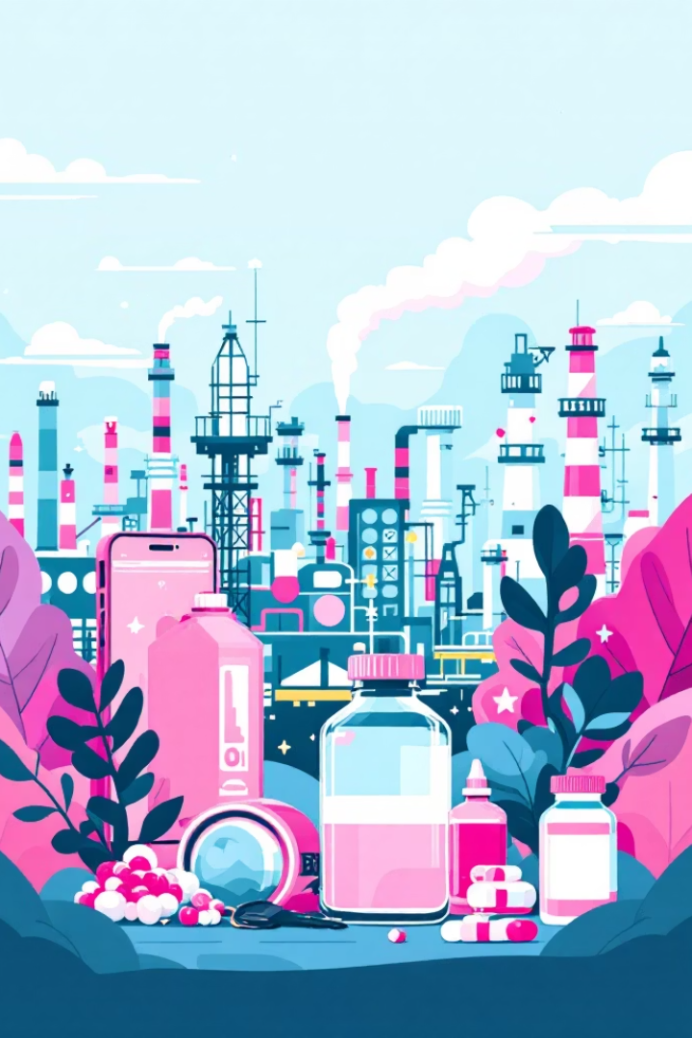
GLOBAL IMPACT
Chemistry Powers Our World
The journey from crude oil deep within the Earth to the myriad products that define our daily lives is a testament to the power and ingenuity of industrial chemistry. The petroleum industry doesn't just extract and refine; it transforms a raw natural resource into the very fabric of modern society.
From fueling global commerce and transportation to providing the raw materials for countless consumer goods and advanced medical applications, petroleum products are indispensable. This industry vividly demonstrates how fundamental scientific principles are applied on a massive scale, driving innovation and shaping the contemporary world.

Slide 8
Optimizing Voiceover Settings
Gender Selection
Speed Adjustment
Choose a neutral, male, or female documentary voice for clarity and authority. Consistency in gender helps maintain audience focus.
Set the playback speed to approximately 0.9x. A slightly slower pace enhances comprehension and allows complex information to be absorbed effectively.
Tone and Emotion
Maintain an informative, confident, and curious tone. Avoid robotic delivery; infuse it with a blend of authoritative knowledge and engaging inquiry to captivate the listener.
These settings are crucial for delivering a high-quality audio experience that complements the visual content and reinforces the educational message effectively.

Slide 9
Recommended Export Settings
Format
Resolution
Always export in MP4 format to ensure broad compatibility across platforms and devices, guaranteeing consistent playback quality.
Opt for 1080p resolution. This standard offers a sharp, clear visual experience, suitable for both large screens and detailed viewing.
Aspect Ratio
Captions
Select 9:16 for short-form content (e.g., social media Shorts) or 16:9 for traditional presentations, ensuring optimal display.
Enable captions (ON) for accessibility and to boost virality. This feature makes content more inclusive and shareable.
Implementing these export settings will maximize the reach and impact of your presentation, making it accessible and engaging for a wider audience.

