Slide 1
A Marketing Research of
Pastillicious
“The pastillas that you’ll
Remember”
Submitted by: Alta Vielle Gato
Submitted to: Dr. Annabelle G. Bughao

Slide 2
INTRODUCTION
Food is a source of sustenance and a significant component of people's everyday lives now, as it has been in earlier years. People cannot survive if they do not consume enough food. Food innovation occurs as time passes, not only in terms of how people live, but also in terms of the food they eat. There are many foods that have been popular in recent years, including flavored Pastillas that can be organic milky flavored
Pastillas, De Leche literally known as milk candies, is an integral part of food culture, and one of the favorite sweet delicacies or desserts among Filipinos. Eating Pastillas De Leche does not only your cravings but it also gives health benefits to the body.

Slide 3
COMPANY DESCRIPTION
About the company
Pastillicious Pastillas De Leche aspires to be competitive enough with existing delicacy Products , and because consumers in the market are price conscious, food products that offer a variety of health benefits and delicious satisfaction at a fair price are in high demand.

Slide 4

Company logo

Slide 5
Logo Description
The Company Logo has a happy face that symbolize the satisfaction face of the customers in eating the company’s product which is the pastillas de leche that will surely love the taste the customer.

Slide 6
Vision
Pastillicious Pastillas de Leche is a low-cost, high-quality, and delicious product. To have a Highest number of consumers to provide contentment that leads to innovation, the extra flavors of products will be consistent and reliable for improve the experience, and to create a favorable environment where children, rather than people, would enjoy eating

Slide 7
Mission
The company's mission is to establish a healthy and long-term relationship with customers by providing excellent and affordable product service in a timely manner. To deliver the finest Service possible while maintaining a constant product taste.

Slide 8
Tagline
Patillicious pastillas de leche tagline is “The pastillas that you’ll remember” ensuring that the product will consistent and give the satisfying taste that will customer remember and love the product.

Slide 9
ABOUT THE PRODUCT
Product’s Name
Pastillas are the best sweet dessert to satisfy your cravings, and the company loves to make a product that is delicious and sweet for customers of all ages. Most people nowadays love sweet and delicious things. Pastillicious is composed of two words: pastillas and delicious; when these two words are combined, the product's meaning is revealed.

Slide 10
Health Benefits
Eating Pastillas de leche does not only give satisfaction taste to one’s craving, pastillas de eche can also give a health benefits to the customers
Exceptional Nourishment ¬– The main ingredient, powdered milk contains magnesium,
phosphorus, potassium, vitamin C, vitamin A, and vitamin D.
Improves Bone – Milk is said to be rich in calcium, patillas will create an addition to building bones
and keeping them healthy.

Slide 11
Improve Vision – Vitamin A which is present in powdered milk, aids in improving vision and preventing night-blindness and macular degeneration.
Prevents Body from Aging - Chocolate is a popular sweet treat with health advantages. It
Includes anti-oxidants rich in flavonoids. Antioxidants protect the body from free radical- induced aging
Memory and Cognitive Function – The brain is heavily reliant on a consistent supply of glucose to feed its cells.

Slide 12
Product Ingredients
2/3 cup Powdered Milk
1/3 cup Skim Milk
½ cup Condensed Milk
Granulated Sugar for dusting
Chocolate syrup
Strawberry syrup
Ube syrup

Slide 13
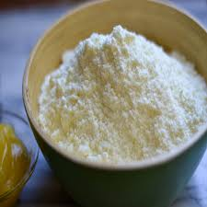
•Powder milk
is a manufactured dairy product made by evaporating milk to dryness. One purpose of drying milk is to preserve it; milk powder has a far longer shelf life than liquid milk and does not need to be refrigerated, due to its low moisture content.

Slide 14
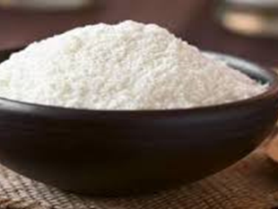
•Skim Milk
Skim Milk Powder is obtained by removing water from pasteurized skim milk. It contains 5% or less moisture (by weight) and 1.5% or l less milkfat (by weight) and a minimum milk protein content of 34%..

Slide 15
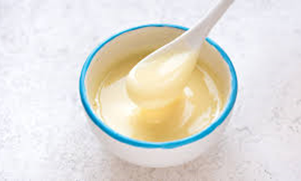
•Condensed Milk
Condensed milk is cow's milk from which water has been removed. It is most often found with sugar added, in the form of sweetened condensed milk, to the extent that the terms "condensed milk" and "sweetened condensed milk" are often used interchangeably today.

Slide 16
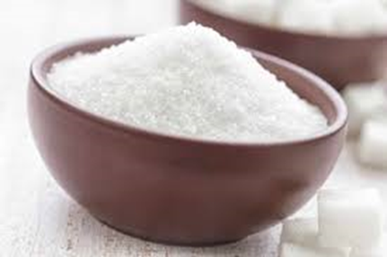
•Granulated Sugar
Commonly called regular sugar or white sugar, granulated sugar is refined sugar that food processors whiten and grind into a size similar to table salt. Baking recipes commonly call for this type of sugar.

Slide 17
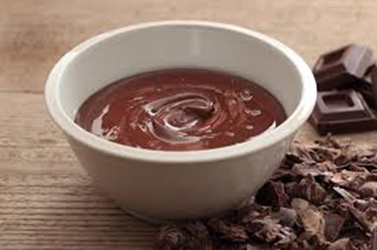
•Chocolate syrup
A sweet, chocolate-flavored condiment. It is often used as a topping or dessert sauce for various desserts, such as ice cream, or mixed with milk to make chocolate milk or blended with milk and ice cream to make a chocolate milkshake

Slide 18
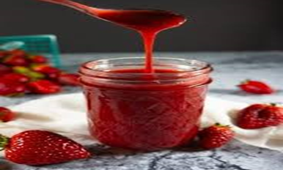
•Strawberry syrup
a type of strawberry sauce. It is a mass-produced food product that is packed into plastic containers and bottles and provided to consumers, businesses, and food manufacturers. The syrup is used in the manufacturing of strawberry sodas.

Slide 19
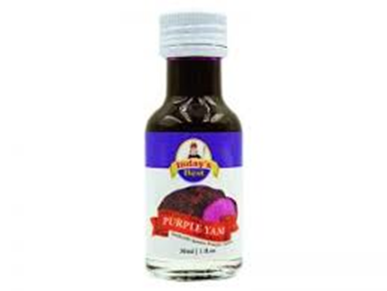
•Ube syrup
This syrup perfectly captures the nutty, creamy taste of the Filipino root vegetable with a smooth vanilla finish.

Slide 20
Equipment and Utensils Needed

Slide 21

•Bowls
A round container with a wide uncovered top. Some kinds of bowl are used, for example, for serving or eating food from, or in cooking, while other larger kinds are used for washing or cleaning

Slide 22
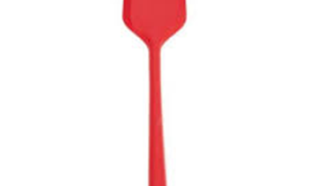
•Spatula
A broad, flat, flexible blade used to mix, spread and lift material including foods, drugs, plaster and paints. In medical applications, "spatula" may also be used synonymously with tongue depressor.

Slide 23
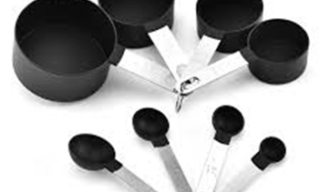
•Measuring Cup
a kitchen utensil used primarily to measure the volume of liquid or bulk solid cooking ingredients such as flour and sugar, especially for volumes from about 50 mL upwards

Slide 24
Product Preparation
Place the condensed milk in a large mixing bowl.
Gradually fold-in the powdered milk and skim milk
Scoop some of the mixture and mold into cylinders.
Roll each molded cylindrical l mixture on granulated sugar
Wrap the pastllas in packaging
Serve for dessert.

Slide 25
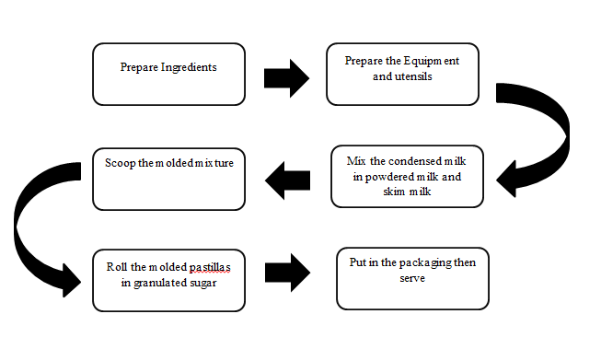
Figure 2.1 Product Flow Chart

Slide 26
III. TARGET MARKET
Geographic
Barangay Pasong Buaya II is situated nearby to Vallejo Place Phase 3, and close to Vallejo. Battle of Santol Pass is situated 3½ km southwest of Pasong Buaya II. Pasong Buaya II is situated at approximately 14.3878, 120.9675, in the island of Luzon. Elevation at these coordinates is estimated at 47.3 meters or 155.2 feet above mean sea level.

Slide 27
Area Profile
Barangay Pasong Buaya II has an estimated population has an estimated population of 35,599
consisting of 6,458 households as of 2022. The target place has one floor and has a size
of 40 s.q.m located along Mendiola St. . Pasong Buaya II Imus Cavite

Slide 28
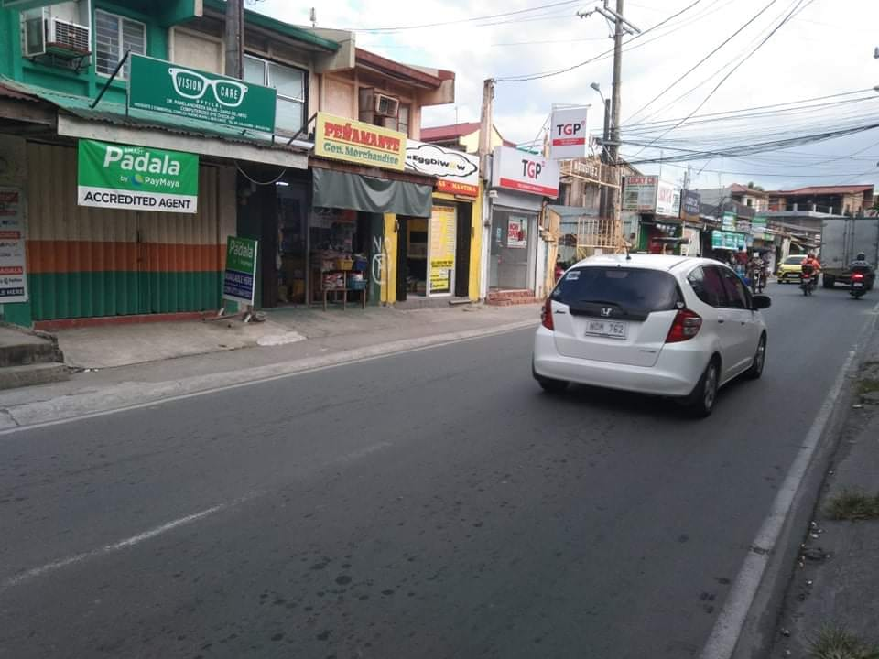
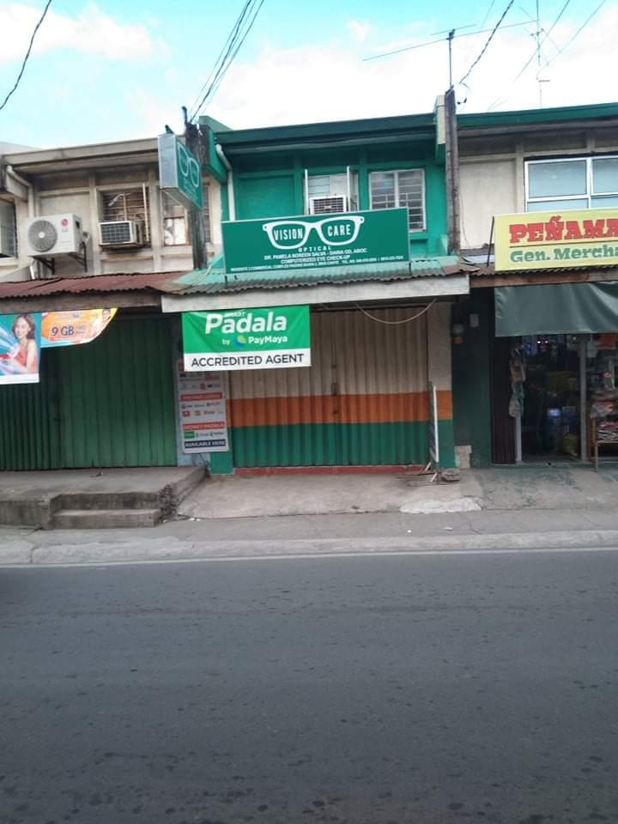
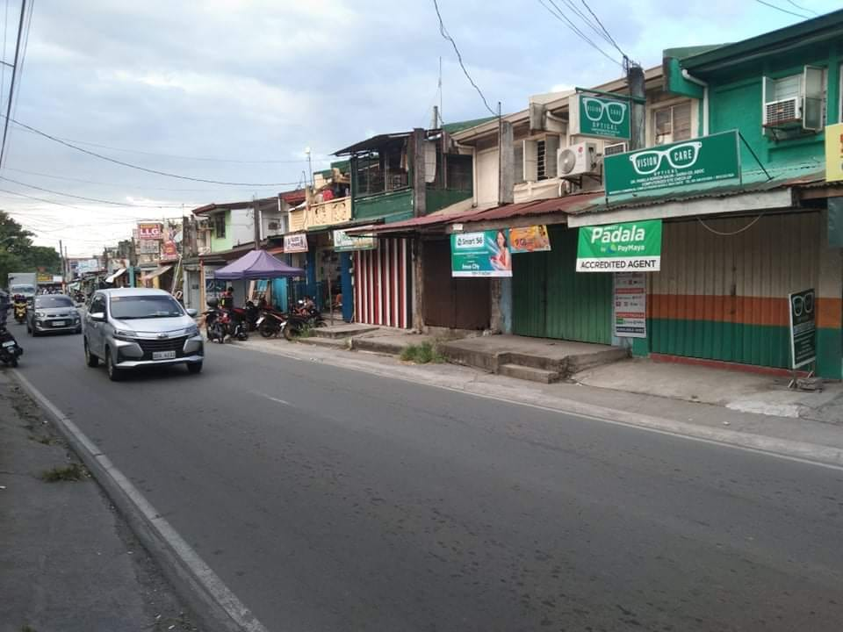
Location Map
The Proposed Location for the Business is in Woodsite 2 Mediola St. Pasong Buaya II Imus Cavite.

Slide 29
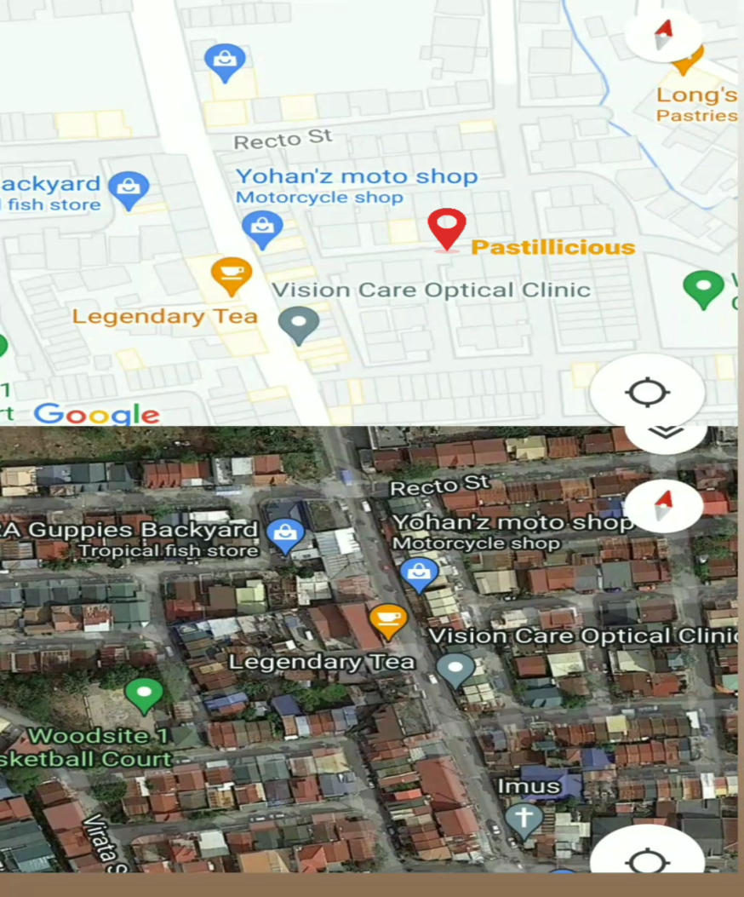

Slide 30
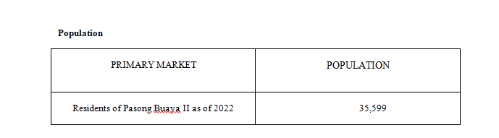
Demographic
The target customers of Pastillicious are the residents of Pasong Buaya II, regardless of their age or social status. Everyone within the barangay can be a target market but the most defined
target customers are those who live near the location.

Slide 31
Market Needs
Pastillicious will give satisfaction and pleasure to the customers in every taste. The Company intends to sate clients' appetites while also providing them with perks that will satisfy both their stomach and their wallet.
High-quality Products. The company will ensure that the food product and the ingredients utilized are of high quality.
Reasonable Price.The product will be reasonably priced to fulfill the needs of all customers

Slide 32
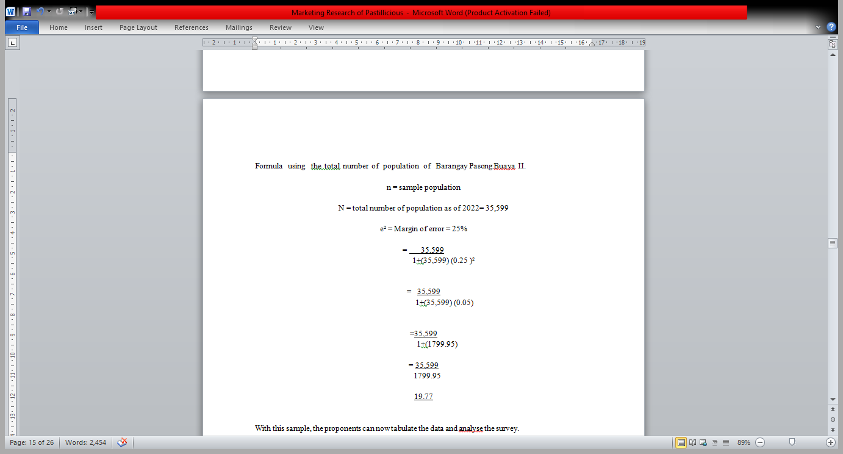
IV. SUMMARY OF DATA
The number of respondents was based on the sampling method which is the use of Slovin’s Formula using the total number of population of Barangay Pasong Buaya II.

Slide 33
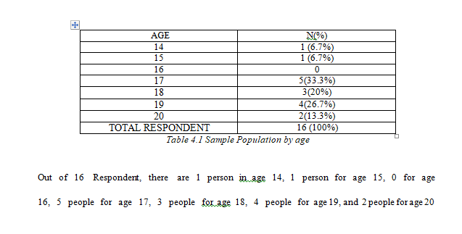

Slide 34
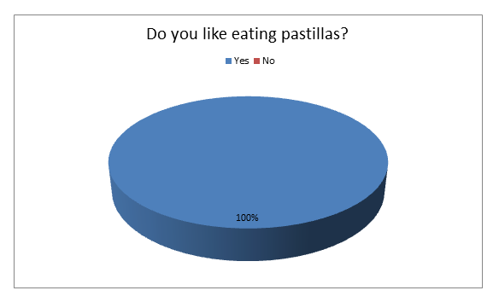
The proponent asked the respondents if they like to eat pastillas, wherein all respondent agreed to the questions

Slide 35
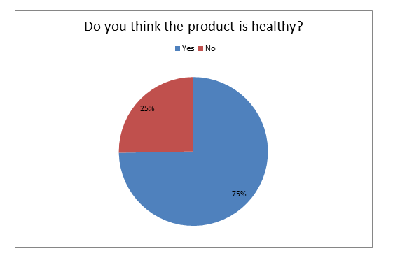
The proponent asked the respondents if they think the product are healthy, majority of the respondent agreed wherein 75%

Slide 36
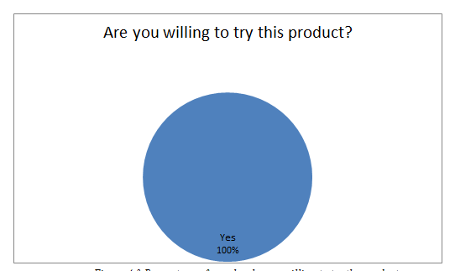
The proponent asked the respondent if they are willing to try this product and all of them want to try the Product and all of them are willing to try the product.

Slide 37
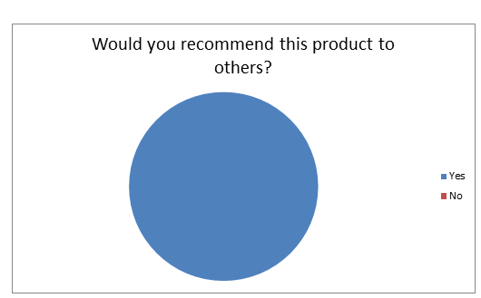
The proponent asked the respondent if they were recommend the product to others and all of them answered yes wherein 100%

Slide 38
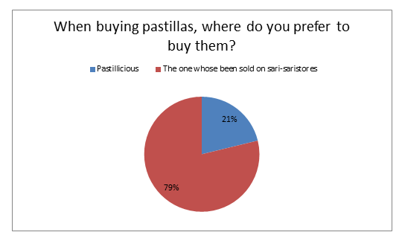
The proponent asked the respondent of where do their prefer buy pastillas, 79% of respondent prefer to buy on the sari-sari store, and 21% of the respondents prefer to buy in Pastillicious.

Slide 39
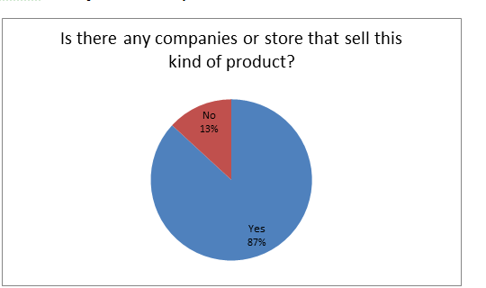
The proponent asked the respondent if is there any companies of store that sell this kind of product 87% of respondent answered yes

Slide 40
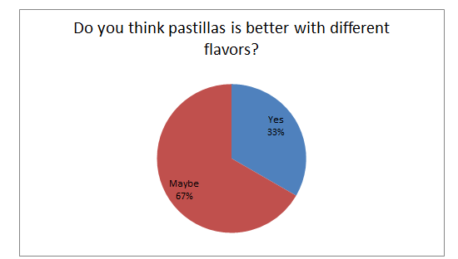
The proponent asked the respondents if they think pastillas is better with different flavors, 67% of Respondent answered maybe

Slide 41
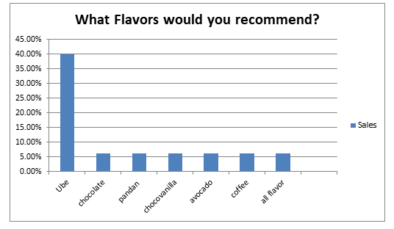
The proponents asked for the preferred flavors of the respondents, 6 respondents wants ube flavor, 2 respondents wants chocolate, 1 respondent want pandan, 1 respondent want choco vanilla, 1 respondent want 1 avocado and one suggest of all flavor

Slide 42
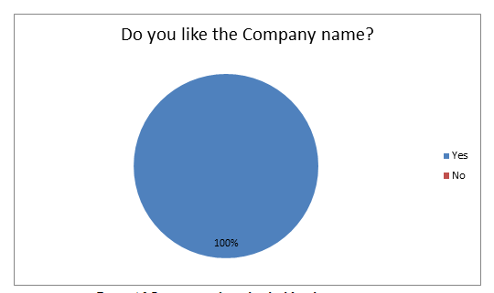
The proponent asked the respondent if they like the company name, all of the respondent like the Company name

Slide 43
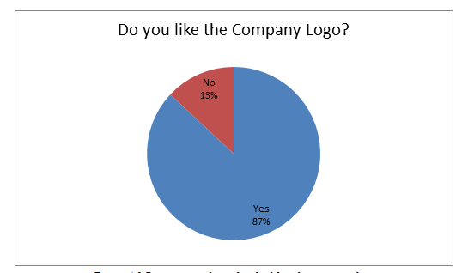
The proponent asked the respondent if they like the Company logo, majority of the responders liked the Company logo wherein 87%

Slide 44
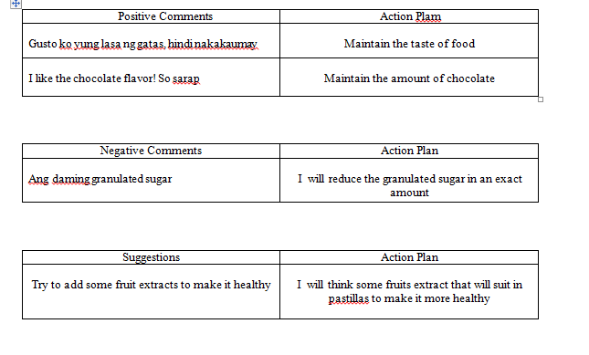
Comments/ Suggestions:
Listed below are the comments and suggestions of the respondents about the food product.

Slide 45
V. CONCLUSION
Based on the gathered data some respondent wants to add some flavors that will make them more satisfy, good thing we knew their opinions and suggestions that’s why Pastillicious is willing to try new flavors to make the Customer happy and satisfy.
Majority of the customers likes the Patillicious and some of them give a positive Comments although the product is not unique yet the taste of the product is new and give them satisfaction and enjoy the taste of the product in every little bite.
In Conclusion although the product is not unique yet the taste is new to the customers , due of its originality and quality, customers are likely to patronize Pastillicious Pastillas De Leche after it is released to the market, especially if the proponents have already implemented the modifications and innovations proposed by the respondents or the customers themselves.

Slide 46
VI. MORAL LESSON
So many things I learned for this, the first one is time management it is not easy to finish the task in just one day because academics activities is not only my prioritize, I learned that it should be allotted time in anything. Second is committing in this activities, you have to commit yourself by doing this to have a better outcome because it will benefit you to learn more in running your own business in the future. Third is trusting in yourself, I realized by doing this individually you have to trust yourself by creating an idea from the name logo to the satisfaction of customers.

Slide 47
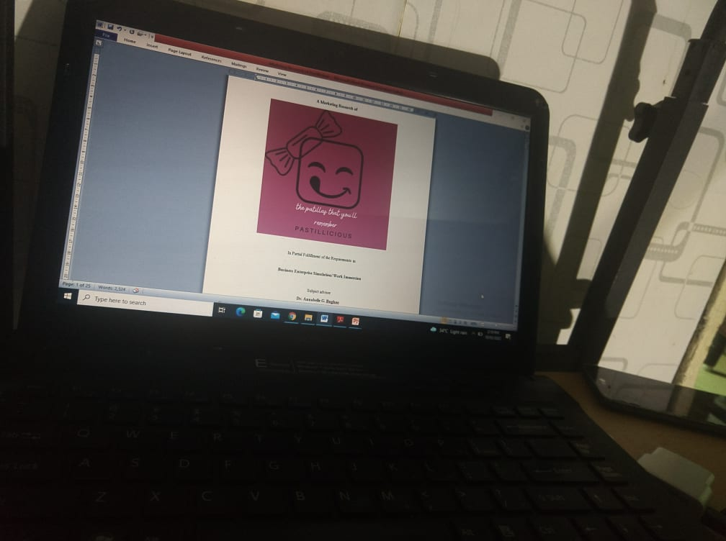
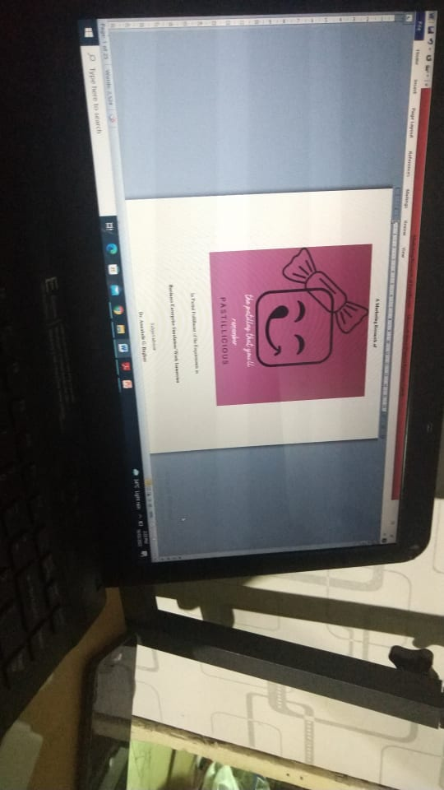
VII. Research Documentation

Slide 48


