Slide 1
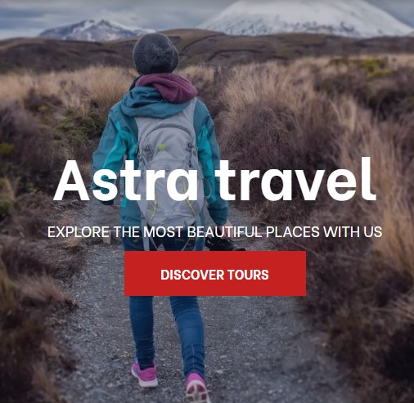
10-Day Bosnia and Herzegovina and Olimpic Mountain Trebevic Tour

Slide 2

10 days Bosnia tour first brings you the story of the Sarajevo Siege. You will have amazing opportunity to Explore the Olimpic mountain Trebevic by quad and enjoy one of the best views of the city of Sarajevo and the nearby mountain peaks. East Bosnia – West Serbia gives you a ride down green Drina River and a historic train ride journey. Socialist Rhapsody will give you valuable information about the history, culture and life within the Socialist system. Take a step back in time with us and you will be amazed by what you will discover. You willl have opportunity to explore the historic towns of Konjic, Pocitelj, and Blagaj; admire natural wonders Jablanicko Lake, Neretva river canyon and Kravice Waterfall and visit the UNESCO-listed town of Mostar on a guided walking tour. Also, in the cities through which Neretva river flows you will be able to meet culture, history and tradition of the entire area and be amazed with its beauty as well as Herzegovinian cities.

Slide 3
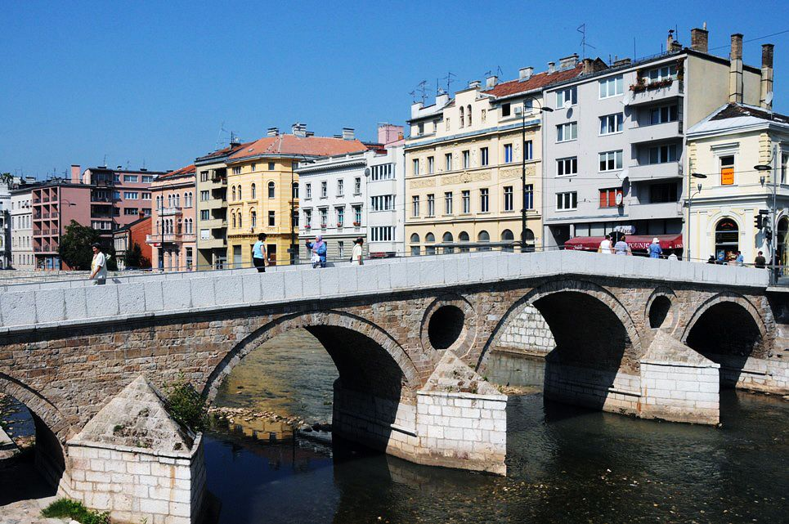
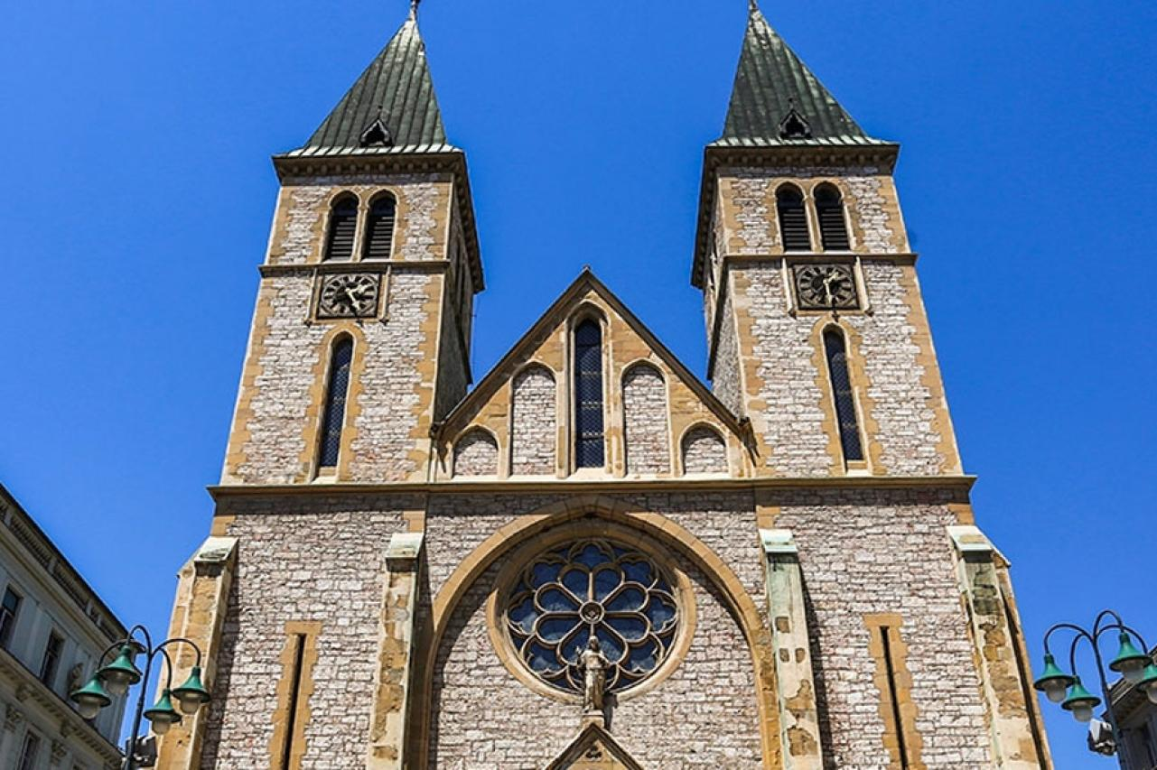
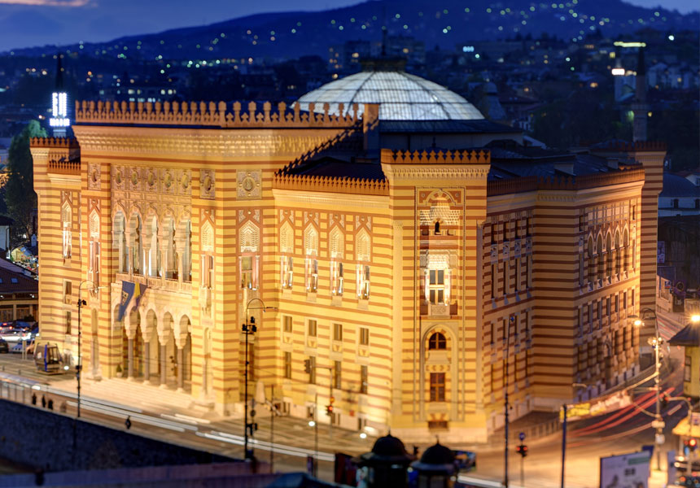
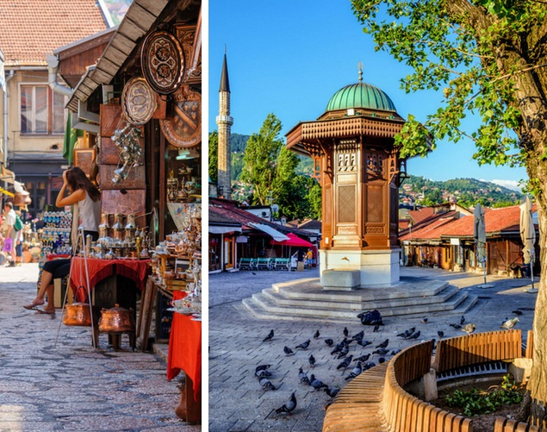
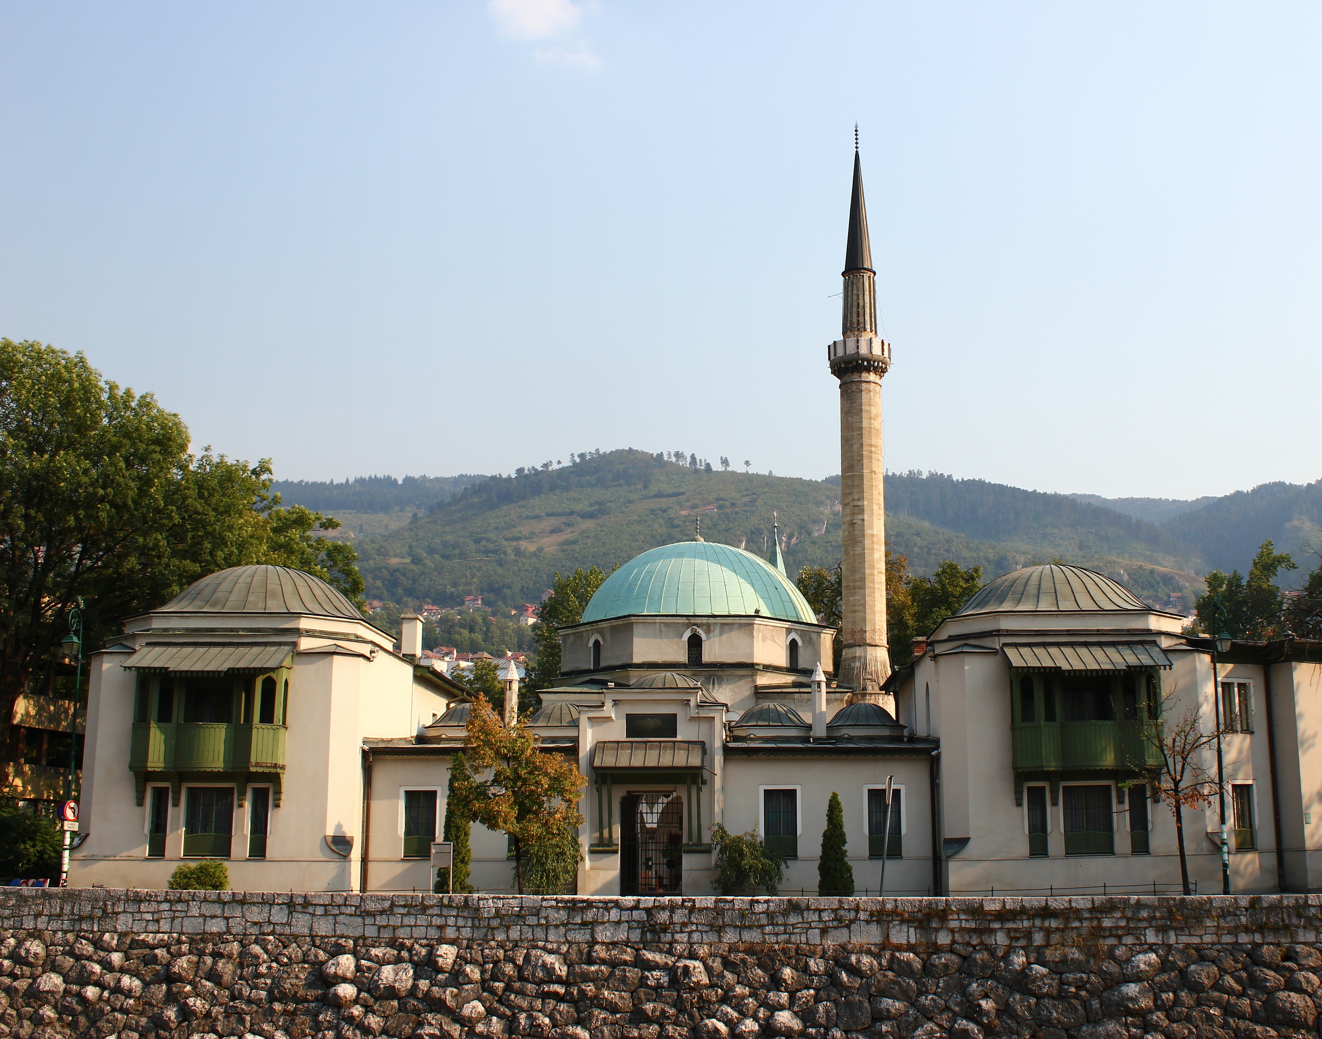

Slide 4
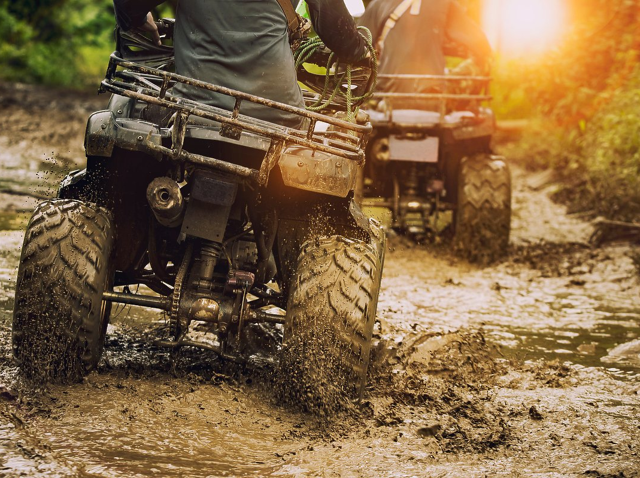
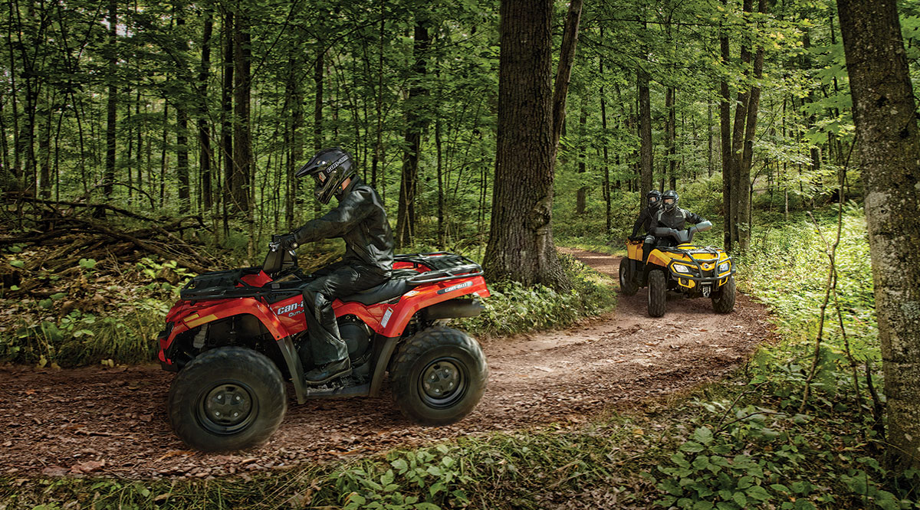
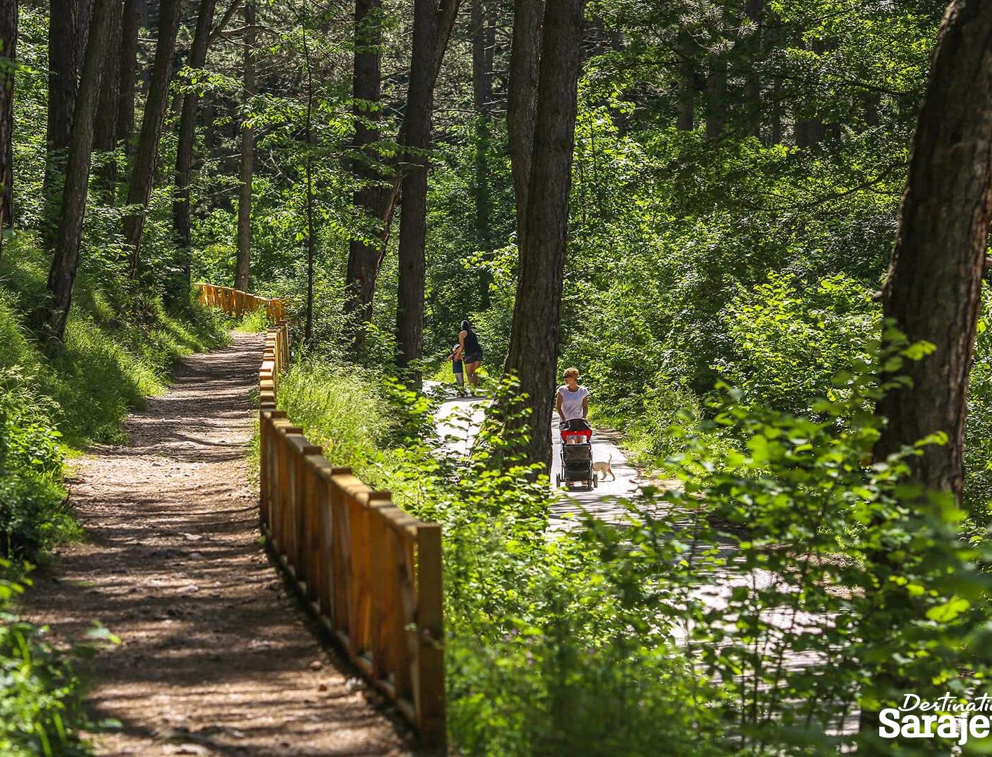

Slide 5
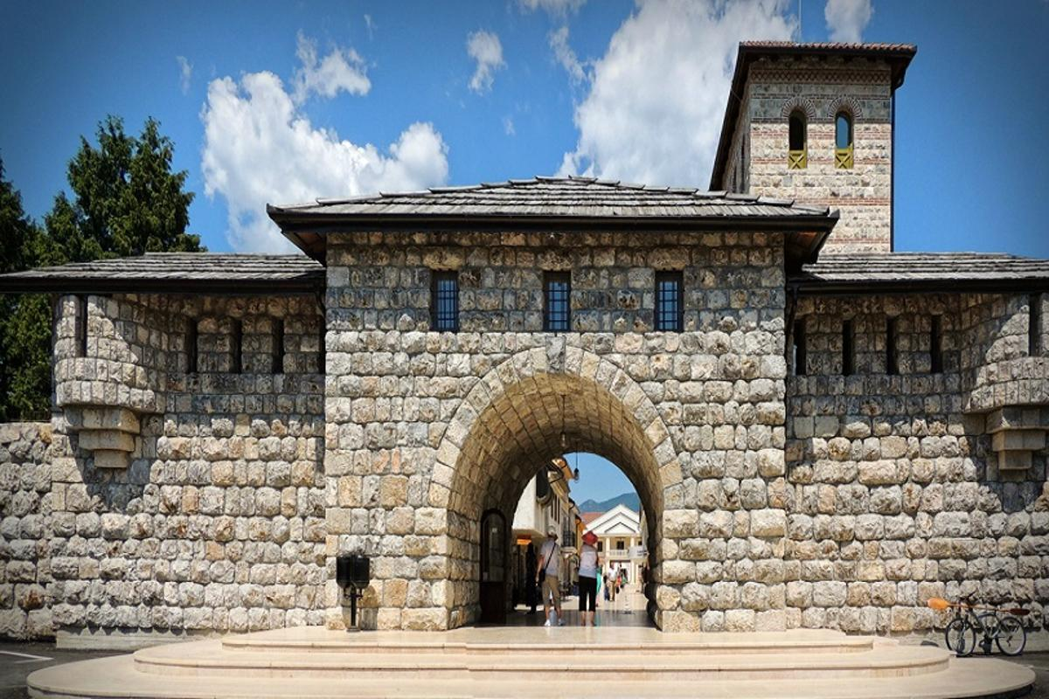
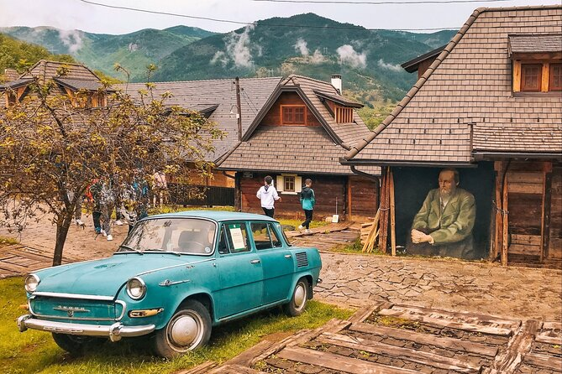
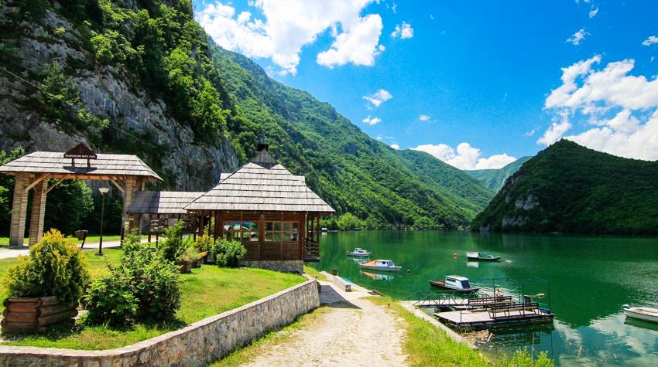
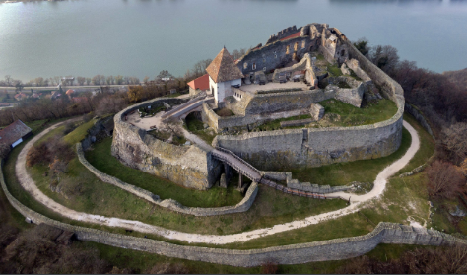
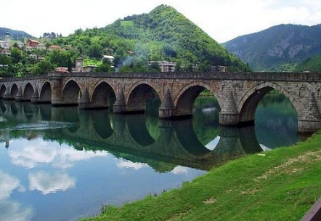
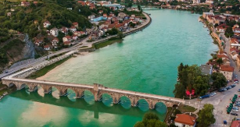
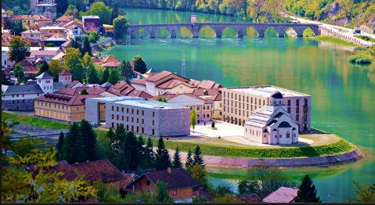

Slide 6

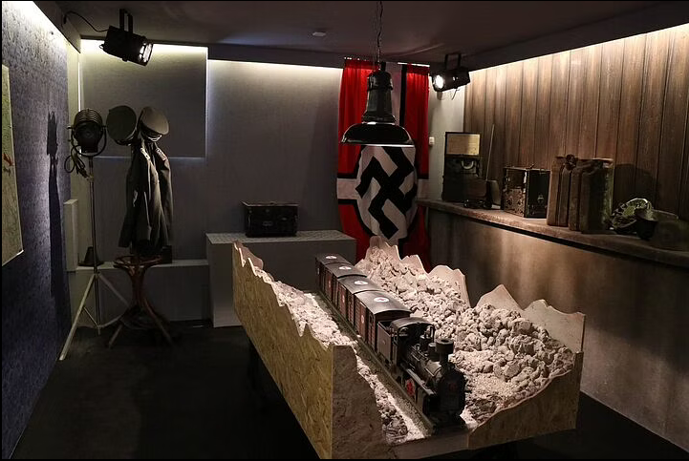
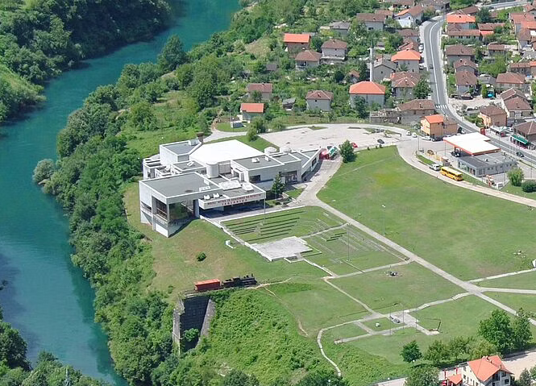
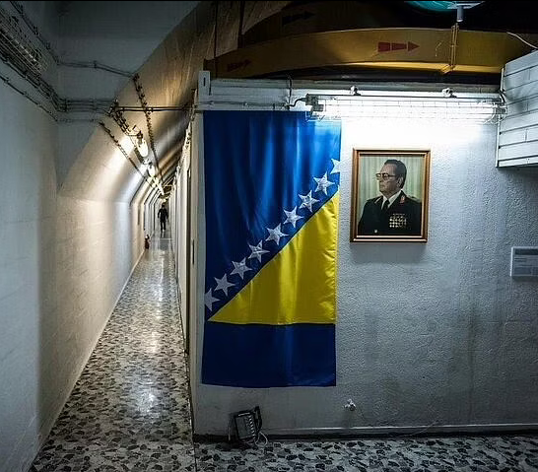

Slide 7



Slide 8
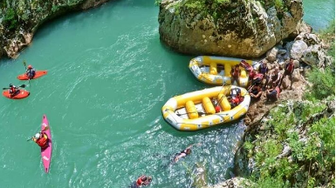

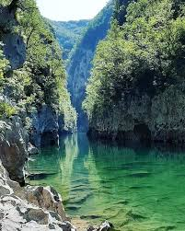
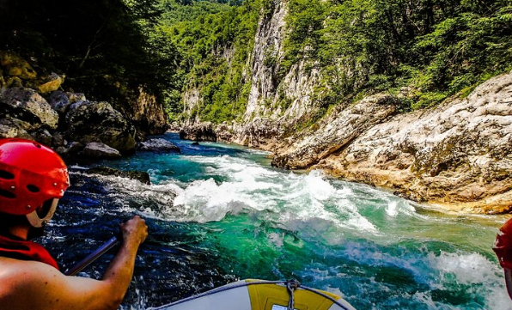


Slide 9
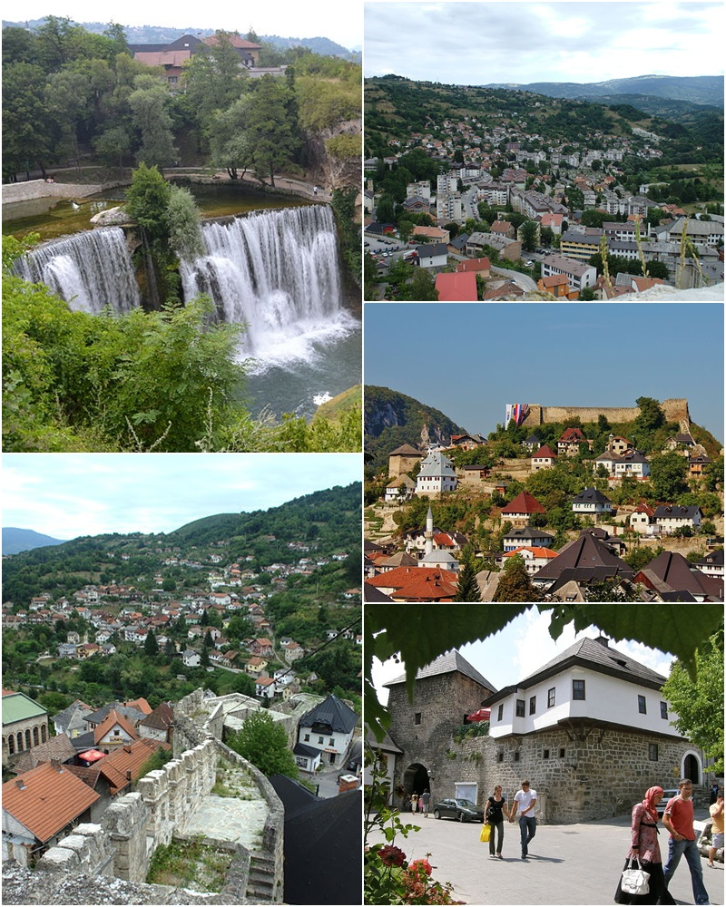
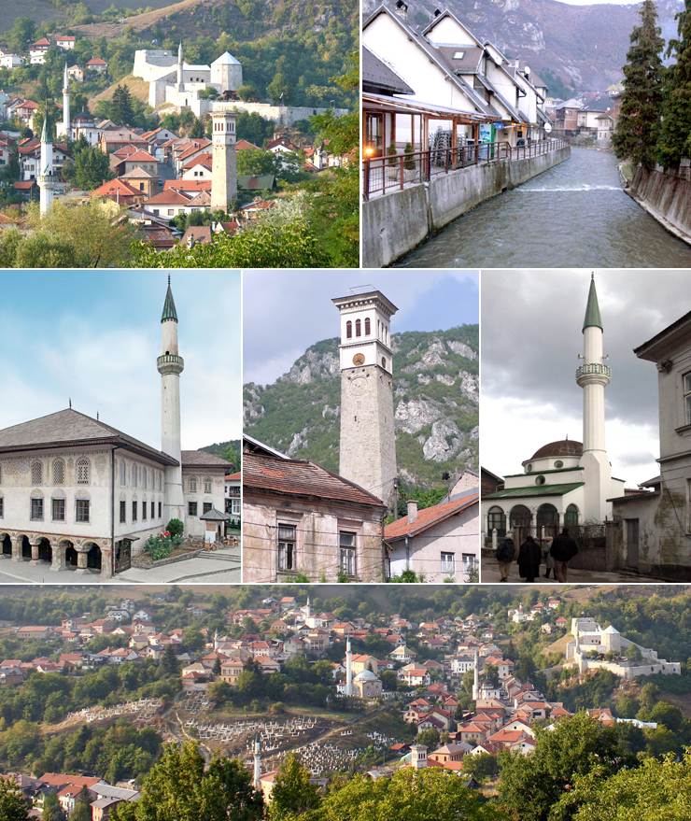

Slide 10
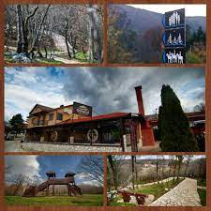
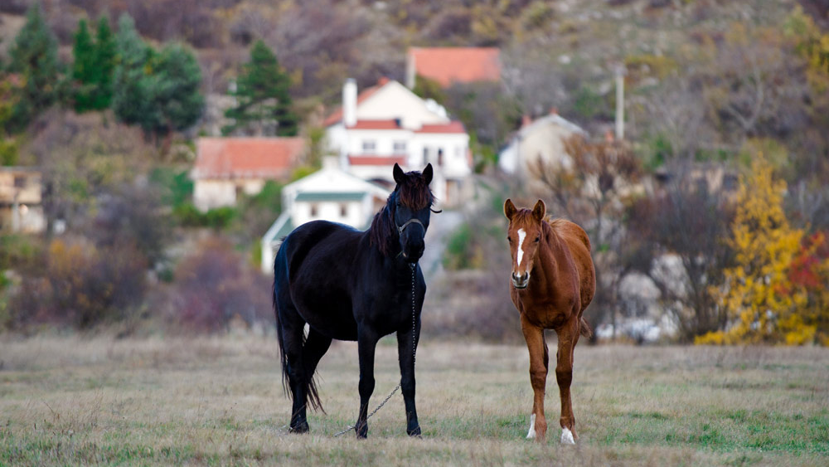
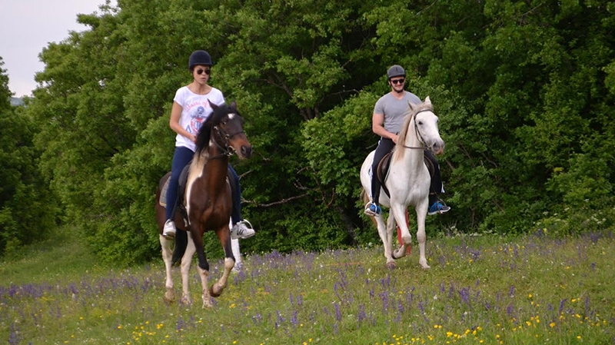
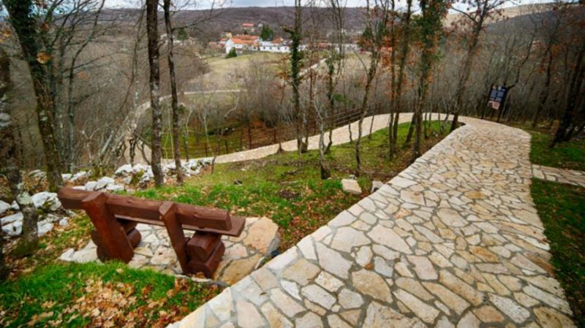

Slide 11


