Slide 1

GRADE 7 - MAPEH (MUSIC)
QUARTER 3 - WEEK 1-2
* VOCAL MUSIC OF MINDANAO
*INSTRUMENTAL MUSIC OF MINDANAO
Notes:
GOOD MORNING CLASS
TODAY WE WILL BE DISCUSSING ABOUT THE VOCAL MUSIC OF MINDANAO
AND
INSTRUMENTAL MUSIC OF MINDANAO %%TTS_FEMALE%

Slide 2
MUSIC OF MINDANAO
Mindanao is home of the Islamic cultures and anchored its music to its people’s traditions. Moreover, the music of Mindanao does not only consist of Islamic music but also Non Islamic music.
The musical practices of the people in the coastal and lowland areas of Western Mindanao are vital elements in their social life that serve as the main source of their ethnic identities. The musical practices of these indigenous people are a mixture of Western and Nonwestern ideas.
Mindanao music is mostly composed of musical style called folk style. The folk music of Mindanao includes the ancient Muslim folk songs. These songs are usually accompanied by drums, gongs, or other percussion instruments.
Notes:
MUSIC OF MINDANAO
Mindanao is home of the Islamic cultures and anchored its music to its people’s traditions.
Moreover, the music of Mindanao does not only consist of Islamic music but also Non Islamic music.
The musical practices of the people in the coastal and lowland areas of Western Mindanao are vital elements in their social life that serve as the main source of their ethnic identities.
The musical practices of these indigenous people are a mixture of Western and Nonwestern ideas.
Mindanao music is mostly composed of musical style called folk style. The folk music of Mindanao includes the ancient Muslim folk songs.
These songs are usually accompanied by drums, gongs, or other percussion instruments.%%TTS_FEMALE%

Slide 3
Generally, music is evaluated based from the musical elements and styles. The following are some of the basic musical elements:
1. Dynamics – musical aspects relating to the relative loudness (or quietness) of music (e.g. pianissimo, piano, mezzo-piano, mezzo-forte, forte and fortissimo)
2. Rhythm – the organization of music in time and is closely related to meter
3. Texture – the density (thickness or thinness) of layers of sounds, melodies, and rhythms in a piece. Most common types of texture: monophony - a single layer of sound (e.g a solo voice); homophony - a melody with an accompaniment (e.g. a lead singer and a band; a singer and a guitar or piano accompaniment); polyphony - two or more independent voices (e.g a round or fugue).
4. Tempo – the speed of music.
Notes:
Generally, music is evaluated based from the musical elements and styles. The following are some of the basic musical elements:
Dynamics – musical aspects relating to the relative loudness (or quietness) of music (e.g. pianissimo, piano, mezzo-piano, mezzo-forte, forte and fortissimo)
2. Rhythm – the organization of music in time and is closely related to meter
3. Texture – the density (thickness or thinness) of layers of sounds, melodies, and rhythms in a piece. Most common types of texture: monophony - a single layer of sound (e.g a solo voice); homophony - a melody with an accompaniment (e.g. a lead singer and a band; a singer and a guitar or piano accompaniment); polyphony - two or more independent voices (e.g a round or fugue).
4. Tempo – the speed of music. %%TTS_FEMALE%

Slide 4
Vocal Music
1. CHANTS- a lyrical rendition of different improvised text.
* Lugu-chants used in reading their Qur’an and books they use in their Islam religion Kalangan-songs used for serenading loved ones
* Sail/Lunsey- a chant to be sung by the wife-to-be during the ceremony
* Dikker- sacred songs highlighted by quotations from the Qur’an
* Bayok- semi-generic term for a lyrical rendition of different improvised text
2. LULLABY- a chant- style or chant formula used for rocking a baby to sleep
* Ya-ya- song of the Yakans to put the baby to sleep
* Bayok- maranao term for lullaby
Notes:
Vocal Music of Mindanao
CHANTS- a lyrical rendition of different improvised text.
These are the examples of Mindanao chants.
Lugu-chants used in reading their Qur’an and books they use in their Islam religion Kalangan-songs used for serenading loved ones.
Sail/Lunsey- a chant to be sung by the wife-to-be during the ceremony
Dikker- sacred songs highlighted by quotations from the Qur’an
Bayok- semi-generic term for a lyrical rendition of different improvised text
2. LULLABY- a chant- style or chant formula used for rocking a baby to sleep.
These are the examples of Mindanao Lullaby.
Ya-ya- song of the Yakans to put the baby to sleep
* Bayok- maranao term for lullaby%%TTS_FEMALE%

Slide 5
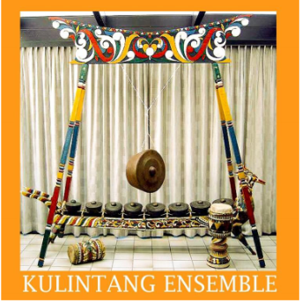
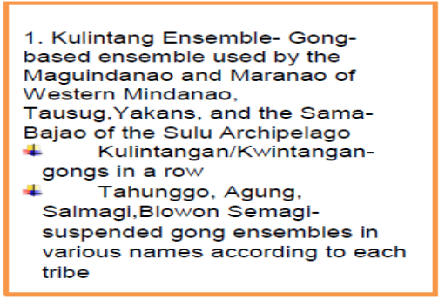
Instrumental Music
Notes:
THESE ARE THE TYPES OF INSTRUMENTAL MUSIC OF MINDANAO
KULINTANG ENSEMBLE, BAMBOO ENSEMBLE, AND SOLO INTRUMENTS.
FIRST WE WILL BE DISCUSSING THE KULINTANG ENSEMBLE.
KULINTANG ENSEMBLE – GONG –BASED ENSEMBLE USED BY THE MAGUINDANAO AND MARANAO OF WESTERN MINDANAO, TAUSUG, YAKANS AND THE SAMA-BAJAO OF THE SULU ARCHIPELAGO.
EXAMPLES OF KULINTANG ENSEMBLE
KULINTANGAN/KWINTANGAN – GONGS IN A ROW
TAHUNGGO, AGUNG, SALMAGI, OR BLOWON SEMAGI – SUSPENDED GONG ENSEMBLES IN VARIOUS NAMES ACCORDING TO EACH TRIBE. %%TTS_FEMALE%

Slide 6
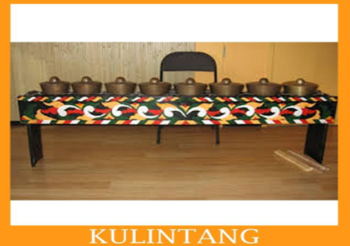
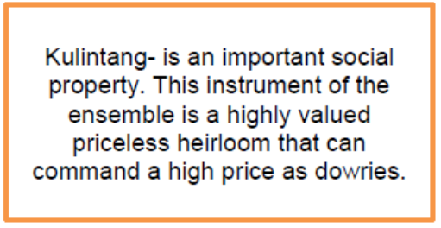
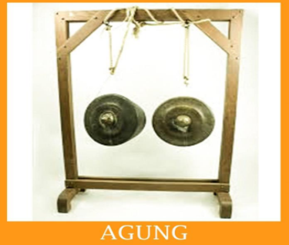
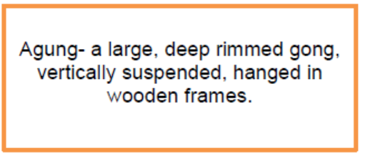
Notes:
KULINTANG – IS AN IMPORTANT SOCIAL PROPERTY. THIS INSTRUMENT OF THE ENSEMBLE IS HIGHLY VALUED PRICELESS HEIRLOOM THAT CAN COMMAND A HIGH PRICE AS DOWRIES.
AGUNG – A LARGE DEEP, DEEP RIMMED GONG, VERTICALLY SUSPENDED, HANGED IN WOODEN FRAMES.%%TTS_FEMALE%

Slide 7
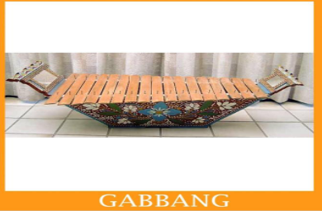
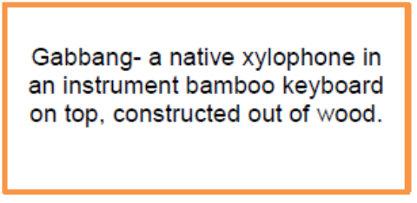
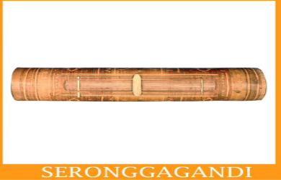
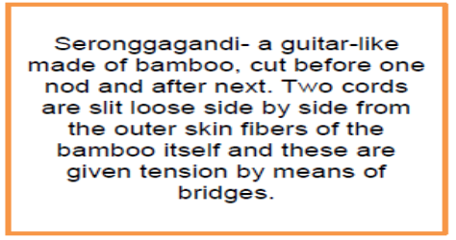
2. Bamboo Ensemble- bamboo instruments were made for the purpose of entertainment and personal expression of their spiritual faith.
Notes:
THE SECOND TYPE OF MUSICAL INSTRUMENT OF MINDANAO IS THE
BAMBOO ENSEMBLE – BABOO INSTRUMENTS WERE MADE FOR THE PURPOSE OF ENTERTAINMENT AND PERSONAL EXPRESSION OF THEIR SPIRITUAL FAITH.
THESE ARE THE EXAMPLES OF BAMBOO ENSEMBLE INTSRUMENTS
GABBANG – A NATIVE XYLOPHONE IN AN ISTRUMENT BAMBOO KEYBOARD ON TOP, CONTRUCTED OUT OF WOOD.
SEROGGAGANDI – A GUITAR-LIKE MADE OF BAMBOO, CUT BEFORE ONE NOD AND AFTER NEXT. TWO CORDS ARE SLIT LOOSE SIDE BY SIDE FROM THE OUTER SKIN FIBERS OF THE BAMBOO ITSELF AND THESE ARE GIVEN TENSION BY MEANS OF BRIDGES.%%TTS_FEMALE%

Slide 8
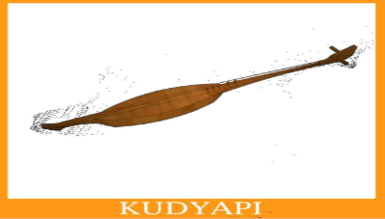
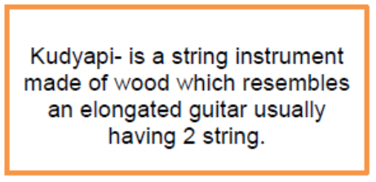
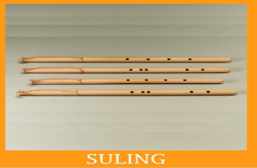
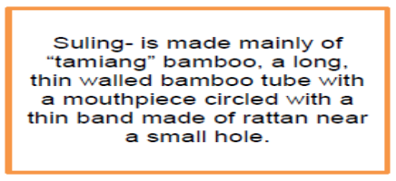
3. Solo Instruments
Notes:
THE LAST MUSICAL INSTRUMENTS OF MINDANAO IS SOLO INSTUMENTS
FIRST IS THE KUDYAPI
KUDYAPI IS A STRING INSTRUMENT MADE OF WOOD WHICH RESEMBLES AN ELONGATED GUITAR USUALLY HAVING 2 STRING.
SULING- IS MADE MAINLY OF “TAMIANG” BAMBOO, A LONG THIN WALLED BAMBOO TUBE WITH A MOUYHPIECE CIRCLED WITH A THIN BAND MADE OF RATTAN NEAR A SMALL HOLE.
HOPE YOU UNDERSTAND LEARNED SOMETHING NEW TODAY%%TTS_FEMALE%

