Slide 1
Annual Report
Heavens Pre-school January 25, 2023
Notes:
%%TTS_FEMALE%
Annual Report
Heavens Pre-school January 25, 2023

Slide 2
Agenda
01. Introduction
02. Status
03. Academic Activities
04. Achievements
05. Our team
Notes:
%%TTS_FEMALE%
Agenda
Introduction
Status
Academic Activities
Achievements
Our team

Slide 3

Introduction
We, Heavens Pre-school is conducting our 10th anniversary “HELAWA” today on 25th of January 2023.
Here is the 2022-23 annual report of Heavens Pre-school, Chennamangallur.
Notes:
%%TTS_FEMALE%
We, Heavens Pre-school is conducting our 10th anniversary helava today on 25th of January 2023.
Here is the 2022-23 annual report of Heavens Pre-school, Chennamangallur.

Slide 4
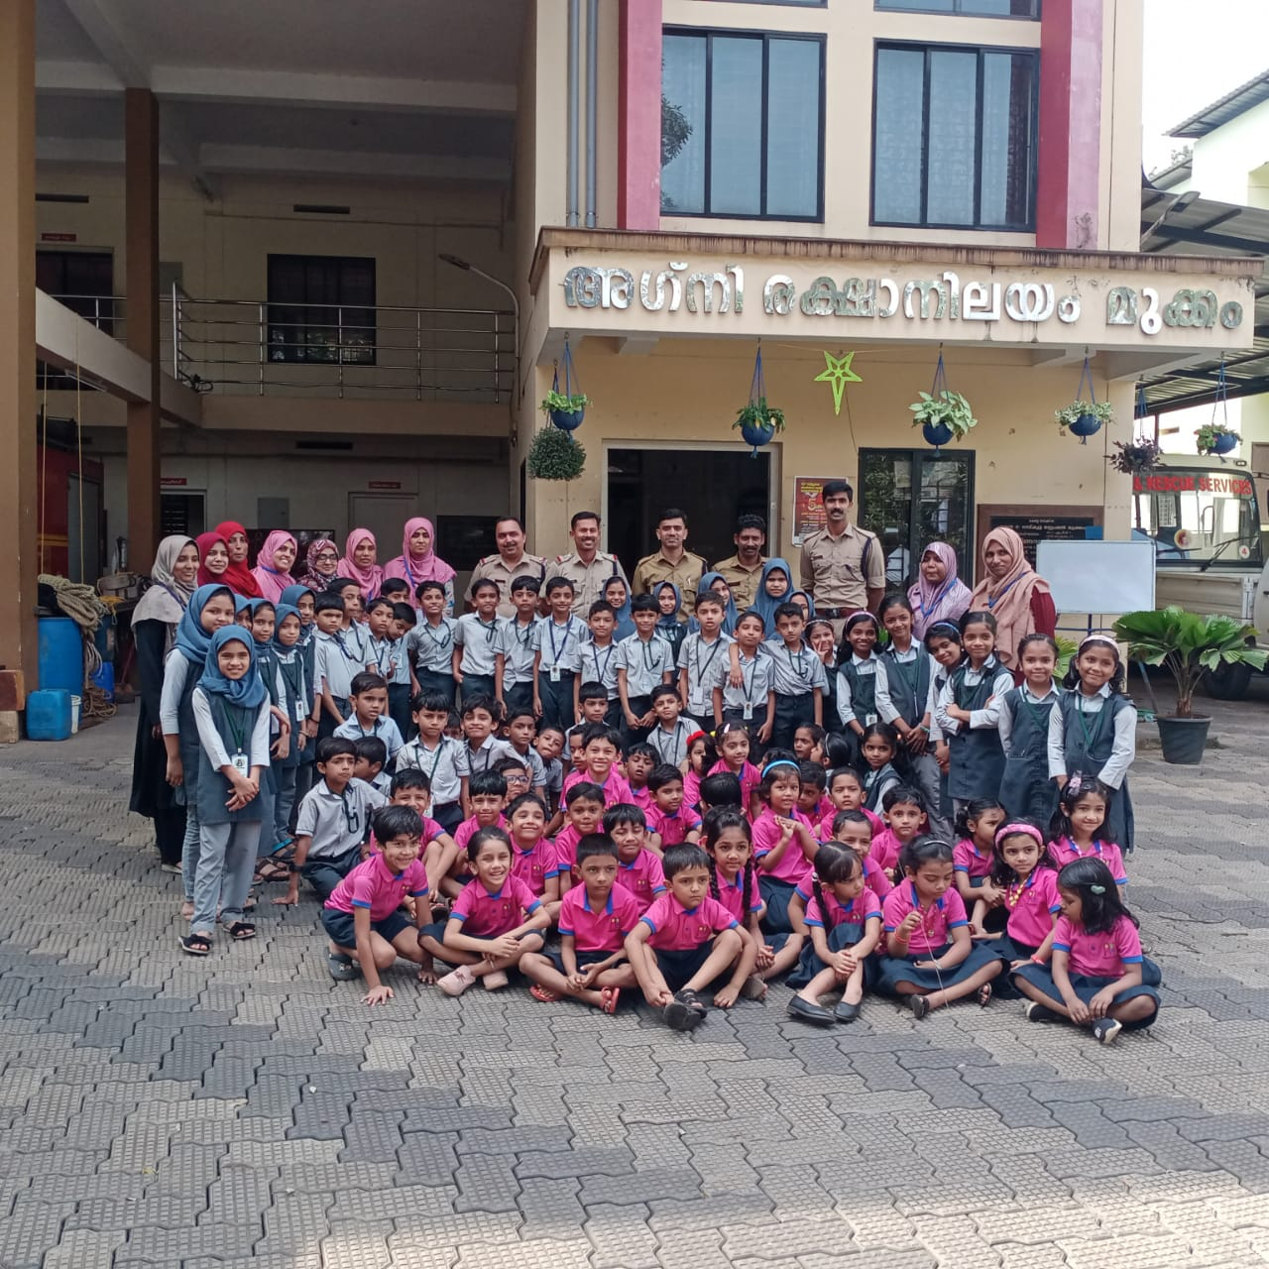
Status
Starting from 2013, we have successfully completed 10 years
Our student strength is 150 and we have overall 18 teaching and non-teaching staffs
Notes:
%%TTS_FEMALE%
Starting from 2013, we have successfully completed 10 years
Our student strength is 150 and we have overall 18 teaching and non-teaching staffs

Slide 5
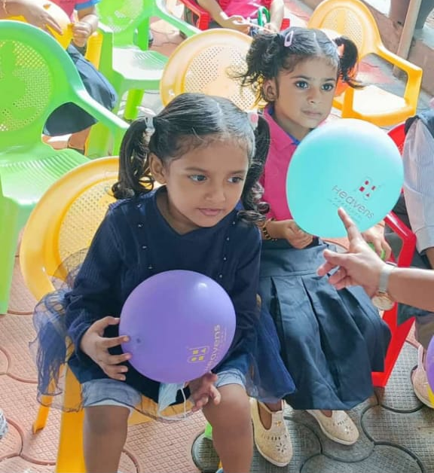
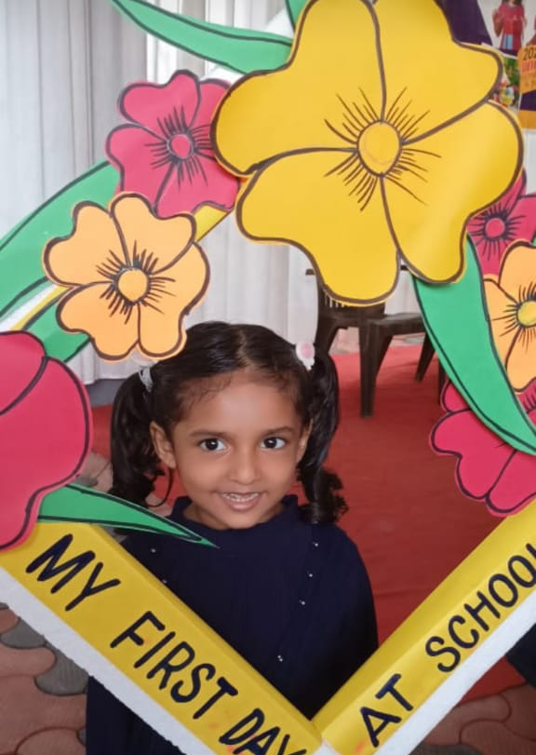
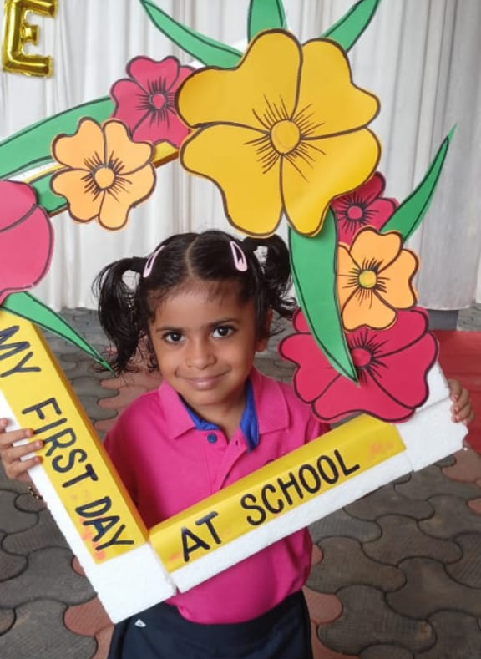
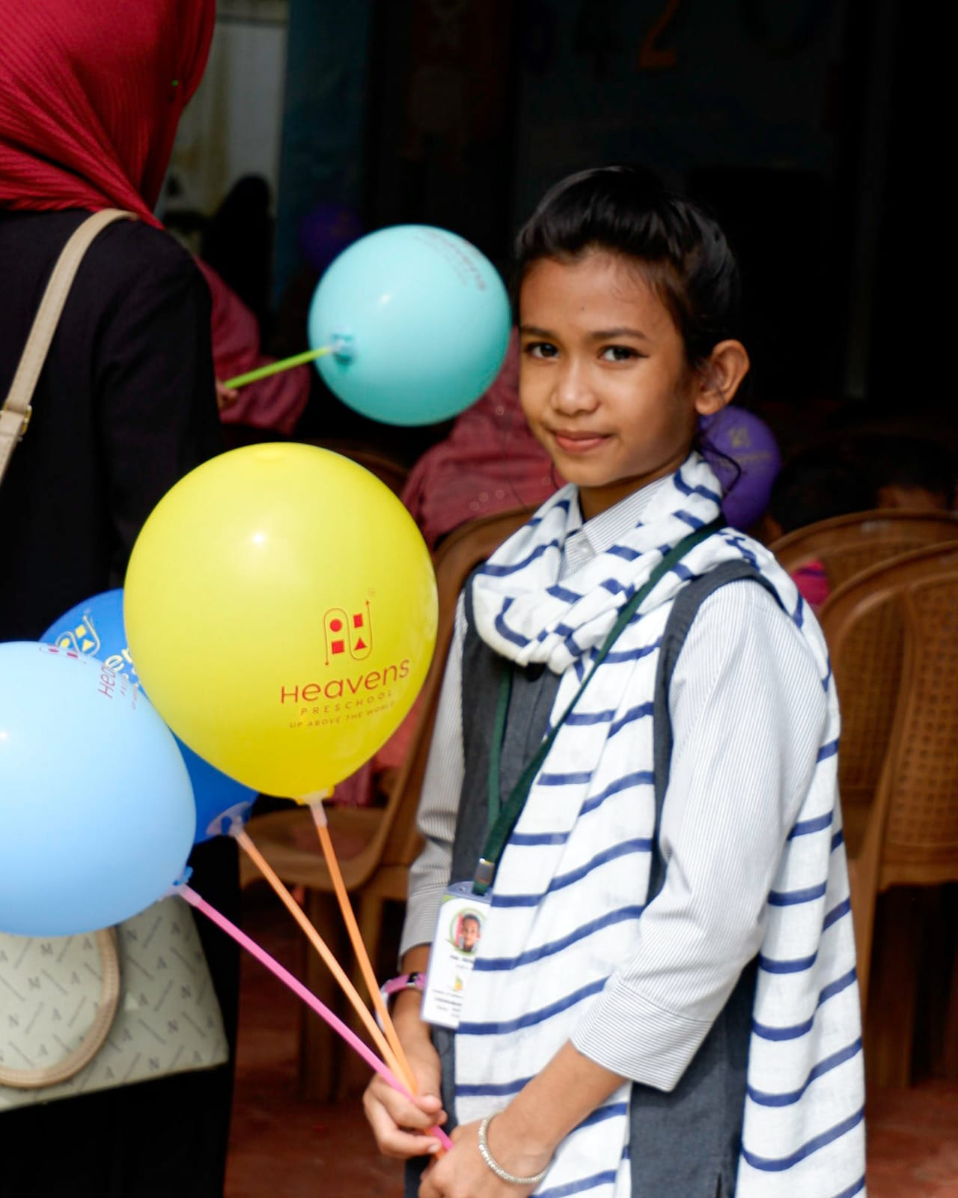
Academic Activities
RE-OPENING DAY
School was reopened on June 1st 2022. It was inaugurated by Mrs. Naseeba Basheer
New students were welcomed by giving sweets and balloons by Sky-3 students.
Notes:
%%TTS_FEMALE%
Academic Activities
RE-OPENING DAY
School was reopened on June 1st 2022. It was inaugurated by Mrs. Naseeba Basheer
New students were welcomed by giving sweets and balloons by Sky-3 students.

Slide 6
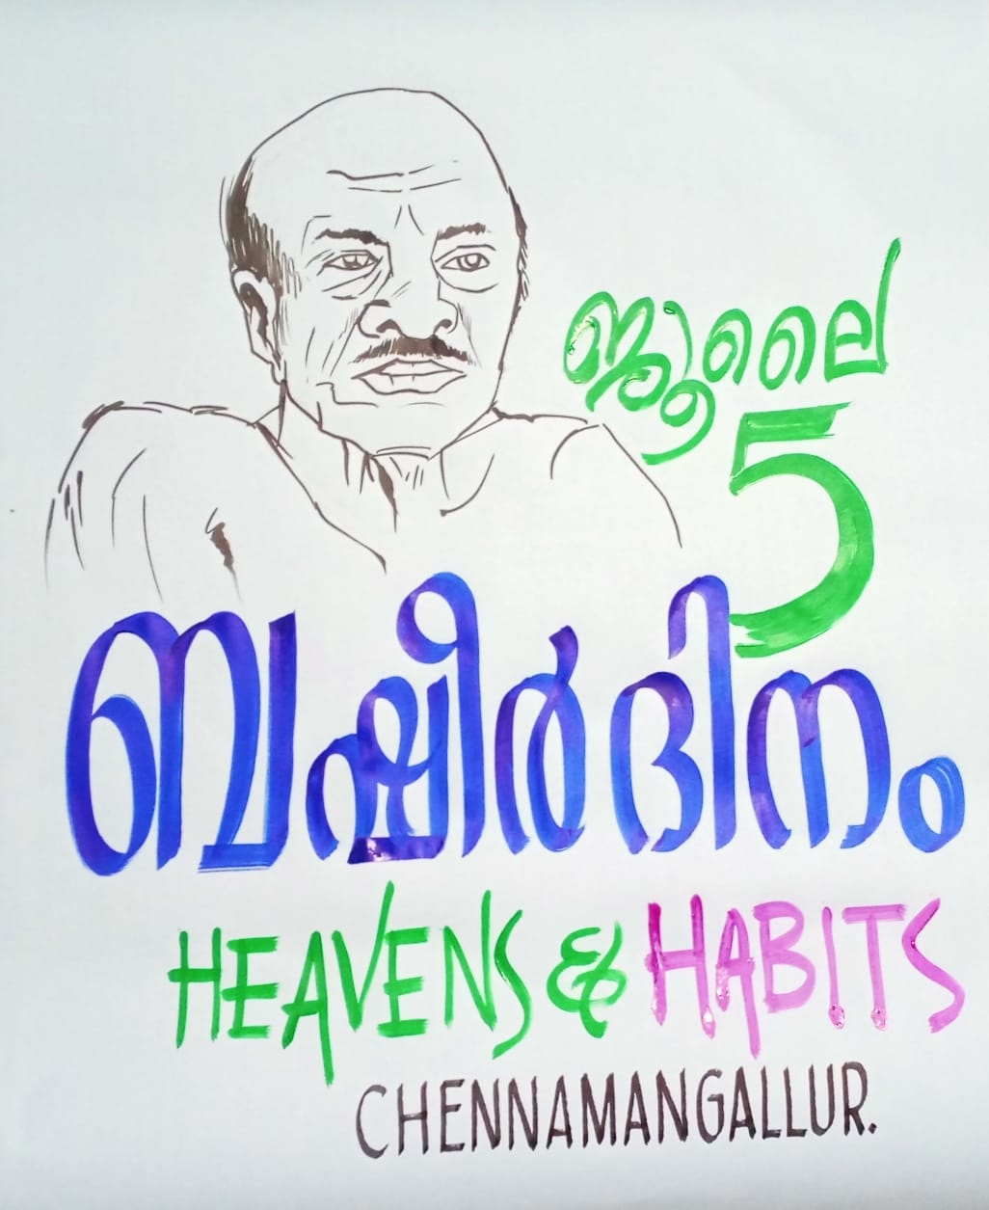
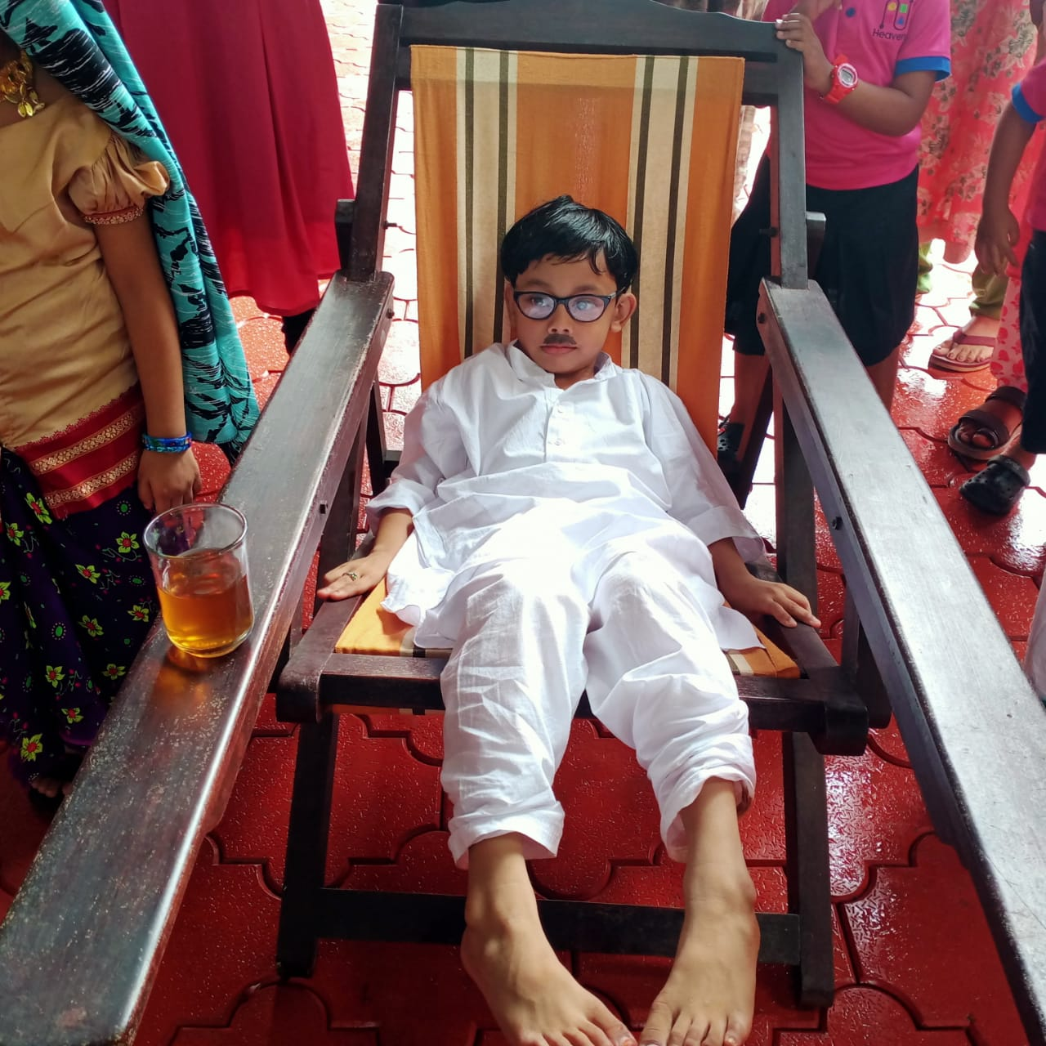
Academic Activities
SPECIAL DAY CELEBRATIONS
Special days like ENVIRONMENTAL DAY (on June 5),
READING DAY (on June 19) were celebrated by our students
BASHEER’S DAY (on July 5)
Students enacted Basheer’s characters to honour him on his day.
Notes:
%%TTS_FEMALE%
SPECIAL DAY CELEBRATIONS
Special days like ENVIRONMENTAL DAY (on June 5),
READING DAY (on June 19) were celebrated by our students
BASHEER’S DAY (on July 5)
Students enacted Basheer’s characters to honour him on his day.

Slide 7
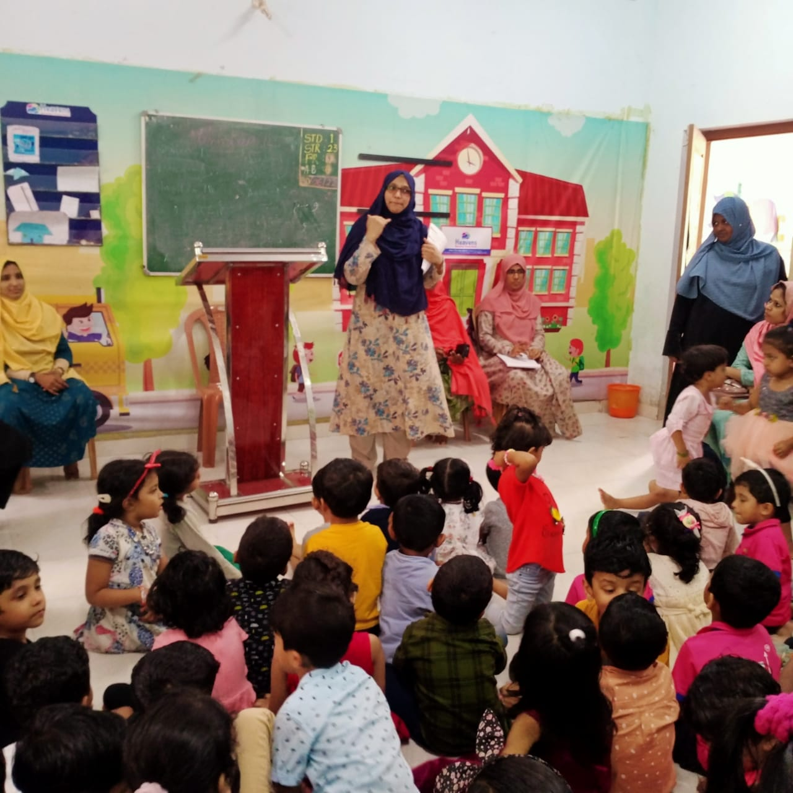
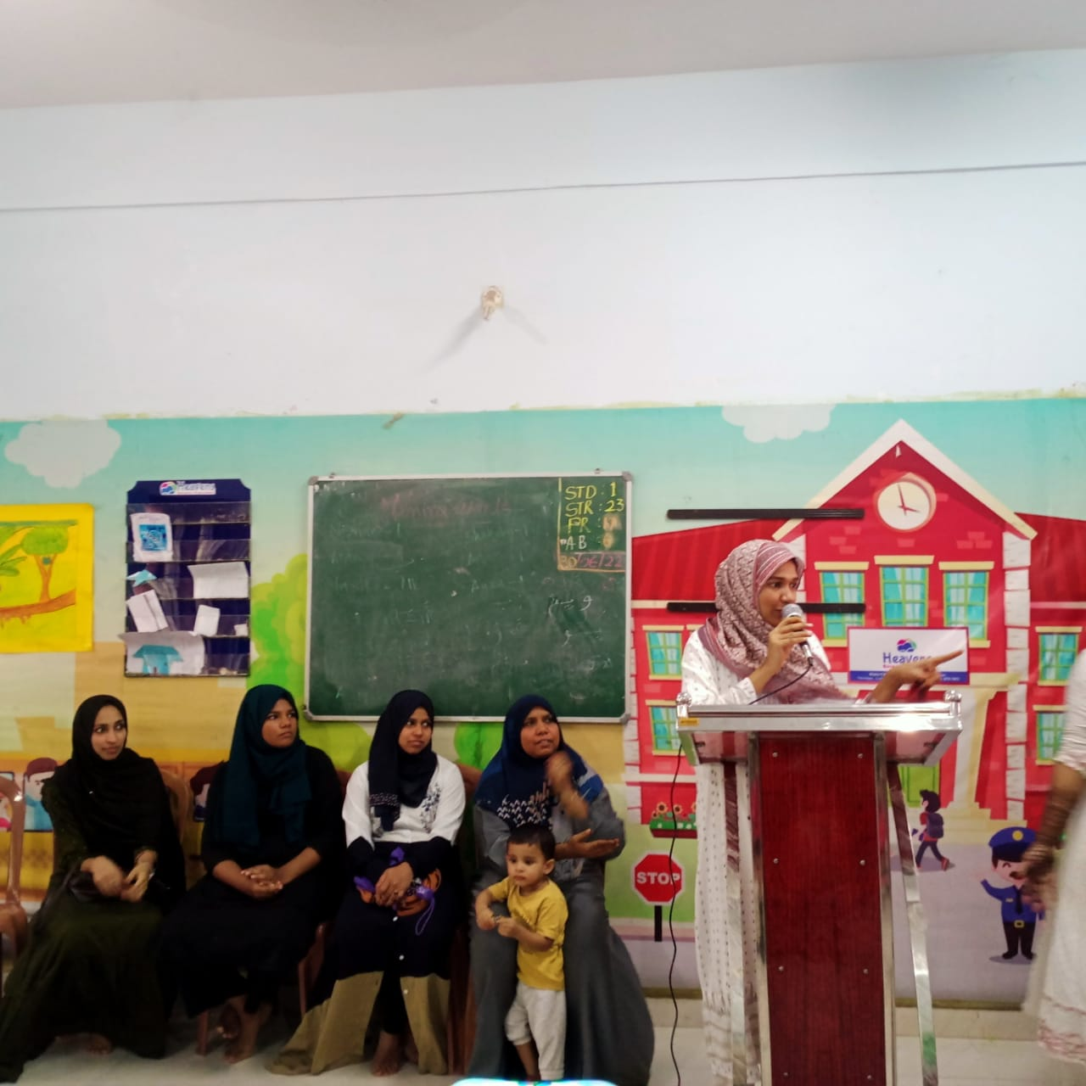
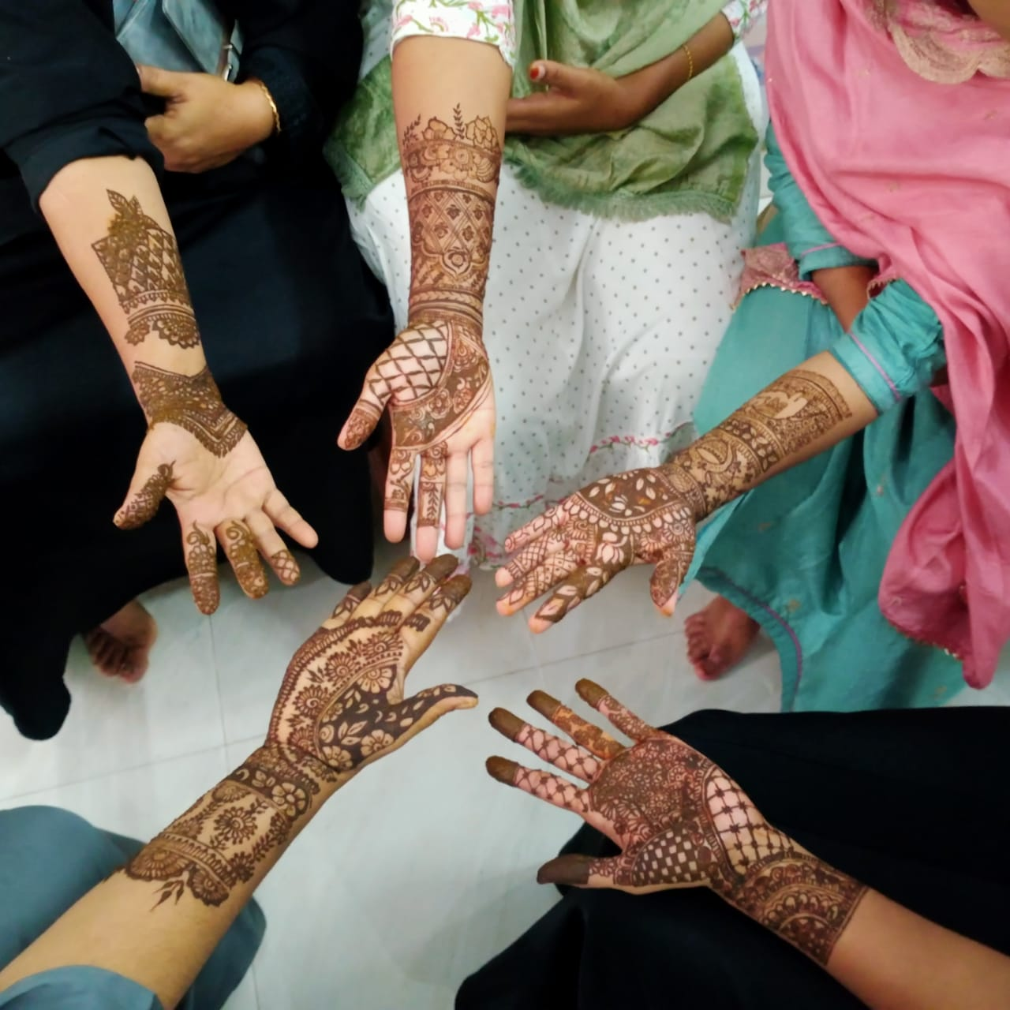
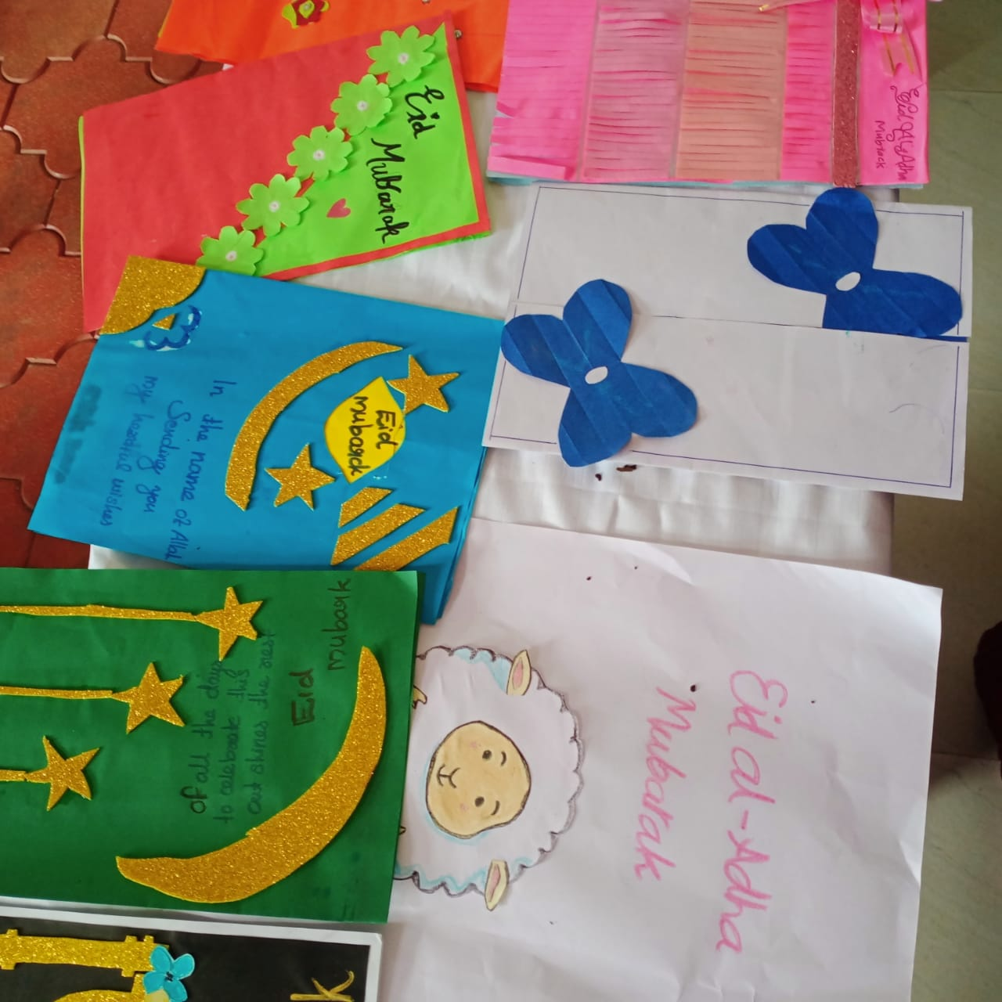
Academic Activities
EID AL-ADHA (on July 10)
Eid related programmes like Islamic song competition, mehndi designing, greeting card making were conducted for the parents and the students as well.
GANDHI JAYANTHI (on October 2)
Quiz was conducted for the students and they were asked to clean their home surroundings.
Notes:
%%TTS_FEMALE%
Eidul adha(on July 10)
Eid related programmes like Islamic song competition, mehndi designing, greeting card making were conducted for the parents and the students as well.
GANDHI jayenthi (on October 2)
Quiz was conducted for the students and they were asked to clean their home surroundings.

Slide 8
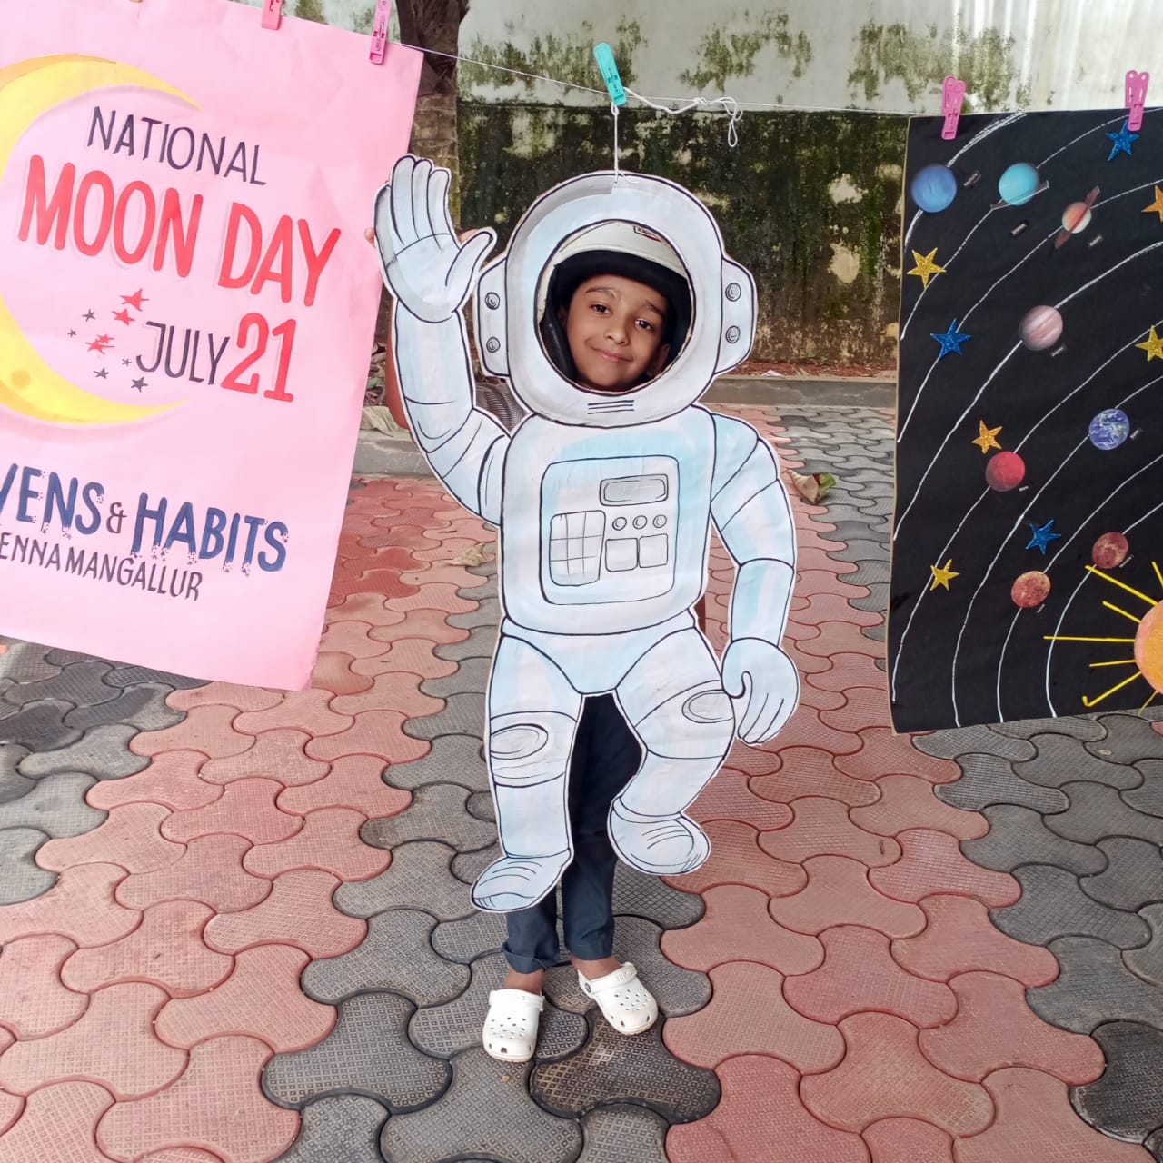
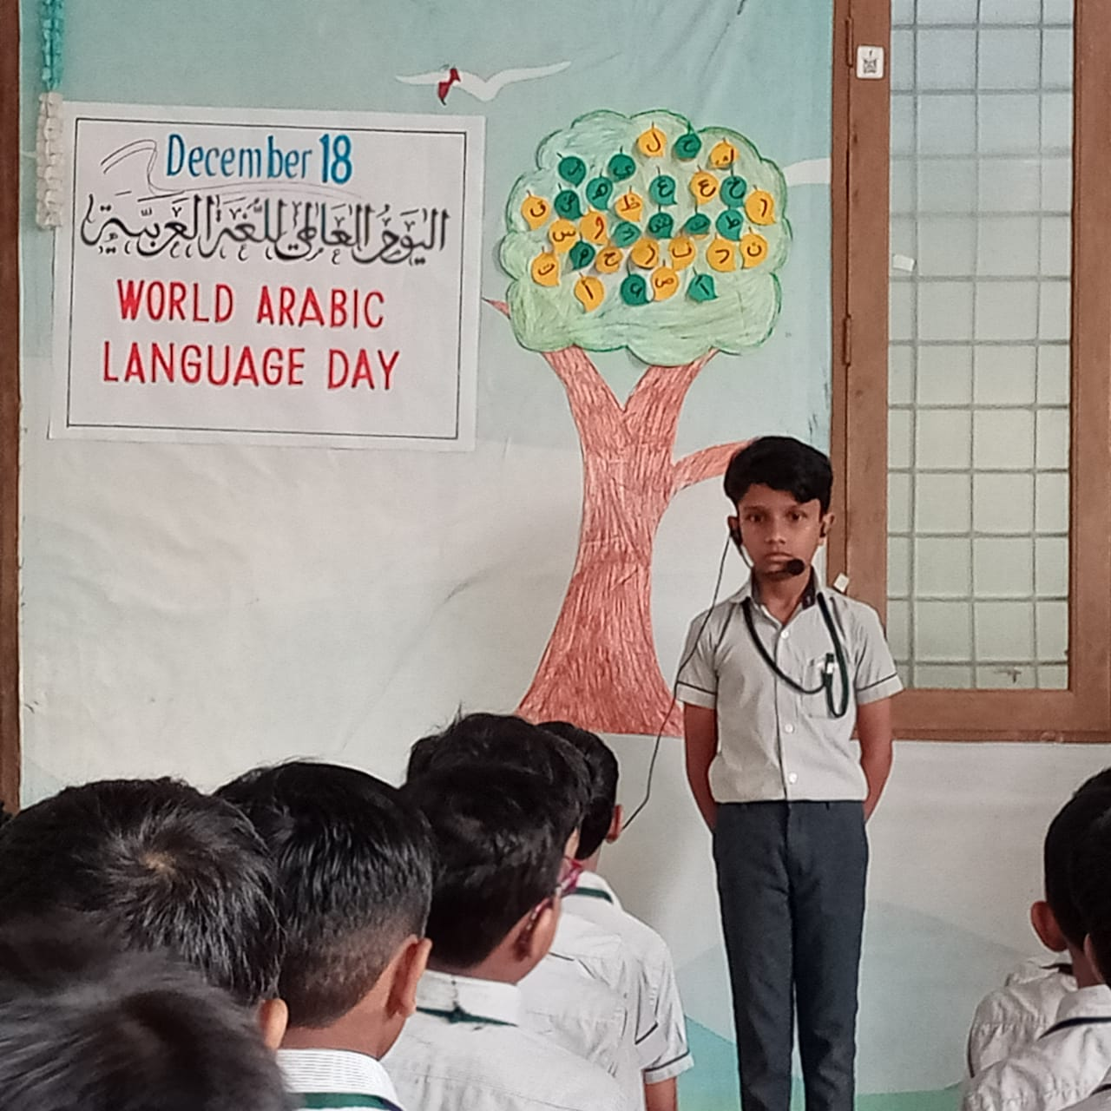
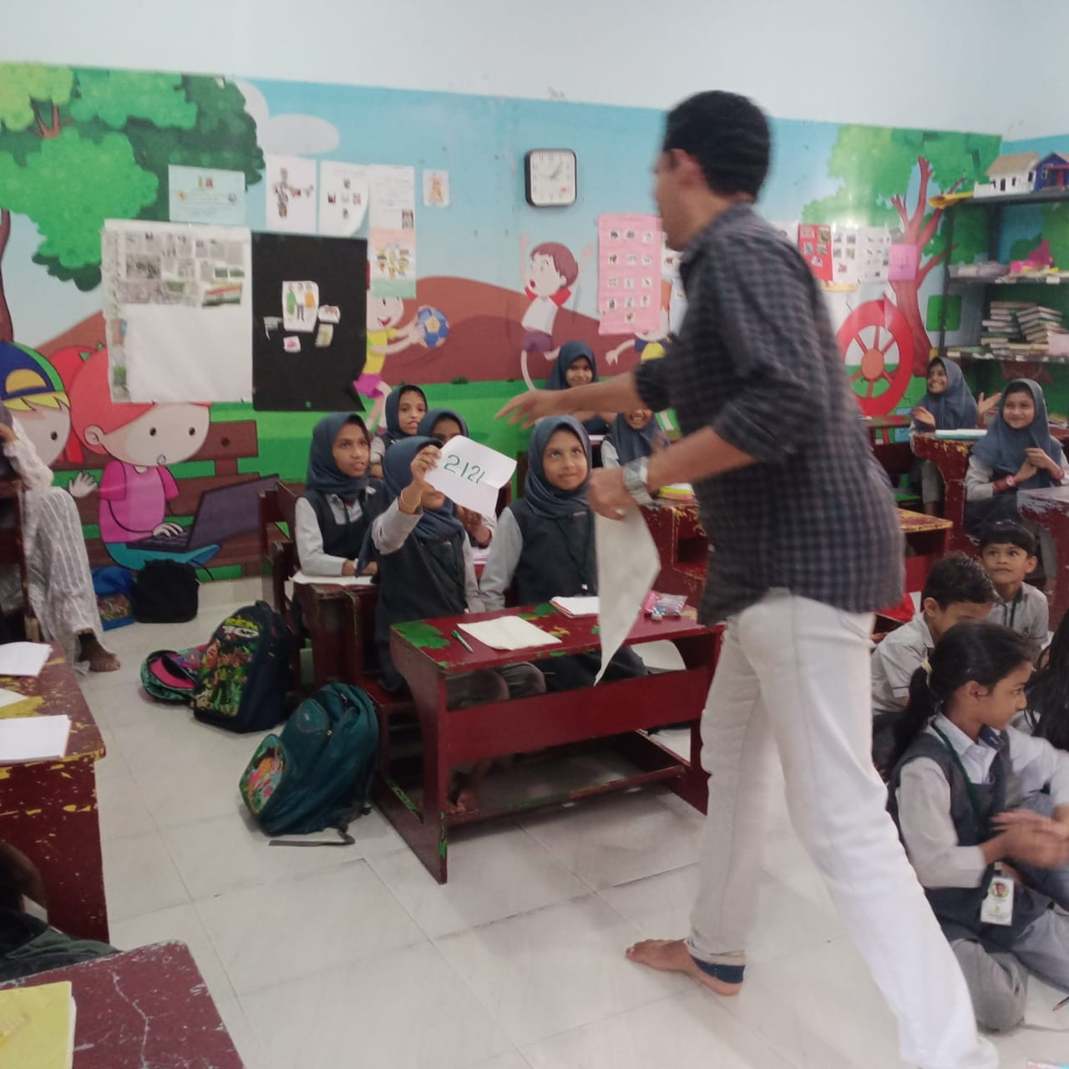
Academic Activities
MOON DAY (on July 21)
ARABIC LANGUAGE DAY (on December 18)
MATHS DAY (on December 22)
Quiz competition was conducted by the teachers.
Notes:
%%TTS_FEMALE%
MOON DAY (on July 21)
Quiz competition was conducted by the teachers.
ARABIC LANGUAGE DAY (on December 18)
MATHS DAY (on December 22)

Slide 9
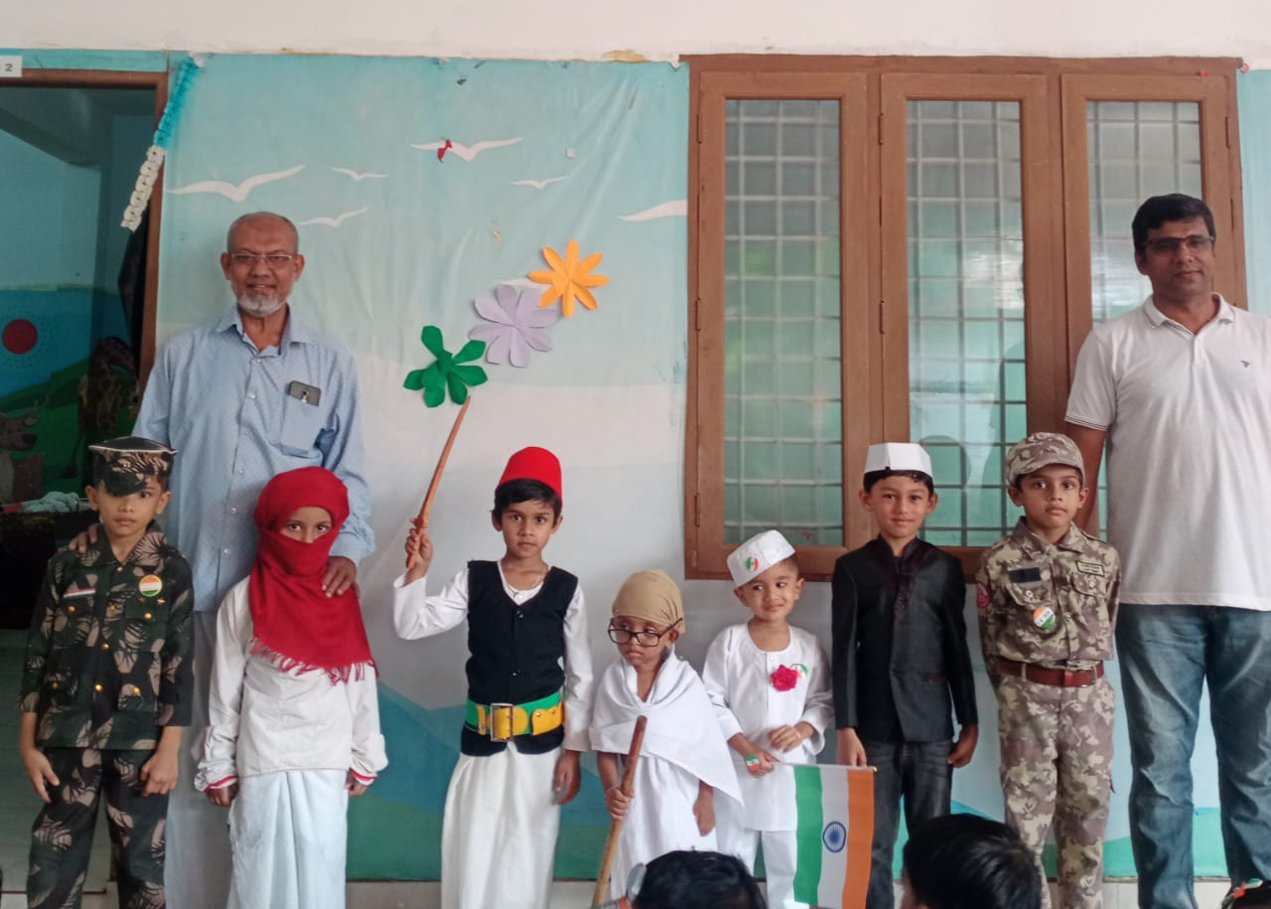
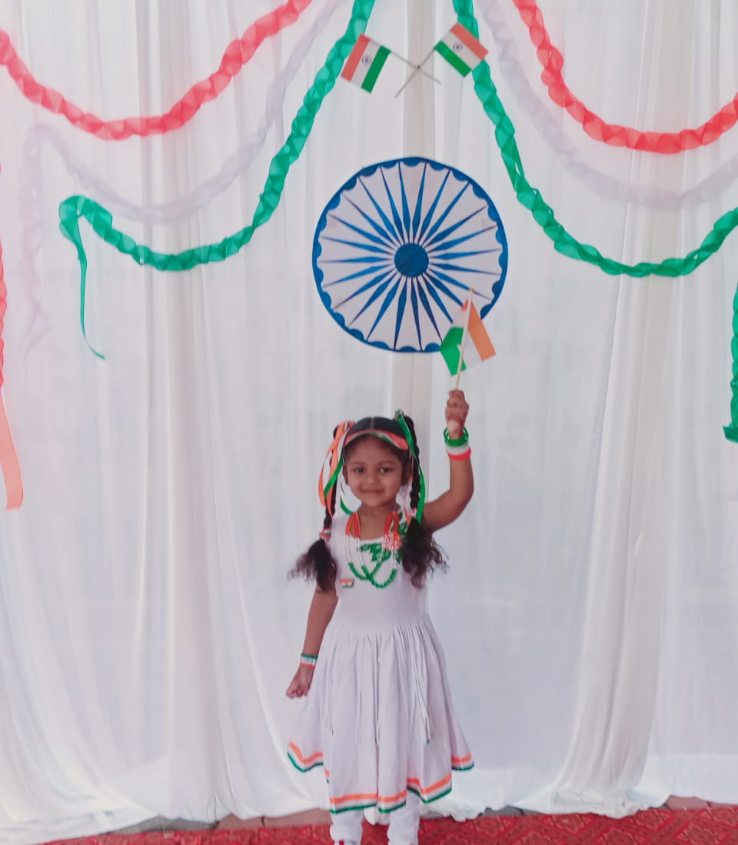
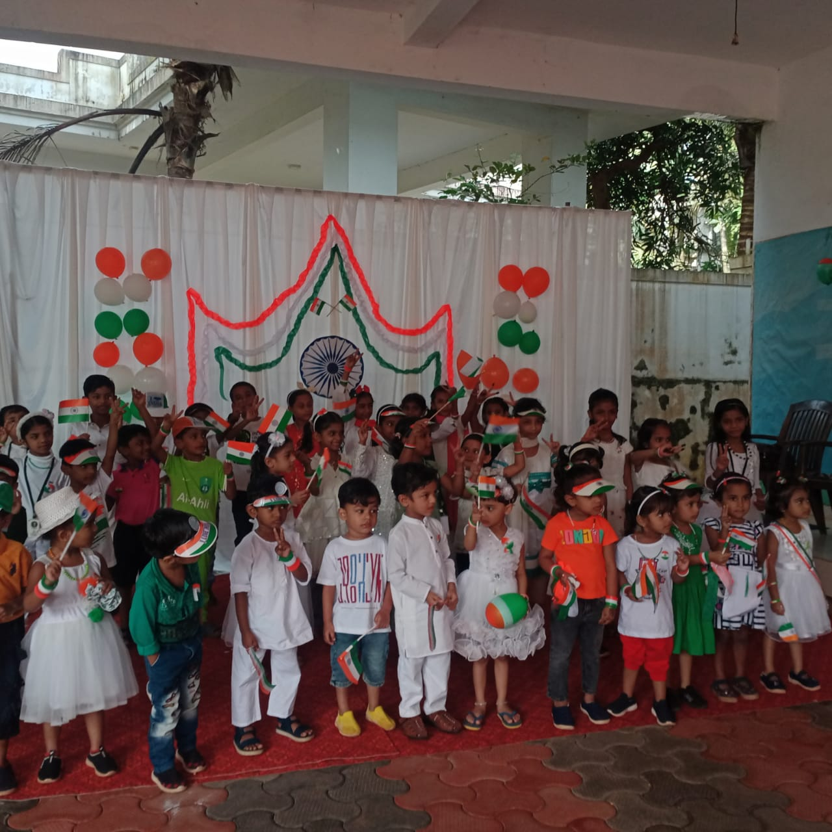
Academic Activities
INDEPENDENCE DAY (on August 15)
Flag was hosted by Mujeeb sir, physical trainer of MAMO college.
Programmes like flag making, quiz, songs and speeches were conducted.
Notes:
%%TTS_FEMALE%
INDEPENDENCE DAY (on August 15)
Flag was hosted by Mujeeb sir, physical trainer of MAMO college.
Programmes like flag making, quiz, songs and speeches were conducted.

Slide 10
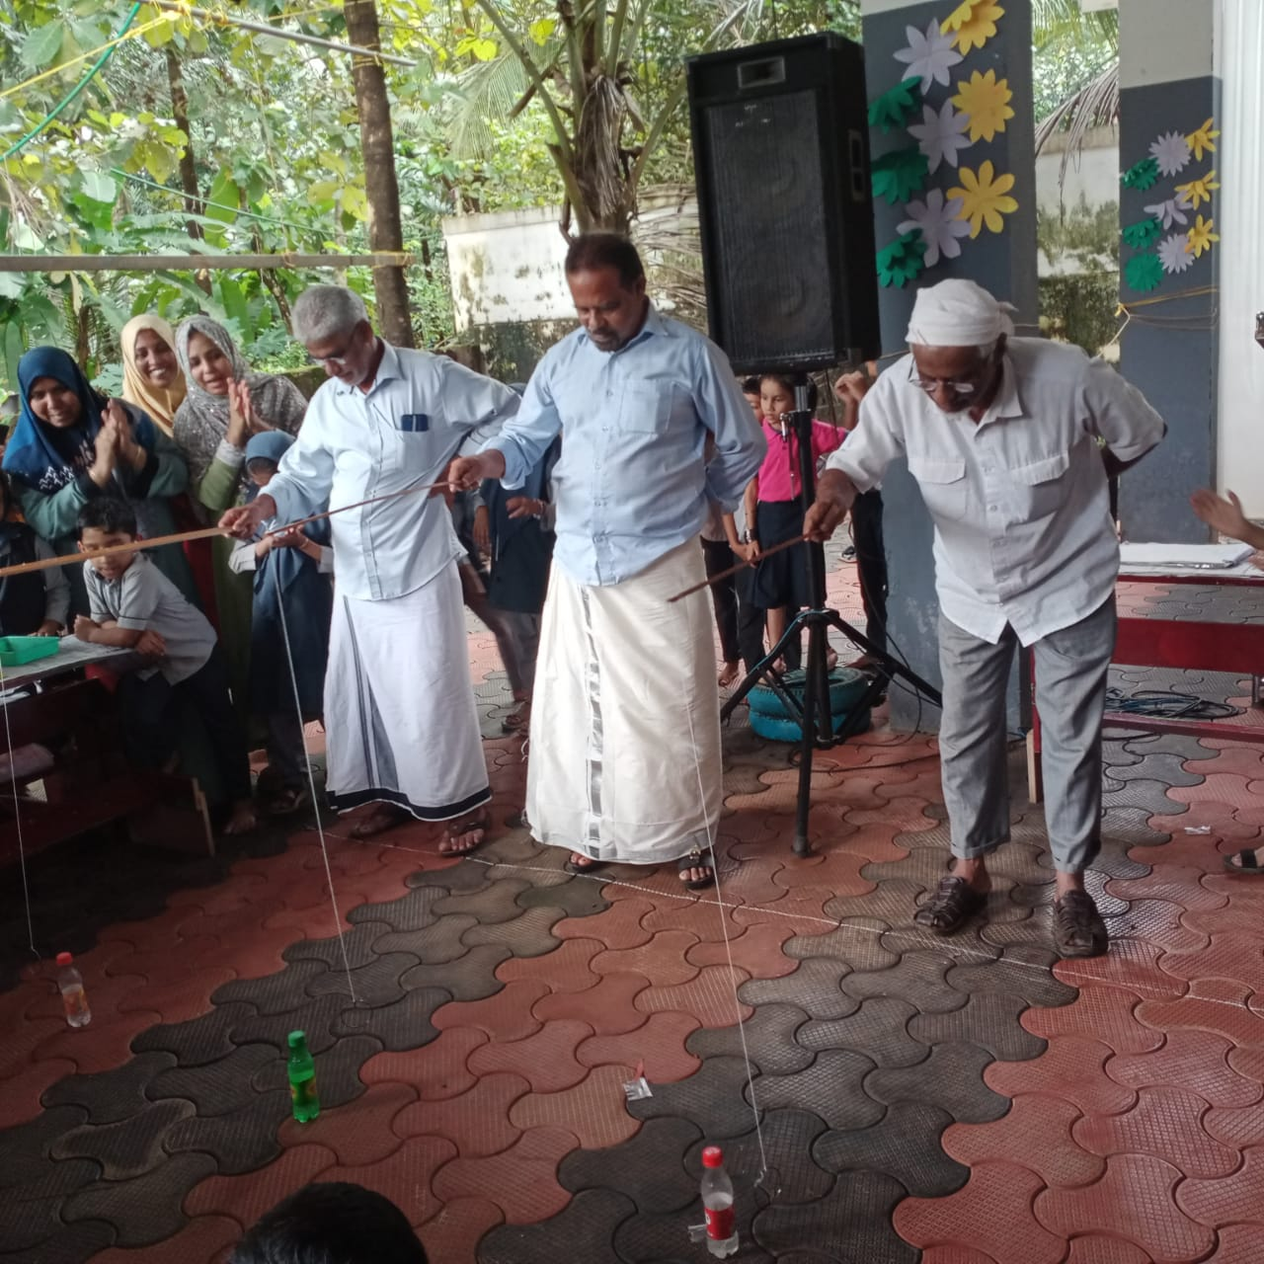
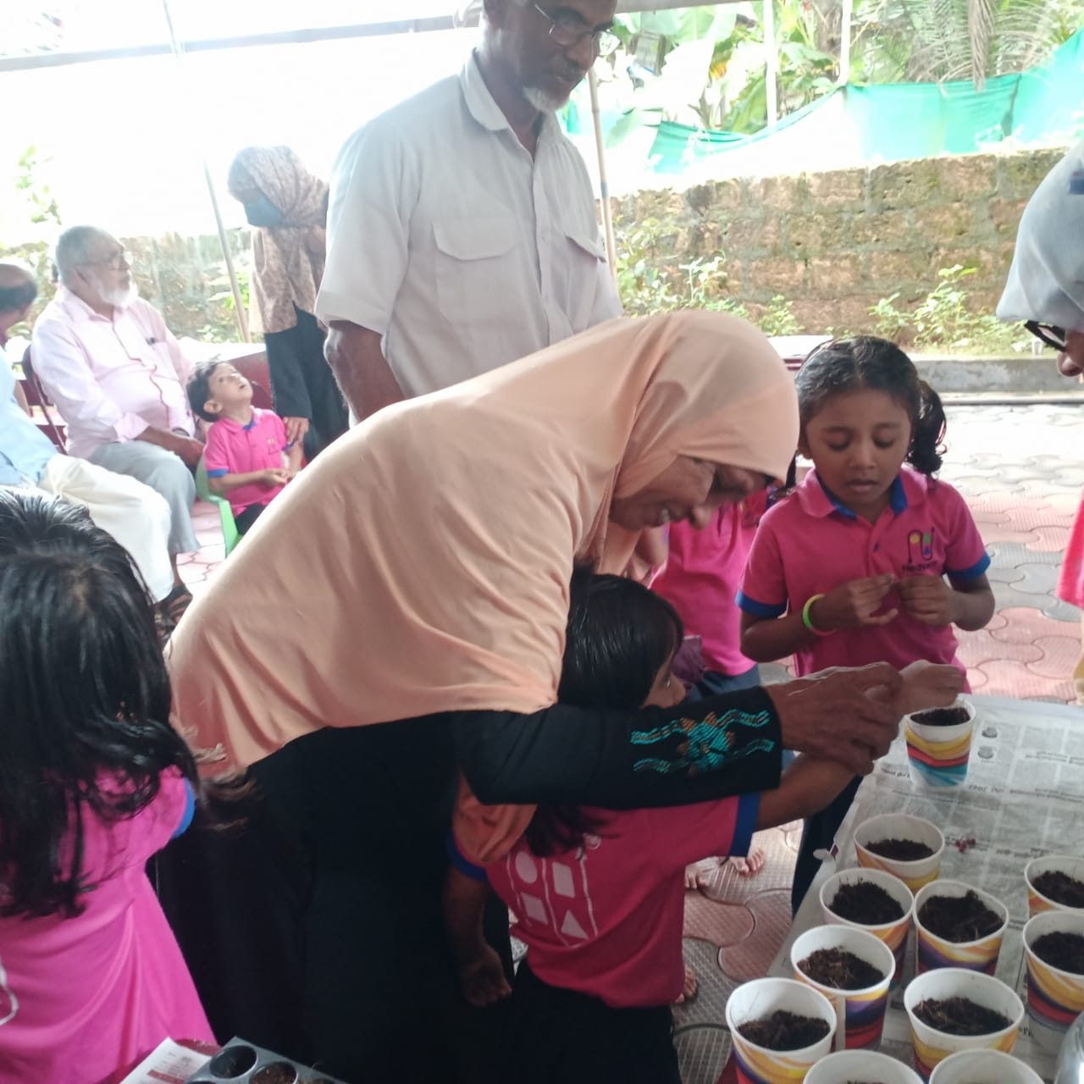
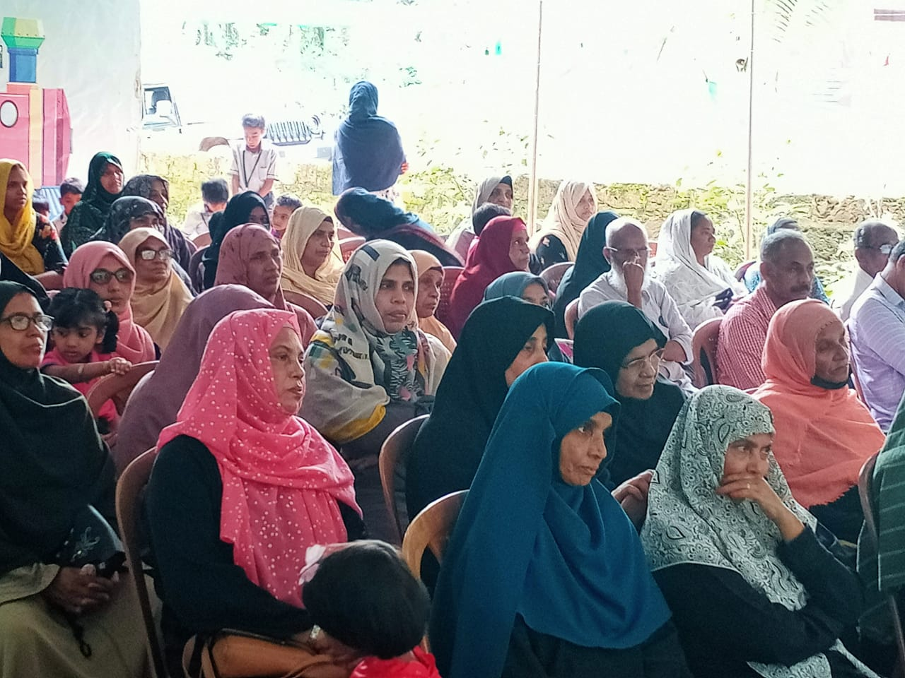
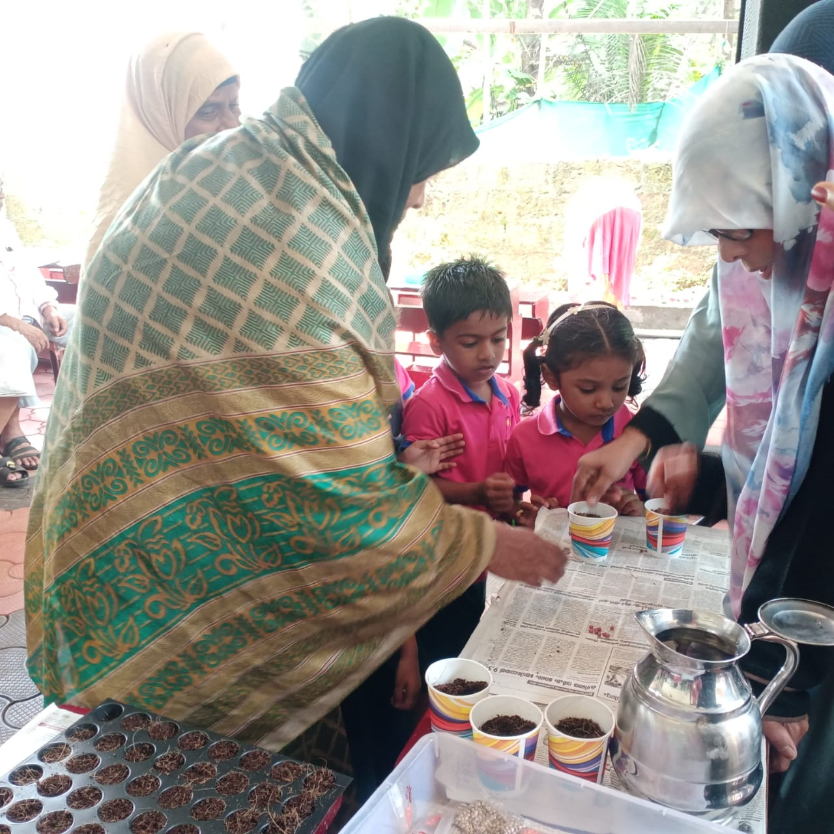
Academic Activities
GRANDPARENTS’ DAY AND SEEDLING DAY (on September 12)
Grandparents’ day was inaugurated by Fathima teacher and various games were conducted for the students and their grandparents.
Seedling day was inaugurated by Fathima T.K and she explained the needs of planting and how it is done.
Notes:
%%TTS_FEMALE%
GRANDPARENTS’ DAY AND SEEDLING DAY (on September 12)
Grandparents’ day was inaugurated by Faathima teacher and various games were conducted for the students and their grandparents.
Seedling day was inaugurated by Faathima T.K and she explained the needs of planting and how it is done.

Slide 11
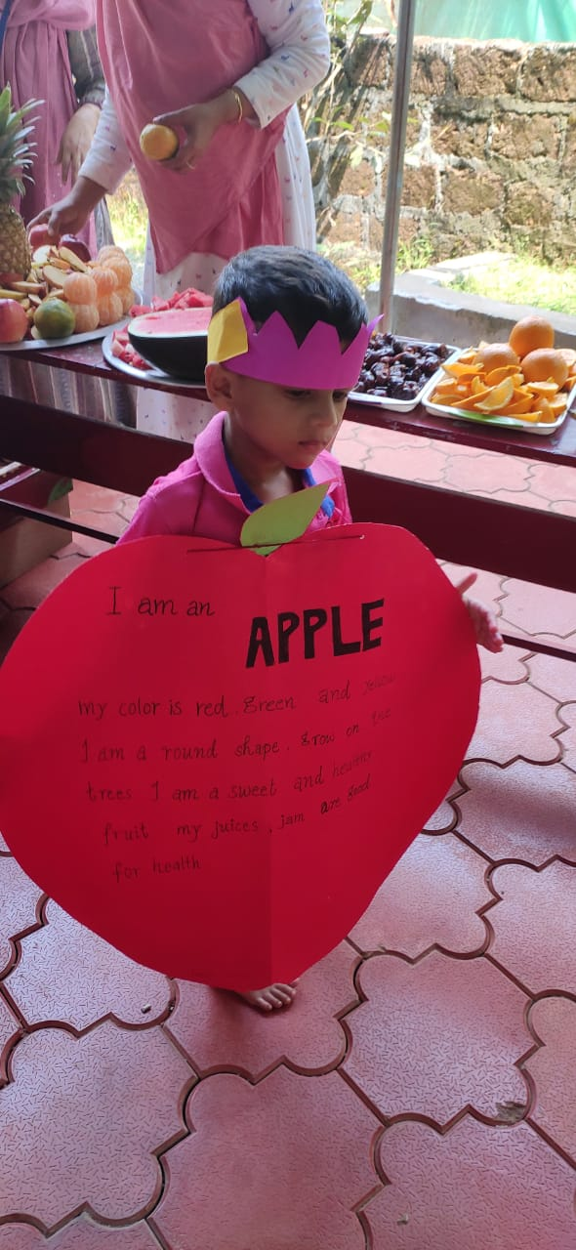
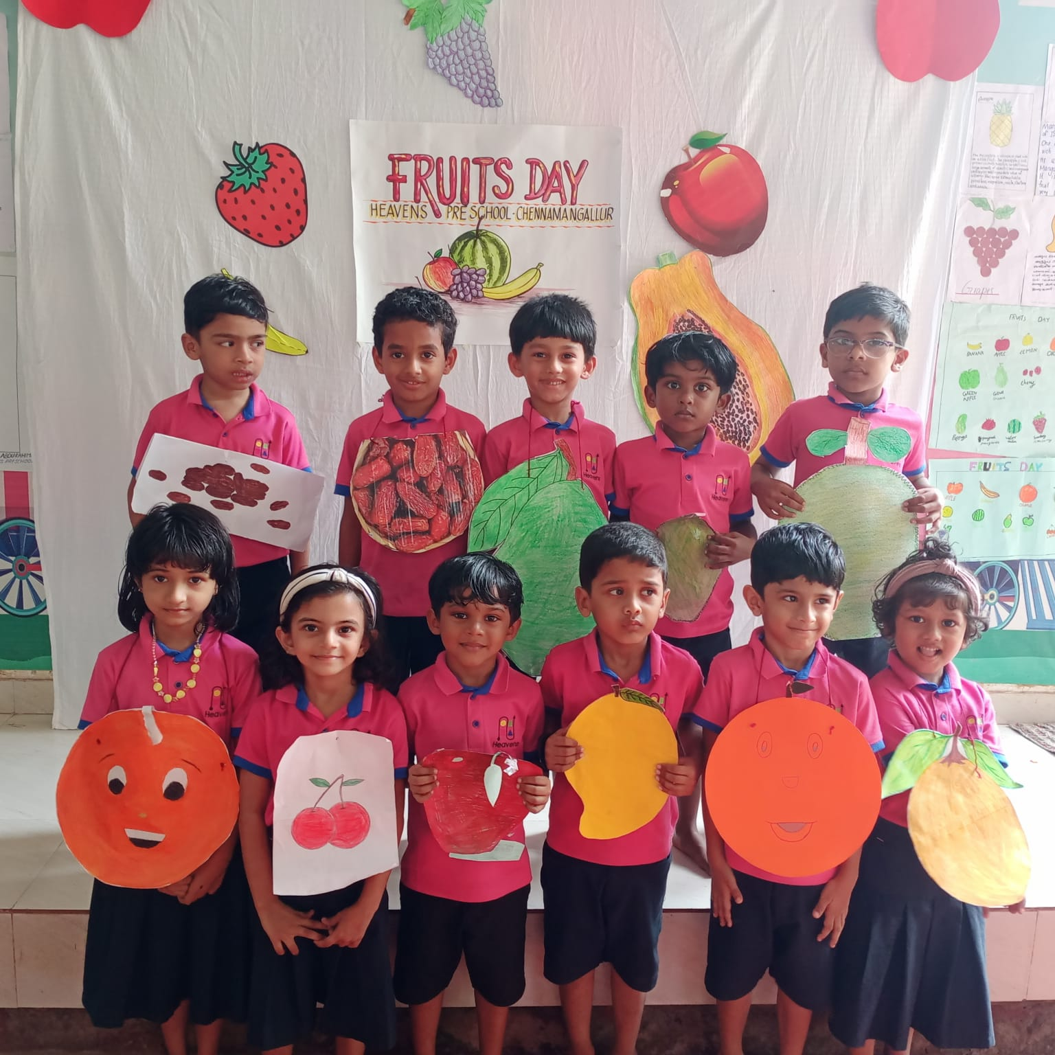
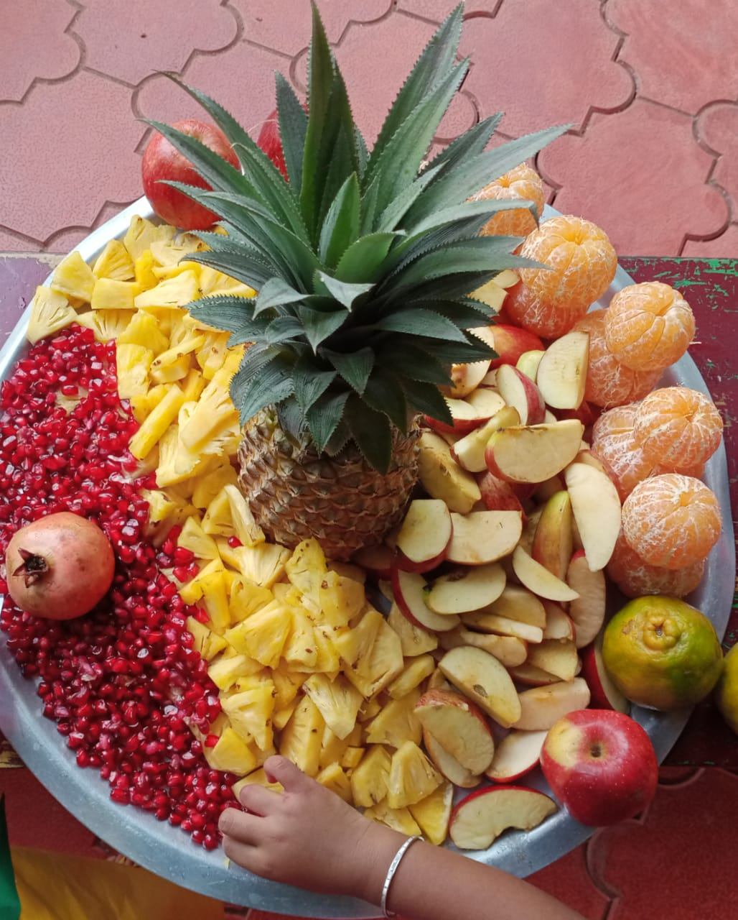
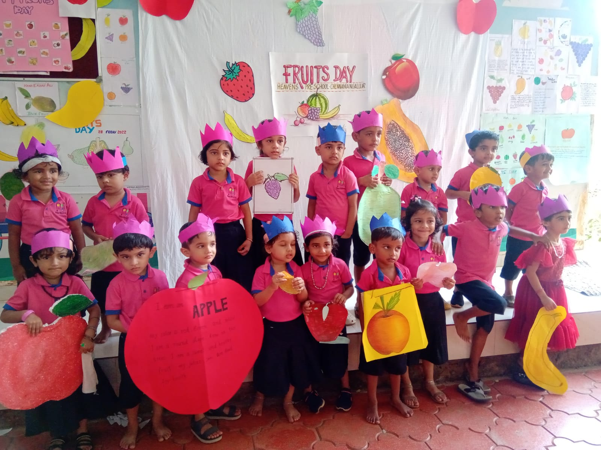
Academic Activities
FRUITS DAY (on OCTOBER 28)
Notes:
%%TTS_FEMALE%
FRUITS DAY (on OCTOBER 28)

Slide 12
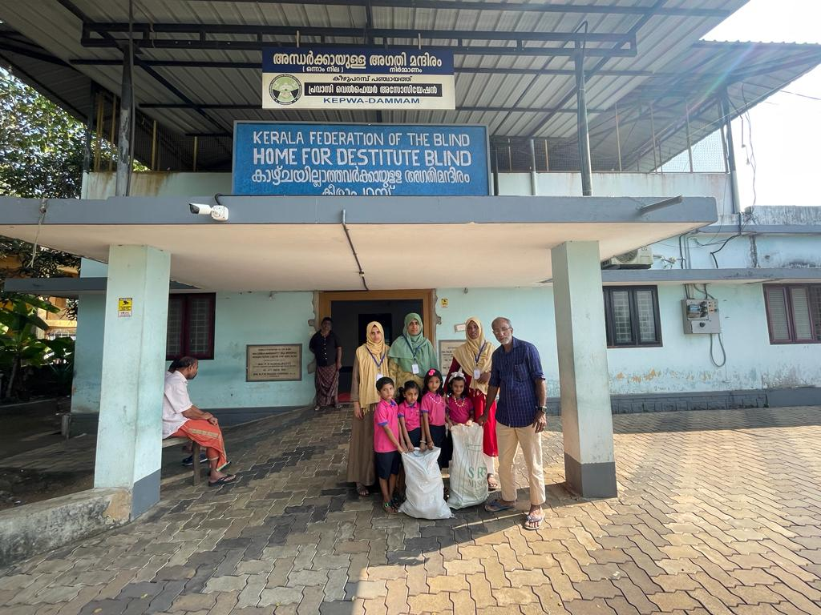
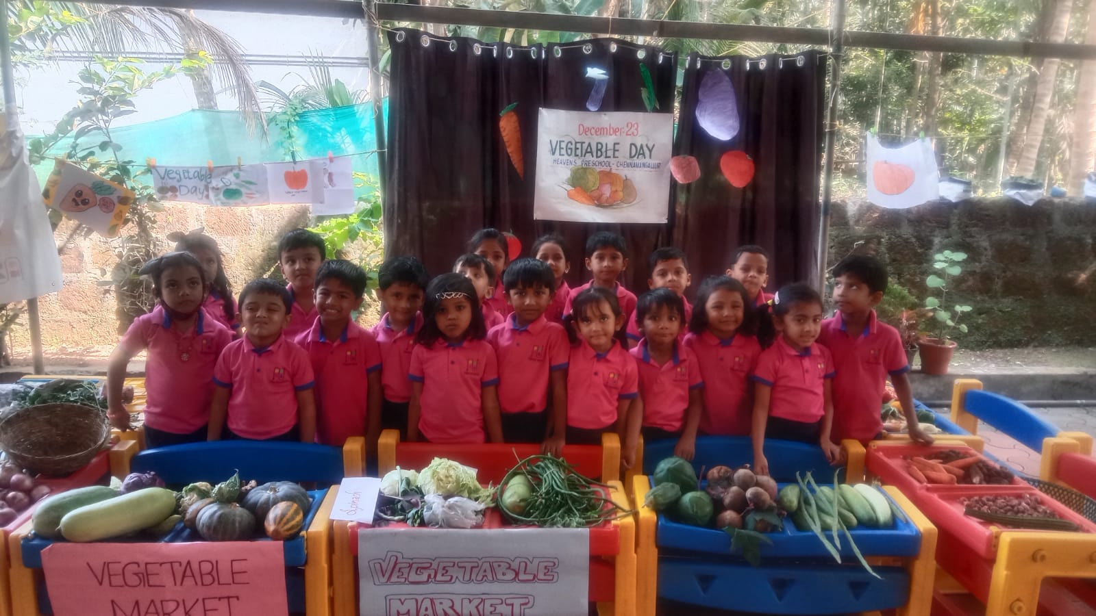
Academic Activities
VEGETABLE DAY (on December 23)
Vegetables were collected by the students and were given to the nearby old age home.
Notes:
%%TTS_FEMALE%
VEGETABLE DAY (on December 23)
Vegetables were collected by the students and were given to the nearby old age home.

Slide 13
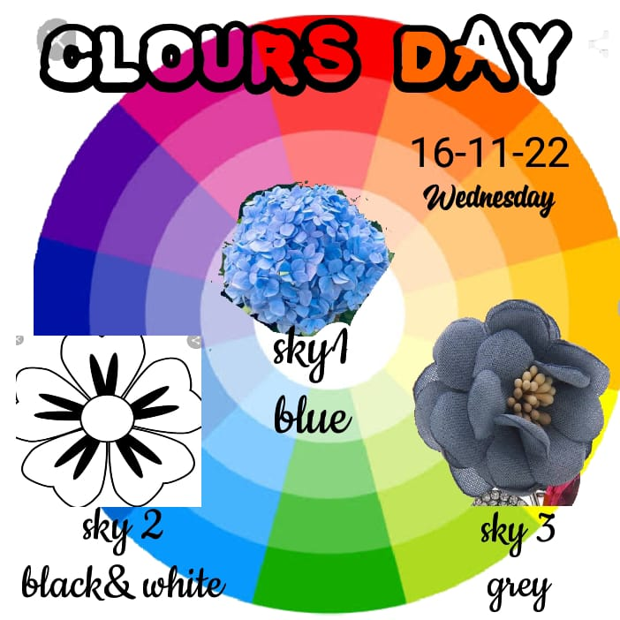
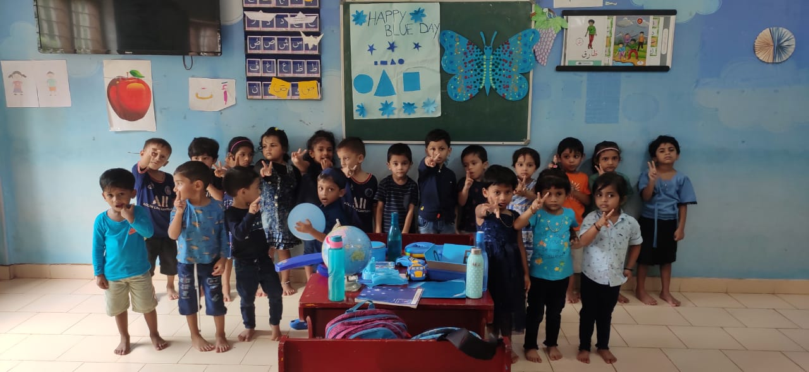
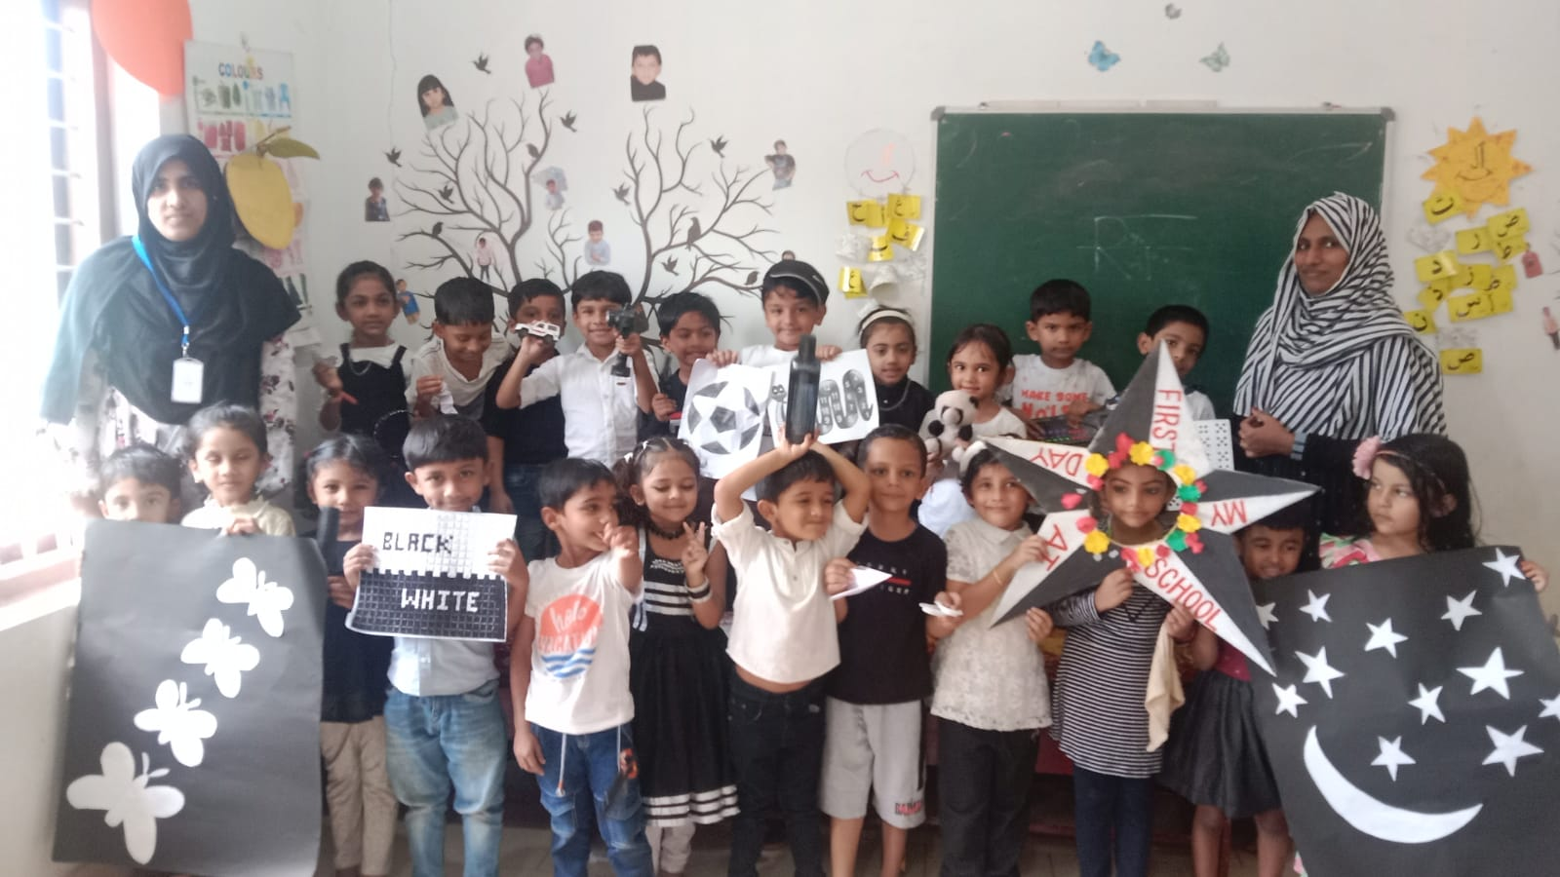
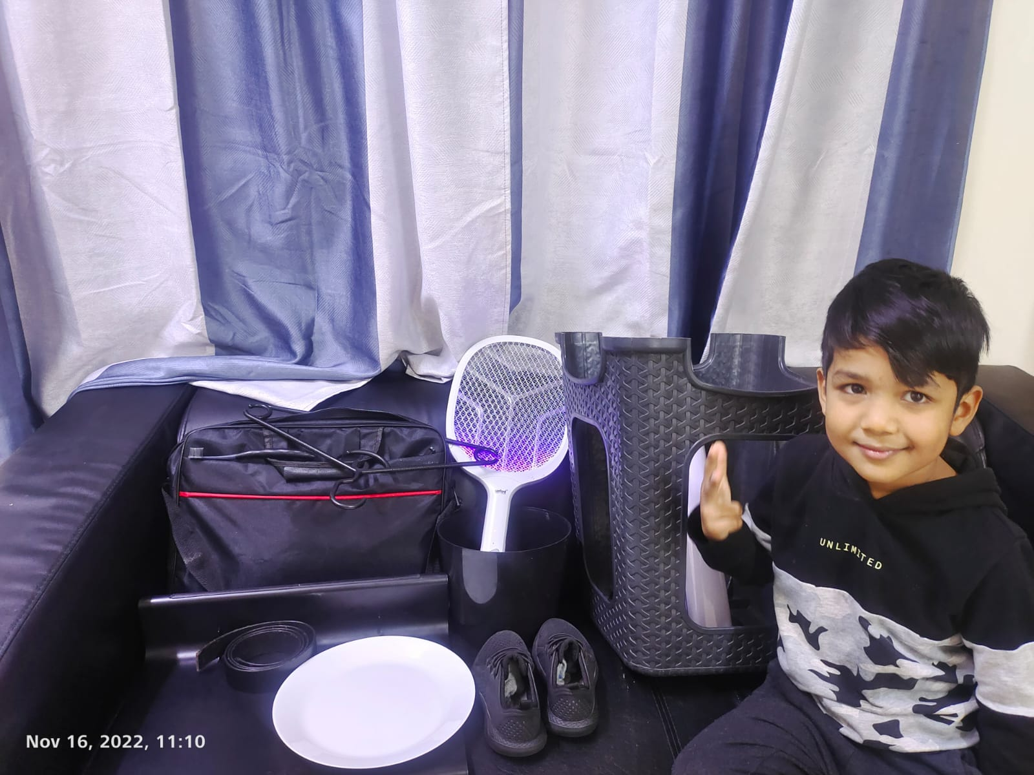
Academic Activities
COLOURS DAY (on November 16)
Notes:
%%TTS_FEMALE%
COLOURS DAY (on November 16)

Slide 14
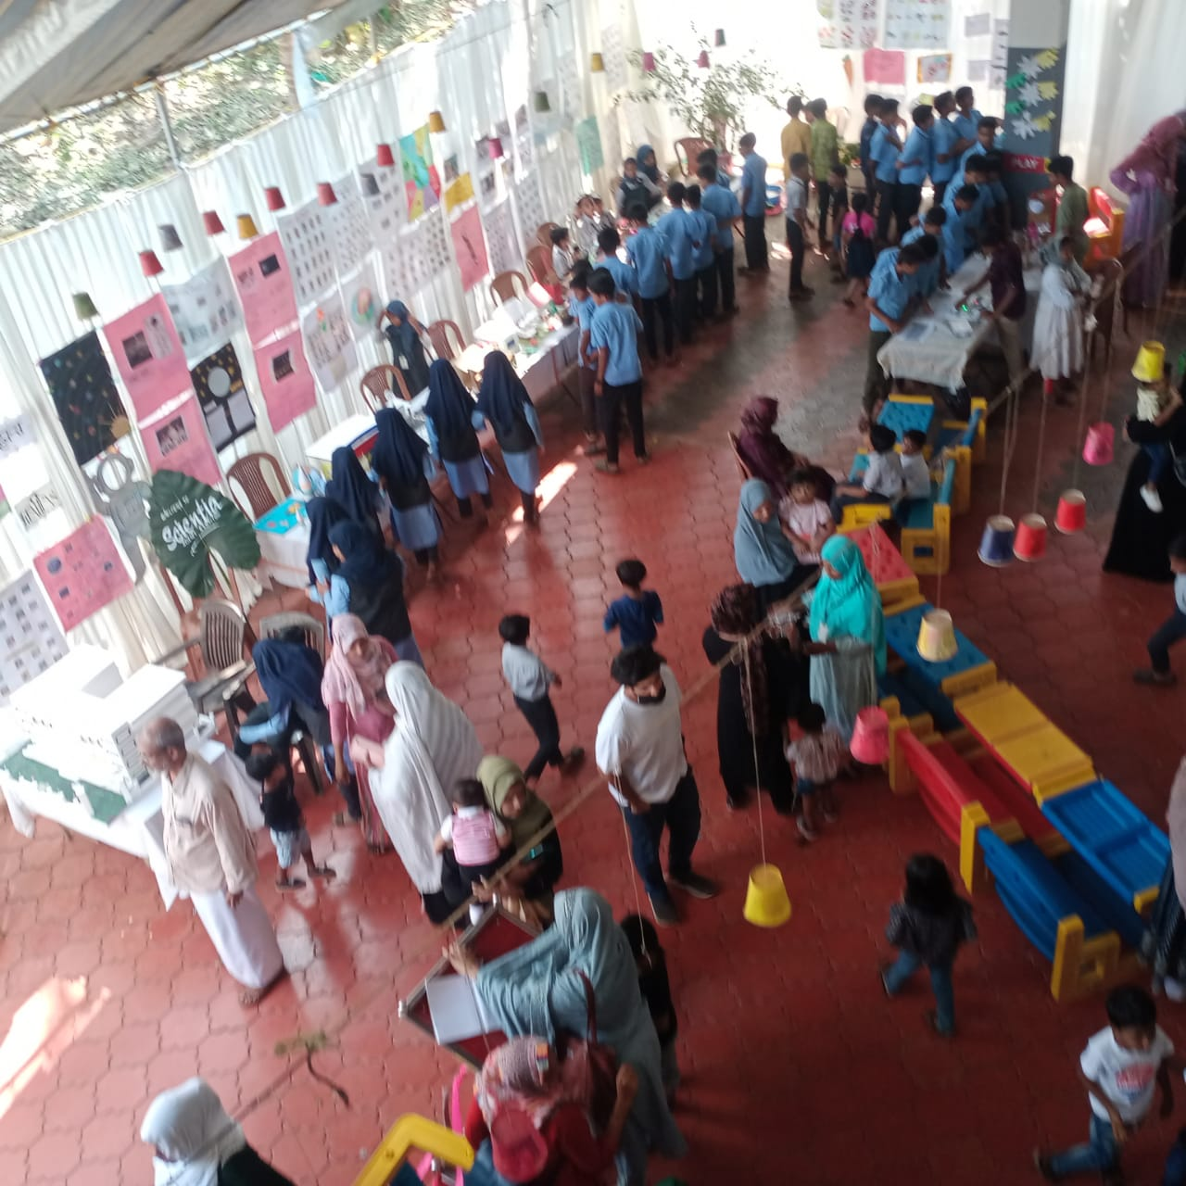
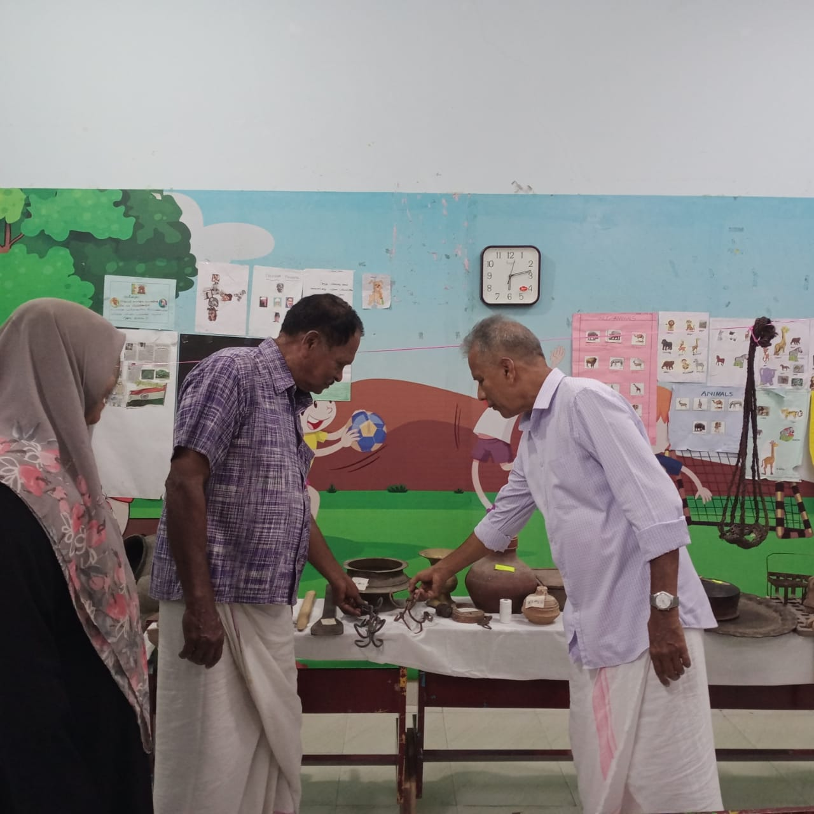
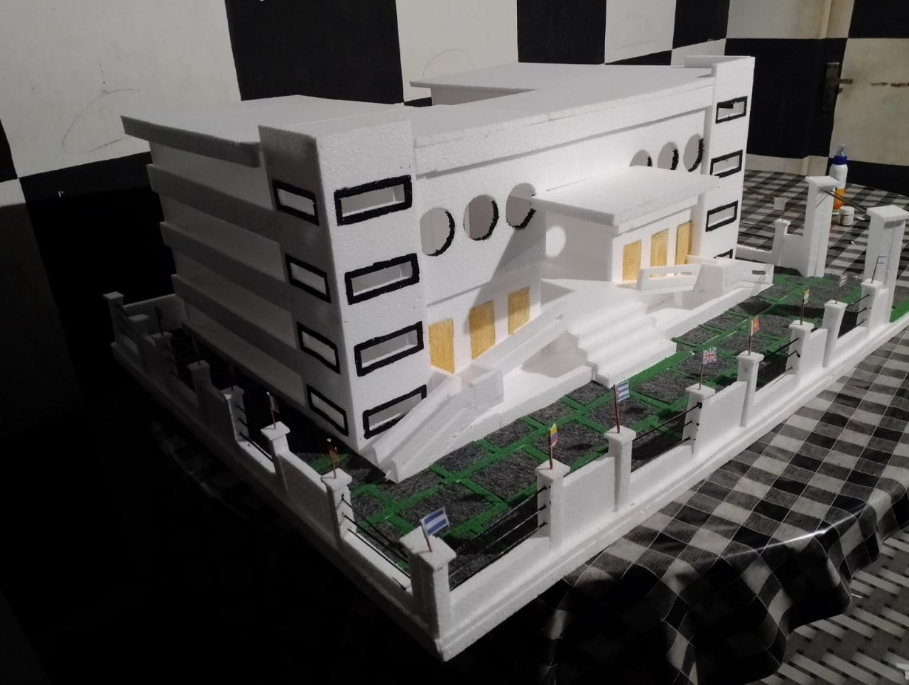
Academic Activities
EDUCATIONAL EXHIBITION
An educational exhibition was conducted by our school students and teachers.
It was inaugurated by O. Abdurahman sir, Madyamam MediaOne group editor.
Notes:
%%TTS_FEMALE%
EDUCATIONAL EXHIBITION
An educational exhibition was conducted by our school students and teachers.
It was inaugurated by O.Abdurrahman sir, Maadyamam MediaOne group editor.

Slide 15
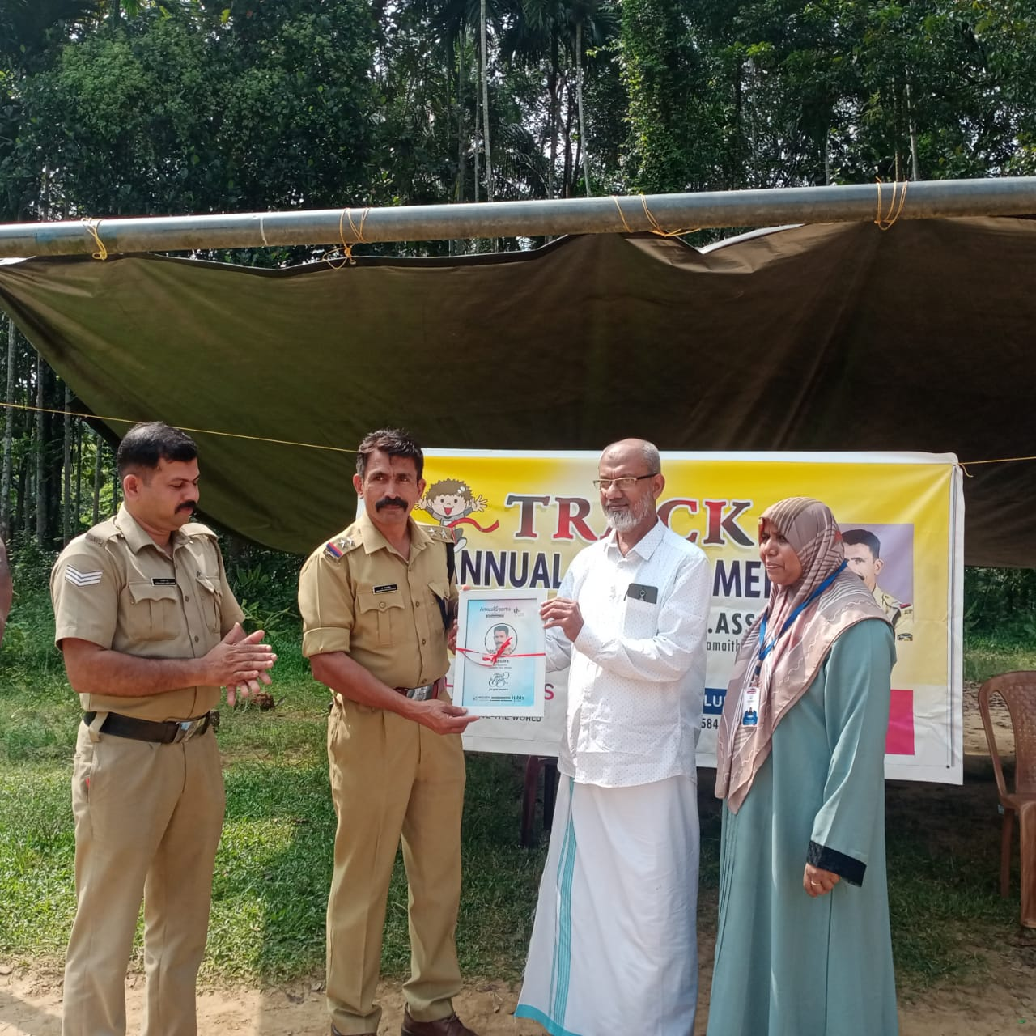
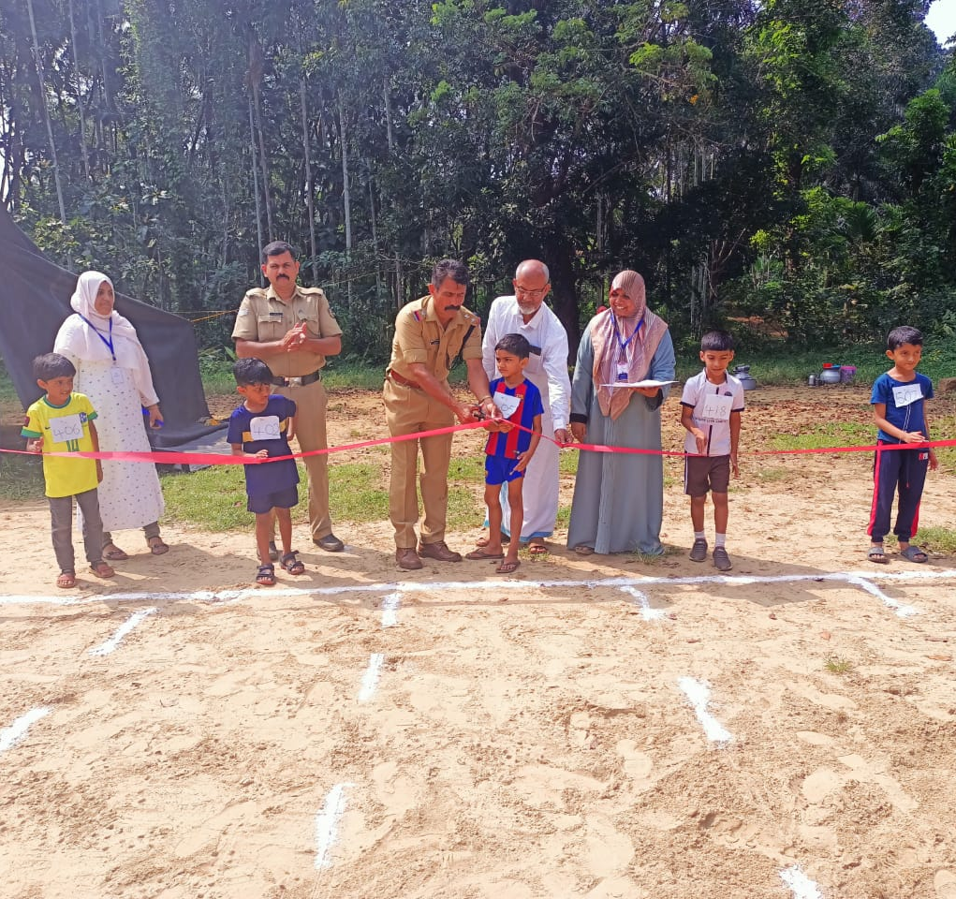
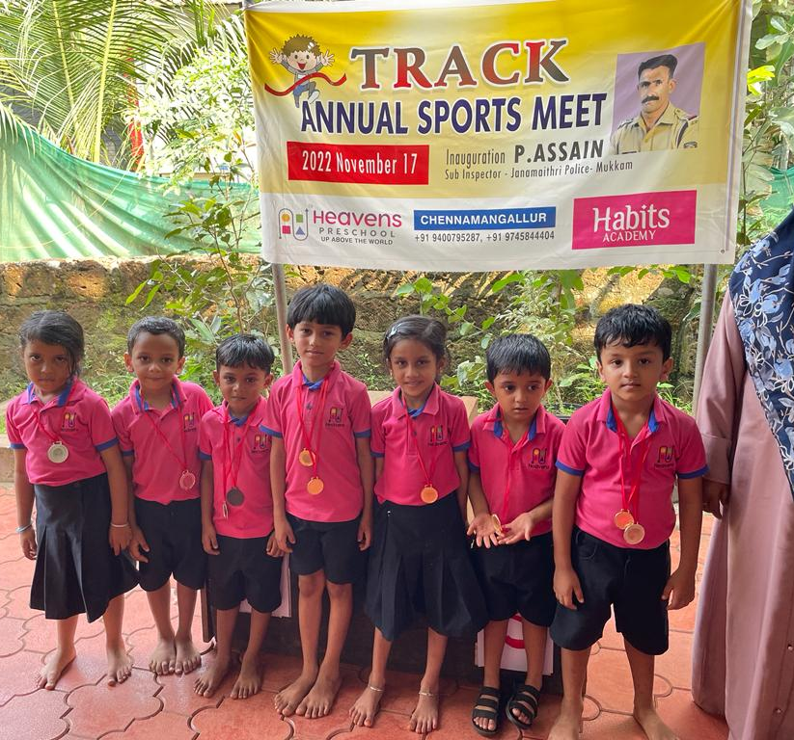
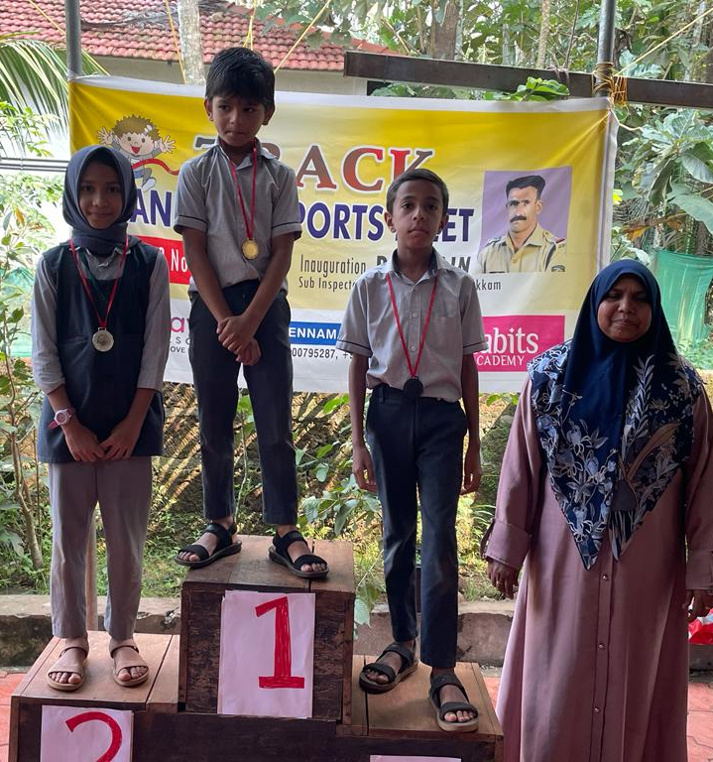
Academic Activities
ANNUAL SPORTS MEET
It was inaugurated by Assain sir, Janamaithree Police Mukkam.
Academic Activities
Notes:
%%TTS_FEMALE%
ANNUAL SPORTS MEET
It was inaugurated by Assain sir, Janamaithree Police Mukkam.

Slide 16
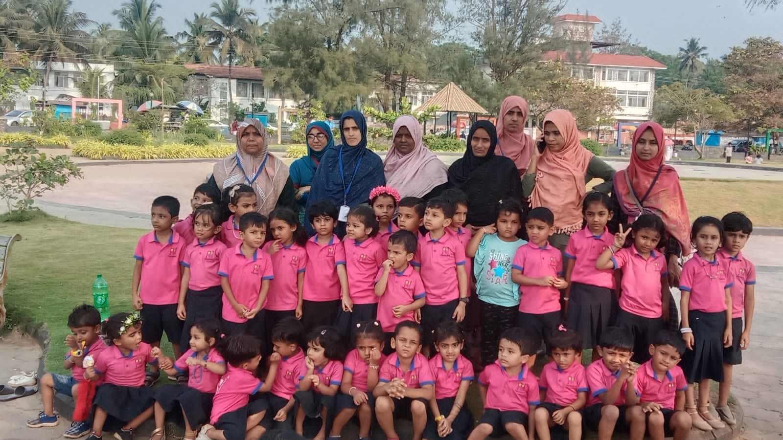
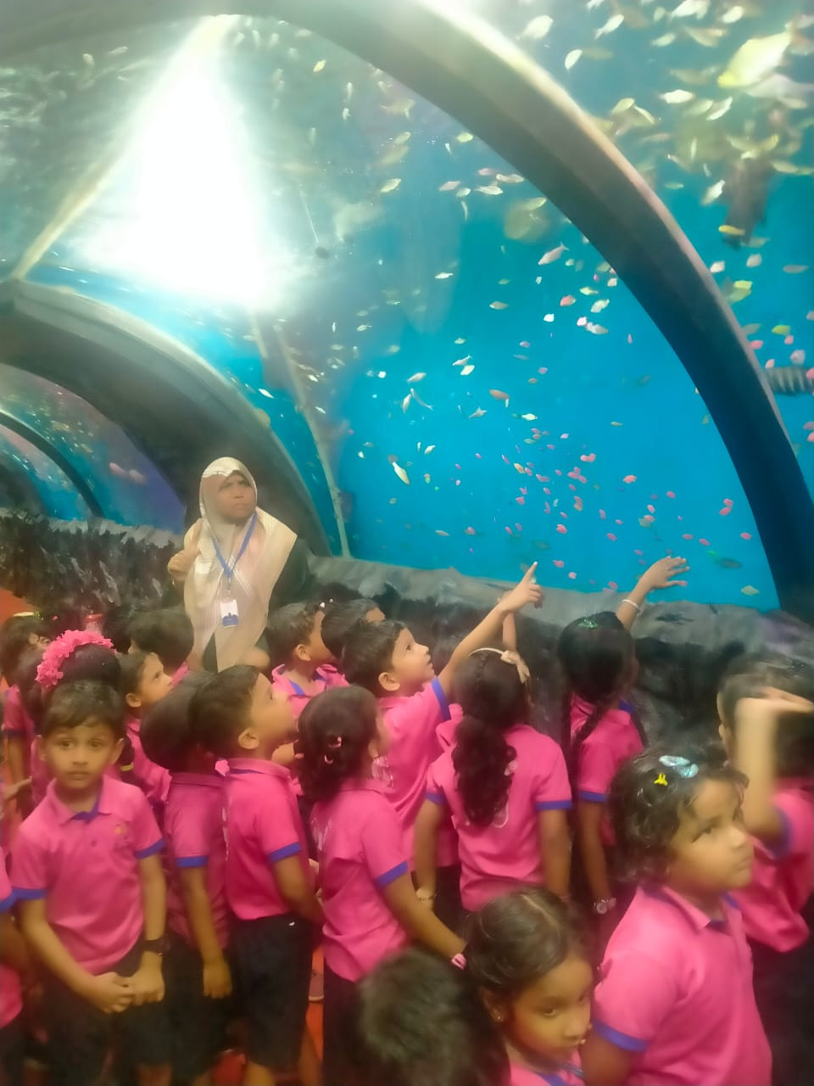
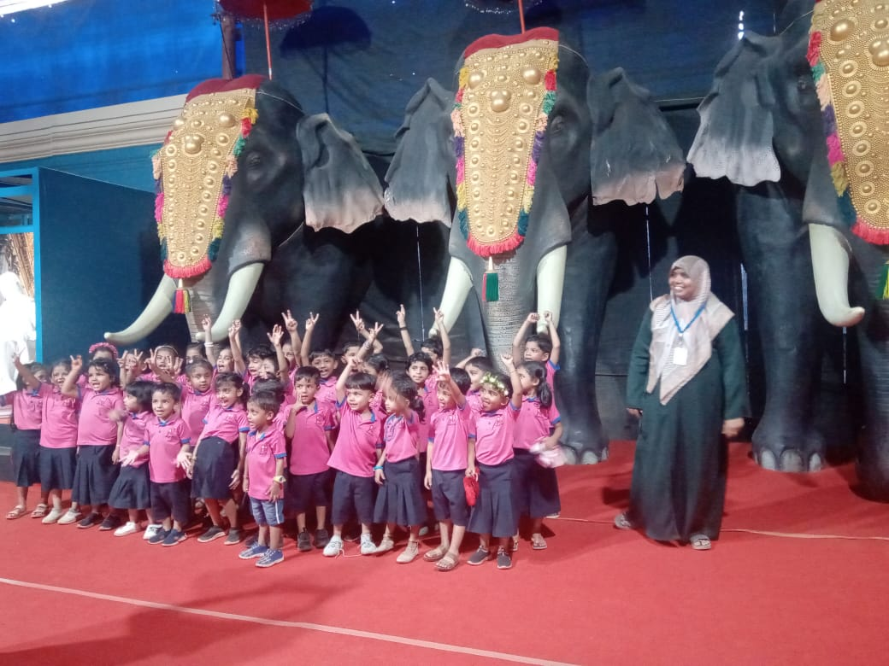
Academic Activities
FIELD TRIP – SKY 1 & SKY 2
Notes:
%%TTS_FEMALE%
FIELD TRIP – SKY 1 & SKY 2

Slide 17
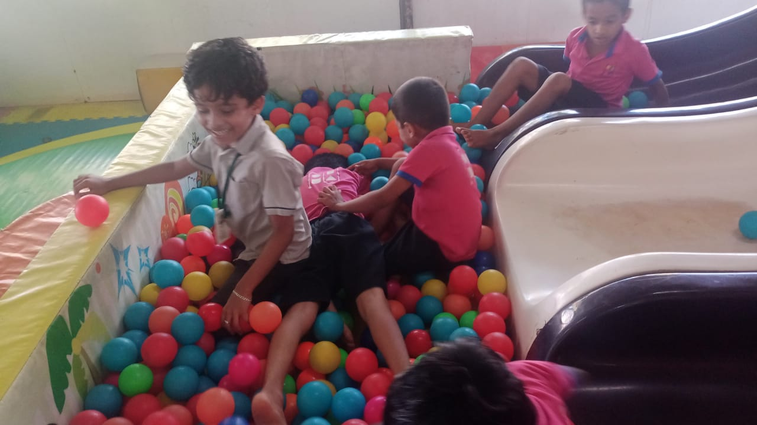
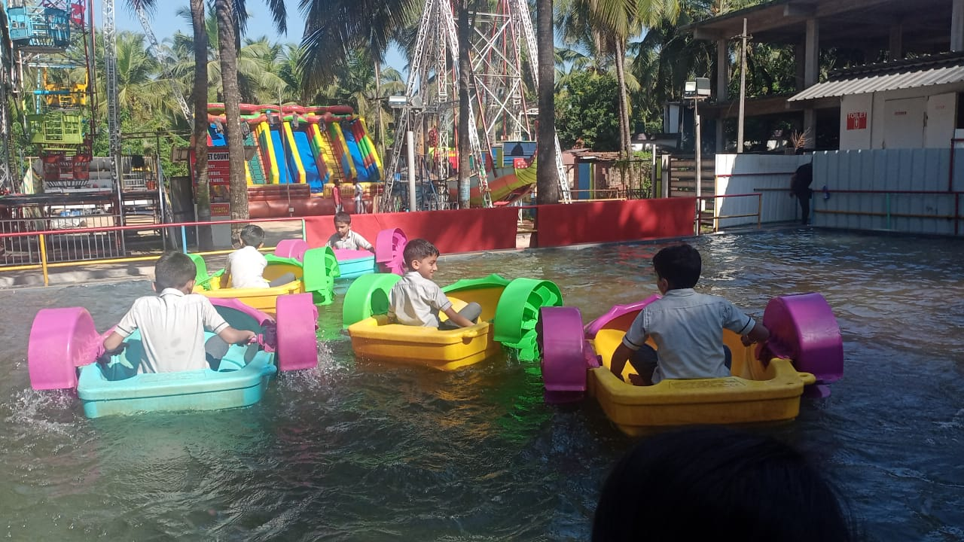
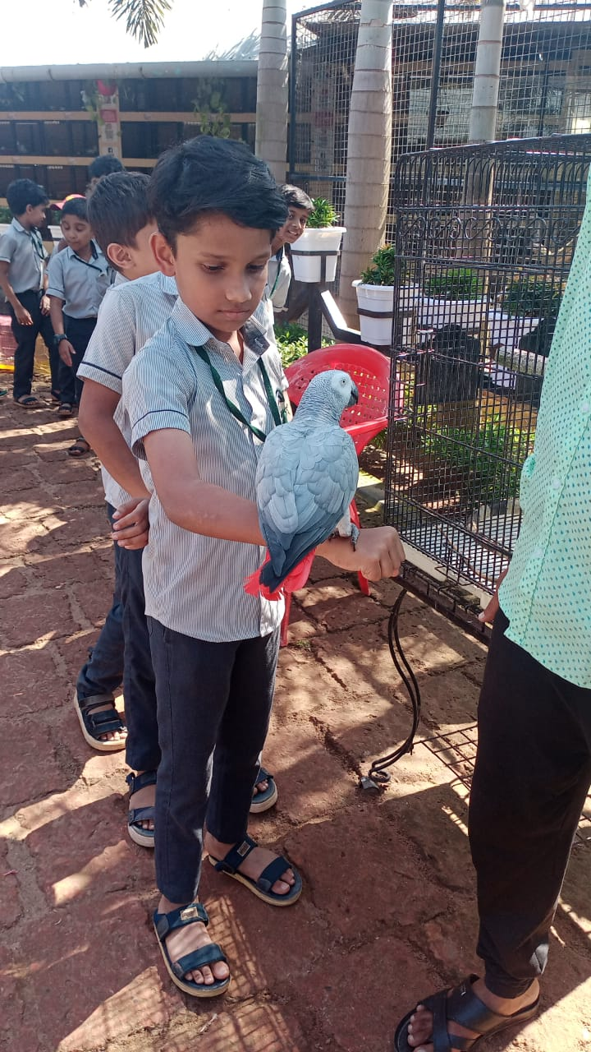
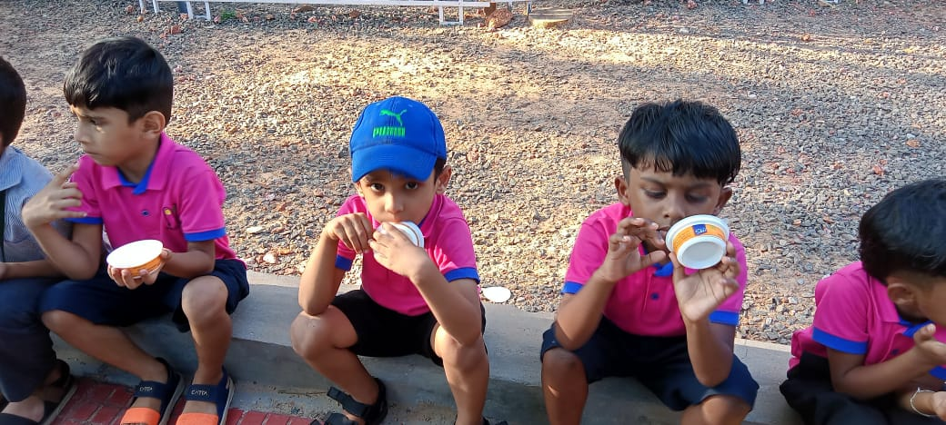
Academic Activities
FIELD TRIP –SKY 3 & HABITS
Notes:
%%TTS_FEMALE%
FIELD TRIP –SKY 3 & HABITS

Slide 18
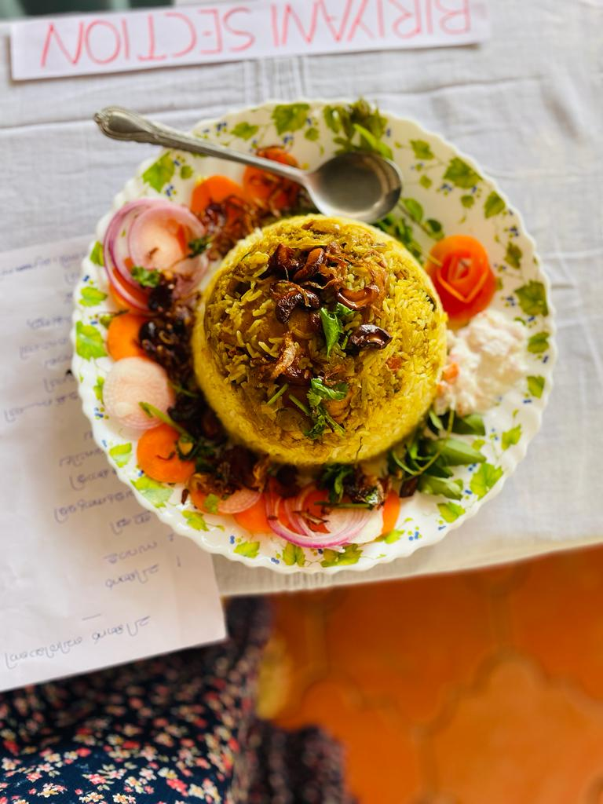
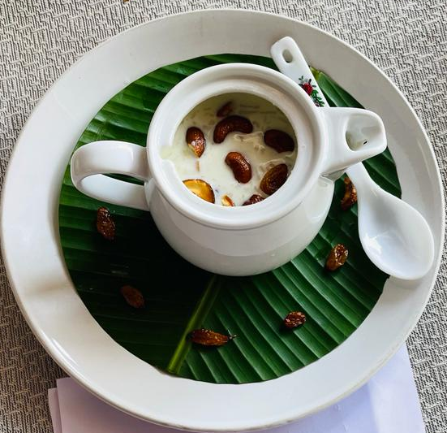
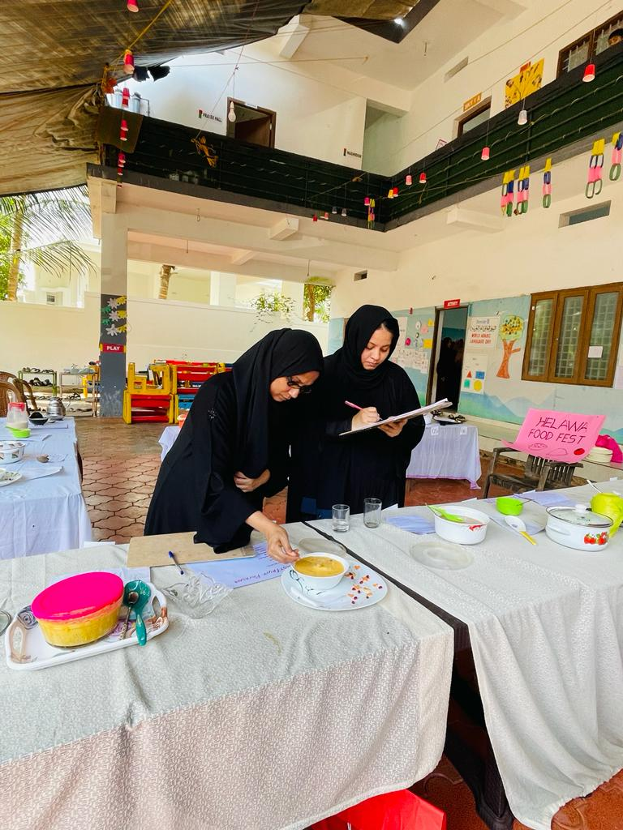
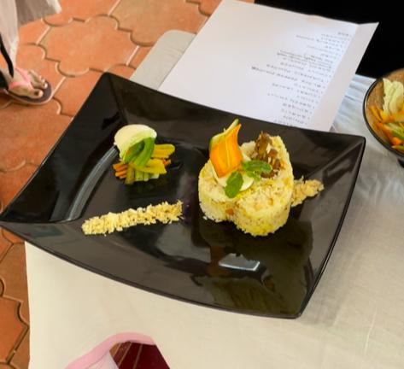
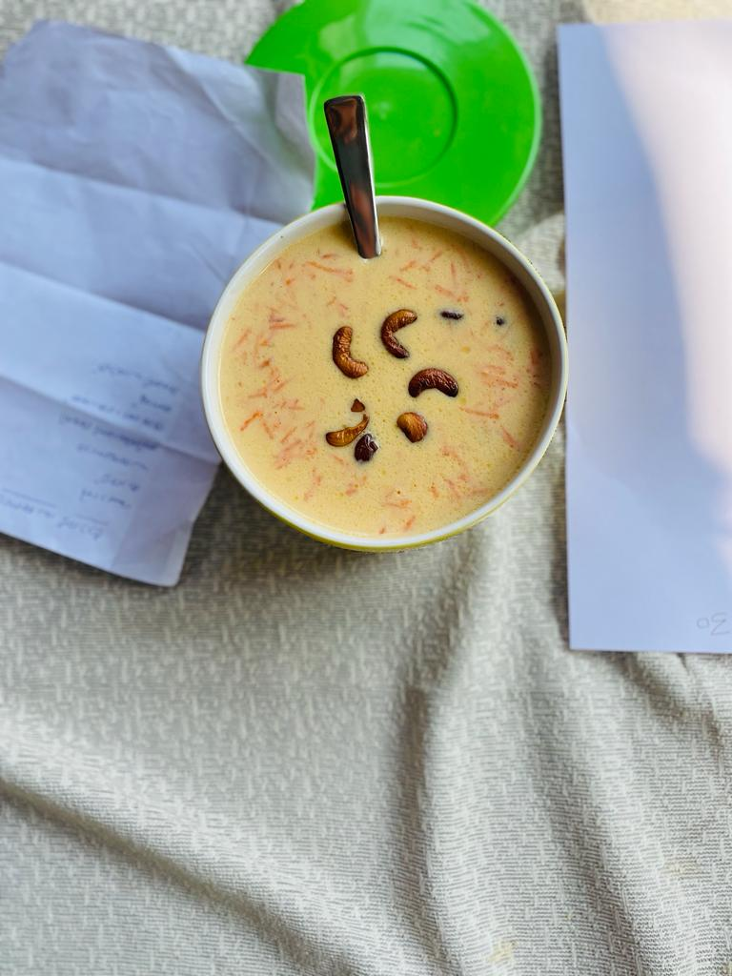


Academic Activities
FOOD FEST
Notes:
%%TTS_FEMALE%
FOOD FEST

Slide 19





Academic Activities
PUBLIC SERVICES
The students visited establishments like Police station, Fire station, Bank, Post office etc.
Notes:
%%TTS_FEMALE%
PUBLIC SERVICES
The students visited establishments like Police station, Fire station, Bank, Post office etc.

Slide 20





Achievements
KIDS FEST
The students participated in the kids fest and achieved second runner-up
Notes:
%%TTS_FEMALE%
KIDS FEST
The students participated in the kids fest and achieved second runner-up

Slide 21




Achievements
SPORTS MEET
Notes:
%%TTS_FEMALE%
SPORTS MEET

Slide 22

Achievements
LEAP TALENT SEARCH EXAM
Notes:
%%TTS_FEMALE%
LEAP TALENT SEARCH EXAM

Slide 23











Achievements
OUR KHATHMUL STUDENTS
Notes:
%%TTS_FEMALE%
OUR Khathmul STUDENTS

Slide 24




Text Book Release - Habits Academy
Notes:
%%TTS_FEMALE%
Text Book Release - Habits Academy

Slide 25









Alumni
Notes:
%%TTS_FEMALE%
Alumni

Slide 26

Our Team
Notes:
%%TTS_FEMALE%
Our Team

Slide 27

Thank You
Thank You parents for your support and commitment.
We look forward to continue working together.
Notes:
%%TTS_FEMALE%
Thank You parents for your support and commitment.
We look forward to continue working together.
%%TTS_FEMALE%

