Slide 1
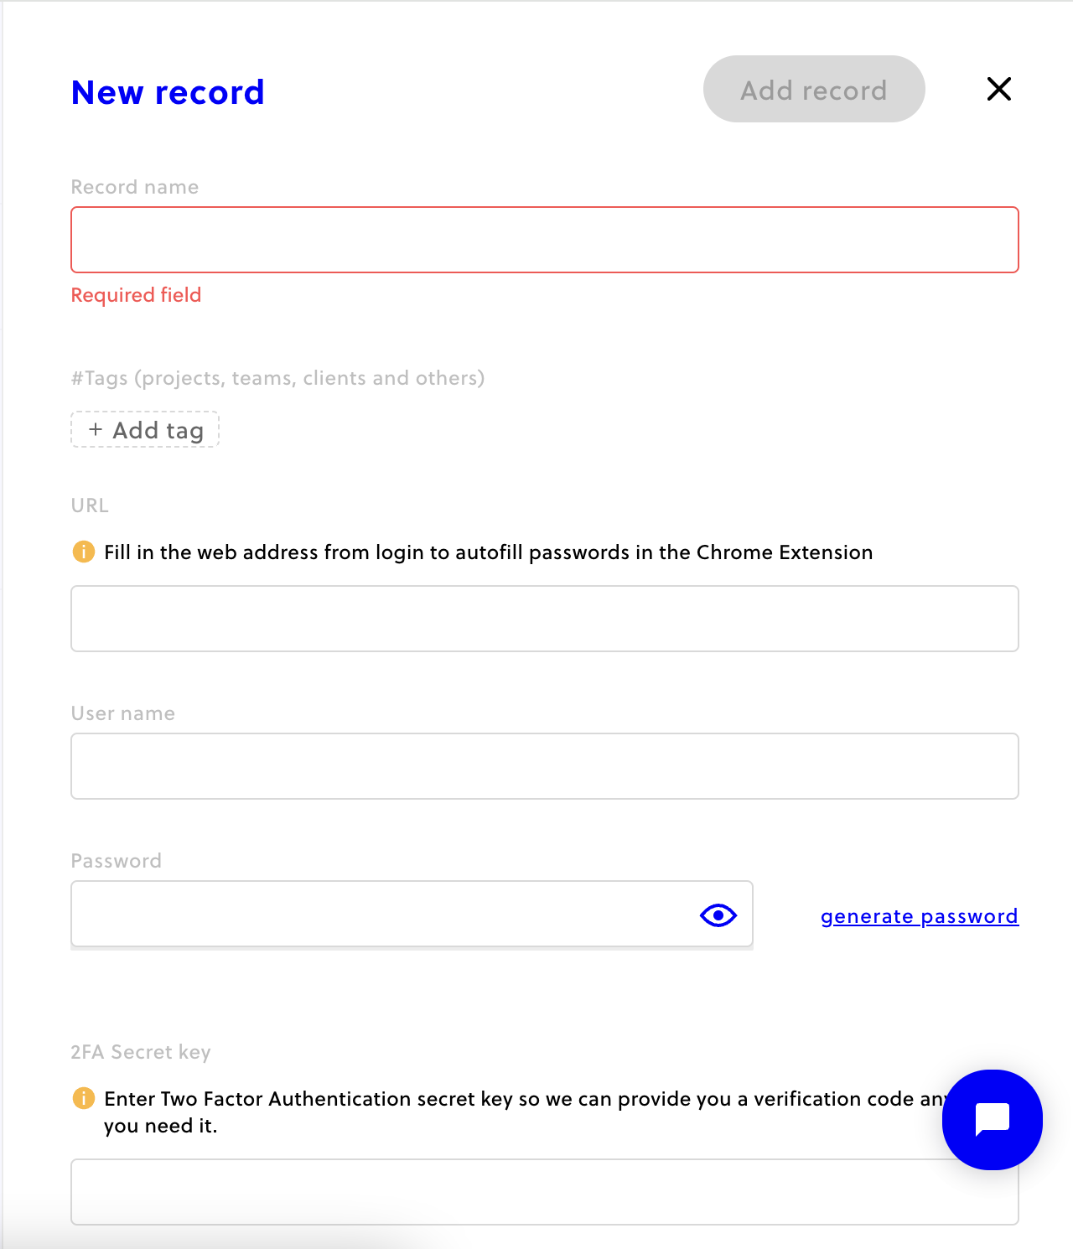
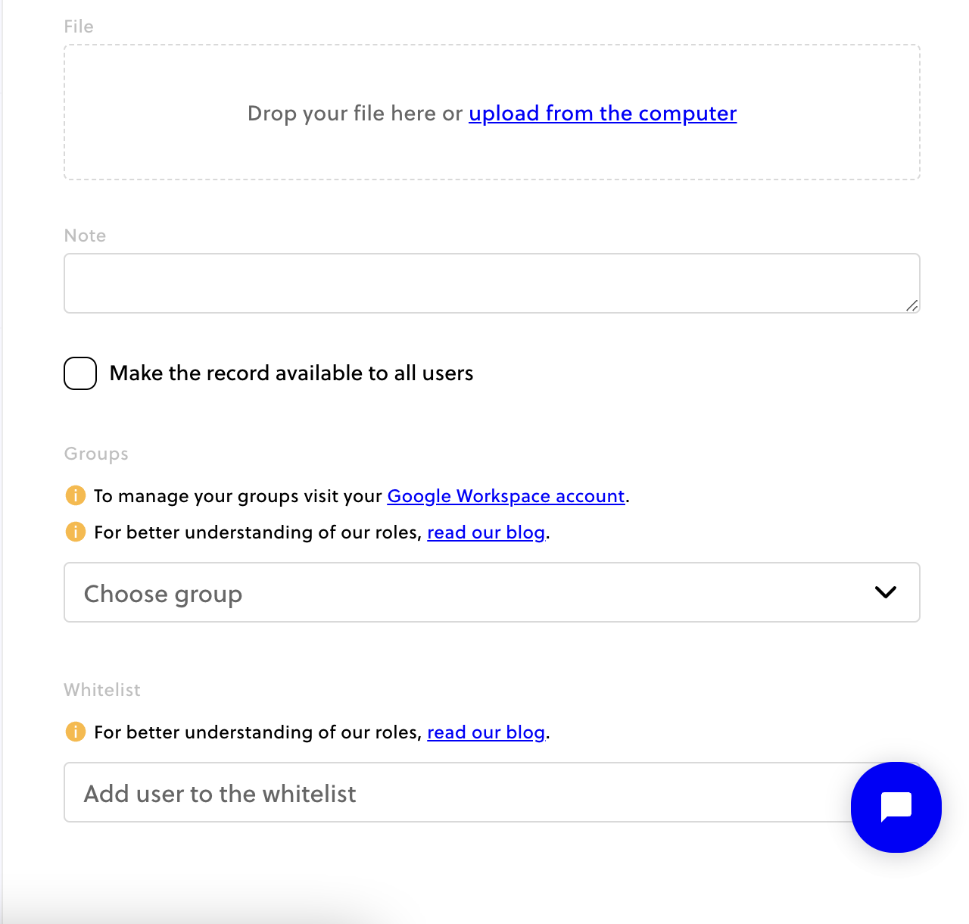
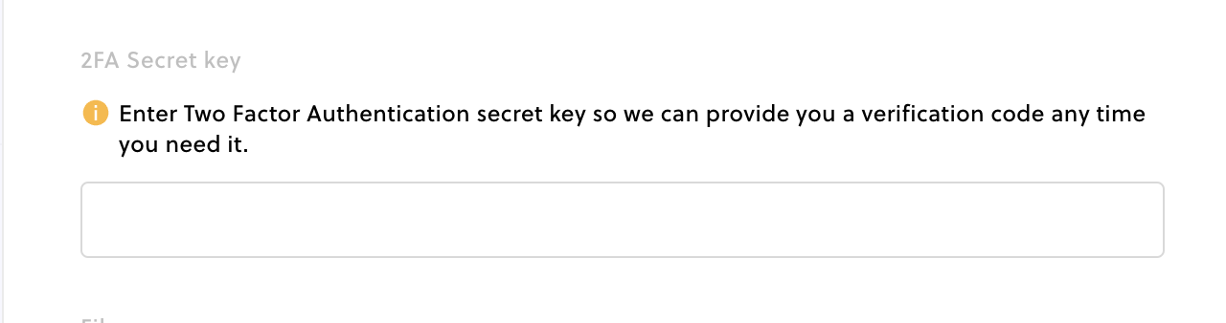
Notes:
Fill the record Name with the name of tool you are using it should be clear and easy to understand.

Slide 2
Notes:
Fill the web address. It should be the page where you are going to use the password. If it’s password for admin portal add that.

