Slide 1
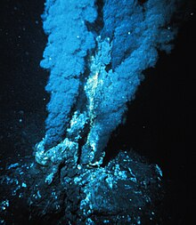
Hydrothermal vents by
Yolie & Liz

Slide 2

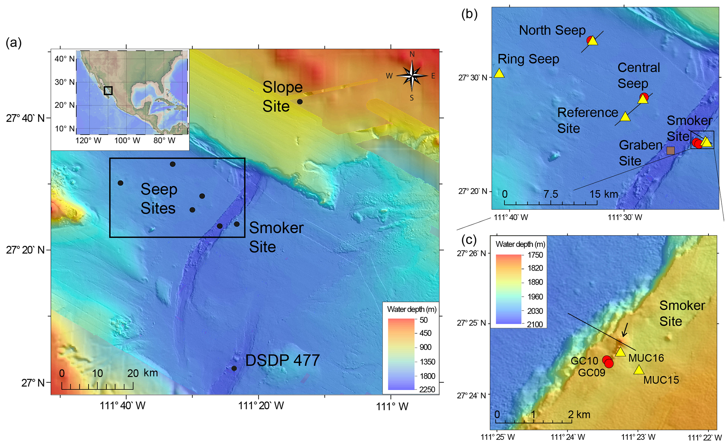
*Geographic distribution of biome*
Key Features
Abiotic features of the biome
  Climate
    Temperature :it’s over 700° Fahrenheit
    Precipitation: Its rapid chemical reactions cause sulfur and other minerals to precipitate
    Other : Hydrothermal vents are considered one of the most extreme and dynamic environments on Earth, with temperatures ranging from 4 to 400°C, high pressure conditions, a complete absence of light, and abrupt chemical and pH gradients
  Geologic features, soil, other?
  sea water percolating down through fissures in the ocean crust in the vicinity of spreading centers or subduction zones(places on earth where two tectonic plates move away or toward one another ).The cold seawater is heated by hot magma and reemerges to form the vents .seawater in hydrothermal vents may reach temperature of over 700degree Fahrenheit .
This Photo by Unknown author is licensed under CC BY.

Slide 3

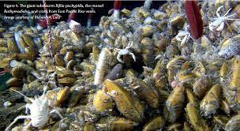
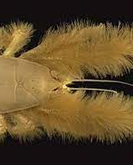
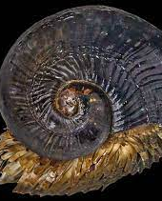
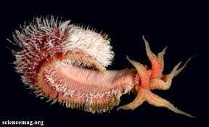
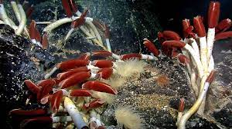
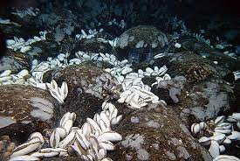
  Species diversity - Overall species diversity (low, medium, high?)
tubeworms, mussels, clams, barnacles, shrimps, limpets, and snails.
Many vent species are like terrestrial weeds—fast growing and good at dispersing to new sites. Like weeds, they reproduce prolifically, releasing large numbers of eggs or larvae that are carried far and wide by ocean currents. Being weedy helps them colonize habitats that might last only a few years to a few decades.
  Dominant plants (at least 3)
    the giant tube worm Riftia pachyptila-grow where hot, mineral-laden water flows out of the deep seafloor

Slide 4
    the large white clam Calyptogena magnifica-specially adapted to life round hydrothermal vents by the chemosymbiotic bacteria it harbours in its gills which oxidize hydrogen sulfide seeping from the vents
    mytilid musel and the Pompeii worm Alvinella pompejana.-Pompeii worms were initially discovered by French researchers in the early 1980's and are described as deep-sea polychaetes that reside in tubes near hydrothermal vents along the seafloor. They can reach up to 5 inches in length and are pale gray with red tentacle-like gills on their heads. Perhaps most fascinating, is that their tail end is often resting in temperatures as high as 176º F, while their feather-like head sticks out of the tubes into water that is a much cooler 72º F. Scientists are attempting to understand how Pompeii worms can withstand such extreme temperatures by studying the bacteria that form a "fleece-like" covering on their backs
More info about Species diversity

Slide 5
    Dominant animals (at least 3) scaly-foot gastropods-endemic to three known hydrothermal vent fields along deep sea ridges in the Indian ocean, as such it has a limited distribution and a fractured range in a specialist environment upon which it is reliant for its food producing chemosynthetic bacteria.
    Chrysomallon squamiferum - one of the most peculiar deep-sea hydrothermal-vent gastropods, and it is the only known extant animal that incorporates iron sulfide into its skeleton yeti crabs -Are crustaceans that have large quantities of hair-like structures called setae covering their bodies.
    Particular adaptations of the plants and animals to that biome
    ---- don't rely on sunlight and photosynthesis.
    ----bacteria use a process called chemosynthesis to convert minerals and other chemicals in the water into energy.
    -----and photosynthesis
To be continued info about species diversity

Slide 6
Fun facts
Value to humans -Hydrothermal vents act as natural plumbing systems that transport heat and chemicals from the interior of the Earth and that help regulate global ocean chemistry. In the process, they accumulate vast amounts of potentially valuable minerals on the seafloor.
Any recent changes - Scientists first discovered hydrothermal vents in 1977 while exploring an oceanic spreading ridge near the Galapagos Islands. To their amazement, the scientists also found that the hydrothermal vents were surrounded by large numbers of organisms that had never been seen before. These biological communities depend upon chemical processes that result from the interaction of seawater and hot magma associated with underwater volcanoes.
Any other unique features- They help regulate ocean chemistry and circulation. They also provide a laboratory in which scientists can study changes to the ocean and how life on Earth could have begun. They also realized that an entirely unique ecosystem, including hundreds of new species, existed around the vents. Despite the extreme temperatures and pressures, toxic minerals, and lack of sunlight that characterized the deep-sea vent ecosystem, the species living there were thriving. Scientists later realized that bacteria were converting the toxic vent minerals into usable forms of energy through a process called chemosynthesis, providing food for other vent organisms.

