Slide 1
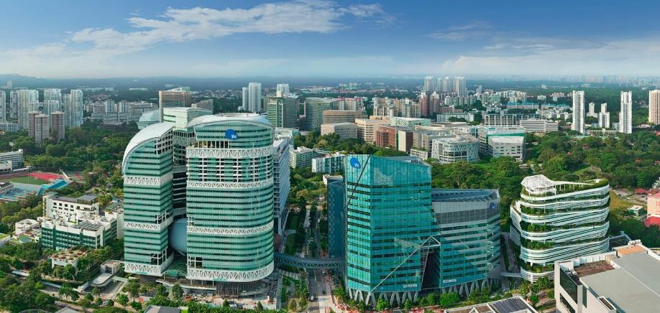
For Development Committee (Tender Board C)’s Approval:
APPOINTMENT OF FACILITIES MANAGEMENT COMPANY FOR FACILITIES MAINTENANCE OF JURONG ISLAND PROPERTIES AND ESTATE FOR A PERIOD OF 3 YEARS
Kenneth Woo
FM West 1
23 January 2024
[CONFIDENTIAL/SENSITIVE NORMAL]
Notes:
Good morning Chairman and DC members. I’m Kenneth from JTC FEM, FM West Division

Slide 2
Objective
To seek Development Committee (Tender Board C)’s approval to accept the following tender (3+3+3):
Recommended Highest PQ Tenderer | Guthrie FMC Pte Ltd
Total Tendered Price | $65,115,796.14 Initial Term (Y1 to Y3) - $20,545,099.72 Option Terms (Y4 to Y9) - $44,570,696.42
SOR adjustments | $377,822.46
Contingency Sum and Incentives | $5,627,548.98
Total Procurement Sought | $71,121,167.58
Notes:
The objective of this paper is to seek DC’s approval to aware FMC contract for Jurong Island at EPV of 73.9 million. The contract period is for 3 years with an option to renew for another 6 years.

Slide 3
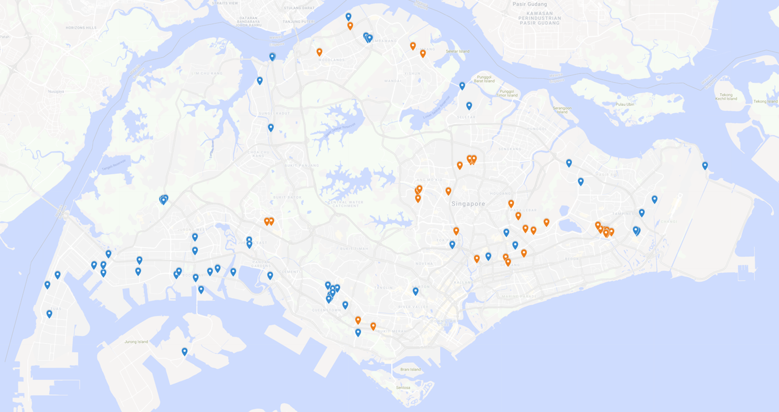




Recap on Consolidation of FMC Contracts in JTC
FOOD HUB
Woodland North coast
WOODLANDS INDUSTRIAL PARK E
YISHUN INDUSTRIAL PARK A
MULTI-STOREY RECYCLING FACILITY
15,20,22 WOODLANDS LINK/LOOP
KRANJI LOOP
MARSILING INDUSTRIAL ESTATE ROAD 3
YS-ONE
FMC3**
TIMMAC
FMW3*
Cochrane
AVIATION 1 & 2
TRENDSPACE
Aerospace 3
AS1 & AS 2
THE OVAL
Punggol Digital District
West
YEW TEE IND EST
East
FMC2**
AMK TECHLINK
FME2***
AMK AUTOPOINT
ANG MO KIO INDUSTRIAL PARK 2
AMK TECH I & II
FME3**
NANOSPACE
ALPS
SIN MING AUTOCARE
& AUTOCITY
JTC Spacce@AMK
Nanospace 2
LAUNCHPAD@JID
FMW2****
ANG MO KIO INDUSTRIAL PARK 1
SPACE @ TAMPINES NORTH
CHANGI NORTH WAY
CLEANTECH 1,2,3
Central
DEFU INDUSTRIAL ESTATE
FMW1*
Bulim@JID
SIN MING INDUSTRIAL ESTATE SECTOR A
GOURMET & SHIMEI EAST KITCHEN
SKYTECH
DEFU INDUSTRIAL CITY
AUTOBAY @ KAKI BUKIT
BDRC
CHANGI NORTH CRESCENT
BUKIT BATOK INDUSTRIAL PARK A
TOA PAYOH INDUSTRIAL PARK
AUTOHUB @ KAKI BUKIT
TAMPINES INDUSTRIAL PARK A
BEDOK INDUSTRIAL PARK EAST
7,9,15 CHANGI BUSINESS PARK
45 QUALITY RD
SUMMIT
FMC1*
TAI SENG
KB1
BEDOK FOOD CITY
EAST TECH
SPACE @ TUAS
KALLANG WAY 5
UBI, UBIPLEX, KAMPONG UBI
EASTLINK
SPACE @ GUL
MEDTECH HUB
POULTRY PROCESSING HUB
JURONG TOWN HALL
65A JLN TENTERAM
ALJUNIED
CHANGI SOUTH AC
TUAS AC
T9 @ TUAS ROAD
SPACE @ BUROH STREET
JURONG PORT ROAD
GEYLANG BAHRU
EUNOS
CHEMICAL HUB
PANDAN LOOP
GEYLANG EAST
PIONEER ROAD
LOGISTIC HUB
SURFACE ENGINEERING HUB
PIER 20
PENJURU CLOSE
MULTI UTILITY HUB
FME1***
Existing FM Contracts Managing FMW1 JI Properties and Estate
ROCHESTER PARK
BIOPOLIS
T9 @ TUAS SOUTH
PULAU DAMAR LAUT
PIXEL
LP@ON
DESIGN ORCHARD
FUSIONOPOLIS 1 & 2
WESSEX
OMC 2
ARC FFS
ALEXANDRA VILLAGE
JTC SPACE @ TUAS BIOMEDICAL PARK
DEPOT LANE INDUSTRIAL ESTATE
JI FMC building contract
JI****
GILLMAN BARRACKS
JI FMC estate contract
OASIS @ SAKRA
Objective
To seek DC’s endorsement to award FMC contract for JI properties and estate
----------------------------------------------------------
*FMW1, FMW3 & FMC1 awarded to C&W
**FMC2, FMC3 & FME3 awarded to CBRE
***FME1 & FME2 awarded to JLL
****FMW2 & JI, currently evaluating tender
Notes:
So far, we have sought DC’s approval for a total of 7 FMC contracts. Out for these 7 contracts, 3 have been awarded, and another 4 are in the tendering stage. Next in the pipeline will be Jurong Island followed by FM West 2 FMC contracts.

Slide 4
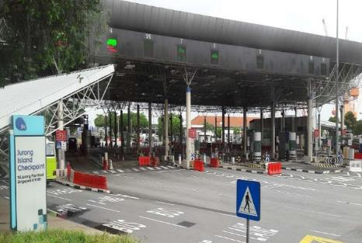
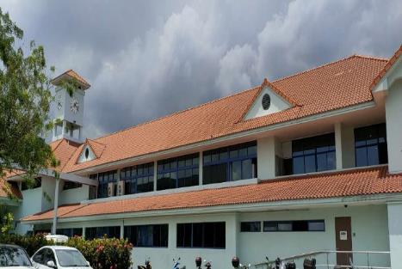
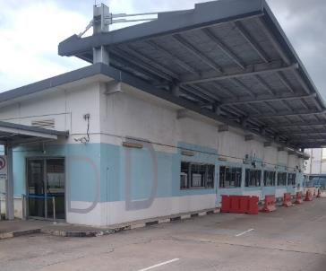
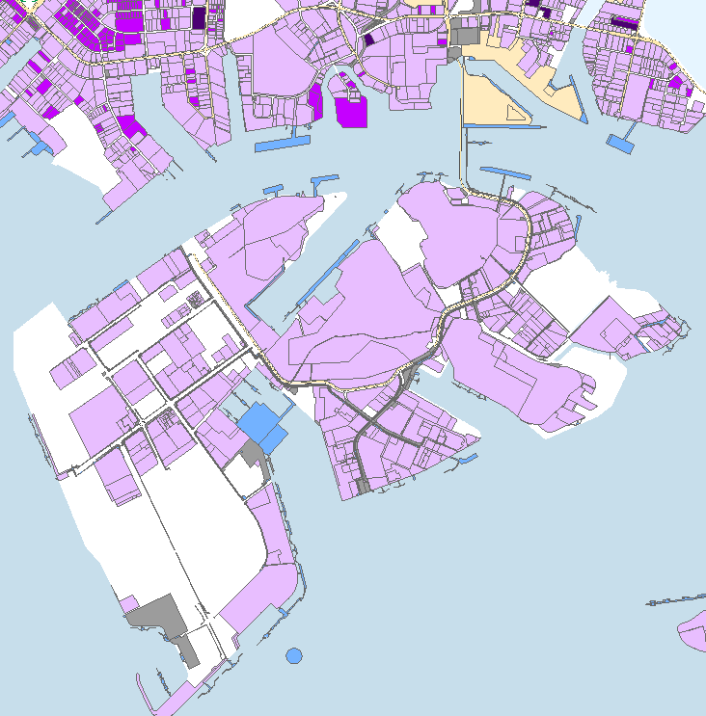

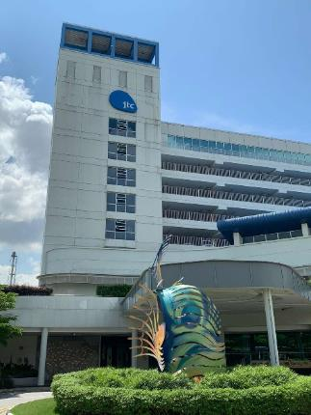
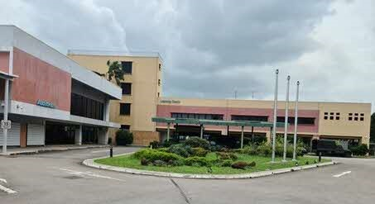
JI Building and Estate
Checkpoint , Pier 20
PDL
FOB
Property | Building Area | Land Aera
JI Checkpoint | 5,856 sqm | 752,081 sqm
Pier 20 | 3,767 sqm
PDL | 2,063 sqm
Total Building | 11,686 sqm
Total Area | 765,481 sqm
Oasis
Property | Building Area | Land Area
Oasis@ Sakra | 5,482 sqm ` | 802,219 sqm
FOB | 7,513 sqm
Security Towers | 405 sqm
Total Building | 13,400 sqm
Total Area | 813,905sqm
Total Building Area | Total Land Aera
25,076 sqm | 1,554,300m²
1,579,386 m2
Notes:
Jurong Island (1,554,300m²)
Oasis @ Sakra (5,482m²)
Pier 20 (3,767m²)
Checkpoint (7,919m²)
Why 50% Quality
FMCs like JLL, C&W, CBRE are better in managing buildings, in terms of estate maintenance it is yet to be tested as the earliest FMC contract which covers both estate and buildings was C3 was awarded last Nov.

Slide 5





Tender Information
Appointment of FMC for West 1/ Jurong Island. Target Commencement Date : 01 May 2024
Approved EPV
$73,931,000 approved on 30 January 2023
Tender Opening Period
21 August 2023 to
16 October 2023
Number of Tenderer
3 Tenders submitted
3 Tenderers eligible
Tender Price Range
Lowest : $64,978,996.14
Highest: $80,269,778.80

Slide 6
Tender Evaluation

Slide 7



Tenderers and Submitted Bids
Tenderer | Bid Price
Guthrie | $64,978,996.14
Savills | $73,468,062.79
 | $80,269,778.80
$64,978,996.14 | $73,468,062.79 | $80,269,778.80

Slide 8
Evaluation Criteria Breakdown
The tender was evaluated based on a PQ ratio of 50% (Price): 50% (Quality).
S/N | Attributes | Weightages
(a) | Price Competitiveness (50%):
(i) | Profit | 5%
(ii) | FMC Core Team Manpower Cost | 5%
(iii) | Lump Sum Tender Price (Less Profits and Core Team Manpower) | 20%
(iv) | Overall Lump Sum Tender Price | 20%
(b) | Quality Criteria (50%):
(i) | Track Records | 10%
(ii) | Organisational Strategy | 6%
(iii) | Subcontractor Management | 10%
(iv) | Organisational Structure | 7%
(v) | Technology/Innovation and Environmental Sustainability Solutions | 12%
(vi) | Savings Glide Path | 5%
Total | Total | 100%
Notes:
For our past FMC tenders, we have adopted a 50-50 Price Quality Evaluation and likewise for this JI tender. So far, it has resonated well with the various stakeholders in the FM industry, evident from the competitive pricing submitted by the FMCs. Based on the last three mega tenders that have been awarded, we have seen a narrowing of the difference between the winning bid and the median tender price down to under 14%.
The current 50-50 PQ score indicates a maturing FM industry where clients are not only looking at price but quality as well. With the support from the WOG, we are working to transform and uplift the FM sector and this has gained traction. As FM Centex, we have given advice to other government agencies who has also adopted a 50-50 PQ, and are successful in attracting very competitive bids.
====================
In addition, our Quality evaluation in today’s context has many aspects as compared to a few years back, the Q-evaluation drives the need for integrating across a myriad of services, technology as a key part of FM and building services, sub-contractor management, operations support and system effectiveness. All these form the basis of a transformative and innovative FM company. SIFMA has adopted some of our Q-evaluation drivers as certification for FM companies under the transformation roadmap - e.g. the presence of a fully-functional CMMS system, an in-house digital team with a CIO / CTO based locally, the presence of engineering and building diagnostics team within the local company structure, etc. The Q-evaluation continues to set the bar high on strategic transformation of the FM company, for them to score high marks for this. We have seen a wider group of companies who have embarked on this transformation due to our 50% Q-criteria - Certis FM, CBM, Engie, Fonda - just to name a few. Therefore, to go back to lesser quality score would set us back to the past and give a contradictory signal to the industry in our trajectory towards a FM partner who can provide good quality FM services where they are committed to train and upskill their staff and partnership with their sub-contractors to achieve better quality and productivity.

Slide 9
Tender Results – Overall PQ Score
Tenderer | Price Score (50%) | Quality Score (50%) – Weighted | Combined PQ Score (100%) | Ranking
Guthrie FMC Pte Ltd | 50.00 | 44.37 (raw score: 33.17) | 94.37 | 1
Savills Property | 42.79 | 50.00 (raw score: 37.39) | 92.79 | 2
CBM Pte Ltd | 31.25 | 32.51 (raw score: 24.231) | 63.76 | 3
Notes:
=(H22/(MAX($H$22:$L$22))*$E$23)
Weighted score takes into consideration after normalisation

Slide 10
Recommendation for Highest PQ Score Tenderer Guthrie
Guthrie has the lowest trade cost among all the tenderers

Slide 11
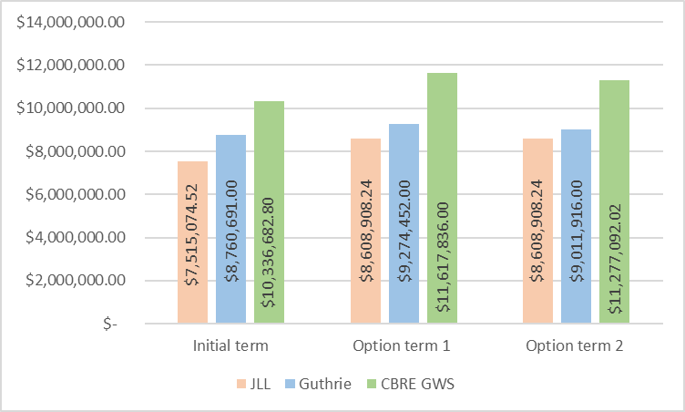
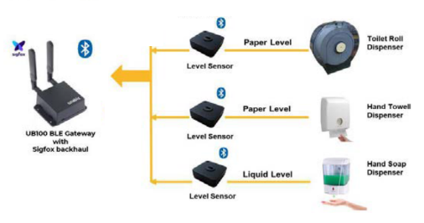
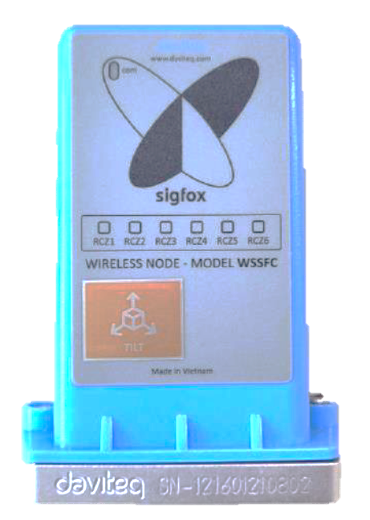
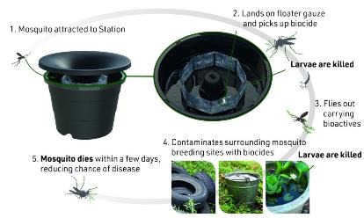
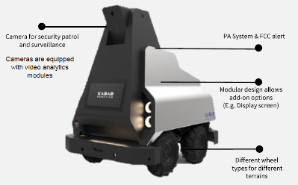
Recommendation for Highest PQ Score Tenderer JLL
JLL proposed a more comprehensive proposal
Smart FM Solutions
Cleaning Cost Comparison
 | JLL | Guthrie | CBRE GWS
Total No. of Solutions | 19 | 12 | 9
Sigfox-BLE Solution for Consumables
Tree Tilt Sensor
The potential savings, extensive manpower deployment, and innovative smart FM solutions proposed by JLL deliver the greatest benefits among the top 3 tenderers, making them the most appealing choice for East 1 properties.
Intelligent Mosquito Trap
Autonomous Outdoor Security Robot
Notes:
Incumbency, staff assimilated into contract, lowest attrition rate
Value add
Guthrie invested in technologies, machinery for road maintenance and repair

Slide 12
Financial Health Evaluation
Credit Ratings for JLL by Singapore Commercial Credit Bureau (SCCB)
With reference to Evaluation Criteria 1.2a, a Financial Health Evaluation was conducted on the proposed tenderer. SCCB was engaged to conduct the evaluation.
Proposed Awarded Tenderer | Credit Risk Score Key
Jones Lang LaSalle Property Consultants Pte Ltd | CA1
SCCB rated JLL as
  Minimal credit risk company
  Maximum Annual Capacity range of SGD165,000,000.

Slide 13
Approved Procurement Value Sought
TEC would like to recommend the Development Committee (Tender Board C) to award the tender as follows:
Recommended Highest PQ Tenderer | Jones Lang LaSalle Property Consultants Pte Ltd
Total Tendered Price | $143,303,246.59 Initial Term (Y1 to Y3) - $49,999,746.15 Option Terms (Y4 to Y9) - $93,303,500.44
SOR adjustments | $5,122,333.20
Contingency Sum and Incentives | $12,163,523.52
Total Procurement Sought | $160,589,103.31

Slide 14
Thank You

Slide 15
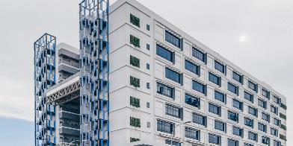
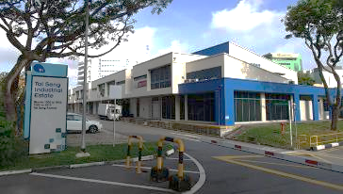
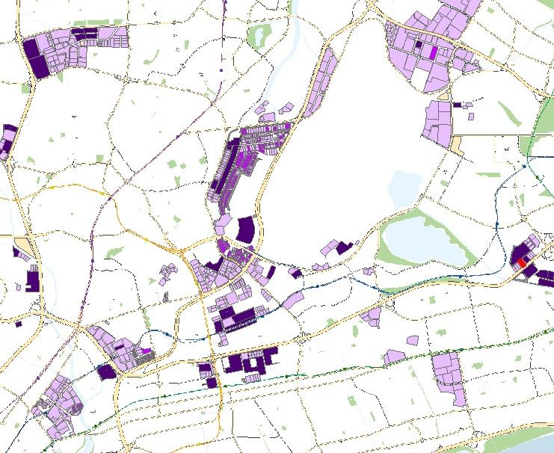

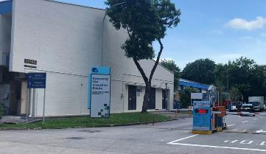
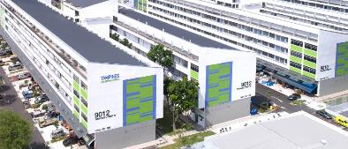
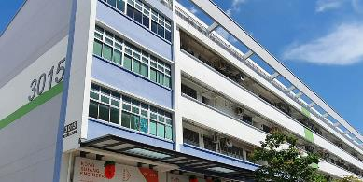
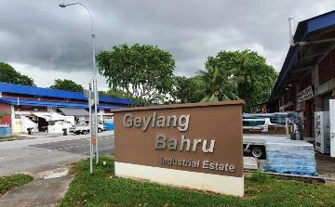
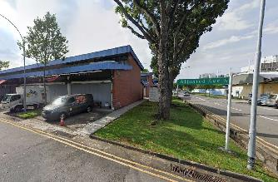
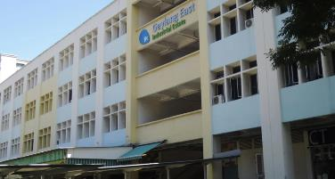
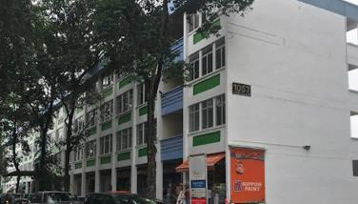
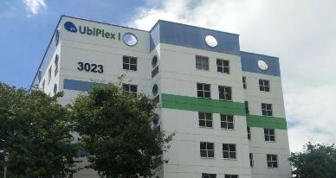
GFA: 777,857sqm
Units: 4,217 nos. Blks: 133 nos.
Estates: 60.9ha
FM EAST 1 PROPERTIES
Space @ Tampines North
Tai Seng Terrace Workshops
GFA: 33,747 sqm | 103 units, 1 blk
GFA: 15,423 sqm | 75 units, 7 blks
Tampines Estate
Estate Area: | 42.3 ha
Ubi Terrace Workshops
Tampines Ind Pk A
GFA: 31,463 sqm | 126 units, 17 blks
GFA: 200,259 sqm | 917 units, 9 blks + 1 MSCP Blk
Kolam Ayer Estate
Kg Ubi Ind Estate & Vacant Land
Estate Area: | 6.1 ha
Kallang Way 5 Shared Compound
GFA: 6,800 sqm | 8 units, 1 blks
Kallang Basin Estate
GFA: 233,807 sqm Vacant Land: 1.3ha | 1,336 units, 16 blks
Estate Area: | 9.4 ha
Geylang Bahru Ind Estate
Aljunied Ind Estate & Vacant Land
Generic Flatted Factories
Geylang East Ind Estate
Eunos Ind Estate
UbiPlex 1
GFA: 21,531 sqm | 185 units, 19 blks
GFA: 10,242 sqms Vacant Land: 1.8ha | 88 units, 8 blks
GFA: 65,775 sqm | 613 units, 4 blks
GFA: 128,410 sqm | 640 units, 48 blks
GFA: 30,400 sqm | 126 units, 1 blk + 1 MSCP Blk
Notes:
Now I will elaborate on the existing contract and management models for JI. Currently it is managed through 2 FMC contracts, namely building and estate both which are awarded to Guthrie. The building contract comprises of the JI Checkpoint building, Pier 20 Long Term Pass Office, PDL Checkpoint, Oasis@Sakra and Forward Operations Base which are spread across the island. For the estate, it covers almost 200km of highway and roads, vacant land, landscape and TNRM which is meant for stray dog management. In my next slides, I shall elaborate on the broad principles for deriving the EPV and yearly cost escalation.
=========================
The Chemical Process Technology Centre (CPTC) is training centre located on Jurong Island, Singapore, which has been managed by Petrofac on behalf of the Economic Development Board of Singapore since June 2008. Petrofac’s Training Services business combines more than 30 years of experience with a first-class technical and operations training centre to deliver competence-led training programmes for both international and national oil companies. It underwent A&A to convert to a Forward Operation Base (FOB) to house Singapore Armed Forces (SAF) personnel that was deployed in Jurong Island and completed in March 2019.

Slide 16
JI Building and Estate
FM West 1 – Jurong Island
FMC (Buildings)– Guthrie JI Checkpoint
Pier 20 (Long Term Pass Office)
Pulau Dama Laut (PDL) Checkpoint
Oasis@Sakra
Forward Operations Base (FOB)
JI Checkpoint
Pulau Dama Laut
(PDL) Checkpoint
Pier 20
FMC (Estate) – Guthrie
Jurong Island Estate
Oasis@Sakra
Forward Operations Base
(FOB)/ JI Data Centre
Notes:
Now I will elaborate on the existing contract and management models for JI. Currently it is managed through 2 FMC contracts, namely building and estate both which are awarded to Guthrie. The building contract comprises of the JI Checkpoint building, Pier 20 Long Term Pass Office, PDL Checkpoint, Oasis@Sakra and Forward Operations Base which are spread across the island. For the estate, it covers almost 200km of highway and roads, vacant land, landscape and TNRM which is meant for stray dog management. In my next slides, I shall elaborate on the broad principles for deriving the EPV and yearly cost escalation.
=========================
The Chemical Process Technology Centre (CPTC) is training centre located on Jurong Island, Singapore, which has been managed by Petrofac on behalf of the Economic Development Board of Singapore since June 2008. Petrofac’s Training Services business combines more than 30 years of experience with a first-class technical and operations training centre to deliver competence-led training programmes for both international and national oil companies. It underwent A&A to convert to a Forward Operation Base (FOB) to house Singapore Armed Forces (SAF) personnel that was deployed in Jurong Island and completed in March 2019.

Slide 17
Recommendation for Highest PQ Score Tenderer Guthrie
Simulation of Manpower Cost
 | Guthrie | Savills | CBM
Proposed Manpower | 73 | 73 | 49
a. Manpower Cost | $50,976,067 | $48,788,831 | $39,523,687
b. Submitted Bid | $143,303,246.59 | $152,367,036.55 | $134,063,283.93
c. Estimated cost for 24 additional manpower | NA | NA | $18,405,508.59*
d. Total Manpower Cost for 73 pax | $50,976,067 | $48,788,831 | $57,929,196.11
Estimated total lump sum (b+c) | $143,303,246.59 | $152,367,036.55 | $152,468,792.52
Overall Price difference with 73 pax compared to JLL | NA | + $9,063,789.96^ | + $9,165,545.93^^
*In alignment with JTC's proposal of 73 personnel, we conducted a simulation to analyse the additional cost required should CBRE GWS increase its manpower deployment from 49 to 73.
^Overall Price difference with 73 pax compared to JLL = Estimated Total Lump Sum Guthrie ($$152,367,036.55) – JLL Submitted Bid ($143,303,246.59)
^^Overall Price difference with 73 pax compared to JLL = Estimated Total Lump Sum CBRE GWS ($152,468,792.52) – JLL Submitted Bid ($143,303,246.59)

