Slide 1
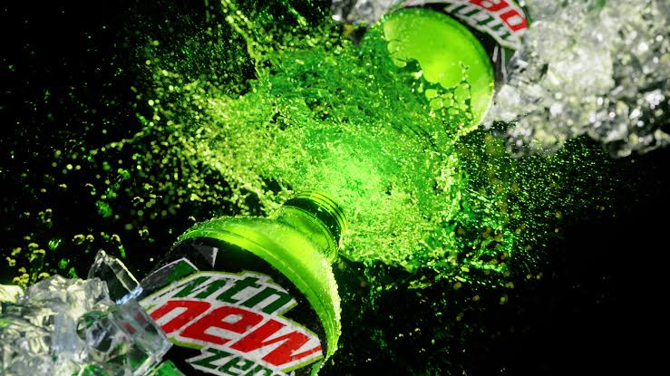
Mountain Due Marketing Mix strategies

Slide 2
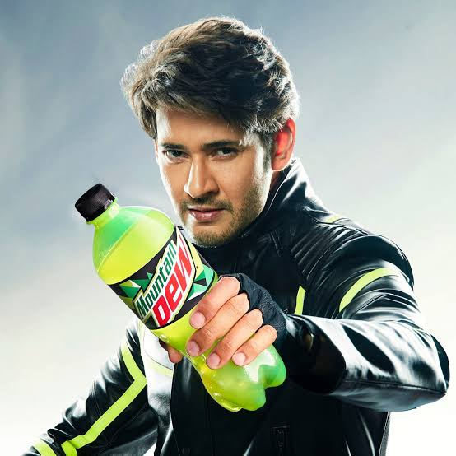
Introduction
Mountain Dew Company Overview.
Importance of Marketing Mix Strategies for Mountain Dew.
Purpose of the Presentation.
1
Notes:
Image source: https://www.mbaskool.com/marketing-mix/products/17314-mountain-dew.html

Slide 3
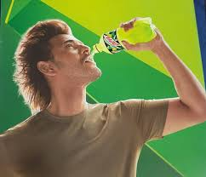
Product Strategy
Mountain Dew's product line includes various flavors and variants.
Constant innovation in product offerings to appeal to different consumer preferences.
Focus on packaging design and branding to create a unique identity.
2
Notes:
Image source: https://smartlabel.pepsico.info/012000205378-0001-en-US/index.html

Slide 4
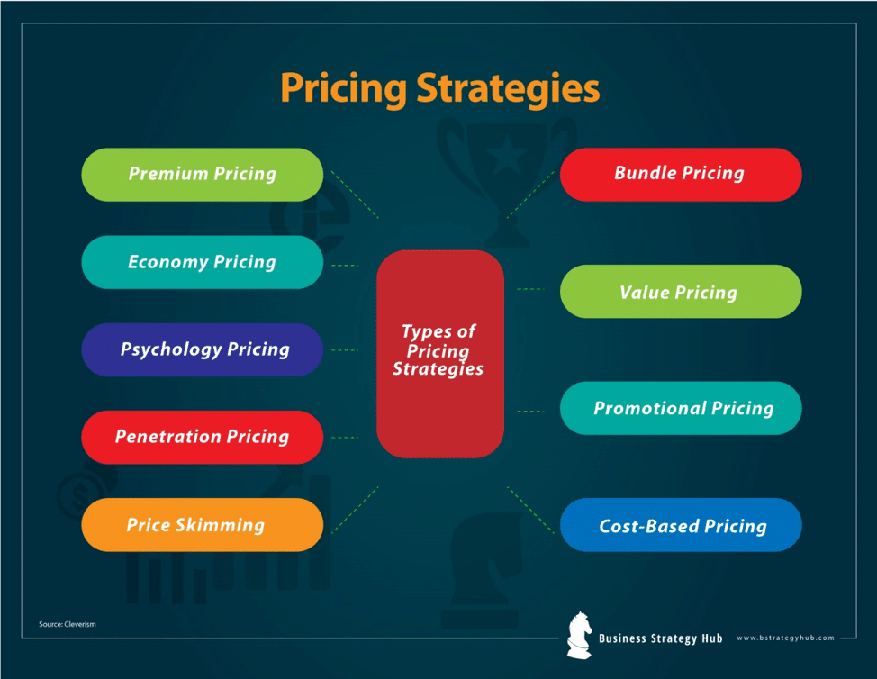
Price Strategy
Competitive pricing strategy to attract price-sensitive consumers.
Use of promotional pricing during key seasons or events.
Premium pricing for limited edition or specialty flavors.
3
Notes:
Image source: https://bstrategyhub.com/9-pricing-strategies-maximize-your-profit-with-a-good-pricing-strategy/

Slide 5
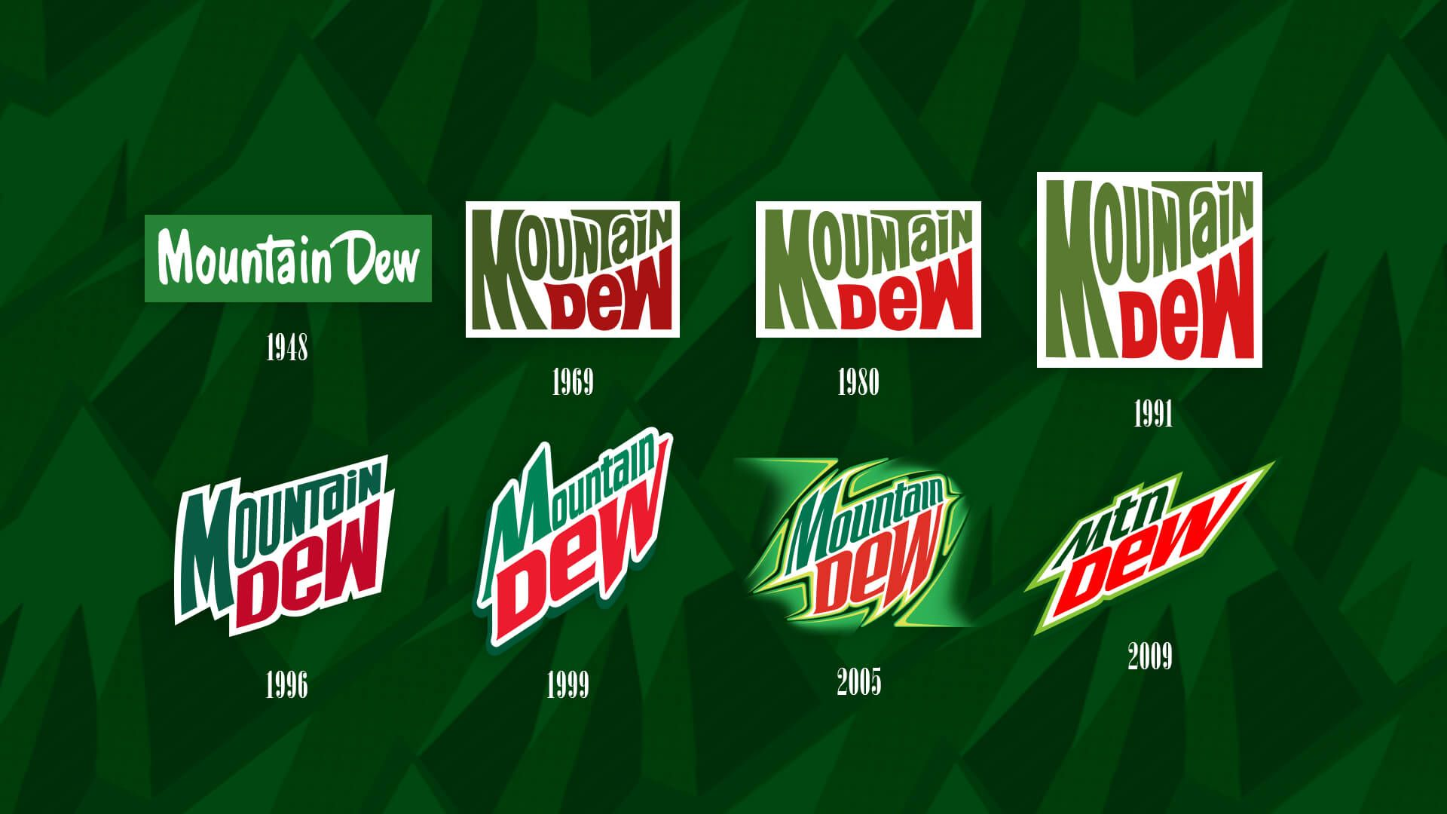
Place Strategy
Mountain Dew's distribution network covers a wide range of retail channels.
Strategic partnerships with convenience stores, supermarkets, and online retailers.
Focus on availability in key locations to ensure maximum reach.
4
Notes:
Image source: https://jumpalima.vercel.app/mountain-dew-logo-history/

Slide 6
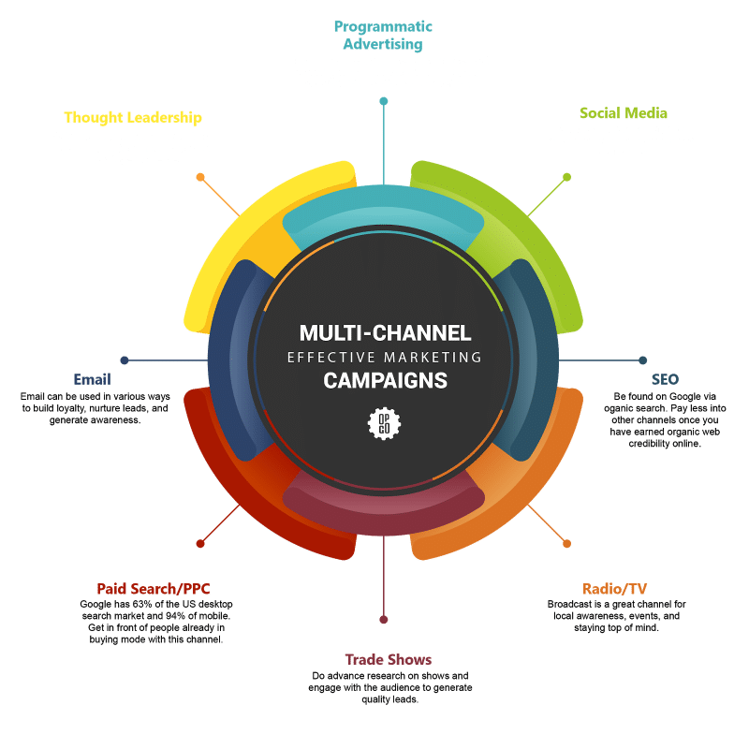
Promotion Strategy
Strong emphasis on digital marketing and social media campaigns.
Sponsorship of extreme sports events and collaborations with influencers.
Use of traditional advertising channels such as TV, print, and outdoor media.
5
Notes:
Image source: https://referralrock.com/blog/marketing-channel-strategy/

Slide 7
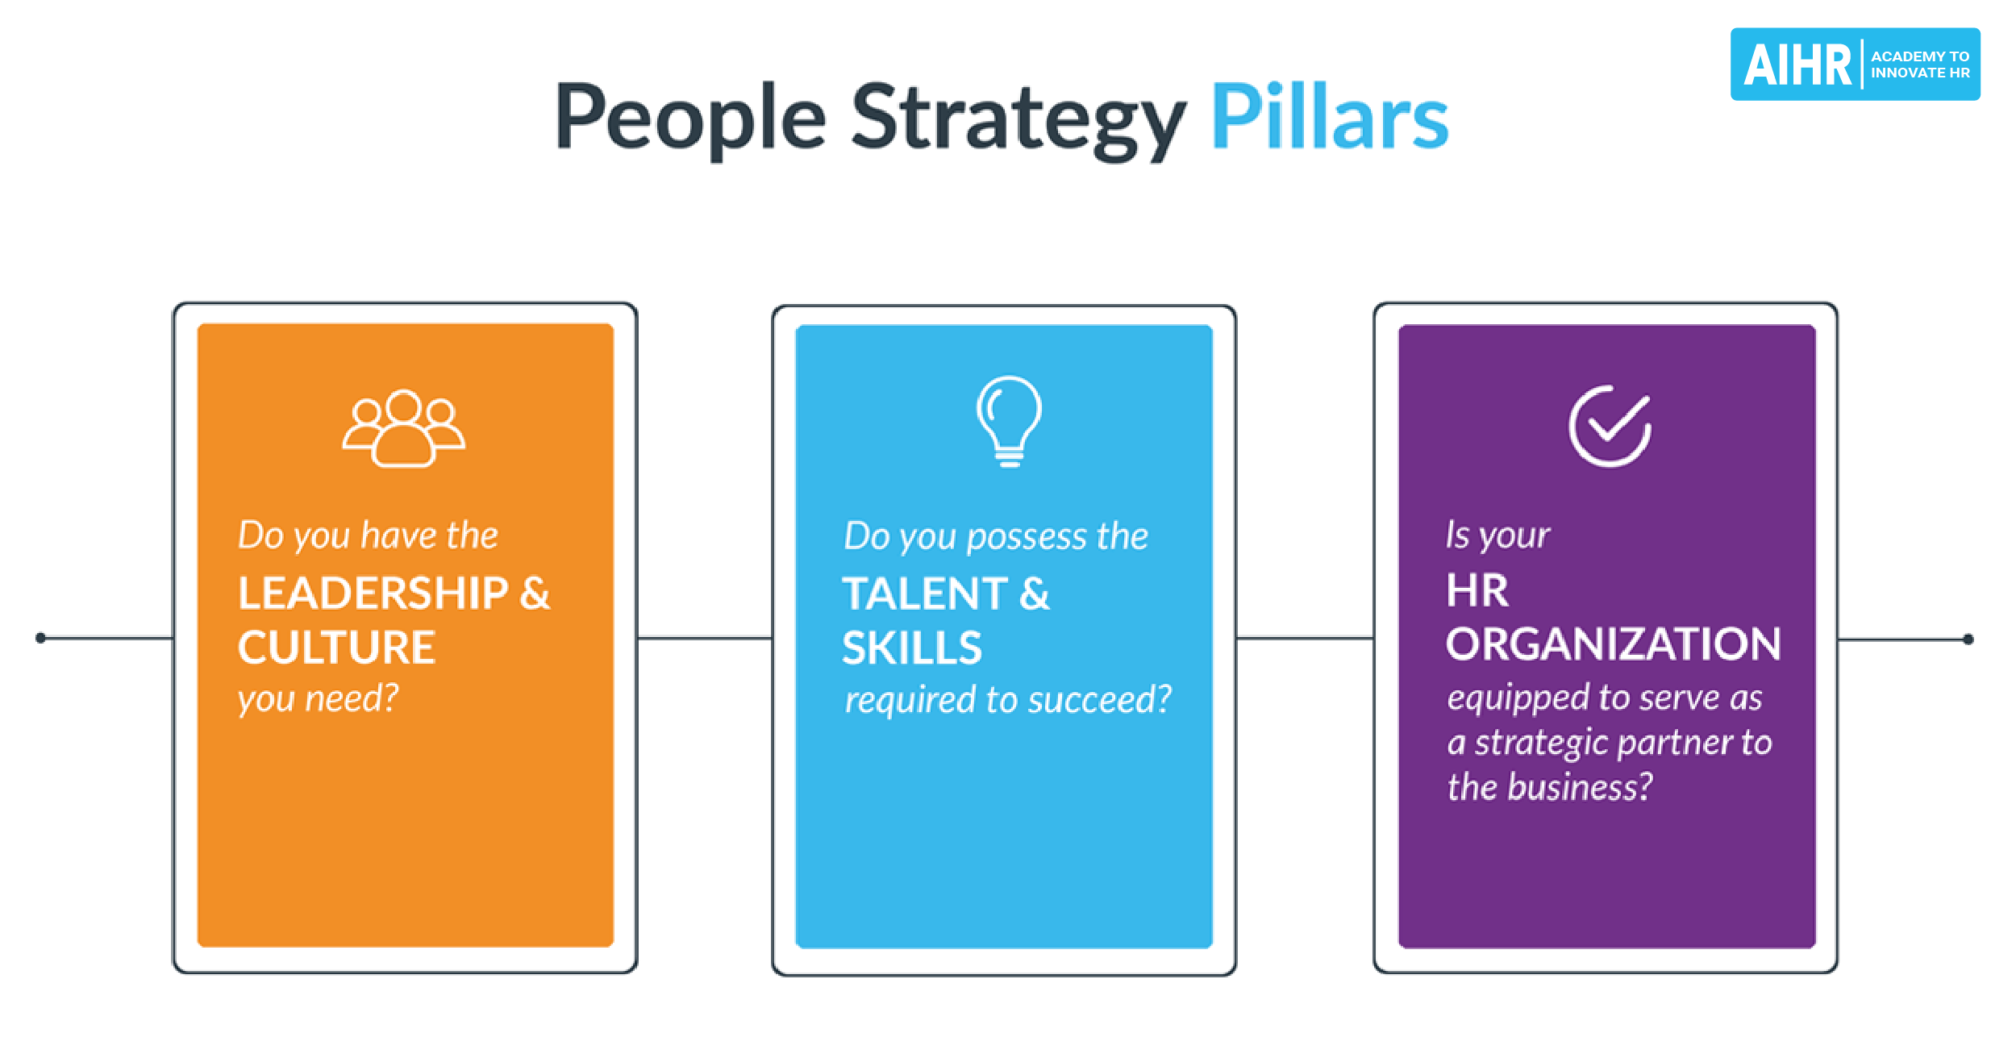
People Strategy
Training programs for employees to enhance product knowledge and customer service.
Emphasis on hiring individuals who embody the brand's energetic and adventurous spirit.
Customer engagement initiatives to build brand loyalty and advocacy.
6
Notes:
Image source: https://www.aihr.com/blog/people-strategy/

Slide 8
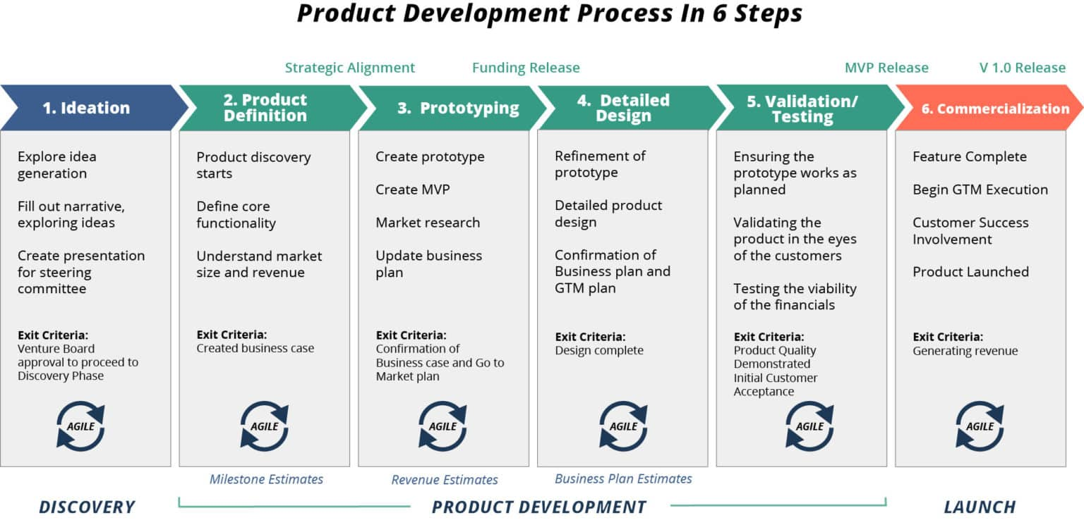
Process Strategy
Streamlined product development processes to enable quick launch of new flavors.
Efficient supply chain management to ensure timely delivery to retailers.
Continuous improvement in manufacturing processes to maintain product quality.
7
Notes:
Image source: https://www.tcgen.com/product-development/process/

Slide 9
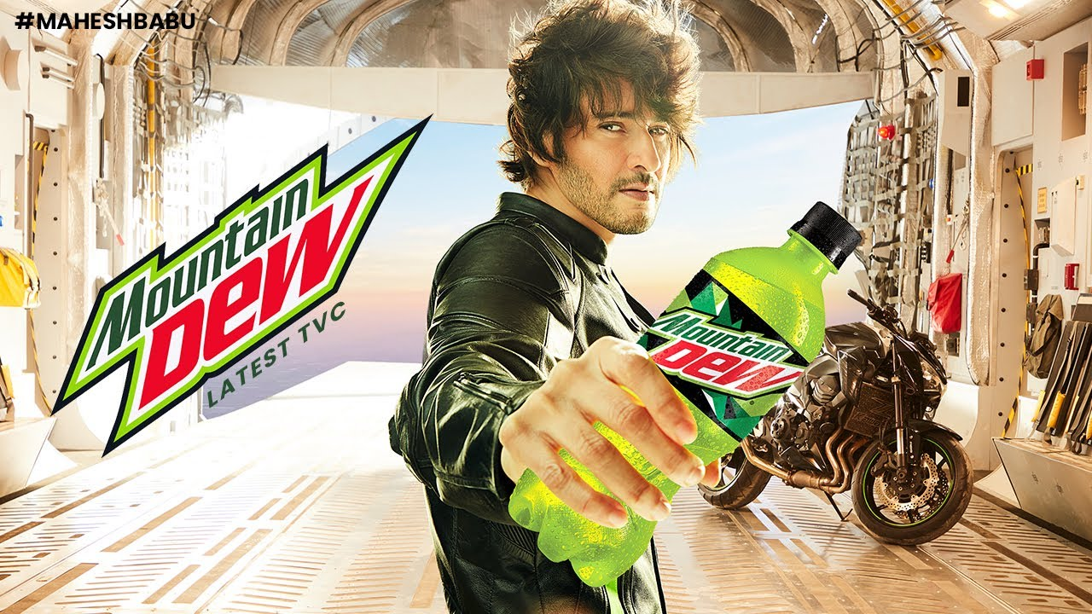
Physical Evidence Strategy
Eye-catching packaging design that reflects Mountain Dew's bold and energetic brand image.
Consistent branding across all touchpoints to create a cohesive brand experience.
Point-of-sale displays and merchandising materials to enhance product visibility in stores.
8
Notes:
Image source: https://noissue.co.nz/blog/packaging-is-an-art-5-eye-catching-ways-to-illustrate-your-packages/

Slide 10
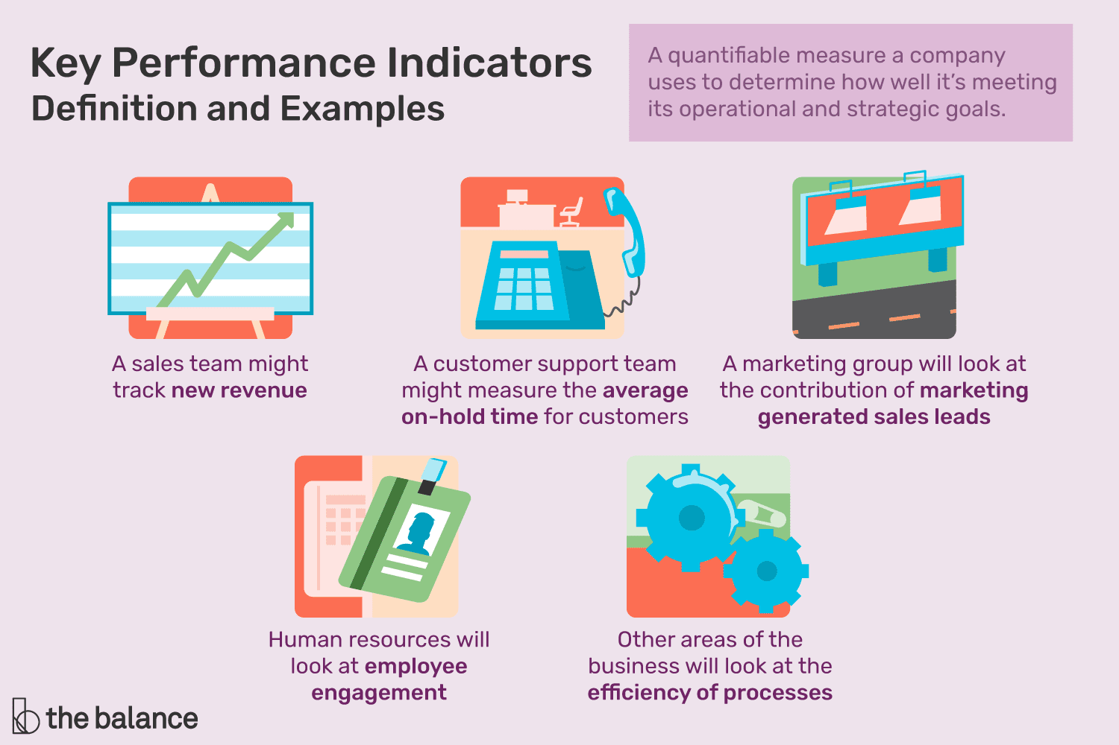
Performance Evaluation
Regular monitoring of key performance indicators such as sales, market share, and customer feedback.
Analysis of marketing campaigns' effectiveness through metrics like ROI and brand awareness.
Use of consumer insights and market research to adapt and refine marketing strategies.
9
Notes:
Image source: https://www.liveabout.com/key-performance-indicators-2275156

Slide 11
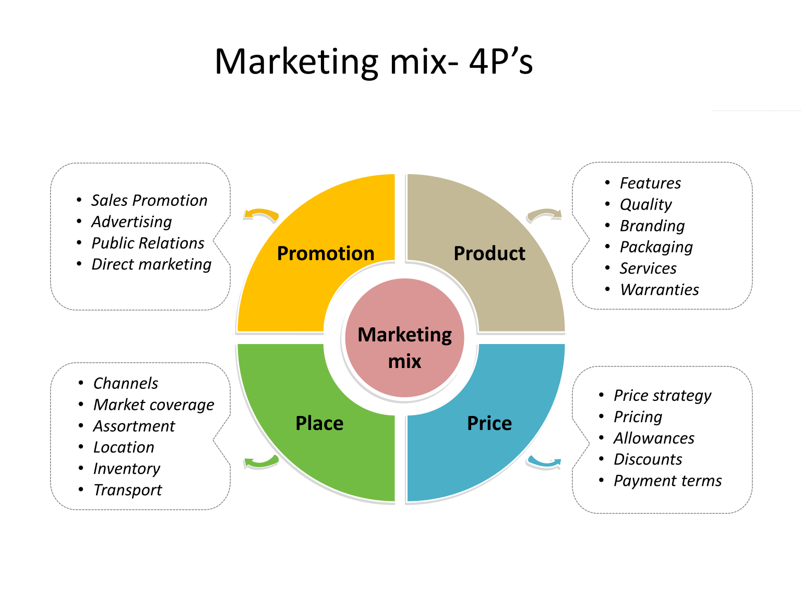
Conclusion
Recap of Mountain Dew's marketing mix strategies.
Importance of a holistic approach to marketing for brand success.
Future outlook for Mountain Dew's marketing initiatives.
10
Notes:
Image source: https://marketerguru.blogspot.com/2020/12/marketing-mix-4ps-of-marketing.html

