Slide 1
HI Friends this is Gaman today I am going to do a AI project
Topic:-Smart school

Slide 2
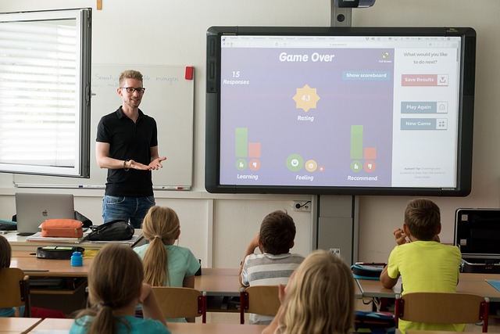
A smart school– as its name suggests – different from a traditional school. This is a kind of school where advanced equipment and technology are used to take the educational process forward. The main idea is to provide the students with a learning experience that is a lot better than what may otherwise have been possible

Slide 3

1. Easy access to information-This is perhaps the biggest benefit of a smart classroom. This is because such a classroom uses many gadgets that have internet connection such as mobile, laptops, and tabs. Thanks to all these devices it is easier for students to gain access to information on the internet.

Slide 4
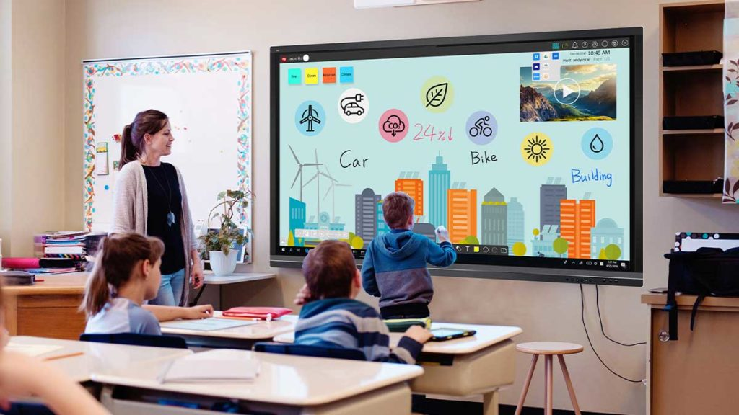
4.A teaching environment that is interactive:-The digital tools are now an integral part of these smart classes. This is why the teaching environment over here can be called interactive in the truest sense of the term. It is one where both students and teachers have definite roles to play. This kind of learning makes the entire process a lot more transparent.

Slide 5
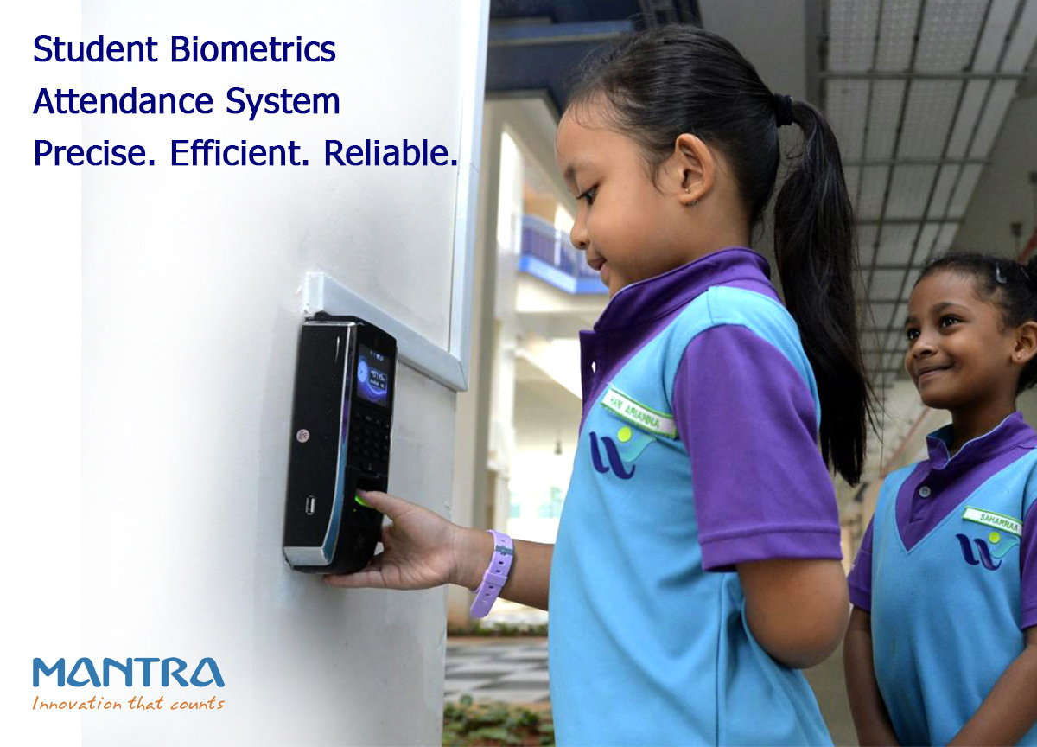
One thing with smart classes is that they are always being recorded. This means that even if you were to miss a couple of sessions you need not to feel bad. This is because there would always be the video recordings to fall back on in case you need them.

Slide 6
Thank you for watching
Class-8th –a
Roll.on-21

