Slide 1
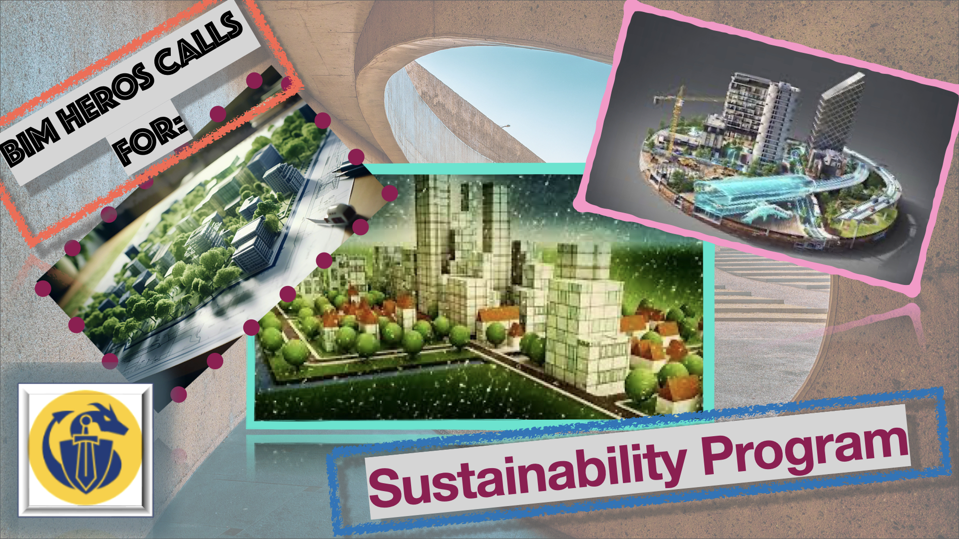
Notes:
Sustainability is the sign off innovation in AEC these days, with all its effect on BIM and stanadrization

Slide 2

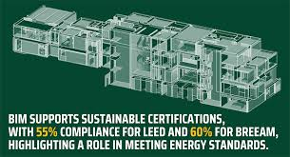
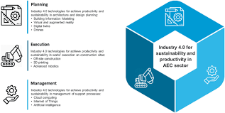

BIM Heroes continues to share knowledge for AEC
Notes:
With the launch of the new free CPD on Sustainability and the Circular Economy in AEC, BIM Heroes continues to share knowledge for AEC

Slide 3
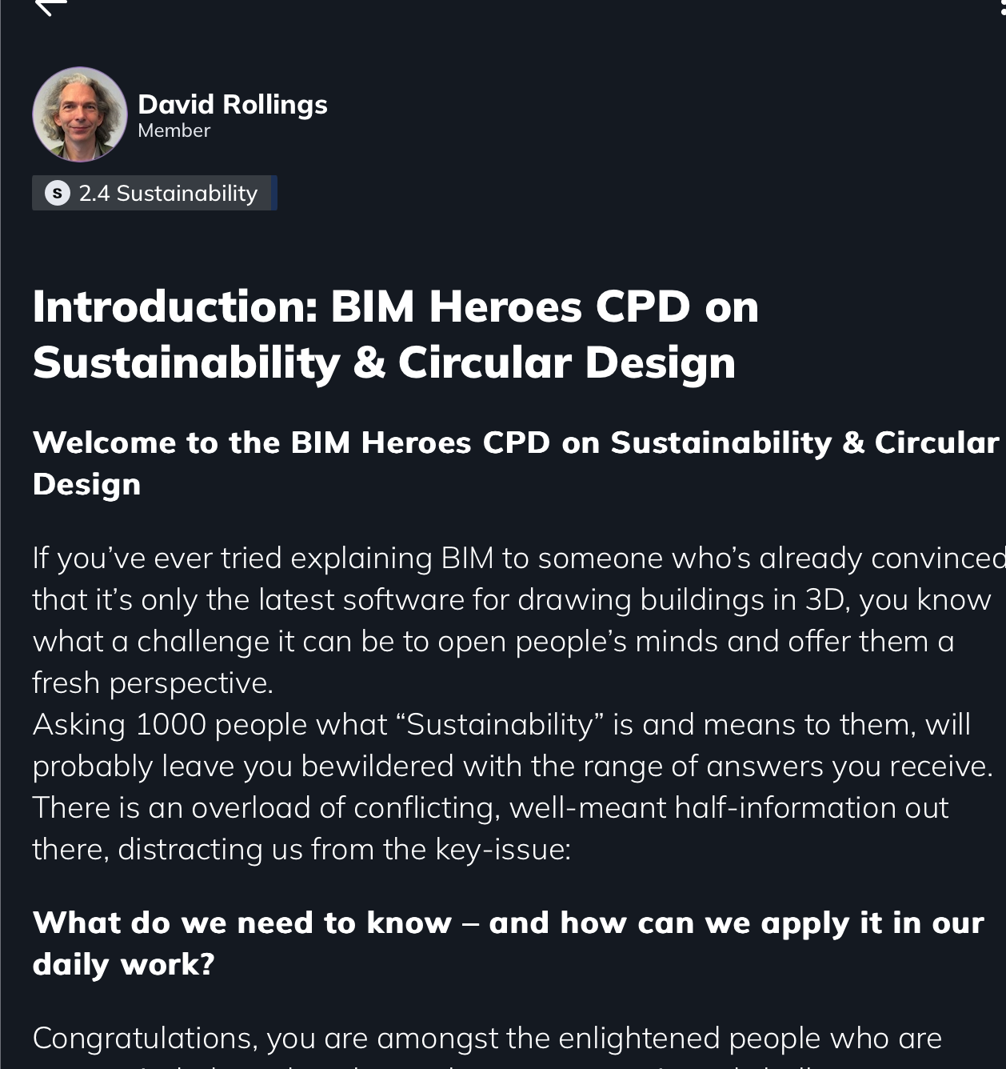
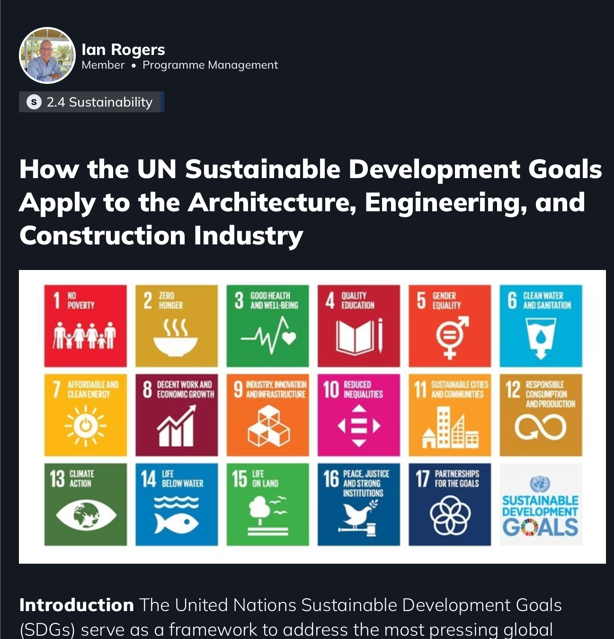
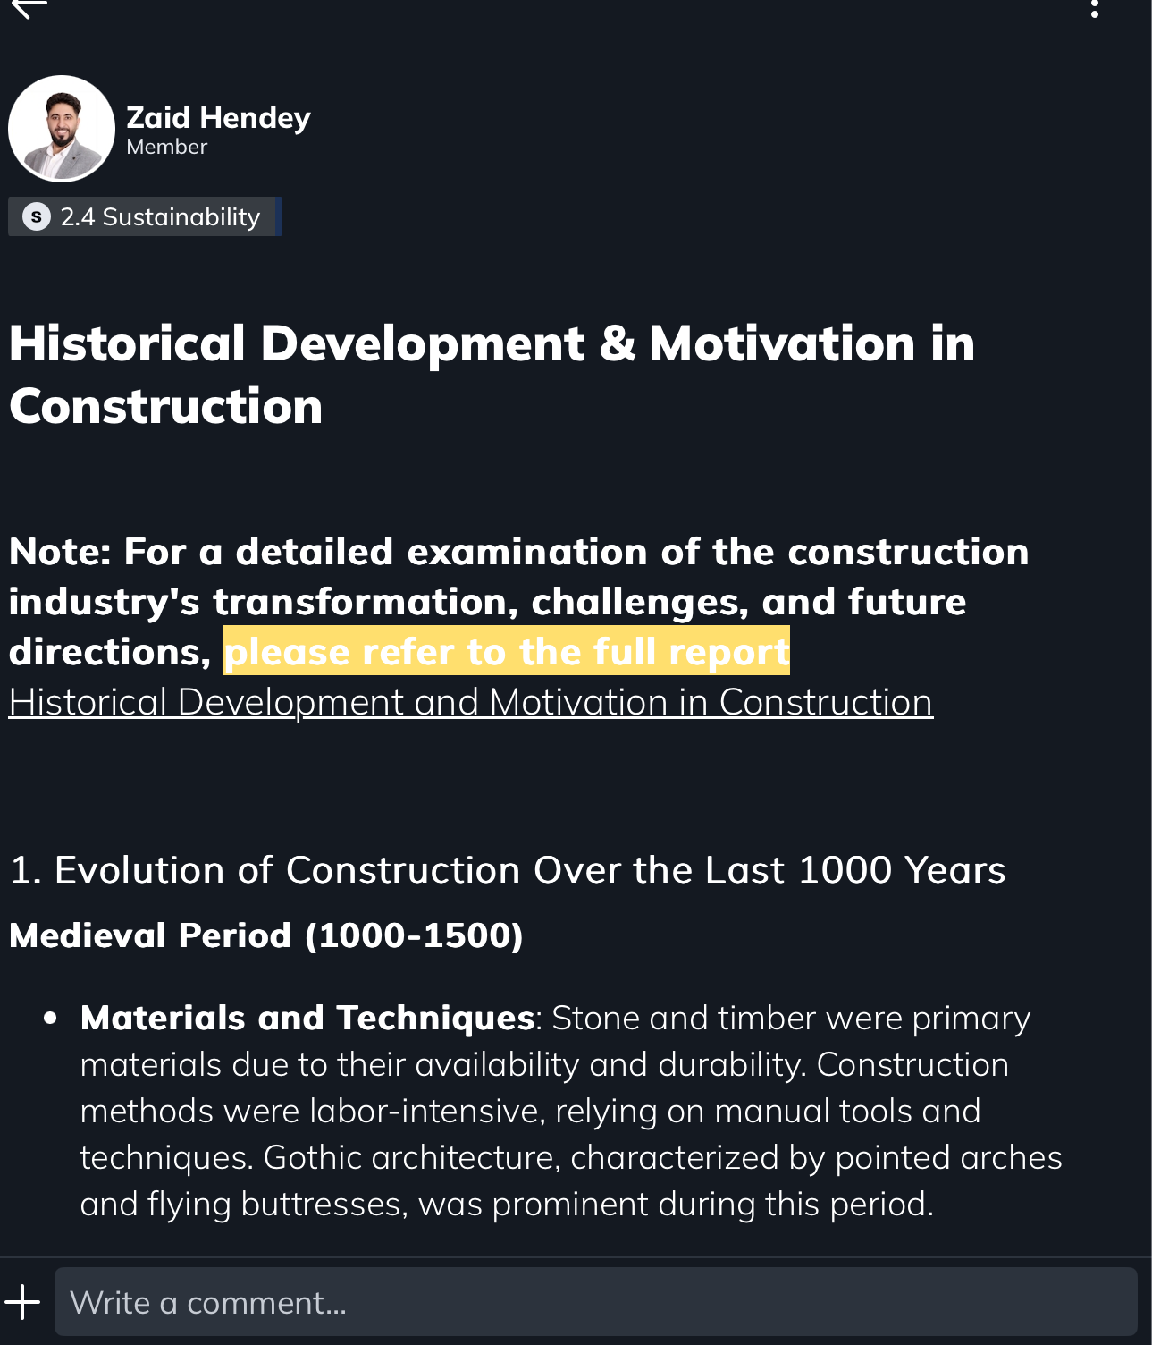
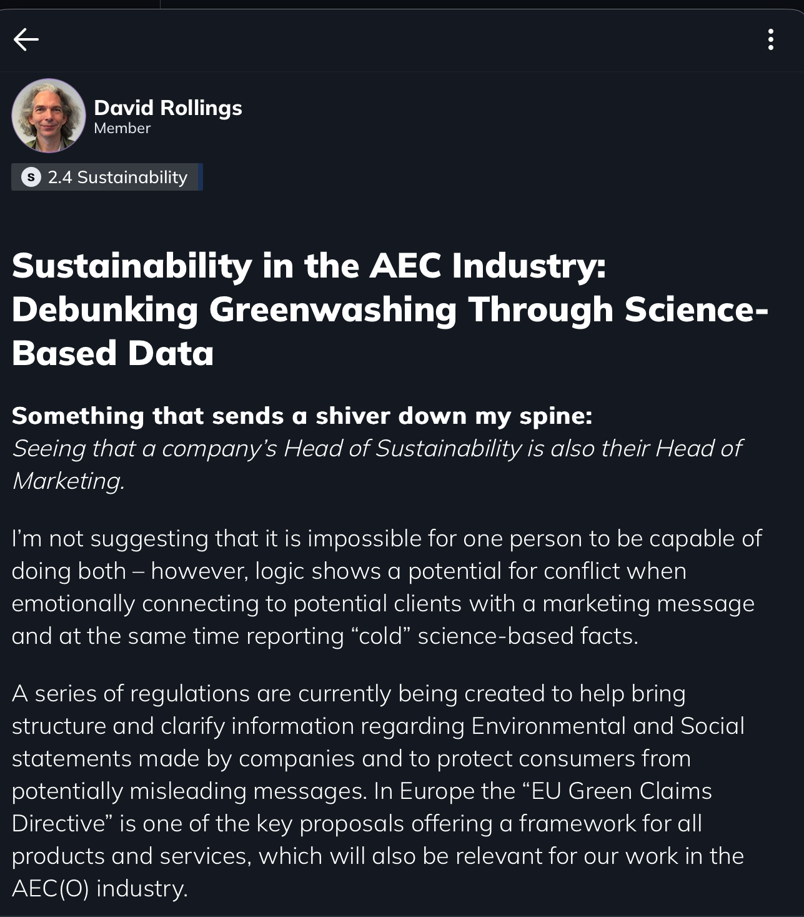
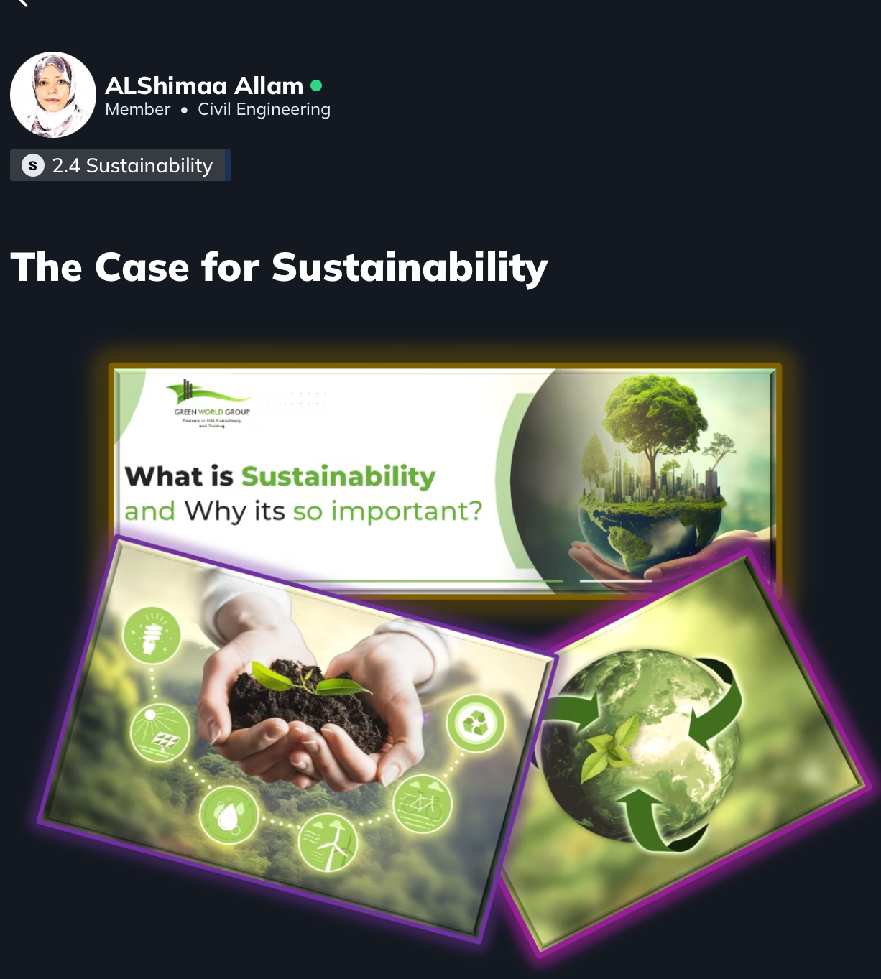
Notes:
This week (week 1 of 8) we start with a “General introduction and background to Sustainability and the Circular Economy within AEC”.
• David Rollings opens by welcoming participants and outlining the programme
• AlShimaa Allam follows on with an article looking at the case for sustainability
• Ian Rogers talks about the UN and how SDG’s are relevant to AEC
• Before David Rollings looks at the issue of “Green Washing”
• Zaid Hendey closes the week by exploring the historical development & motivation for change

Slide 4
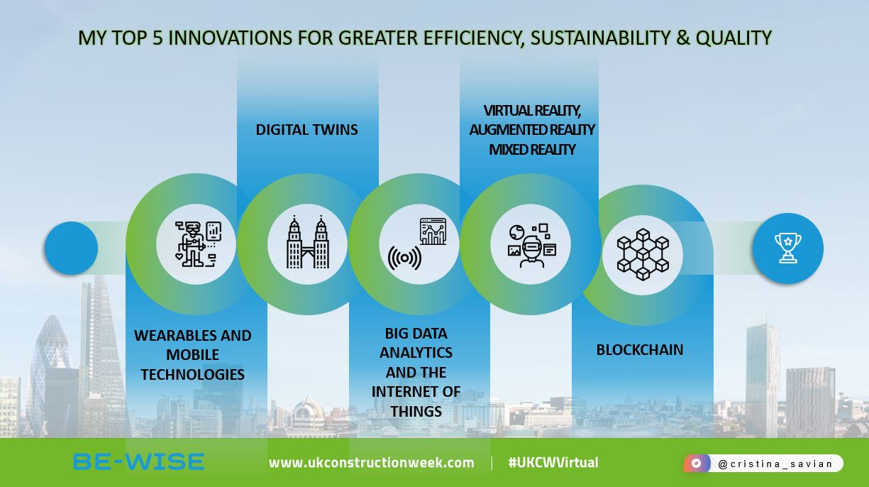
Notes:
Keep your eyes open for week 2 – where we move on to “Circular Design – Circular Economy, Design, Construction, Life Cycles”
WHAT!
You’re not yet a member of the global free BIM Heroes network of BIM/AEC/VDC professionals?
Simply get in touch if you’re a professional in our branch – and I’ll organise an invite for you!

