Slide 1
BARANGAY ASSEMBLY 2026
2ND SEMESTER

Slide 2
ACCOMPLISHMENT REPORT OF KGWD. ENRICO AGAPITO: CO-CHAIRMAN ON LIVELIHOOD & COOPERATIVE, TRADE COMMERCE & INDUSTRY, TRANSPORTATION

Slide 3
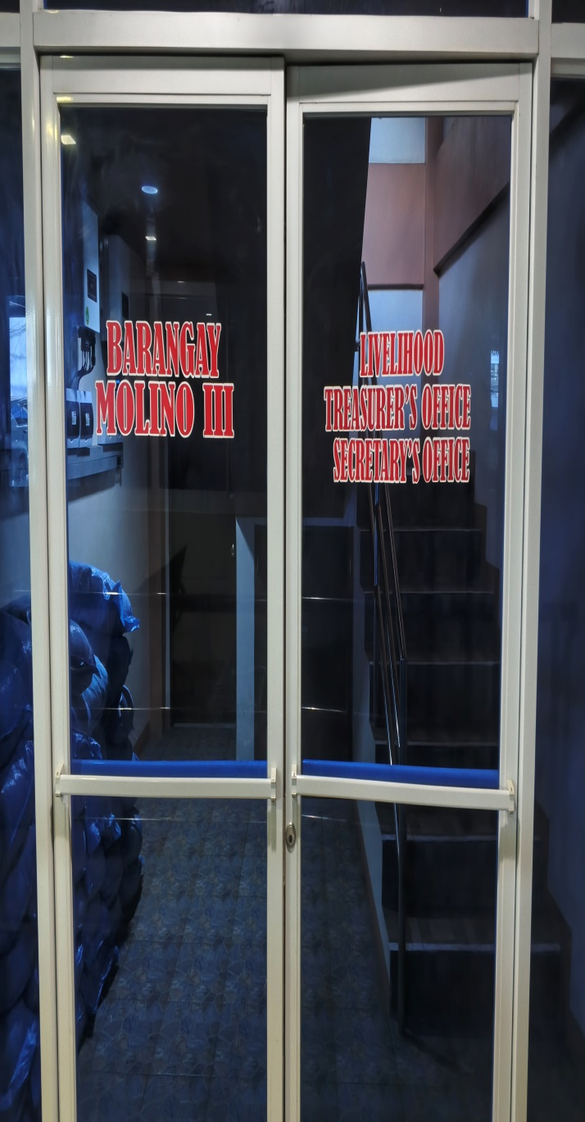
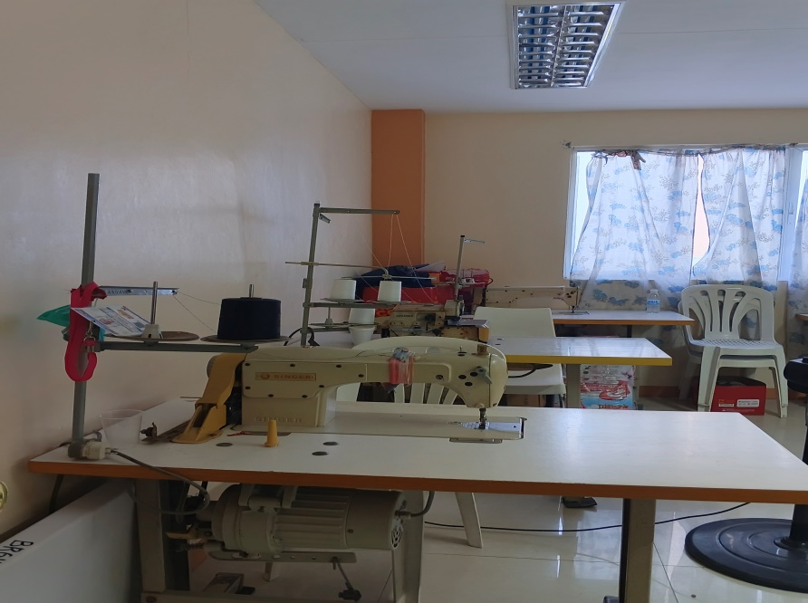
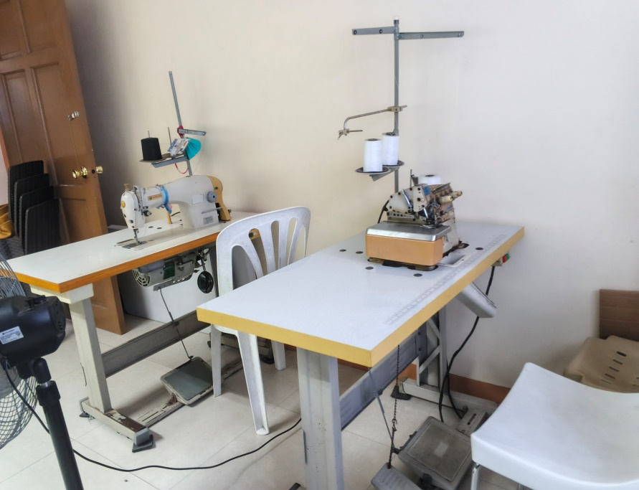
FUNCTIONAL OFFICE OF LIVELIHOOD

Slide 4
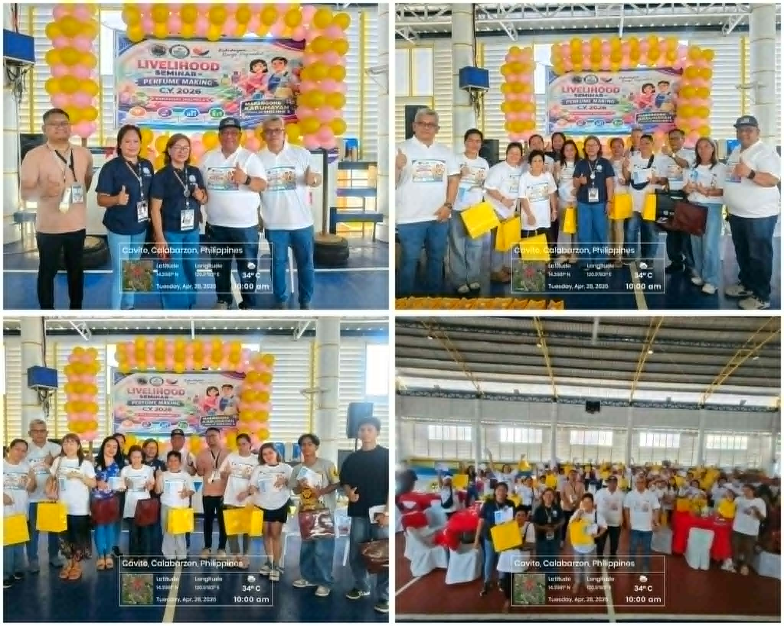
LIVELIHOOD SEMINAR

Slide 5
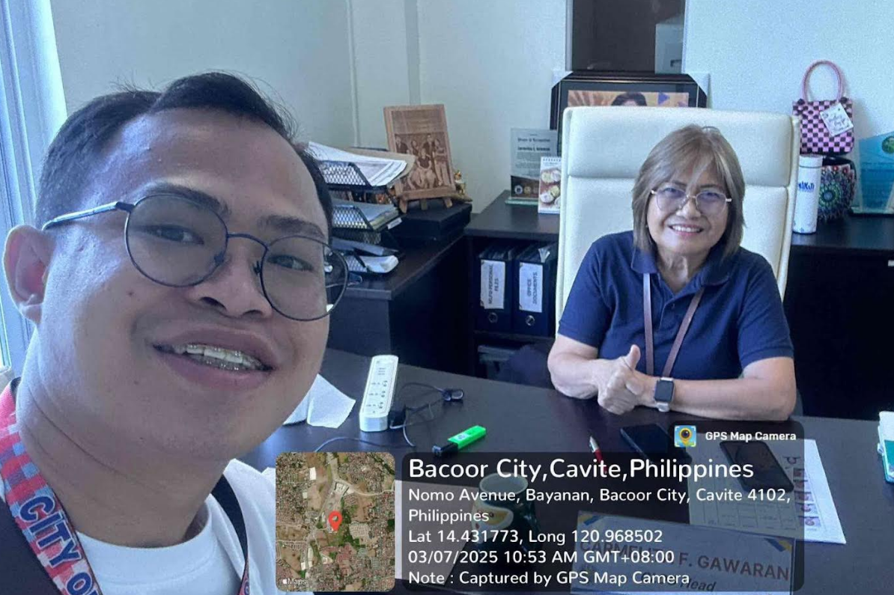
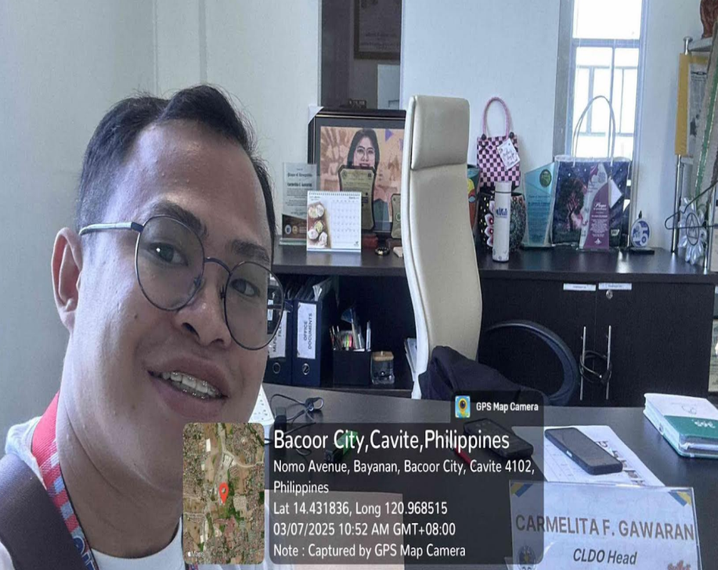
CONSULTATION AT CITY LIVELIHOOD OFFICE

Slide 6

SERVICES OFFER AT CITY LIVELIHOOD OFFICE

Slide 7
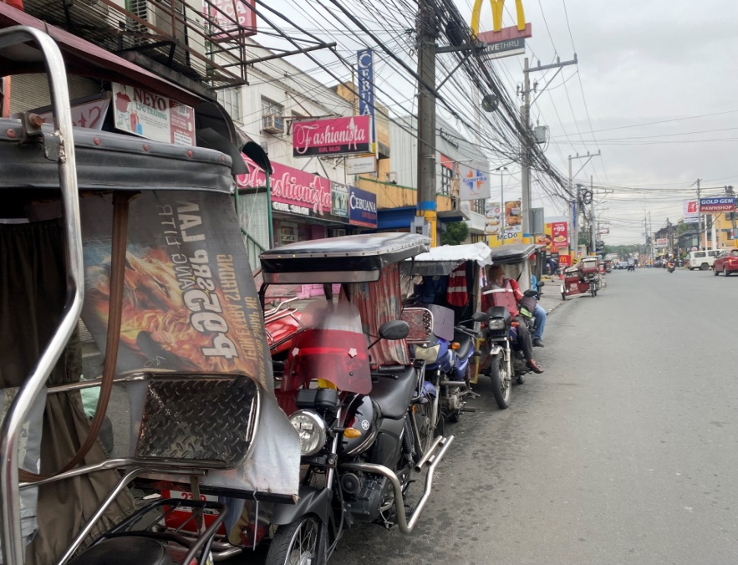
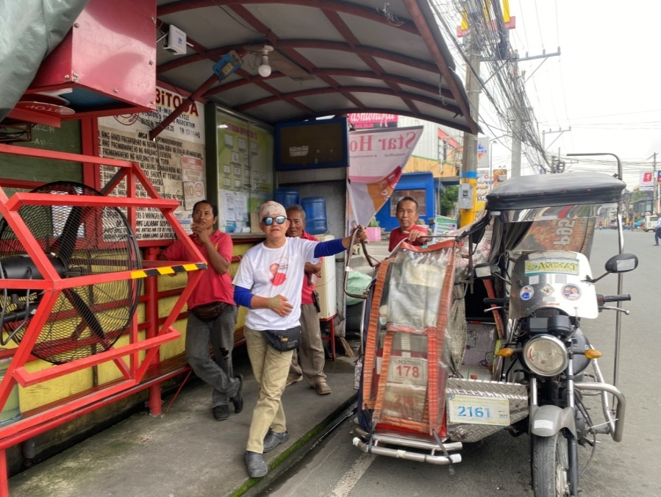
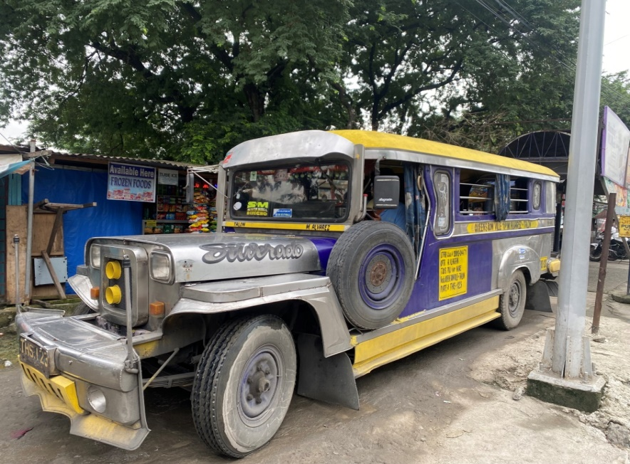
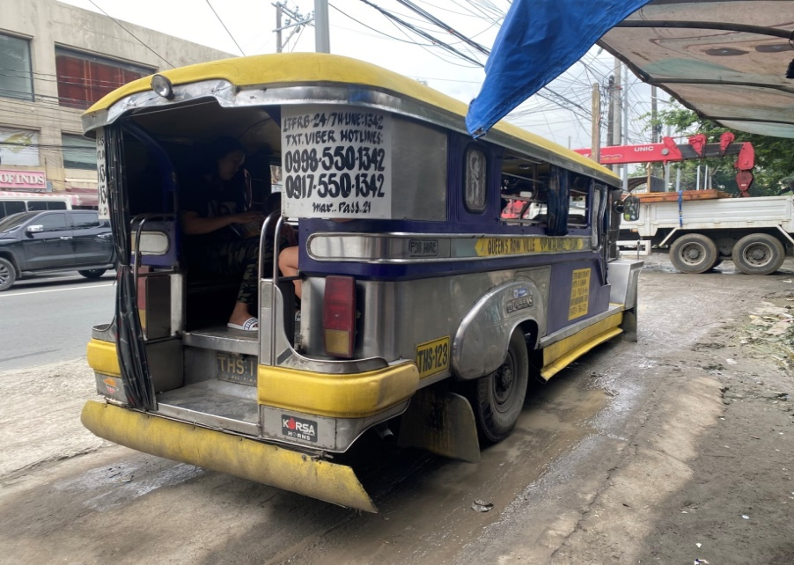
MONITORING OF TRANSPORTATION

