Slide 1



After a succesfulful establishment in other countries, It is great to hear that Estudymania India Private Limited is introducing an online education portal and affiliate marketing program in India also. This initiative can be beneficial for individuals who are interested in pursuing education online (tution) and for those who are looking for a way to earn money through affiliate marketing.
This is the first time for the tutors to earn money with an affiliate marketing parallely with providing tution to their students.
Visit : https://estudymania.com/

Slide 2

With the increasing demand for online education, an online education portal can provide individuals with access to a variety of courses and learning materials from anywhere at any time. This can be particularly useful for those who cannot attend traditional classroom-based courses due to various reasons such as distance, time constraints, or personal commitments.
Affiliate marketing can also be a great way for individuals to earn money by promoting products or services on their own platforms. This can be particularly useful for those who have a strong online presence, such as bloggers or social media influencers.
Overall, the introduction of an online education portal and affiliate marketing program by Estudymania India Private Limited can have a positive impact on the education and employment sectors in India.

Slide 3

For Professional Tutors
Tutors are having two opportunities:
Online Teaching (hourly/ monthly/ courses based)
Affiliate Marketing : with unique reference link or QR code ( direct 50% commission on each referal )

Slide 4


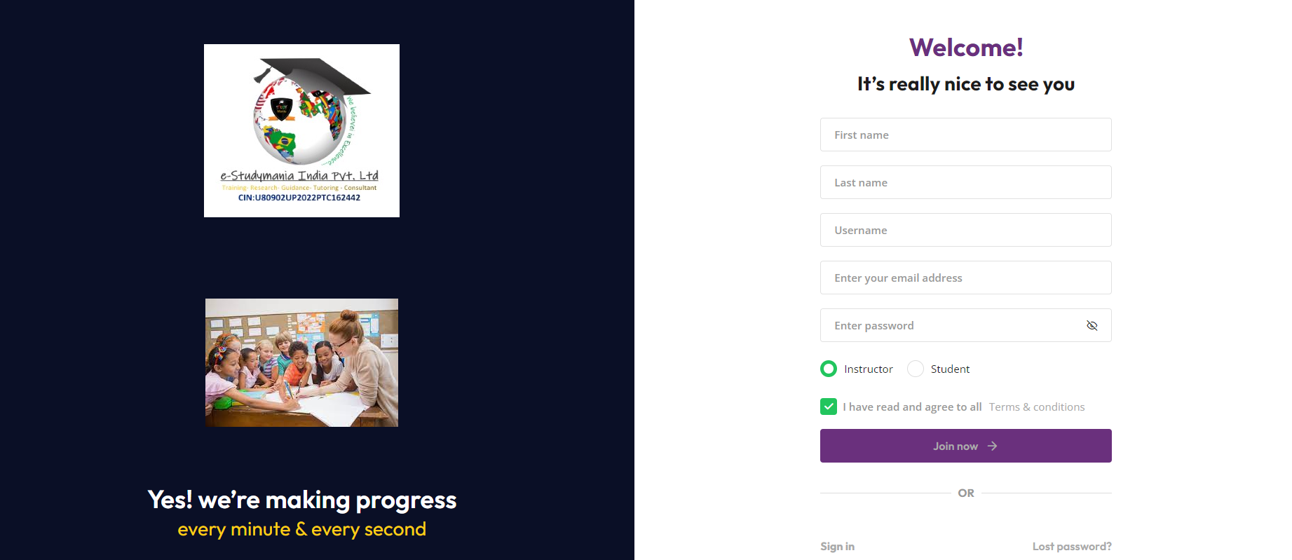
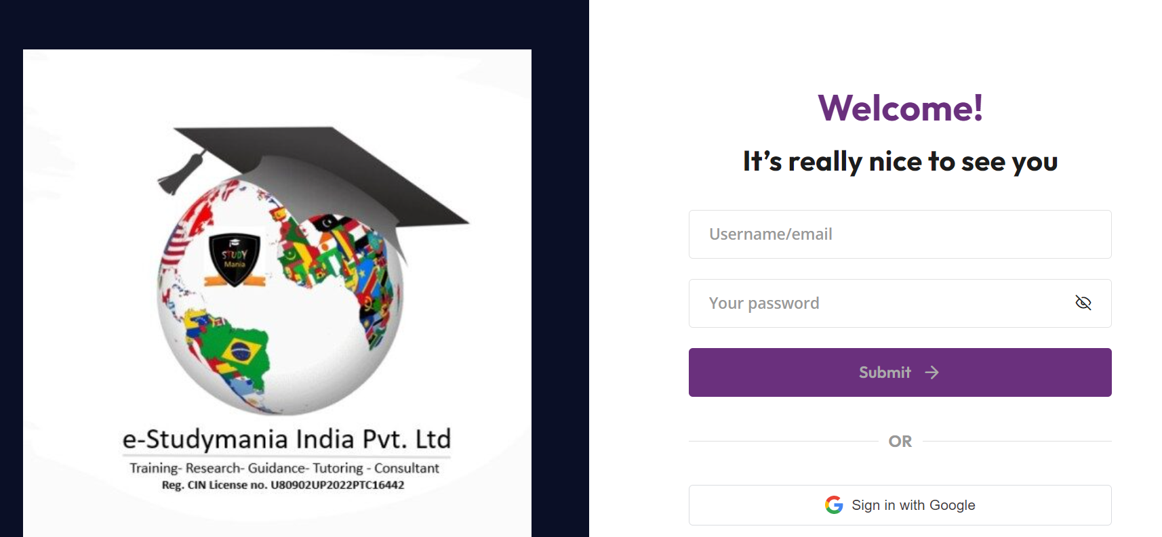
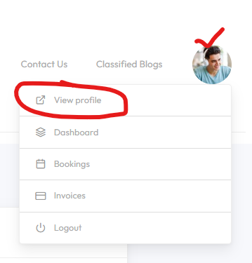
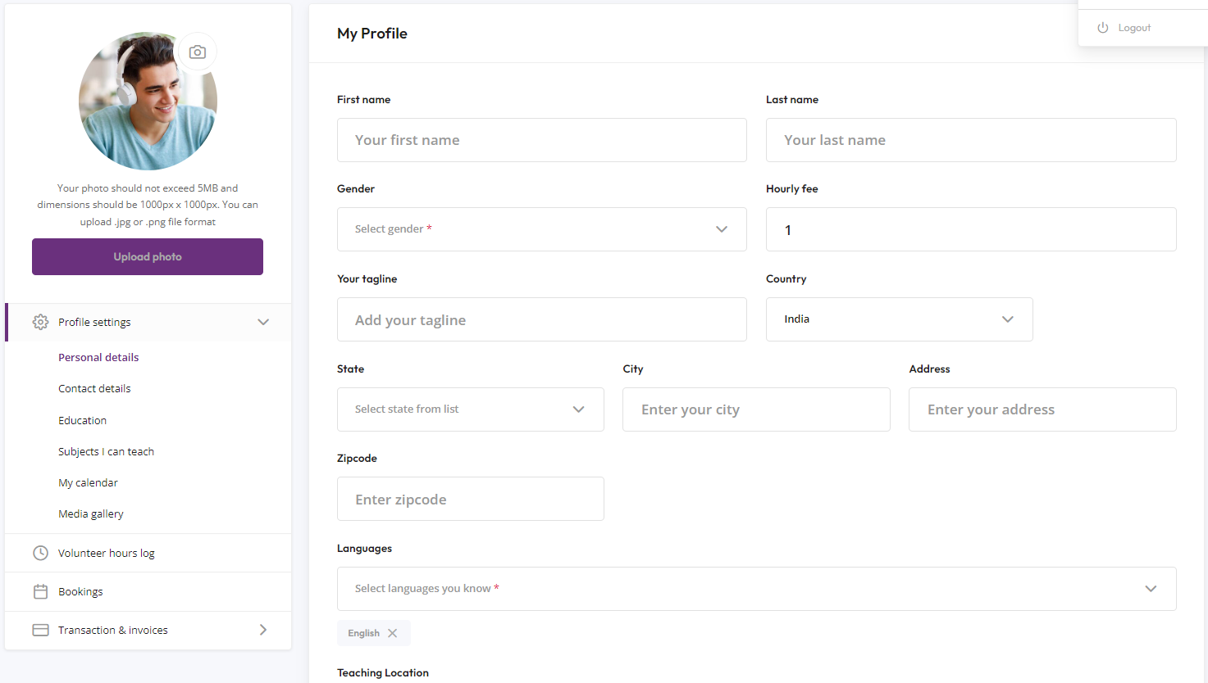
1. Online Tution Program - For Tutors Guide
Step1: Click on link https://estudymania.com/signup/
Sign up as Instructor and fill all the details
Step2: Sign in by clicking on Get started. Open your profile setting and complete all the details with your location and your hourly fees ( monthly fees can be calculated in terms of total no. of hours)
Step3: Complete the profile and update

Slide 5

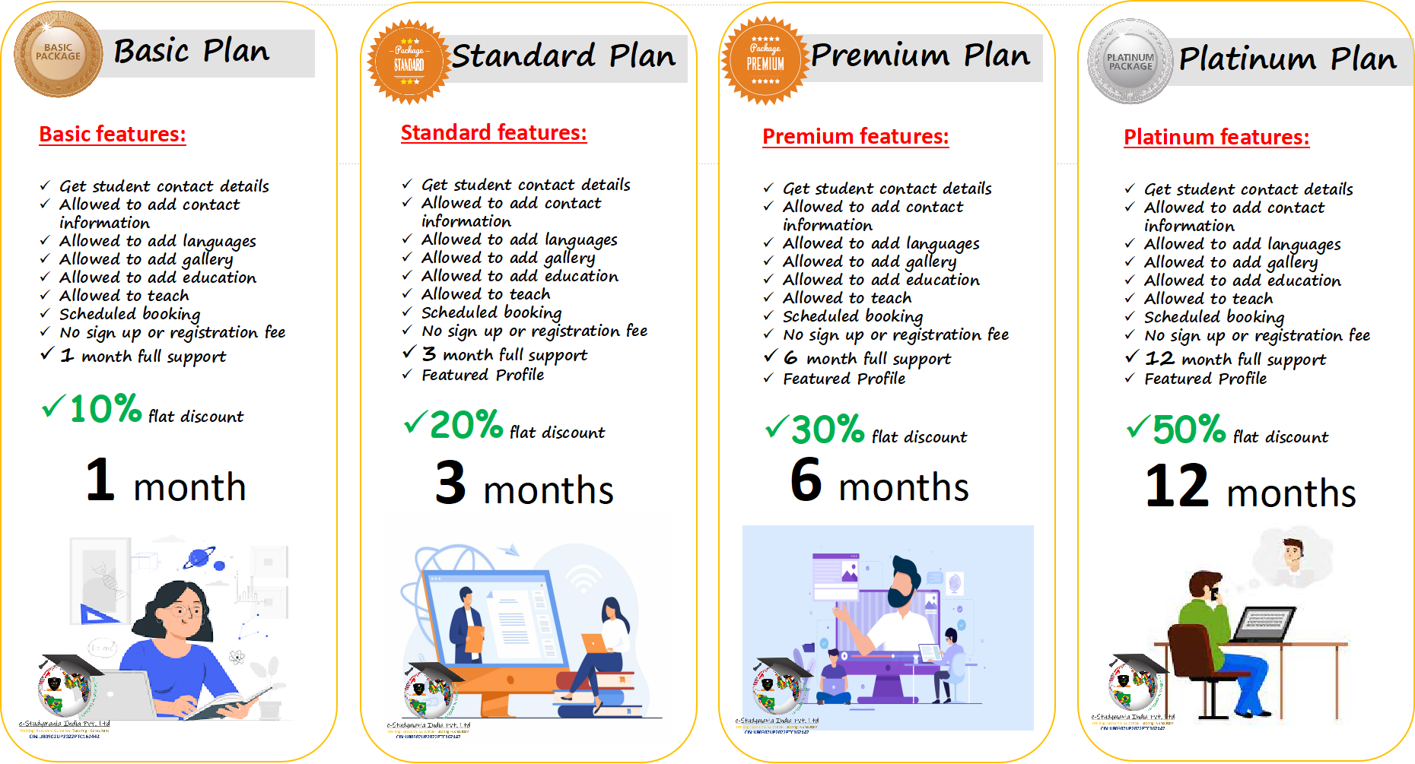
Step 4: Purchase any of the package to get all the benefits with featured profile
Get this plan Free with Affiliate membership
Limited Offer:
Sign up with any of the plan and get 1 month extra subscription

Slide 6


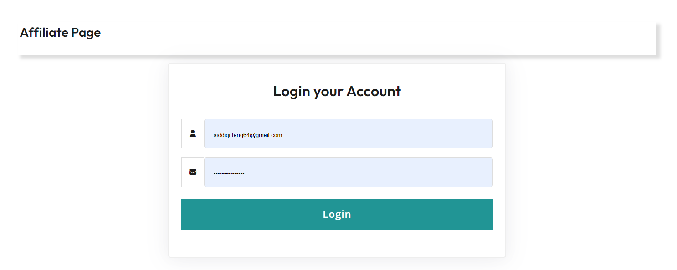
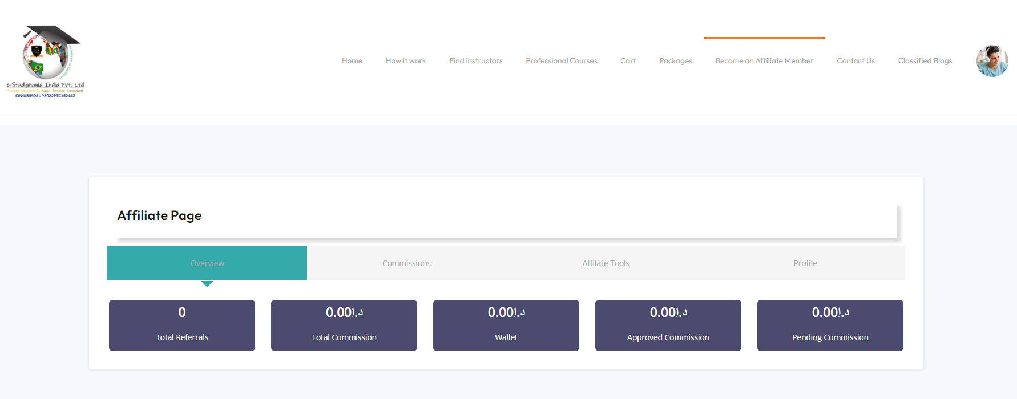
2. Affiliate Marketing : For Tutors
Step 1: After registration, click on Become an Affiliate partner

Slide 7

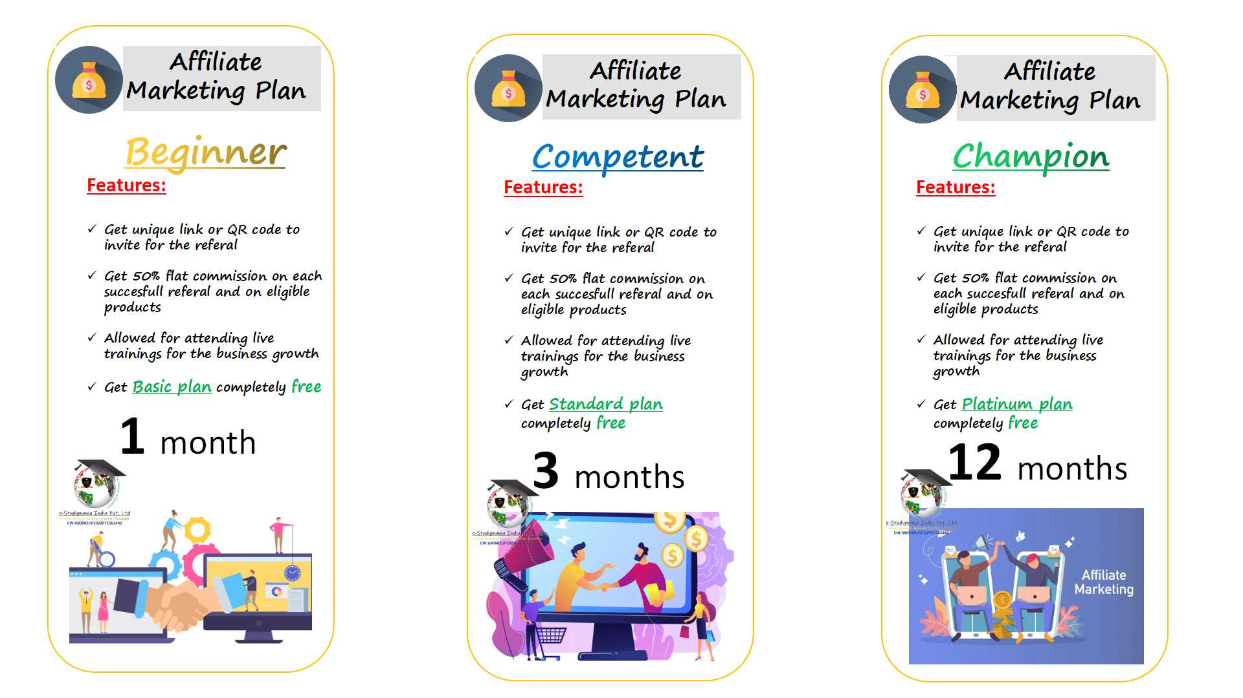
Step 2: Purchase an Affiliate Marketing plan

Slide 8
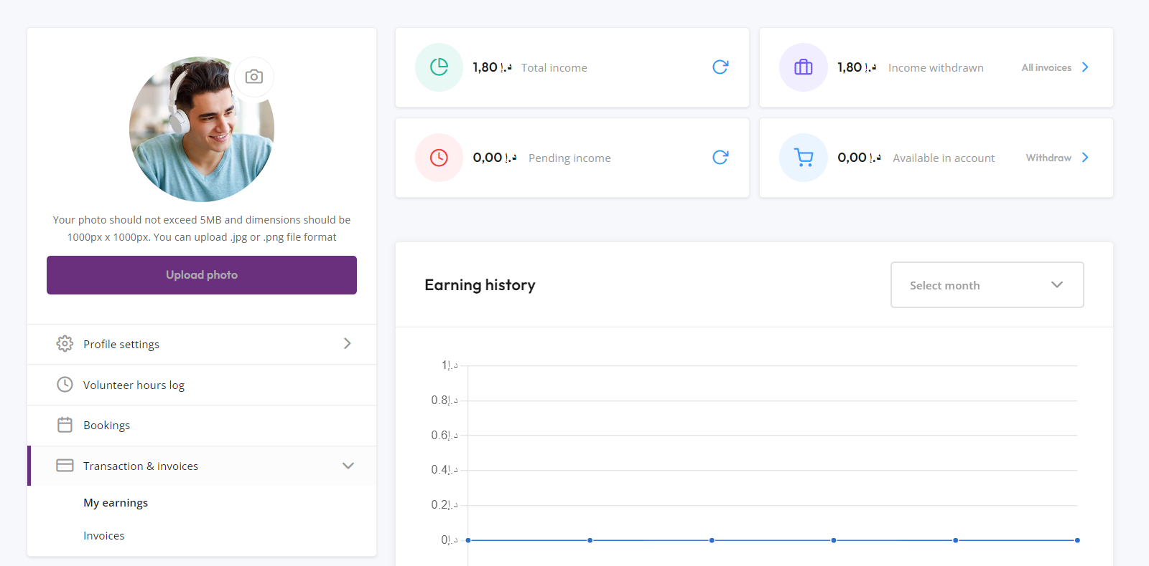
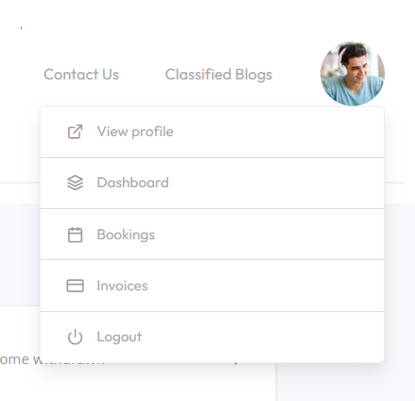
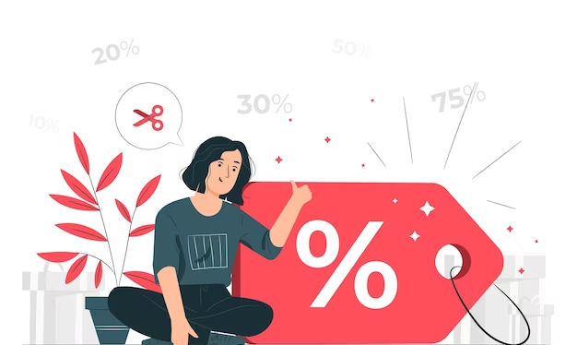
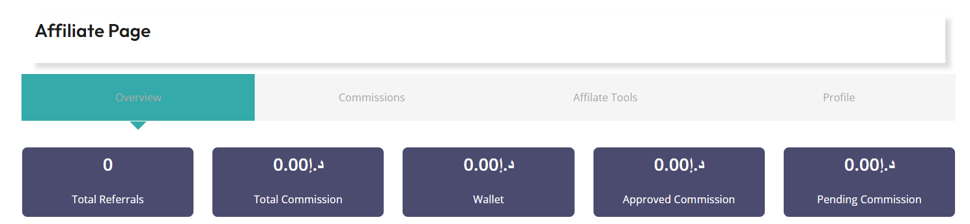
Earnings and Payout
Transparency is our priority
Get 90% of the fees income share, Company will take only 10% commission for the service.
Get 50% share on each successful referal
and on eligible products sale.
*** VAT or any other country tax and payment gateway services charges will be paid by customers only.

Slide 9

All Package Comparison
Code | Package Name | Duration (months) | Sales Price (INR/Rs.) | Discount | Final Price (INR/ Rs.) | Common Advantages
T001 | Basic Plan | 1 | 1000 | 10% | 900 | Get student contact details Allowed to add contact information Allowed to add languages Allowed to add gallery Allowed to add education Allowed to teach Scheduled booking No sign up or registration fee *Featured profile Get 90% of the fees income share, Company will take only 10% commission for the service
T002 | Standard Plan | 3 | 3000 | 20% | 2400
T003 | Premium Plan | 6 | 6000 | 30% | 5100
T004 | Platinum Plan | 12 | 12000 | 50% | 6000
Affiliate Marketing plan
AM01 | Beginner + Basic plan free | 1 | 2000 | 30% | 1400 | Get unique link or QR code to invite for the referal Get 50% flat commission on each succesfull referal and on eligible products Allowed for attending live trainings for the business growth
AM02 | Competent + Standard plan free | 3 | 6000 | 40% | 3600
AM03 | Champion + Platinum plan free | 12 | 24000 | 50% | 12000
*** VAT or any other country tax and payment gateway services charges will be paid by customers only.

Slide 10

Hurry!!!
Limited offer
Get upto
on each package
So, What are you waiting for?
Join today with our fastest growing company......
https://estudymania.com/signup/

Slide 11

Estudymania Group is also offering following services:
Competetive classes on the request of the parents
Professional courses
IT Courses
Health and Safety courses
Echild safety and Montessorie courses

Slide 12









Thanks to Our Partners and helping platforms

Slide 13




World fastest growing education platform.....
Limitless opportunities....
Lets teach the young generation of the world...
You will love with estudymania group because here you will get international exposure on global level
Visit our official website:
https://estudymania.com
Whatsapp at
+919887996642
Linkedin :
https://www.linkedin.com/in/estudymania-international-group-865b76254

