Slide 1

DOCTOR WALA
Product of Another Opinion Pvt. Ltd
At Your Quick Service

Slide 2
INTRODUCTION
DOCTOR WALA
Doctor Wala App is an app that provides quick service to the people and saves the time of the people.
Our objective is by using this website patient can search and view doctor's profiles and also apply for appointments.
Patient modules find doctors and apply for appointment ,and book appointment.
It has a facility of admin login through which the admin can monitor the whole system.
Admin modules manage doctors , appointments , hospitals ,vehicle services, products delivery.
This system in available at the digital platforms that can serve patients to search doctors near by and take appointments and view our appointments status online.
Overall, this project is being developed to help the customer and also reduce the human efforts.

Slide 3

WORKING PROCESS:-
Customer book an appointment /orders on our mobile app.
Our admin receives customer orders.
Our admin sends the customer order to the service provider.
The service provider receives these orders.
The service provider provides their service to the customer and the order is completed.

Slide 4
DATA FLOW DIAGRAM
BOOKING PROCESS FOR CUSTOMER
OPEN APP
DOCTOR WALA
Login/Sign in/Sign up
Accept The Terms & Conditions
Categories wise choose Services
Assistant Nursing
Super Specialty
Pharmacy
Ambulance
Radiology
Medical Officer
Specialty
Hospital
Lab
Cash on Delivery
Date
Time
E/N Emergency
Payment Method
Online
Customer Details
Address
Pin code
ID Proof No.
Upload ID Proof
SUBMIT

Slide 5
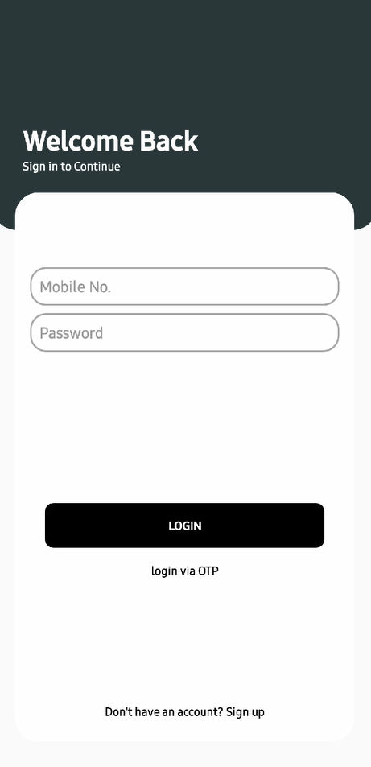
APP BOOKING PROCESS FOR CUSTOMER:-
Step 1:-

Slide 6
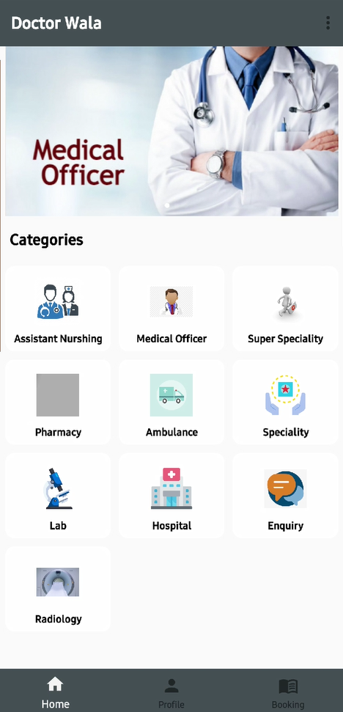
APP BOOKING PROCESS FOR CUSTOMER:-
Step 2:-

Slide 7
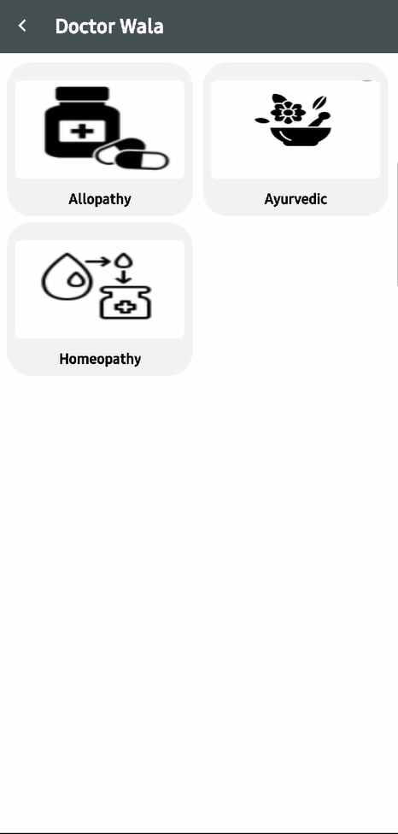
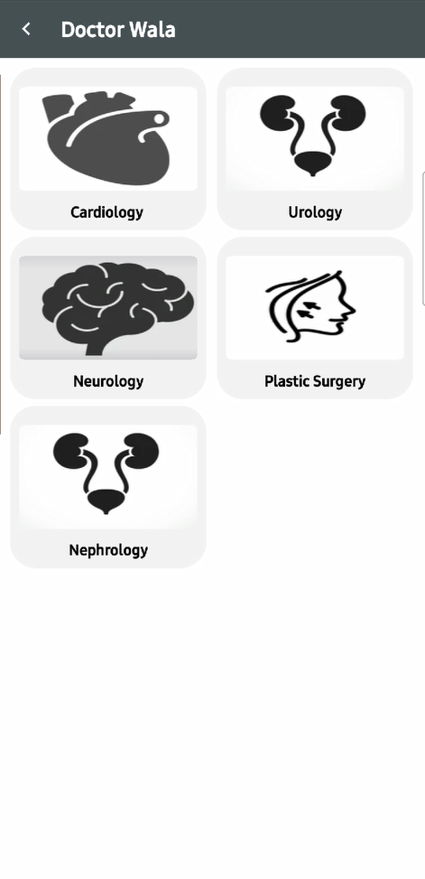
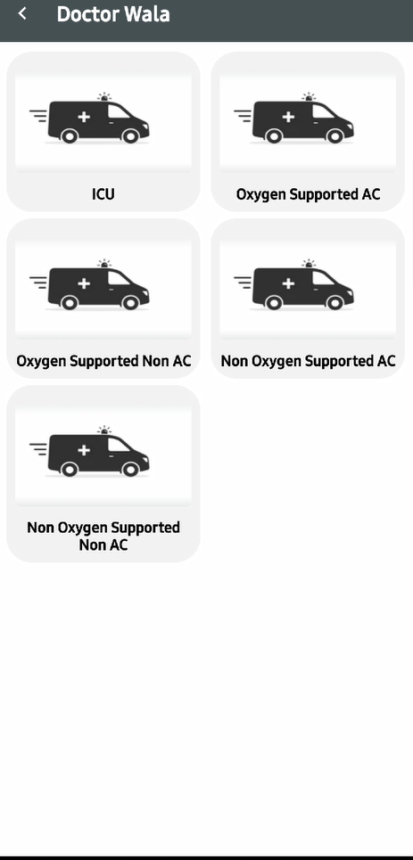
APP BOOKING PROCESS FOR CUSTOMER:-
Step 3:-
Medical Officer
Super Specialty
Ambulance

Slide 8
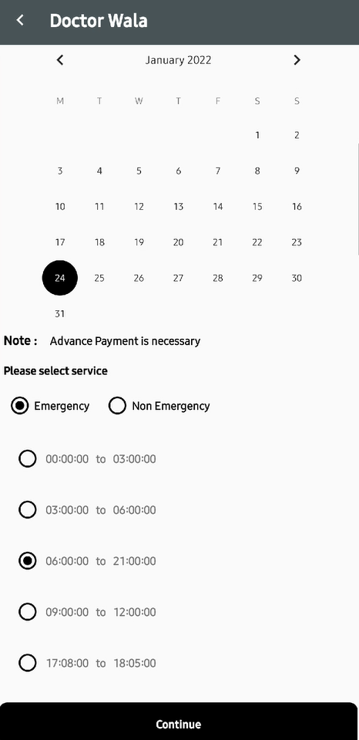
APP BOOKING PROCESS FOR CUSTOMER:-
Step 4:-

Slide 9
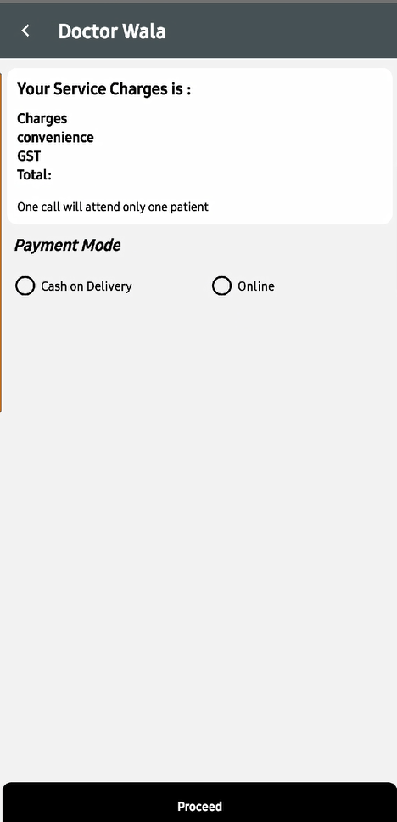
APP BOOKING PROCESS FOR CUSTOMER:-
Step 5:-

Slide 10
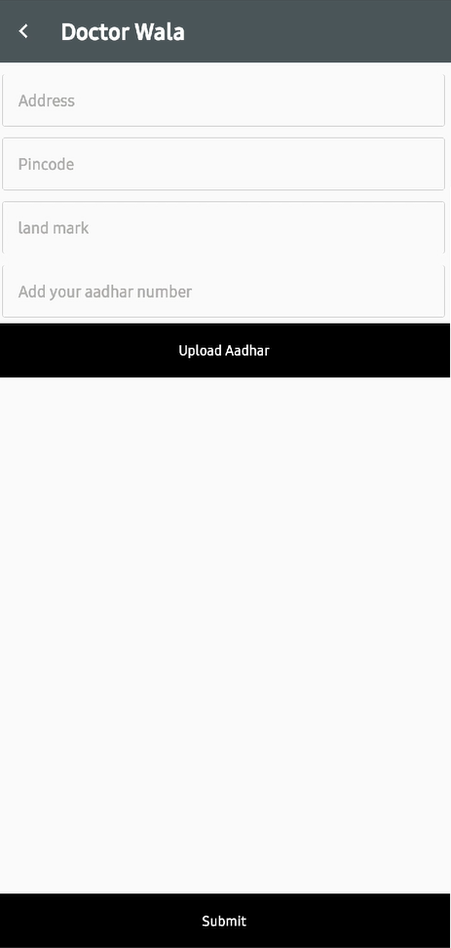
APP BOOKING PROCESS FOR CUSTOMER:-
Step 6:-

Slide 11
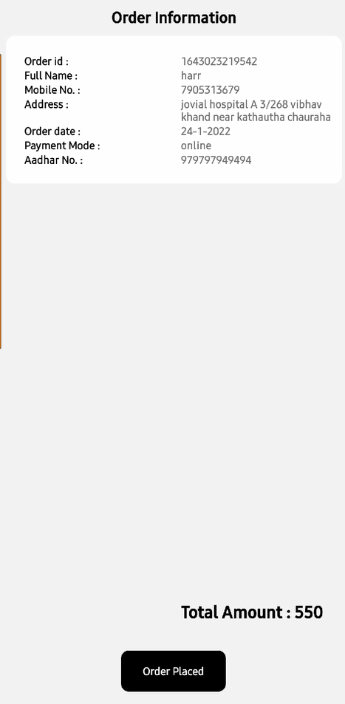
APP BOOKING PROCESS FOR CUSTOMER:-
Step 7:-

Slide 12
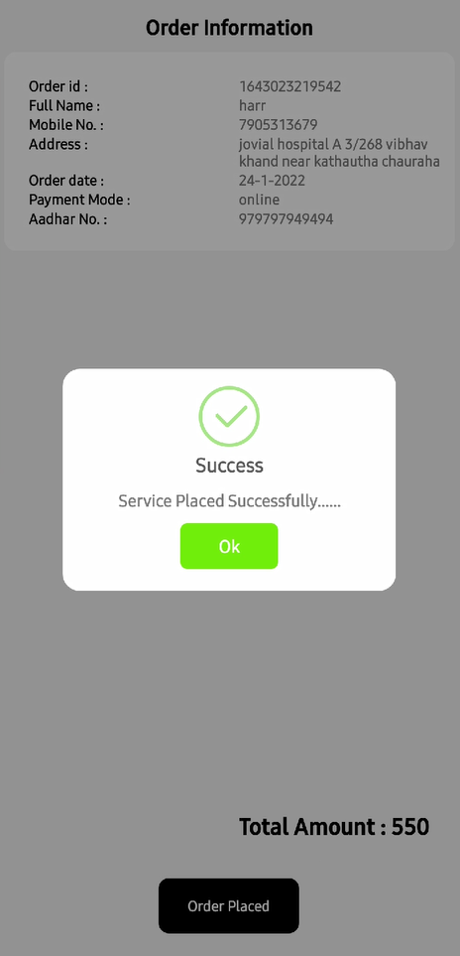
APP BOOKING PROCESS FOR CUSTOMER:-
Step 8:-

Slide 13
DOCTOR WALA
Product of Another Opinion Pvt. Ltd
At Your Quick Service
THANKS FOR WATCHING

