Slide 1
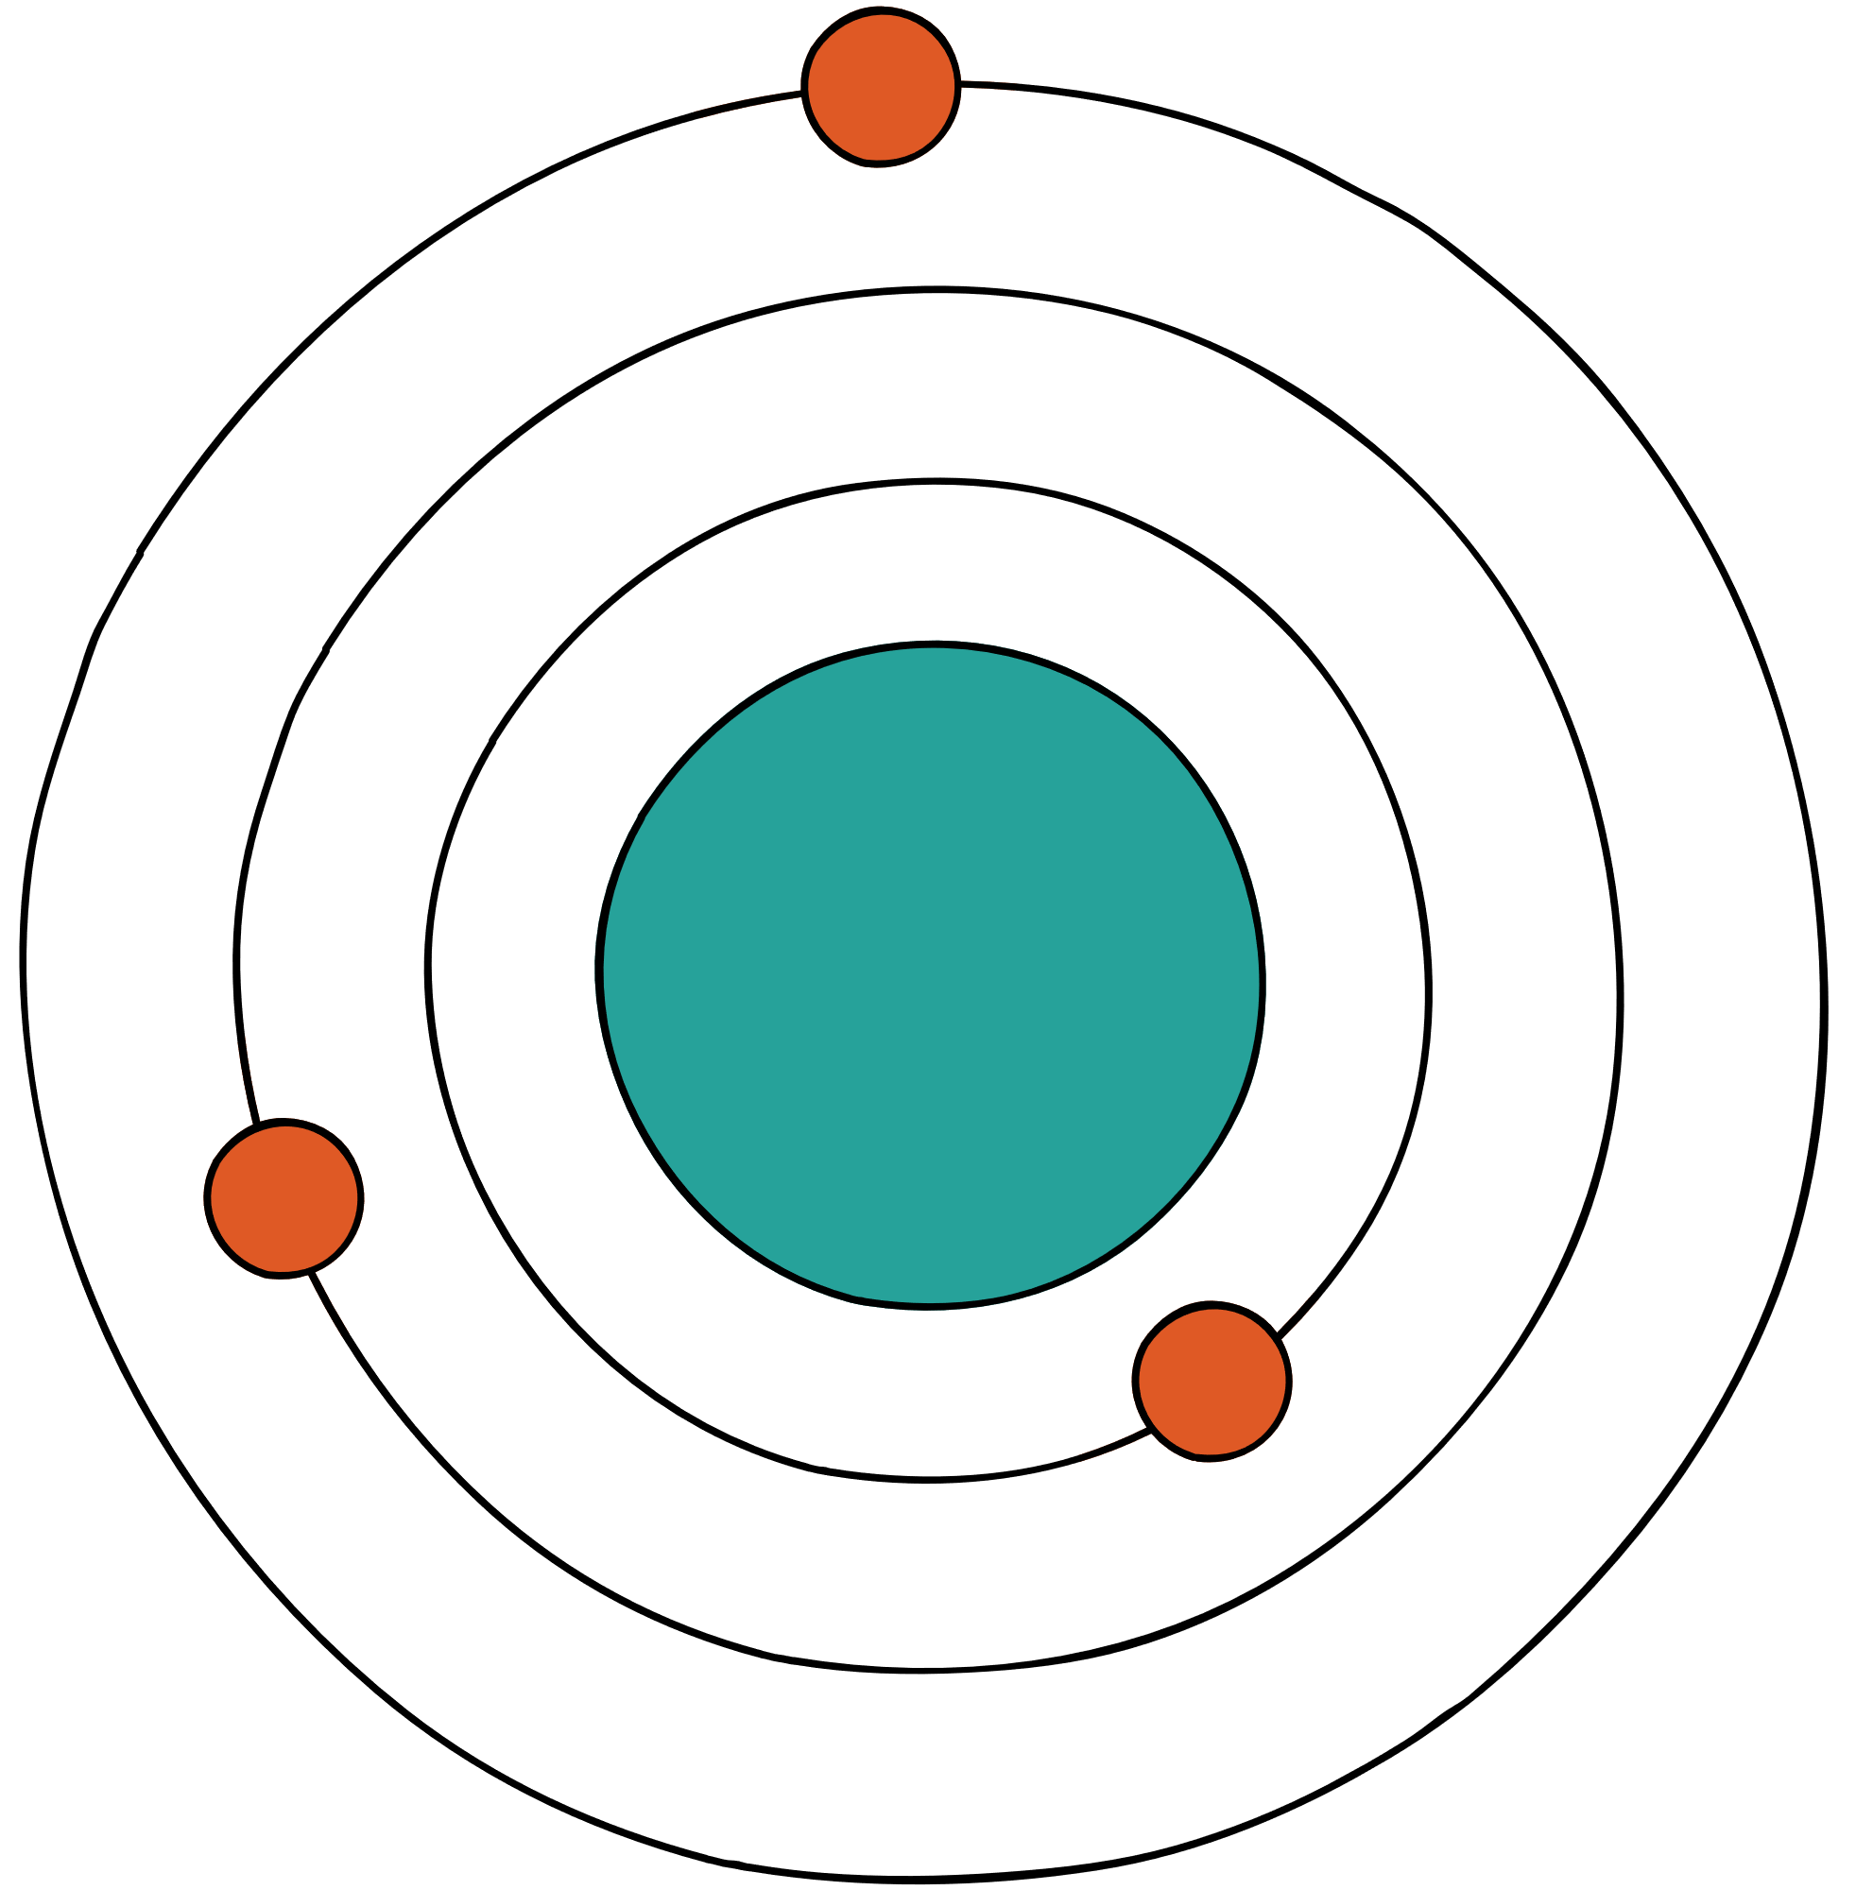










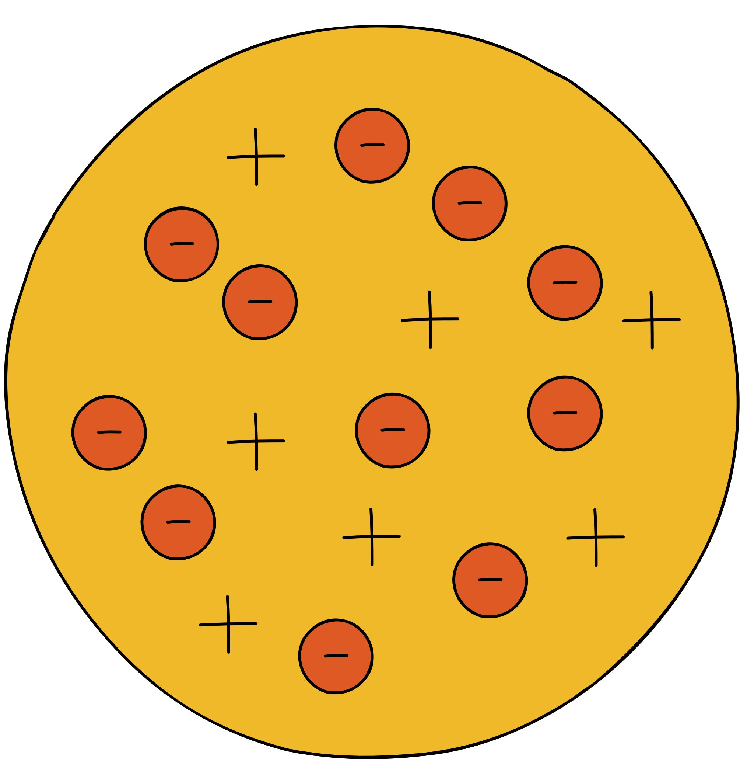


DONE BY ROWAIDA MAGDY 10A
RADIUS TREND
Notes:
Atomic redius trend done by Rowaida magdy 10A

Slide 2




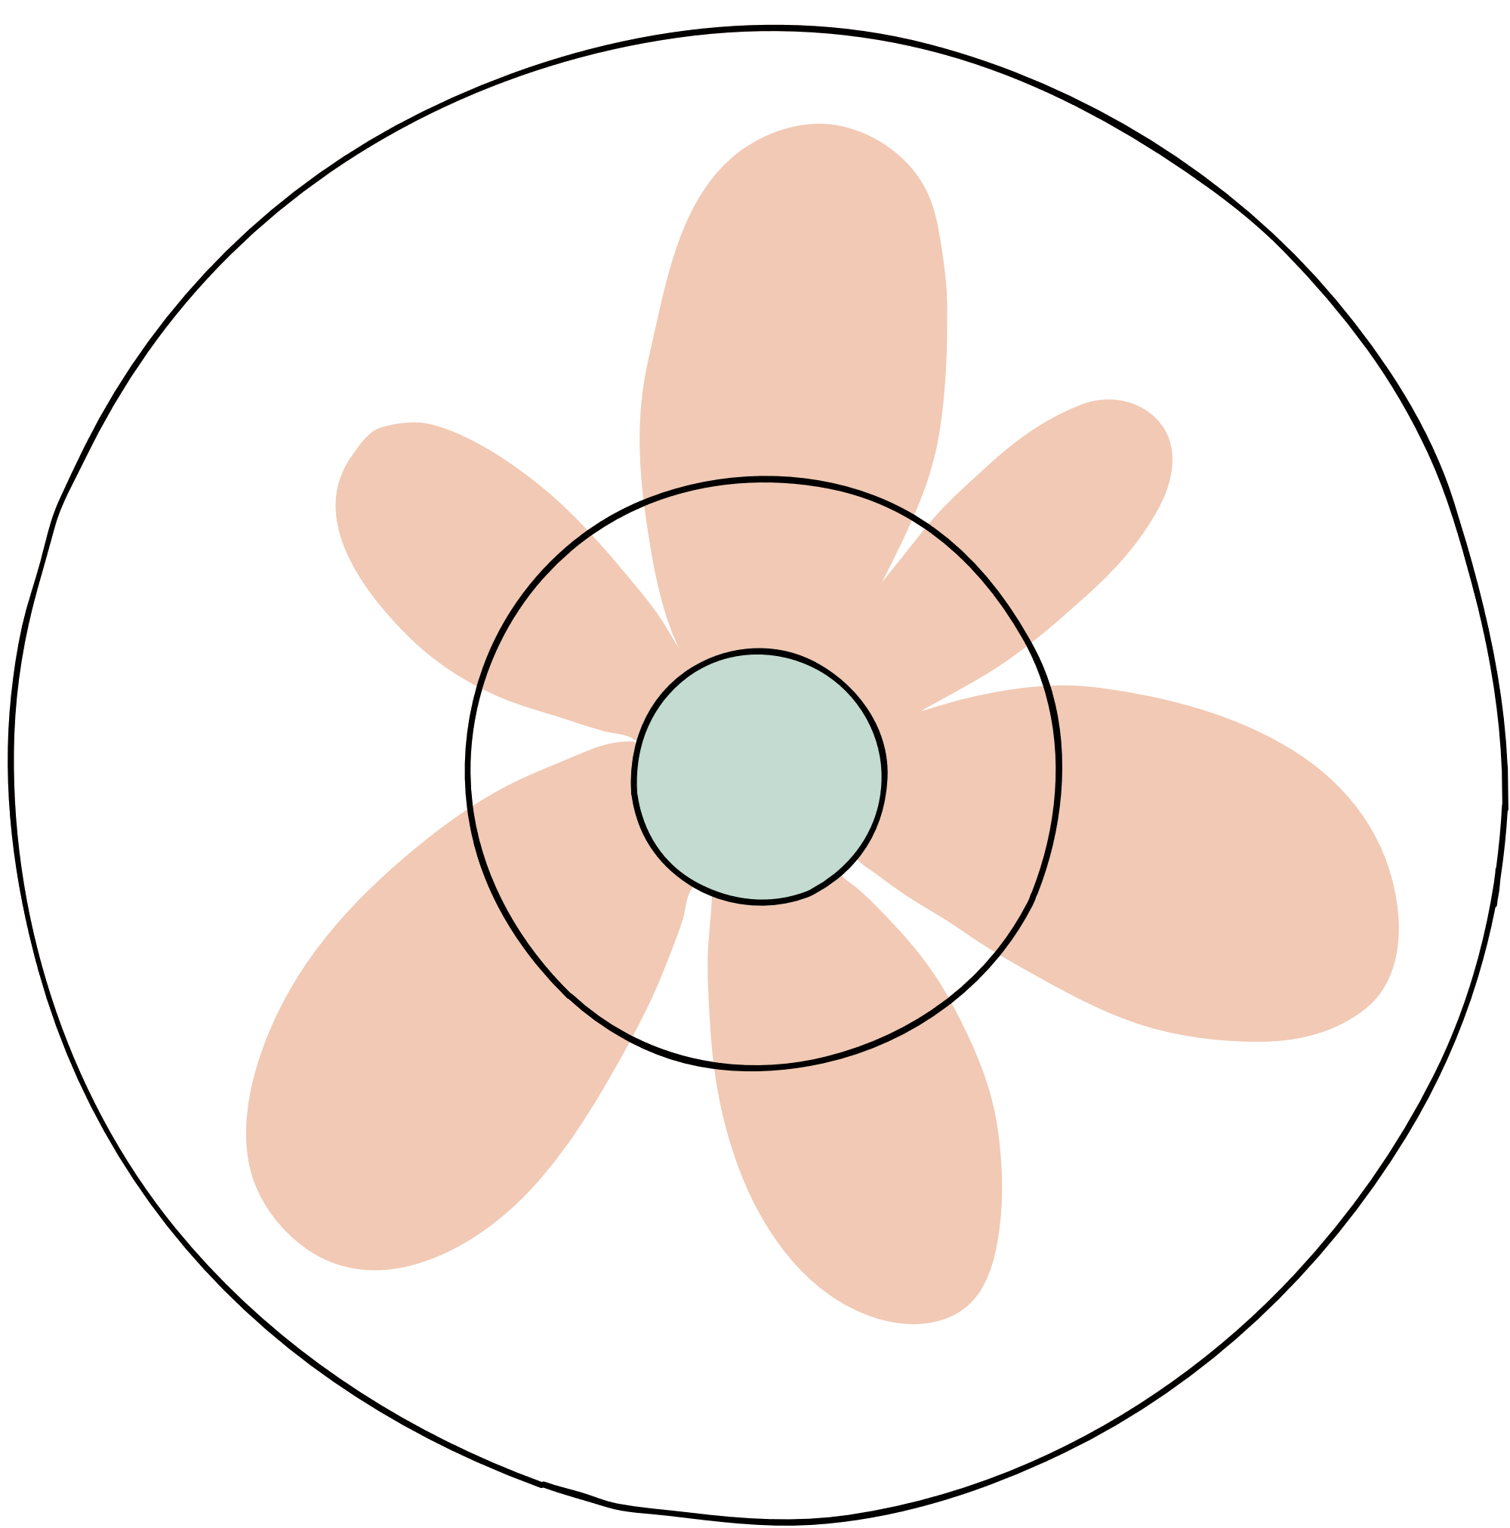

ATOMIC RADIUS TREND ON THE PERIODIC TABLE, ATOMIC RADIUS GENERALLY DECREASES AS YOU MOVE FROM LEFT TO RIGHT ACROSS A PERIOD ,AND INCREASES AS YOU MOVE DOWN A GROUP
The atomic radius decrease as you move from left to right : ( high attraction force this decrease the atomic radius because the electrons become more closer to each other and when it’s less attraction force this increase the atomic radius because the electrons become farther away from each other , this is inversely proportional ) . And the atomic radius increase as you move from up to down : ( less energy level this decrease the atomic radius and more the energy level this increase the atomic radius , this is directly proportional )

Slide 3
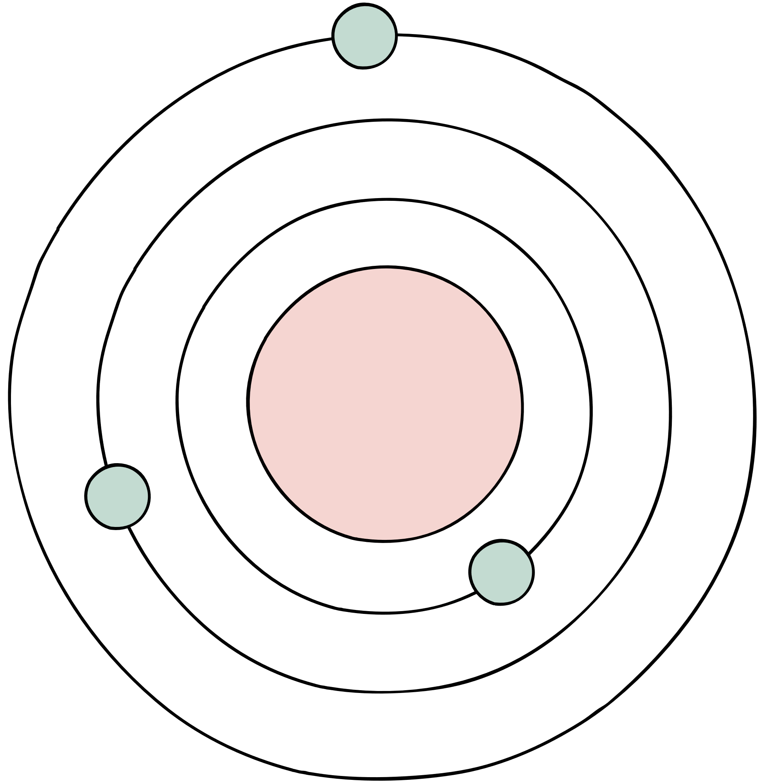
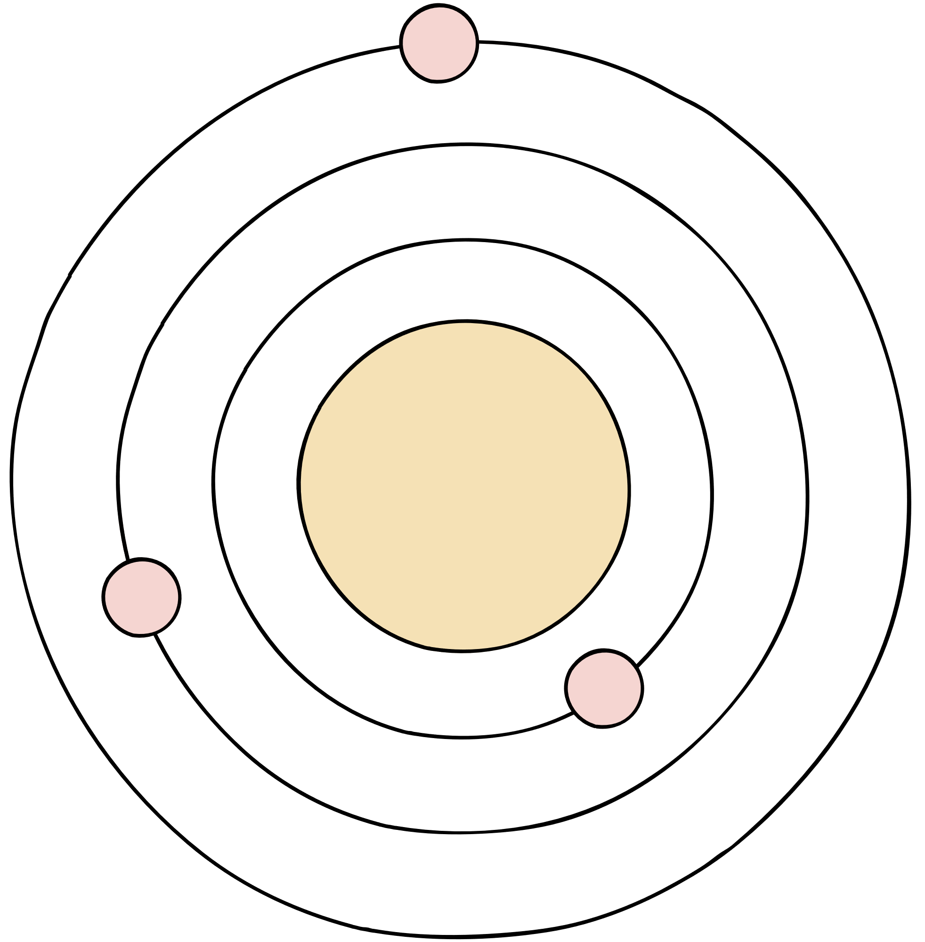



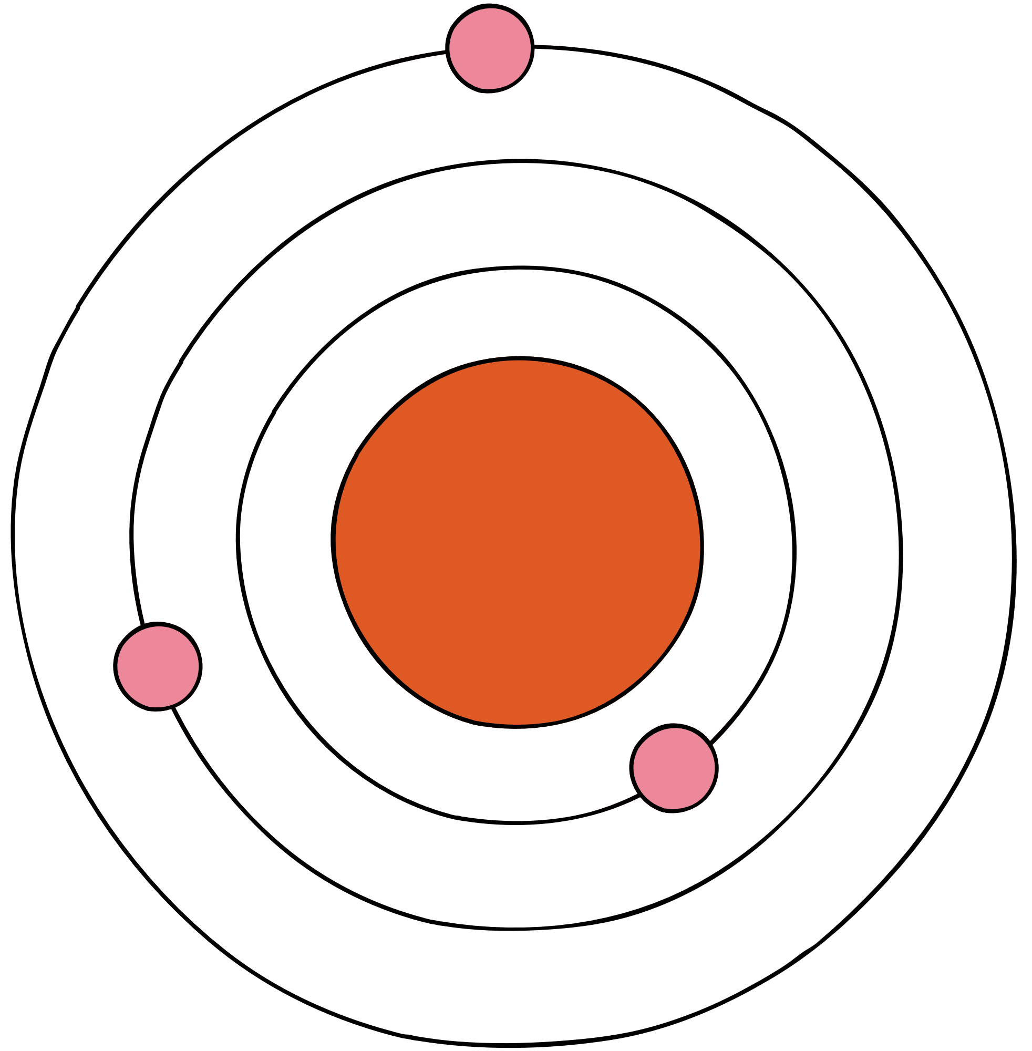
THIS IS MY PROJECT ::

